Slide 1
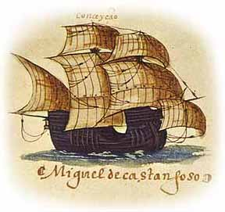
The Age of Exploration
Chapter 3.1 and 4

Slide 2
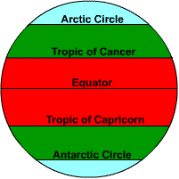
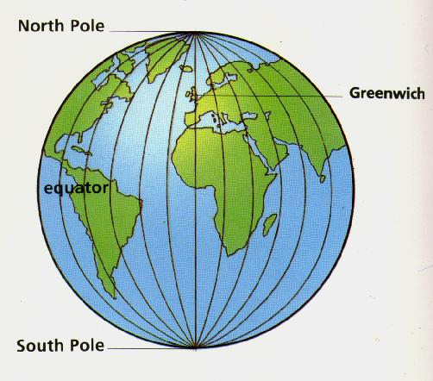
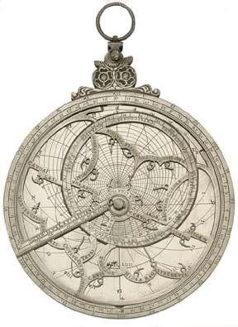
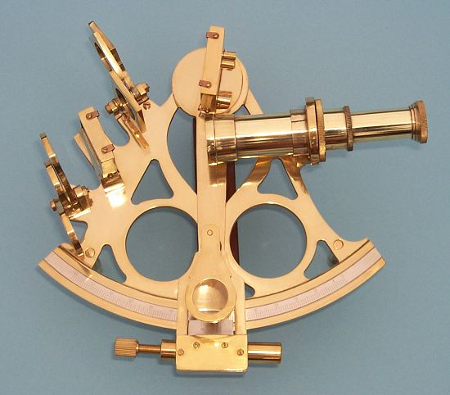
New Technology Makes Exploration Possible
Cartographers -
Map makers begin making more detailed maps that include lines of
Latitude
Longitude
&
Sailors could now use tools to measure latitude and longitude
Sextant measures latitude
Astrolabe measures longitude
Also there was a new, improved magnetic compass for when sailors were out of sight of land

Slide 3
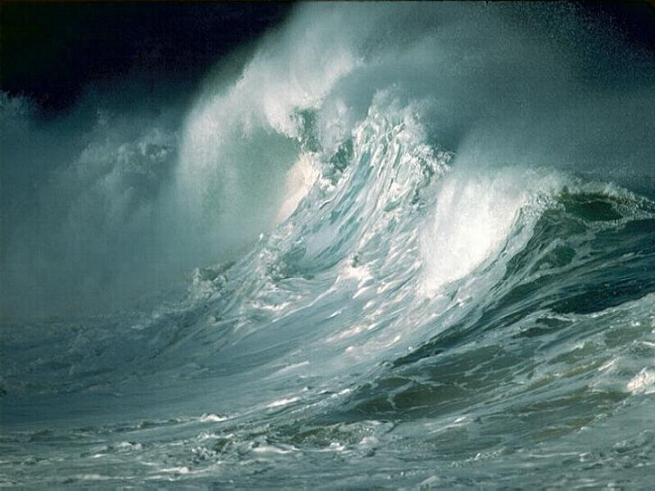
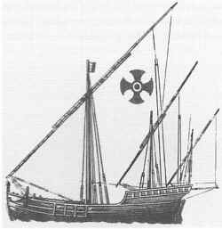
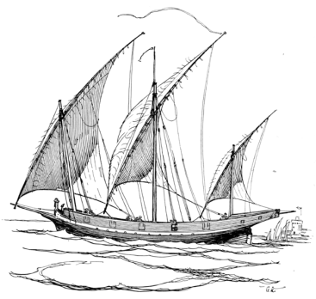
There were also new ships that were in use called Caravels
The Portuguese used a 3 masted version that was
Larger and could hold more
Lateen Sail
All Europeans started using the
Invented by the Arabs
Also, now began to use a stern rudder to help them steer
Expeditions were very expensive, and usually sponsored by a monarch and not a country

Slide 4
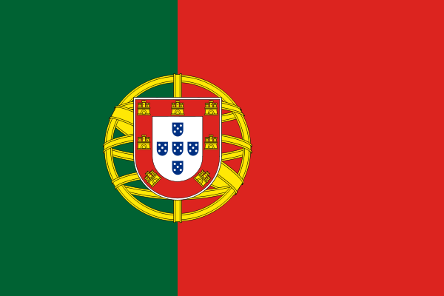
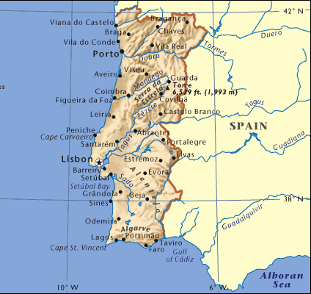
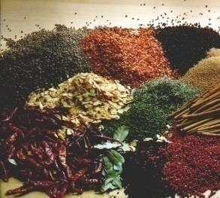

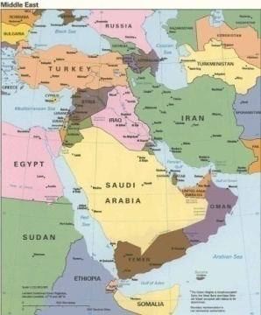

The Portuguese
Far behind in trade because they faced the Atlantic and NOT the Mediterranean
Spices
Silk
All came through the Middle East
To the Mediterranean where the Italians sold it to the rest of Europe
Tea
The only way to make money was to cut out the middle man

Slide 5
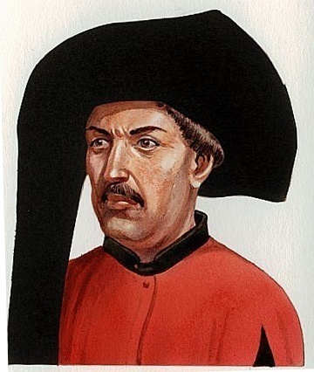
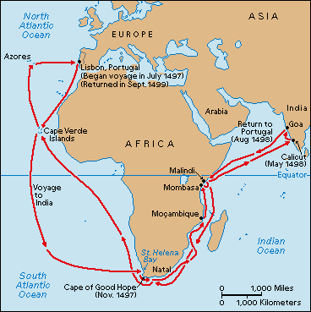

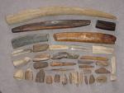
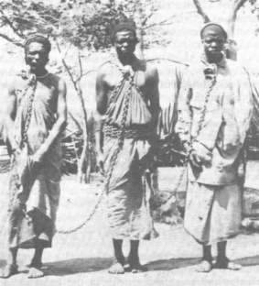
Prince Henry the Navigator 1394-1460
Set up a school for sailors at Sagres w/astronomers, geographers, and mathematicians
1st – Tried to conquer N. Africa, but there was no gold left
2nd – Tried to go to W. Africa to get gold at the source
The Sea Routes around Africa were very dangerous because of wind and ocean currents
Sailed west instead and found the Azores and Madeira where good winds and currents took them around the dangerous capes
Set up trading stations along the coast to bring in gold and ivory
And in 1441, they began buying slaves

Slide 6
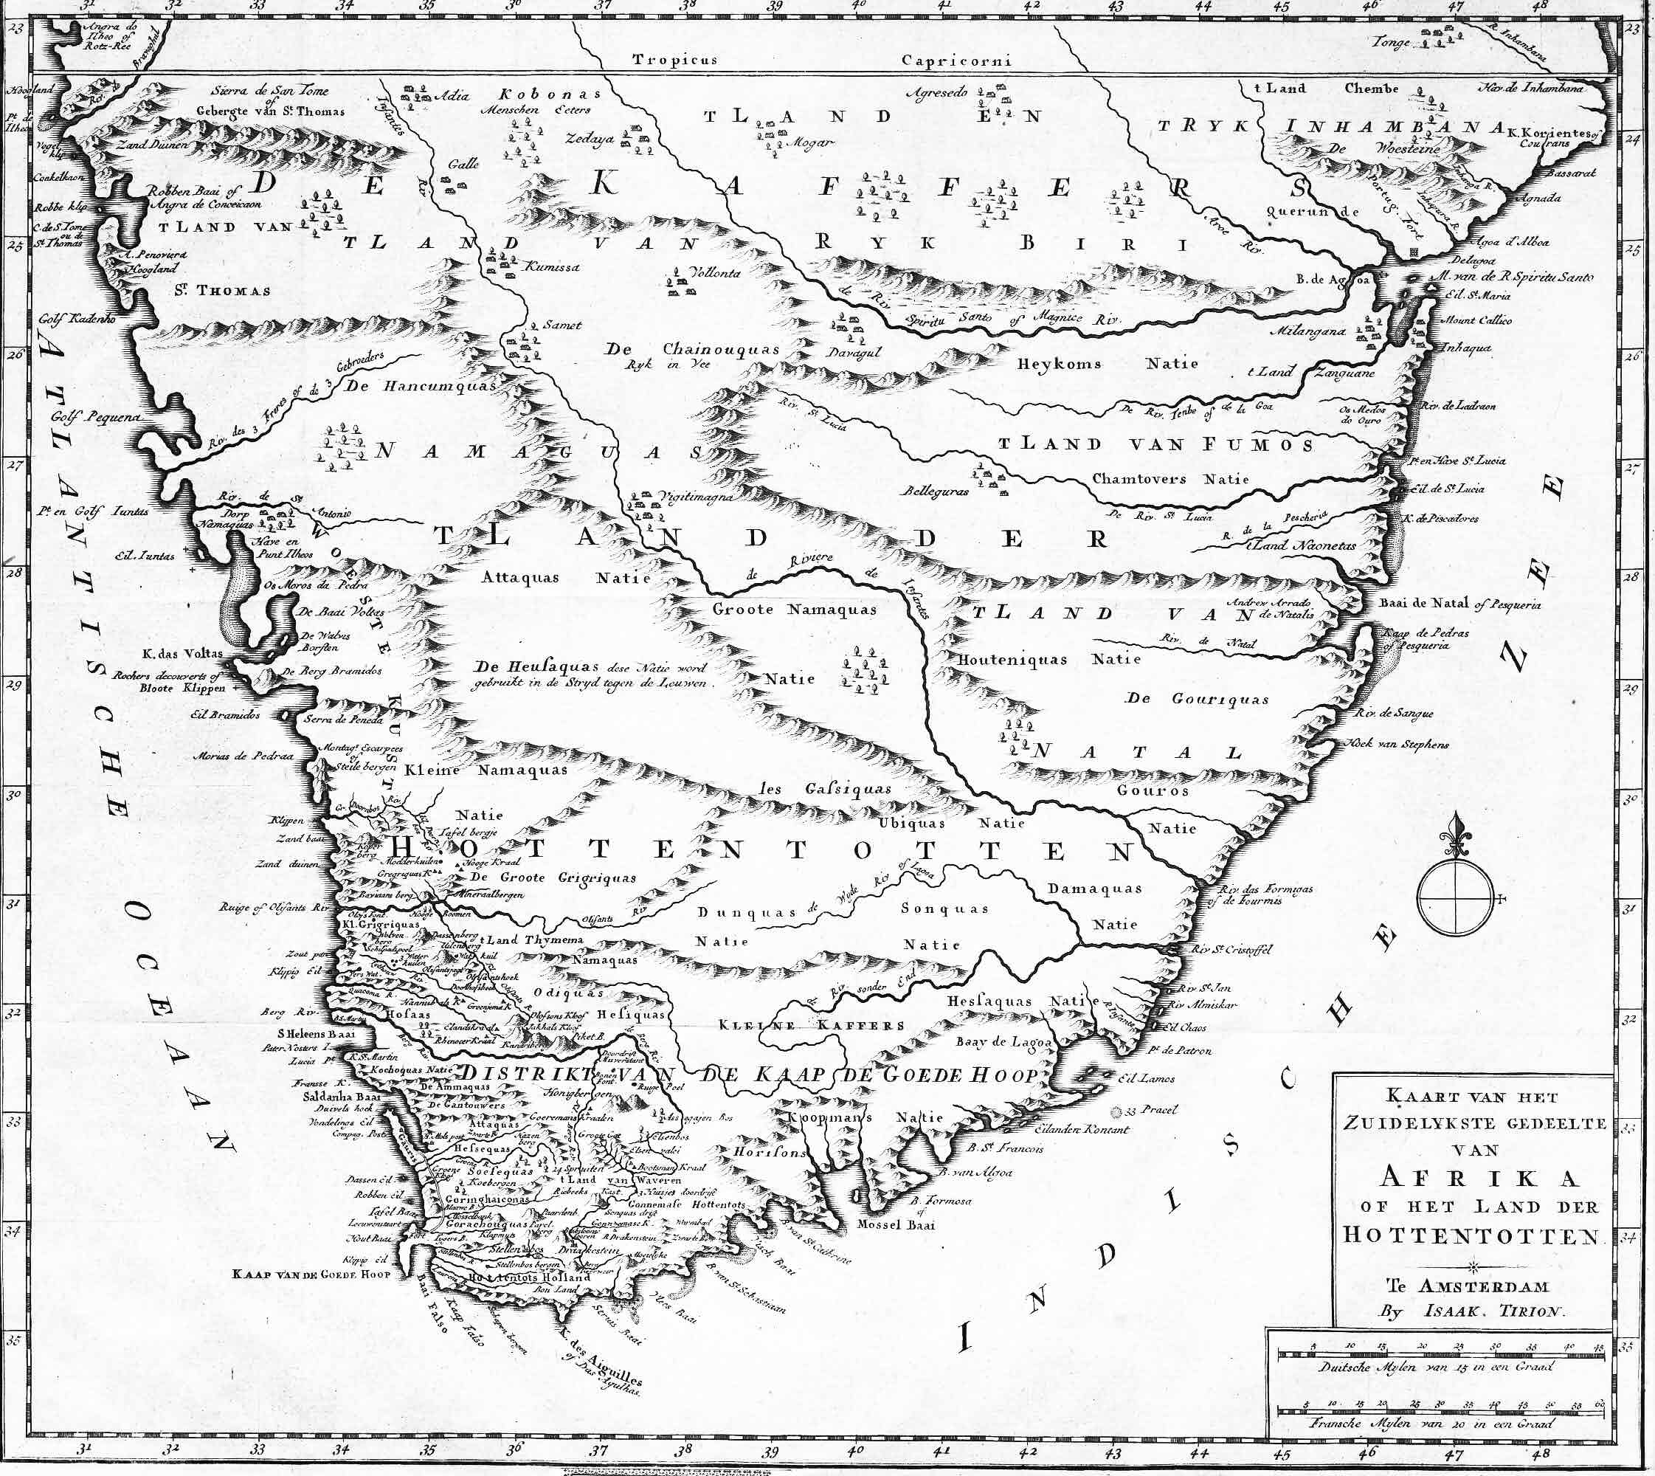
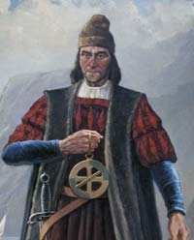
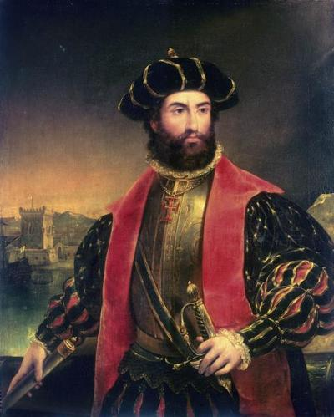
Rounding the Cape of Good Hope
King John II wanted to find an all-water route to Asia
1488 – Bartholomew Dias rounded the tip of S. Africa
Called this area the Cape of Storms because of the horrible weather
King John renamed it the Cape of Good hope
July 1497 – Vasco De Gama leaves Portugal with 4 ships
Quickly rounds the Cape and ends on the East Coast
By May of 1498 he has reached Calicut in India

Slide 7
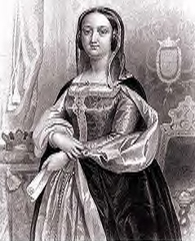
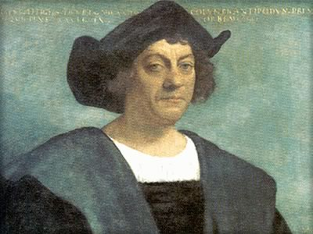
Westward Voyages
Spain also wants direct trade with Asia
Queen Isabella
Wants to spread Christianity as well
Had been trying to convince both Portugal and Spain that he could sail west to get to Asia
Christopher Columbus
He thought he could make it there in 2 months

Slide 8
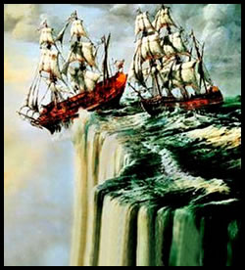
Problem
2 schools of thought on the size of the earth
(Not too many really believed it was flat anymore)
Columbus followed the teachings of Ptolemy and thought the world was smaller than it actually is
Scholars at the University of Salamanca calculated that the Earth was much larger than that
They said there was no way it would only take 2 months.
It would be 4 at the minimum and there was no way to carry enough supplies
Solution
Lucky for Columbus, and his men, there just happened to be a continent 2 months away
It just happens that no one knew it was there

Slide 9
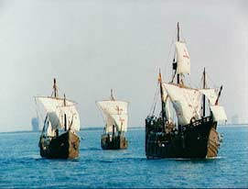
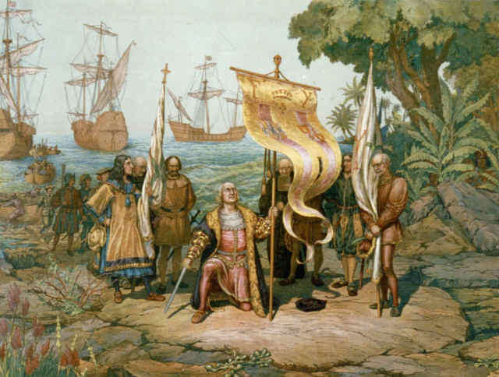
Discovery of the New World
Isabella accepts Columbus’ argument and agrees to his voyage
August 2,1492 – 3 small ships leave Palos Spain
~ Nina, Pinta, and Santa Maria
~ They carry 90 sailors
~ Provisions are starting to run short when they spot land on October 12, 1492
~ Columbus is convinced he’s landed in the Indies and calls the people Indians
~ He explores, Cuba, Hispaniola (Haiti), and the Dominican Republic

Slide 10
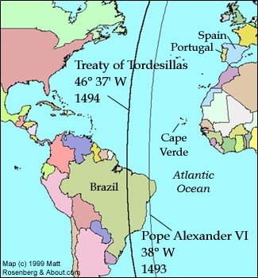
Now the Spanish and Portuguese start fighting over each other’s claims in the Caribbean
They’ve realized that it’s not Asia and dispute rights to explore
Pope Alexander VI decided that he’d heard enough
Treaty of Tordesillas 1494
This drew a
Line of demarcation
That ran north to south about 1100
Miles west of the Azores
Gave land west of that line to Spain
Gave land east of that line to Portugal
Most of North and South America will go to Spain
In 1500 a Portuguese explorer named
Pedro Cabral
Landed on the coast of Brazil and he was able to claim it for Portugal

Slide 11
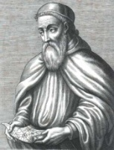
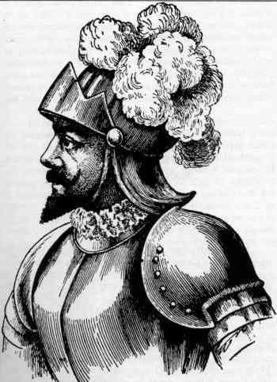
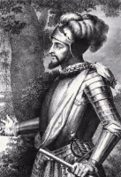
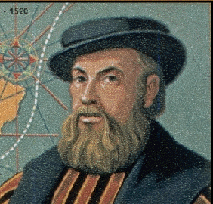
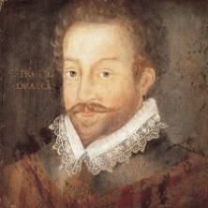
A Land in the Path to India
As more explorers arrive the more obvious it becomes that they aren’t in the Indies
Early Exploration
Amerigo Vespucci
Italian, Charted the Coast of South America and called it
Mondus Novus
In 1507, a German mapmaker calls the new area America, in Vespucci’s honor
1513 – Ponce de Leon sets out to find the fountain of youth
He finds and names Florida
1513 – Vasco de Balboa pushed through central America to the Pacific Ocean
1519 – Ferdinand de Magellan
Entered the Pacific Ocean and Sailed around S. America
1578 – Sir Francis Drake
Went around S. America, attacked Spanish settlements, and then continued around the world, making it back to England in 1580

Slide 12
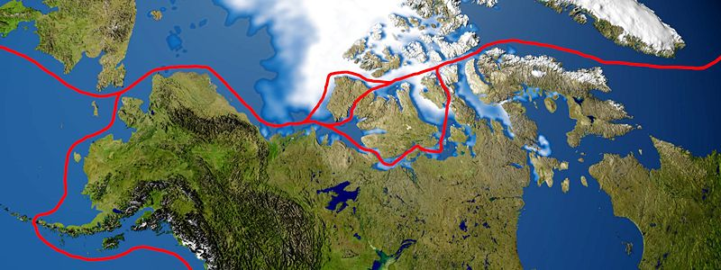
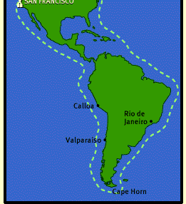
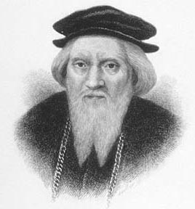
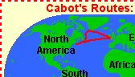
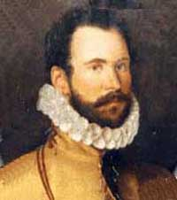
Seeking a Northwest Passage
England, The Dutch, and France all ignored the Treaty of Tordesillas
They realized that going around Africa and Cape Horn
Was very dangerous so they started to look for a different way to the Pacific
1497
John Cabot
Agreed to sail for England
He explored from Delaware to Newfoundland
Now, N. American exploration slowed until in 1567 Martin Frobisher
Reached the Hudson strait and returned with what he thought was gold

Slide 13
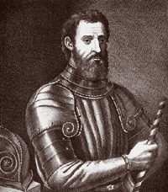
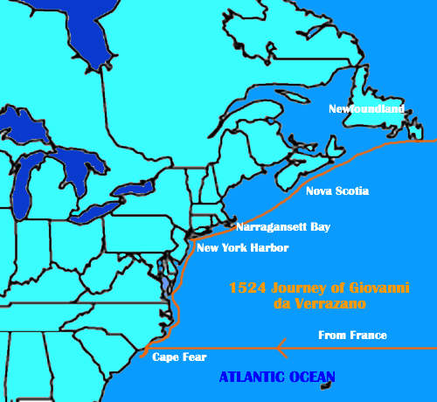
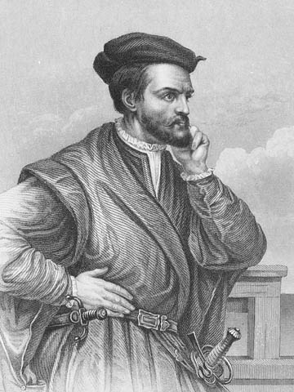
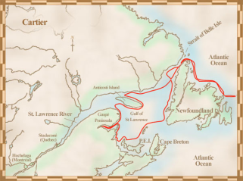
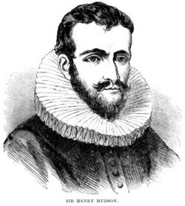
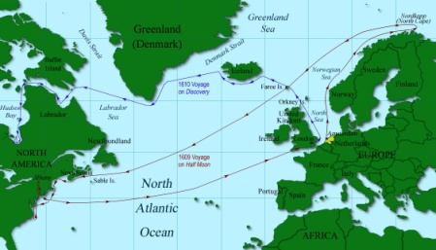
Seeking a Northwest Passage, cont.
1524
French financed Giovanni de Verrazano
Who explored from the Carolinas to Nova Scotia
1530s
Jacques Cartier
Sailed up the St. Lawrence river
He was hoping for a sea route to the Pacific
The Dutch hired Henry Hudson
Who sailed as far as Albany before turning back

Slide 14
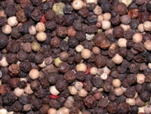
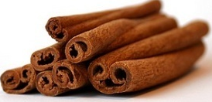

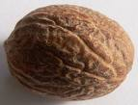
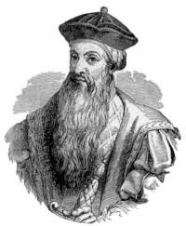
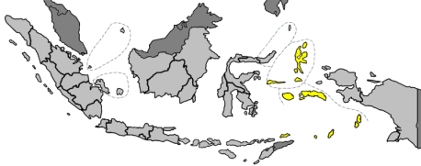
Trade with the East
People were still travelling to Asia via South Africa
Christian Missionaries accompanied the Portuguese and helped set up trading posts
Traders were interested in spices for preserving meat
* Portuguese ships carried
Pepper from India
Cinnamon from Ceylon
Cloves and Nutmeg from the East Indies
The Muslims resisted and the Portuguese turned it into a Crusade
Burned ships and wharves, ransacked cities, tortured prisoners
1509 Alphonso de Albuquerque
Was made governor of the trading posts in Goa India
He seized key trading routes including the gateway to the Moluccas, or spice Islands

Slide 15

Competition
The Portuguese
Set up trading ports in E. Indies
The Dutch
1595 Dutch send a fleet to explore the E. Indies
1602 Dutch found Dutch East India co. and attack Port. shipping
The British and the French
Focused on India and got trading privileges there
Hindus use Europeans as allies against their Muslim Conquerors

Slide 16




Trade with China and Japan
The Portuguese met Chinese traders in Malacca and sailed to China for Silks, satins, and porcelain
By 1535 the Chinese had confined the Portuguese to Macao and other Europeans to Canton
1542- The Portuguese are blown off course and they land safely in Japan
begin to trade with the Japanese for:
The Chinese and Japanese want guns
The Portuguese begin taking land at gun point (possibly with the help of missionaries)
In 1639 the Japanese expel all foreigners
The Dutch will be allowed one ship per year to the port of Nagasaki

Slide 17
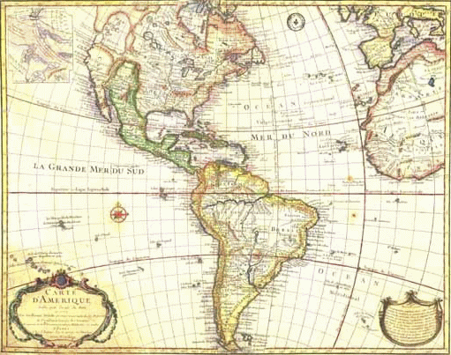

Conquests in the Americas
The Spanish didn’t fund their expeditions directly
Instead, they gave conquistadors
The right to establish posts in C. and S. America
They had to agree to give the Spanish Crown 1/5 of any treasure
Risked their own money to get there

Slide 18
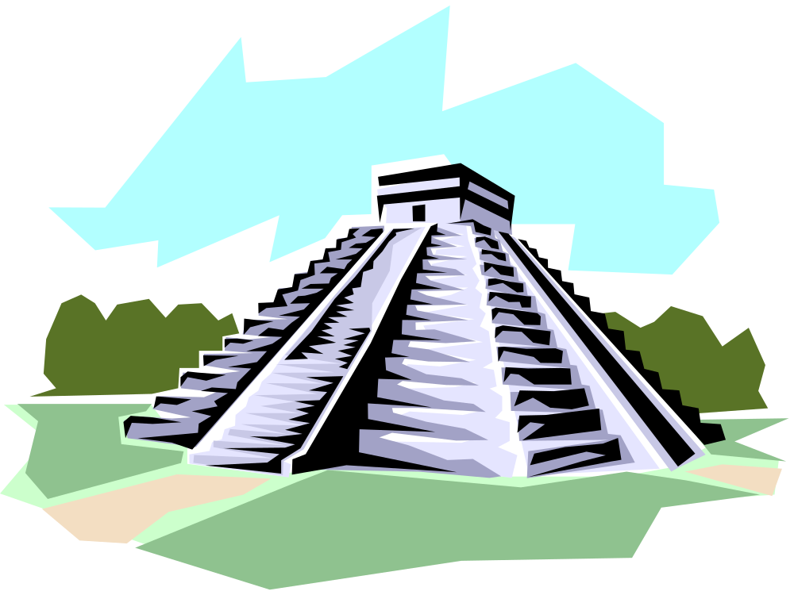
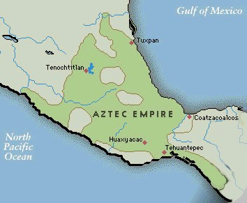
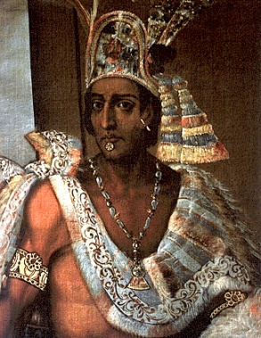

The Aztec
The Aztec Empire was located in what is today southern Mexico and Northern C. America
The first Europeans in C. America made the Aztec leaders nervous
Why?
Montezuma
Knew that a powerful god named Quetzalcoatl
Had promised to return from the East.
According to the Aztec calendar, the only year he could return was equal to 1519 in the European calendar
The Spanish very coincidentally arrived in 1519
The priests began demanding human sacrifice
Conquered people are very unhappy

Slide 19


The Spanish Arrive
1519
Hernando Cortes
Lands on the coast of Mexico looking for gold
He makes alliances with some of the small tribes that hated the Aztec
He matched the description of the white skinned gods who’d be returning with Quetzalcoatl for his revenge
Other coincidences
Arrived at harvest time (when they weren’t prepared to fight) and after the Aztec had seen “portents of doom” such as:
Daytime comet
The destruction of two temples (One of which was made of straw, and struck by lightning
A fire in the night sky (Caused by ships burning in the harbor)
The “Boiling” of lake Texcoco (Caused by a horrible windstorm)

Slide 20




The Spanish Arrive, continued
Cortes marches 200 men and 16 horses into Tenochtitlan
He arrested Montezuma and made him promise to become a subject of the Spanish king
1520
The Aztec revolt and almost win…almost
1521
Cortes and his Indian allies destroy Tenochtitlan
And 180 soldiers land on the Pacific coast of S. America and come across the Inca, in the middle of a civil war
1530
Francisco Pizarro
Pizarro was looking for the city of gold
Pizarro controls most of the Inca Empire, including the capitol at Cuzco
He finds and arrests Atahualpa, the Inca Emperor
1535
Atahualpa offers Pizarro a room full of gold in return for his life

Slide 21






Why did the Spanish Win so Easily?
The Spanish had better weapons
Guns
Cannon
Horses
Aztec may have thought the Spanish were returning gods
Germs and disease
Smallpox, chickenpox, measles, etc were endemic to the European population, but became Epidemics in the Native Populations
Many of the local tribes hated the Inca and Aztec and helped the Spanish defeat them

Slide 22
The new Spanish empire
Spain set up a new, strong central government in the areas they conquered
Divided area into 5 provinces
The top 2 were New Spain (Mexico) and Peru
King appointed a Viceroy to be his representative
Enforced royal policy in the new world
Council of the indies
Set up the
Met in Spain and made laws for the colonies
Theoretically worked with the viceroy to rule
Regulated the most trivial things like the direction and length of streets
cabildo
Spain supervised the local governments
King appointed a city council called a
Supervised the building of towns and cities
By 1600 Mexico had public water, paved and lighted streets, printing presses and a University

Slide 23


The New Spanish empire, continued
Spanish policy towards Native Americans
Conquistadors, settlers, and missionaries flooded into the New World
The Spanish government granted
Enconmiendas
This is the right to demand taxes and labor from the Native People living on the land making them serfs
Spanish found silver
In Mexico and Peru, and forced the Indians to mine it
Protested the treatment of the Indians and said Africans should be imported instead
Some Spanish missionaries, such as Bartolmew de las Casas
The New Laws
Passed in 1542 – Said that Indians couldn’t be made slaves and they could grow crops and cattle

Slide 24








The Plantation System
Settlers exported huge amounts of goods and crops from the new world
Central and South America
Gold
Cacao
Lumber
Silver
Coffee
West Indies
Sugar Cane
Tobacco

Slide 25


The Slave Trade
The Portuguese and Spanish took more and more slaves as they explored Africa
Slaves suffered brutal treatment along the voyage across the Atlantic
The Middle Passage
The Middle Passage was the voyage across the Atlantic
Slaves that survived were sold to plantation owners where they worked long hours often under brutal conditions
As profits grow, so does the trade
Becomes known as the triangle trade

Slide 26



Portuguese Empire in Brazil
King appointed a captain general to oversee the government.
He then gave loyal subjects large parcels of land
A landowner (or donatario) governed the territory he received then enlisted people to farm his land or trade.
In the late 1600s diamonds and emeralds were found
  Settlement boomed

Slide 27



North America
1497
Henry VII sends John Cabot
He took a shorter route around the N. Atlantic
Found North America, and it was promptly ignored for 50 years
The First European Settlements
Spanish
were the first north of Mexico
Looking for gold and silver
Went up the California coast
Missionaries set up churches for converting the native people
Everything they touched was claimed for Spain

Slide 28



North America, Cont.
The Dutch
By the early 1600s the Dutch were as far north as Albany
Peter Minuit
Became the first governor of New Netherland
1626
Minuit bought Manhattan for Cloth and Beads
About 200 Dutch settlers built a village there and called it
New Amsterdam
To get people to move there, Minuit gave large estates to
Patroons
A Patroon is a wealthy landowner that then brought other Dutch farmers to work for them

Slide 29





North America, Cont.
The French
The French primarily set up fishing and fur trading outposts
By 1535 the French had built up along the St. Lawrence river in what is today
Canada, and selling furs to Europe for huge profits.
The French king didn’t encourage settlements except for fur traders
Huguenots – French protestants – wanted to move there but were forbidden
1608
Samuel de Champlain
Was sent to set up a permanent settlement in Quebec
1665
French traders had reached the great lakes and set up forts there

Slide 30






King Louis XIV limited the power of fur traders and appointed his own governor,
Who encouraged trade and exploration
Comte de Frontenac
1673
Louis Joliet (a fur trader) and Jacques Marquette (A Jesuit Priest)
Mapped a route from the Great Lakes to the Wisconsin river to Missouri
1682
Robert Cavalier, sur de la Salle,
Reached the mouth of the
Mississippi River and named the area Louisiana in honor of the French King

Slide 31


The English
1660s
The English settled N. America from Newfoundland & Nova Scotia to what is now Georgia
The English founded 13 colonies that would become the U.S.
Massachusetts Bay
New York
Rhode Island
Georgia
Connecticut
Pennsylvania
New Hampshire
Maryland
New Jersey
Some were set up as trading colonies and others were owned by a specific individual
Virginia
North Carolina
Each had an elected assembly that made local laws and appointed council, and a governor that carried out royal policy
Delaware
South Carolina

Slide 32






The English encouraged settlement and between 1630 and 1700 the population grew from 900 to 200,000
Small farms dominated the northern and middle Atlantic colonies
But, in VA, NC, SC, and GA a plantation system developed
First they grew tobacco
And rice
Then cotton
English had many problems with the local native population
There were wars, raids, and villages destroyed

Slide 33


European Rivalries
In the late 1600s and early 1700s wars broke out between the powers
Some tried to ally themselves with Native People
The French joined with their chief trading partners, the
Algonquin
The Dutch joined with the
Iroquois
In 1694, the Dutch were kicked out of New Netherland
New York
The English rename it
And fight with the French for control of the west and of Canada

