Slide 1
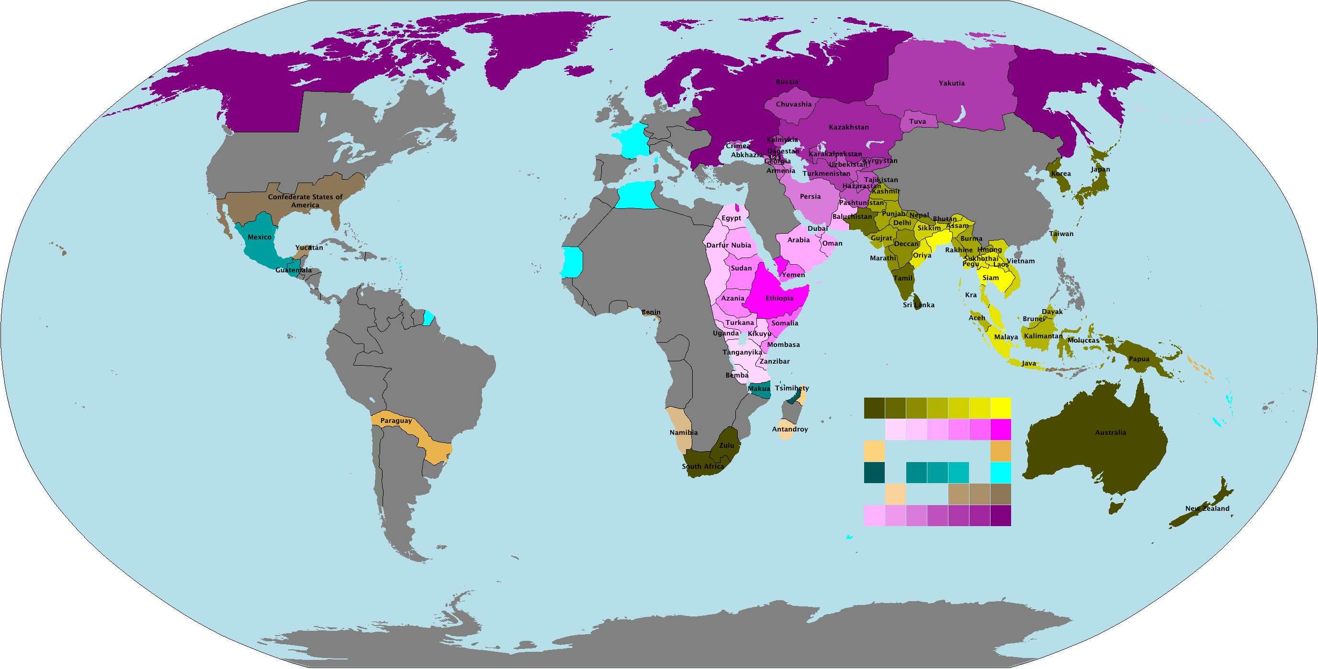
Revolution and Reaction
1815-1848

Slide 2
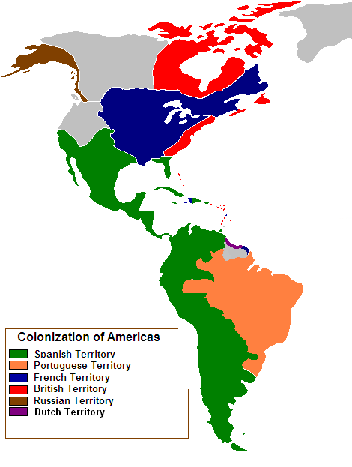
Latin American People win Independence

Slide 3
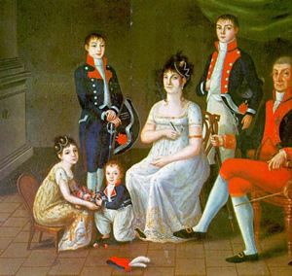
Colonial Society Divided
Class dictated a person’s role in society and your job
At the top of Spanish American society were the Peninsulares
These are people who were born in Spain
        They made up only a small percentage of the population
        They were the only people who could hold high office in Spanish colonial government.

Slide 4
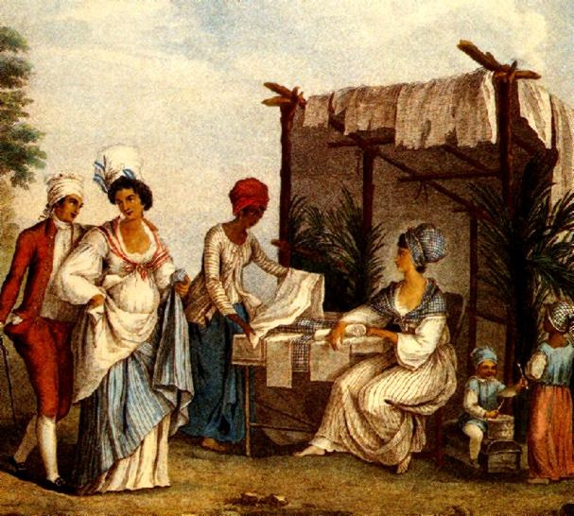
Creoles were below the Peninsulares in rank
These are Spaniards born in Latin America
They could not hold high political office
They could rise as officers in Spanish colonial armies

Slide 5
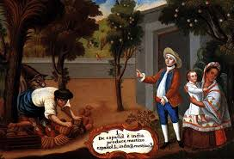
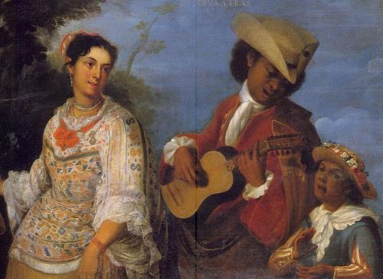
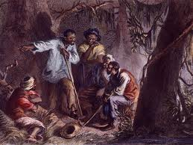
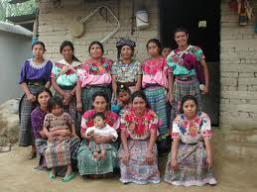
Below the Peninsulares and the Creoles in rank were the Mestizos
Next were the Mulattos
People of Spanish and Native American Descent
People of mixed Spanish and African Descent
Then were the enslaved Africans
And the Native Indians

Slide 6
Revolutions in the Americas
    The success of the American Revolution, as well
    as ideas from the enlightenment encouraged the
    Latin American colonies to try to gain their
    independence.

Slide 7
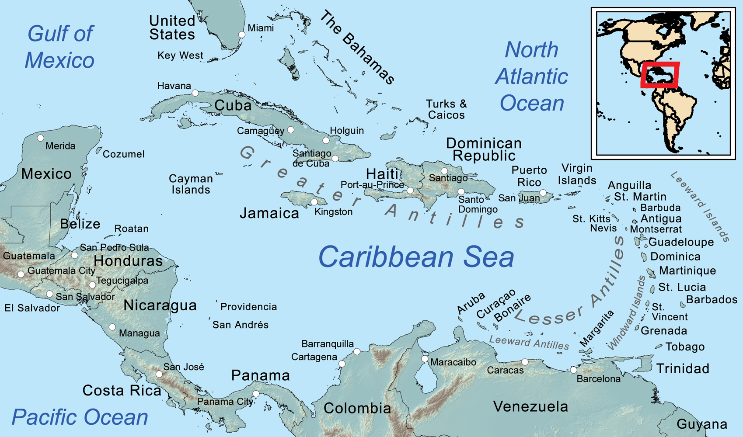
Revolution in Haiti

Slide 8
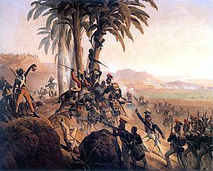
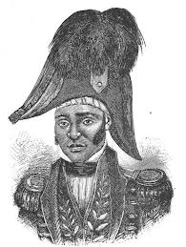
The French colony called Saint Domingue was the first Latin American Colony to free itself from European rule
Haiti occupied the Western 1/3 of Hispaniola in the Caribbean sea
There were 500,000 enslaved Africans working on French plantations there
When the French Revolution was happening the Haitians rebelled against their French masters
In August of 1791 100,000 slaves revolted
They were led by Toussaint L’Ouverture, a former slave
By 1801 he had taken control of the entire island and freed all the slaves

Slide 9
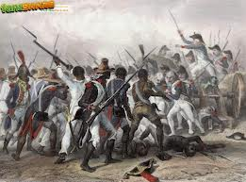
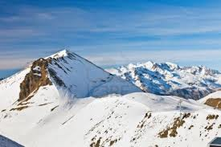
In January 1802, 30,000 French troops landed in Saint Domingue to remove L’Ouverture from power
He agreed to end the revolution if the French would stop slavery
They agreed but then accused him of planning another rebellion
L’Ouverture was arrested and sent to the French Alps where he died in 1803

Slide 10
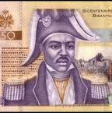
Haiti’s Independence
L’Ouverture’s lieutenant was a man named Jean-Jacques Dessalines
On January 1, 1804 General Dessalines declared the colony an independent country
It was the first black colony to free itself from European control
Dessalines renamed the country Haiti, which means Mountainous Land

Slide 11
Creoles lead independence
Though they were denied the ability to hold public office, Creoles were the least oppressed people born in Latin America
They were also well educated
Many travelled to Europe for their education
They brought ideas of the enlightenment home with them when they returned
When Napoleon removed King Ferdinand VII and replace him with his brother Joseph the colonies rebelled

Slide 12
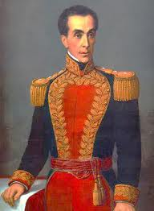
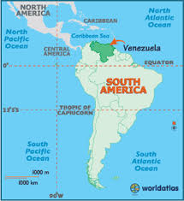
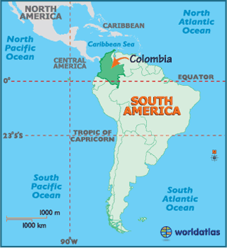
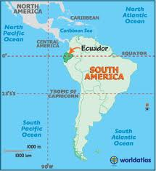
Simón Bolívar
Simón Bolívar was a Creole from Venezuela
Venezuela declared its independence from Spain in 1811 but the war didn’t go well at first
The turning point came in August of 1819
Bolívar led 2,000 soldiers on a march through the Andes into what is now Colombia
From this direction he took the Spanish Army in Bogotá by surprise
By 1821 Bolívar had won Venezuela’s independence
He then marched south into Ecuador where he met José de San Martín

Slide 13
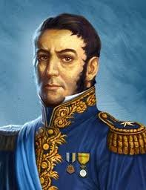
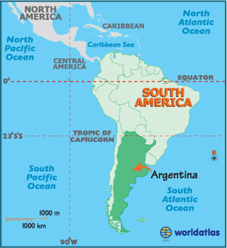
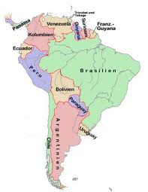
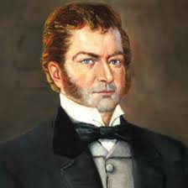
José de San Martín
San Martín was a Creole from Argentina
Argentina had declared its independence from Spain in 1816
But there were still Spanish forces in Peru and Chile who posed a threat
In 1817 he marched his troops across the Andes into Peru where he met up with Bernardo O’Higgins’ forces
The Two men freed Chile

Slide 14
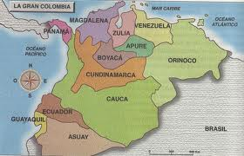
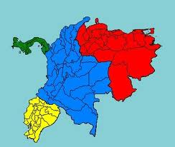
In 1821 San Martín planned to drive the remaining Spanish forces out of Lima but he didn’t have enough troops
San Martín and Bolívar met in Guayaquil, Ecuador in 1822 where San Martín left his army for Bolívar to command
The combined forces defeated the Spanish at the Battle of Ayacucho (Peru) on December 9, 1824
The Spanish colonies now had their freedom and were united into a country called Gran Colombia
Made up of the modern countries of Venezuela, Colombia, Panama, and Ecuador

Slide 15
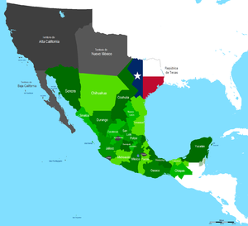

Mexico ends Spanish Rule

Slide 16
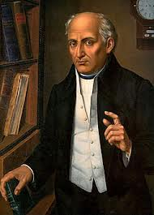
A Cry for Freedom
Padre Miguel Hidalgo
In1810 Hidalgo, a priest in the small village of Dolores, rang the bells of his church
When the people showed up he issued a call for rebellion against the Spanish
Today this is known as the Grito de Delores
        The next day, September 17, 1810, Hidalgo’s Indian and Mestizo followers began a march towards Mexico City
        The army soon numbered 80,000 men.

Slide 17
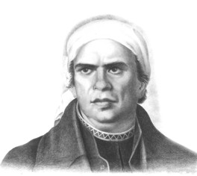
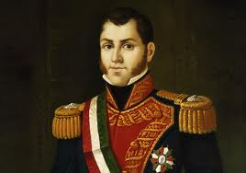
The Spanish Army and the Creoles were alarmed because they thought they would lose their land and privilege
They defeated Hidalgo in 1811.
The rebels then rallied around Padre José María Morelos.
Morelos led the rebellion for 4 years until he was defeated by Agustín de Iturbide in 1815

Slide 18
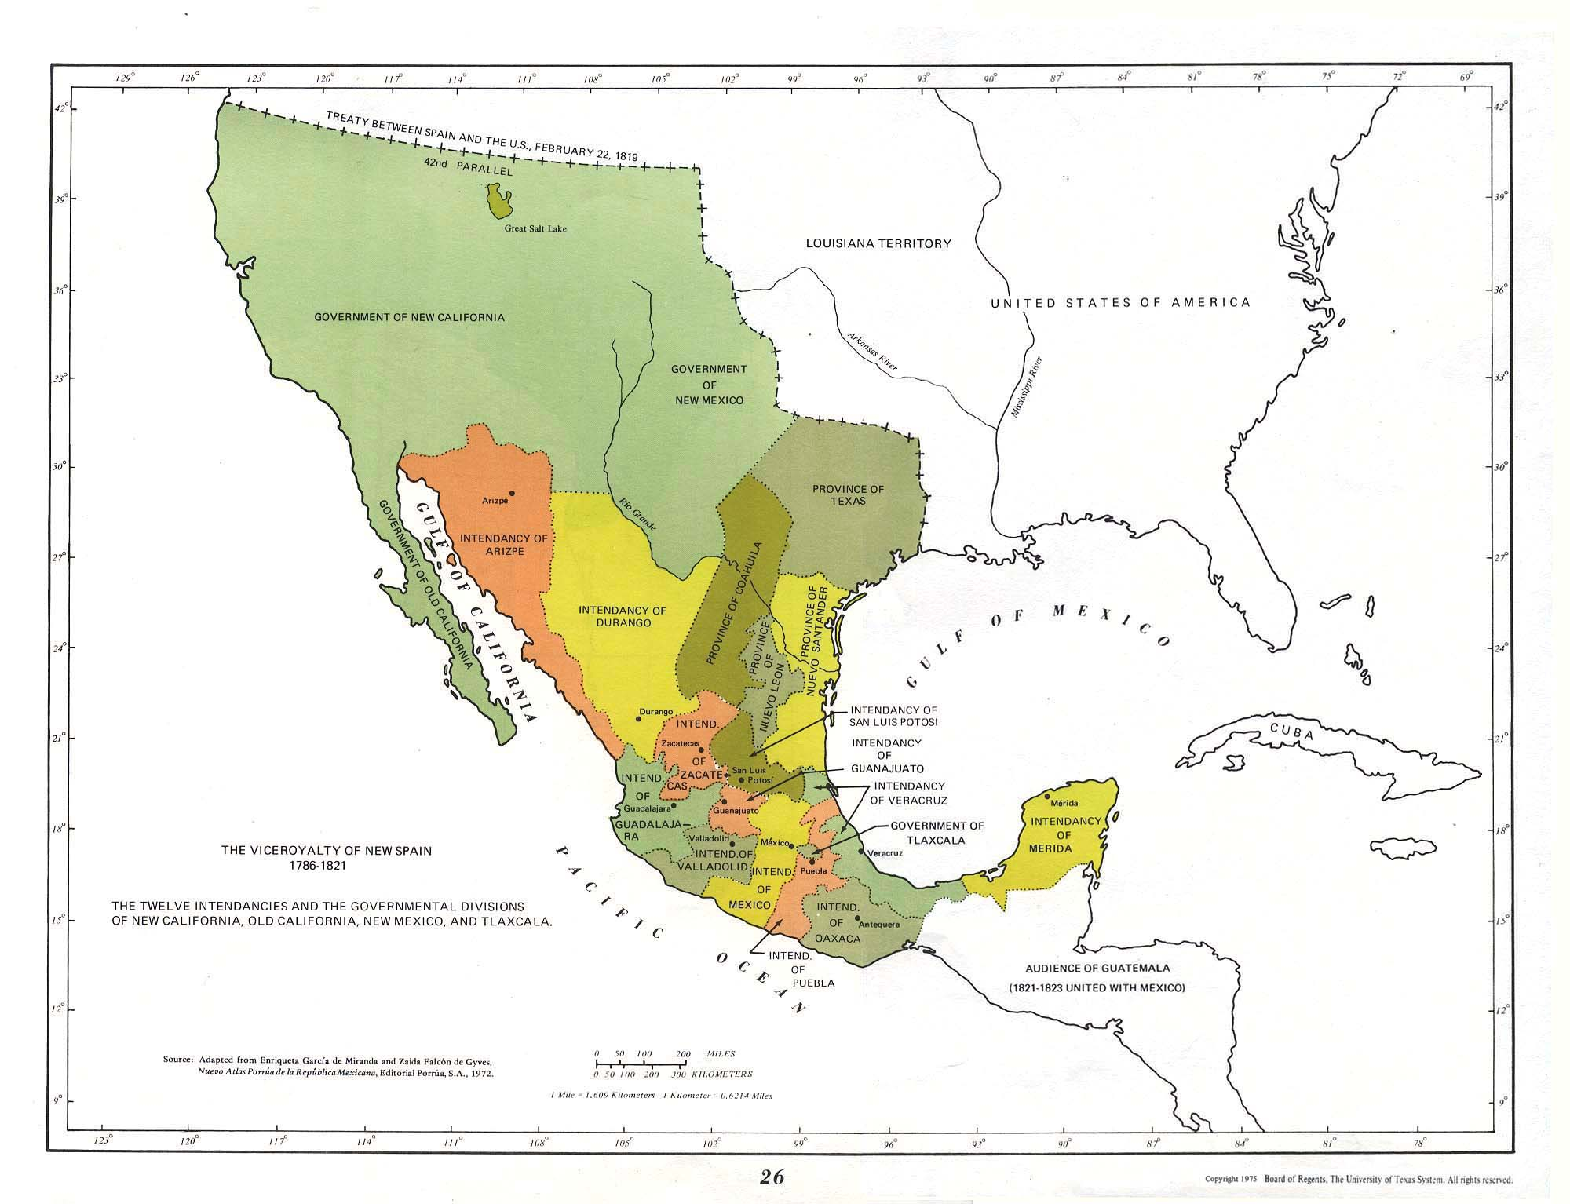
    Mexico’s Independence
In 1820, a liberal group took power in Spain
Mexico’s Creoles feared a loss of their traditional power so they united for Mexican Independence
Agustín de Iturbide proclaimed it in 1821
Before the Mexican Revolution, all of Central America had been part of the Viceroyalty of New Spain

Slide 19
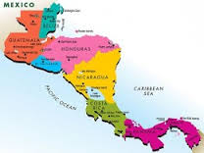
In 1821, several C. American states declared their independence from Spain and from Mexico
Iturbide, who had declared himself emperor, refused to recognize these claims
He was overthrown in 1823
Central America claimed absolute independence from Mexico in 1823
Called itself the United Provinces of Central America
Included Nicaragua, Guatemala, Honduras, El Salvador, and Costa Rica

Slide 20

Brazil’s Royal Liberator

Slide 21
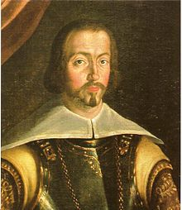
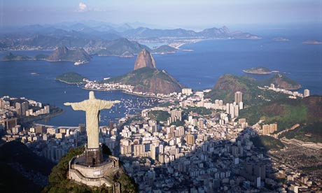
Led by a member of the Portuguese Royal Family
In 1807 Napoleon invaded both Spain and Portugal
His goal was to close their ports to British Shipping
Prince John (Joao) and his family fled to Brazil
Rio de Janeiro became the capitol of the Portuguese empire
Lasted 14 years

Slide 22
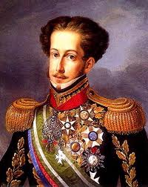
After Napoleon’s defeat in 1815 King John returned to Portugal
His son Dom Pedro stayed behind
King John intended to make Brazil a colony again
8,000 Brazilians signed a petition asking Dom Pedro to rule them as an independent nation
He declared Brazilian independence on September 7, 1822

Slide 23
Europe Faces Revolutions
  Clash of Philosophies
    There are three schools of thought that were around in Europe right now
    Liberal: Mostly middle-class business leaders and merchants
    Wanted to give more power to elected parliaments, but
    only the educated and the landowners could vote
    Conservative: Usually wealthy property owners and nobility
    Wanted to protect the traditional monarchies of Europe
    Radical: Came from all classes
    Favored drastic change to extend democracy to all people
        They believed that governments should practice the ideals of the French Revolution
        Liberty, equality, fraternity

Slide 24
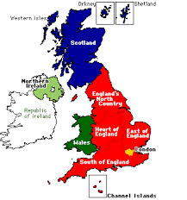
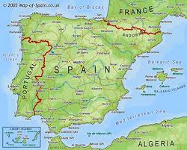
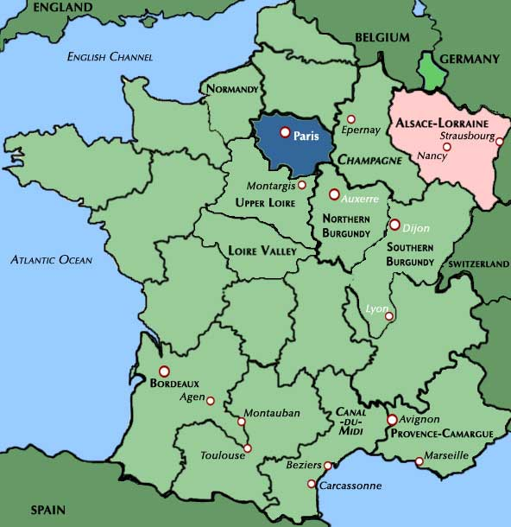
Nationalism Develops
Nationalism is the belief that people’s greatest loyalty should not be to a king or an empire but to a nation of people who share a common culture and history
When a nation had its own independent government it became a nation-state
A nation-state defends the nation’s territory and way of life and it represents the nation to the rest of the world
In Europe in 1815 France, England, and Spain could be called Nation States
    Most people who believed in Nationalism were either liberals or radicals
      Usually the liberal middle class led the way

Slide 25
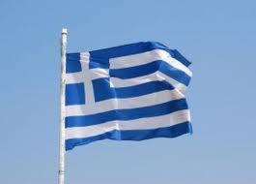
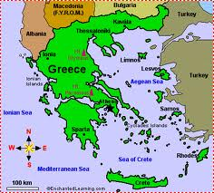
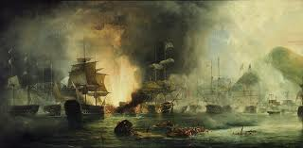
Nationalists challenge conservative power
Greeks Gain Independence
Unlike most if not all independence movements, the Greek movement had popular support all over the world
Russians felt a connection to the Greek Orthodox Church
Educated Americans and Europeans loved and respected Ancient Greek Culture
Eventually as support spread, the major powers of Europe took the side of the Greeks
In 1827 a combined British, French and Russian fleet destroyed the Ottoman fleet at the Battle of Navarino.
1830 Britain France and Russia signed a treaty guaranteeing an independent kingdom of Greece

Slide 26
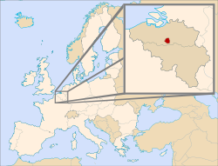
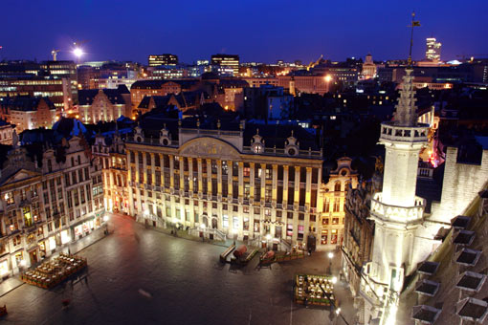
1830s Uprisings Crushed
By the 1830s the Congress of Vienna was breaking down
      Nationalist riots broke out against Dutch rule in the Belgian city of Brussels
      In October of 1830 the Belgians declared their independence from Dutch control

Slide 27
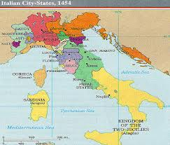
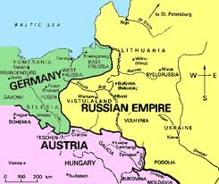
      In Italy, nationalists worked to unite the many separate states on the Italian peninsula
        Some of these areas were controlled by Austria, some were independent, and others were controlled by the pope
        Eventually, Metternich sent in Austrian troops to restore order to Italy
      The Polish people living under Russian rule also revolted
        Took place in Warsaw
        Took Russia an entire year to put down the uprising

Slide 28
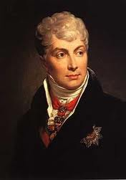
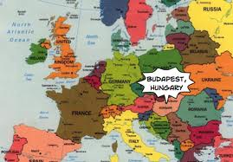
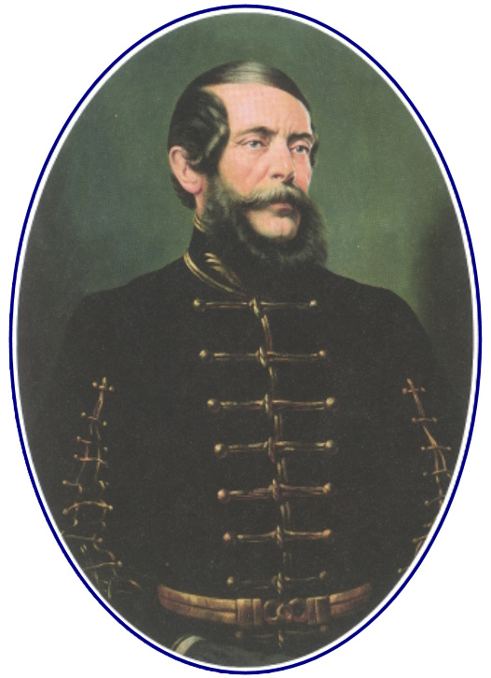
    1848 Revolutions Fail to Unite
      Ethnic uprisings erupted throughout Europe and the Austrian Empire
        Got worse after Metternich’s resignation.
        In Budapest the nationalist leader
        Louis Kossuth
        called for Parliament and self-
        government for Hungary.

Slide 29
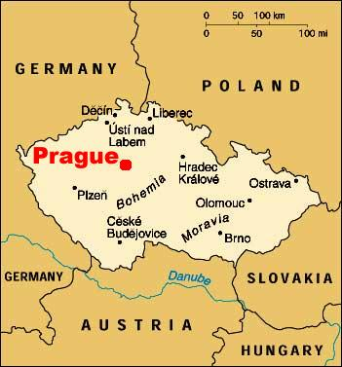
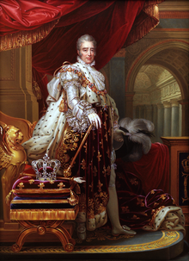
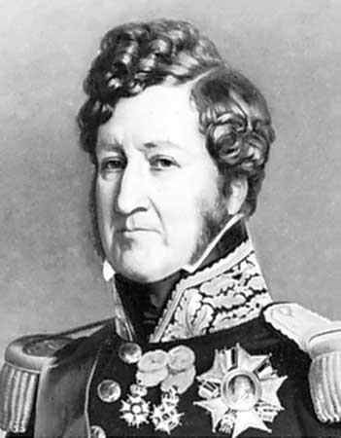
        In Prague, Czechs demanded Bohemian independence.
      However, these revolutions never gained the strength they needed to make any real difference and by 1849, Europe was in the hands of conservatives again
  Radicals Change France
    France was the only country in Europe where the goal of the revolutionaries
    was democratic reform.
    In 1830 Charles X tried to go back to absolutism
      This led to revolts that made Charles flee to Great Britain
        He was replaced by Louis-Philippe
        Louis-Philippe had long been a supporter of liberal reform
        He falls from favor in 1848
        He was overthrown by a Paris mob and they created another republic

Slide 30
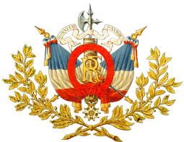
      The Third Republic
        This republic began to fall apart almost immediately
          One group of radicals wanted only political reform
          The other group wanted political, social, and economic reform as well
            Because of all this fighting, people turned away from the radicals and a moderate constitution was written in 1848
              It called for a strong president and an elected parliament

Slide 31


France Accepts a Strong Ruler
In December of 1848 Louis Napoleon won the presidential election
He was the nephew of Napoleon Bonaparte
Four years later, Louis Napoleon Bonaparte took the title: Emperor Napoleon III
This was approved by a majority of French voters
        The French wanted a strong leader who would
        bring stability and peace to France
        As emperor, Napoleon III built railroads,
        encouraged industrialization, and promoted an
        ambitious program of public works
        Because of his policies, unemployment decreased
        and the country prospered

Slide 32

Reform in Russia

Slide 33


Russia hadn’t begun to industrialize like the rest of Europe in the 1800s
Under Russia’s feudal system, serfs were bound to the nobles whose land they worked
Nobles had almost unlimited power over them
This feudal system meant that Russia couldn’t modernize the way the rest of Europe was
But Czars were not willing to free the serfs because it would make the nobles angry and they needed the landowners to stay in power

Slide 34


Defeat Brings Change
Eventually the lack of development in Russia became obvious to everyone
In 1853 Czar Nicholas I threatened to take over part of the Ottoman Empire in the Crimean War
        However Russia’s industries and transportation system failed to provide adequate supplies for the country’s troops
        As a result Russia lost the war in 1856 against the combined forces of France, GB, Sardinia, and the Ottoman Empire

Slide 35

After the war, Alexander II decided to move Russia toward modernization and social change
He felt that these changes would allow Russia to compete with western Europe for world power
The first of Alexander’s reforms was a decree freeing the serfs in 1861 with the Emancipation Edict
The abolition of serfdom didn’t work however
The peasant communities received about ½ of all the farmland in the country
Individual peasants got nothing
The government paid the nobles for their lost land
Peasants had 49 years to pay back the government for the land they got
Even though they were technically free, now they were tied to the land by debt

Slide 36

All reform ground to a halt when Alexander II was assassinated in 1881
His son Alexander III tightened czarist control over the country
He and his ministers encouraged industrial development to expand Russian Power
Nationalism was a main driving force behind this industrial expansion

Slide 37





Nationalism
  Nationalism: A Force for Unity or Disunity
    There were three types of nationalist movements
      Unification
        Mergers of politically divided but culturally similar lands
        19th century Germany and Italy
      Separation
        Culturally distinct groups resist being added to states or try to break away
        Greeks in the Ottoman Empire
        French speaking Canadians
      State-Building
        Culturally distinct groups form into a new state by accepting a single culture
        The United States

Slide 38
  Nationalism Shakes Aging Empires
    The breakup of the Austrian Empire
      Many different ethnic groups lived in the
      Austrian Empire
        Slovenes
        Hungarians
        Germans
        Czechs
        Slovaks
        Croats
        Poles
        Serbs,
        Magyars
        Italians

Slide 39


In 1866 Prussia defeated Austria in the Austro-Prussian War
        Prussia gained control of the newly organized North German Confederation
        This was a union of Prussia and 21 smaller states.
      Pressure by the Hungarian Magyars led Austrian Emperor Franz Joseph to split his empire in half
        Austria and Hungary were made individual independent states
        Franz Joseph was the leader of both
        Now called Austria-Hungary or the Austro-Hungarian Empire
        There were nationalist revolts in Austria for the next 40 years
        It eventually breaks up into several separate nations after WWI

Slide 40
    The Russian Empire Crumbles
      Many different ethnic groups also lived in Russia
        100,000,000 Russians
        22,000,000 Ukrainians
        8,000,000 Poles
        And smaller numbers of Lithuanians, Latvians, Estonians, Finns, Jews, Romanians, Georgians, Armenians, Turks, and others.
        Each of these groups had their own culture, and in some cases, their own language.

Slide 41

The Romanov dynasty of Russia was determined to maintain iron control over this diversity
They instituted a policy of Russification
This was forcing Russian culture on all the ethnic groups in the empire
Instead of weakening nationalism, it strengthened ethnic nationalist feelings and helped to tear Russia apart
The Czars couldn’t survive the combination of WWI and the Communist Revolution
        The last Russian Czar, Nicholas II, was murdered in 1917, ending the Romanov dynasty in Russia.

Slide 42



    The Ottoman Empire Weakens.
      The Ottoman Empire a vast empire of many different ethnic groups
        Greeks
        Slavs
        Arabs
        Bulgarians
        Armenians
      In 1856 the British and French pressured the Ottomans into granting equal citizenship to all people under their rule
        Angered conservative Turks who wanted no change in the situation
        As a result of this the Ottomans killed or deported many of
        their “newly equal” people
        From 1894-1896 and again in 1915 the Ottomans massacred the Armenians.
      The Ottoman Empire, like the Austro-Hungarian empire broke up shortly after WWI

Slide 43



Camillo di Cavour
Cavour Unites Italy
Cavour leads Italian Unification
Piedmont-Sardinia was the most powerful of the Italian Nation States
They had adopted a liberal constitution in 1848
In 1852, King Victor Emmanuel II named Camillo di Cavour as his prime minister
Victor Emmanuel II

Slide 44
He realized that the biggest roadblock to unifying Italy was Austria’s presence in the North
In 1858 Napoleon III agreed to help drive Austria out of the northern Italian provinces
Cavour then provoked a war with the Austrians
The combined forces of France and Sardinia won two quick victories
Italy got Lombardy but France was afraid of annoying Austria too much and signed a separate peace allowing Austria to keep Venetia

Slide 45

Giuseppe Garibaldi
Garibaldi Brings Unity
As Cavour was uniting northern Italy, he was helping nationalist rebels in southern Italy
In May of 1860 the Red Shirts, a group of nationalists led by Giuseppe Garibaldi captured Sicily
From there he crossed to the Italian mainland and marched north
Eventually Garibaldi agreed to unite the southern areas he had conquered with Piedmont-Sardinia
Cavour arranged for King Victor Emmanuel to meet Garibaldi in Naples
He agreed to step aside and let the Sardinian king rule
In 1866 the Austrian province of Venetia became part of Italy
In 1870 Italian forces took over the last part of the Papal States
Rome now came under Italian control
and the pope would keep a self-governing section called Vatican City

Slide 46

  Bismarck Unites Germany
    Prussia leads German Unification
      Advantages
        Prussia was mainly German and therefore nationalism united them instead of dividing
        Prussia’s dedication to militarism made their army the strongest in Central Europe
        In 1848 Prussia had a liberal constitution that paved the way for unification

Slide 47

    Bismarck takes Control
    In 1861 Wilhelm I took the throne
        The liberal parliament refused him the money for reforms that would strengthen the army
        He saw the parliament’s refusal as a challenge to his authority
        He was supported by the Junkers
        These are conservative members of Prussia’s wealthy landowning class

Slide 48
      In 1862 Wilhelm I chose a Junker named Otto Von Bismarck as his prime minister
        Bismarck practiced realpolitik
        Means the politics of reality
        With the kings approval, Bismarck declared that he would rule without the consent of parliament and without a budget
        This was in violation of the constitution.
        He told the people in parliament that it wasn’t speeches that would get them anywhere, but blood and iron
Earned him the nickname “Iron Chancellor”

Slide 49


    Prussia expands
      In 1864 Bismarck took the first step towards empire
        Prussia and Austria formed an alliance and went to war against Denmark
        Wanted to win Schleswig and Holstein
        Defeated Denmark quickly and gained support for a unified Germany
        Austria got Holstein
        Prussia got Schleswig

Slide 50

    The Seven Weeks War
      Bismarck intentionally stirred up conflict with Austria in the Schleswig-Holstein area.
        Austria then declared war on Prussia in 1866
        Prussia defeated Austria in 7 weeks with superior training and technology
        Austria lost Venetia which was then given to Italy
        Prussia annexed northern Germany
        This united the eastern and western parts of the Prussian kingdom for the first time
        In 1867 the remaining states of the north joined the North German Confederation, which was dominated by Prussia

Slide 51


    The Franco-Prussian War
      In 1867 there were a few German states that remained independent
        They were mostly catholic and were afraid that they’d lose their culture in a protestant Prussian dominated Germany.
        Bismarck felt that he could gain the support of the south if they had a common enemy from the outside
        He provoked a war with France through the Ems Telegram
        This telegram made it look like the French Ambassador had insulted the Prussian King
        In response, France declared war on Prussia on July 19, 1870

Slide 52


        The Prussian Army surrounded the main French force at Sedan and Napoleon III was taken prisoner.
        This victory united the south as well and on January 18, 1871 they captured the French palace of Versailles
        King Wilhelm I of Prussia was crowned Kaiser
        Called their Empire The Second Reich

