Slide 1
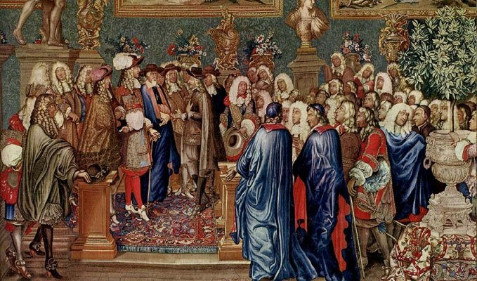
The Age of Absolute Monarchs
Spain, France, England, and Russia

Slide 2
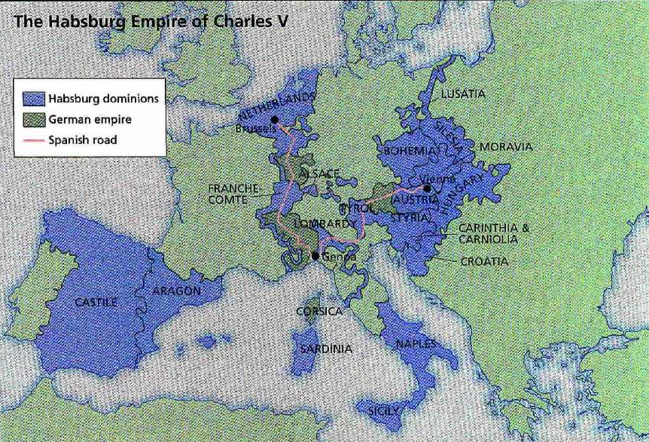
The Golden age of Spain
The Hapsburg rulers of Spain started out as dukes in Austria.
Through marriage they got an empire bigger than ancient Rome

Slide 3
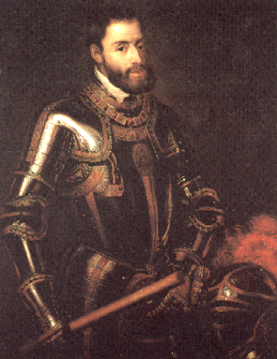
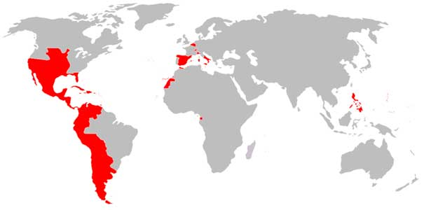
Empire reached its greatest size under Charles V who ruled from 1516 - 1556
    Charles inherited Spain and its empire in the Americas through his grandparents Ferdinand and Isabella.
He was elected Holy Roman Emperor in 1519 by the German Princes
Inherited the American part of the Empire from his grandparents

Slide 4
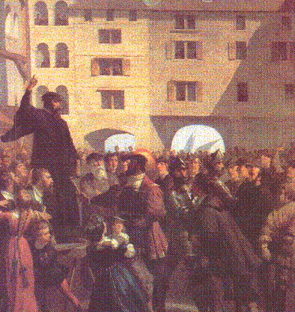
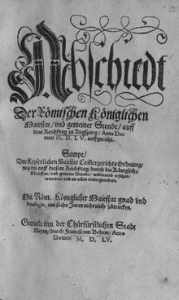
Charles was a devout catholic and he had to deal the Protestant Reformation
He tried to get the princes to respect the Pope’s authority, but he was sick of fighting so he signed the Peace of Augsburg in 1555 that allowed the Princes to determine the religion of their state

Slide 5
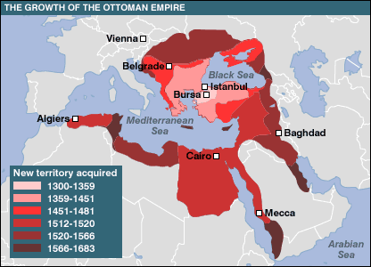
International Diplomacy
Fought the French for Italy, Burgundy, and Flanders
Fought the Ottomans in Austria after Suleiman defeated the Hungarians and travelled up the Danube
Charles and his brother Ferdinand signed a treaty allowing the Ottomans to control most of Hungary

Slide 6
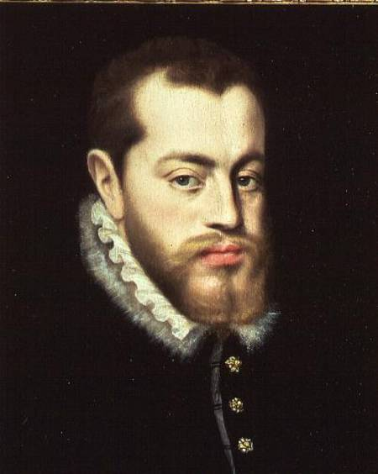
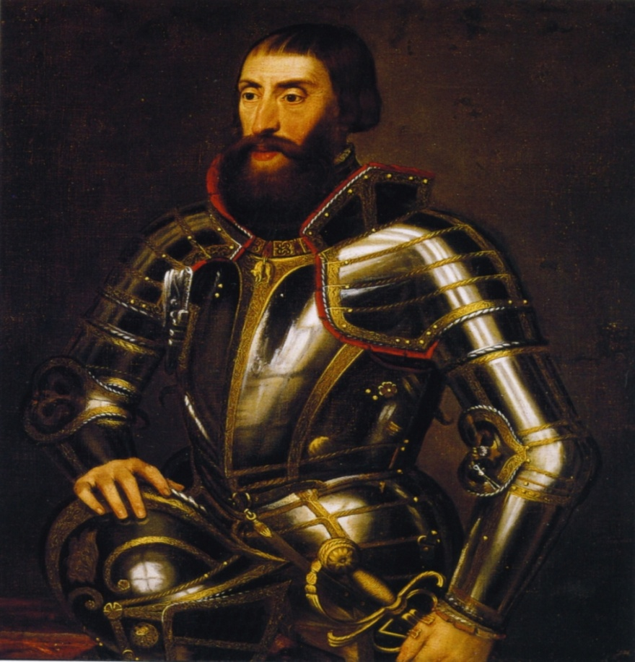
Charles abdicated and divided his empire between:
His son Philip
And his brother Ferdinand
He thought it was too big for one man to rule
Got the Spanish part of the Empire including: Spain, Spanish land in the Americas, the Netherlands, Naples, and Milan
Got Austrian part of the empire and was later crowned Holy Roman Emperor Ferdinand I

Slide 7
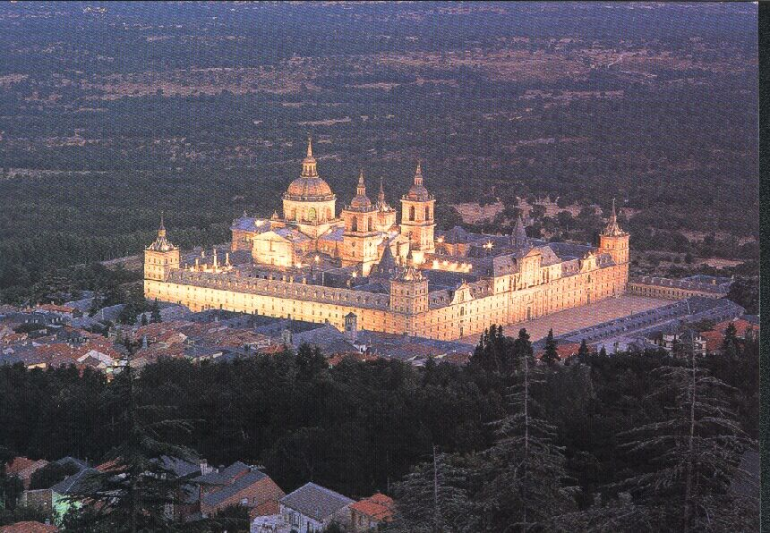
Philip II of Spain
Empire reached its greatest size under Charles V who ruled from 1516 - 1556
Ruled from 1556 to 1598
Spain became the most powerful empire in Europe under his rule
Ruled as An Absolute Monarch
Believed in Divine Right – His right to rule came from God
Built the Escorial outside of Madrid it was his office, home, monastery and burial vault

Slide 8
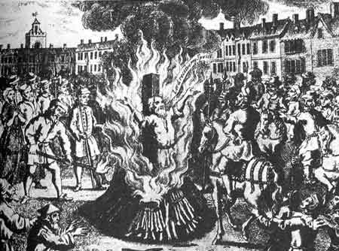
Philip believed it was his duty fight heretics and protect the unity of the Catholic Church
He led the Catholic Reformation and Inquisition in Spain
He sent missionaries out to try to gain converts
Managed to bring some of the German princes, Eastern Europe and the Netherlands back under Papal Authority

Slide 9
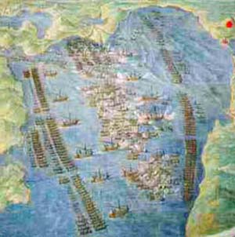
Philip fought many wars:
He fought France for control of Italy
Attacked Turkish strongholds in the Mediterranean
At the Battle of Lepanto in 1571, Philip defeated the Turkish Navy
BUT
He wasn’t able to drive them completely out of the Mediterranean

Slide 10
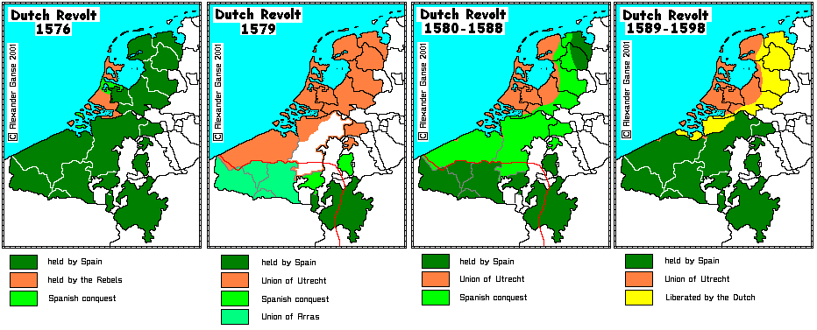
Revolt in the Netherlands

Slide 11
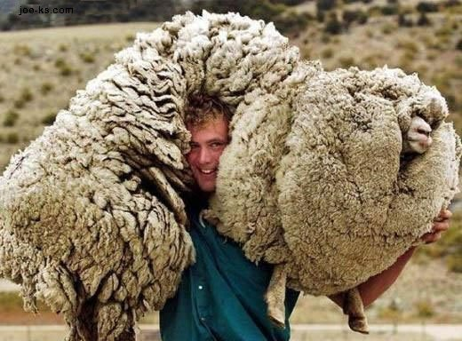
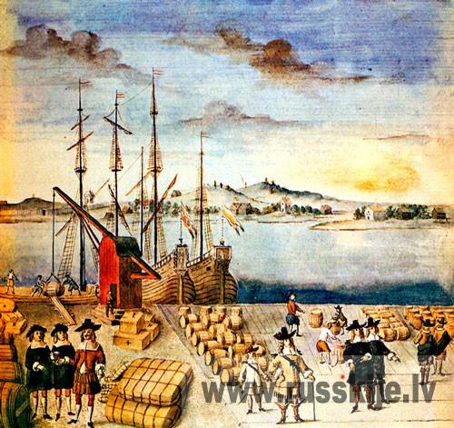
Since the Middle Ages, the Netherlands had flourished as a center of trade and commerce
Wool made the cities of Bruges and Ghent very wealthy
Antwerp and Amsterdam were busy trading ports
      Many people in the Netherlands resented the fact that a Spanish king ruled them and put the interests of Spain ahead of those of the Netherlands.

Slide 12


There was also a great deal of religious dissent.
By the mid 1500s many people had become Calvinist
But Philip was a devout Catholic
In 1566 Philip ordered officials to enforce laws against Protestants
SO

Slide 13
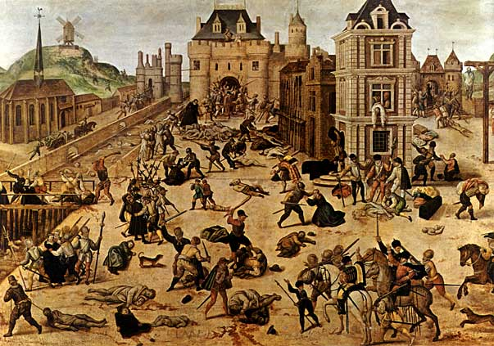
The Dutch Revolted
Catholics joined the Protestants because they hated Spanish rule more than they hated each other
The Protestants went on a rampage destroying statues of saints and breaking stained glass windows in Catholic churches.
Philip sent 20,000 troops to the area and their commander claimed to have killed 18,000 people
They seized Dutch property an imposed taxes on the people

Slide 14
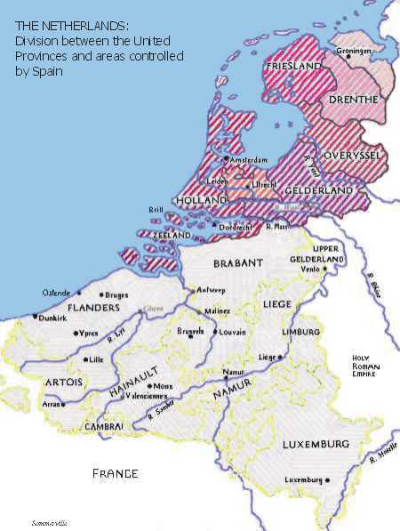
  In 1581 the 7 northern provinces of the Netherlands, which were mostly Protestant, declared their independence from Spain
    Became known as the Dutch Netherlands
    The 10 Southern provinces, which were largely Catholic, stayed the Spanish Netherlands (Became Belgium in 1830)
      Wars dragged on but Spain never regained lost Northern provinces.
The Dutch became a powerful trading force
        - They dominated sea trade
        - Competed with the Portuguese in the East Indies
        - Seized some land in the Spanish West Indies
        - Sent settlers to N. America

Slide 15
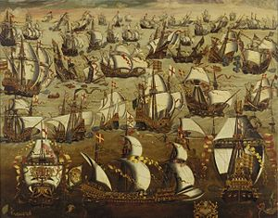
The Mighty Armada

Slide 16
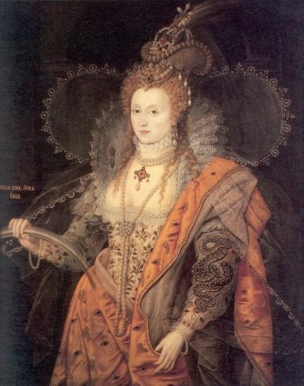
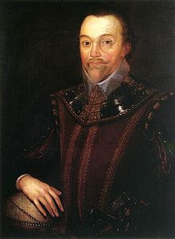
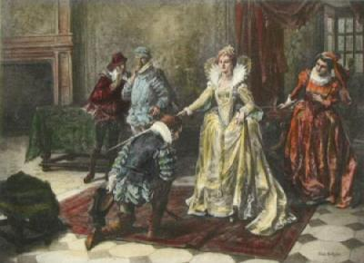
Protestant Queen Elizabeth feared that if Philip crushed the Dutch revolt he would launch an attack against England
She cautiously supported the Dutch against the Spanish
She also allowed Sea dogs to attack Spanish ships with immunity
Sir Francis Drake attacked Spanish colonies in S. America and the W. Indies
Philip wanted Drake punished as a pirate
Instead, Elizabeth knighted him

Slide 17
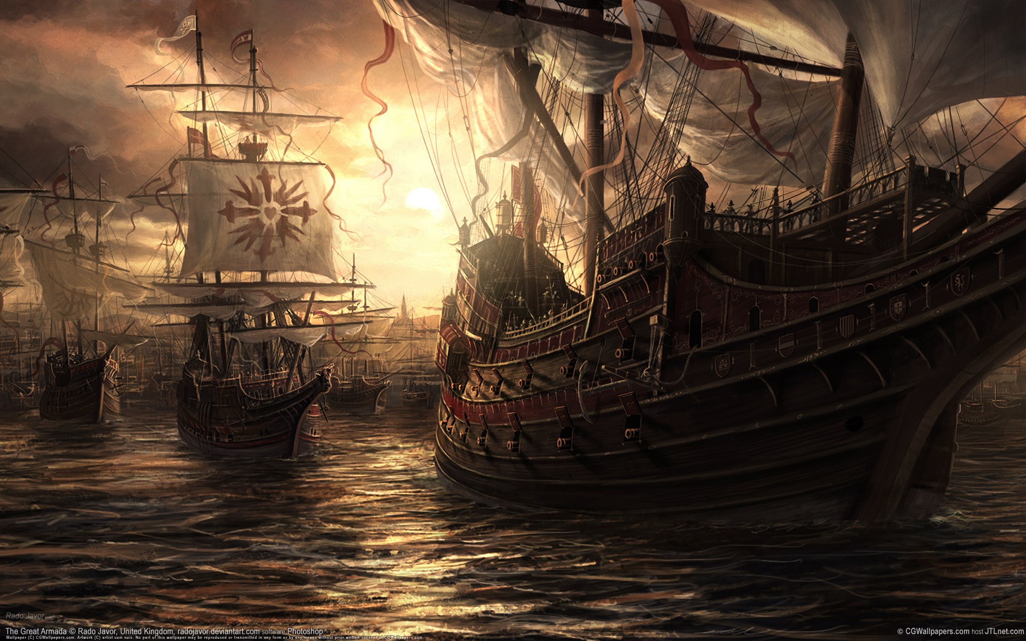
In 1588 Philip launches an attack against the English
He assembles an Armada of 68 ships and 60,000 troops to invade England
The British ships were smaller and faster and they destroyed many of the Spanish Ships
Helped by storms that became known as the Protestant Wind

Slide 18
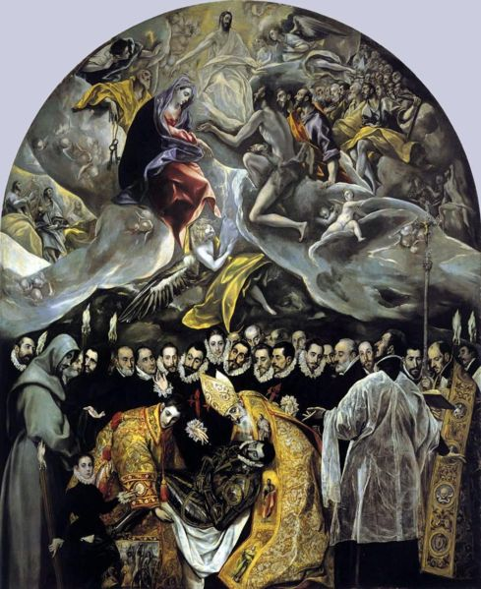
A Century of Spanish Genius

Slide 19
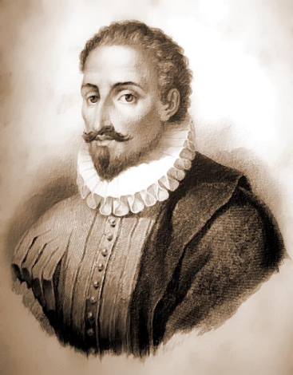

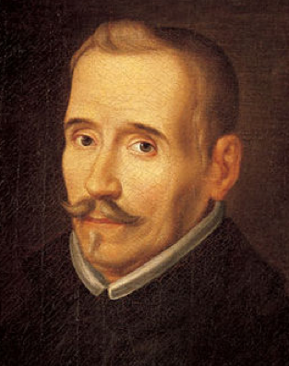
Under Philip II Spanish culture bloomed and this became part of the “Century of Gold”
From about 1550 – 1650 Spanish writers, philosophers, and artists created many masterpieces
Cervantes
Wrote Don Quixote
Lope de Vega
Wrote at least 700 plays and influenced Drama which included:
Religious dramas, histories, and comedies focused on God, the King, and Romance

Slide 20
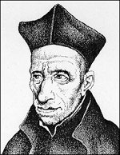
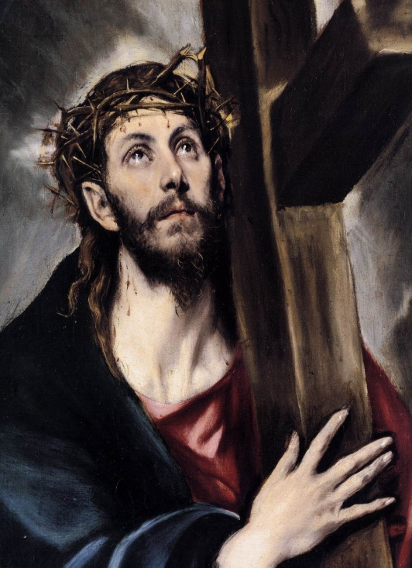
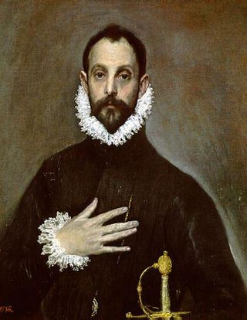
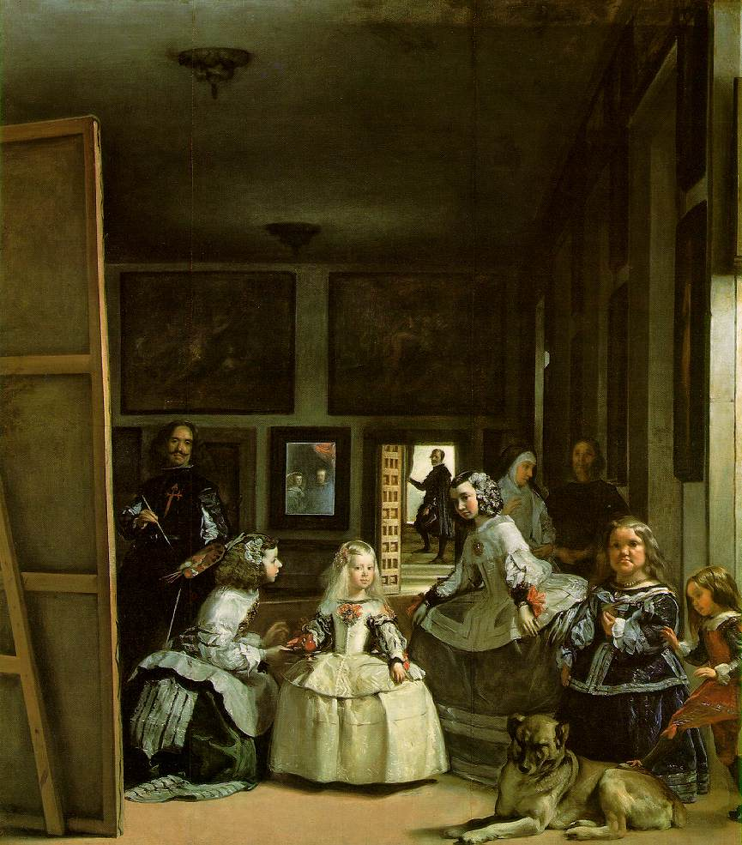
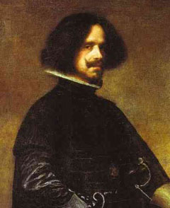
Francisco Suarez wrote about the relationship between reason and faith
El Greco made portraits of the saints
Actually a Greek who moved to Spain
Drew long distorted faces and bodies that created dramatic effect
Diego Velazquez was a court painter in Madrid who painted the royal family

Slide 21
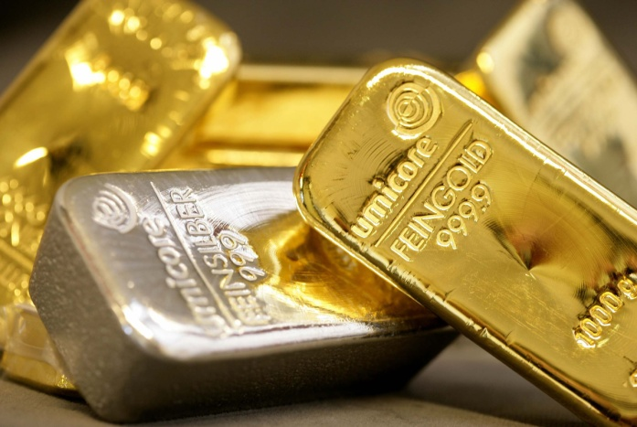
A Troubled Economy
Spain began to lose position in Europe
Although they still ruled a huge empire in the Americas, they had economic problems
Spanish Gov. relied on gold and silver from Mexico and Peru
In the 1500s their value rose dramatically
But the treasury was soon drained to pay for wars. Most of the Spanish treasury went to arms dealers and foreign banks

Slide 22
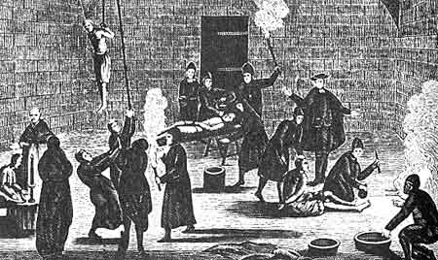
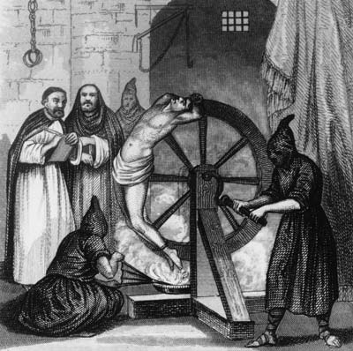
To make matters worse, the religious policies of Philip and his successors drove people out of the country
Continuing Inquisitions now persecuted Moriscoes
These were Spanish Muslims who had converted to Christianity

Slide 23
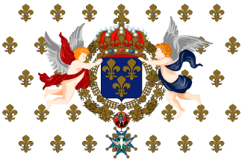
The French Monarchy

Slide 24
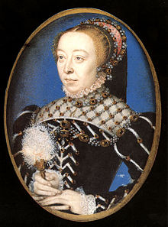
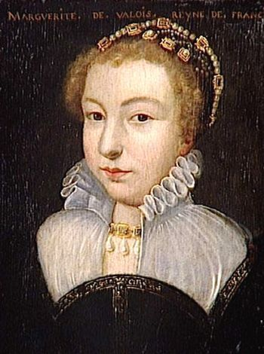
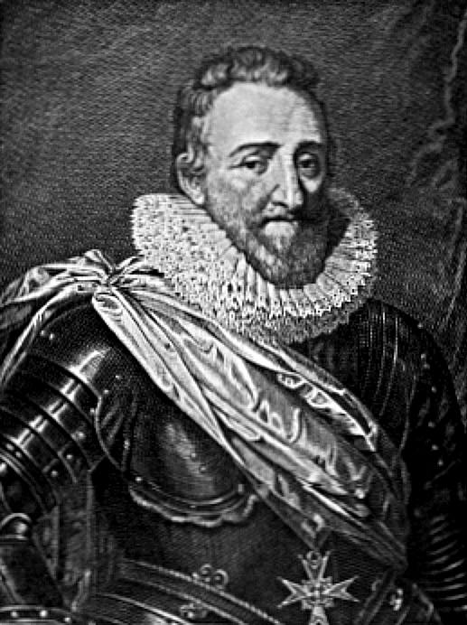
Catherine De’Medici was the Queen Mother of France
Her sons were incompetent and it was her job to keep them on the throne
In order to do this she intentionally caused problems between Catholics and Protestants
August 1572 thousands of Huguenots came to Paris for the wedding of Catherine’s daughter Marguerite to Henry of Navarre (he was Protestant)
August 24th 1572 was St. Bartholomew’s Day and 10,000 protestants were slaughtered.

Slide 25
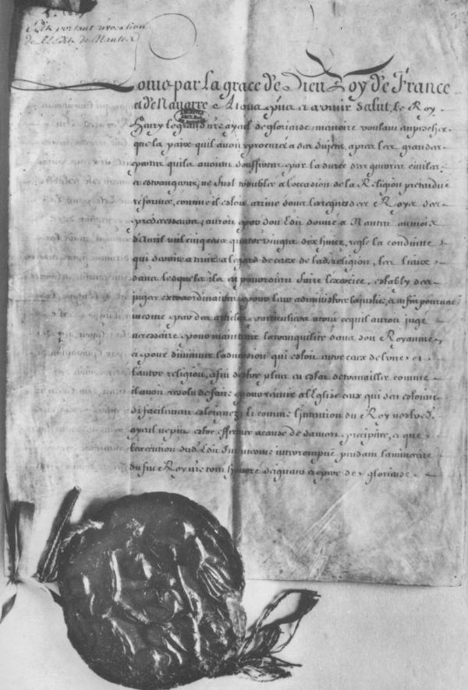
The Wars of Religion 1572 - 1598
Royal power in France nearly disappeared at this time.
1589 – Henry of Navarre becomes King Henry IV
Though he was Protestant he converted to Catholicism to try to stop the war
This didn’t stop the fighting.
1598 – Henry issues the Edict of Nantes
Gave Huguenots: freedom of worship
the right to set up churches (in certain areas)
The same Civil Rights as Catholics
the right to have Protestant troops protect their cities.

Slide 26

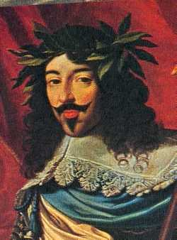
Foundation of Royal Power
Henry revived royal authority by rebuilding bureaucracy, collecting taxes, and overseeing the courts.
He also repaired roads and encouraged new business
In 1610 Henry was assassinated and his 10 year old son became King Louis XIII

Slide 27
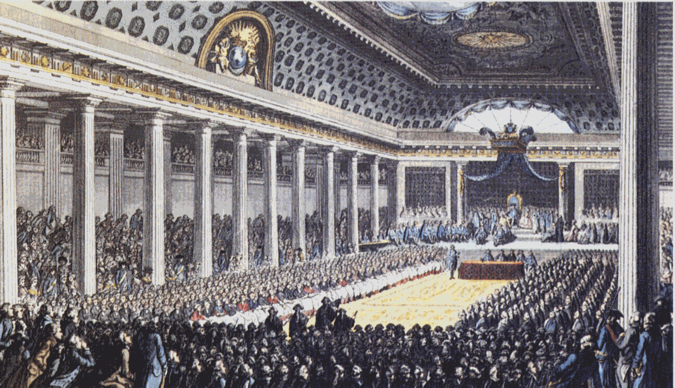
Early in Louis’ reign nobles began to try to take back some of their power.
In 1614 they forced him to call the Estates General.
The EG is a French parliament made up of 3 houses – Clergy, Nobles, everyone else (the nobles almost always won)
However the nobles were fighting and the EG was dismissed in 1615 and won’t meet again for 175 years
During this time the French Monarchy gained absolute power.

Slide 28
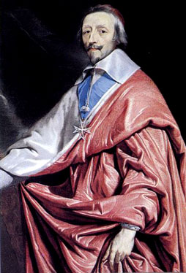
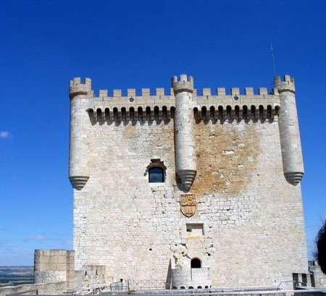
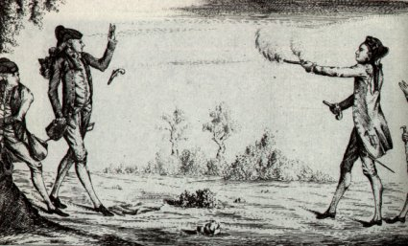
Louis advisor, Cardinal Richelieu, was mostly responsible for this
He wanted to prevent the Huguenots from gaining power, but he knew he couldn’t destroy them without starting another civil war.
He took away certain rights like the right to fortify their towns
Also ordered that all provincial nobles castles be destroyed
Outlawed dueling among nobles

Slide 29
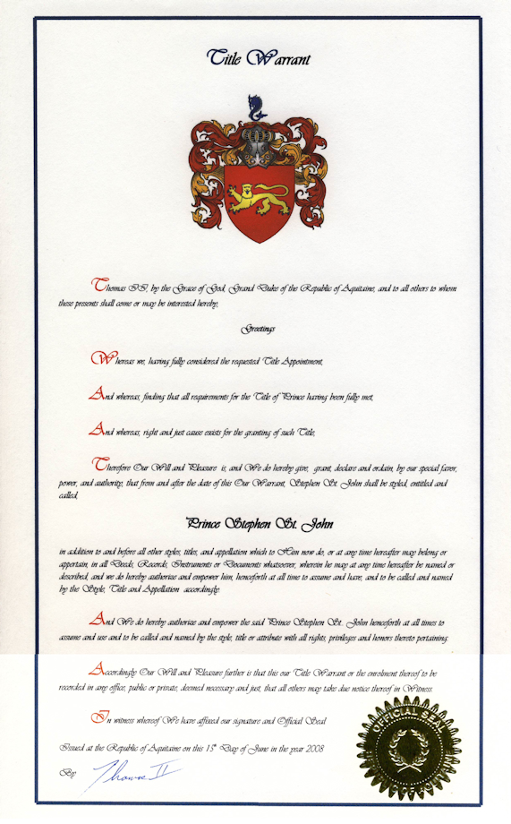
Richelieu was a mercantilist and believed in strengthening the monarchy through trade
To promote commerce he encouraged nobles to support overseas trading companies
He rewarded successful merchants
He let them buy titles of nobility on occasion
These new nobles were quite loyal to the King and often got government jobs

Slide 30

The Sun King

Slide 31
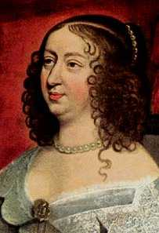
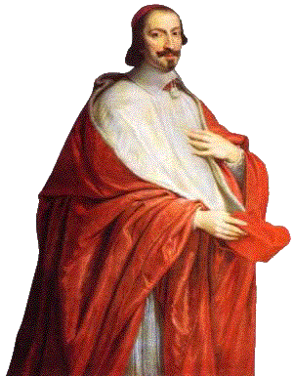
When Louis XIII died in 1643 his son Louis XIV was 3 1/2
The boy’s mother, Anne of Austria and Richelieu’s successor,
Cardinal Mazarin ruled in the boys name
They continued to centralize power
When Mazarin died in 1663 Louis was 23 years old.
He immediately summoned his advisors and announced that he would rule on his own

Slide 32
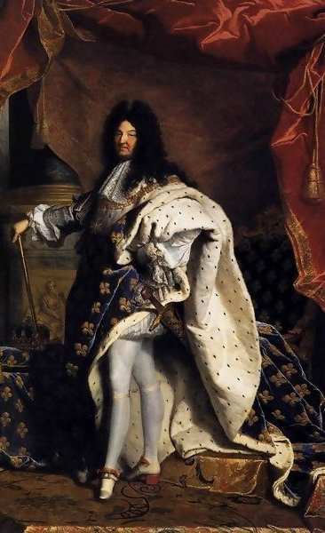
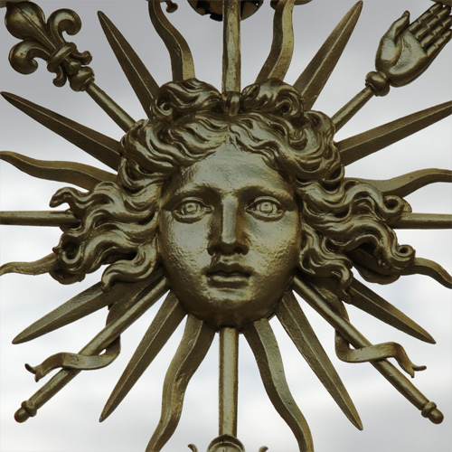
For the next 54 years Louis XIV ruled France
During his reign France dominated Europe
He used the Sun as his royal symbol to suggest that he was the center of the French Universe

Slide 33
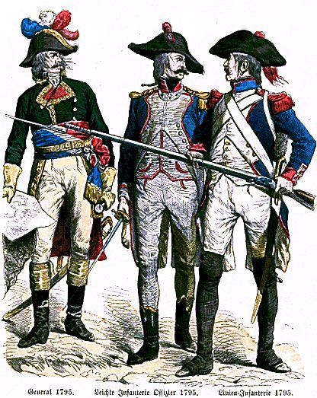
I Am the State
Louis believed in Divine Right and he continued to expand royal power
He centralizes the army
All French soldiers were now to fight for the king not for their own particular nobles
They were given uniforms and assigned rank
He increased the size of the army from 10,000 to 40,000

Slide 34

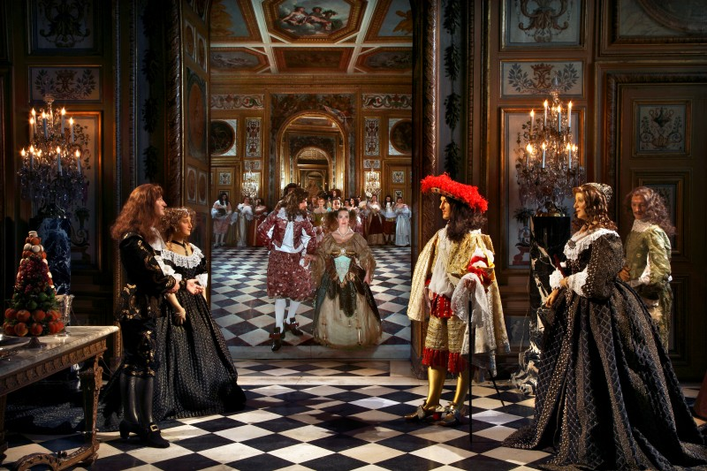
He also closely directed the administration of the government
He appointed intendants who were royal agents that ruled the provinces
They collected taxes, recruited soldiers and administered royal policy
Local parliaments were supposed to approve the laws
Louis was a staunch Catholic and he wanted to make France a unified Catholic country
In 1685 Louis XIV cancelled the Edict of Nantes and many Huguenots fled France

Slide 35

The Palace of Versailles
Louis built a spectacular new palace at Versailles, 12 miles west of Paris
The palace took 27 years to build

Slide 36


Had 2,000 acres of gardens and woods
Inside the palace were royal apartments and rooms for hundreds of nobles and servants
Hall of Mirrors was lit with 4000 candles set in gold and silver chandeliers
Served as the center of government
Far enough from the city that disturbances wouldn’t interrupt government
Louis encouraged nobles to live there so he could keep an eye on them
Louis invited artists and playwrights to Versailles
France became the envy of Europe

Slide 37

Colbert: Architect of the economy
Louis needed to maintain his lifestyle and everything he had built cost a fortune
For most of his reign, Colbert successfully managed royal finances
Colbert was a mercantilist who was determined to increase royal power by strengthening the economy.
Developed a 2 part strategy for increasing money
Reformed tax collection and reduced corruption among tax collectors
Introduced higher taxes (hard to do because the nobles and some of the middle class didn’t have to pay taxes at all)
Encouraged new industry by excluding new businesses from taxes for 1 year. Once they were thriving they could be taxed
Colbert also encouraged the building of ships, roads and canals to improve transportation and trade
To promote trade he did away with some local internal tariffs and put tariffs on imported goods. He also encouraged colonial growth.

Slide 38

Wars of Louis XIV
Louis spent most of the money Colbert made on foreign wars
He dreamed of extending France to its “Natural Frontiers”
Had already reached the Pyrenees in the south
But Louis believed that the frontier in the east should go to the Alps then on to the Rhine River
In the north he wanted it to the North Sea or the English Channel

Slide 39



Louis’ ambitions threatened nearly every other European power and because of this for nearly 30 years, France was at war.
He fought the Dutch Netherlands, Sweden, England, Spain and all of its possessions

Slide 40

The Worst war was also Louis’ last
The War of Spanish Succession
Began in 1701 when Louis’ grandson inherited Spain and all its possessions
Other European powers formed an alliance to prevent Louis from uniting Spain & France
The Allies finally got their way
The Peace of Utrecht - 1713

Slide 41
The Peace of Utrecht - 1713
Louis XIV has to agree that Spain & France will never unite
Louis grandson was recognized as Philip V of Spain – he could never be king of France
Spain kept its American Colonies
Spain had to give up its Italian lands including Milan, Naples, & Sicily – these went to the Austrians
England got: Newfoundland & Nova Scotia in NA from France and Minorca and Gibraltar in the Mediterranean from Spain
Louis lost popularity in his last years and he had spent almost all of France’s money
No one who came after him would ever be able to fix the debt problem

Slide 42

Struggles among the German States
The 30 years war
Began when the Protestants in Bohemia couldn’t deal with Catholic Emperor Ferdinand II anymore
Germany was made up of several independent states
In theory these states were under the authority of the Holy Roman Emperor
In practice, the HRE had little power over them and the princes were often arguing
Whenever a HRE died 7 leading German Princes (electors) met to choose a new emperor
From 1400 on, they always picked a Hapsburg
As rulers of Austria, Bohemia and Hungary, they were the most powerful dynasty in Europe
Other princes accepted the Hapsburg emperor, they did not accept his authority over them.

Slide 43

Political divisions within the empire got worse during the Reformation
Under the Peace of Augsburg each G. prince had the right to decide his state’s religion
German Catholics became increasingly upset when more and more chose to be Protestant
Became more of a problem when some started to become Calvinist.
The Protestants had a problem when the Catholic Reformation began to change many of their areas back to Catholicism

Slide 44

The war began in 1618 and lasted until 1648
    In the early years the war was fueled by Religious issues
      Protestant princes sought help from Denmark, Sweden and the Dutch Netherlands
    As the war dragged on, more often political and territorial issues became more important than religion
      Ferdinand tried to establish Hapsburg control over all the German States
      Ferdinand was helped by the strongly catholic Hapsburgs of Spain
        To prevent the Hapsburgs from becoming too powerful the catholic Cardinal Richelieu of France supported the German Protestants

Slide 45

The German states were absolutely devastated by the invading armies during the war who burned and looted towns
Peasants got the worst of it
In some areas entire villages were wiped out
        Farming became difficult or impossible
        Famine and plague broke out
        The population dropped from 21 million people in 1618 to about 13.5 million in 1648.

Slide 46

The Peace of Westphalia
In 1648 the warring powers sent reps to Westphalia to negotiate a peace settlement
This ended the Hapsburg dream of creating a strong central gov. in the HRE
Terms of the Treaty
Hapsburgs still hold family lands in Austria, Bohemia, and Hungary
Hapsburgs remain the most powerful German rulers, BUT they have little control over the other princes

Slide 47


Terms of the Treaty, continued.
1. Settlement guaranteed the independence of about 309 German states
Each prince had the right to declare war and negotiate treaties
Princes would continue to meet in the imperial Diet (assembly)
They will now get to approve any request from the Emperor for taxes
2. Allows Lutherans and Calvinists but no other Protestant denominations
3. Acknowledges territorial and political changes of the previous 50 years
Now recognizes Dutch Netherlands, and the Swiss Confederation as ind. states

Slide 48



The King of Sweden, Gustavus Adolphus had taken and lost huge parts of German Territory
Treaty left him in charge of some German areas along the Baltic and North seas
4. France gained parts of Alsace and Lorraine
The boundaries set by the peace will remain unchanged for almost 150 years

Slide 49

The Rise of Prussia

Slide 50


One German prince gained a lot from the peace of Westphalia
Frederick William, Elector of Brandenburg was of the Hohenzollern Family. They’d ruled Brandenburg since the 1400s.
Had become Lutherans during the reformation
1618 they inherited Prussia and got other German lands with the Peace of Westphalia
Brandenburg had been invaded several times during the 30 years war
Invaders had destroyed Berlin and much of the countryside
After this FredWill establishes absolute control over his land

Slide 51

To do this, he built a strong army that was under his control
BUT
Armies are expensive so to raise money he tried to raise taxes
The noble landowners said NO!!
He eventually forces and compromises his way to collecting taxes for the army and the Junkers don’t have to pay any taxes

Slide 52

Ruling a strong Prussian state
During the 1700s the Hohenzollerns established an Absolute monarchy an transformed Prussia from a small state to a major power.
1713 Frederick William I (grandson to FW) dedicates his life to making the state stronger
He recruited officers from the Junker class and sets up universities to train them
He believed strongly in discipline and obedience and he tended to go through the streets telling people how they should dress, live, etc.
Strengthened the economy also.
Because the population was small, he encouraged Protestants from France and other Catholic areas to settle his lands

Slide 53

Newcomers contributed to his nation’s growth.
Whenever something bad happened somewhere else he would send out emissaries to get more settlers
Peasants got land and merchants got loans to restart businesses.
FW I’s son Frederick seemed unlikely to be a good successor
His father thought that his hobbies were foolish.
But when Frederick became Frederick II in 1740 he proved an even better leader than his father.
Became known as Frederick the Great.

Slide 54

Forceful Rulers in the Austrian Empire
There were many different cultures and languages in the empire
Austria was German Speaking
Bohemians were Slavic
Hungary was the homeland to the Magyars
Between 1648 and 1740 the Hapsburgs tried to limit the power of the local nobles and make the Austrian Empire a Catholic Stronghold
They took land from Protestant nobles in Bohemia

Slide 55


The Hapsburg empire was fragile though and Charles VI had no son to inherit
He feared that the princes of Austria wouldn’t recognize his daughter Maria Theresa as Ruler
He persuaded the German princes to sign the Pragmatic Sanction
States that Hapsburg lands wouldn’t be divided
Recognized Maria Theresa’s right to inherit the throne
Forced other European countries to recognize the Sanction as well

Slide 56

Charles VI died in 1740 and Frederick the Great ignored the Sanction and seized Silesia.
This was valuable because of its iron ore and strong textile industry
Maria Theresa had to act fast to protect her place on the throne
The War of Austrian Succession
Maria Theresa was 23 years old when she became queen of Austria
She had just had her son with her husband Joseph when she went to Hungary for help
She promised to safeguard their traditional rights, showed them there was a male heir, and got their help
They sent 100,000 troops to fight the Prussians

Slide 57

Other countries joined the war
France and Spain helped the Prussians
Great Britain and the Dutch Netherlands sided with Austria BUT they only sent money, not troops.
1748 signed the Treaty of Aix-la-Chapelle
This said that all areas went back to where they were before the war except Silesia, which Frederick could keep

Slide 58
The European Balance of Power
By 1750 Austria and Prussia were among the major powers in Europe
They both had strong central governments and absolute monarchs
They had strong standing armies
Now there’s a race to balance power
The major European powers competed for trade and territory
England and France will be against each other in every major war because of this
Austria wanted revenge against Prussia for taking Silesia
Prussia and Russia wanted to expand their territories
All of these conflicts eventually lead to the SEVEN YEARS WAR

Slide 59

Fought on 3 Continents
- Europe
- Asia
- North America
In North America it was called the French and Indian War.
1756 Frederick the Great invaded Saxony
He faced the combined forces of France, Austria, and Russia
Only pulling out of Saxony could save the Prussians from defeat
The French and British fought in N. America and India
British captured Quebec and gained control of New France
Drove the French out of India

Slide 60

The Peace of Paris 1763
Britain received Canada and all French possessions east of the Mississippi River
Spain got Louisiana
France got its trading ports back in India and kept 2 sugar producing areas in the W. Indies
This would cause problems between the British and the French for decades and cause debt in both nations

Slide 61

Developments in Eastern Europe

Slide 62



The Romanov Dynasty in Russia
During the 1400s and 1500s Russia emerged as a powerful state in Eastern Europe
(Ivan Grozni or Ivan the Terrible)
Ivan III and Ivan IV brought the lands around Moscow under their control
Ivan IV accidentally killed his son and heir after a fight over is daughter-in-law’s being beaten for being immodestly dressed and having a miscarriage as a result

Slide 63

As Czars (Tsars) they claimed absolute power
But when Ivan IV died there was a long period when Russia had no strong leader
- His son Feodor I was inept
This became known as the Time of Troubles
During this time (1604 – 1613) nobles in Russia schemed to put their own candidates on the throne
Once a new Czar was installed he would be murdered

Slide 64

Finally in 1613 the nobles elected 17 y/o Mikhail Romanov as Czar
This dynasty will rule Russia until 1917
Mikhail knew that as an elected monarch his power would be limited so over time he and his heirs did away with the tradition of electing Czars
He brought Nobles under his control by giving them absolute power over their peasants and enacting strict laws to keep them from running away
Serfdom in Russia was unlike serfdom in the rest of Europe and more closely resembled slavery

Slide 65


Romanovs expanded their territory to the east
Russian traders and trappers crossed the Ural Mountains and discovered that Siberia had vast iron, timber and fur resources
Russians went as far east as the Bering Strait
By the end of the 1600s, Russia extended to the Pacific ocean

Slide 66

Peter the Great 1689 - 1725
Expanded Russia to the West
Encouraged Westernization
Introduced Western dress, Military skills and technology
1696 – visited W. Europe and worked in disguise to learn about technology
Didn’t usually work because he was 7’ tall

Slide 67

Peter’s Reforms
Hired 700 European engineers, shipbuilders and mathematicians and paid them high salaries to teach their skills to Russians
Had scholars simplify the Russian Alphabet
Forced nobles to give up “backwards” traditions
  Ordered them to shave off their beards and fined those who refused
  Insisted that Russian Noble women be seen in public and dress in French Fashion

Slide 68

He modeled the government after the Gov. of Louis XIV
  He replaced the Duma (elected assembly) with a senate he could order around
  Set up a bureaucracy
  Promoted talented commoners
  Sent nobles’ sons abroad to study
  Forced nobles to serve in the army or as gov. officials
Foreign Policy
Expanded Russian borders
Main goal was a warm water port

Slide 69



1700 – fought Sweden for control of the Baltic
Russian army of 40,000 were flattened by a Swedish army of 8,000 led by Charles XII
In response Peter rebuilt his army on the western model and in 1709 defeated the Swedes at the Battle of Poltava
He gained a trading port on the Baltic Sea
Decided to build his new capitol here and named it St. Petersburg

Slide 70

Catherine the Great
Was not born Catherine, was not born Russian, and was not born Great
She was a German Princess who learned Russian and converted to Orthodoxy then married Peter III
She took over Russia as Czarina when he died and she ruled for 34 years
She won the support of the nobles by writing up a charter of their rights
Exempted from taxes
Excused them from the services that Peter The Great had required of them
Peasants now expect a charter of their rights, and when this doesn’t
happen, they rebel.
This is the largest rebellion in Russian history, but it fails

Slide 71

Catherine became known as “the Great” because of her aggressive foreign policy
She won a warm water port on the Black Sea
She got a piece of Poland in return for not chopping up the Ottoman Empire

Slide 72

The Partitions of Poland

Slide 73
By 1772, the first of 3 partitions of Poland took place
Frederick the Great took western Poland with Brandenburg and Prussia
Catherine took part of eastern Poland where Ukrainians and Russians lived
Maria Theresa of Austria took Galicia even though she initially protested carving up Poland
At one time Poland had been a powerful nation
Polish nobles became more independent of the king, they began to act like feudal lords and the government was in chaos.

Slide 74

Nobles met in the Diet (legislature) to pass laws but the Diet didn’t do anything
All laws had to be passed by ALL nobles
All had the free veto (liberum veto)
By saying that he opposed a law a noble could force the Diet to disband and wipe out all the laws that they’d already passed
This is known as
“exploding the diet”
Between 1652 and 1754 48 of 55 Diets had exploded

Slide 75
Poland is now at the mercy of its neighbors.
After the 1st partition the Poles united behind their king but it was too late
In 1793 Prussia and Russia took another piece
In 1795 Prussia,
Russia,
and Austria carried out the 3rd and final partition of Poland
Poland ceases to exist at this point until 1919

