Slide 1
The Age of Democracy and Progress
1815-1914

Slide 2

Reform in Britain

Slide 3
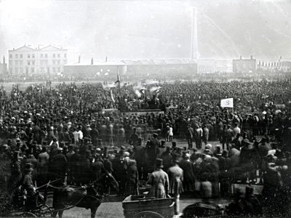
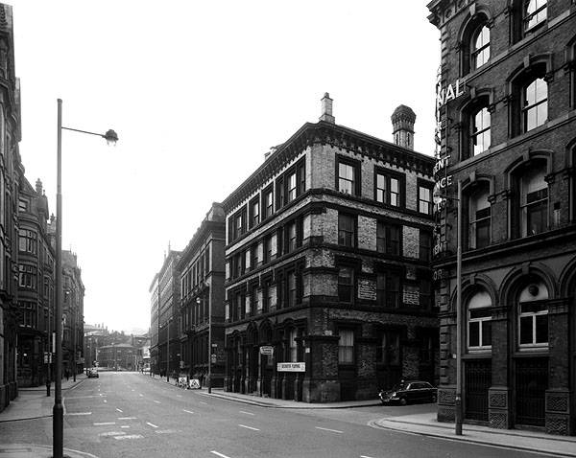
The Reform Bill of 1832
The Middle Class were the first to demand more say in politics
In 1830 there were riots in England demanding an extension of suffrage
Suffrage – The Right to vote
Because of revolts in France in 1830, parliament was afraid there would be revolution in England
1832: They passed the Reform Bill
Eased Property Restrictions so wealthy middle class men could vote
Gave more representation to industrial centers

Slide 4
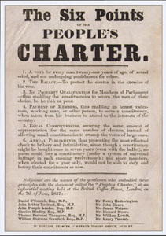
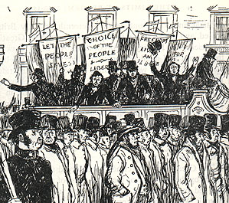
The Chartist Movement
7%
The Reform bill extended suffrage BUT only
of people over age 20 in Britain could vote
And that was only men
The People’s Charter was proposed to Parliament in
1838
Called for Suffrage for all men
Annual parliamentary Election
Secret Ballot
End to property requirements to be in parliament
Paying members of Parliament so poorer people could afford to serve
Demands of the Chartists were rejected by Parliament

Slide 5
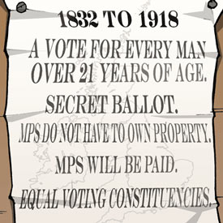
People began to support the ideas of the Chartists and Parliament will eventually pass some reform
1867 – Working Class men will get the right to vote
1884 – Rural working men gain suffrage
Early 1900s – all demands EXCEPT annual elections had become law

Slide 6
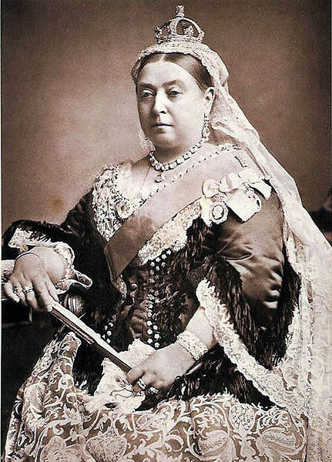
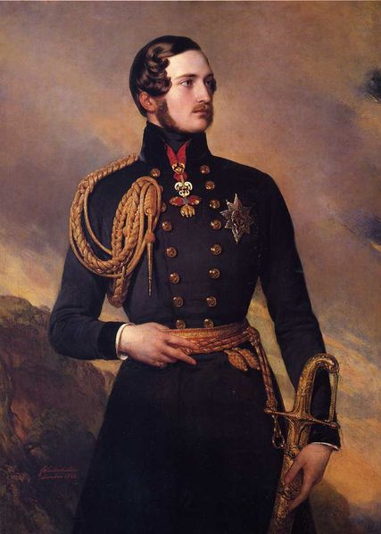
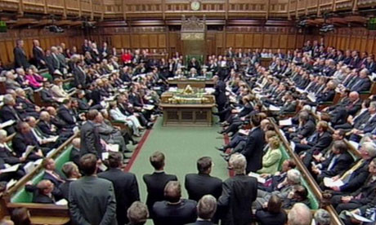
The Victorian Age
Queen Victoria took the throne in 1837 at the age of 18
She married her cousin Albert who was a German Prince
She reigned for 64 years and during her reign Britain reached the height of its power
She was very popular among her people
She was forced to take a less powerful role
Previous kings had great influence over Parliament
Changes in the Democratic process shift power back to Parliament especially to the house of commons
Now the Monarch became a figure head and the government was controlled by a Prime Minister and Parliament
During Victoria’s reign, there were 19 prime ministers

Slide 7
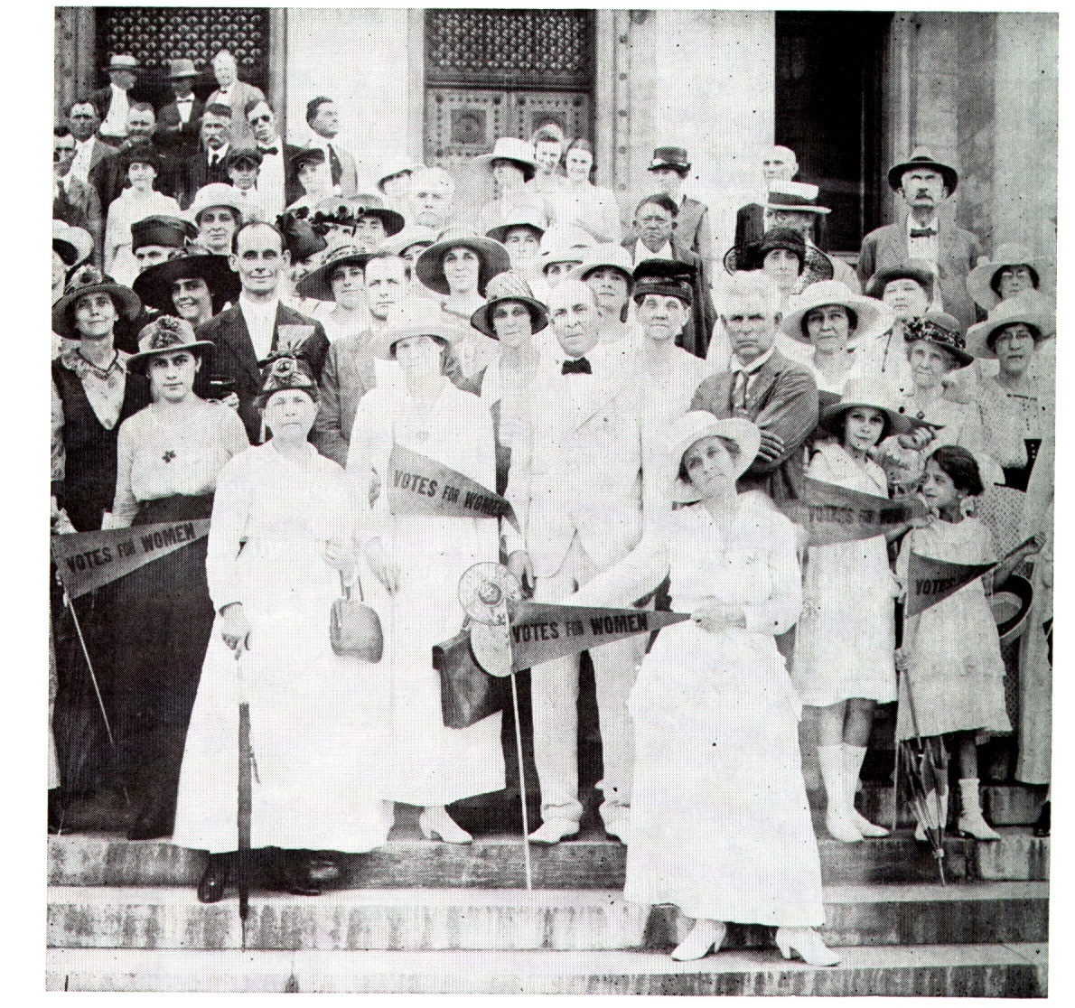
Women get the Vote
By 1890 several nations allowed universal male suffrage
Women didn’t get he right to vote in any western nation until 1893 in New Zealand
Other European nations gave the right to vote after WWI
In the U.S. women got the vote in 1920, though Wyoming and some other western territories granted the vote as early as 1869

Slide 8
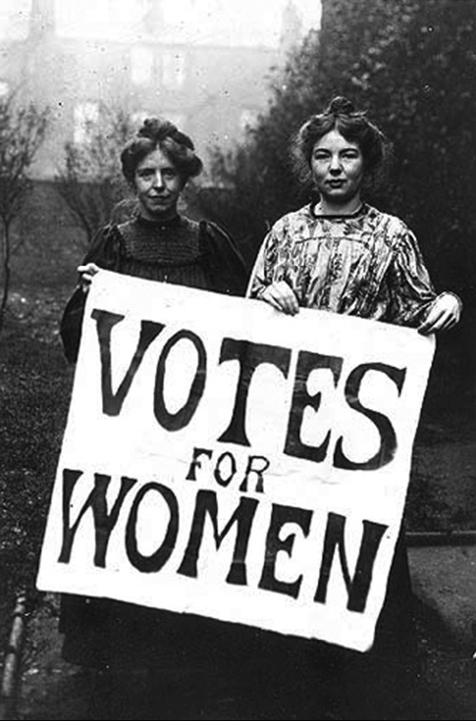
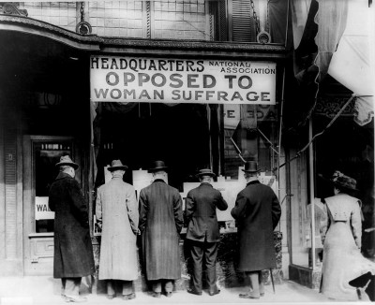
During the 1800s women in both Great Britain and the U.S. worked to gain the vote
British women organized reform societies and protested unfair laws and customs
The more vocal they became, the more resistance to the movement grew
Arguments against women’s suffrage included: too dramatic a shift from tradition, women weren’t smart enough to get involved in politics

Slide 9
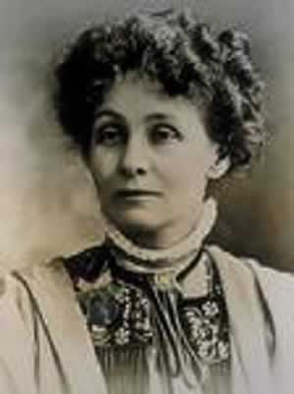
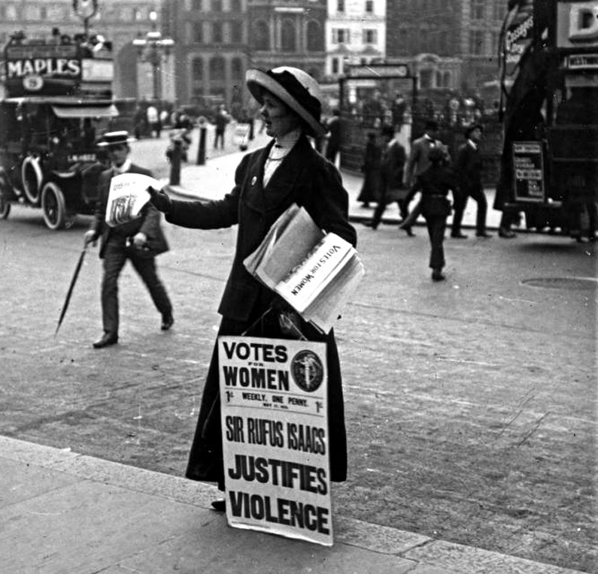
Some women began to take drastic steps after more peaceful efforts failed
In Britain, Emmeline Pankhurst
Formed the WSPU in 1903
Women’s Social and Political Union
Became a militant group for women’s rights
Goal was to draw attention to suffrage
Pankhurst and her 2 daughters were repeatedly arrested and imprisoned
Pankhurst would go on hunger strikes to keep in the public eye

Slide 10

France and Democracy

Slide 11
France went through a series of government crises after the Franco-Prussian War in 1871
Government changed almost yearly from 1871 - 1914
There were over a dozen political parties
In1875 The National Assembly Declared a Republic
Lasted over 60 years but did nothing to unite France

Slide 12
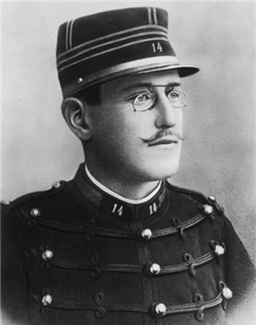
The Dreyfus Affair
In the Third Republic monarchists, aristocrats, clergy, and officers wanted to go back to a monarchy or to martial law.
In 1894 Captain Alfred Dreyfus was one of only a handful of Jewish officers in the French Army
At this time there is a lot of Anti-Semitism in Europe
Anti-Semitism is hatred or prejudice against Jewish People
Dreyfus was accused of selling military secrets to Germany and he’s sentenced to life in Prison
It only takes a few years to prove that Dreyfus had been framed by other officers

Slide 13
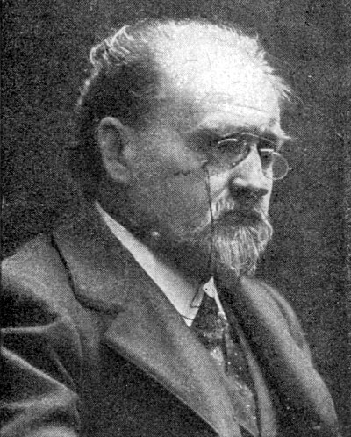
Some people didn’t want to reopen Dreyfus’ case because they thought it would make the army look bad
Others thought that Justice was more important that the Army’s honor
In 1898 Emile Zola
published an open letter called J’Accuse
Zola denounced the army for covering up the scandal
He was sentenced to a year in prison for his views

Slide 14
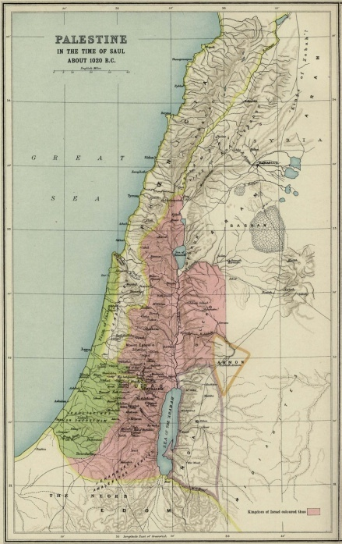
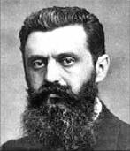
The Rise of Zionism
As bad as persecution of Jews was in Western Europe it was much worse in Eastern Europe
Russian officials allowed Pogroms against Jews
A pogrom is an organized campaign of violence
Because of this, many Jews fled to the U.S.
The long history of Violence convinced many Jews to work for a homeland in Palestine
The leader was Theodore Herzl, an Austrian writer from Vienna
In the 1890s a movement called Zionism developed to pursue this goal

Slide 15
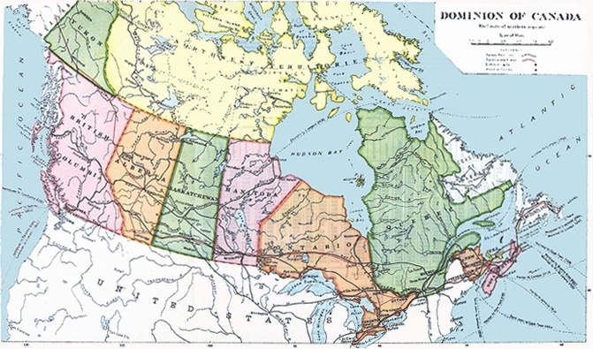
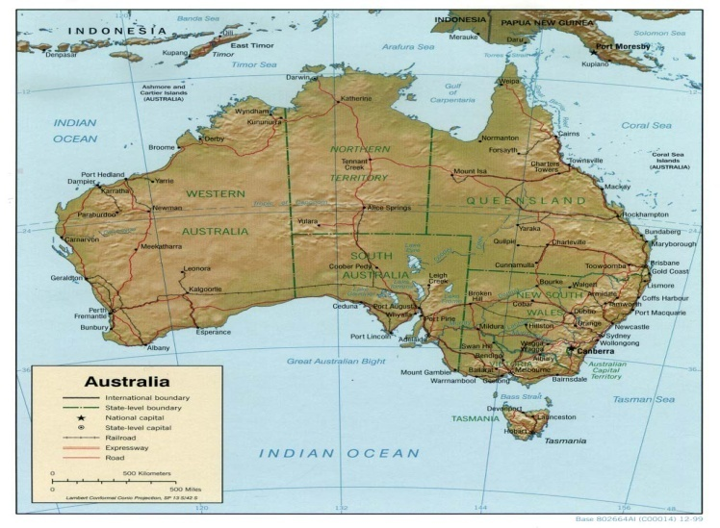
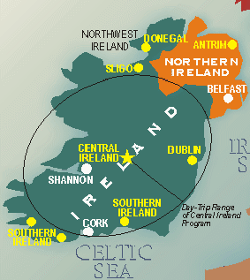
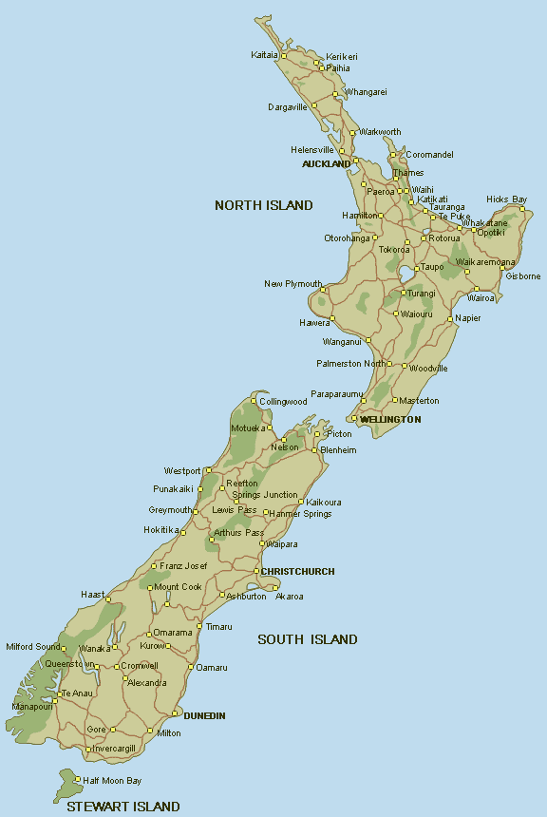
Self Rule for British Colonies
Canada
Australia
Ireland
New Zealand

Slide 16

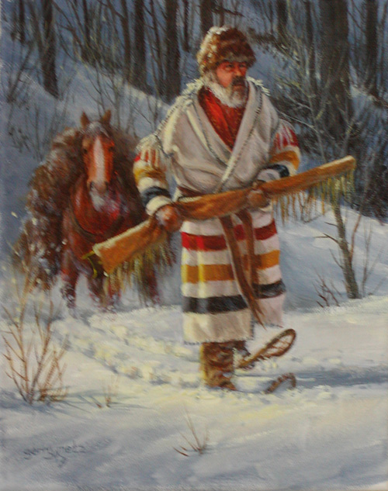
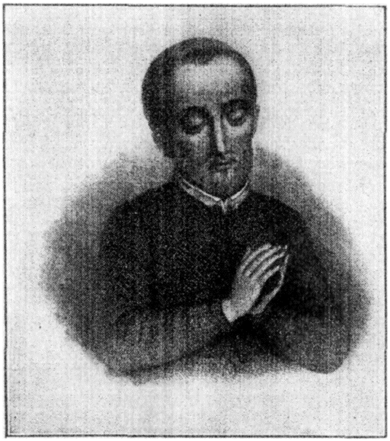
Canada Struggles for Self-Rule
France was the first country to colonize Canada
Mostly Fur trappers and missionaries
They lived and intermarried with Native Americans

Slide 17
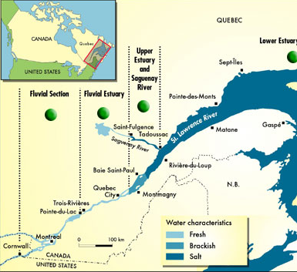
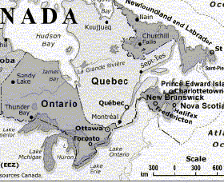
GB takes control of Canada in 1763 after France loses the French & Indian War
The French who still lived there stayed in the Lower St. Lawrence River Valley
The English who came settled along the Atlantic seacoast and the Great Lakes

Slide 18
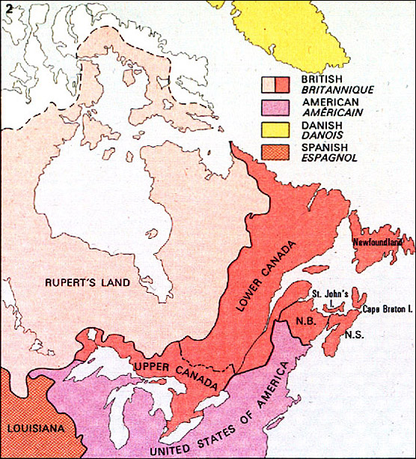
French and English Canada
Conflict was caused by religious and cultural differences between the Catholic French and the Protestant English
Both groups pressed parliament to give Canada more freedom in controlling their own affairs
In 1791 Parliament tries to solve the problem by creating 2 new Canadian Provinces
French Speaking
English Speaking

Slide 19
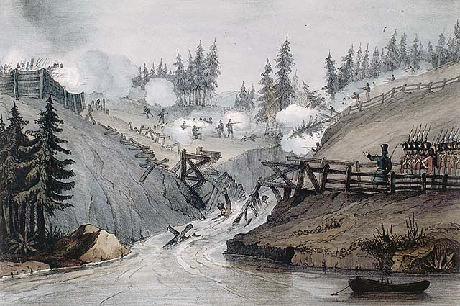
The Durham Report
During the early 1800s both colonies began to demand political and economic freedom
In lower Canada it was because they resented British Rule
In the late 1830s rebellions broke out in both Upper and Lower Canada

Slide 20
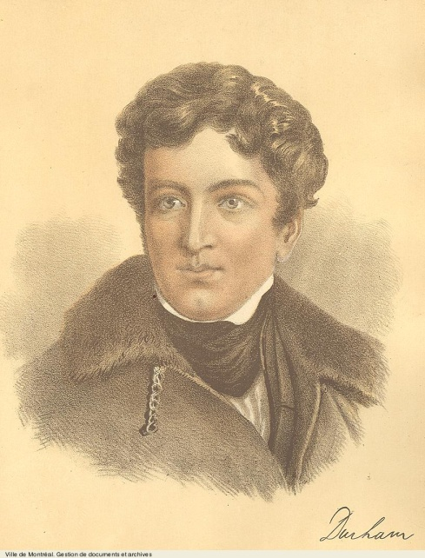
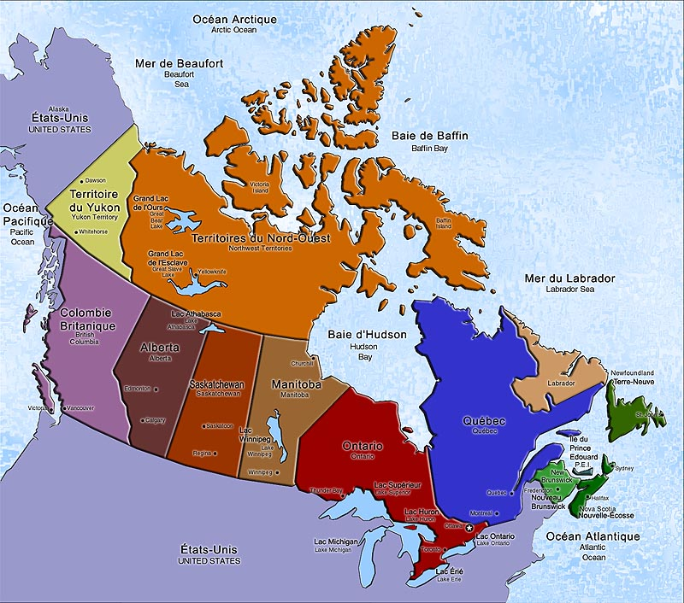
The British sent Lord Durham to investigate
In 1839 Durham sent a report to parliament that urged 3 major reforms
1. Upper and Lower Canada Should be united as the provinces of Canada
2. British Immigration should be Encouraged
Colonists in the Provinces of Canada
should be allowed to govern themselves in domestic matters

Slide 21
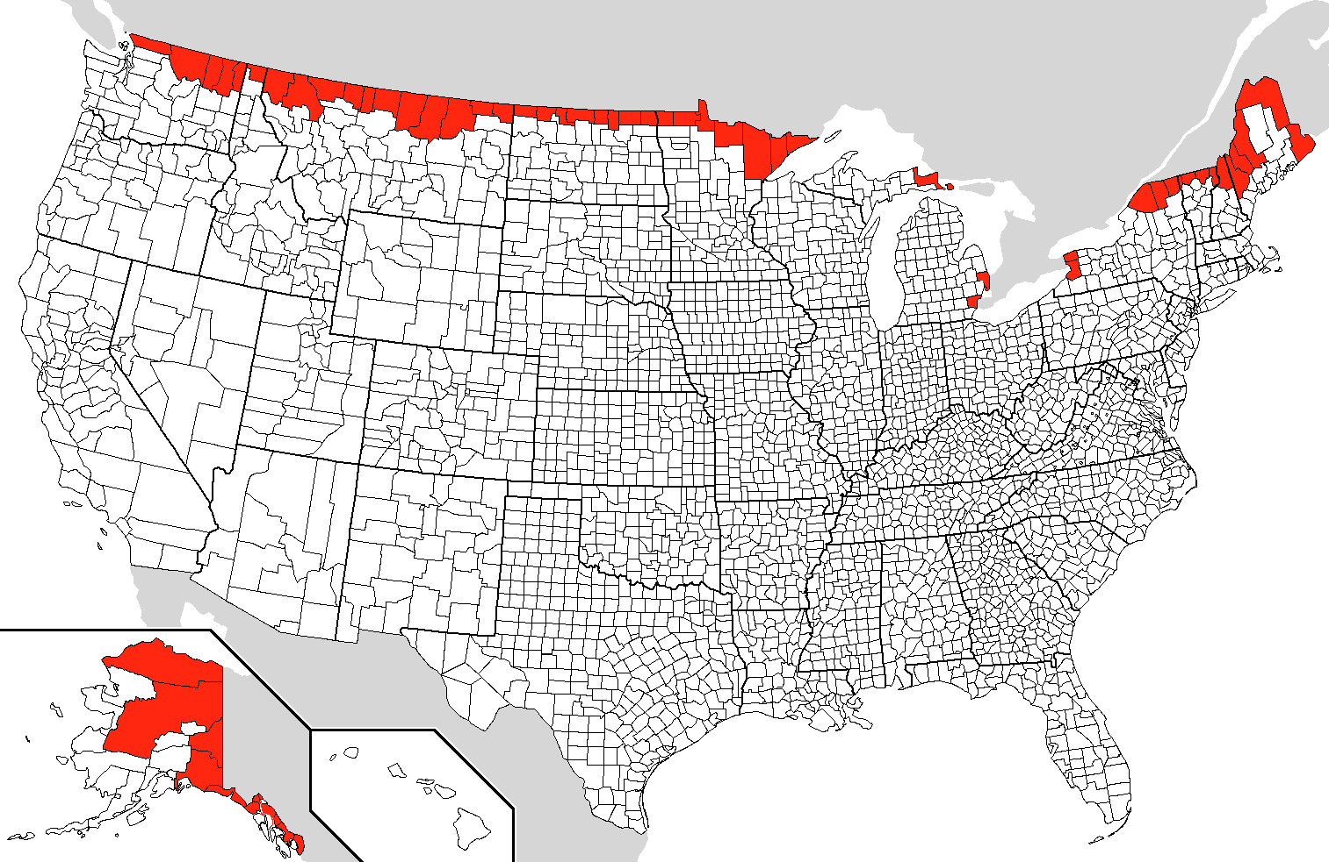
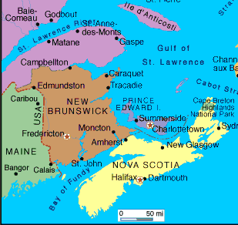
The Dominion of Canada
By the mid 1800s many Canadians believed that Canada needed a central government
They would be able to protect Canadian interests against the U.S. to the South
In 1867 New Brunswick and Nova Scotia joined the Province of Canada to form the Dominion of Canada
As a Dominion, Canada as self-governing in domestic affairs but remained part of the British Empire

Slide 22
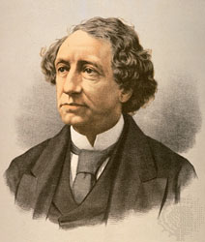
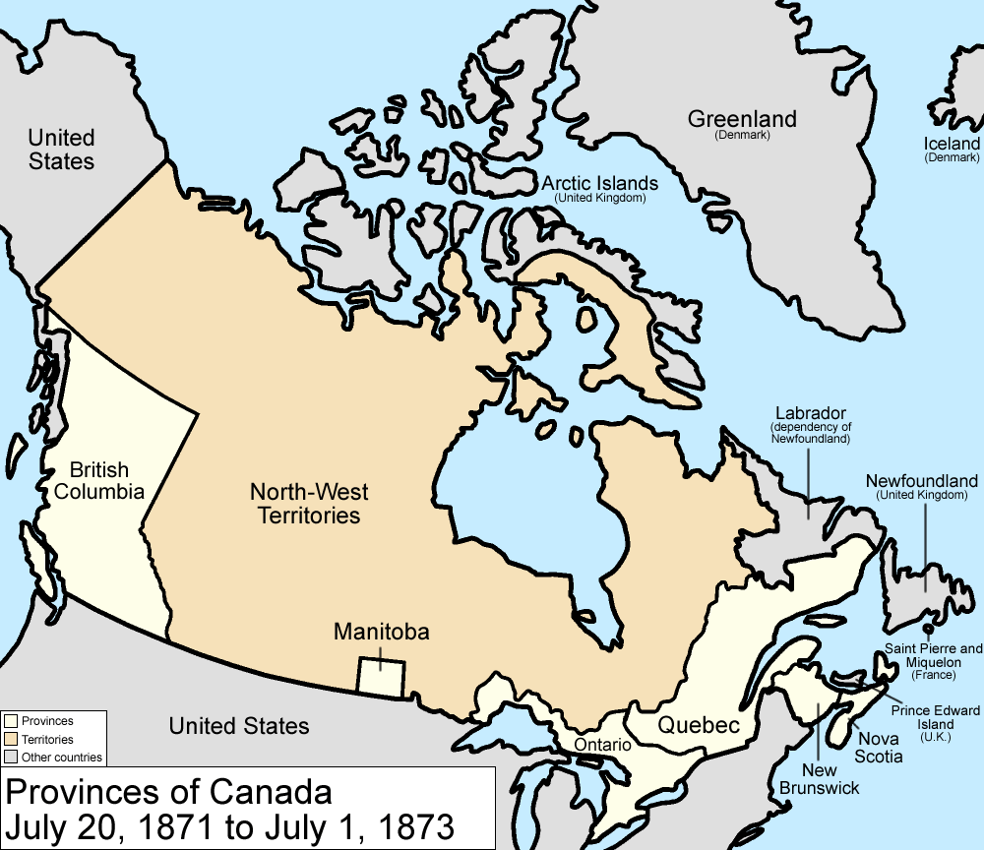
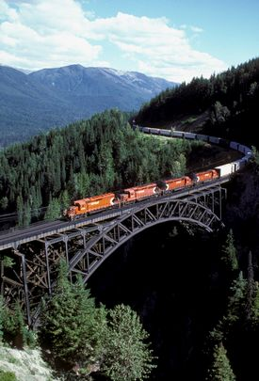
Canada’s Westward Expansion
Canada’s first Prime Minister was John MacDonald
Expanded Canada westward by purchasing land, and persuading territories to join.
By 1871 Canada stretched from Atlantic to Pacific
Also began the construction of a trans continental railroad that was completed in 1885

Slide 23
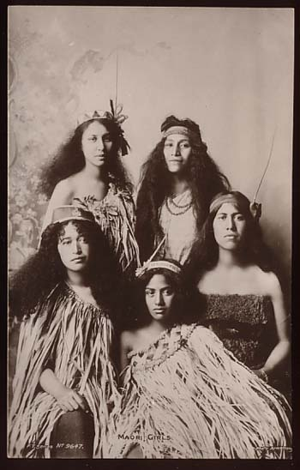
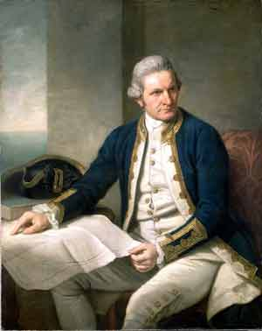
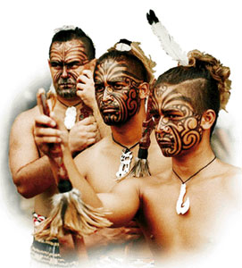
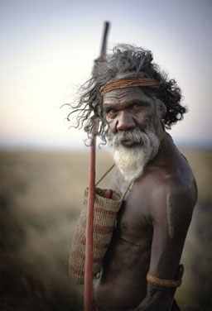
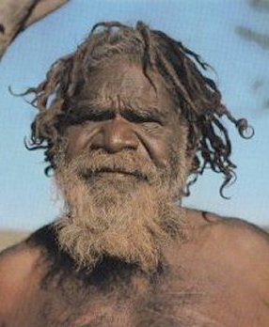

Australia and New Zealand
claimed New Zealand and part of Australia for GB
In 1769-1770 Captain James Cook
New Zealand was inhabited by the Maori that had settled there around 800 A.D.
Cook considered Australia uninhabited but it was actually inhabited by native people that the British will call Aborigines

Slide 24
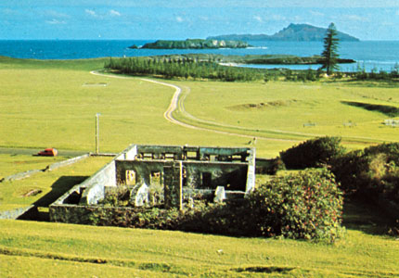
Britain’s Penal Colony
1788 – The British begin to colonize Australia with convicted criminals because their own prisons were so overcrowded
A penal colony is a place where convicts are sent to serve their sentences
The prisoners could then buy land and settle in Australia

Slide 25
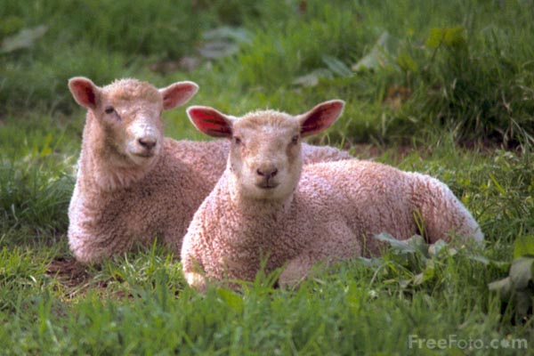
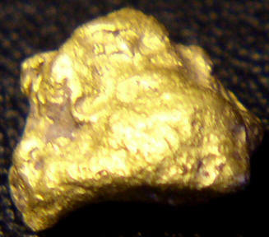
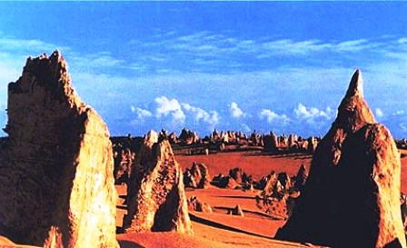
Free Settlers Arrive
Free settlers soon joined the convicts in Australia and New Zealand
They begin to raise Sheep
Sheep aren’t native but wool soon becomes the major export
To Encourage Immigration the government offered cheap land to settlers
Grew steadily until the 1851 gold rush that created a population boom
Scattered settlements became separate colonies
Some pushed west across the desert to make outposts in Western Australia

Slide 26
Settling New Zealand
This happened more slowly than Australia
They didn’t claim NZ the way they claimed Australia
They recognized the land rights of the Maori People
1814 – Missionaries begin to arrive
The more settlers arrive the more conflict there is over land
1839 GB annexed NZ in response to Birtish settlers demands and appointed a governor to negotiate with the Maori
1840 the Maori accept British rule in exchange for their land rights

Slide 27
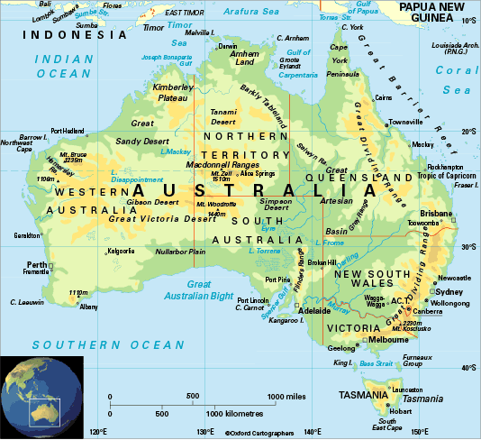
Self Government for Australia and New Zealand
Australia and New Zealand wanted to run themselves but still be part of the British Empire
During the 1850s colonies in both Aus and NZ became self governing and created parliamentary forms of government
In 1901 Australian colonies united under a federal constitution as the Commonwealth of Australia
Both became dominions in the early 1900s
People here pioneered a number of reforms
Secret Ballot - 1850
Full voting rights to white women in 1893

Slide 28
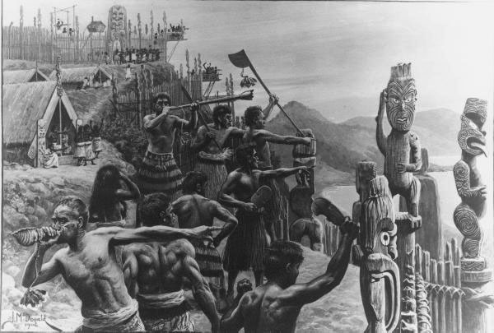
Status of the Native People
Natives and other Non-European people were excluded from these reforms
Disease and colonization killed or displaced many of the Aborigine or Maori
Between 1845 and 1872 The British and the Maori fought a series of wars
The Maori were defeated and fled to a remote part of the country

Slide 29

The Irish Win Home Rule

Slide 30
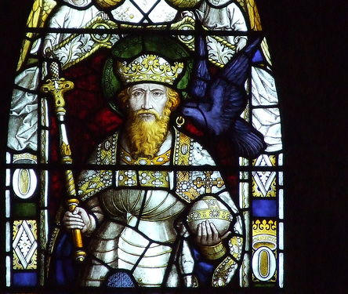
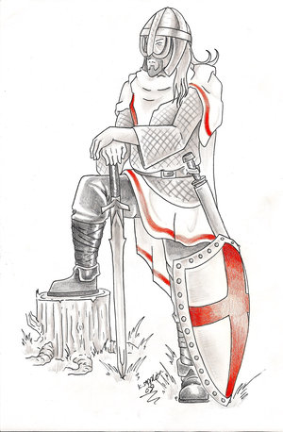
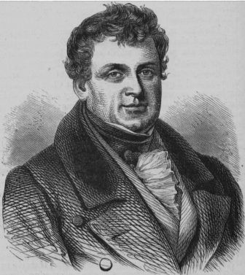
The English King was granted control of Ireland by the Pope in the 1100s
Knights invaded and settled there to form their own aristocracy
The Irish had their own culture, language, and ancestry. They resented the British being there
The English imposed laws on the Irish that limited the rights of Irish Catholics and favored English Protestants in both Religion and Language
Gaelic is Outlawed
Britain formally joined Ireland to themselves in 1801
This will give the Irish more representation in Parliament.
Daniel O’Connell persuaded parliament to pass the Catholic Emancipation Act of 1829
Gave Catholics back many of their rights.

Slide 31
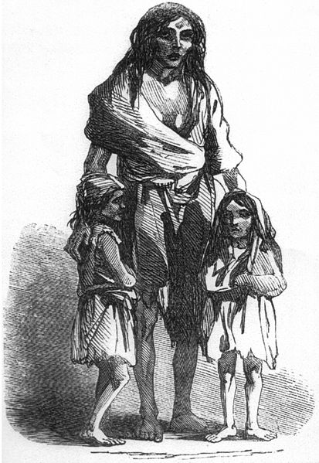
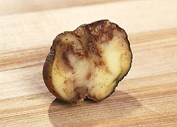
The Great Famine
In the 1840s Ireland experienced one of the worst famines in modern history
Irish peasants depended on Potatoes as their sole source of food
From 1845-1848 a plant fungus called potato blight destroyed nearly all the Irish potato crop
About 1/8 of the Irish population (about 1 million people) died from starvation and disease over the next few years
Another 1/8 (approx. 1-1.5 million) fled from Ireland
Most went to the U.S.
Some went to Britain, Canada, and Australia
The British government enforced British landlord laws, and forced the Irish tenant farmers to pay rent even though their crops had failed
Most peasants went deep into debt and lost their farms

Slide 32

Demands for Home Rule
During the 2nd ½ of the 1800s, opposition to British rule in Ireland took 2 forms:
Some Wanted Independence
Some wanted Home Rule
Home Rule is local control over internal matters
The British refused to consider either option.
They feared independence movements
Feared for the Protestant minority in Ireland
Protestants were primarily in Ulster; a county in N. Ireland
In 1914 Parliament passed a home rule bill for S. Ireland, but WWI broke out and Home Rule was put on hold.

Slide 33



Rebellion and Division
The Easter Rising
Frustration over the delay of home rule led a small group of Irish nationalists to rebel in Dublin during Easter week 1916
The British put down the uprising and executed the leaders
After WWI the Irish Nationalists won a victory in elections for Parliament
As a protest, they didn’t go, but formed an underground government called the Irish Republican Army, or IRA
The IRA is an unofficial military force that fights for Irish independence
They attacked British Officials in N. Ireland and this led to a war

Slide 34


In 1921 Britain divided Ireland and granted home rule to S. Ireland
Ulster, or Northern Ireland, remained part of Great Britain
Southern Ireland became the Irish Free State
Many Irish nationalists, led by Eamon De Valera, continued to seek total independence from Britain.
In 1949, the Irish Free State declared itself the Republic of Ireland

Slide 35

War and Expansion in the United States

Slide 36


Americans Move West
In 1803, President Thomas Jefferson
bought the Louisiana Territory from France
This doubled the size of the country and extended the boundary to the Rocky Mountains
In 1819 Spain gave up Florida to the U.S. and in 1846 a treaty with Great Britain gave the U.S. Part of the Oregon Territory
The United States now stretches from Atlantic Ocean to Pacific Ocean

Slide 37
Manifest Destiny
This is the belief that the U.S. has the right and the Duty to rule N. America from Atlantic to pacific
The Government will use this belief to evict Native Americans from their ancestral Tribal lands
The Indian Removal Act of 1830 will make this action official policy

Slide 38



The Trail of Tears
The Cherokee in Georgia will be forced to move
Most move to Oklahoma, 800 miles away, primarily on foot
Becomes known as the Trail of Tears
About ¼ of the Cherokee on the Trip will die of starvation or exposure
As white settlers move west, Native Americans continued to be pushed off their lands

Slide 39


Texas joins the United States
Mexico won its independence from Spain in 1821
Lands included area west of the Louisiana Purchase
With Mexican permission, American settlers moved into the Mexican territory of Texas
In 1836 Texans revolted against Mexican Rule and won their independence
They were now their own country run by Sam Houston
1845 – The U.S. annexes Texas with their permission
Mexico sees this as an act of war because they still claim Texas

Slide 40


War with Mexico
In May of 1846 Mexico declared war on the United States
Mexico surrendered in February of 1848
As part of the treaty, Mexico ceded territory to the U.S. including areas in California and the southwest
In 1848 the Gadsden Purchase from Mexico brought the lower continental U.S. to its current borders

Slide 41





The Civil War Tests Democracy
The South’s economy was agricultural and relied on a few key cash crops
The North had a diverse economy with farms and industry
The primary cash crops were rice, tobacco, cotton, and sugar
They used free workers
They relied on slave labor

Slide 42

Economic differences between the two regions led to a conflict over slave labor
Most northerners felt that slavery was morally wrong
Most white southerners felt that slavery was necessary to the survival of the economy
They wanted laws to protect slavery in the west so they could continue to raise cotton there
This will lead to a debate about whether the states had the right to leave the union or not and who had more rights; the states or the federal government
Northerners felt that the Constitution had established the Union and it had to stay the way it was
Southern politicians say states freely joined the union, so they could freely leave it

Slide 43


Civil War Breaks Out
1860 – Abraham Lincoln is elected to the presidency
Southerners were opposed to Lincoln because he had promised to stop the spread of slavery
Southern states began to secede from the Union
They became the Confederate States of America

Slide 44


On April 12, 1861 Confederate forces fired on Ft. Sumter, a federal fort in Charleston, SC.
Lasted 4 years and was fought primarily in the south
The south had superior military resources
The North had a larger population, better transportation, greater resources, and more factories
The South surrendered in June of 1865.

Slide 45

The Abolition of Slavery
Lincoln declared that the war was being fought to save the Union NOT to end slavery
He wanted to keep the support of the border states
Border states were slave states that hadn’t seceded.
Lincoln will eventually decide that ending slavery will save the Union

Slide 46


1863 – The Emancipation Proclamation is issued
This freed the slaves
But only the Confederate slaves NOT the slaves in the border states.
The Confederate States of America had appointed Jefferson Davis as its President
The Emancipation Proclamation also kept European Nations out of the Civil War
They would most likely have joined the Confed. because they needed Cotton
Because the Emancipation Proclamation ended slavery, those countries that were opposed to slavery didn’t join the war

Slide 47



The 13th Amendment was passed at the end of the war
It abolished slavery in the U.S.
The 14th and 15th amendment extended citizenship to all Americans and voting rights to freed slaves.

Slide 48

Reconstruction
The South was occupied by federal troops from 1865- 1877
After the Civil War the south continued to pass laws limiting the rights of African-Americans
These laws encouraged segregation
Segregation is the separation of people based on race
Discrimination was also prevalent in the North

Slide 49

The Post War Economy
Immigration:
Industrialization in the U.S. could not have happened as fast as it did without immigrants
During the 1870s immigrants arrived at a rate if 2000/day
By 1914 there were over 20 million immigrants in the U.S. from Europe and Asia.

Slide 50




The Railroads
The nation’s rail system moved west as people settled there
By 1862 Congress had the money for a trans-continental railroad
Completed by immigrants in 1869
Linked California to the East Coast
By 1900 nearly 200,000 miles of track linked farm to city and helped trade and industry

Slide 51






19th Century Progress

Slide 52


Inventions make life easier
Gasoline powered internal combustion engines will replace coal
This engine will make the automobile possible
By the late 1870s electricity was being created by generators

Slide 53


Thomas Edison
Patented over 1000 inventions
2 of his inventions were the light bulb and the phonograph

Slide 54

He started his research lab in Menlo Park, NJ
Most of Edison’s important inventions were created with the help of researchers he employed
One of his researchers was an African American man named Lewis Latimer

Slide 55


Alexander Graham Bell
&
Guglielmo Marconi

Slide 56

Bell was a teacher of the deaf who invented the telephone in his spare time.

Slide 57


Marconi used theories about electromagnetic waves to create the first radio in 1895
This invention sent messages using Morse Code
and became standard equipment on ships at sea

Slide 58





Pioneers of the Automobile Industry

Slide 59


Henry Ford Sparks the Automobile Industry
In the 1880s Gottlieb Daimler and Rudolph
Diesel used gasoline to power the first cars
Technology developed quickly but was very expensive
Ford decided to make cars that were more affordable using standard, interchangeable parts, built on an assembly line

Slide 60
An assembly line is a line of workers that each put a single piece on the unfinished cars as they passed on a moving belt
Assembly line workers could put together an entire Model T Ford in less than 2 hours
In 1908 it sold for $850 but dropped to less than $300 when production prices dropped
“Any customer can have a car painted any color that he wants so long as it is black.”

Slide 61
The Wright Brother’s Fly

Slide 62


Orville and Wilbur Wright were bicycle mechanics from Dayton, OH
December 17, 1903 they flew a gasoline powered flying machine called the Wright Flyer at the beach in Kitty Hawk, NC. The longest flight was 100 yards in 59 seconds

Slide 63

New Ideas in Medicine

Slide 64



The Germ Theory of Disease
Louis Pasteur realized in the mid 1800s that fermentation was caused by microscopic organisms that he called bacteria
He realized that heat killed bacteria
He began to pasteurize liquids such as milk to prevent spoilage

Slide 65

People begin to realize that bacteria also caused disease
Joseph Lister realized that bacteria may have something to do with the 50% mortality rate after surgery
In 1865 he demanded that surgical wards be kept clean
And that wounds be washed with antiseptic (germ killing) liquids
About 85% of Lister’s patients survived
Other hospitals began to implement Lister’s methods.

Slide 66






Cities began to realize that cleanliness helped prevent disease
They began building plumbing and sewer systems
Medical researchers developed vaccines for deadly diseases such as typhus, typhoid, diphtheria, cholera, and yellow fever

Slide 67

New Ideas in Science

Slide 68


Charles Darwin and the Theory of Evolution
This is Called the Theory of Evolution
Darwin concluded after research that all forms of life, including people evolved from earlier living things that had existed millions of years ago.
In 1859 he published “On the Origin of the Species by Means of Natural Selection.” which said that populations outgrow food supply and that leads to competition.
Species that survive are the fittest or best adapted to survive
These species then have offspring with heir adaptations and gradually new species are created through this process

Slide 69

Mendel and Genetics
In the 1850s and 60s an Austrian Monk named
Gregor Mendel discovered the way things passed on their traits.
He crossed pea plants to see which traits the offspring possess
This helped explain Darwin’s theory
Became the foundation of Genetics

Slide 70


Advances in Chemistry and Physics
1803 – John Dalton theorized that all matter was made up of tiny particles called atoms
These atoms all have their own specific weight
Compounds have more than one kind of atom

Slide 71


1869 – Dmitri Mendeleev, a Russian Chemist, organized a chart with a ll the known elements arranged in order from lightest to heaviest
He left gaps where he predicted that new elements would be discovered
The Periodic Table is still used today

Slide 72



Marie and Pierre Curie discovered two of the Elements that were missing from Mendeleev’s Table
Radium and Polonium
They were found in a mineral called Pitchblende
They released a powerful form of energy that the Curies called Radioactivity

Slide 73

Physicists around 1900 kept working with the atom
Scientists had believed that the atom was the smallest particle that existed
Ernest Rutherford suggested that atoms were made up of smaller particles including a nucleus and electrons that surrounded that

Slide 74

Social sciences explore behavior
New social sciences such as archaeology, anthropology, sociology, and psychology developed in the late 1800s

Slide 75


Psychology was the study of the human mind and behavior
Ivan Pavlov, a Russian psychologist believed that human actions were unconscious reactions to experiences and could be changed by training
He worked with dogs to prove that a dog would drool after it heard a bell if it were conditioned to think the bell corresponded with food

Slide 76


Sigmund Freud was an Austrian doctor who also believed that the unconscious mind drives how people think and act
He believed that people’s suppressed memories, desires, and impulses shaped their behavior
Developed a type of therapy called psychoanalysis to deal with these conflicts

Slide 77





The Rise of Mass Culture

Slide 78
Changes produce Mass Culture
Mass culture was the appeal of art, music, writing, and other entertainment to a larger audience
      Changes included increased literacy, cheaper books, and music directly in homes because of the radio and phonograph, and a shorter workday that led to more leisure time.

Slide 79

    Music Halls, Vaudeville, and Movies
On a typical night, a music hall may have offered a dozen different acts
In the U.S. Musical Variety shows were called Vaudeville
They travelled from town to town appearing in theaters

Slide 80
Several inventors also tried projecting moving images
The Vitascope was one of the first successful motion picture projectors that could show images to large groups
There were lots of people working on motion picture projectors at the time
The earliest movies were black and white and lasted less than a minute
Called movies because they moved

Slide 81


Sports
With more time people began to enjoy sports and outdoor activities
Baseball and football soared in popularity
In England, Soccer clubs drew huge crowds
English sports such as Cricket spread to the colonies

Slide 82


In 1869 the first Olympic games were held in Greece and they were held every 4years from that point on.

