Slide 1
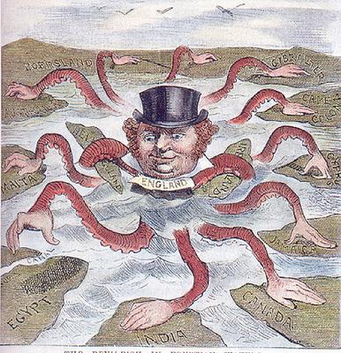
The Age of Imperialism

Slide 2
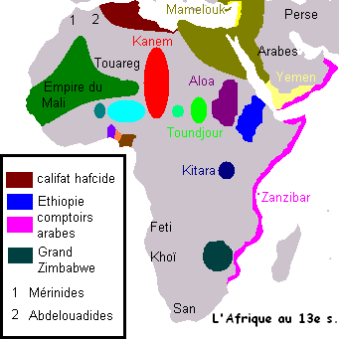
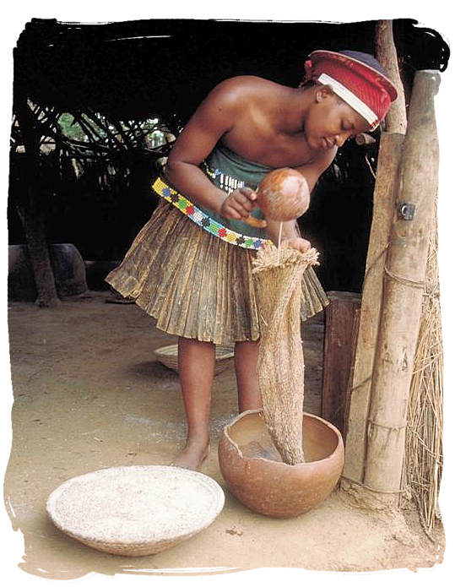
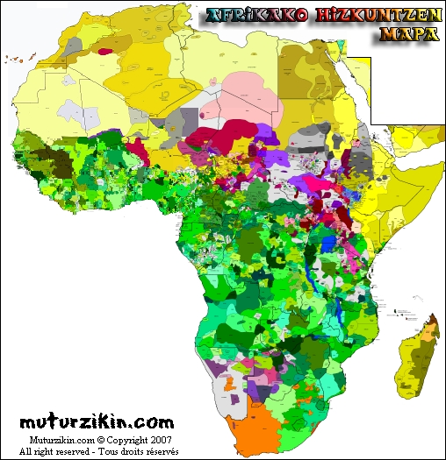
The scramble for Africa
Africa before European Domination
In the mid – 1800s, African people were divided up into hundreds of ethnic and linguistic groups
Most followed traditional beliefs
Some converted to Christianity or Islam
These groups spoke more than 1000 languages
Politically they ranged from large empires with united ethnic groups to small independent villages

Slide 3
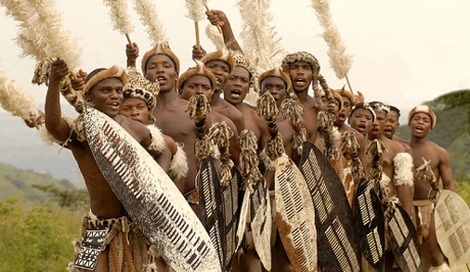

Europeans had established contacts with sub-Saharan Africans as early as the 1450s
African armies were strong enough to keep the Europeans out of most of Africa for about 400 years
By 1880 Europeans only controlled 10% of the continent and mostly on the coast
Disease and non-navigable rivers kept Europeans out for many years

Slide 4
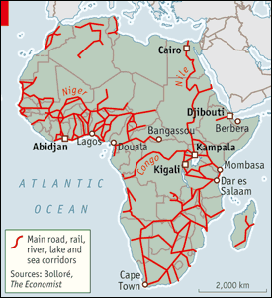
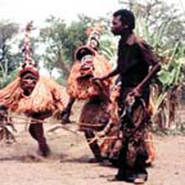
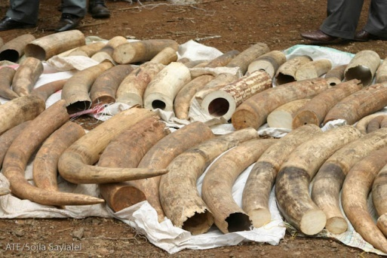

Africans controlled their own trade networks and provided trade items
Trade networks were highly specialized
One tribe, the Chokwe, devoted themselves to collecting ivory and beeswax in Angola for example

Slide 5
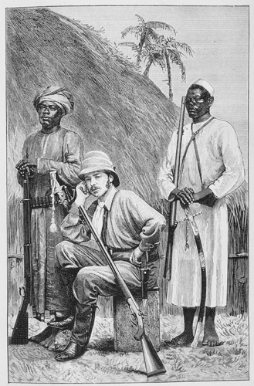
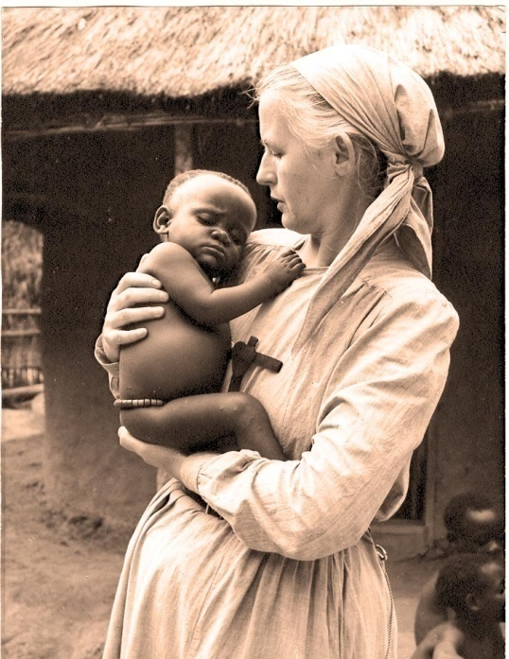
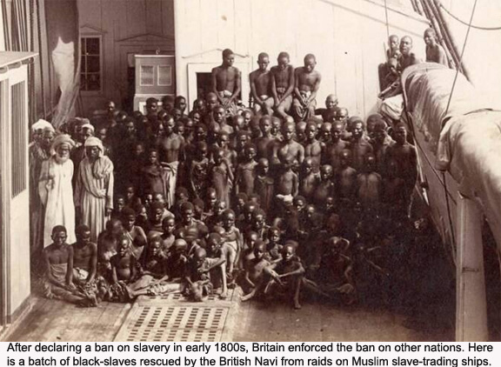

Nations compete for overseas empire
The Europeans who did make it into the interior of Africa were explorers, missionaries or humanitarians who were opposed to the slave trade
Europeans and Americans learned about Africa through travel books and newspapers.

Slide 6
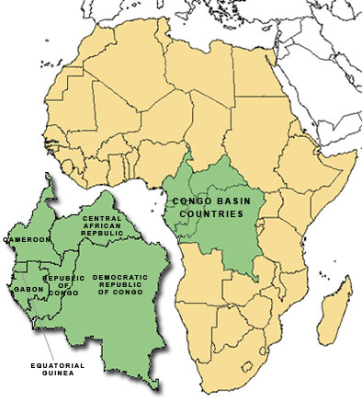
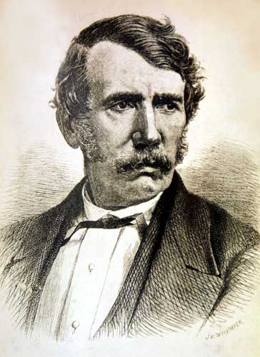
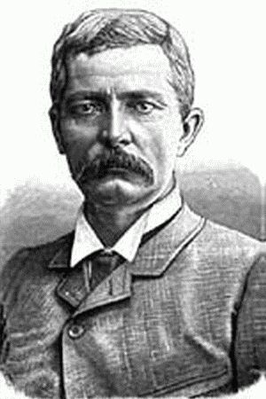
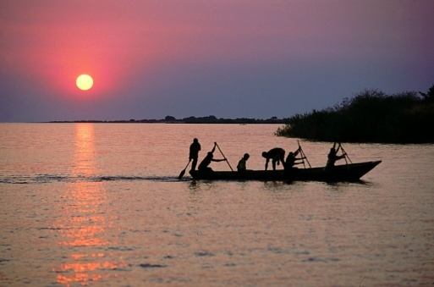
The Congo sparks interest
In the late 1860s, David Livingstone, a Scottish missionary travelled into central Africa to promote Christianity
When no one heard from him for 10 years they assumed he was dead
An American newspaper hired reporter Henry Stanley to find Livingstone
In 1871 he found Dr. Livingstone on the shores of Lake Tanganyika.

Slide 7
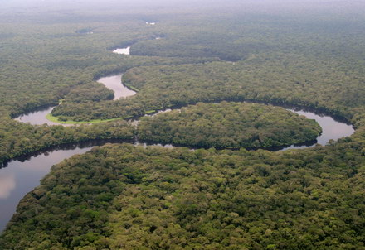
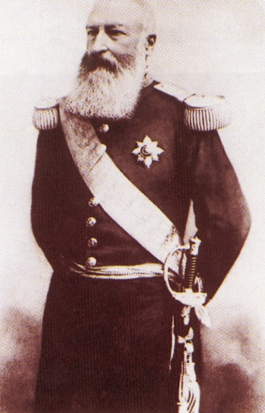
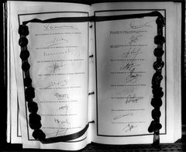
Stanley the set out to explore Africa himself and trace the course of the Congo River
His explorations got the interest of King Leopold II of Belgium
He commissioned Stanley to help him obtain land in the Congo
Between 1879 and 1882 Stanley signed treaties with local chiefs of the Congo River valley
These treaties gave Leopold control over these lands

Slide 8
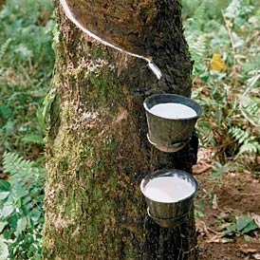
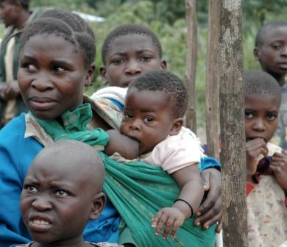
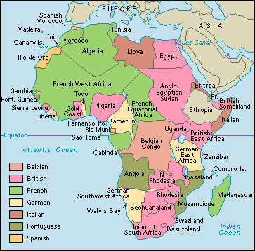
Leopold said he was colonizing these areas to stop the slave trade and spread Christianity.
However he used the Congolese people to collect sap from Rubber Trees
At least 10 million Congolese died
Because of his abuses the Belgian government took the colony away from Leopold in 1908
The French had signed a treaty getting everything north of the Congo River and the New Belgian Congo included some of their territory
It didn’t take long for all the European powers to claim land in Africa

Slide 9
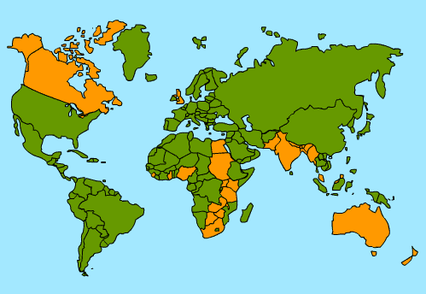
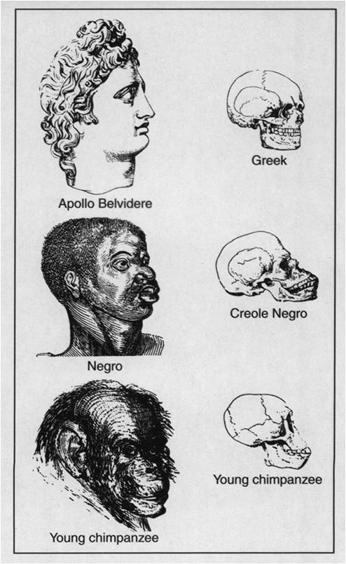
The Forces Driving Imperialism
Belief in European Superiority
National pride played a part
An Empire meant your country was powerful/great
As competition increased, each country was determined to plant their flag in Africa
Many Europeans subscribed to the beliefs of Social Darwinism and Racism
Racism – the belief that one race is superior to another
Social Darwinism – when you apply Darwin’s theory of Evolution to human society
Those who were fittest were the ones who were wealthy and prosperous
Non-Europeans were considered to be on a lower level of physical and cultural development
Because they hadn’t made the same sci and tech gains

Slide 10
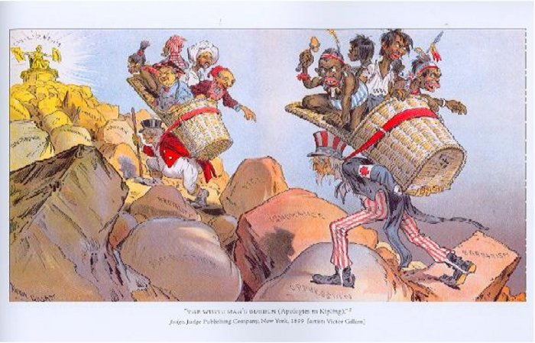
The White Man’s Burden

Slide 11
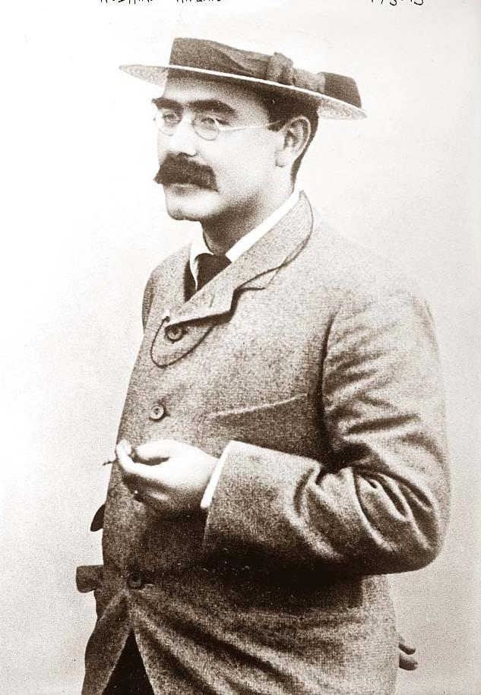
This was written as a poem by Rudyard Kipling
But really, it laid out what Europeans believed about their colonies.
Europeans felt that it was their right and duty to bring their progress to the more “backwards” countries
Missionaries also pushed for expansion for religious conversion
They also wanted to “civilize” and “westernize” the people they were colonizing

Slide 12
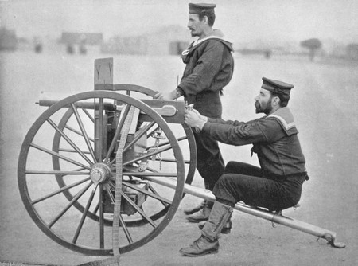

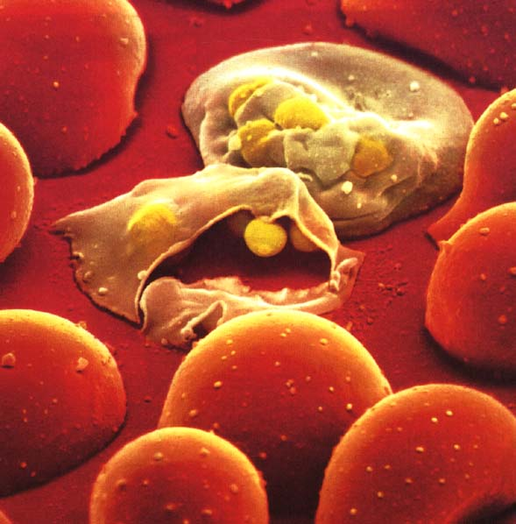
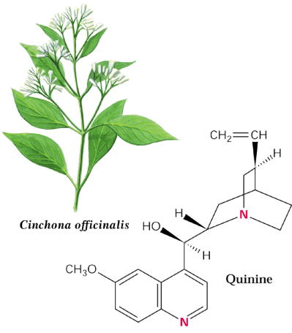
Factors promoting imperialism in Africa
One major advantage that Europeans had was technology
The Maxim Gun, invented in 1884, was the first automatic machine gun
Africans had to use outdated weapons like guns that had been traded during the slave trade years earlier
Europeans could also control their colonies
Steam engines allowed travel into the interior by rail and by river
Quinine, developed in 1829, took care of the malaria problem and allowed Europeans to travel away from the coast

Slide 13
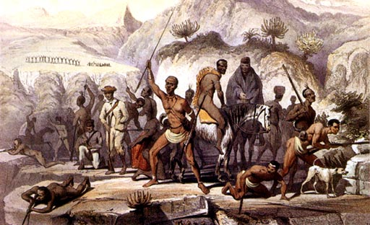
In Africa itself there were factors that made the continent easier to colonize
There were hundreds (or perhaps thousands) of different languages and cultures
Each tribe, empire or ethnic group was constantly fighting with other groups over land, water, etc.
The Africans couldn’t unite against the Europeans

Slide 14
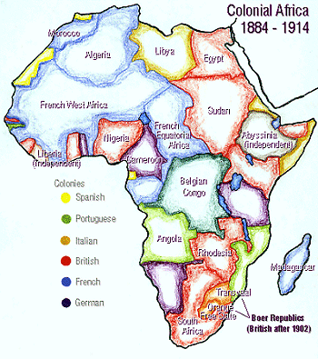

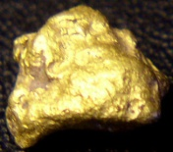
The Division of Africa
The scramble for African territory began around 1880
The French began to move from the western African coast to western Sudan
The discovery of gold and diamonds in South Africa increased the desire to colonize

Slide 15
The Berlin Conference divides Africa
European countries feared that they would go to war with each other over Africa.
To prevent this, 14 countries got together in Germany in 1884-5 to lay down ground rules for dividing Africa
This was called the Berlin Conference
Rules said that any European country could claim Africa as long as they ID’d the claim and proved they could control it
By 1914 only Ethiopia and Liberia remained Free

Slide 16
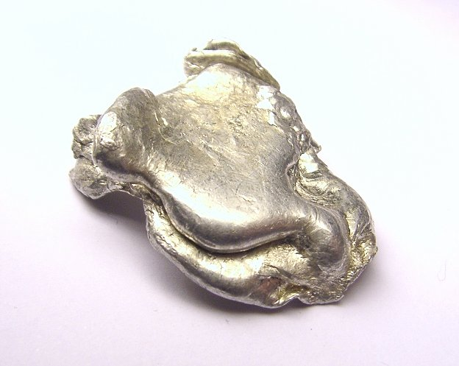
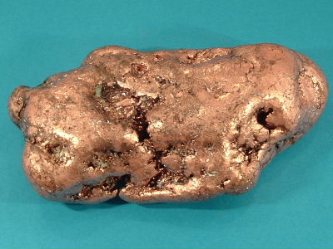


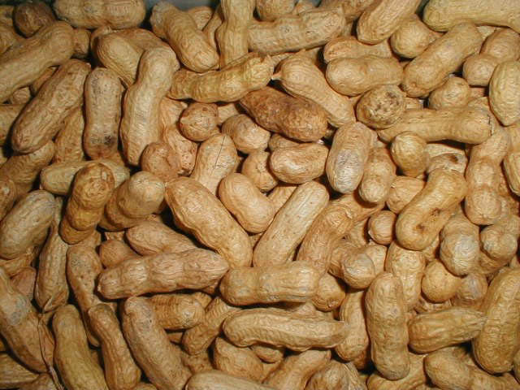

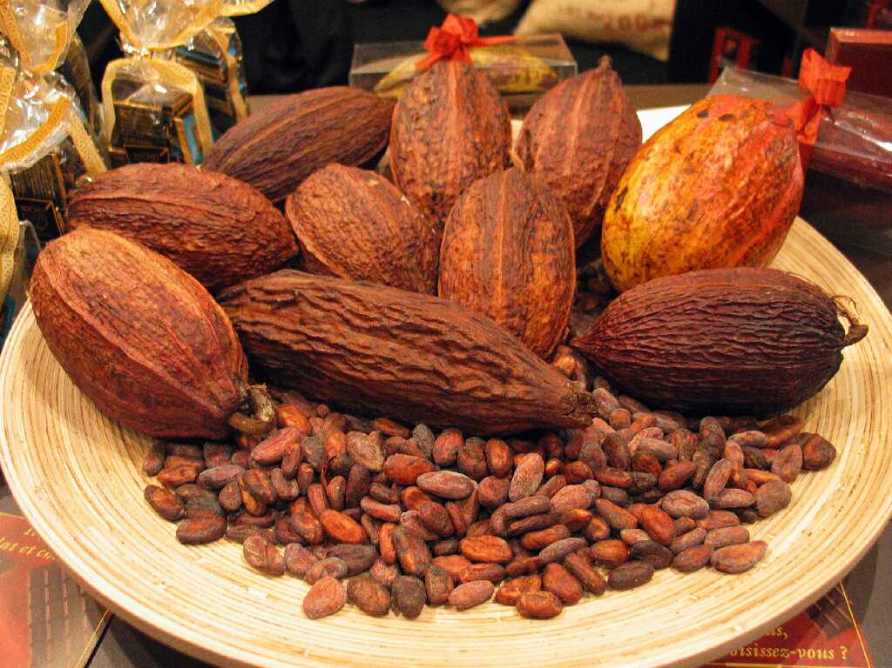
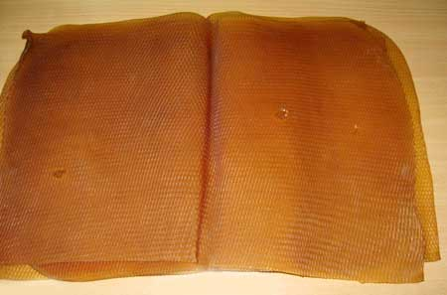
Raw Materials
Most Europeans thought that Africa would soon start buying huge quantities of European goods
They didn’t
European businesses needed raw materials from the continent and there were many natural resources in Africa
The Belgian Congo had copper and Tin
South Africa had gold and diamonds
There were also cash crop plantations that grew peanuts, palm oil, cocoa, and rubber

Slide 17
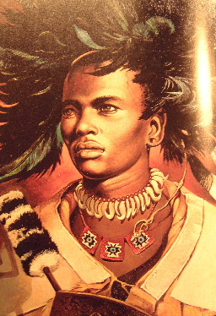
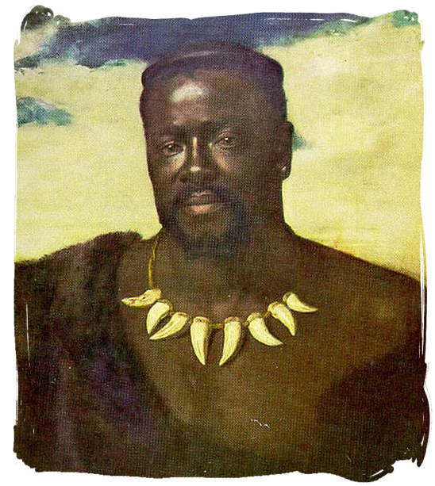
Three groups clash over South Africa
In 1816 a Zulu chief named Shaka created a large, centralized African State
His successors couldn’t keep the empire together though
In 1879 the British invaded after Cetshwayo refused to dismiss his army and accept British rule
The Zulu nearly defeated the British
The Zulu lost at the battle of Ulundi in 1879
In 1887 the Zulu nation was finally under British control

Slide 18
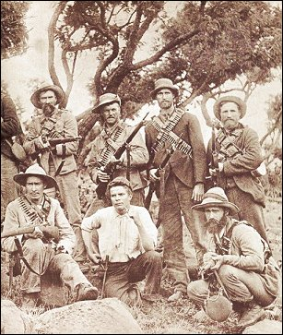
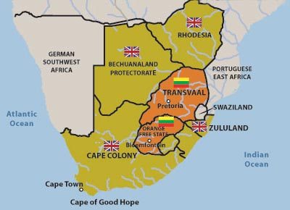
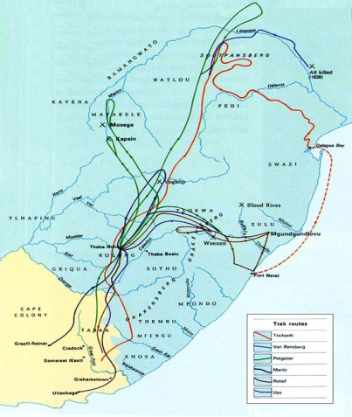
The Boers and the British settle the Cape
The first Europeans to settle in South Africa were Dutch
They came to the Cape of Good Hope and set up a weigh station for their exploring ships
Dutch Farmers known as Boers (Afrikaners) gradually took African land and set up large farms
The British took over Cape Colony in the early 1800s
The Dutch and the British clashed over land and slavery
In the 1830s the Boers began to move north – this is known as the Great Trek
They soon found themselves in conflict with the Zulu and other tribes they came across

Slide 19
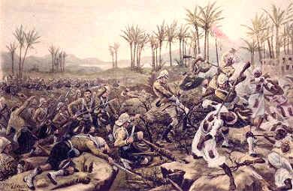
The Boer War
When diamonds and gold were discovered in Southern Africa people began to flood in
The Boers tried to protect their territory by keeping the outsiders from getting political rights
A rebellion against the Boers failed but the Boers blamed the British and in 1899 went to war against them

Slide 20
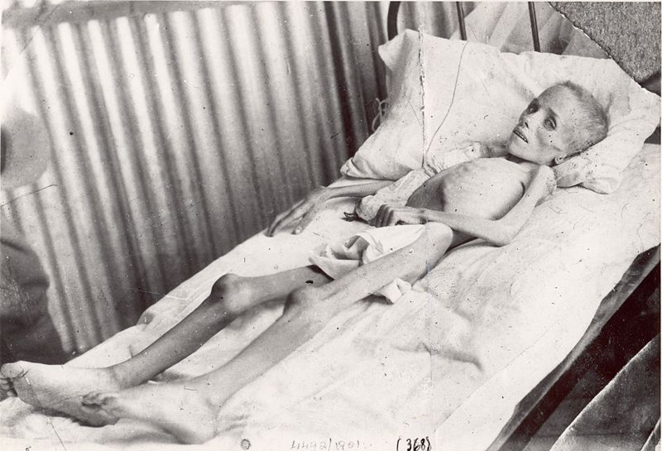
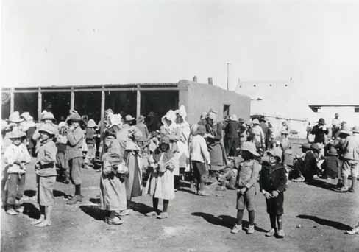
This was the first “Total War”
The Boers used commando guerilla raids against the British
The British burned farms, slaughtered livestock, and imprisoned women, children, and the elderly in concentration camps
Statistics of Deaths in Concentration Camps
Married Women | 3,288
Girls over 16 | 825
Boys over 16 | 209
Children under 16 | 22,057
Total Women & Children | 26, 379
Old Men | 1,421
Grand Total | 27, 800

Slide 21
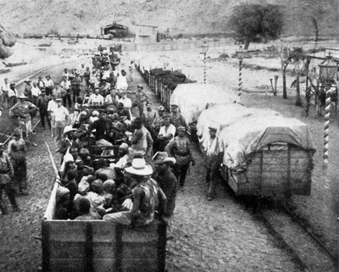
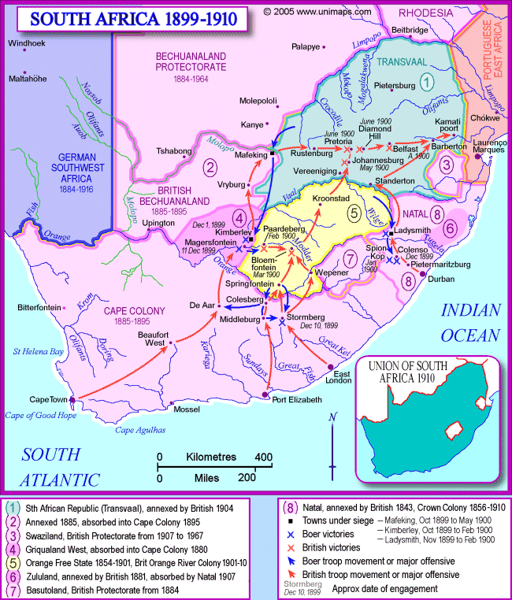
Black Africans were also involved in the war
Some fought, some served as scouts, guards, drivers, and workers
Black Africans who were captured were also put into the concentration camps
Approximately 107,000 Black Africans were put in the camps and approximately 20,000 died there
In 1910 the British won the war and the Boer republics were joined into a self-governing Union of South Africa that was controlled by the British

Slide 22
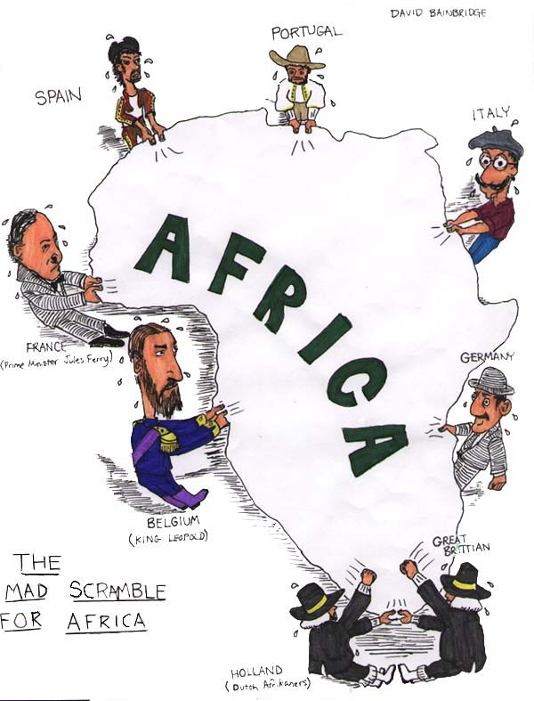
Imperialism

Slide 23
A New Period of Imperialism
Each European nation had certain policies and goals for establishing colonies
Four forms of taking and controlling territory emerged
Colony
A country or territory governed internally by a foreign power
Protectorate
A country or territory with its own internal government but under the control of an outside power
Sphere of Influence
An area in which an outside power claims exclusive investment or trading privileges
Economic Imperialism
An independent but less developed country is controlled by private business interests rather than another government

Slide 24
Methods of Management
Direct Control
Paternalism
Europeans governed their people in a parental way
Provided for needs but didn’t give them any rights
Europeans brought in their own bureaucrats and didn’t train local people in European Government
Assimilation
This was the theory that over time the local populations would adopt European culture
Mostly used by France
To aid in the transition, all local schools, courts, and business were based on French institutions
In practice, the French abandoned assimilation and used association instead. This is similar to indirect control but regarded African institutions and culture as inferior to the French

Slide 25
Indirect Control
Relied on Existing rulers
Local rulers handled much of the daily management of the colony
Each colony had a legislature that included colonial officials as well as local merchants and professionals nominated by the colonial government
Theory was that people would be trained in the British form of government and then the local population would govern itself

Slide 26
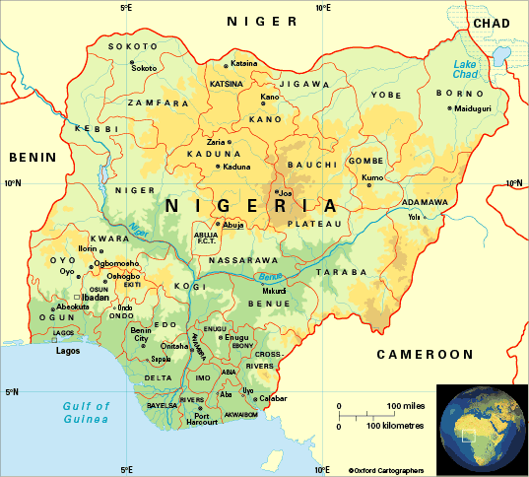
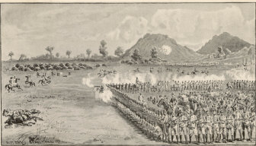
Nigeria: A British Colony
The British gained control of Nigeria through alliances and war
N. Nigeria was captured by the Royal Niger Company
The Co. took control of the palm oil trade along the Niger river after the Berlin Conference
This gave the British a protectorate over the Niger River Delta
By 1914 the British claim all of Nigeria as a colony

Slide 27
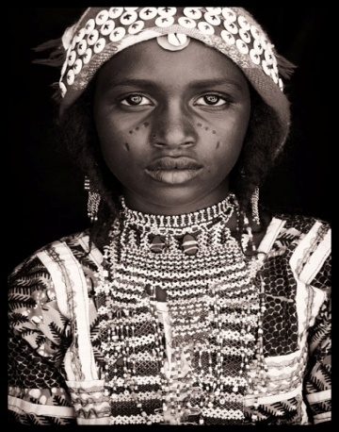


Managing the colony
Because the area was so diverse the British used indirect control
You had to claim a colony and govern it
About 250 ethnic groups lived in Nigeria
The Hausa-Fulani in the North
This worked well with the Hausa Fulani
But the Yoruba and the Igbo resented British control and loss of power
The Yoruba in the Southwest
The Igbo in the Southeast

Slide 28




African Resistance
Unsuccessful attempts at resistance
These movements generally included active military resistance and religious resistance
The Algerians resisted French rule for almost 50 years
Samori Toure led resistance in French West Africa for 16 years
In German East Africa, native people believed that maji maji, or magic water sprinkled on their bodies would turn German bullets to water
This was unsuccessful but it united 20 different ethnic groups who believed that their war was ordained by God and their ancestors would return to help them
Official death toll was 75000, but probably double after the famine

Slide 29



Ethiopia: A Successful Resistance
Menelik II became emperor of Ethiopia in 1889
He successfully played European powers against each other
While he was doing that he built up a large modern arsenal bought from France and Russia
Menelik signed a treaty with Italy that he thought only gave up a small piece of land, but Italy claimed the whole thing as a protectorate
In 1869, at the battle of Adowa, Ethiopian forces successfully defeated the Italians and kept Ethiopia independent.
Kept his weapons stockpile as well

Slide 30
The Legacy of Colonial Rule
The Good
The Bad
The Good
The Bad
Colonialism reduced local warfare
Africans lost control of their land
Improved sanitation, hospitals and schools
Africans lost independence
Lifespan and literacy both improved
Many died of new diseases
African products became valuable on the international market
Famines b/c of cash crops instead of subsistence farming
Railroads, dams, telephone, and telegraph lines were built in villages
Traditional culture broke down
Trad. Authority figures were replaced
** This really only benefitted Europeans, not the Africans living there
Men were forced to leave villages to find ways to support their families
Admiration for Euro culture undercut African culture
Africa was divided with no regard for language, culture, or political issues that existed

Slide 31

Europeans claim Muslim lands

Slide 32



The Ottoman Empire Loses Power
Reforms Fail
After Suleyman I died in 1566, the government broke up into many bickering factions
Corruption led to financial loss
Coinage was devalued leading to inflation
Selim III came to power in 1789
He attempted to modernize the army
Older Janissaries resisted, he was overthrown, and reform stopped
Now nationalist revolts start to break out
In 1830 the Greeks win their independence and Serbia got self-rule
Ottoman weakness was becoming obvious to the European powers and now they started looking for ways to expand into Muslim areas

Slide 33

Geopolitics
This is the interest in or taking of land for its strategic location or products
This area was important to the Europeans
The Ottomans controlled access to the Mediterranean and the Atlantic sea trade
They controlled access to the Black Sea
Any landlocked European country had to go through Muslim lands to trade
Oil was also discovered in Persia in the early 1900s focusing more attention on the area

Slide 34

Russia and the Crimean War

Slide 35

The Russians had launched wars on the Ottomans for generations trying to get a warm water port on the Black Sea
In 1853 – War breaks out between Russia and the Ottoman Empire
The Crimean War
Called this because this is the peninsula in the Black Sea where most of the fighting happened
The Brits and the French want to keep Russia from gaining any more Ottoman land, so they take the side of the Ottomans and defeat the Russians

Slide 36

The war showed the weakness of the Ottomans
They continued to lose land
Russians aided the Slavs of the Balkans when they rebelled
The Ottomans lost control of Romania, Montenegro, Cyprus, Bosnia, Herzegovina, and Bulgaria
They also lost almost all of their land in North Africa

Slide 37


The Great Game
This was the geopolitical struggle between GB and Russia over Muslim lands in C. Asia
This primarily fought over India
Russia attempted to extend its empire and gain access to India’s riches
Britain defended its colony and attempted to spread its empire beyond India’s borders
Afghanistan became the center of these struggles

Slide 38



In the 1800s Afghanistan was an independent Muslim kingdom
Mountainous terrain and determined people kept invaders out
1881 – Britain withdrew from Afghanistan
1917 – The newly formed Soviet Union signs a non aggression pact with Afghanistan.
1921 – Britain agrees that it’s empire will not spread beyond the Khyber pass
1979 – The USSR invades Afghanistan

Slide 39


Egypt Initiates Reform
Military and Economic Reform
Modernization happened because of Fr interest in the area AND its strategic location at the head of the Red Sea
After Napoleon’s loss in Egypt an new leader came to power
Muhammad Ali
He was originally part of an Ottoman expeditionary force, but he broke away.

Slide 40



1831 Ali fought a series of battles where he won Syria and Arabia
European powers now recognize him and him heirs as the hereditary rulers of Egypt
Ali began a series of reforms in the military and economy
He changed Egyptian agriculture to the plantation system where they grow cotton
Peasants suffered because they lost their traditional farm land and had to grow cash crops instead of food crops
He brought Egypt to the international marketplace

Slide 41


The Suez Canal
Muhammad Ali’s grandson Isma’il continued the modernization of Egypt
He supported the building of the Suez Canal
This was a waterway to connect the Red sea with the Mediterranean
Built mainly with French $ from private groups using Egyptian labor
Opened in 1869
Isma’il’s modernization efforts were expensive and put Egypt in debt of $450,000,000
In 1882 the British took control of the canal and occupied Egypt

Slide 42




Persia Pressured to Change
Russia and Britain competed to try to bring Persia under their sphere of influence
Russia wanted access to the Persian Gulf and the Indian Ocean
Persia gave territory to Russia twice after losses in 1813 and 1828
Britain wanted Afghanistan as a buffer between India and Russia
In 1857 Persia was forced to give up all claims in Afghanistan
When oil was discovered there in 1908 interest grew

Slide 43




Persia could not develop its own resources
To raise money, the ruler began granting concessions to western business
These concessions allowed businesses to buy the right to operate in an area or develop a certain product
The Anglo-Persian oil co. began to develop Persia’s oil fields in the early 1900s
The Battle over Tobacco
The people of Persia didn’t like the selling of concessions
Religious leaders usually supported the people
1890- Nasir al-Din sold a concession to the British for Tobacco
Jamal al-Din al-Afghani wanted to modernize Persia
He organizes a tobacco boycott and the concession is cancelled
1906 – revolutionaries force the ruler to create a constitution
1908 – Russia and Britain take the country and divide it into spheres of influence

Slide 45


British Expand Control over India
The East India Company Dominates
Officially controlled by the British government BUT unofficially the East India Company ruled India with little to no interference from Britain
The Company even had their own army
Led by British officers but staffed by Indian soldiers called Sepoys

Slide 46

The “Jewel in the Crown”
India was considered the most valuable of all British colonies because of their raw materials and huge population
Over 300,000,000 people were a huge market for British goods
The British restricted the Indian economy from operating on its own
Had to produce raw materials and buy British goods, BUT making their own goods was prohibited
British Transport Trade Goods
Built RRs to transport raw products from the interior and manufactured goods back

Slide 47






Most raw materials were agricultural products
Tea
Indigo
Coffee
Opium
Cotton
Jute
Shipped to china for Tea that was then sold in England

Slide 48
Indian goods benefitted from outside conflict
Russian jute couldn’t get to Scottish Jute mills because of the Crimean War
Increased the demand of jute from Bengal
Cotton production had to increase when the U.S. Civil war cut off British cotton supplies
Impact
Negative
Positive
India lost political and economic power
Much the same as in Africa
Indians lost their industries
British ended local warfare
Emphasis on cash crops reduced food supplies
Increased sanitation and literacy
Increased presence of missionaries and racist attitudes affected traditional life
Helped India to modernize

Slide 49

The Sepoy Mutiny
Indians Rebel
Indians resented the British
1857 – a rumor spread that the cartridges of the new Enfield rifles were greased with beef and pork fat
To use the cartridges, soldiers had to bite off the ends
Hindus consider the cow sacred (and are generally vegetarians)
and Muslims can’t eat pork
Both groups were outraged
Commanders were shocked when Sepoys refused their cartridges
The British reacted badly and those who refused their cartridges were jailed

Slide 50

May 10, 1857 – The Sepoy Rebelled
They marched to Delhi and took the city
From there they moved through the rest of the country
The East India Co. took over a year to put down the rebellion
Indians couldn’t unite against the British because of weak leadership and religious issues
Muslims didn’t want the Mughals restored
Hindus preferred British leadership to Muslim leadership
Local leaders who had made deals with the EIC didn’t get involved
The Sikhs remained loyal to the British

Slide 51

Turning Point
1858 - British take direct control of India
Called the Raj
British rule in India during the reign of Queen Victoria
Cabinet ministers in England made policy, a governor
general in India carried it out
Princes who stayed loyal were rewarded
The British gained more and more control
Mutiny increased the distrust between the British and the Indians

Slide 52



Nationalism in India
Ram Mohun Roy
Well educated Indian who began a campaign to modernize India
Others began to attach themselves to Roy’s ideas and push for westernization
Nationalist groups form
Indian National Congress – 1885
Muslim League - 1906
Wanted self government for India
1905 – The British divide Bengal into a Muslim section and a Hindu section
1911 – Pressure from nationalist groups forces Britain to unite the area

Slide 53

Imperialism in Southeast Asia

Slide 54

Europeans invade the Pacific Rim
The Dutch expand control
The Dutch East India Company seized land in Malacca, fought for Java, and took Sumatra, part of Borneo, Celebes, the Moluccas, Bali, and part of Indonesia
To manage these colonies the Dutch brought settlers to run the plantations
Created a strict social class system of Dutch, educated Indonesians, then plantation workers
Dutch forced the farmers to plant 1/5 of their land as specific export crops.

Slide 55




The British take Malaya
The British wanted a trading port to compete with the Dutch
Took Singapore on the tip of the Malay Peninsula
Also took land in Malaysia and Burma (Myanmar)
Exported Tin and Rubber
Chinese encouraged to immigrate to be workers on rubber plantations
So many came to Malaysia that the native Malay became the minority in their own country

Slide 56




French Control Indochina
French had been in SE Asia since the 1600s
Helped the Nguyen Dynasty come to power
1840 – 7 French Missionaries were killed by the anti-Christian Emperor
Napoleon III ordered the French army to invade South Vietnam
They also added Laos, Cambodia (Kampuchea), and Northern Vietnam
They called the area French Indochina

Slide 57

Used Direct Control
Filled all the gov. positions with French
Didn’t encourage local industry
Increased the production of rice by 400% but most of it was exported
This started the Vietnamese resistance against the French

Slide 58

Colonial Impact
Mixed Results
Economies grew based on export of cash crops
Modernization mostly benefitted European business
Education, sanitation, and health did improve
Area became a melting pot of culture and religion because of huge influx of immigrant workers
There are still religious and cultural problems today because of this

Slide 59



Siam Remains Independent
Siam (Thailand) maintained independence all through the colonial period
It lay between British Burma and French Indochina
Siamese kings played the British and French against each other to keep their independence
Modernized under King Mongkut and his son Chulalongkorn
Started schools, reformed the legal system and reorganized government
Built its own railroads and telegraph systems
Ended Slavery
Because the changes came from within, the Siamese people escaped problems other countries faced

Slide 60




United States Imperialism in the Pacific Islands
The Philippines change hands
The United States got the Philippines, Puerto Rico, and Guam after the Spanish-American War in 1898
Emiliano Aguinaldo claimed that the U.S. had promised immediate independence

Slide 61


Declared independence and established the Philippine Republic
U.S. defeated the Filipino nationalists in 1902 then promised to prepare them for self-rule
Built roads, railroads, hospitals, and schools BUT they encouraged cash crops and that led to famine

Slide 62


Hawaii becomes a republic
1790s Hawaii is a port on the way to China and East India
1820s Americans established sugarcane plantations
By the 1850s sugar plantations account for 75% of Hawaii’s wealth

Slide 63

1890s McKinley Tariff Act eliminated tariffs on all sugar now entering the U.S.
Hawaiian sugar is cheaper now than sugar coming from elsewhere
Business leaders start to push for annexation
This is the adding of territory to the U.S.
If they become part of the U.S. sugar can be sold for an extra $.02/lb

Slide 64

Queen Liliuokalani
1893 she called for a new constitution that would increase her power and restore the political power of Hawaiians
1893 – she is overthrown by U.S. businessmen

Slide 65


1894 Sanford B. Dole (pineapples) was named president of the new Republic of Hawaii
Asked U.S. to annex it but President Cleveland said no
U.S. annexed Hawaii in 1898
By the end of the 1800s all land is claimed and these competing claims will be the focus of the 20th century.

