Slide 1
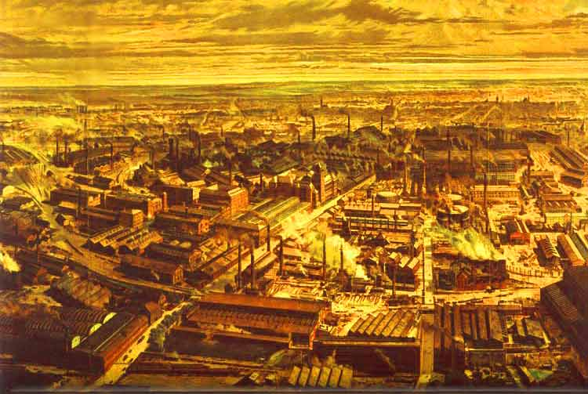
The Industrial Revolution
1700 - 1900

Slide 2
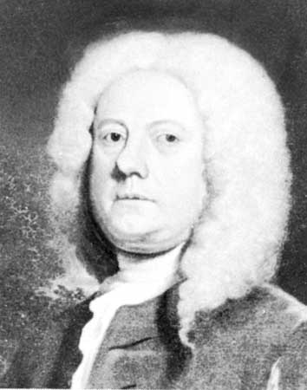
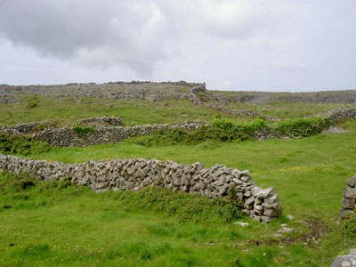
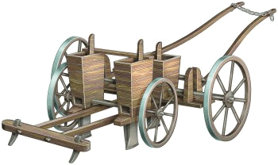
The Beginnings of Industrialization
Began in Britain with changes in farming
Wealthy landowners began buying up small village farms and then separating the land with fences
These are called enclosures and they meant larger fields to grow crops
Farmers like Jethro Tull could now experiment with better ways to seed.
He invented the seed drill which meant farmers could plant well seeded straight rows

Slide 3
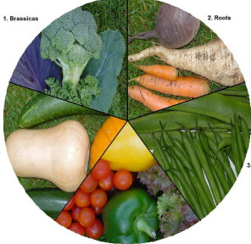
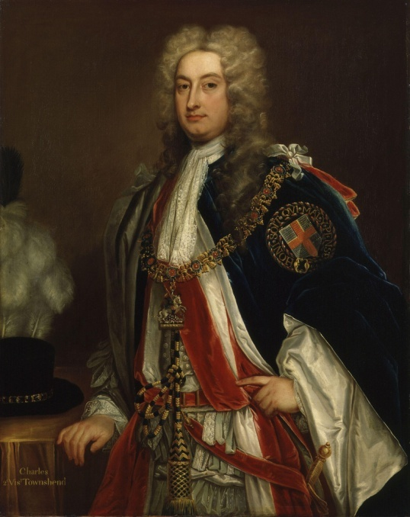
People also tried new harvesting methods now, including:
Crop Rotation:
Crop rotation says that if you divide a field into different crops you should move those crops to a different part of the field next season
Charles Townshend introduced this idea

Slide 4
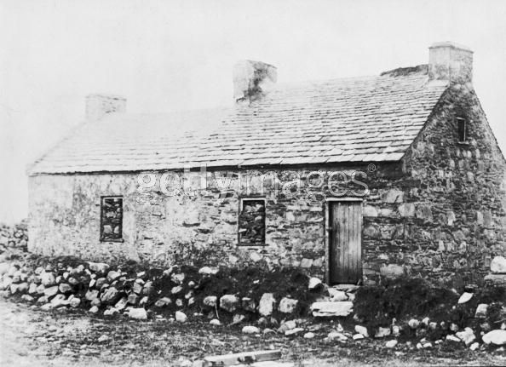
Large landowners brought in tenant farmers to work on their land
A tenant farmer was a person who worked on another person’s land and paid rent there
If you didn’t want to do this you had to move to the city and hope to find work there

Slide 5
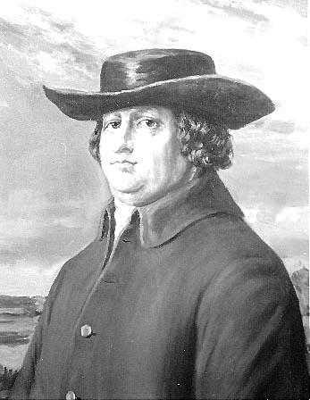
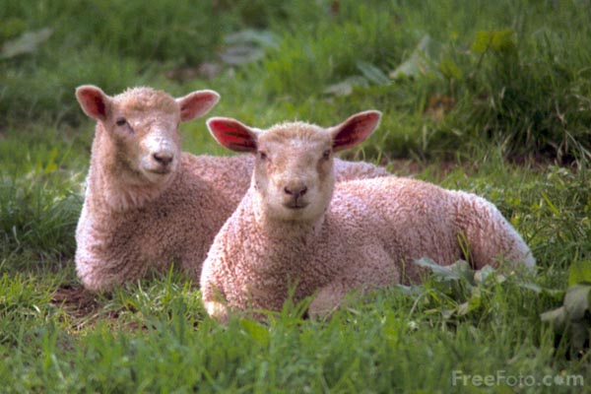
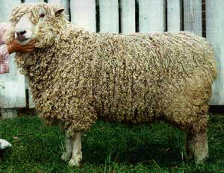
Livestock breeders began to work on making better animals as well
Robert Bakewell
Increased mutton output by only allowing his best sheep to breed
Lambs increased in size from 18 to 50 pounds
This increases the supply of meat available to the population
As food supplies grow and living conditions improve, the population grows
A growing population means a growing demand for “stuff.”

Slide 6
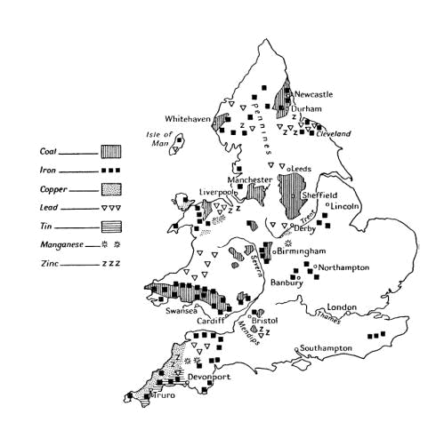
Why does industrialization begin in England?
Because they have many natural resources
Water – to run factories and machines
Coal – for power
Iron ore – for construction of machines tools and buildings
Rivers – for transportation
Deep Harbors – For shipping
Because they have a growing economy
Business people invest in new inventions
Loans are available for expansion
Britain is increasing overseas trade
Because they have a stable government
Britain took part in wars, BUT not on their own soil
Military was successful

Slide 7
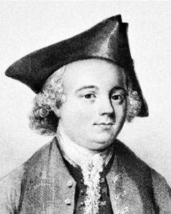
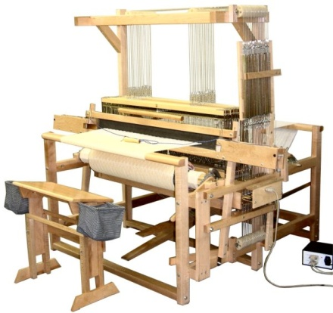
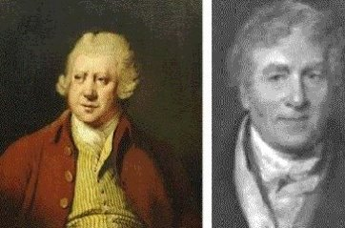
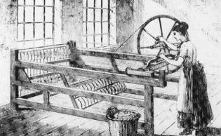
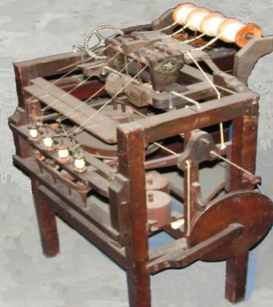
Inventions Spur Industrialization
The Textile Industry:
1733 – John Kay
Flying shuttle
Boat shaped piece of wood that speeds back and forth
This doubles the amount of work a weaver can do in a day
Helped weavers keep up with the flying shuttle
One spinner can now work 8 threads at a time
1764 – James Hargreaves
Spinning Jenny
Water Frame
Used waterpower to drive spinning wheels
1769 – Richard Arkwright

Slide 8
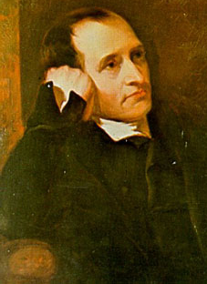
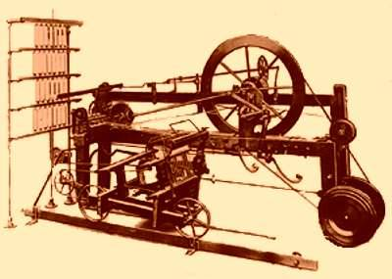
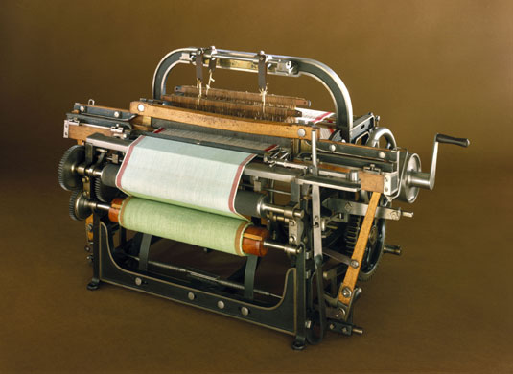
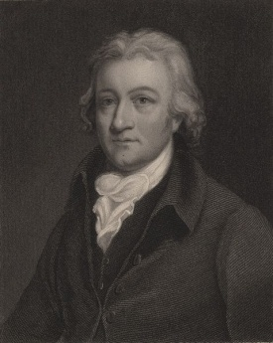
Combination of the Spinning Jenny and the Water Frame.
Made finer, stronger, consistent thread
1779 – Samuel Crompton
Spinning Mule
All the elements of the previous inventors are combined into one machine
1787 – Edmund Cartwright
Power loom
These items are all large and expensive so they can’t be kept in cottages
Merchants now set up factories near rivers with these machines in them

Slide 9

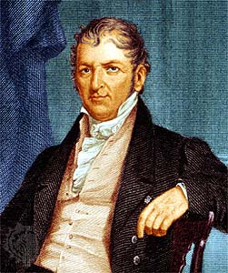
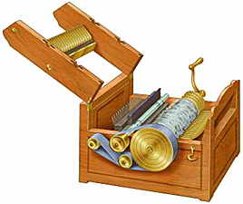
England got its Cotton from the American South and the demand was so large that people invented ways to pick and clean it faster
In 1793 Eli Whitney invented the cotton gin
Removed seeds from raw cotton
Increased amount of cotton that could be cleaned by one person
Increased American cotton production from 1.5 million pounds to 85 million pounds between 1790 and 1810
Cotton Gin

Slide 10
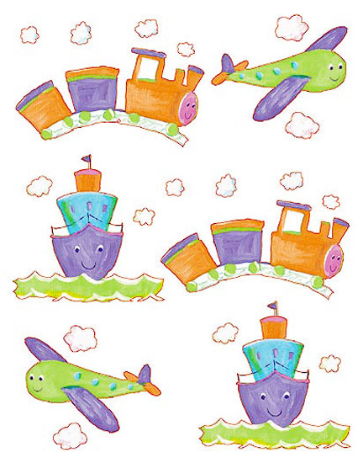
Transportation

Slide 11
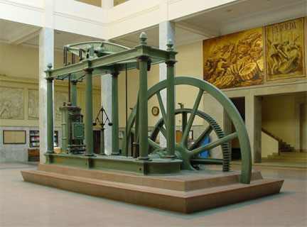
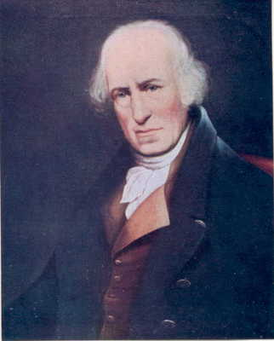
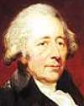
The Steam Engine
In 1765 James Watt improved the existing steam engine to make it safer and more efficient
In 1774 Watt joins forces with an entrepreneur named Matthew Buolton
An entrepreneur organizes, manages, and takes on the risks of a business
Boulton pays Watt’s salary and encourages him to make better and better engines

Slide 12
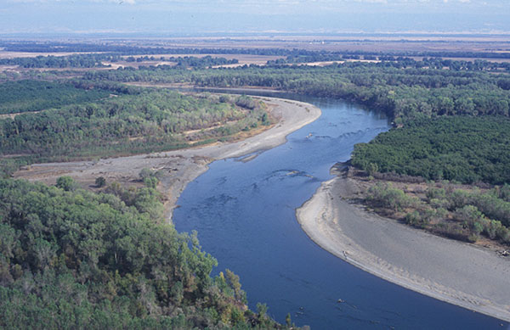
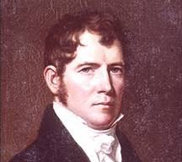
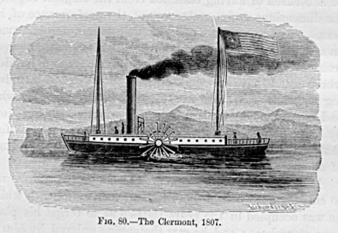
Water Transportation:
Steam could be used to propel boats
Robert Fulton put a Watt steam engine into a steamboat called the Clermont
First successful trip – 1807 – then it became a ferry up and down the Hudson River

Slide 13
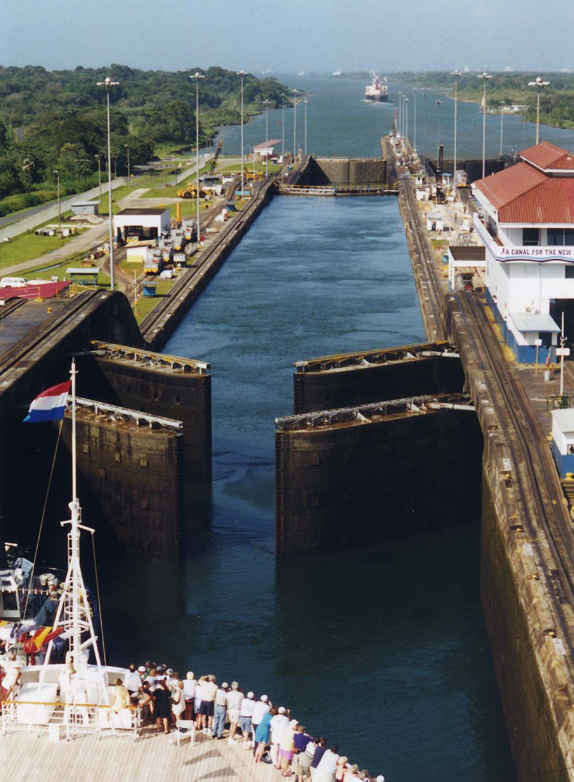
Water Transportation, cont.:
Canals:
Manmade waterways
By the mid 1800s there are 4,250 miles of canal in England
Greatly reduced the cost of transporting goods

Slide 14
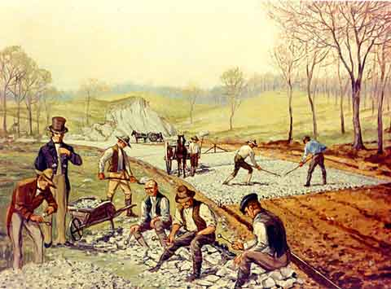
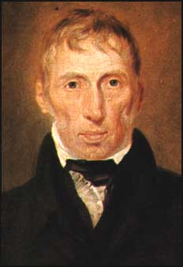
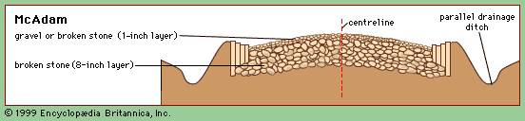
Road Transportation:
Dramatic improvements were made because of a man named John McAdam
In the early 1800s, McAdam layered road beds with large stones for drainage, over these he put crushed rock
Now even in bad weather heavy carriages could travel the roads without sinking.
Private investors built these roads and operated them for profit
Called turnpikes because you had to stop at a turnstile to pay the toll and move on

Slide 15
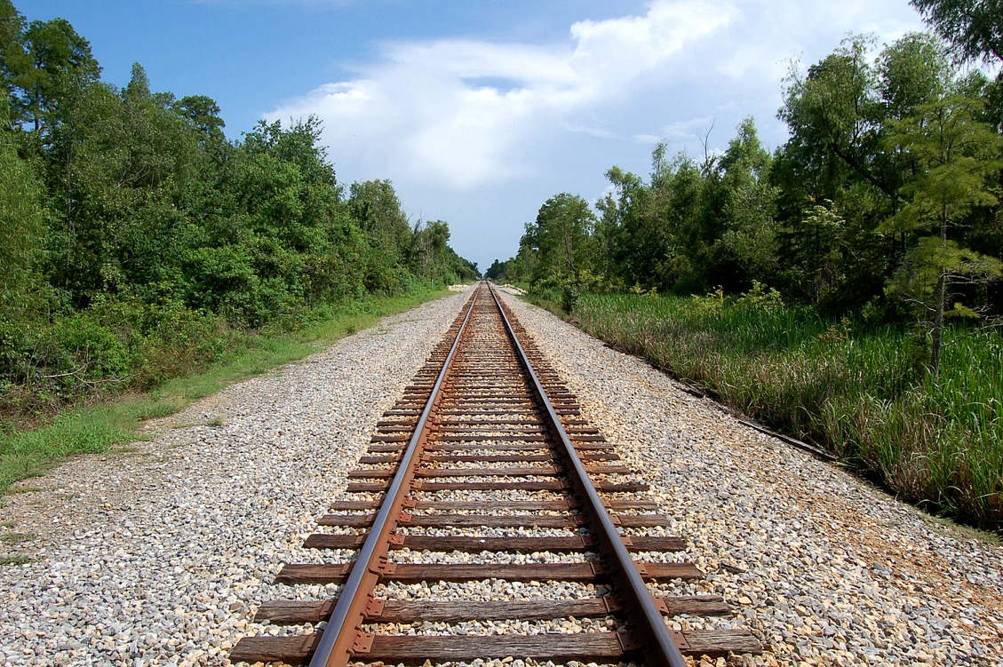
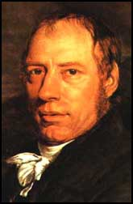
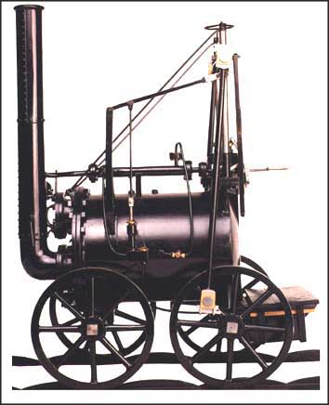
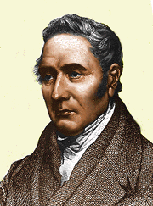

The railway age begins
1804 – Richard Trevithick hauled 10 tons of iron over 10 miles of track in a steam locomotive
1821 – George Stephenson created the world’s first railroad line that ran 27 miles from Yorkshire to Stockton

Slide 16
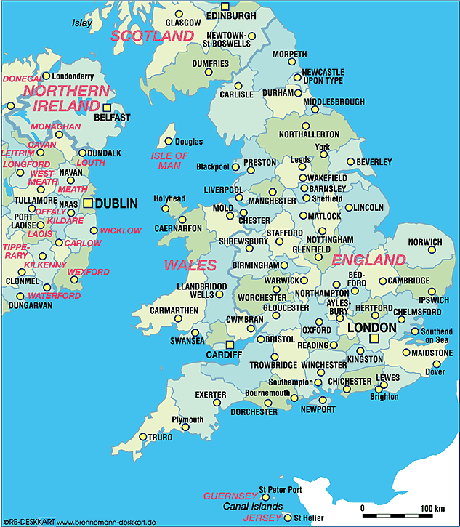
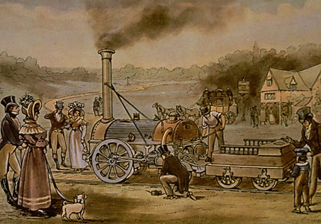
The Liverpool – Manchester Railroad
Investors wanted a railroad line to connect the port of Liverpool with the inland city of Manchester
In 1829 trials were held to find the best locomotive
Stephenson’s Rocket won when It reaches speeds of 24 mph hauling 13 tons
.-
The line officially opened in 1830

Slide 17
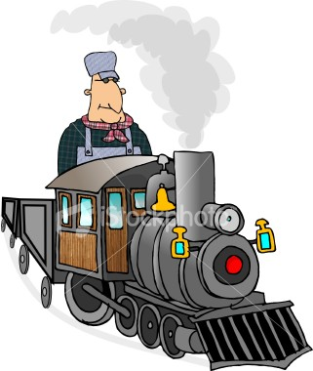
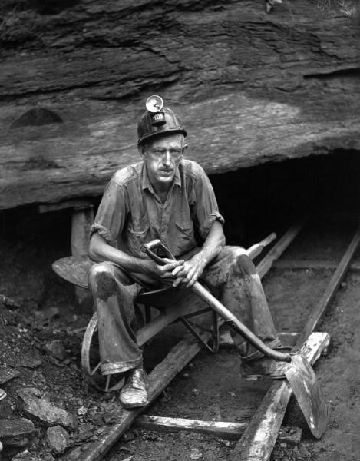

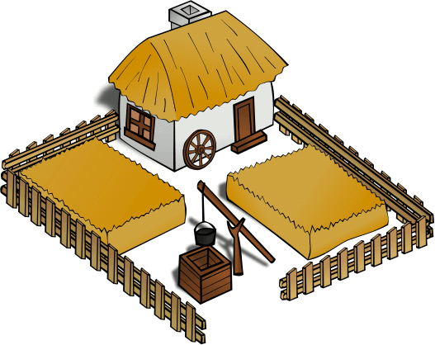
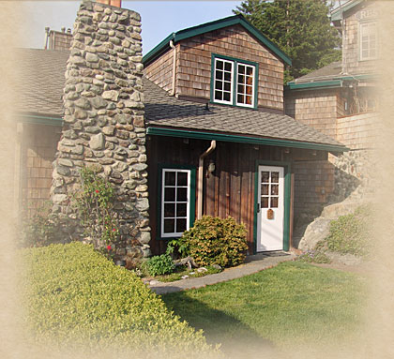
Railroads revolutionize life in Britain
4 major effects
Spurred growth with cheap transportation
Created hundreds of thousands of new jobs for engineers and miners
Engineers drove the trains, miners provided the iron to build them and the coal to power them
Boosted agricultural and fishing industries
Goods could now get from the sea to the city and from the farm to the city
Made travel easier and encouraged people to take trips or commute to work
Lured city dwellers to resorts in the countryside and made the hospitality industry grow

Slide 18
Industrialization

Slide 19
Industrialization changes life
The Rise of Industrial Cities
Population Change in Europe
Growth of Cities in Europe
Population shift was because of factories
Most urban areas at least doubled in population
urbanization
The act of building and moving into cities

Slide 20
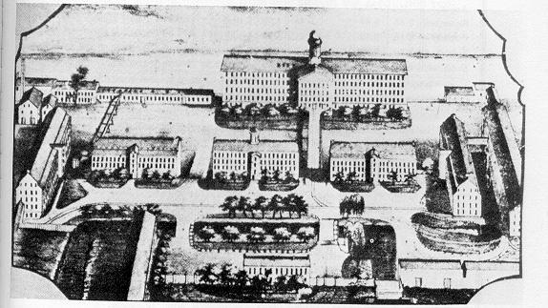
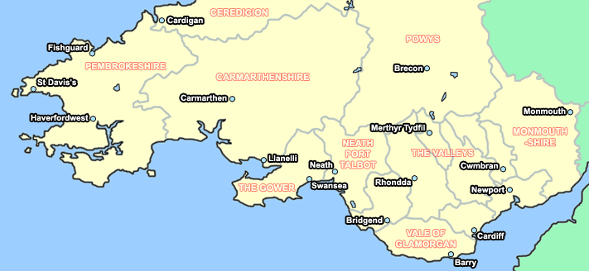
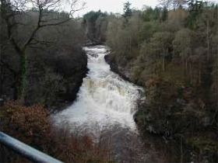
Factories developed in clusters near sources of power
Major new industrial centers sprung up in the coal rich areas of Southern Wales and the Clyde River valley in Scotland

Slide 21
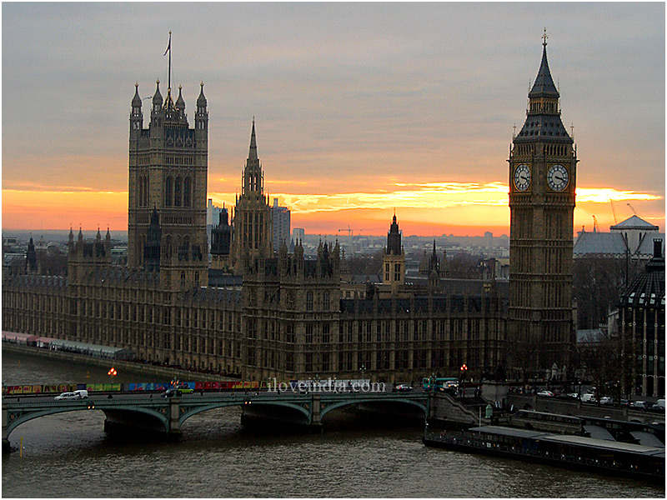
The most important city was London, England
During the 1800s the population exploded creating a huge labor pool and market for goods
London became Europe’s largest city but was soon challenged by newer cities
Sheffield and Birmingham are iron smelting centers
Leeds and Manchester dominate textile manufacturing
Liverpool and Manchester are the center of the cotton industry

Slide 22
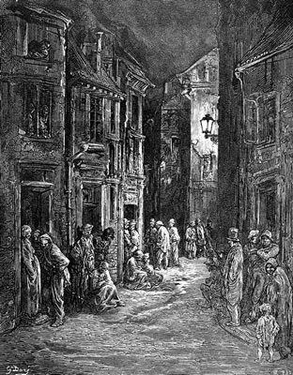
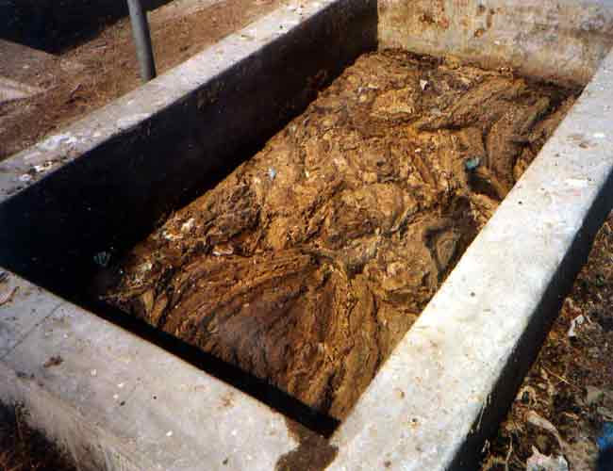
Rapid growth led to miserable living conditions
No development plans, sanitary codes, or building codes
No adequate housing, education, or police
Unpaved, undrained streets that filled with garbage and sewage

Slide 23

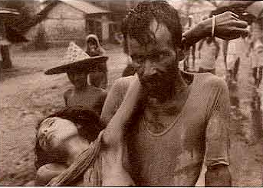
Sickness was widespread
Cholera swept through housing areas
The average lifespan in industrial areas was 17.
In surrounding areas it was 38
The wealthy moved to the suburbs and rarely suffered sickness or poverty

Slide 24

Working Conditions:
To make as much money as possible, owners kept factories open as many hours as possible
The average worker worked 6 days a week for 14 hours a day

Slide 25




People were often injured in factories

Slide 26



Mills were:
- poorly lit
- Unclean
- no safety features
- no government protections for on the job
injuries or unemployment
- Coal dust destroyed lungs
- the average miner’s lifespan was
10 years shorter than other workers
- Women and children worked in Mines
- smaller and could get into smaller
spaces
- cheapest form of labor available

Slide 27
Class Tensions Grow
The Rise of the Middle Class
The new middle class will change the class structure of Great Britain
In the past landowners and nobles had been at the top of British Society
Now, the middle class had the most wealth
Soon a Middle Class arose that was neither rich or poor and was divided into subclasses
Upper middle class – doctors, government employees, lawyers, and factory managers
Lower middle class – factory overseers, skilled workers, mechanical drafters, toolmakers, and printers

Slide 28


The Working Class:
During the 1800s laborers saw little improvement in their working conditions
Some were even put out of work by better machines
Because of that some people destroyed machines that they thought were putting them out of business
Called Luddites after Ned Ludd who supposedly destroyed weaving machines around 1779 and they attacked whole factories in GB in 1811
Actually destroyed laborsaving machines

Slide 29
Positive effects of the Industrial Revolution
Created jobs
Contributed to the wealth of nations
Fostered technology and inventions
Increased production of goods
Raised the standard of living
Provided hope
Better diet
Better housing
Cheaper mass produced goods like clothing
Educational opportunities
And in the long term:
More affordable consumer goods
Better working conditions
More tax revenue
  These are invested to improve everyone’s standard of living

Slide 30

The Mills of Manchester
Advantages:
Easy access to water power
Cheap labor
Outlet to the sea
But:
Fast growing and filthy
Great numbers of poor
Industrialists made a fortune
$ was spent on improvements
Used the cheapest labor available
Children as young as 6 worked in the factories for up to 84 hours/week
The first Factory Act of 1819 finally limits working age and hours

Slide 31
Industrialization Spreads

Slide 32
Industry in the U.S.
Just like in Britain it began in the textile industry
The British forbade engineers, mechanics, and toolmakers from leaving the country to keep industrial secrets safe
Didn’t Work

Slide 33





1789 – Samuel Slater emigrated to the U.S. and built a spinning machine from memory
1790 – Moses Brown opened the first factory in the U.S. in Pawtucket RI, using Slater’s design. His factory only made thread.
1813 – Francis Cabot Lowell and four other investors mechanized every stage of cloth making. Their first factory, in Waltham, MA was so successful they were able to build a bigger business in another town. When Lowell died, the other investors named Lowell, MA after him.

Slide 34


Thousands of young women flocked to the mills in factory towns for the chance of decent wages and some independence
They worked 12 hrs a day, 6 days per week.

Slide 35

    Later Expansion of U.S. Industry
The Northeast experienced industrial growth, but most of the rest of the country remained agricultural
This ends with the Civil War in 1865

Slide 36






Reasons for U.S. industrial growth
Natural Resources
- Coal
- Oil
- Iron
New Inventions
- Light bulb
- Telegraph
- Telephone

Slide 37


There was also a growing population that demanded more goods
Development of Railroads led to products being shipped inexpensively nation wide
2/3 of all railroads were owned by a small number of companies
They controlled all shipping and prices

Slide 38

The Rise of Corporations
To raise money, companies sold stock
Stocks are pieces of the company that people own in return for giving money to the company
If you buy stock, you become part owner of the company BUT you aren’t responsible for any of its debt
Larger corporations like Carnegie Steel or Standard Oil tried to control every aspect of their own industry to make the biggest profits
The larger the Co. the cheaper it is to make goods
Laborers can be paid very low wages because they have no option to work elsewhere

Slide 39
Continental Europe Industrializes

Slide 40



Began in Belgium
They had coal and iron, as well as good waterways
A British worker named William Cockerill brought plans for a spinning machine to Belgium in 1799
His son John eventually built a huge industrial system in Belgium making equipment

Slide 41

Industrialization in Germany
Unlike the rest of Europe, Germany was scattered over a large area in the 1800s
They industrialized in resource rich areas of the country like the Ruhr Valley which was rich in coal
Began sending their children to Britain to learn industrial management
Imported British Equipment and Engineers
Built railroads to link manufacturing cities

Slide 42

This development allowed Germany to develop as a military power
By unification in 1871 Germany had become a world industrial and military power

Slide 43
Expansion elsewhere in Europe
Most European expansion happened by region and not by country
Tended to develop in areas that were rich in coal, iron, and natural waterways
Bohemia
Catalonia
Northern Italy
Developed a spinning industry
Processed more cotton than Belgium
Worked with spinning silk

Slide 44


France
Most growth happened after 1830
They had a strong agricultural economy that kept industry in check

Slide 45
Elsewhere:
Most other countries were limited in their ability to industrialize because of their location or situation
Austria – Hungary & Spain:
Transportation was the biggest problem because they had mountains and a lack of good roads

Slide 46

The Impact of Industrialization

Slide 47


The Rise of Global Inequality:
This is the increase in the gap between wealthy industrialized nations and poor undeveloped nations
Raw material came from under developed nations and industrialized nations saw these places as markets for finished goods
Economic Imperialism
The policy of extending one country’s rule over many other nations for economic gain

Slide 48



Transforming Society:
1700 – 1900 will see a totally rearranged society
There is now a large working class and a large, wealthy middle class
The middle class can now afford to educate their children
This will lead to more reform
The upper class becomes VERY wealthy
People’s health improves leading to a longer lifespan

Slide 49
Reforming the Industrial World

Slide 50



The philosophers of industrialization:
Laissez – Faire economics:
This means letting owners and businesses set working conditions without interference
Adam Smith
Wrote “The Wealth of Nations” in 1776
Says that economic freedom guaranteed economic progress
Law of Self interest
People work for their own good
Law of Competition
Competition forces people to make a better product
Law of Supply and Demand
Enough goods would be produced at the lowest possible prices to meet demand in a market economy

Slide 51


Laissez- Faire Capitalism
Thomas Malthus and David Ricardo
All the factors of manufacturing are privately owned and money is invested to make a profit
1817 Ricardo wrote “Principles of Political Economy”
Believed that the poor would always be poor
Wages and population go through cycles
1776 Malthus wrote “The Essay on the Principal of Population”
Better wages = more population = more workers
New workers can be paid less b/c there are more of them
Lower wages = lower population = fewer workers
Population increases more rapidly than food supply
Without wars & disease to kill people off, they are destined to be miserable

Slide 52


The rise of Socialism:
Utilitarianism
Jeremy Bentham
John Stuart Mill
Believed that people should judge things and actions on their usefulness
Felt that gov. should get involved with industry to try to deal with poverty and starvation
Wanted to do away with dif. In wealth and redistribute income
Felt that government should try to promote the greatest good for the greatest number of people
Favored women’s rights, including suffrage, and cooperative agriculture

Slide 53


Utopian Socialism:
Robert Owen
Built a factory in New Lanark, Scotland where he provided low rent housing, prohibited children under 10 from working, and provided free schooling.
In 1824 he travelled to the U.S. and built a community called New Harmony, IN in 1825.
This community only lasted 3 years.
Socialism
System where the factors of production are owned by the public and operated for the good of all
Felt that gov. should plan the economy so they could end poverty and promote equality

Slide 54


Karl Marx
Karl Marx and Friedrich Engels wrote the Communist Manifesto
        Argued that human societies have always been divided into warring classes
            The haves and the have-nots
            The haves were the employers and the have-nots were the workers
            The haves would always exploit the have-nots
            The haves would not freely give up their power Change could only be made through revolution

Slide 55
The Future According to Marx
      Believed that Capitalism would eventually destroy itself
Factories would drive small artisans out of business leaving a small number of manufacturers to control all the wealth
The workers would then revolt and seize the factories and mills form the capitalists and produce what society needed
Workers would then share profits and bring about economic equality for all people
        This would be a Dictatorship of the Proletariat
        After a period of cooperative living and education, the state or government would wither away as a classless society developed

Slide 56

      This final phase is called Communism
        A form of complete socialism where all means of production would be owned by all people
        Private property would cease to exist
        All goods and services would be shared equally

Slide 57




The Communist Manifesto (1848)
Book describing communism
There were many small revolts in Europe because of this but most were put down quickly
In the 1900s the Manifesto will be successful in creating lasting governments
- Soviet Union (Russia) 1917 – 1991
- China 1949 – present
- Cuba 1950s
Cuba (and China to some extent) are “Adaptive Communism”
created to meet specific national needs

Slide 58

Marx and Engels believed that Economic forces alone dominated society
They didn’t take into consideration religion, nationalism, ethnic loyalty, or democratic reform.
And probably most importantly, human nature

Slide 59

Labor Unions and Reform Law
A Union is a voluntary association of workers that speaks for all workers in that trade
They engage in collective bargaining for better wages and working conditions
If factory owners refuse to meet demands workers can refuse to work
STRIKE
Unions were generally started by skilled workers because they were hard to replace
Many governments were against unionization and refused workers to unionize

Slide 60

Combination acts of 1799 and 1800
Outlawed Unions and Strikes
Repealed in 1824 because people unionized anyway
By 1875 British unions had won the right to strike and picket peacefully. They had a membership of about 1 million
In the US skilled workers belonged to unions since the 1800s
In 1866 several unions joined together to form the AFL (American Federation of Labor)

Slide 61
Reform Laws
Factory Act of 1833
Illegal to hire children under the age of 9
Children from 9 – 12 could not work more than 8 hours/day
From 13 – 17 a person could only work 12 hrs/day
Mines Act of 1842
Women and children are prevented from working underground in mines
The 10 hours act
The workday is limited to 10 hours for women and children in factories

Slide 62

U.S. Reform Laws
1904 – The National Child Labor Committee is organized to end child labor
- Union members joined because they argued child labor lowered everyone’s wages
- They urged the government to ban child labor
- 1919 – Supreme Court ruled against a federal child labor law saying that the states should decide what was acceptable

Slide 63



The Reform Movement Spreads
The Abolition of Slavery
William Wilberforce leads the fight in parliament to end slavery and the slave trade in the British empire
1807 – Parliament passed a bill ending the slave trade in the west indies
1833 – Slavery is abolished in the British Empire

Slide 64



The End of Slavery in the Western Hemisphere
Slavery will not end in the U.S. until the Union won the Civil War in 1865
1873 – Slavery ended in Puerto Rico
1886 – Slavery abolished in Cuba
1888 – Slavery abolished in Brazil

Slide 65

Fight for Women’s Rights
Industrialization was a mixed blessing for women because they made more money than working from home BUT only 1/3 of what a man made for the same work
In the mid 1800s women joined unions in trades they dominated
Some even served as factory inspectors
In both the U.S. and GB women who worked for the abolitionist movement began to wonder why they should be denied rights because of gender

Slide 66


College educated Jane Addams ran a settlement house called Hull House in Chicago, IL
This was a community center that provided support to poor working women in the inner cities
It included a nursery, Gym, kitchen, and boarding house for working women

Slide 67

1848 – Women’s movements began in the U.S.
Women from all over the world founded the International Council for Women in 1888
Women from 27 countries met at the council’s first meeting in 1899

Slide 68


Reforms Spread
Horace Mann of Massachusetts
Favored free public education for all children
By 1850 many states were starting public school systems
In Western Europe free public schooling became available in the late 1800s

Slide 69


1831 – Alexis de Tocqueville sought prison reform
Wanted to help prisoners gain the means to lead useful lives upon release
Alexis de Tocqueville
Felt that prisons should rehabilitate NOT just punish

