Slide 1
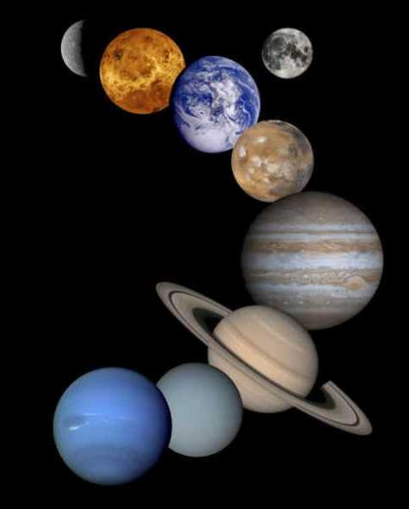
The Scientific Revolution and Enlightenment
Chapter 6

Slide 2
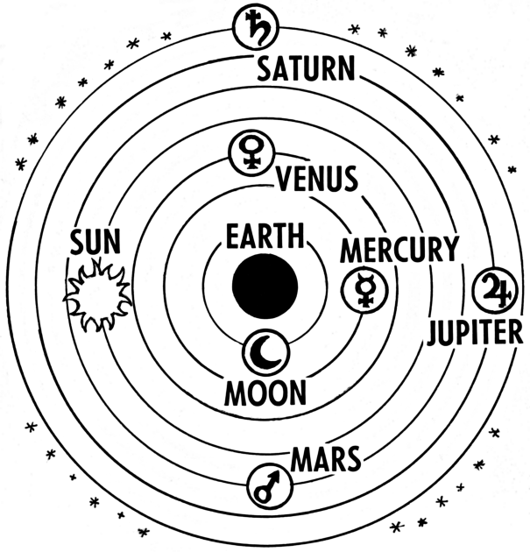
Scientific Knowledge is mainly based on ancient teachings.
A Scientific Revolution is a major change in scientific thought, beliefs, and practices
Astronomers
Name:
Ptolemy
Location:
Rome – but most likely Greek
Belief:
That the earth was the center of the universe.
the universe was made up of seven spheres.
God existed beyond the 7th sphere
Geocentric
(Think of a grape inside a ping pong ball inside a golf ball inside a baseball inside a softball etc)

Slide 3
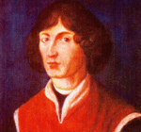
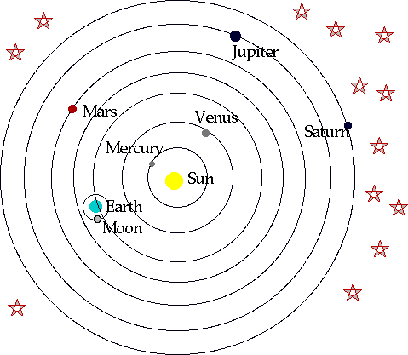
Nicholas Copernicus
Name:
Poland
Location:
Book/writing:
“On the Revolutions of the Heavenly Spheres”
Belief:
The Sun was near the center of the universe. All planets revolved around the sun and rotated on their axes (axees). Planetary revolutions were circular.
Heliocentric

Slide 4
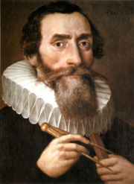
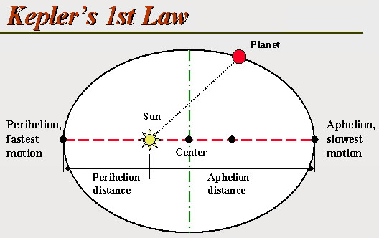
Name:
Johannes Kepler
Germany
Location:
Belief:
Believed that planets revolved around the sun on elliptical orbits, not on circular ones. He confirmed Copernicus Heliocentric theory

Slide 5
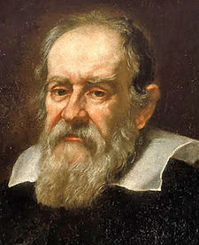
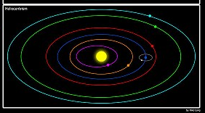
Name:
Galileo Galilei
Location:
Italy
Book/writing:
Sidereus Nuncius (Starry Messenger)
Belief:
Believed in the heliocentric theory with the sun at the center of the universe and all the planets revolve around it.
Also believed that the planets were spheres with geographical features just like the Earth

Slide 6
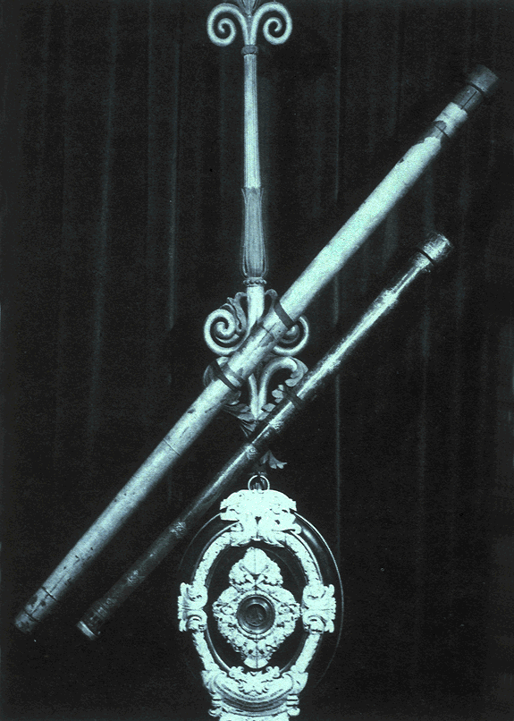
Tool:
Telescope
Problem with the Catholic Church:
Galileo’s beliefs left no room for God
Roman Inquisition:
Galileo was put on trial in Rome for his beliefs.
He was told he would be excommunicated if he didn’t recant.
Galileo decided to:
Recant or take it back

Slide 7
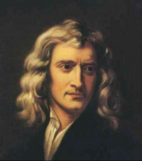
Name:
Sir Isaac Newton
Location:
England
Book/writing:
Principia Mathematica
Universal laws of Gravitation:
All bodies with mass are drawn towards all other bodies with mass
(The Earth pulls on you {and the moon and the sun} and you {and the moon and the sun} pull on the Earth)

Slide 8
Universal laws of motion:
Inertia: A body in motion will stay in motion (a body at rest will stay at rest) unless acted upon by an equal and opposite force
Force = mass times acceleration
For every action there is an equal and opposite reaction

Slide 9
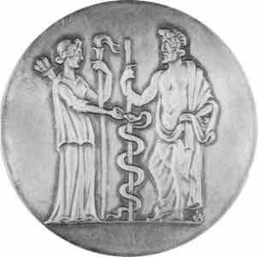

Medicine
And
Chemistry

Slide 10
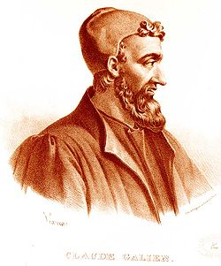
Name:
Galen
Location:
Rome
Belief:
Did dissections to learn about human anatomy but he was usually wrong…used animals as his subjects.
Believed that the veins and arteries carried 2 types of blood
Thought that circulation began in the liver

Slide 11
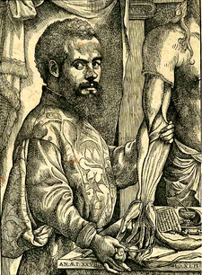
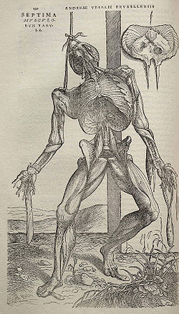
Name:
Andreas Vesalius
Location:
Belgium
Book/writing:
On the Workings of the Human Body
Belief:
Dissected human corpses (executed prisoners) and proved Galen wrong
Vesalius noted that the heart had four chambers, the liver two lobes, and that the blood vessels originated in the heart, not the liver.

Slide 12
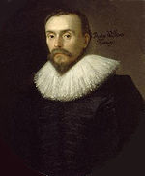
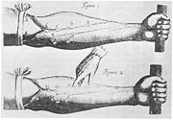
Name:
William Harvey
Location:
England
…On the Motion of the Heart and Blood…
Book/writing:
Belief:
There was one circulatory system that carried one type of blood
Arteries carried blood away from the heart and veins carried blood towards the heart

Slide 13
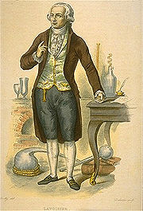
Name:
Antoine Lavoisier
Location:
France
Father of Modern Chemistry
Helped create the Metric System
Proposed that a body’s mass never changes, even if the body changes shape
Famous For:

Slide 14
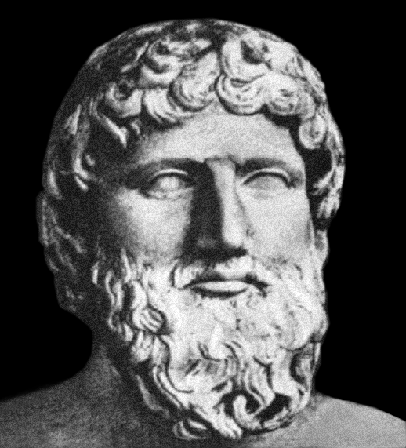
Philosophy

Slide 15
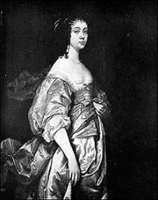
Name:
Margaret Cavendish
Location:
England
Book/writing:
Observation Upon Experimental Philosophy
Beliefs:
That just because people use reason doesn’t make them superior to nature
That women should be equal to man because they are capable of reason

Slide 16
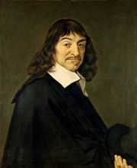
Name:
Rene Descartes
I Think Therefore I am
Location:
France
Book/writing:
Discourse on Method
Belief:
    Things only exist because we believe that they exist
Universe:
Must be doubted
Must be separate
Mind and Matter:
Father of :
    Rationalism

Slide 17
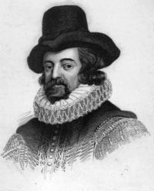
Name:
Sir Francis Bacon
Location:
England
Belief:
    Inductive Reasoning
      Develop: A Hypothesis or a theory
      Use: Experiments to test that theory
      Base conclusions on : Observed evidence
Inductive Reasoning:
    Observation and experimentation should be used to achieve reason

Slide 18
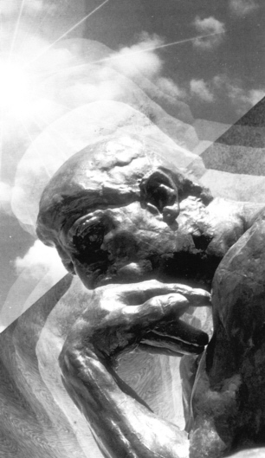
THE ENLIGHTENMENT

Slide 19
The Enlightenment was:
        18th Century: Philosophical movement of people greatly impressed by the scientific revolution and the use of reason
          Use Reason – to look at the world and your surroundings
          Wanted to create: better society
            Led by philosophes who: “Applied himself to the study of society with the purpose of Enlightenment and bettering society for all mankind”

Slide 20
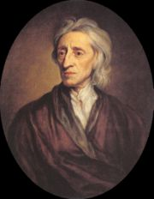
Name:
John Locke
Location:
England
Book:
Essay concerning human understanding
Belief:
Every person is born with a blank mind/tabula rasa
People are molded by their experiences/ people could change if experience changed
Create a new society where people could be exposed to these good experiences

Slide 21
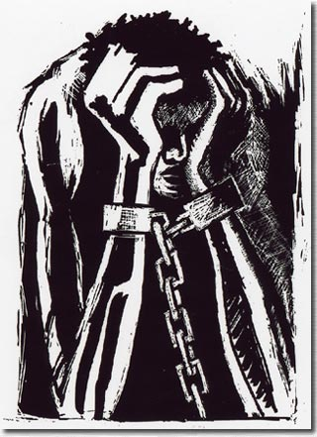
        Views on Government
        There is no government without the consent of the people being
        governed
        2. Governments were formed to protect people’s basic rights
        The right to life
        The right to liberty
        The right to property
        3. Power should be divided equally among 3 branches of government
        Legislative to make laws
        executive to enforce laws
        judicial to interpret laws
        If any government abused these rights, the people had the right to overthrow that government
        Slavery was wrong: no man should be held against his will

Slide 22
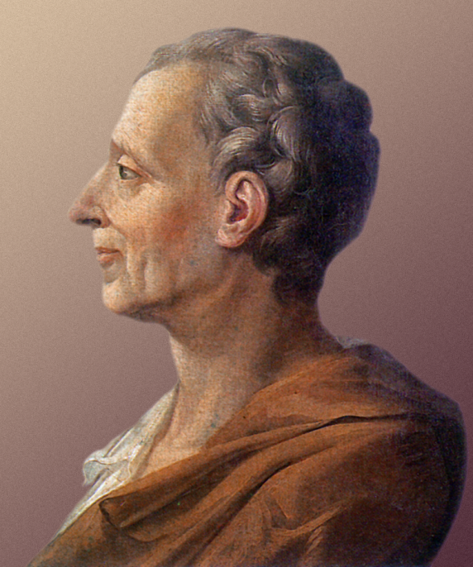
Name:
Montesquieu: Charles Louis de secondat, baron de Montesquieu
Location:
France
Book:
Spirit of the Law
Belief:
Views on Government:
should have a separation of powers
Hoped that knowledge of government and laws would keep people from being abused by the government
Separation of Powers: would limit and control the branches of government through checks and balances to keep any one branch from becoming too powerful

Slide 23
Three Branches of government (Using England as an Example)
Executive – Monarch
Legislative – Parliament
Judicial - Courts
Three types of Government
Republics for small states
Monarchies for middle sized states
Despotism for Large states
Did not believe that all people were equal and slavery was ok
Also didn’t believe in equality for genders or social classes

Slide 24
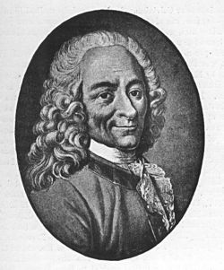
Name:
Voltaire: Francois Marie Arouet
Location:
France
Book:
Treatise on Toleration
Belief:
Deism
        God created the universe then set it in motion, like a clockmaker, and He lets it run without interference (Deus ex Machina)
        Voltaire was against tyranny

Slide 25
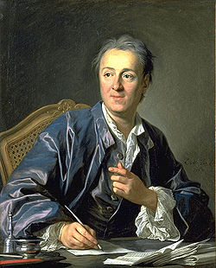

Name:
      Denis Diderot
Location:
      France
Book :
      Encyclopedia (28 Volumes)
Goal:
      To change the general way of thinking
Included essays on:
      Social, legal, and political issues, and Religious toleration

Slide 26
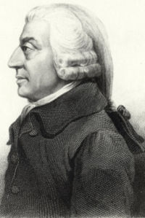
NAME:
              Adam Smith
LOCATION:
Scotland
BOOK:
The Wealth of Nations
HE WAS A:
              Physiocrat: A person who wanted to make natural laws apply to society
BELIEF:
              State should not involve itself in the economy or markets
              Called Laissez-Faire: Let the people do as they choose
Believed government had 3 roles:
Protect society from invasion (army)
Defend citizens from injustice (police)
Keep up public works such as canals and roads

Slide 27
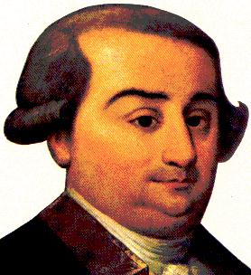
Name:
      Caesar Beccaria
Location:
Italy
Book/writing:
On Crime and Punishment
Belief:
        Punishment shouldn’t be brutal
        No capitol punishment (death penalty)
        or torture
        b. It doesn’t deter crime
Punishment in the past was cruel because it needed to deter crime without the power of a police force

Slide 28
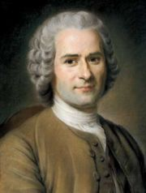
Name:
Jean Jacques Rousseau
Location:
France
Book/writing:
The Social Contract
        Everyone should agree to follow the will of the majority
        All people are equal
        All rank and title should be abolished
        Social contract: described an agreement between people and their government:
          People should form a government
          People should make a contract with that
          government
          c. People should have to give up some freedom in favor
          of the general will
          d. Everyone would be forced to be free
Beliefs:

Slide 29
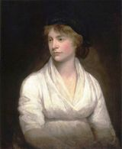
Name:
Mary Wollstonecraft
Book:
Vindication of the Rights of Woman
Belief:
        Women should have the same rights as men
        Women should have the same opportunity for education and political involvement
        Just like a king’s absolute authority over his subjects is wrong, so is a man’s over woman.
        The Enlightenment is based on reason, women have reason, so women should have the same rights as men

Slide 30
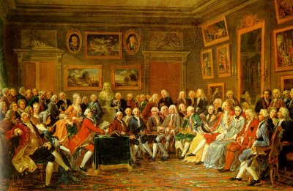
Society during the Enlightenment

Slide 31
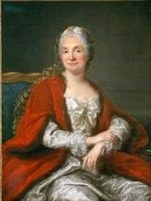
  Salons:
Elegant drawing rooms in wealthy households where philosophes got together to discuss current issues
    Women played an important role in the enlightenment by hosting these salons in their homes
    Wealthy women held the salons in their homes and often participated in the discussions
    Had to be invited

Slide 32
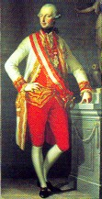
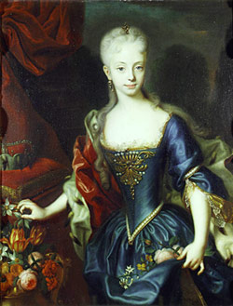
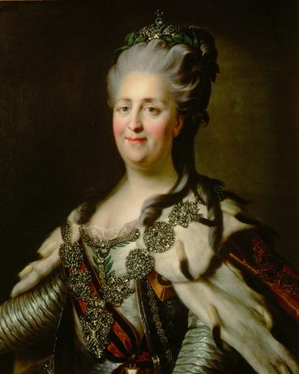
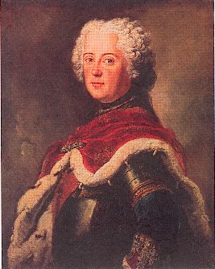
    Maria Theresa and Joseph II of Austria
      Tried to limit, then finally abolished Serfdom in the Holy Roman Empire
      Gave equal rights to all before the law
      Reforms ended after Joseph’s death
The Enlightened Despots
Catherine the Great of Russia
Invited Diderot to visit Russia and discuss enlightenment ideas
She couldn’t change too much because she knew that she needed the support of the nobles, and freeing the serfs would alienate the nobles
She granted limited free speech and limited free press and allowed for religious toleration
She abolished the death penalty and torture except in murder cases
Frederick the Great of Prussia
Invited Voltaire to Prussia
Granted limited free speech and limited free press and religious toleration
      but kept society relatively rigid

Slide 33
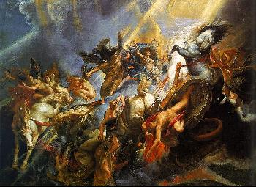
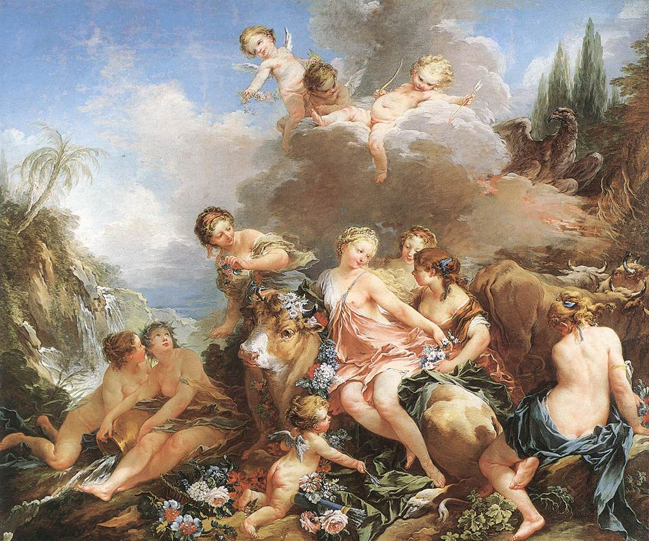
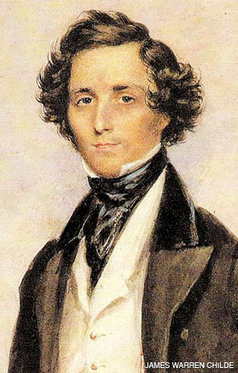
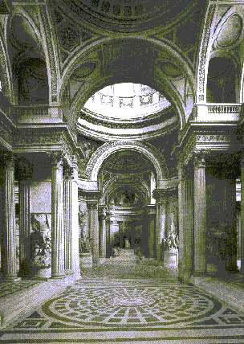

Art and Music
Baroque: Grand, loud, and powerful
    Rococo: graceful, delicate, light and charming
Neoclassical: art and architecture Based on ancient Rome and Greece
    Music: Greatest time period in the history of European Music
Notes:
Society during the Enlightenment

