Slide 1
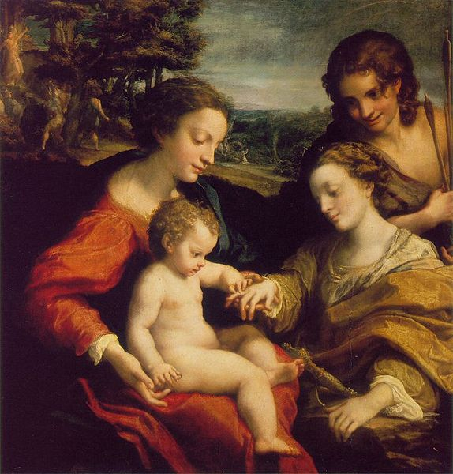
The Renaissance and Reformation
The Rebirth of Art, Literature, and the Church in Europe

Slide 2
The Italian Renaissance
The Renaissance, just like the plague began in, and spread from, Italy
  Why?
  1. Italy is more urban than most of Europe
    2. It is a major trading center
      a. This means there are goods AND ideas flowing through
60% of the population there died of plague
There were fewer people, so workers could now make demands for better wages
b. There was no reason to expand business so the wealthy had nothing to do with their money
- Decided they’d become patrons of the arts – or a person who supported an artist financially
Italy had many small city states that acted as individual countries
a. The merchant class was wealthy and powerful and they dominated politics
b. Thought that privlege should be based on worth not birth

Slide 3
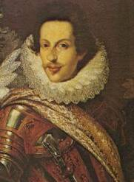
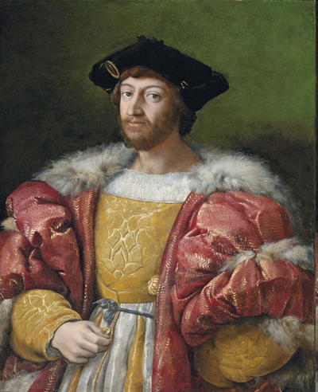
Florence and the de Medicis
Cosmo de Medici ruled Florence as a dictator for 50 years
Lorenzo de Medici came to power in 1464
Came to power by loaning money to city leaders
Known as Lorenzo the Magnificent
Both men were patrons of the arts
Made Florence the place to be if you were an Italian artist

Slide 4
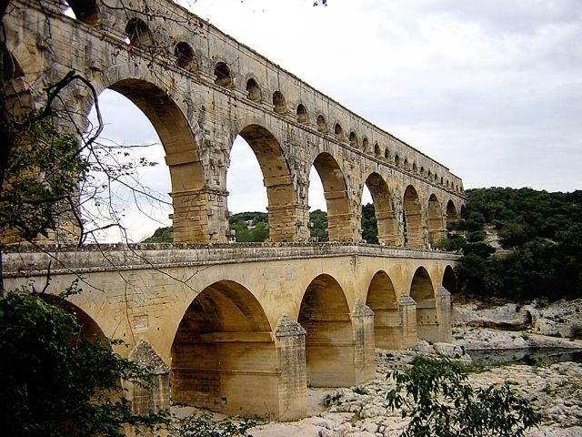
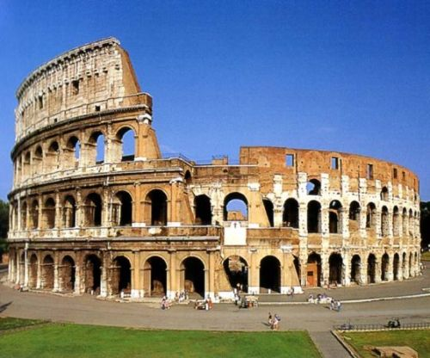
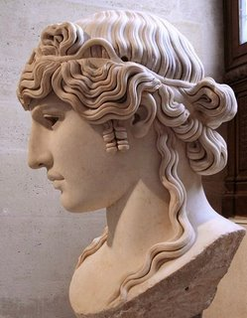
A Return to Classical Ideals
People began to look down on Medieval Art and wanted to return to the Classical Period
This meant to go back to the art and values of Ancient Greece and Rome
Italian artists were lucky, they were surrounded by the remains of the Roman Empire

Slide 5
Humanism
Focus on human potential and achievement
People wanted a “classical” education that included History, Philosophy, and Literature
Humanists started to tell people that you didn’t have to suffer to make God happy
The point of this whole thing was to understand Greek and Roman values, not to just agree with the Church
People started wearing more comfortable clothes and eating food with more spices BUT they didn’t just break with the church…most people remained devoutly Catholic, with their church and secular lives now separate.

Slide 6
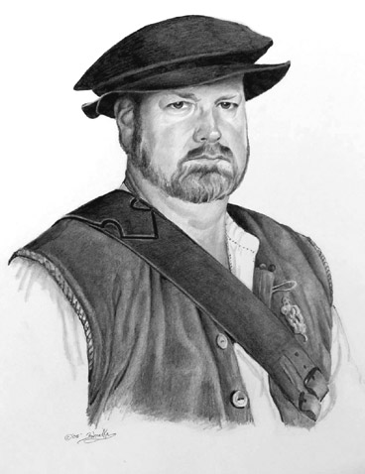
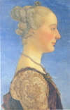
The Renaissance Man
And Woman
Men were expected to
  Be Charming
  Be witty
  Be well educated in classics
  Dance
  Sing
  Play an instrument
  Write poetry
  Ride a horse
  Wrestle
  Swordsmanship
  Self control
Women were expected to
  Be charming
  Know classics
  Inspire art not create it
This is based on Baldasare Castiglione’s book The Courtier
A Renaissance man is a Universal Man

Slide 7


Slide 8
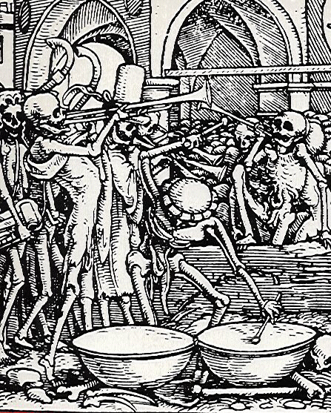
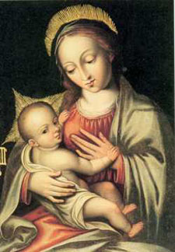
A Revolution in Art
In the Middle Ages, art was primarily Religious in nature, or after the Bubonic Plague, dealt with death
Mary and Jesus: artist unknown
The Dance of Death: Hans Holbein the Younger

Slide 9
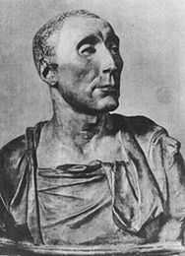
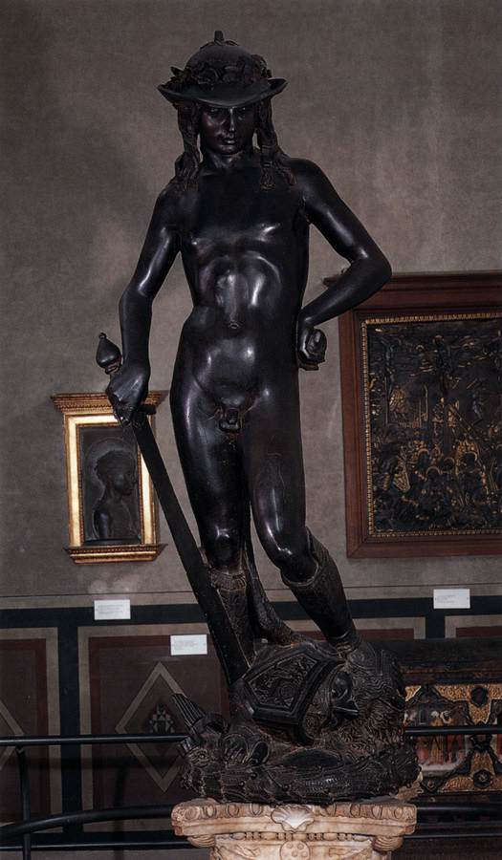
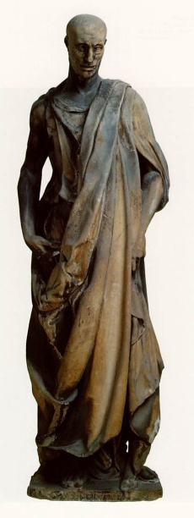
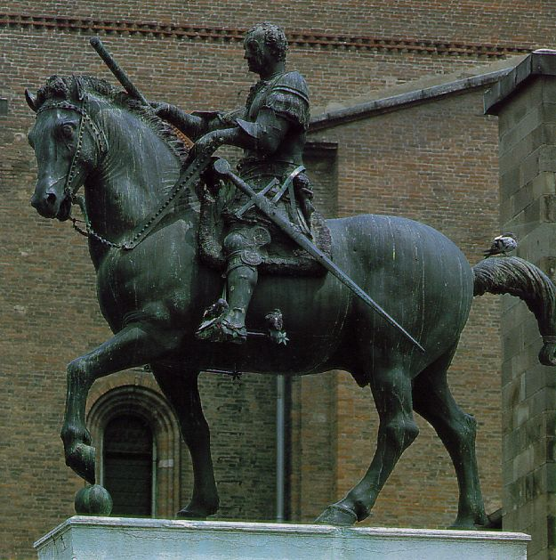
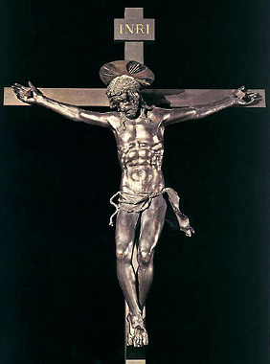
A Revolution in Art, Continued
In the Renaissance, art was primarily done of wealthy people, for wealthy people
Donatello
A humanist sculptor who glorified the human body. He used natural poses and expressions to show movement and personality
His most famous work is David…a large free standing nude
But that isn’t his only work:

Slide 10
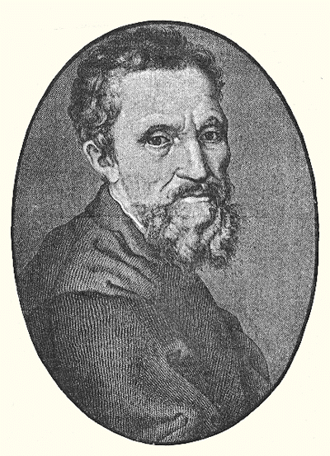
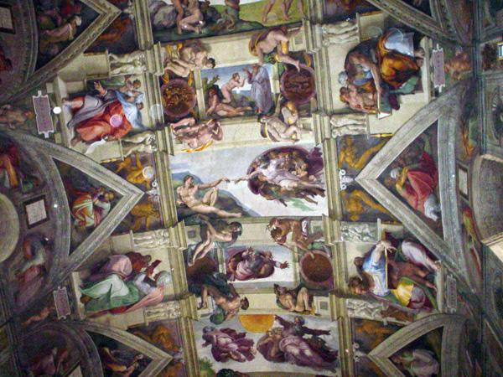
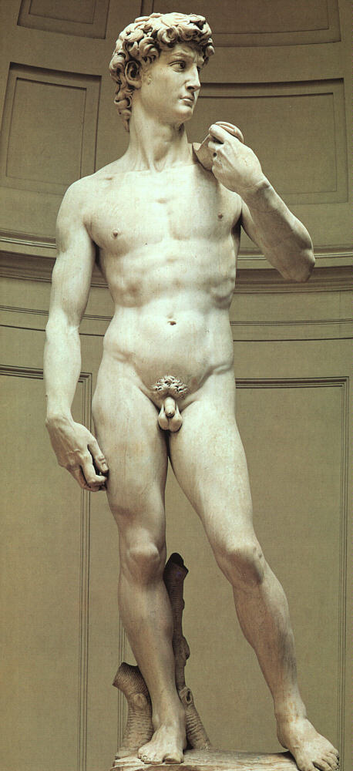
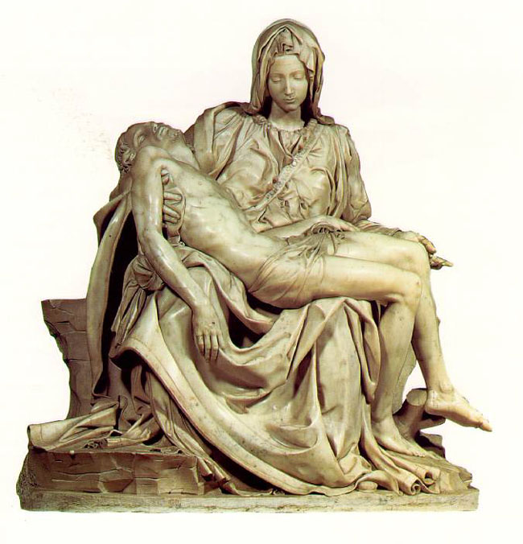
Michelangelo
Michelangelo was also a sculptor and painter
Like other artists of his time, he glorified the human form
His most famous works are David
The Sistine Chapel
and The Pieta

Slide 11
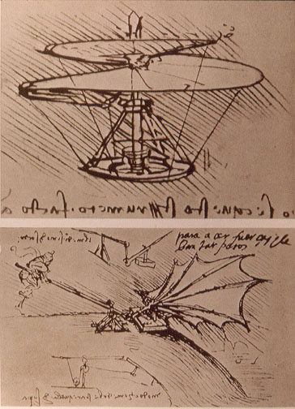
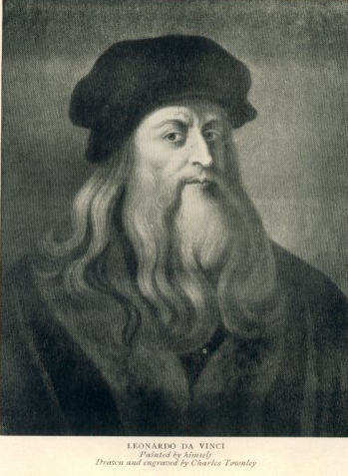
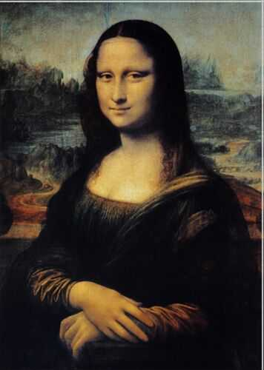
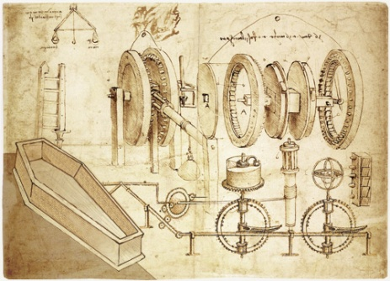
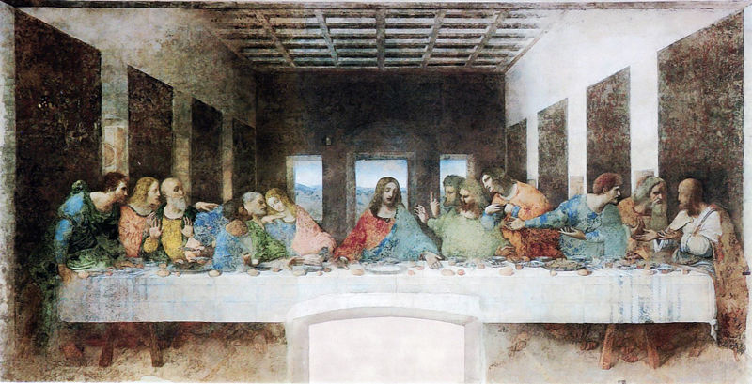
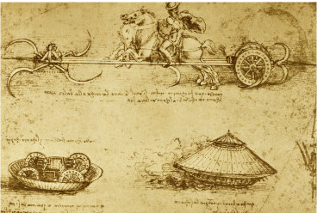
Leonardo da Vinci
Sculptor, Painter, Scientist, and Inventor
Painted the Mona Lisa and the Last Supper
Also had a notebook of sketches of inventions

Slide 12
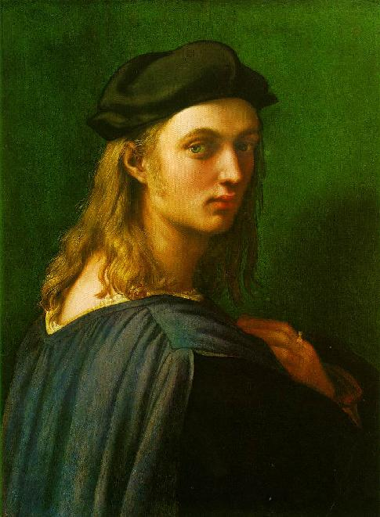
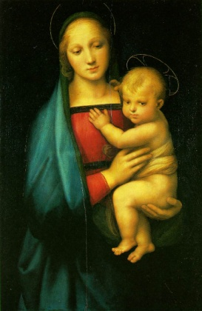
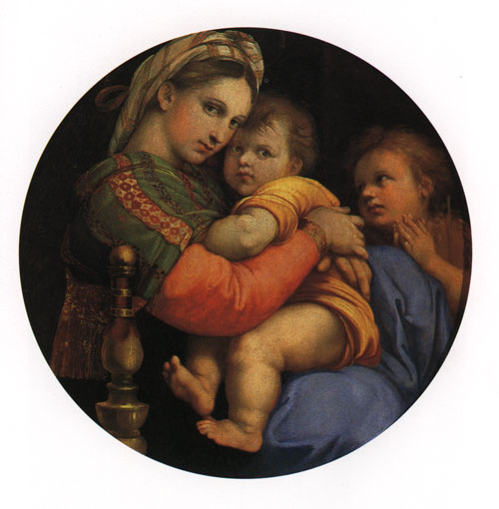
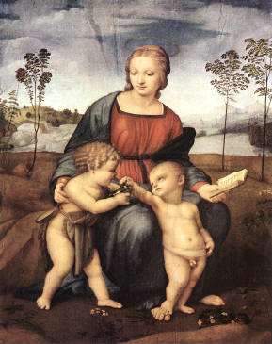
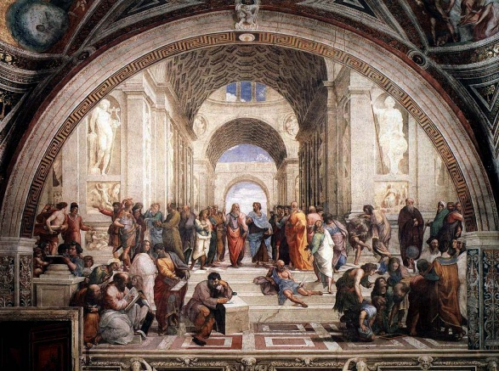
Raphael
His favorite subject is the Madonna and child.
Younger than both Michelangelo and Leonardo
Studies their work to learn
Painted “The School of Athens” which shows renaissance artists learning from the ancient philosophers

Slide 13
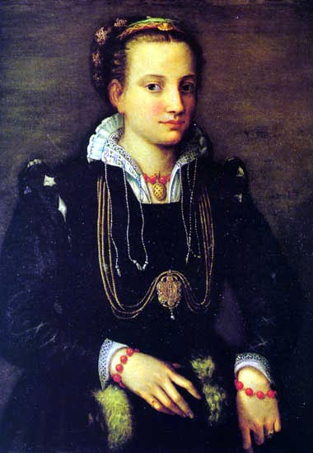
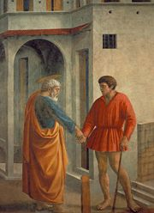
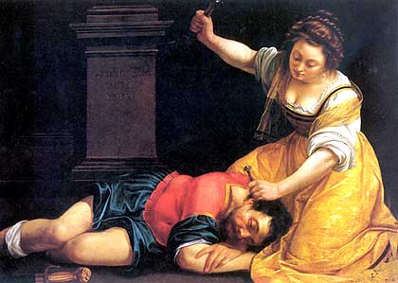
Other Artists of the Renaissance
Masacchio
Sofonisba Anguissola
Painted her sister, and King Philip II of Spain
Female Artists of the Renaissance
Used Perspective to give paintings depth
Artemesia Gentileschi
Trained by her father and painted heroic, and often murderous, women

Slide 14
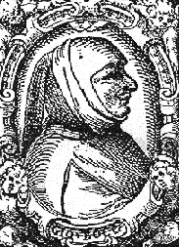
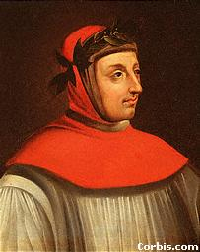
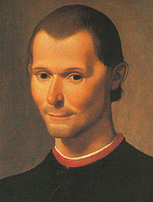

Authors of the Renaissance
Reflected their time period and often written in the vernacular
Vernacular – common language of the people…not Latin
Petrarch
Boccaccio
Machiavelli
Politician, diplomat, and statesman
Wrote: The Decameron
Humanist author and poet
Wrote: The Prince
Realistic stories told by young people waiting out the plague
Wrote in both Italian and Latin
1512 – political guidebook
His most famous works are sonnets written for Laura, his love who died in 1348
Do what’s best for the state no matter what and you will stay in power. Being feared is better than being liked

Slide 15

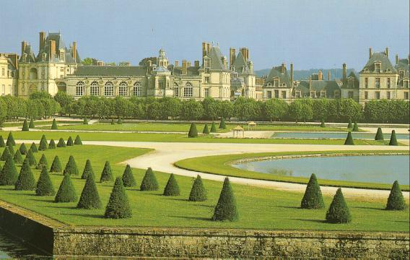
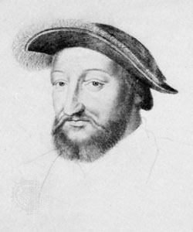
By 1450, the population of Europe was rebuilding from the Plague
By 1453 the Hundred Years War between England and France was over
1494 – The French King claimed the throne of Naples and Invaded N. Italy
As the war dragged on, many Italian artists fled for N. Europe, bringing their ideas and techniques with them
Cities began to grow rapidly and people began to sponsor artists
Started in Flanders because of the long distance cloth trade
The Northern Renaissance
In England and France it was Kings who sponsored artists
Francis I of France
Invited Leonardo to move to France
Bought Renaissance Art
Built Fontainebleau…a highlight of the French Renaissance

Slide 16
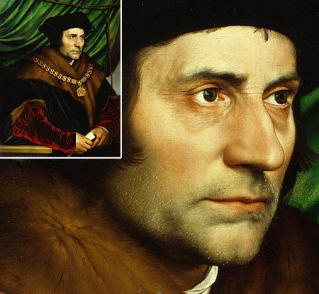
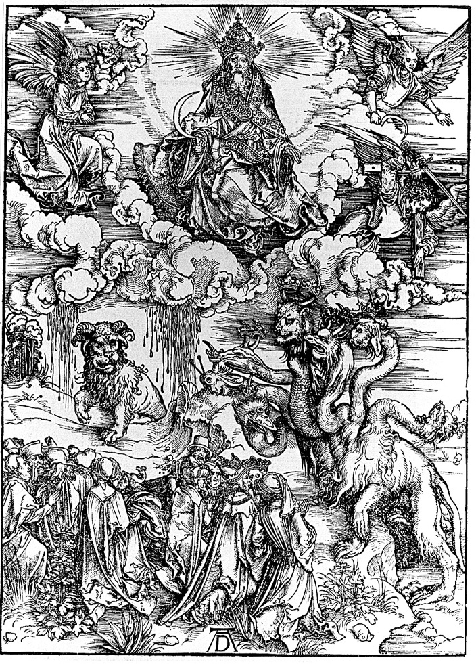
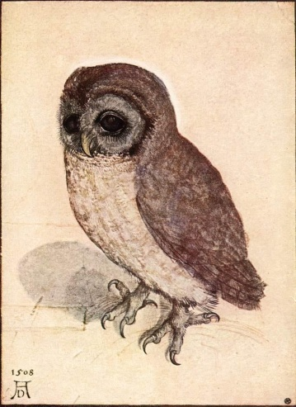
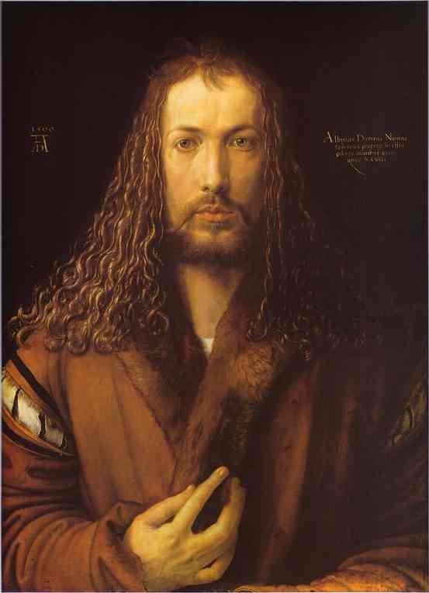
German and Flemish Painters
Son of a goldsmith, wanted to become an artist
Portraits were almost photographic in detail
Travelled to Italy in 1494
Produced woodcuts and Engravings as well as paintings
Generally mythical or religious
Albrecht Durer
Hans Holbein the Younger
From top left: Revelation, a little owl, and Self-Portrait
Popular in England where he painted Henry VIII and other members of the royal family

Slide 17
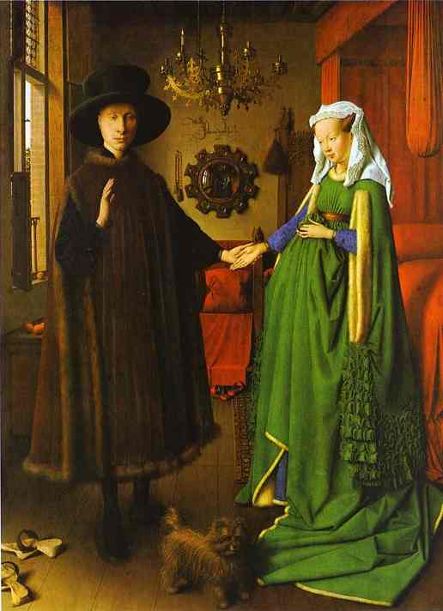
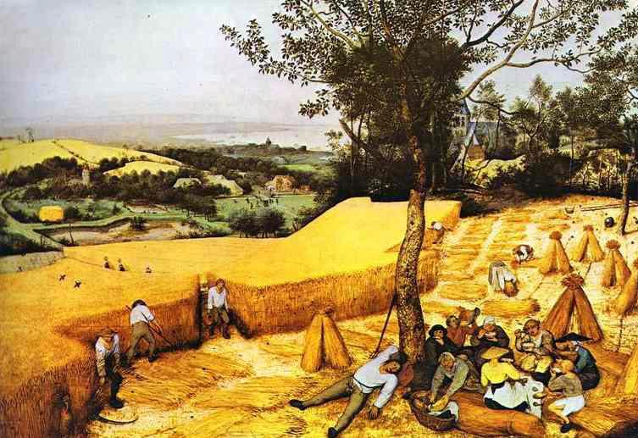
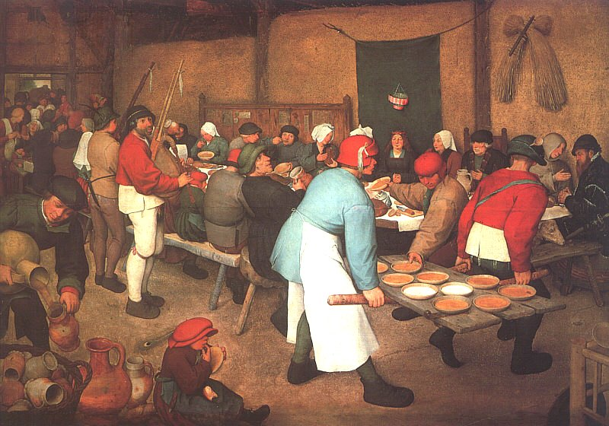
Used recently developed oil paints or easy blending and subtle color
Wanted detail, realism, and individuality
Primarily painted peasant life
Weddings, harvests, feasts, dances, etc.
Jan Van Eyck
Pieter Bruegel the Elder
The Arnolfini marriage
As well as more realism

Slide 18
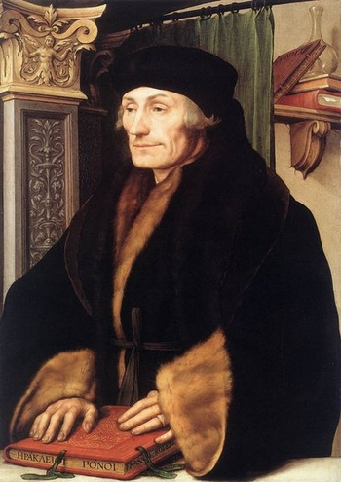
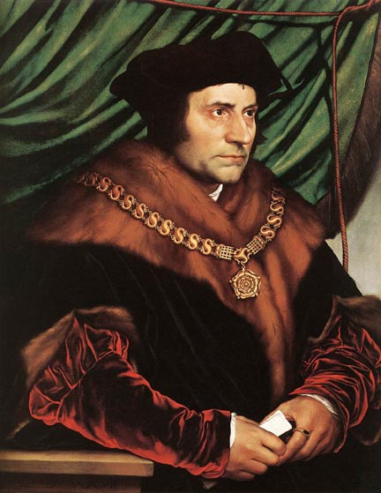
Northern Authors
The Christian Humanists
Erasmus
Born in Rotterdam
Wrote The Praise of Folly while staying with More
Made fun of erchants, lovers, scholars, and the clergy
Strongly Christian, but of the heart, not of ceremony
Felt that all people should be able to study the Bible
Thomas More
Wrote Utopia in 1516
A perfect place inhabited by peace loving people where greed, corruption, war, and crime no longer exist and money is unnecessary

Slide 19
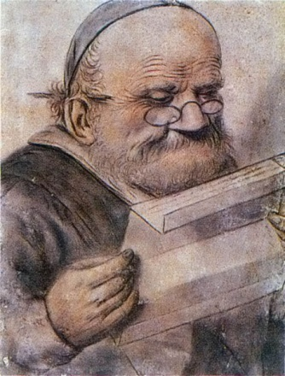
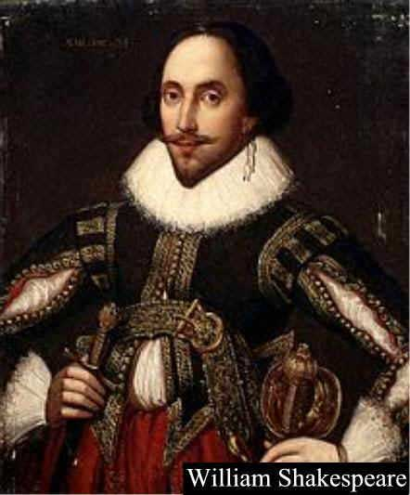
Secular Authors
Francois Rabelais
Wrote Gargantua and Pantagruel in vernacular French
Poked fun at society through the actions of his giants
Believed that people were generally good and should live by their instincts
William Shakespeare
Wrote in Renaissance England
Plays and Sonnets were al written in English
Wrote about human conflict often with humor and showed the souls of both his male and female characters
Known as the Elizabethan age for Queen Elizabeth I
She was educated in Eng, Fr., Lat., and It.
She wrote poetry and patronized the arts
Born 1564 in Stratford upon Avon

Slide 20
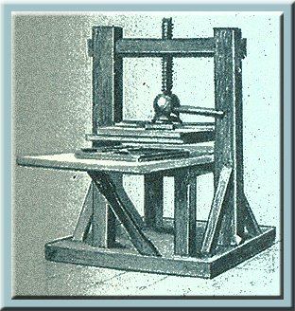
The Printing Press and the End of the Renaissance
Johann Gutenberg
There was a high demand for books during the Renaissance and it couldn't be met
Johann Gutenberg of Mainz, Germany introduced the moveable type printing press in 1450, printing a Bible in 1455
Books now become affordable which means more people are reading
Books are printed in the Vernacular now
Travel guides, medical manuals, and
Bibles

Slide 21
The Protestant Reformation
Problems in the Catholic Church:
Critics of the church begin to say that the church and its officials are corrupt
They spent tons of money on secular things like art
Some officials even had wives, mistresses, and/or children

Slide 22
Simony:
Selling Church offices
Lay Investiture:
Putting non religiously trained people into high church office
Indulgences:
Get out of hell free card. A way of buying less punishment for a dead sinner

Slide 23

Lower Clergy:
Many were uneducated – if you can’t read, you can’t teach
Some were married and had children
Some gambled and drank too much

Slide 24


Early calls for reform:
Began to advocate for church reform in the late 1300s and early 1400s
John Wycliffe of England
John Huss of Bohemia

Slide 25

Reforms:
The reforms that Wycliffe and Huss wanted included:
Denying the pope had any secular authority. It should be spiritual only
The Bible has all the authority, church leaders do not

Slide 26

In the 1490s an Italian friar named girolamo Savonarola
Came to Florence calling for reform

Slide 27


1497
People of Florence burned all their worldly goods in a huge bonfire
People of Florence burned Savonarola in a huge bonfire for heresy
1498

Slide 28


Other Challenges to the Church
Martin Luther:
Son of a Miner
Wanted to be a lawyer but went to seminary instead
Began teaching scripture in 1512 at the University of Wittenberg in Saxony
1517 – took a stand against Johan Tetzel selling indulgences to rebuild St. Peter’s

Slide 29


Slide 30

Luther’s 95 Theses
Luther wrote 95 formal statements against the selling of indulgences
On October 31, 1517 he posted these statements on the wall of the castle church and invited people to debate him
Someone made copies and suddenly Luther was famous all over Germany

Slide 31
The Reformation Begins
The Reformation -
A movement for religious reform that led to churches
that did not accept the pope’s authority
Luther eventually went beyond indulgences and began demanding the whole church be reformed

Slide 32
Luther’s 3 main teachings:
1.
People could win salvation only by faith, not by behavior
2.
All church teachings should be based on the Bible.
The Pope and church tradition were false authorities
3.
All people with faith are equal. People don’t need priests to translate the Bible for them

Slide 33

Response to Luther:
Threatened with excommunication by Pope Leo X for his statements against the church
Luther told people to drive the Pope out
Luther was excommunicated

Slide 34

Holy Roman Emperor Charles V
summoned Luther to Worms to stand trial in 1521
Known as the Diet of Worms

Slide 35
At Worms, Luther refused to recant, or take back, his statements about the church
Charles issues the
Edict of Worms
which declares Luther an Exile and Heretic.
All of his books are to be burned, and no one is to feed, clothe, or shelter him

Slide 36

Frederick the Wise of Saxony
Shelters Luther anyway, and while Luther is there, he translates the New Testament into German

Slide 37

Luther returns to Wittenberg in 1522
He finds that many of his beliefs are already being put to use
Including:
Simple clothing, calling themselves Ministers, and Marrying
Became a separate religious group called
Lutherans

Slide 38
Germany at war
Many German princes supported Luther
Some for religious reasons, some for political reasons
In 1529 the princes who were against Luther joined forces
The Princes who supported Luther signed a protest against that agreement and became known as Protestants

Slide 39

The Peace of Augsburg
Charles V went to war against these Princes.
He defeated them but did not force them back to Catholicism. (1547)
Charles was tired of fighting and called all the princes to Augsburg where he allowed local princes to determine the religion of the state

Slide 40


England Becomes Protestant
Henry VIII
Catherine of Aragon
But he needed a son (heir) to prevent civil war
He and his wife, had a daughter, Mary, but no woman had ever taken the throne successfully
Henry is afraid that 42 y/o Catherine won’t have anymore children so he wants a divorce
Most of his reign he was a devout Catholic

Slide 41


Slide 42


Henry has a problem…the church doesn’t allow divorce.
He could annul (set aside like it never happened) his marriage if there was a reason it wasn’t legal (1527)
He tries telling the Pope that the marriage isn’t valid because she was married to his brother Arthur first (This is technically true, as she was married to Arthur but he died of “English Sweating Sickness” before they could consummate the marriage)
Nope!
Divorce?
Pope said NO because of Charles V’s relationship to Catherine
)

Slide 43

Henry solved his own problem
1529 – Henry called Parliament and ends the Pope’s power in England
1533 – Henry secretly marries Anne Boleyn
1534 – Parliament legalizes Henry’s divorce from Catherine
1534 – Parliament passes the Act of Supremacy making Henry the head of the English Church.

Slide 44

Consequences:
Henry closed all English monasteries and confiscated their land
This made Henry very wealthy
Anne doesn’t produce an heir for Henry, so he has her imprisoned in the tower of London, and beheaded in 1536
They had one child, a daughter, named Elizabeth.

Slide 45

Henry will marry 4 more times.
His third wife will finally give him a son, Edward. She dies of complications shortly thereafter
Henry dies in 1547 and all 3 of his children will rule England.
Will cause religious turmoil
Edward becomes king at age 9 and rules for 6 years, at which time the Protestants will gain power

Slide 46


Slide 47


He is replaced by lady Jane Gray (she ruled for 9 days)
Replaced by Mary. She’s Catholic and returns control of the church to the Pope
Known as bloody Mary for all the Protestants she had killed
Forced to recognize Protestant ½ sister Elizabeth as her when she has no sons of her own.

Slide 48

Elizabeth takes the throne in 1558
She will restore Protestantism as the State religion in England
1559 – Parliament sets up a national church like that under her father Henry
- The Anglican Church will be the
only church in England
Elizabeth is its Head
People are required to attend
services or pay a fine

Slide 49
THE ANGLICAN CHURCH
Priests can Marry
Services in English.
  This is taken from the Protestants.
Wore rich robes
Golden crosses, incense, etc.
  This is taken from the Catholics

Slide 50

The Spanish Armada
Elizabeth is threatened by Philip II of Spain with invasion for several reasons
  She supported a Protestant Rebellion against him
  She supported Protestant revolts in other parts of Europe.
    In 1558: 140 Ships, 8000 sailors, and 19000 soldiers were assembled in Spain
    Reached the coast of England on July 29th
    Defeated by bad weather and the English Navy

Slide 51

The Reformation Continues:
John Calvin 1509-1564
1536 – published Institutes of Christian Religion
Created a new theology - Calvinism
Men and women are sinful by nature
God chooses very few people to save
AND they’re already chosen
Predestination
Believed that the perfect form of government is
Theocracy
Government run by a religious leader
1541 Protestants in Geneva Switzerland asked Calvin to run their city (Strict Rules!!)
Everyone must attend religious classes
NO bright clothes or card games
Could be excommunicated, imprisoned, or banished
Preaching a different religion = burning @ the stake

Slide 52

Huldrych Zwingli
Was a priest in Zurich, Switzerland
Influenced the city council who began to make religious reform
Abolished Relics, images, paintings, decorations from churches
Scripture reading, prayer, and sermon
replaced the Catholic Mass
Tried to get support from Luther and other reformers
Had problems when they couldn’t agree on
the meaning of Communion
October 1531 Zwingli dies in a battle between
Catholic and Protestant states
His body is cut up and burned
Leadership of the Protestant movement now moves to Calvin

Slide 53
The Anabaptists
Believed that the true church was made up of adults who had been reborn and baptized
  All other Christians baptized infants
Believed in following the practices and spirit of the early Church
  Considered all believers equal
  Chose their own minister
  All Christians were considered priests so anyone could be a minister
Felt that church and State should be separate
  State should have no political authority over real Christians
  Refused to hold office or bear arms
Generally they were viewed as Radicals
  One thing both Catholics and protestants could agree on was that the Anabaptists were not Okay.

Slide 54
The Catholic Reformation
Protestantism is spreading all over Europe.
The Counter-Reformation was supported by 3 chief ideals
The Council of Trent
The Jesuits
The Reform Papacy
The Council of Trent
March 1545
Group of high church officials and theologians met in Trent for the next 18 years

Slide 55
The Final Decrees:
Both faith AND good works were necessary for Salvation
Upheld that there were 7 Sacraments
The view of the Eucharist was reinforced
Clerical celibacy was reinforced
Belief in Purgatory was strengthened
  1. Indulgences couldn’t be sold anymore, though they were still considered a valid expression of your faith.

Slide 56

Ignatius of Loyola
A Spanish Nobleman who was wounded in battle
Forced to stay in bed to recuperate.
He had nothing to do except read the Bible and contemplate the life of Jesus
1522 – Wrote Spiritual Exercises
Laid out a day to day plan for prayer,
meditation, and study.
1540 – The Pope made Loyola’s followers a religious order called the Society of Jesus (or Jesuits)
Founded schools all over Europe
Teachers were trained in both classical studies and theology.
Sent out missionaries to convert non-Christians to Catholicism
Stopped the spread of Protestantism in Poland and S. Germany

Slide 57
The Reforming Popes

Slide 58

Directed the Council of Cardinals to investigate abuses within the Church
Approved the Jesuits
Used the Inquisition to seek out and punish Heresy
Called the Council of Trent in 1545
Pope Paul III
1534 - 1549

Slide 59

Pope Paul IV
Carried out the Council’s Decrees
  1559 – books considered dangerous to Catholicism were listed on the Index of forbidden books
  Catholic Bishops were ordered to round up these books and burn them
  In Venice 10,000 books were burned in one day

