Slide 1
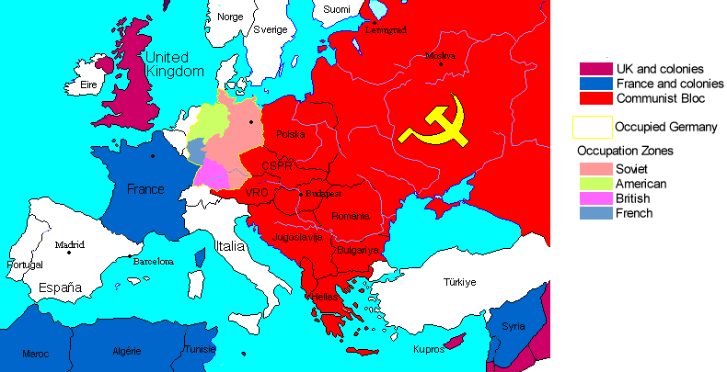
Restructuring the Post-War World
1945 - Present

Slide 2
Cold War: Superpowers Face Off
The U.S. and U.S.S.R had been allies during WWII, but their alliance was weak even then.
The U.S. was upset the Stalin had signed a nonaggression pact with Germany in ’39 and Stalin was upset that the Allies hadn’t invaded German held Europe before ’44.

Slide 3
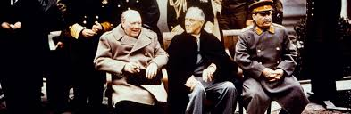
The Yalta Conference
The conference started in February of 1945 even though the war hadn’t ended yet.
Winston Churchill, Franklin Roosevelt, and Joseph Stalin met at the Soviet Black Sea resort of Yalta.
Here they agreed to divide Germany into zones of occupation controlled by the Allies and Germany would have to repay the Soviet Union for the loss of life and property.
Stalin agreed to join the war against Japan. He also agreed to allow free elections in Eastern Europe. (Churchill didn’t buy it, and he was right.)

Slide 4
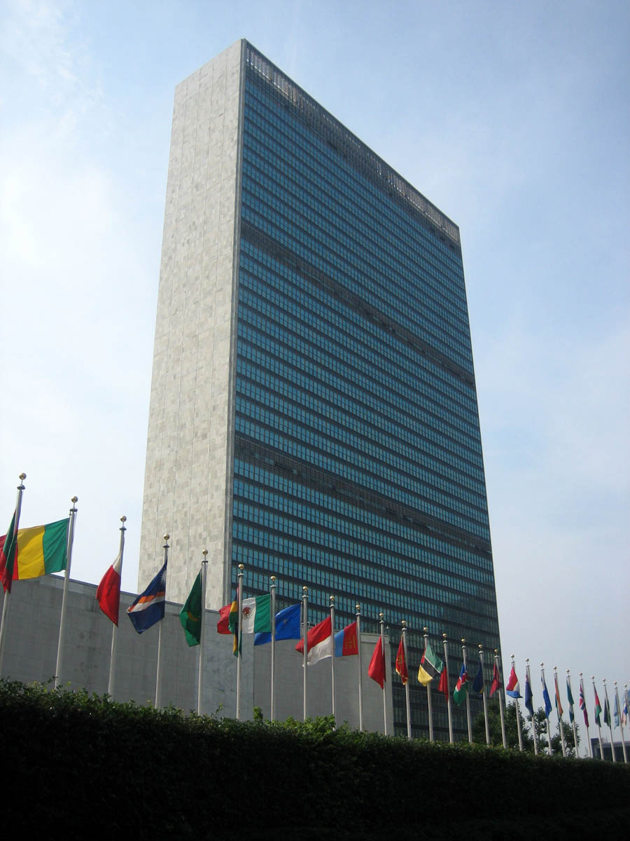
In June of 1945 the U.S. and the U.S.S.R temporarily set aside their differences and joined with 48 other countries to create the United Nations – Which was intended to protect its members from aggression.
It was based in New York.
The Charter created a large governing body called the General Assembly. There each member would cast its vote on a broad range of issues . An 11 member “Security Council” had the real power to investigate and settle disputes.
The 5 permanent members of the UNSC were Britain, China, France, the U.S. and the Soviet Union. Each one of them had to power to veto any UN action to prevent any members from voting as a bloc against any other member.

Slide 5
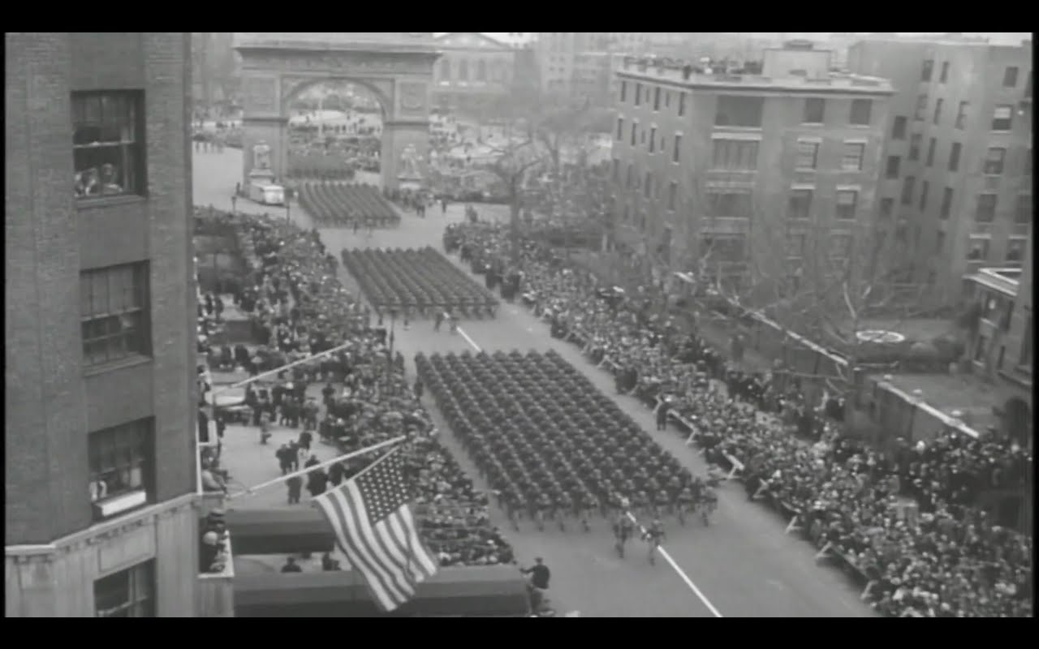
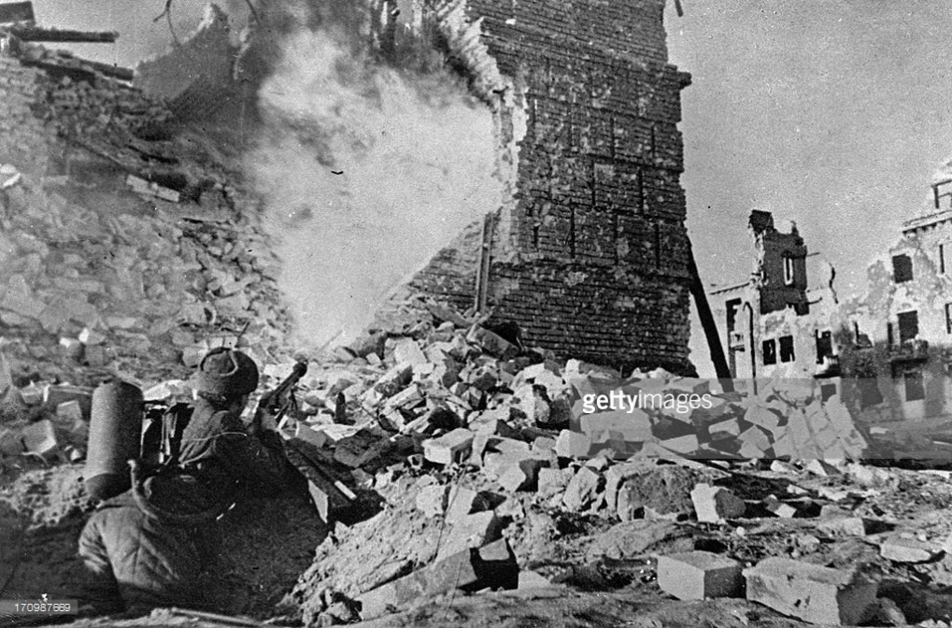
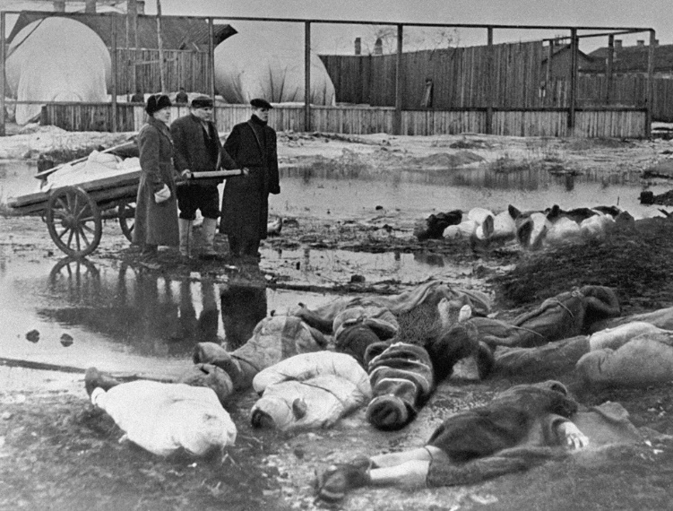
The U.S. and the U.S.S.R split sharply after the war, primarily because of the affect of the war on both nations.
The Soviet’s however lost 20 million people, including civilians (1 in 4 was injured or killed during the war), Many cities were totally destroyed as well.
The U.S. had lost a little over 420,000 people but their factories and cities were untouched.

Slide 6
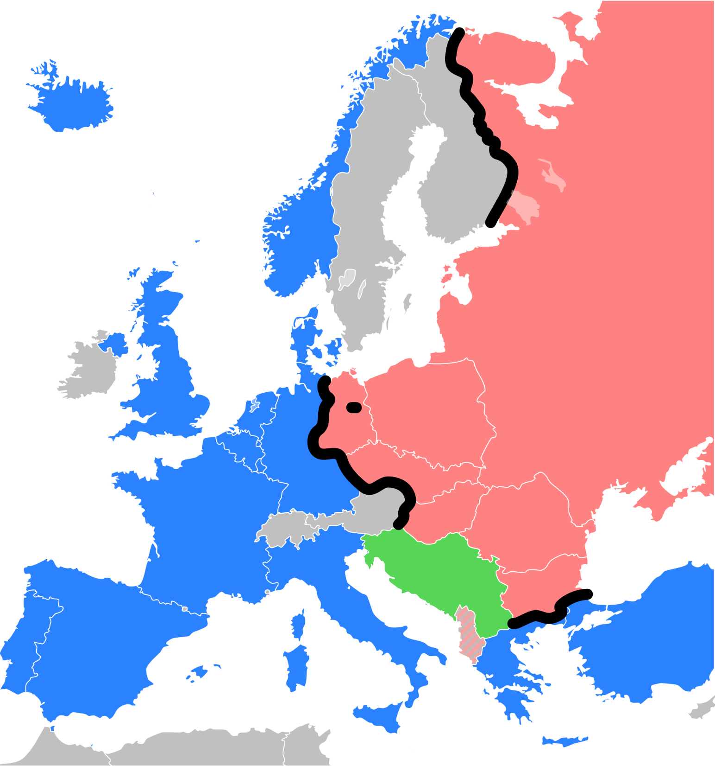
The Iron Curtain
A major goal of the Soviet Union was to shield itself from another invasion from the west. Centuries of history told them to be wary of their western border.
As WWII was ending and the Soviets pushed the Nazis back across Eastern Europe they occupied the land they liberated.
These newly liberated, and now soviet occupied countries, were seen by Stalin as a necessary buffer against aggression.
He then promptly ignored his agreements at Yalta and installed or secured Communist governments in Albania, Bulgaria, Hungary, Czechoslovakia, Romania, Poland, and Yugoslavia

Slide 7
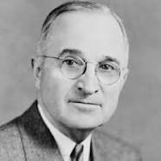
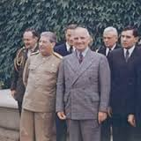
Roosevelt had died on April 12, 1945 and to new President Harry Truman, Stalin’s reluctance to allow free elections in Eastern European nations was a clear violation of those countries’ rights.
Truman, Stalin, and Churchill met at Potsdam Germany in July of 1945.
Truman pressed for free elections and Stalin refused. The next day Stalin announced that Communism and Capitalism could not exist in the same world.

Slide 8
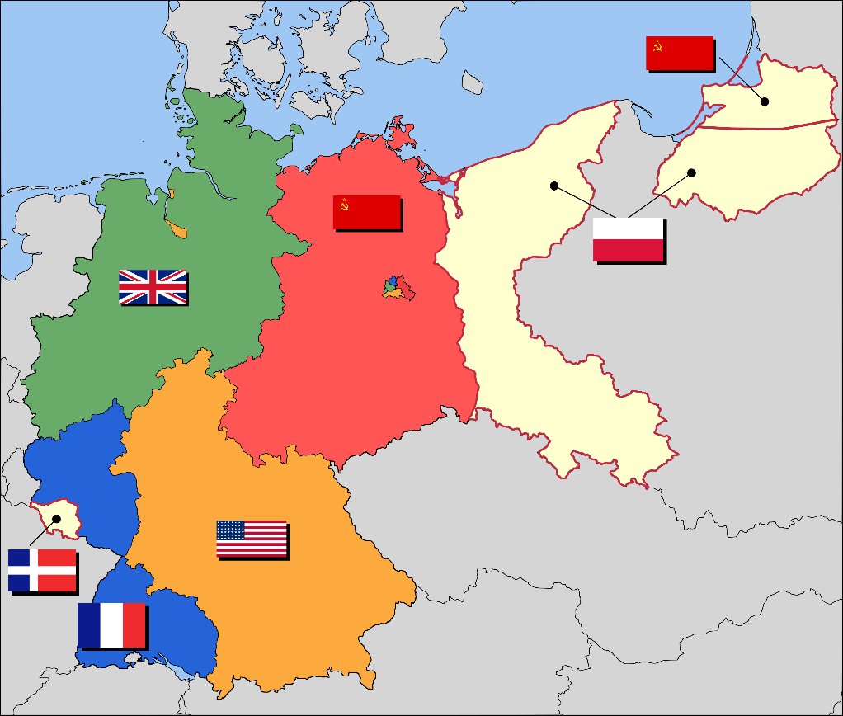
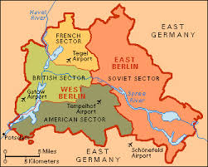

Europe was now divided between east and west.
Germany had been split into 4 sections (Each controlled by one of the Allied powers). The Soviets controlled the Eastern part that included the capital, Berlin. Berlin was then divided as well.
East Germany was renamed the German Democratic Republic and West Germany became known as the Federal Republic of Germany in 1949.
Churchill then made a speech calling this division the “Iron Curtain.”

Slide 9
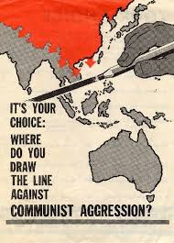
The United states then adopts a foreign policy called “containment.”
This policy was directed at blocking Soviet influence and stopping the expansion of Communism in Europe, and eventually, in Asia as well.
Policies included forming alliances and helping weak countries resist Soviet advances.

Slide 10
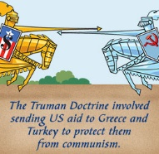
The Truman Doctrine
Truman came up with a plan to give aid to countries that were resisting Communism. Even though many people protest the U.S’ continued involvement in European affairs Congress immediately authorized more than $400 million in aid to Turkey and Greece.

Slide 11
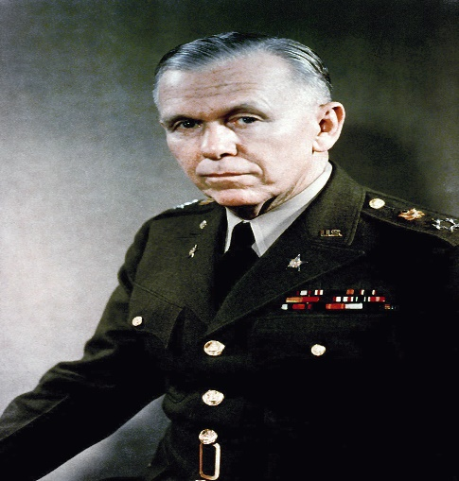

The Marshall Plan
In 1947 Secretary of State George Marshall proposed that the US give aid to needy European countries.
This plan would provide food, machinery, and other materials needed to rebuild Western Europe.
As Congress debated the 12.5 billion dollar program, the Soviets took power in Czechoslovakia. Congress immediately voted approval.
It was a spectacular success and even once-communist countries got aid when they broke away from Communist control.

Slide 12
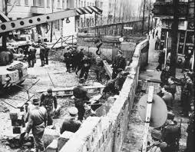
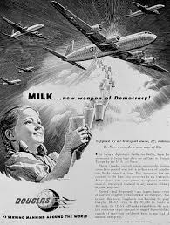
The Berlin Airlift
The US and its allies clashed with the Soviet Union over Germay.
The Soviets wanted to keep Germany weak and divided, but in 1948 France, Britain, and the U.S. decided to withdraw their forces from the Western part of the country and allow it to form into a united nation. The Soviets responded by basically holding Berlin hostage.
The Soviets cut off highway, water, and rail traffic into Berlin’s western zones. Stalin figured the west would surrender and either give up West Berlin to him or give up the idea of a reunified Germany. Instead American and British officials flew food and supplies into Berlin for nearly 11 months. In May of 1949 the Soviets lifted the blockade.

Slide 13
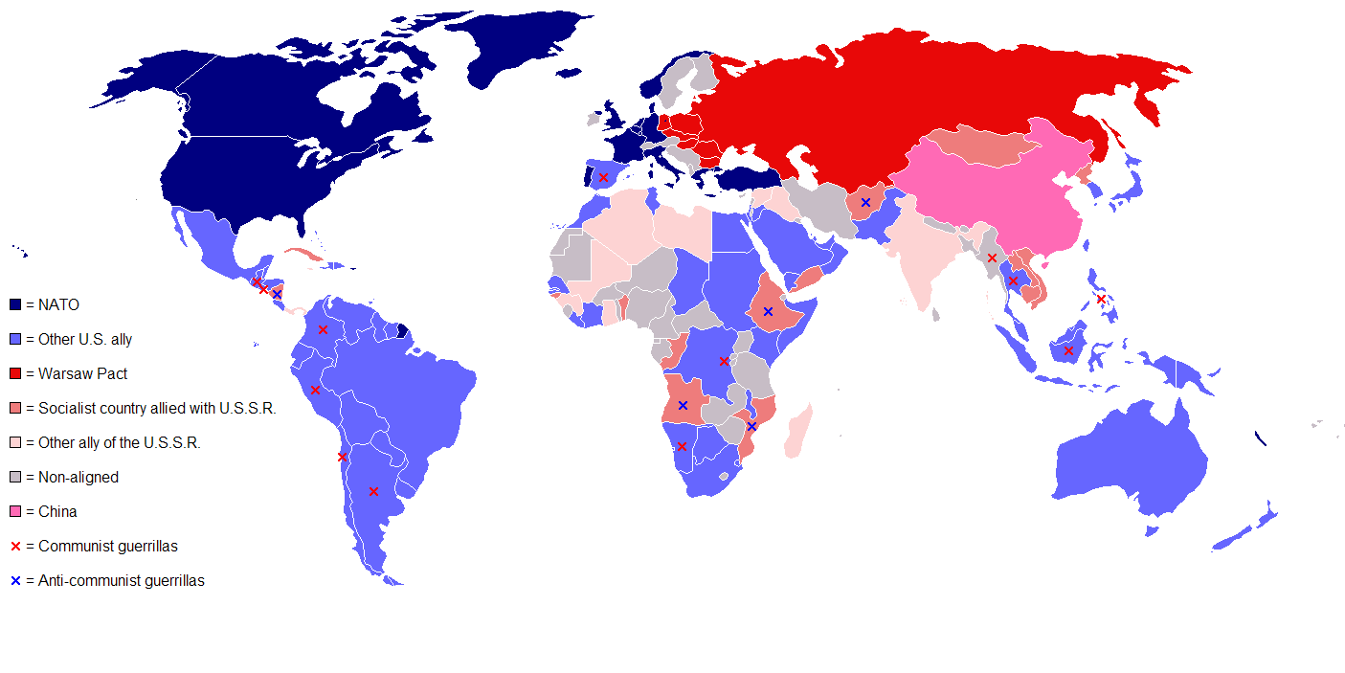
The Cold War Divides the World

Slide 14
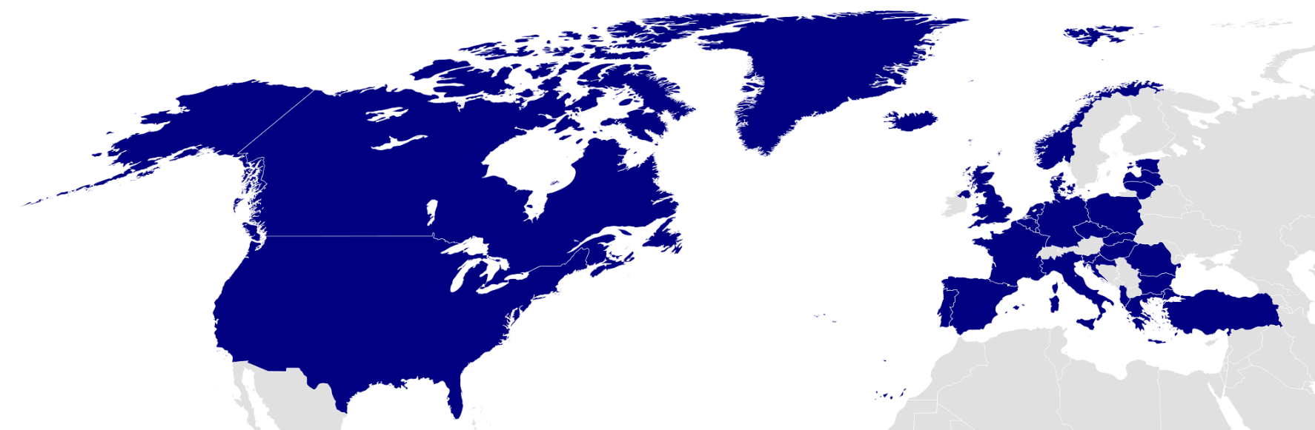
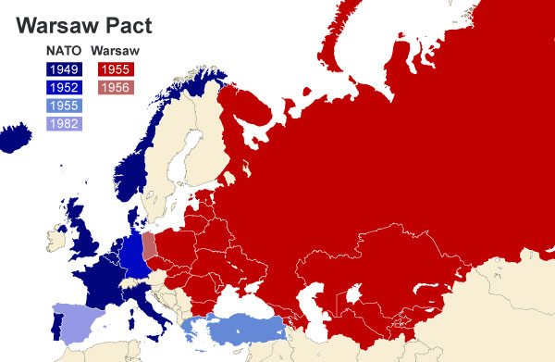
After the Berlin blockade, Western Europe was afraid of soviet aggression.
As a result, 10 western European nations joined with the U.S. and Canada in 1949 to form a defensive military alliance called NATO (North Atlantic Treaty Organization) An attack on any NATO member would be met with armed force by all member nations.
The Soviets saw NATO as a threat and created its own alliance in 1955 called the Warsaw Pact. The Warsaw Pact included the Soviet Union, East Germany, Czechoslovakia, Poland, Hungary, Romania, Bulgaria, and Albania.

Slide 15
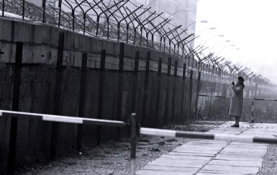
The Berlin Wall
In 1961 the East Germans built a wall to separate East and West Berlin.
The Berlin Wall ended up coming to symbolize a divided world.

Slide 16
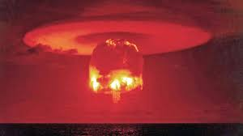
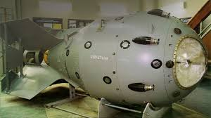
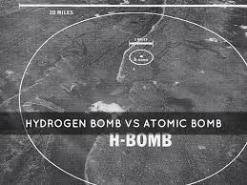
The Threat of Nuclear War
The Cold War threatened to destroy the world.
The U.S. already had atomic weapons and in 1949 the Soviet Union detonated RDS-1.
President Truman was determined to develop a more deadly weapon before the Soviets could, and in 1950 he authorized work on a thermonuclear weapon called the H-Bomb. The hydrogen bomb would be thousands of times more powerful than the A-bomb.

Slide 17
Atomic bombs use fission, or the breaking apart, of large atoms of Uranium or Plutonium.
Hydrogen bombs rely on fusion, or the joining together, of long chains of atoms to create their power

Slide 18

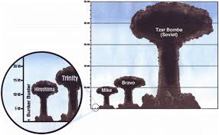
In 1952 the U.S. tested the first Hydrogen bomb.
In 1953 the soviets exploded a hydrogen bomb. In 1961 they detonated Tsar Bomba, a massive Hydrogen weapon.

Slide 19
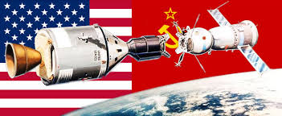
Space, The Final Frontier…
The Cold War now moves to the skies and science and technology education programs in the US and USSR are changed forever.

Slide 20
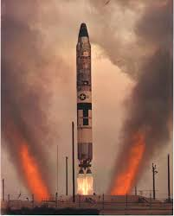
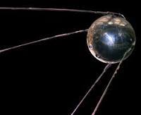
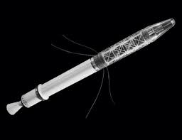
August 1957 – The Soviets announce that they have developed an Intercontinental Ballistic Missile or ICBM. This rocket, like its name states, could travel huge distances.
October 4, 1957 – the Soviets launch Sputnik, an unmanned satellite into space.
The US government poured money into Science and Tech education and a year later, the US launched their first satellite.

Slide 21

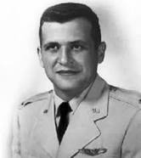
In 1955 Eisenhower had suggested that the US and USSR be able to fly over each other’s territory to guard against a nuclear attack
The Soviets say no and in 1960 the CIA started flying secret, high-altitude, spy flights over Soviet territory in U-2 spy planes.
In May of 1960, Francis Gary Powers was captured after being shot down in his U-2 over Russia.

Slide 22
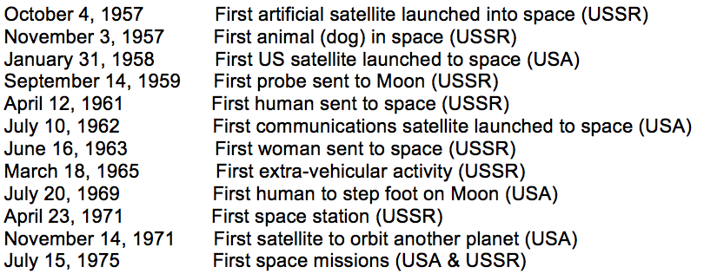

Slide 23
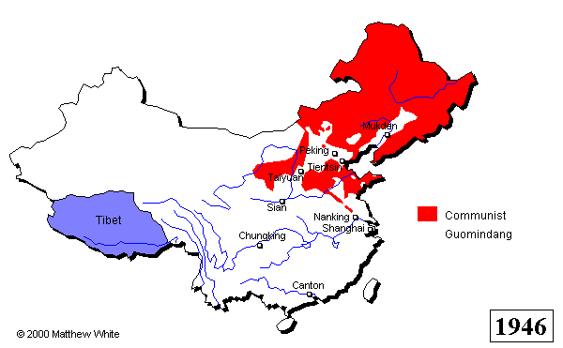
Communists take Power in China
Under Mao Zedong, the Communists had a stronghold in northwestern China.
From there they led mobilized peasant guerilla war against the Japanese in the northeast.
The communists won the support of peasants with literacy movements and increased food production plans.

Slide 24
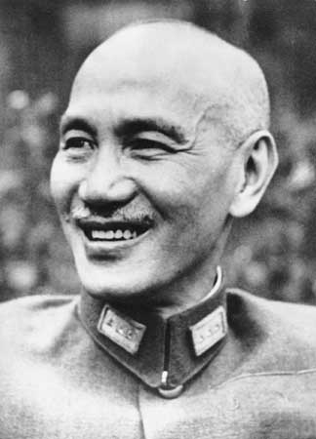
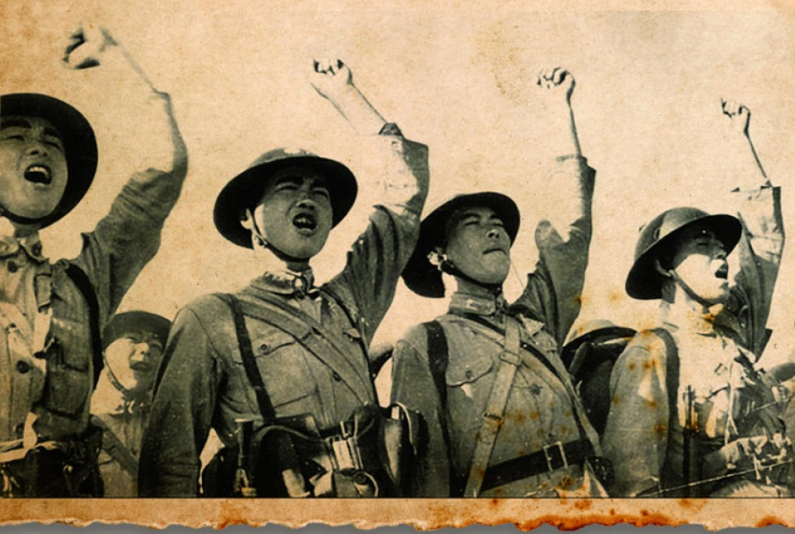
At the same time, the Nationalists, led by Jiang Jieshi were powerful in the southwestern part of china.
Jiang gathered an army of 2.5 million men while the communists were busy fighting the Japanese. He also got millions of dollars in aid from the US to fight the Japanese.
Regardless of this, the nationalists fought very few battles against the Japanese and the money and supplies often ended up with corrupt officers. The Nationalist army bided their time until the Japanese were defeated then they struck at the Communists.

Slide 25
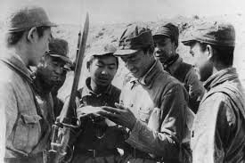
The Chinese Civil War Resumes
The civil war lasted from 1946 – 1949.
The Nationalists did well at first because they had 3x as many soldiers and $2 billion in aid from the U.S.
What the nationalists didn’t have however, was popular support and as the war dragged on, many nationalists fled to the communists.

Slide 26
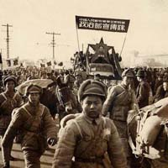
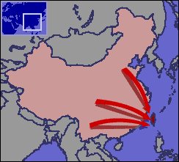
In spring of 1949 China’s major cities fell to Mao.
His troops were well trained and energetic about his plans and policies to return land to the peasants.
By October of 1949 Mao gained control of the country and proclaimed it “The People’s Republic of China.”
Jiang’s army fled south and eventually to the island of Taiwan (Formosa)
The Soviets and the Chinese signed a “treaty of Friendship” in 1950 and the anti-Communist feelings in the US grew.

Slide 27
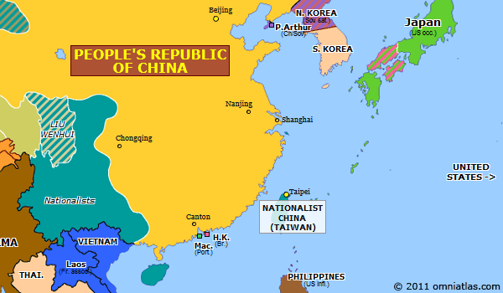
Two Chinas one Cold War
After Jian fled to Taiwan, the US helped him set up a Nationalist government on that island called the Republic of China.
The Soviets gave aid to Communist China and they signed a mutual aid treaty saying they’d come to each other’s defense if either was attacked.

Slide 28
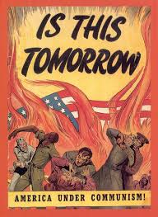
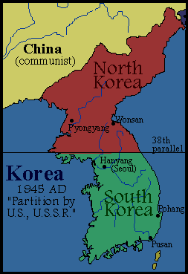
The US feared the spread of Communism in Asia and tried to stop Soviet expansion there.
When Soviet forces occupied the northern half of Korea after WWII and put in a communist government, the US supported a separate state in the South with a democratic government

Slide 29
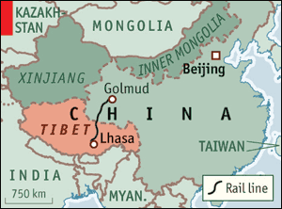
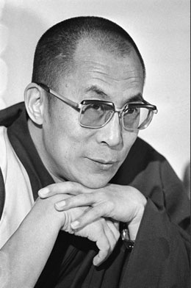
At first, under Mao, Chinese troops expanded into Tibet, India, and Inner and Outer Mongolia
In 1950 and ‘51 in a series of brutal assaults, China took Tibet. They promised self-rule to the Tibetans, who followed the
Dalai Lama, a religious leader. The Dalai Lama had to flee to India along with many other Tibetan refugees when Chinese control tightened. The two countries still hate each other today over the border area.

Slide 30
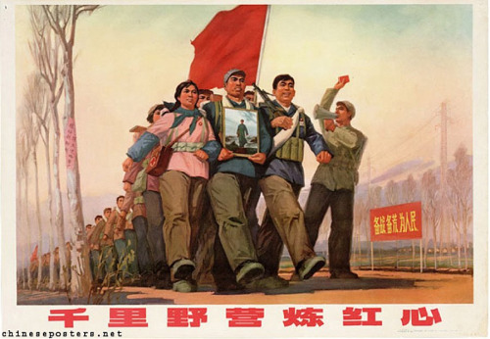
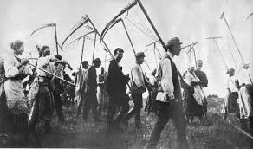
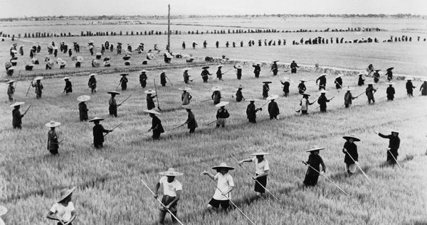
The New Mandate of Heaven
The Communists made up only 1% of the Chinese population, so to solidify their control, they claimed a Mandate of Heaven, or that Heaven had put them in power. Mao was determined to shape China’s economy based on Marxist Socialism. To do this he passed the Agrarian Reform Law in 1950 that redistributed farm land among the peasants. People who resisted the loss of their land were killed. Peasants were then forced to live and work on collective farms of 200 – 300 families.

Slide 31
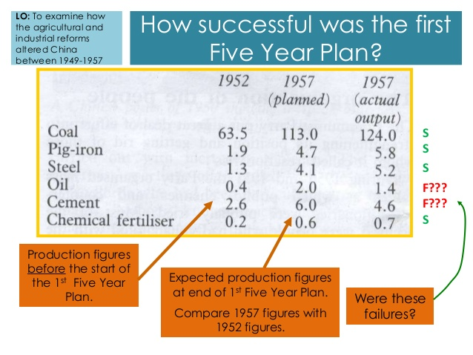
In 1953 Mao launched a five year plan setting high production goals for industry.
By 1957 Chinese output of coal, cement, steel, and electricity had increased dramatically.

Slide 32
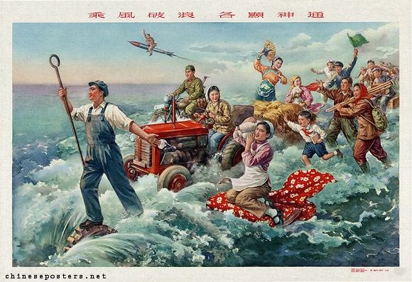
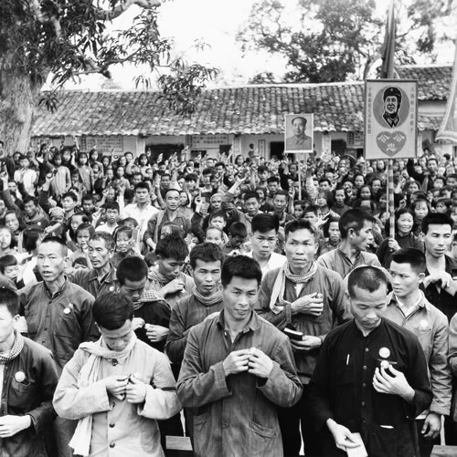
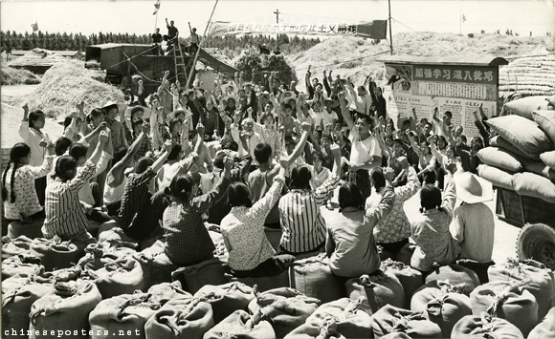
The Great Leap Forward
To expand on the 5 year plan, Mao proclaimed the “Great Leap Forward” in early 1958.
This plan called for larger collective farms, called communes and by the end of ’58 there were about 26,000 communes.
The average commune was about 15000 acres and held 25000 people. The people worked, ate, slept, and raised their children in communal rooms and they owned nothing. The program ended in 1961 after a crop failure led to the starvation of about 20,000,000 people.

Slide 33
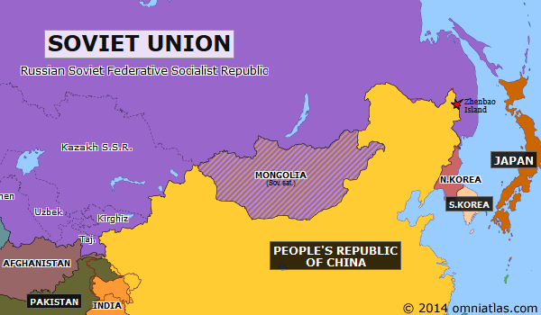
The relationship between the Russians and the Chinese began to fade as each one wanted to be the leader of the worldwide Communist movement.
There were also many territorial disputes over their long shared border.

Slide 34
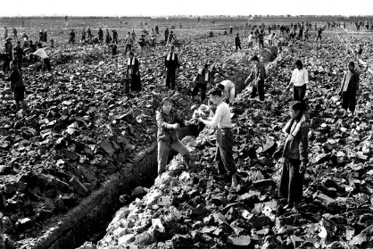

After the failure of the Great Leap Forward, China moved towards a different type of communism.
Farm families could now live in their own homes and sell crops that they grew on small private plots of land. Factory workers could compete for wages and promotions.
Mao didn’t like this type of communism because he felt it moved away from the goal of social equality.
In 1966 he urged the young people of China to “learn revolution by making revolution.” Millions of young Chinese left school and joined militia units called the “Red Guard.”

Slide 35


The Red Guard led a major uprising known as the cultural revolution. The goal of which was to establish a society of peasants and workers who were all equal.
Work with your hands was glorified. Work that required thought or creativity was deemed dangerous and so the Red Guard shut down schools and colleges. Intellectuals were forced to “purify” themselves through hard labor in remote villages. Thousands more were imprisoned or executed.

Slide 36

Chaos closed factories and limited farm production.
Mao decided that the Cultural Revolution had to stop and he ordered the Chinese army to put down the Red Guard.
Zhou Enlai, the Chinese premier and founder of the Chinese Communist Party began to
Restore order.

Slide 37


War in Korea and Vietnam

Slide 38

The Korean War
Korea was divided after WWII along the 38th parallel.
In the North, Japanese troops had surrendered to Soviet troops
In the South, Japanese troops had surrendered to American troops
As a result of this, like in Germany, two separate countries emerged.
One was the industrialized Communist north, the other was the non-communist, rural, south supported by western powers.
In 1949 most troops had been removed from Korea, but the Soviets supplied the north with tanks, troops, money, and weapons for an eventual take over of the peninsula assuming the Americans wouldn’t defend it.

Slide 39

On June 25, 1950 North Koreans crossed the 38th parallel in a surprise attack on South Korea. Within days, the North Korean troops were deep into the south surrounding Pusan.
Truman didn’t want a repeat of Mussolini, Hitler, and the Japanese.
His containment policy was being tested and he refused to allow South Korea to fall to Communism.
South Korea also asked the UN to intervene and when the matter came to a vote the Soviet Union was absent. (They were protesting the admittance of Nationalist Taiwan instead of Communist China.)
Because of that, the USSR couldn’t veto the UN plan to send a force to Korea.
15 nations include the US and Britain participated under the command of General Douglas MacArthur.

Slide 40
The North Koreans continued their advance. And by September of 1950, they controlled the entire Korean peninsula except for a tiny area around Pusan.
That same month MacArthur launced a surprise attack at Inchon and surrounded the North Korean troops. About half of them surrendered and the rest retreated.
MacArthur’s UN troops chased the retreating North Koreans over the 38th parallel and pushed them almost all the way to the Yalu River.
In October 1950 the Chinese sent 300,000 troops into North Korea, greatly outnumbering the UN forces.
By January of 1951 UN and S. Korean troops were pushed out of N. Korea. The Chinese then moved south and captured the S. Korean capital of Seoul
By 1952 the UN had regained control of S. Korea
July 1953 UN and N. Korea signed a cease fire and st the border near the 38th parallel
4 million soldiers and civilians died.

Slide 41

During the war, MacArthur called on Truman to drop nuclear weapons on China.
Truman responded by saying that he was trying to prevent WWIII not cause it.
MacArthur went over Truman’s head and tried to appeal to congress and the press to get those bombs dropped.
In response, Truman removed him.

Slide 42


War in Vietnam
In the early 1900s France controlled French Indochina (Vietnam, Laos, and Cambodia), but nationalist movements began to develop.
A young man named Ho Chi Minh turned to the Communist for help in his struggle against the French.
During the 1930s, Ho’s Indochinese Communist Party led revolts and strikes against the French.
The French responded by jailing protesters and sentencing Ho to death. He fled but returned in 1941 after the Japanese conquered Vietnam. He created the Vietminh (Independence) League. When the Japanese were defeated and forced out of Indochina, the French intended to get their colony back.

Slide 43



Vietnamese Communists and Nationalists joined together to fight the French Army. While the French managed to hold the cities, the Vietminh had wide support in the countryside. They used hit-and-run tactics to keep the French confined to the cities and in 1954 the French suffered a major defeat at Dien Bien Phu and they surrendered.

Slide 44

The US had supported the French in Vietnam and wit their defeat saw a rising threat of the spread of communism.
President Eisenhower described this threat as the Domino Theory a belief that the rest of Southeast Asia were like a row of dominoes and the fall of one to communism would lead to the fall of it’s neighbors.
This Domino Theory was the justification for US foreign policy during most of the Cold War.

Slide 45


After France’s defeat, an international peace conference met in Geneva to discuss the future of Indochina.
Based on these talks, Vietnam was divided at 17* North Latitude. North of that line, Ho’s communists ruled. South of that line the US set up an anti-Communist government under the leadership of Ngo Dinh Diem
Ngo ruled the south as a dictator and opposition to his government grew. Communist guerillas called Vietcong began to gain strength in the countryside.

Slide 46

The Vietcong were made up of trained North Vietnamese soldiers and south Vietnamese who just hated Ngo. As time went on the Vietcong got more and more support in the country side. In 1963 a group of South Vietnamese generals had Ngo Assassinated but they were no more popular than he was. War was pretty much inevitable.

Slide 47



In August of 1964 U.S. President Lyndon Johnson told Congress that North Vietnamese patrol boats had attacked two U.S. destroyers in the Gulf of Tonkin
Because of this, congress authorized troops in Vietnam.
By late 1965 more than 185,000 US soldiers were in country
By 1968 more than 500,000 were there

Slide 48


Even though the US was well equipped and had advanced weaponry they were fighting against a guerrilla force in unfamiliar jungle terrain.
The government the US was defending was also becoming more unpopular while support for the Vietcong was growing and getting help from the Soviets and the Chinese.

Slide 49





The US was making little headway on the ground so they turned to air assault.
The US bombed millions of acres of farmlands and forests and used napalm and agent orange to destroy plants and trees where Vietcong troops may have been hiding. Thousands of peasants were caught in this and it strengthened their opposition to US involvement in Vietnam.

Slide 50


In the late 1960s the war became increasingly unpopular in the US and there were protests and riots, especially among young, college aged people.
In 1969 President Nixon began withdrawing troops from Vietnam. His plan was called Vietnamization which allowed for US troops to gradually leave while South Vietnamese troops increased their combat role.

Slide 51



Operation Menu
To help maintain the South Vietnamese government and pursue Vietnamization, Nixon authorized a massive bombing campaign against suspected (and actual) Vietcong bases and supply routes in Laos and Cambodia especially along an area called the Ho Chi Minh trail.
The last US troops eft Vietnam in 1973.
In 1975 the North overran the south.
When the war ended 1.5 million Vietnamese and over 58,000 Americans were dead. The numbers of wounded and missing are also high

Slide 52

Postwar Southeast Asia

Slide 53



War didn’t bring an immediate end to the bloodshed in SE Asia.
In Cambodia (AKA Kampuchea) communist rebels called Khmer Rouge set up a brutal government under Pol Pot
His followers slaughtered 2 million people in an event that became known as the Killing Fields

Slide 54

In 1978 the Vietnamese invaded, overthrew the Khmer Rouge, and put in a less repressive government.
The Vietnamese were in Cambodia until 1989 and in 1993 UN peacekeepers helped Cambodia create a new government that included a democratic constitution and free elections

Slide 55


Postwar Vietnam
After 1975 the North Vietnamese imposed tight control over the south.
Thousands of people were sent to “reeducation camps” for training in communist thought.
Industries were nationalized and business was strictly controlled
Because of communist oppression 1.5 million people fled Vietnam. Many of these people left in overcrowded boats. More than 200,000 “Boat people” died at sea. The survivors spent months in refugee camps. About 70,000 of them eventually settled in the US or Canada.
The US normalized relations with Vietnam in 1995 even though Vietnam is still a communist country.
Saigon was renamed Ho Chi Minh City.

Slide 56

The Cold War Divides the World

Slide 57

After WWII the world’s nations were grouped into three “Worlds.”
The First World include industrialized, capitalist, nations like the U.S.
The Second World was the communist nations led by the Soviet Union
The Third World was developing nations not aligned with either of the Super Powers (US or USSR)

Slide 58

The Third World was located in Africa, Latin America, and Asia. They were economically poor and politically unstable, because of years of colonial control. Each of these nations needed a stable economy to build their society around and U.S. capitalism or Soviet communism were the main choices.

Slide 59

The U.S., the USSR, and to some extent China, used a variety of ways to influence the Third world.
They backed revolutions, liberation movements, and counterrevolutions as it suited their needs.
The CIA and the KGB often used secret activities ranging from spying to assassinations (both countries assassinated people that were ‘in the way’ of them achieving whatever goals they had in whatever nation they were in).

Slide 60


The US gave military aid, built schools, developed anti-poverty programs, and sent volunteers to work in Third World Nations
The Soviets offered military and technical assistance. They also sent food.

Slide 61

Brinkmanship is the policy of going to the brink of war to make the other side back down
Espionage is spying on other countries to try to gain an advantage
Foreign Aid is when financial or social aid (food) is given by a nation to a Third World nation to try to win allies.
Multinational Alliances included NATO and the Warsaw Pact
Propaganda is material that is intended to make one nation better than another. It was often broadcast as movies and radio.
Surrogate Wars are wars that are fought as substitute wars. The U.S. and U.S.S.R didn’t fight each other directly, instead they backed opposing sides in other conficts. (Korea, Vietnam, Iran, etc.)

Slide 62


Developing nations often needed assistance and they became very important to the competition between the U.S. and the U.S.S.R., and later on, China.
Many countries like India and Indonesia tried to stay neutral and uninvolved.
In 1955 Indonesia hosted the Bandung conference where many Asian and African nations met to create a “third force” of independent, nonaligned, countries.

Slide 63


Confrontation in Latin America
In the 1950s Cuba was ruled by the unpopular dictator Fulgencio Batista, who was supported by the US
The Cubans had a popular revolution in January of 1959 that overthrew Batista.
That revolution was led by a young Fidel Castro.
At first, Castro was popular for bringing social reform and improving the economy. However he became a dictator that suspended elections, jailed or executed his opponents, and tightly controlled the press

Slide 64



When Castro nationalized the Cuban economy he took over US owned sugar mills and refineries.
In response to this Eisenhower ordered an embargo on all trade with Cuba. In response, Castro turned to the Soviets for help.
In 1960, the CIA began training anti-Castro Cuban exiles and in April 1961 sent them to invade Cuba with the promise of US backup. The exiles landed at the Bay of Pigs and the US did not send the promised air support and the exiles lost very quickly.

Slide 65


The Cuban Missile Crisis
The failure of the Bay of Pigs convinced Soviet leader Nikita Khrushchev that the US would not resist Soviet expansion in Latin America
In July 1962, the Soviets secretly began to build 42 missile sites in Cuba.
In October an American spy plane detected the sites.

Slide 66


President Kennedy declared that the missiles were a threat to the US mainland and demanded their removal and announced a naval blockade of Cuba to prevent the Soviets from installing the missiles
Castro said they were being used as “pawns” but they were collaborating with the soviets. Kennedy’s demands put the US and the USSR into a combative situation and people feared nuclear war. Fortunately, after a stand off Khrushchev agreed to remove the missiles in return for a US promise not to invade Cuba.

Slide 67

Castro would now be completely dependent on the USSR for support. In return for their support, he had to back Communist revolutions in Latin America and Africa.
When the Soviet Union collapsed in 1991 Soviet aid ended and the Cuban economy collapsed. In response, Castro loosed state control of Cuba’s economy and tried to get better relationships with other countries.

Slide 68


Civil War in Nicaragua
The US had also funded the dictatorship of Anastasio Somoza and his family since the early 1930s in Nicaragua.
In 1979 Sandinista rebels overthrew Somoza’s son. The US and USSR both initially supported the Sandinistas and their leader
Daniel Ortega

Slide 69


The Sandinistas were giving help to other Marxist rebels in El Salvador and to help the El Salvadoran government fight those rebels, the US supported Nicaraguan anti-Communist forces called Contras (contrarevolucionarios)
The civil war lasted nearly 10 years and weakened the economy. In 1990 President Ortega agreed to hold free elections for the first time in Nicaragua’s history. He was defeated by Violetta Chamora, a reform candidate. The Sandinistas were also defeated in 1996 and 2001

Slide 70

Confrontations in the Middle East

Slide 71


The oil industry was causing issues between religious and secular groups.
This was most evident in Iran. After WWII, Iran’s leader Shah Mohammed Reza Pahlavi
began to move towards western governments and wealthy oil companies.
Nationalists resented these alliances and united under Prime Minister Muhammed Mossadeq
He nationalized a British owned oil company and in 1953 forced the shah to flee. The US helped restore the Shah to power out of a fear of communism spreading to Iran.

Slide 72


With American support, Shah Pahlavi began to westernize the country and by the end of the 1950s Tehran was a modern, western style city.
Conservative Muslim leaders known as ayatollahs led religious opposition to Pahlavi’s government and western influence. The most powerful of these was Ayatollah Ruholla Khomeini
Iranians rioted in every city in late 1978 spurred on my Khomeini's tape recorded messages. The Shah fled in 1979 and Khomeini returned to establish an Islamic state and to export Iran’s militant form of Islam.
Millions of Iranians however were still extremely poor.

Slide 73

Khomeini was ruled by strict Islamic beliefs that controlled his domestic policies, but his foreign policy was dominated by a strong continuing hatred for the US and its support of the Shah.
In 1979 young Islamic revolutionaries took the US embassy in Tehran and took more than 60 American hostages. They demanded that the US force the shah to face trial. Most of the hostages were held for 444 days until they were finally released in 1981.

Slide 74

Khomeini encouraged Muslims everywhere to overthrow their secular leadership. It was intended to unify all Muslims but instead heightened tension with Iraq, a traditional enemy of Iran.
Saddam Hussein governed Iraq as a secular state.
In 1980 a war broke out between Iran and Iraq. The US supported both sides because it didn’t want to change the balance of power in the area. The Soviets supported Iraq.
A million Iranians and Iraqis died in the war before a UN negotiated cease fire in 1988

Slide 75


After WWII Afghanistan managed to maintain its independence from both the Soviet Union and the US, but in the 1950s Soviet influence grew and in the late 1970s a Muslim revolt threatened to topple the government.
In 1979 Soviet troops invaded Afghanistan expecting to prop up the communists there and then quickly withdraw. Instead the Soviet Union found themselves stuck there fighting a rebel force that outmaneuvered them.
The Afghanis, called mujahedeen (holy warriors) were supplied with American weapons. The Taliban got it’s start here and took over in 1996 after soviet withdrawal in 1989.

Slide 76


President Carter had warned the Soviet union about an invasion to try to control the Persian Gulf and to protest the invasion of Afghanistan, Carter cut off US grain shipments to the USSR and ordered a US boycott of the 1980 Moscow Olympics.
In the 1980s Soviet Premier Mikhail Gorbachev acknowledged the devastation of the war and withdrew all troops by 1989. It was too little to late to stop the issues in Afghanistan.

Slide 77
A Thaw in the Cold War

Slide 78

After Stalin died in 1953, Nikita Khrushchev became the dominant Soviet leader. In 1956 he denounced Stalin for the jailing and killing of loyal Soviet citizens. This began a policy of destalinization, or purging the country of Stalin’s memory.
Workers destroyed monuments.
Khrushchev called for “peaceful competition” with capitalist states.

Slide 79


The soviet satellite countries resentment turned to active protest.
In October 1956 the Hungarian army joined protesters to overthrow the Hungarian government. They stormed the capital of Budapest, and waved Hungarian flags with the hammer and sickle torn out.
A popular Hungarian Communist leader called Imre Nagy formed a new government and promised free elections. He demanded that Soviet troops leave the country. In response Soviet tanks and infantry invaded Budapest in November ’56 and were met by thousands of troops and freedom fighters armed with pistols and bottles.
The protesters were defeated and a pro-Soviet government was installed. Nagy was later executed

Slide 80


Revolt in Czechoslovakia
In 1964 party leaders voted to remove Khrushchev from power and replace him with Leonid Brezhnev. Brezhnev quickly went back to repressive domestic policies.
Laws limiting free speech and worship, government censorship of writers and publishers, and secret police arresting protesters became a common occurrence. Anyone could be a target, for example Alexander Solzhenitsyn a Nobel Prize winning author was arrested and expelled from the country.

Slide 81


Brezhnev made it clear that he would tolerate no dissent in Easter Europe either.
In 1968 Czech Communist leader Alexander Dubček loosened control on censorship to give his country “socialism with a human face.” This period of reform became known as Prague Spring.
On August 20, 1968 armed forces from the Warsaw Pact nations invaded Czechoslovakia. Brezhnev justified this by saying that the Soviet Union had the right to keep their satellite states from rejecting communism. This became known as the Brezhnev doctrine.

Slide 82
China and the Soviets Split
China was committed to communism and Stalin and Mao had signed a 30 year treaty of friendship in 1950. It didn’t last.
The Soviets assumed China would follow soviet leadership in word affairs but the Chinese government didn’t want that and they began to spread their own brand of communism in Africa and other parts of Asia.
In 1959, Khrushchev punished the Chinese by refusing to share nuclear secrets, in 1960 the soviets stopped sending aid, and eventually there will be skirmishes along their border.

Slide 83

The policy of Brinkmanship had led to several terrifying crises; the U-2 incident, the Cuban Missile Crisis, escalation in Vietnam, etc.
Under Richard Nixon, détente replaced brinkmanship. Détente is a policy of reducing the tension between the powers. This developed from the idea of realpolitik or reality in politics. Basically this meant dealing with other powers in a more realistic and flexible manner.
Nixon had been strongly anti-communist so this was an about face in his belief system. He was the first president to visit Communist China.

Slide 84



Three months later he visited the Soviet Union (May 1972)
While there he participated in a series of talks called SALT or Strategic Arms Limitation Talks. He and Brezhnev signed the SALT I treaty. This 5 year treaty limited the number of ICBMs and submarine launched missiles to 1972 levels.
In 1975, 33 other nations joined the US and the USSR in commitment to détente and cooperation. This was known as the Helsinki Accords.

Slide 85


Détente continued under Nixon and Gerald Ford but in the 1970s Jimmy Carter, concerned over the harsh treatment of protesters in the Soviet Union, made the second round of SALT talks difficult. Carter and Brezhnev finally signed SALT II but Congress refused to ratify it when the USSR invaded Afghanistan later that year.
Other nations also began to build nuclear arsenals who hadn’t been included in the SALT talks or the Helsinki accords.

Slide 86


Ronald Reagan took office in 1981. He was fiercely anti-communist and he continued to move away from détente.
He increased defense spending, putting military and economic pressure on the soviets and effectively spending the USSR out of existence.
In 1983 he announced SDI or the Strategic Defense Initiative (Star Wars), a program to protect against enemy missiles. It was never implemented, but it represented the mistrust between the two nations.
Reagan also supported the Contras and funneled money through
Iran in a controversy that would hurt later hurt his Presidency.
Eventually new leadership in the USSR will finally bring an end to the Cold War.

