Slide 1

The Crisis Years
1919-1939

Slide 2
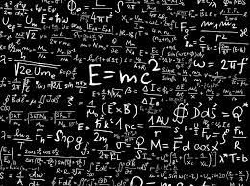
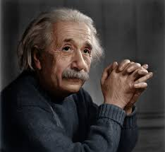
A New Scientific Revolution
Albert Einstein, a German-born physicist, offered new theories on space, time, energy, and matter.
Scientists had found that light travels at the same speed no matter which direction it’s travelling in. Einstein agreed but said that other things such as space and time can change when measured relative to an object moving at or near the speed of light. (186,000 mi/s).
This is called the Theory of Relativity
This made people uncomfortable because there had been a sense of order and absolutes based on Newton’s laws prior to this.

Slide 3
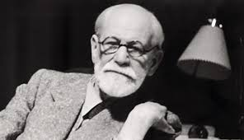
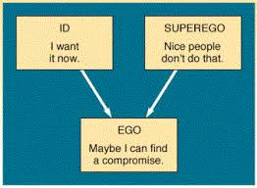
Sigmund Freud was an Austrian physician who treated patients with psychological problems.
He constructed theories about the human mind that said that much of what people do is irrational and controlled by the unconscious mind especially the pleasure-seeking drives that the conscious mind was unaware of.
His beliefs weakened the belief in reason.
Regardless, his ideas had widespread recognition and acceptance by 1920

Slide 4
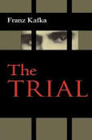
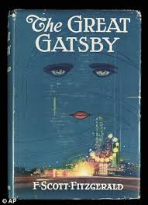
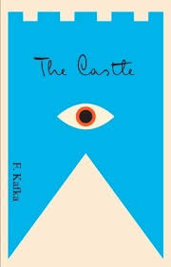
Literature of the 1920s

Slide 5
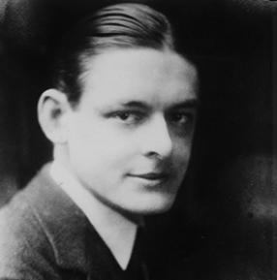
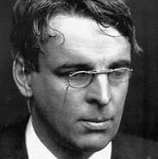
Many authors and poets reflected the disillusionment of the first World War.
Poets T.S. Eliot and William Butler Yeats spoke of the dark, barren wasteland that the post-WWI world seemed to have become to many people
William Butler Yeats (1865-1939)
THE SECOND COMING
Turning and turning in the widening gyre
The falcon cannot hear the falconer;
Things fall apart; the centre cannot hold;
Mere anarchy is loosed upon the world,
The blood-dimmed tide is loosed, and everywhere
The ceremony of innocence is drowned;
The best lack all conviction, while the worst
Are full of passionate intensity.
Surely some revelation is at hand;
Surely the Second Coming is at hand.
The Second Coming! Hardly are those words out
When a vast image out of Spiritus Mundi
Troubles my sight: a waste of desert sand;
A shape with lion body and the head of a man,
A gaze blank and pitiless as the sun,
Is moving its slow thighs, while all about it
Wind shadows of the indignant desert birds.
The darkness drops again but now I know
That twenty centuries of stony sleep
Were vexed to nightmare by a rocking cradle,
And what rough beast, its hour come round at last,
Slouches towards Bethlehem to be born?

Slide 6
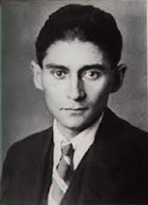
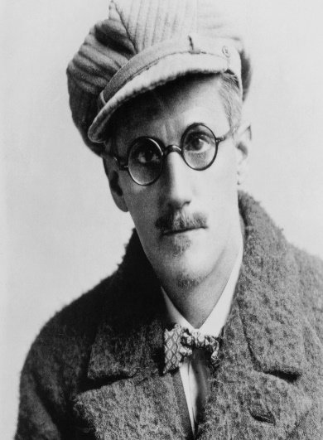
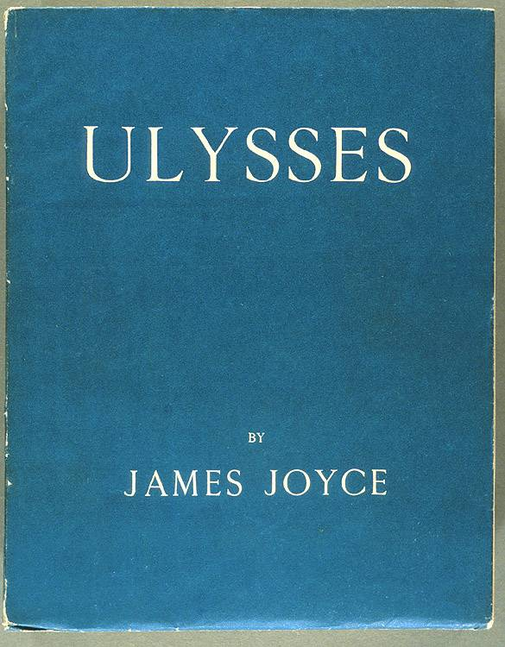
Writers such as Franz Kafka wrote books like The Trial and The Castle which feature people trapped in terrifying situations that they can’t escape or understand
Other authors wrote books that relied heavily on Freud’s ideas of the unconscious mind.
James Joyce’s Ulysses was written in stream of consciousness and breaks with common literary structure to show a single day in the lives of 3 Irish people. The point is to try to hold a mirror to the workings of the human mind.

Slide 7
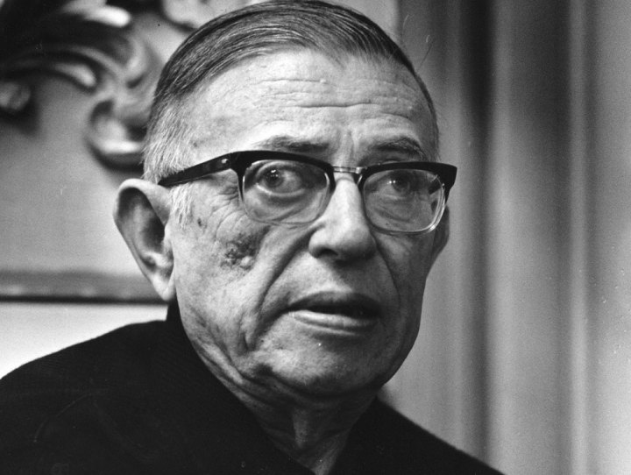
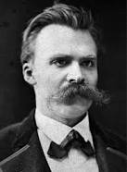
Existentialism
Existentialists believe that thee is no universal meaning to life. Each person creates his or her own meaning through their choices and actions.
The leader of this movement is Jean Paul Sartre
The existentialists took their beliefs from the work of German philosopher Friedrich Nietzsche
who wrote that Western ideas such as reason, democracy, and progress had stifled people’s creativity and actions.
Nietzsche urged a return to the ancient heroic virtues of pride, assertiveness and strength. His beliefs will be particularly influential in Germany

Slide 8
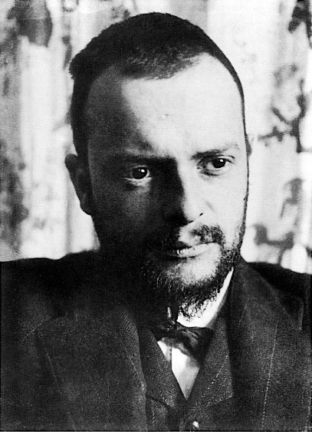

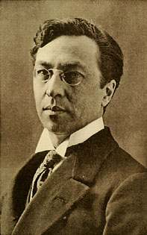
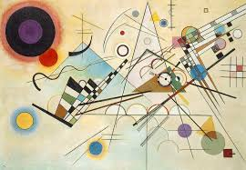
A Revolution in Art
Artists began to rebel against the earlier, realistic, style of painting and instead wanted to show the world of emotion and imagination.
Expressionist painters such as Paul Klee and
“Senecio”
Wassily Kandinsky used bold colors and distorted or exaggerated images.
“Composition VIII”

Slide 9
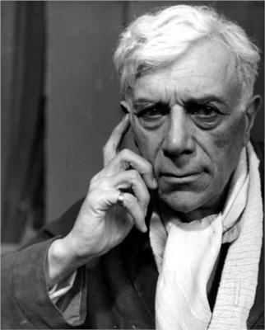
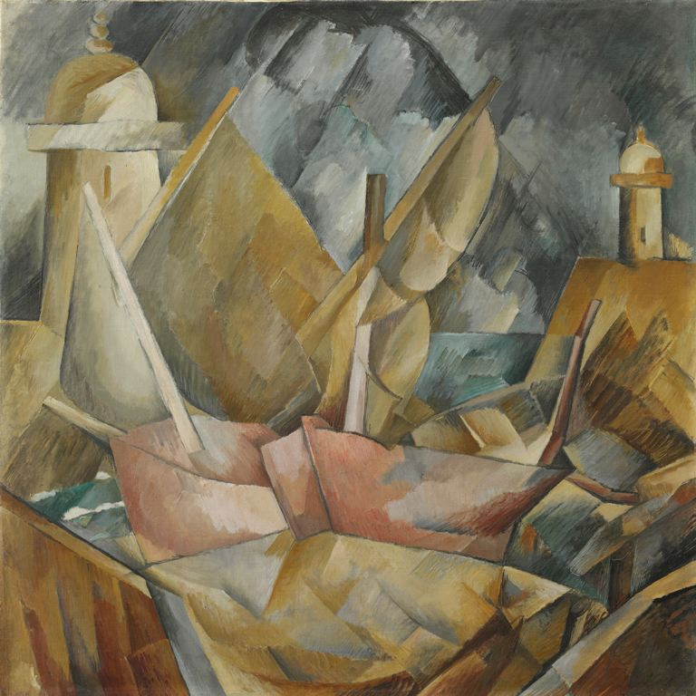
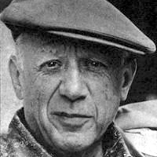
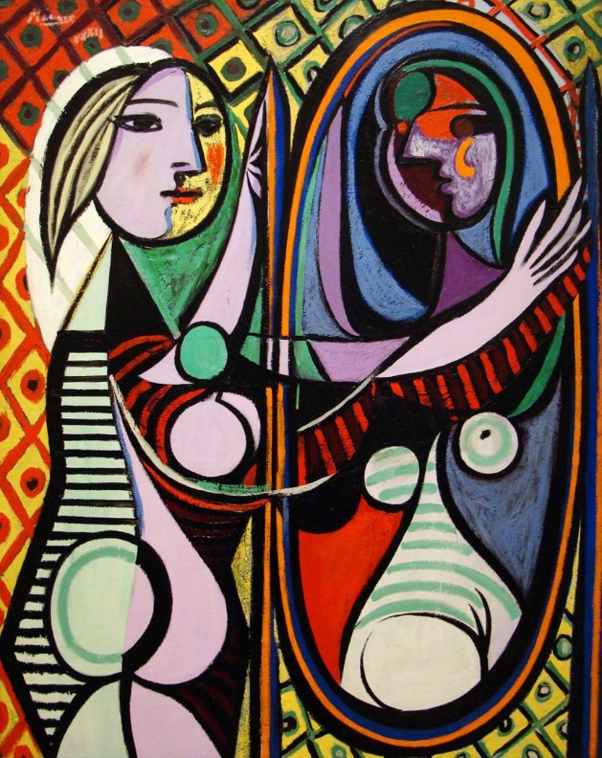
A Revolution in Art
Others like Georges Braque “Port en Normandie”
and Pablo Picasso “Girl Before a Mirror”
founded cubism which transforms natural shapes into geometric forms with sharp angles and edges with different points of view shown at the same time.

Slide 10
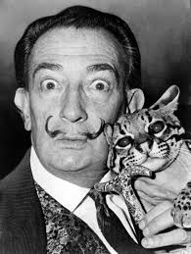
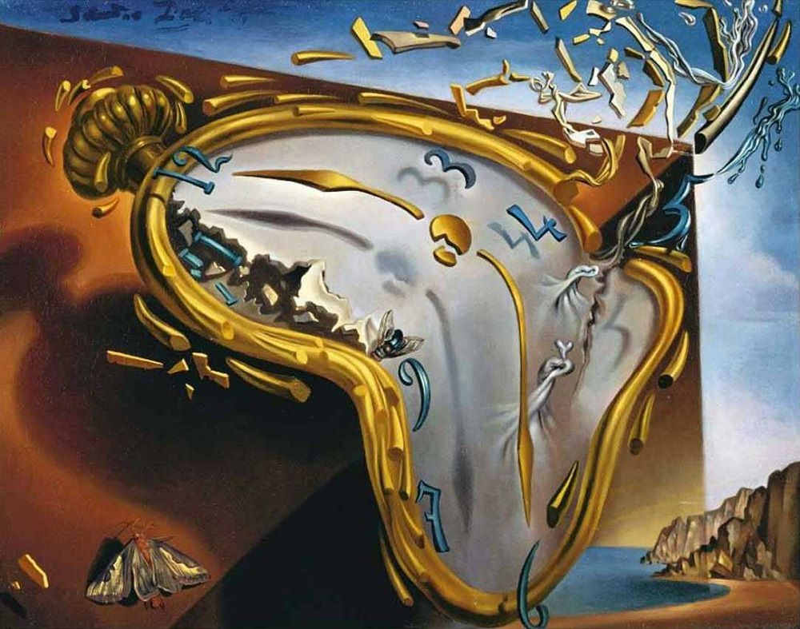
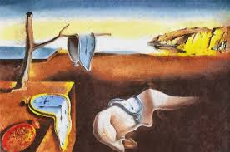
A Revolution in Art
Surrealism
Is a movement that sought to link the world of dreams with real life. It was inspired by Freud.
Surreal means beond or above reality.
Surrealists tried to call on the unconscious part of their minds
Many of their paintings have an eerie, dreamlike quality and depict objects in unrealistic ways
Salvador Dali The Persistence of Memory The Melting Watch

Slide 11
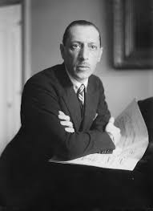

A Revolution in Art
Composers Try New Styles
People began moving away from traditional styles.
For example, in his ballet The Rite of Spring, Igor Stravinsky used irregular, harsh, combinations of sound

Slide 12
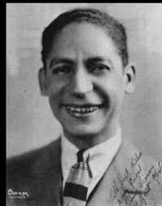
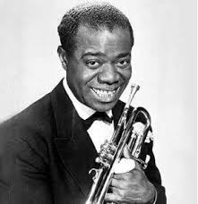
A Revolution in Art
Jazz emerged and became popular in the United States.
It was developed primarily by African-American musicians in New Orleans, Memphis, and Chicago.
It was composed of lively, loose, beats.
The song playing in the background is Wild Cherry Rag by Eddie Morton

Slide 13
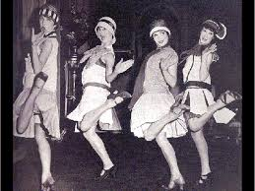
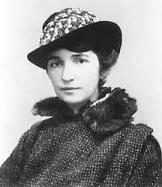
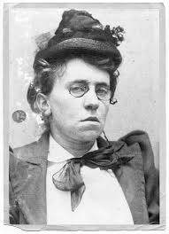
New Challenges in Society
Young people began challenging conventional thought and were especially willing to break with the past.
The Roles of Women Change
Women had begun to work outside the home during WWI and this support of the war effort helped win suffrage in many countries, including the US, after the War ended.
Women also began to wear loose fitting clothes, cut their hair short or “bobbed,” wear makeup, drink and smoke in public, and drive cars.
Many however still followed the traditional path of marriage and family.
Others however spoke out for greater freedoms and new careers such as medicine, education, and journalism.
Margaret Sanger and Emma Goldman fought for the right to use birth control

Slide 14
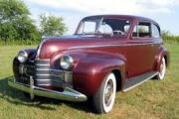
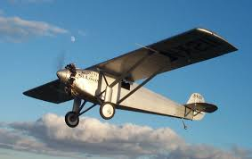
War time technological advances made the car affordable to the average family.
People began to travel for pleasure and new businesses opened to cater to them.
People also moved to the suburbs and began to commute to work in the city
Technology Improves Life
International air travel also became a goal after the war and in 1919 two British pilots made the first successful transatlantic journey from Newfoundland to Ireland

Slide 15
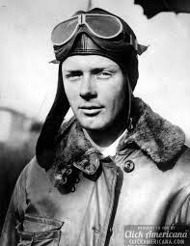
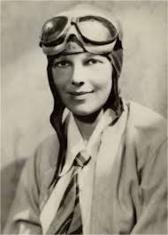
In 1927 Charles Lindbergh made the first solo flight across the Atlantic in 33 hours. He flew from New York to Paris.
In the 1920s the rich could fly on passenger airlines both domestically and internationally.
Amelia Earhart was the first woman to fly solo across the Atlantic. She did this in 1932.

Slide 16
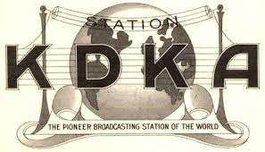
Radio became very popular after WWI. Originally it had been used for battlefield communication
In 1920 KDKA Pittsburg became the world’s first commercial radio station.

Slide 17

It didn’t take long for every major city to have a station broadcasting news, plays, and live sporting events.
Eventually, almost all families owned their own radio.
1940 – Superman –The Baby from Krypton

Slide 18
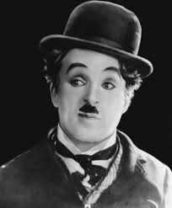
Motion pictures were also a major industry in the 1920s.
Many countries produced movies. In Europe they were considered serious art.
In Hollywood, where 90% of movies were mad, they were entertainment.
The king of the silent film was British born Charlie Chaplin. His most famous character was the Little Tramp.
At the end of the 1920s sound transformed movies into Talkies

Slide 19
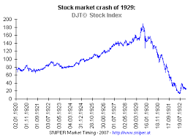
A Worldwide Depression
Communication and ease of travel made it so that global economies were more interconnected than ever.
By the 1920s the nations that had suffered the worst in WWI were starting to rebuild their economies, often times by borrowing money from the United States.

Slide 20
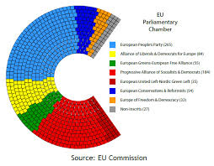
Postwar Europe:
The end of the war saw the sudden rise of new, but unstable, democracies.
From 1914 – 1918 most of Europe’s absolute rulers had been overthrown.
Most people didn’t have any experience with democracy, and in those countries that had had parliamentary systems before, the rise of large numbers of political parties made effective government nearly impossible.
Coalition government, a temporary alliance between parties, was often the only way to get anything done.
They tended to fall apart very quickly and because of this it was very difficult to make any real changes to the government.

Slide 21
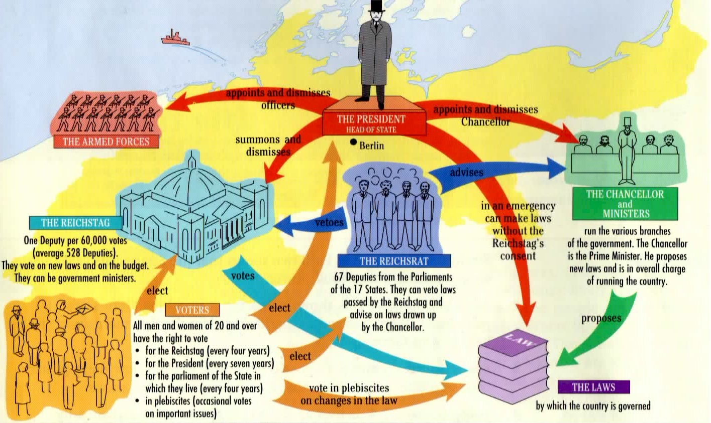
The Weimar Republic
Set up in 1919 and had serious weaknesses from the start; no strong democratic tradition, several political parties, and Germans blamed this government, instead of the wartime government, for their loss and humiliation after WWI.

Slide 22
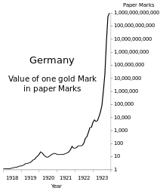
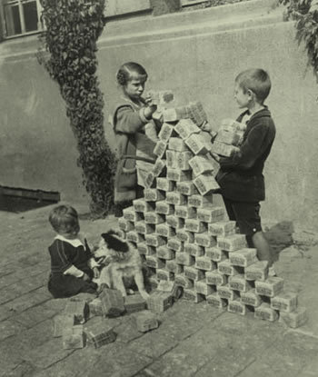
Yep, those kids are
playing with bricks of
money
Germany also suffered from hyperinflation after the war.
They had not increased their wartime taxes to pay for the war, instead they just printed more money.
After the war the money steadily lost value.
To make their reparations payments, they just printed more money which made the value fall even more
A loaf of bread cost 1 mark in 1918 and 200 Billion Marks by 1923

Slide 23
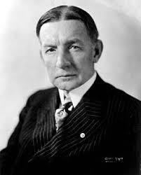
In 1923 an international committee led by Charles Dawes,
n American Banker, finally helped Germany recover.
The Dawes Plan
Provided $200 million loan from American Banks
Set a more realistic schedule for repayments
Put into effect in 1924 and helped slow inflation
By 1929 German factories were producing as much as they had before the war

Slide 24
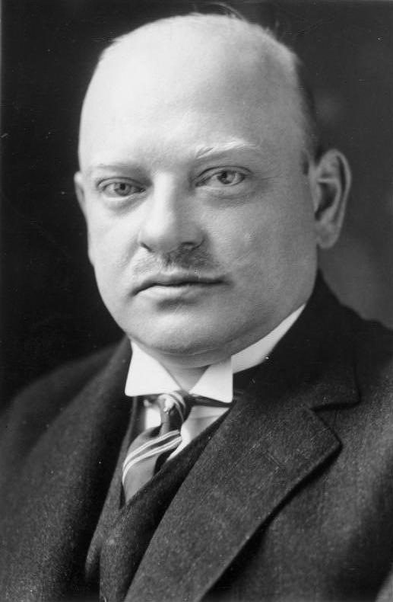
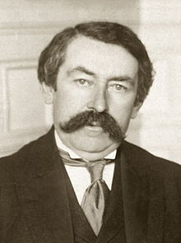
Gustav Stresemann and Aristide Briand
Tried to improve the relationship between Germany and France.
In 1925 the two men met in Locarno, Switzerland with officials from Belgium, Italy, and Britain.
They signed a treaty promising that France and Germany would never go to war against each other again.
Germany also agreedto respect the existing borders of France and Belgium. They were now allowed in the League of Nations

Slide 25
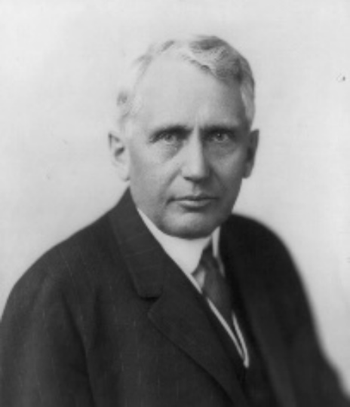
In 1928 the Kellogg-Briand pact was signed.
U.S. Secretary of State Frank Kellogg and Aristide Briand of France arranged this agreement that stated that
“war will never again be used as an instrument of national policy”
Almost every country in the world signed it, including the Soviet Union.
Unfortunately, there was no real way to enforce it because the League of Nations did not have it’s own armed forces.
Also, the U.S. refused to join the League.

Slide 26
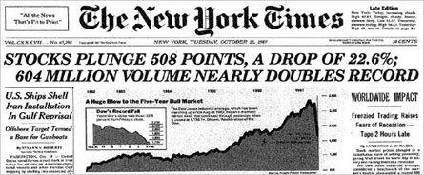
Financial Collapse and the Great Depression
Most American families at this time made less than $2,000 a year, which meant that they couldn’t afford to buy all the goods being produced in American factories. This led to lay offs in the factories and fewer people being able to buy goods.
The same happened with farms that now were producing huge amounts of crops and facing stiff competition from foreign countries.
Farmers and Factory owners couldn’t pay their debts to the banks, businesses closed, banks closed, yet some people continued to invest

Slide 27
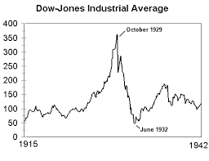
In 1929 stocks for sale at the NYSE were soaring in price, which meant many people who couldn’t afford them borrowed money from their stockbroker to pay for them.
Called “buying on margin.” This worked great when stocks were high, people used the dividends to pay their loans, but when prices fell, they lost everything.
In September of 1929 some people began to sell their stocks thinking that prices were going to go down soon. By October the market was in a steep slide and no one wanted to buy.
On Tuesday October 29,1929 a record number of stocks were sold (16,000,000) and the market collapsed.

Slide 28
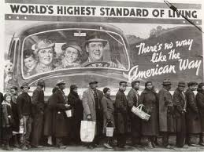
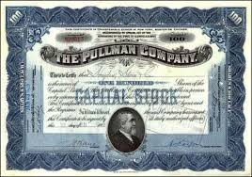
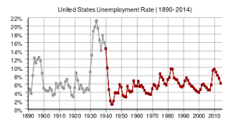
People who had money now had nothing.
Stocks were worthless.
Unemployment rates skyrocketed, while production, prices and wages declined

Slide 29


This leads to a Global Depression
Nervous American bankers begin to demand repayment of foreign loans and investors withdrew their money from Europe.
Congress placed new, high, tariffs on European goods and demand collapsed, causing worse conditions in the U.S and the World

Slide 30


World trade dropped by 65% and unemployment rates soared globally.
Because of their war debts Germany and Austria were hit harder than most other European nations.
In Austria particularly, the value of their exports fell by more tan 50% between 1929 and 1931.
Latin America suffered when U.S. demand for their products; sugar, beef, and copper, dropped and prices collapsed

Slide 31

Each country had to face the challenge to their economic and political system in their own way.
Britain:
British voters elected a multiparty coalition government called the National Government.
This did several things to improve the economy.
Passed high protective tariffs
Increased taxes
Regulated the currency
Lowered interest rates to encourage industry (makes people spend instead of save)
These measures brought about steady, if slow, growth and by 1937 unemployment was cut in half and production had risen above 1929 levels.

Slide 32

France:
France was more agricultural so they were more self sufficient but they still had a million people unemployed by 1935
France’s more pressing problem was political instability.
In 1933 five coalition governments formed and all 5 failed.
Many political leaders were afraid of the rise of anti-democratic forces in Europe and this led to the creation of The Popular Front in 1936. This was a coalition government of Socialists, Communists, and moderates.
They passed a series of reforms to help workers. Unfortunately though prices rose faster than wages and unemployment stayed high.
They stayed a democracy however.

Slide 33

Socialist Scandinavia finds Solutions:
In Denmark, Sweden, and Norway socialist governments successfully met the challenges of the depression
Sweden sponsored massive public works to keep people employed.
All of them raised elderly pensions, increased unemployment insurance, increased
Housing subsidies, and other welfare benefits.
To pay for this they taxed everyone.
They also remained democratic.

Slide 34

In the U.S. Franklin Roosevelt was elected in 1932
Roosevelt put in a plan called the New Deal that included plans to create jobs for the unemployed.
Huge amounts of public money were spent on welfare and relief programs. He believed that government spending would create jobs and speed recovery.
He also regulated the stock market and banks by creating government oversight in the form of the SEC (Securities Exchange Commission) & the FDIC (Federal Depositors Insurance Co.)

Slide 35



The Rise of Fascism in Europe
Benito Mussolini – Italy Adolph Hitler - Germany

Slide 36
Fascism in Italy
Many people initially looked on Benito Mussolini as a force for order in the chaos that came after WWI. Many Italian nationalists were unhappy with the terms of the treaty ending the war.
In 1919 socialists won more seats in parliament than any other party and this scared middle-class Italians. (They yelled “long live Socialism!” instead of greeting the king when parliament met, which as customary)
In the summer of 1920 workers went on strike and occupied factories.
In the countryside landless peasants revolted and took land from the wealthy landowners.
The government was unable to do anything about the turmoil and Benito Mussolini use this to his advantage to gain and keep power in Italy.

Slide 37


As a young man Mussolini had been a socialist but when WWI started he instead became a nationalist and fought for Italy.
In 1919 Mussolini organized war veterans into the Fascist party.
(From the Latin “Fasces” or a bundle of sticks around an axe handle – it symbolizes unity)
He often spoke of the glory of ancient Rome to inspire patriotism and obedience to authority.
At first, Mussolini didn’t really have any solid goals for the fascists, but eventually he turned it into a political movement.

Slide 38

The key idea of fascism is glorification of the state. “Everything in the state, nothing outside the state, nothing against the state”
Fascists condemned democracy because they felt that rival political parities destroyed unity. They also hated socialism and communism.
Instead, they supported a single strong ruler in a 1 party system and defended private property and private enterprise.
They were also aggressively nationalist and believed that a strong nation had every right to take over a weaker one and that a desire for peace indicated weakness.
Military sacrifice was glorified.

Slide 39


Fascism’s Appeal
Fascism appealed to many people in Italy
Veterans of WWI appreciated the militarism
Italian Nationalists applauded the idea of reviving the glory of ancient Rome
Young Italians loved Mussolini’s speeches about “action” and “struggle.”
  Many joined Fascist youth groups where they learned military skills and nationalist ideals
Some middle and upper class Italians were impatient for a strong leader who would keep order
  They also supported the ideas of private property

Slide 40


The March on Rome
In the early 1920s bands of Mussolini’s followers, called black shirts, roamed the streets of Italy beating up communists, socialists and union members.
They kicked out communists and socialists from local governments and grew in power.
October 1922 Mussolini leads a “march on Rome” to protect the capital from “communist takeover.”
There was no communist threat however, but instead the perceived threat of the black shirts marching on the capital frightened the government into surrender.
The king refused to use troops against them and named Mussolini Prime Minister a few days later

Slide 41
As Prime Minister, Mussolini was given emergency powers for a year.
Before the year ended, he pushed a law through parliament that guaranteed a Fascist majority in parliament and steadily increased his power
To the outside world Italy was still a constitutional monarchy with an elected parliament.
In reality Mussolini had the right to make laws on his own and his party controlled elections and outlawed all other political parties

Slide 42


Mussolini adopted the title Il Duce (The Leader) and the Fascist party bought major newspapers and wrote articles about how awesome he was.
Mussolini is always right was the motto everyone was supposed to believe in and if you didn’t you could be arrested and thrown into remote prisons or beaten on the street.
School children were taught Fascism and loyalty to the party and Mussolini and wore the black shirted uniforms of the fascist party.

Slide 43

Fascism and Communism differed on their belief about private enterprise
Mussolini introduced the corporate system to Italy where employers and employees in each industry joined a government sponsored “corporation”
Labor Unions were abolished.
The “Corporation” controlled prices and wages in the industry it controlled.
This did lead to a brief economic recovery in the 1920s but the Depression still hit Italy hard.
To distract people from their issues Mussolini blamed the world for the economic issues and embarked on an aggressive foreign policy.

Slide 44




“We have the right to an empire.”
1924 Negotiated a treaty with Yugoslavia that gave Italy the city of Fiume
1927 Imposed a protectorate over Albania
1934 Mussolini demanded territory from Ethiopia after border clash between them and Italian Somaliland
  1935 Italy invaded Ethiopia (October) after the League of Nations delayed action
    The League will eventually call for sanctions against Italy that would have stopped or slowed the sale of weapons and oil.
May 1936 Ethiopia fell to Italy.
June 1926 Haile Selassie (Exiled emperor of Ethiopia) travelled to Geneva to ask the League of Nations for Help
July 1926 Economic sanctions against Italy were cancelled.

Slide 45

The Rise of Nazi Germany

Slide 46

Adolf Hitler
Born in Austria in 1889, he dropped out of high school in 1905.
In 1907 he moved to Vienna and tried to get into art school, but he wasn’t successful
While he was there he was influenced by Austrian nationalists who talked about the close ties between Austria and Germany. They also preached anti-Semitism.
He served in WWI and was wounded. At the end of the war he settled in Munich and joined a tiny right-wing political party that would eventually take the name National Socialist German Workers’ Party (Nazi)
They adopted the swastika as their symbol.

Slide 47

In a short time, Hitler became the leader (der Fürher) and he plotted to seize power.
In 1921 there were about 6,000 people in the Nazi party. By the end of 1923 after the French occupation of the Ruhr there were approximately 50,000.
November 8, 1923
Hitler led an uprising against the Weimar Republic in Munich called the Bier Hall Putsch.
He expected it to start a popular uprising but it didn’t and he was arrested, tried for treason, found guilty, and sentenced to 5 years in prison. (He was out in less than a year)
While in prison he wrote Mein Kampf or My Struggle which set forth his beliefs and goals for Germany where he said that “Aryans” were the “Master Race.” (Also, Germans aren’t Aryan, but really why quibble…) All non-Aryans were “Inferior.” This group include Jews, Slavs, and Gypsies.

Slide 48

He also called the Versailles Treaty a disgrace (Okay, so it was unfair to Germany…) and vowed to take back land that Germany had lost.
He also declared Germany “over-crowded” and said that they needed Lebensraum or living space.
To get that living space he vowed to conquer Russia and Eastern Europe.

Slide 49
When Hitler was released from prison in 1924 he worked to broaden the appeal of the Nazi party.
He was widely ignored until the Great Depression made his promises of benefits to peasants, workers, and the middle-class suddenly had more appeal.
As the unemployment rate skyrocketed, support for Hitler and the Nazi party grew as people looked to him for strong leadership and the Nazi party provided free meals to the unemployed.
Unemployment in Germany 1928 – 1933
Year Unemployed
1928 650 000
1929 1 320 000
1930 3 000 000
1931 4 350 000
1932 5 102 000
1933 6 100 000

Slide 50


In 1932 the Nazis were the largest single party in the Reichstag
January 30, 1933 President Paul von Hindenburg asked Hitler to become chancellor.
Because the Nazis were large but did not have a majority Hitler had to form a coalition government. He called for new elections in March of 1933.
6 days before the election a fire was started that destroyed the Reichstag.
It was probably set by Nazis, but they blamed communists for the fire and for planning a revolt.
He convinced von Hindenburg to issue emergency orders doing away with freedom of assembly and speech. He also managed to win a small majority for the Nazis in parliament. (Some sources say it wasn’t a majority at all)

Slide 51




Hitler now gets dictatorial powers from the Reichstag for 4 years.
He bans all other political parties and has his opponents arrested.
In 1934 he combines the offices of President and Chancellor when von Hindenburg died.
He calls his government the Third Reich (Third Empire) and declares that it will last 1000 years.
He also creates a paramilitary protection squad called the Schutzstaffel or SS that is loyal only to Hitler.
Hundreds of Hitler’s enemies are rounded up and murdered.
This, plus the terror of the Gestapo (Secret Police) shocked most Germans into total obedience.

Slide 52





The Nazis quickly took command of every aspect of German life, including the economy
New laws banned strikes, dissolved labor unions, and gave the government control over business and labor.
People were put to work building factories, highways, making munitions, and serving in the military.
As a result, unemployment dropped from ~ 6 million to ~1.5 million by 1936.
Joseph Goebbels, the minister of propaganda, made radio stations play military music and speeches glorifying the Nazi state.
Students were encouraged to join the Hitler Youth or the League of German Girls where they were taught military discipline, patriotism, and obedience.

Slide 53



The Hitler Youth and League of German girls happily wore uniforms and badges and rounded up books that were considered “Un-German” and burned them in huge bonfires.

Slide 54


Slide 55


The Nazis forced most private Roman Catholic schools to close to force all children into public school where they could be indoctrinated.

Slide 56
The War Against the Jews
In March of 1933 Jews were expelled from all government jobs and all teaching positions in the universities. Shortly after that Jews were forbidden to practice law and medicine.
The Nuremberg Laws of 1935 took away citizenship from Jews and forbade Jews from marrying non-Jews.
At this point, many Jews began to leave Germany, including physicist Albert Einstein.
The United States notoriously strictly limited the number of Jewish immigrants from Europe. Latin America, with the notable exception of Bolivia which admitted 30,000 people by 1938, also maintained strict quotas, regardless of the persecution going on in Germany.
Many European countries took in Jewish refugees but as the Nazis invaded these people were killed.

Slide 57





Kristallnacht
November 9, 1938 a German diplomat, Ernst Eduard vom Rath, was murdered by a Jewish Youth, Herschel Grynszpan, in Paris.
In response, on the night of November 9th to the 10^{th,} 1938 Nazi gangs organized riots in German citites. They attacked Jews in their homes and destroyed businesses and synagogues.
The Government arrested about 20,000 Jews and sent them to concentration, or prison camps and required all Jews to wear a yellow Star of David on their clothes so they could be identified easily. This begins the true beginning o the process of eliminating the Jews from Germany

Slide 58



The Nazis Aggressive Foreign Policy

Slide 59
March 7, 1936 – Germany invaded the Rhineland. This was an important industrial area and also a 30 mile wide buffer zone between Germany and France that Germany was forbidden to enter.
The stunned French were unwilling to go to war and the British urged Appeasement or giving in to the aggressor Germans to keep peace.
This was an important step towards war since Hitler admitted later that he would have backed down if France and Britain had stepped up.
It strengthened Hitler’s power and prestige
It shifted the balance of power in favor of Germany
Belgium and France were now vulnerable to attack by the Germans
Appeasement actually encouraged Hitler to speed up expansion instead of scaling back.
In October of 1936 Hitler and Mussolini signed an agreement called the Rome-Berlin Axis, and along with Japan became known as the Axis Powers.

Slide 60
One of Hitler’s first foreign policy goals was the combining of Germany and Austria or Anschluss (1938) He invaded in March of 1938.
To prepare for German expansion, Hitler increased the military from the imposed limit of 100,000 to more than 500,000 and claimed that he had to because the Soviet Army was growing also.
The League of Nations condemned Hitler’s actions but did nothing about it. (Not that Germany cared, they hadn’t been part of the league since 1933)
France however was concerned with this and signed an anti-German alliance with Russia.
Unfortunately, the rest of Western Europe and the United States couldn’t unite in their response to Hitler’s aggressive foreign policy.

Slide 61
Hitler then turned to Czechoslovakia.
There were about 3,000,000 German speaking people lived in a heavily fortified area called the Sudetenland, which was Czechoslovakia’s primary defense against Germany.
The Anschluss raised pro-German feelings in the Sudeten Germans.
In September of 1938 Hitler demanded the Sudetenland be given to
Germany.
The Czechs refused and turned to France for help

Slide 62


The Munich Conference
Mussolini proposed a meeting of Germany, France, Britain, and Italy in Munich, Germany (Held on September 29, 1938). The Czechs weren’t invited.
Neville Chamberlain, British Prime Minister believed that he could preserve peace by GIVING IN TO HITLER’S DEMANDS!
Britain and Franc agreed that Hitler could take the Sudeten land and in return Hitler would respect Czechoslovakia’s new borders

Slide 63
“I Believe it is Peace for our Time.”

Slide 64

When Chamberlain returned to London, he told cheering crowds “I believe it is peace for our time.”
Winston Churchill, however, strongly disagreed. He felt that appeasement would only make the Nazis and other fascist regimes more aggressive.
He was right.
Within 6 months Hitler took the rest of Czechoslovakia. Mussolini took Albania. Hitler then demanded the port of Danzig back from Poland.
The Poles refused and turned to Britain and France for help.

Slide 65

Britain and France asked the Soviet Union to join them against Hitler.
As Stalin talked to them he was also negotiating with Hitler.
On August 23, 1939 Nazi Germany and Soviet Russia signed a nonaggression pact.

Slide 66


Democratic Nations try to Preserve Peace
Instead of taking a stand against the spread of Fascist powers, Britain and France repeatedly made concessions hoping to keep the peace because they remembered the horrors of WWI.
The United States Congress passed 3 Neutrality Acts that barred loans and sale of arms to warring
nations. Many Americans supported Isolationism (the policy of staying out of world affairs)

Slide 67


Other European Nations fall to Fascists
1919 – Hungary’s military forces and wealthy landowners combined forces to make Admiral Miklos Horthy the first European post war dictator
1926 – Poland – Marshal Jozef Pilsudski seizes power.
In Yugoslavia, Albania, Bulgaria, and Romania monarchies turned to “strong-man” rule, suspending constitutions and silencing their foes.
1935 – only 1 eastern European democracy remained – Czechoslovakia
Many nations turned to dictatorships (no matter how brutal like Communist Russia or Nazi Germany) because they saw it as the only way to maintain stability.

Slide 68

Spain Erupts in Civil War
Spain had been a monarchy until 1931 when a republic was declared.
The liberal socialist government had managed to hold office during the crisis following the Depression.
In July 1936 army leaders, wanting a Fascist government, joined General Francisco Franco in a revolt.
The civil war that followed lasted 3 years.
Hitler and Mussolini sent troops, tanks, and airplanes to help Franco’s Nationalist forces.
Western democracies sent no help, choosing instead to remain neutral.
The Soviet Union sent equipment and advisors to support the Republican forces. People from many other nations joined the Republican resistance on their own, but it wasn’t enough and Spain fell to Fascism in 1939

Slide 69


On April 26, 1937 Franco’s allies bombed the ancient Basque city of Guernica.
Pablo Picasso painted Guernica, using the principle of Cubism, to show the human horror

Slide 70

Japan Seeks an Empire

Slide 71


In 1922, Japan signed an international treaty agreeing to respect the borders of China and in 1928 they signed the Kellogg-Briand pact renouncing war as foreign policy
Their democracy was weak though, Parliament and the Prime Minister were severely restricted, and the military only answered to the Emperor.
The Japanese had signed a disarmament agreement stating that they would keep their navy below the size of the American or British fleets at the London Naval Conference in 1930

Slide 72


When the depression hit in 1929 the military took power looking to reestablish traditional leadership and control of the government to the military.
By may of 1932 the military had set up a military dictatorship in Japan
They made Emperor Hirohito the symbol of state power. This won popular support for the military leaders who ruled in his name.
The leaders of this movement were extreme nationalists who wanted to solve economic problems through imperial expansion and they planned a pacific Empire that would provide Japan with raw materials and markets for goods, as well as lebensraum for their growing population.

Slide 73

Manchuria was rich in iron and coal and had seen a lot of Japanese business investment.
In 1931 the Japanese army invaded Manchuria against the objections of the parliament.
The army set up a puppet government that wouldn’t object.
Japan sent engineers and technicians to build mines and factories in Manchuria.
China went to the League of Nations to protest. The League did nothing but complain. Japan ignored the protests and withdrew from the League of Nations in 1933.

Slide 74
In 1937 a border incident touched off a full scale war between Japan and China.
Japanese forces swept through northern China and easily defeated Jiang Jeishi’s army.
Beijing and other northern cities including the capital at Nanjing (Nanking) fell to the Japanese.
At this point, Japan slaughtered between 30,000 and 400,000 men, women, and children in a bloodbath that became known as the Rape of Nanking. Japanese soldiers brutalized the captive population using rape and torture murder as their primary means of terror. There was also a well documented (and admitted to) “race” between two Japanese soldiers to see who could kill 100 people with a bayonet first. The terror lasted until 1938.
I’m sorry…I can’t put any pictures in this slide. I can’t bring myself to put pictures of what happened. We’re starting to get into the time when graphic images are available, but I won’t be the one to show them to you.

