Slide 1
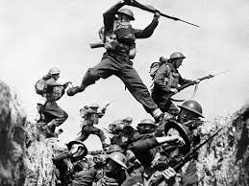
The World At War
1914 - 1918

Slide 2
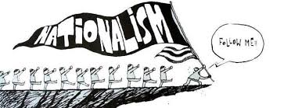
Rising Tensions in Europe
Nationalism: Pride and devotion to your country and culture.
It can unify and it can tear apart.
People with similar backgrounds and cultures can become a country or they can try to remove themselves and form a new one

Slide 3
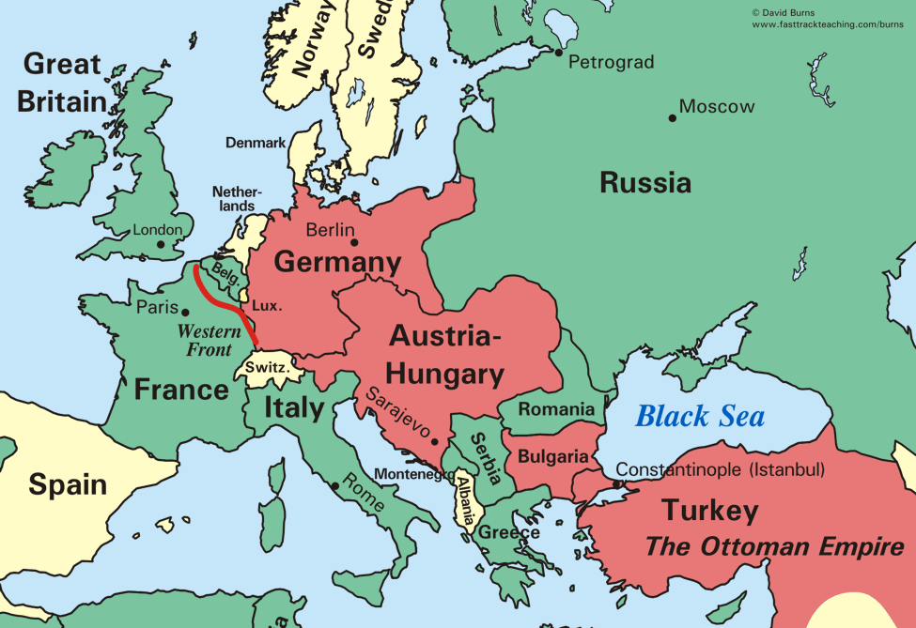
The 6 major powers of Europe:
Great Britain
Russia
Germany
Austria-Hungary
France
Italy
Were often competing with each other because of nationalism.

Slide 4
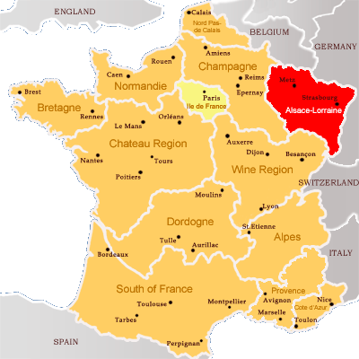
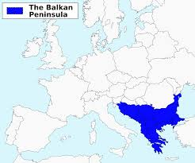
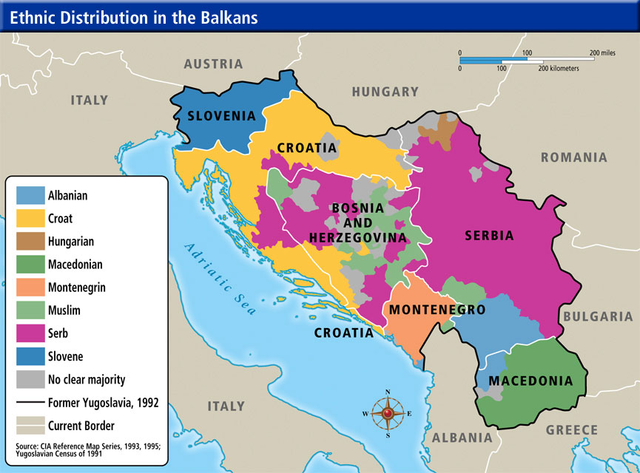
There were a couple big sources of tension between the powers
Competition for materials and markets
Territorial disputes
  The French lost Alsace Lorraine to the Germans in 1870 during the Franco-Prussian War and they were still unhappy about it in 1914
  b. Austria Hungary and Russia were both trying to dominate in the Balkans
  c. In the Balkans there were multiple ethnic groups that all wanted their independence

Slide 5
Imperialism and Militarism
Imperialism is the domination of one country economically, socially, and/or politically by another country
The major powers came to the brink of war more than once over their colonies in Africa and Asia and it led them to a lot of mistrust
Militarism is the love and glorification of the military and of war
This leads to an arms race as each country tried to outdo the others with
the number and strength of troops, weapons, etc.
By 1914 all of the major powers except Great Britain have large standing
armies
This leads to people feeling patriotic, but also to fear other countries, increasing the
levels of mistrust

Slide 6
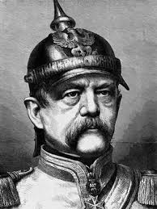
Alliances lead to war
Otto Von Bismarck
Between 1864 and 1871 Bismarck used war to unite Germany out of 309 independent states
In 1871 Germany declared itself a “satisfied power” and decided to seek peace instead
They knew France was still angry about Alsace Lorraine and decided that isolating France was the best way to keep peace in Europe.
To do that Bismarck will make alliances with other European Powers
1879 – The Dual Alliance – Austria-Hungary and Germany
1881 – Germany signs a treaty with Russia so they won’t have to fight war on 2 fronts
1882 – The Triple Alliance – Germany, Italy, and Austria-Hungary

Slide 7
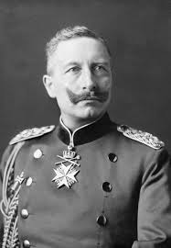
Kaiser Wilhelm II forces Bismarck to resign and then things really get bad

Slide 8
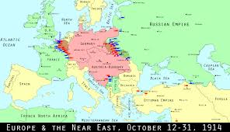
Kaiser Wilhelm II lets the Russian treaty lapse
When this happens Russia signs a treaty with France in 1892 and again in 1894
When the war starts, Germany will have to fight on two fronts. This was Bismarck’s nightmare.

Slide 9
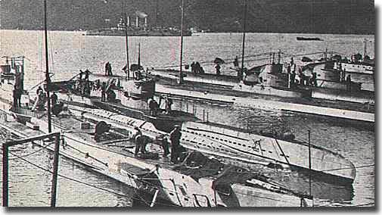
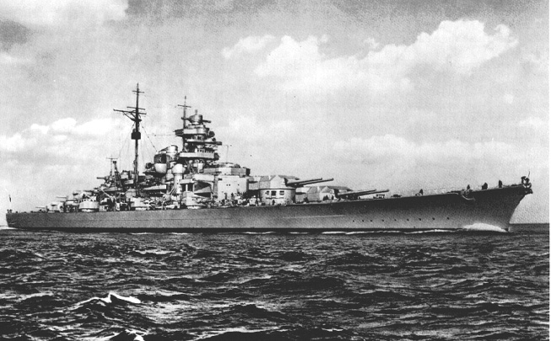
Wilhelm II then goes on a ship building spree trying to make the German Navy equal or greater than that of Britain
Britain now joins the Triple Entente with Russia and France
This means there are now 2 major alliances in Europe:
Triple Alliance (Germany, AH, Italy) and Triple Entente (GB, Russia, France)

Slide 10
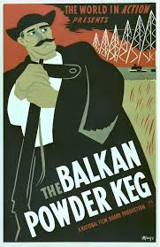

Slide 11
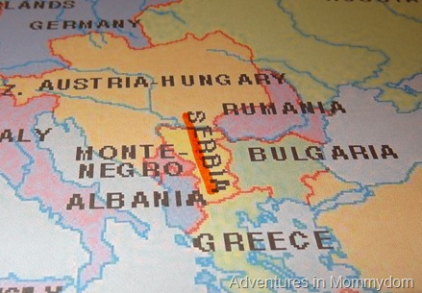
The people of the Balkans had been pushing for independence from the Ottoman Empire for years
A few, Greece, Bulgaria, Montenegro, Romania, and Serbia had succeeded

Slide 12
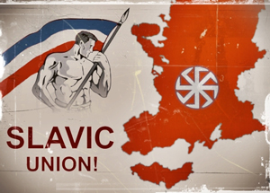
Pan-Slavism - Unity for all Slavic Peoples (Especially those controlled by non-Slavic empires)
This is the reason why Serbians wanted to extend through the Balkans
Austria – Hungary doesn’t want them to because they control some of those states
Russia does support Serbia however because they’re also Slavic
In 1908 A – H took over Bosnia and Herzegovina (Both areas were largely Slavic)
Serbia vowed to take them back, Austria – Hungary vowed to crush Serbia

Slide 13
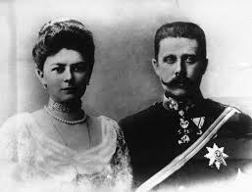
The Assassination at Sarajevo
June 28 1914 – Archduke Franz Ferdinand and his wife Sophie make a state visit to Sarajevo, Bosnia
Unfortunately this had traditionally been Bosnia’s Independence Day. Serbia was angry that Austria-Hungary had taken Bosnia away from them

Slide 14
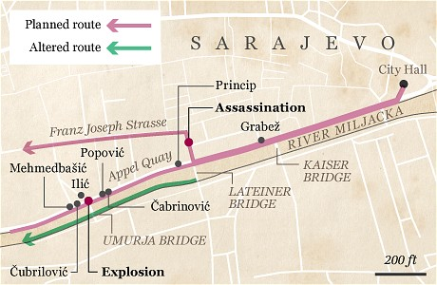
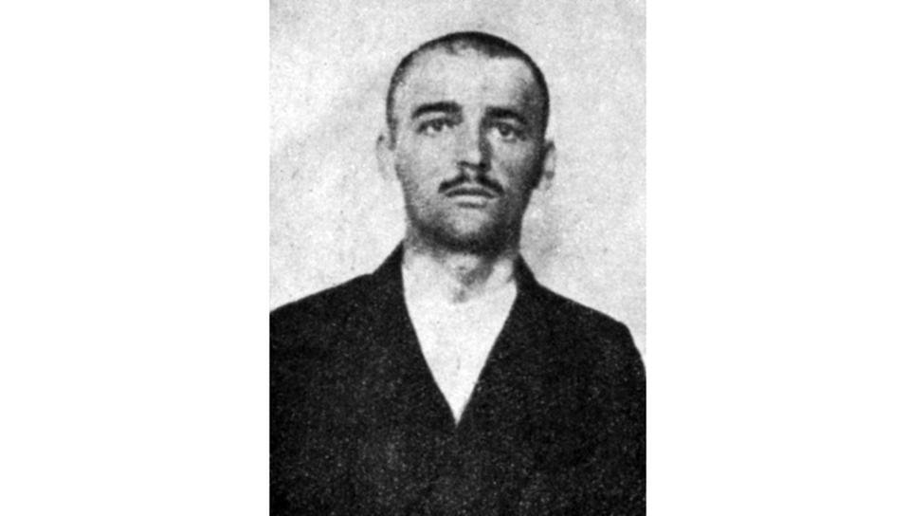
As the motorcade travelled along a well published route, a hand grenade was thrown by a man named Nedeljko Cabrinovic. It bounced of the door and injured a bodyguard

Slide 15

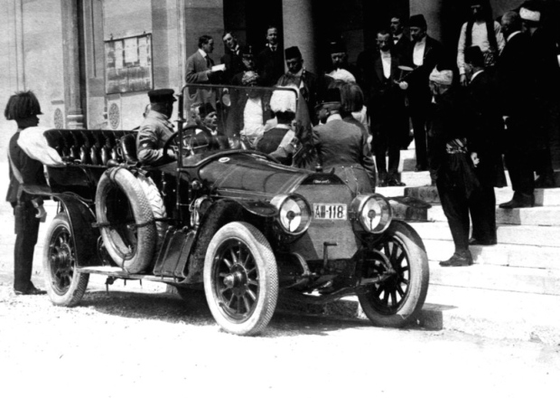
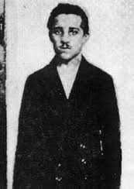
At this point, the security guards should have gotten the royal family out of there. Instead Franz-Ferdinand decided he wanted to visit the injured bodyguard then continue on with his trip. AND THEY LET HIM!!!
As the car continued down the same (!) route it reached a sharp turn and it was too large to make the turn without backing up.
When the car backed up it stopped right in front of Gavrilo Princip, a 19 year-old member of the Black Hand (Freedom Fighters? Terrorists? Depends on who you ask)
Their motto was Unity or Death

Slide 16
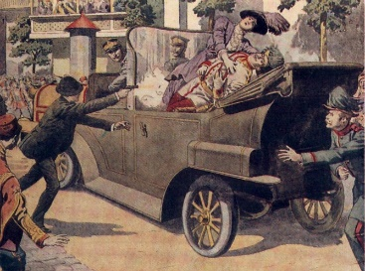
Princip shot the Archduke and his wife point blank, killing both of them
The Archduke’s last words were “Sophie, Sophie! Don’t die! Stay alive for the children!”

Slide 17
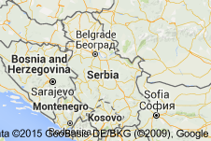

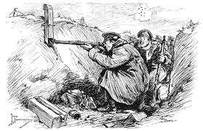
Pricip was a Serbian so Austria-Hungary blamed Serbia for the murders.
They issued an ultimatum that said that Serbia had to allow Austrian investigators into the country to investigate the murders.
Do what we say or else!
Serbia couldn’t agree without giving up their sovereignty to Austria – Hungary
BUT they couldn’t say no without going to war.
Serbia agreed to most of the terms of the ultimatum and offered to have an international council determine what should be done

Slide 18
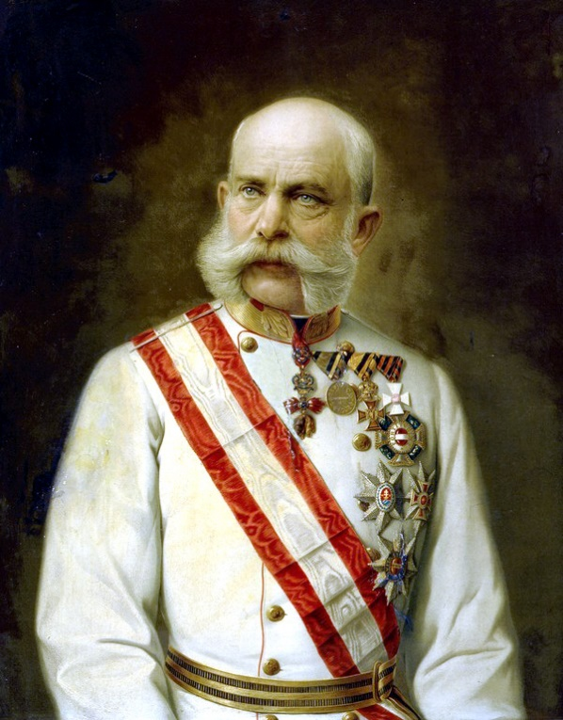

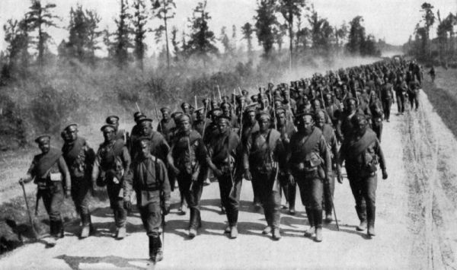
July 28, 1914
Austria – Hungary said NO to these terms and declared war on
Also on July 28th, Russia started mobilizing its army because they were allies with Serbia

Slide 19
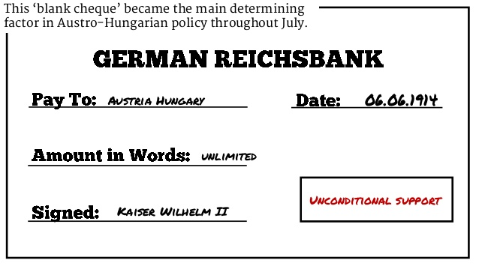
Everyone urged Austria-Hungary to negotiate but they wouldn’t.
Then Kaiser Wilhelm gave Austria-Hungary “Blank Check”
support for whatever they decided to do

Slide 20
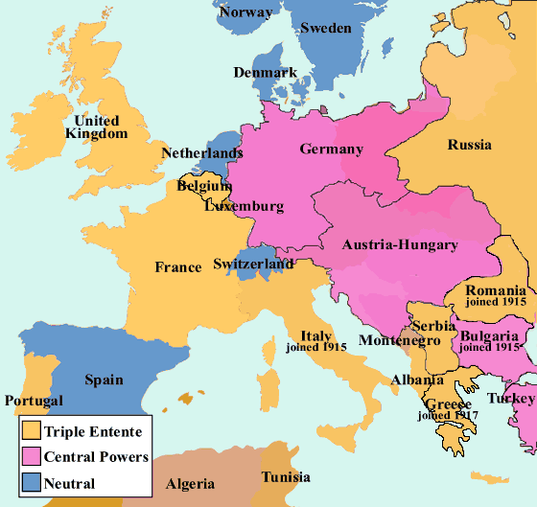
World War I Begins:
A Timeline to War:
July 28th: Austria Hungary declares war on Serbia
July 28th: Russia begins to mobilize their troops
August 1st: Germany declares war on Russia
August 3rd: Germany declares war on France
August 5th: Great Britain declares war on Germany

Slide 21
Europe is divided into two warring powers:
The Central Powers: Germany, Austria-Hungary, Bulgaria, and the Ottoman Empire
The Allied Powers: Great Britain, France, Russia, Italy, and Japan

Slide 22
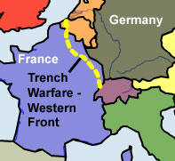
Everyone thought that the war would end quickly
Instead it turned into a stalemate along an area in Northern France called the Western Front
A stalemate is a draw or a time when there is no winner

Slide 23
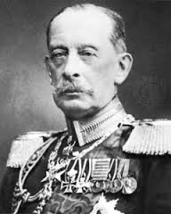
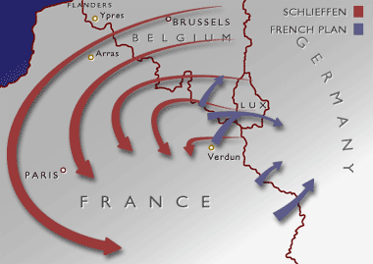
The Schlieffen Plan
Germany had developed a strategy named after General Alfred Graf von Schlieffen
This was a plan for Germany to be able to fight a successful 2 front war
It called for attacking and defeating France then quickly marching east and attacking Russia
This depended on speed, because of the size of the Russian war machine (ridiculously huge), it should take them a very long time to mobilize. The Germans thought they would have time to implement the Schlieffen Plan

Slide 24
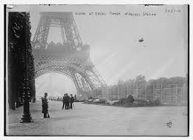
September 1914: The Germans are just outside of Paris
If they can take the city, they will defeat the French

Slide 25
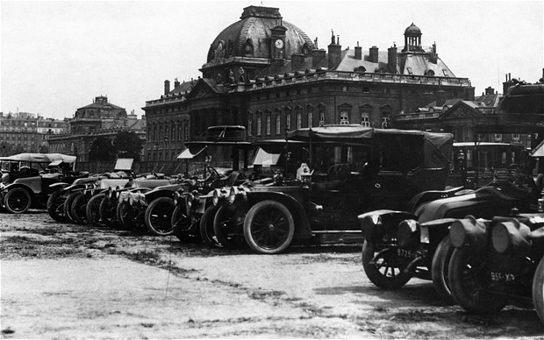
On September 5th 1914 the Allies attack the Germans at the 1st Battle of the Marne
Also called the Taxicab battle because 600 civilian taxis were used to transport every available soldier to the front line

Slide 26
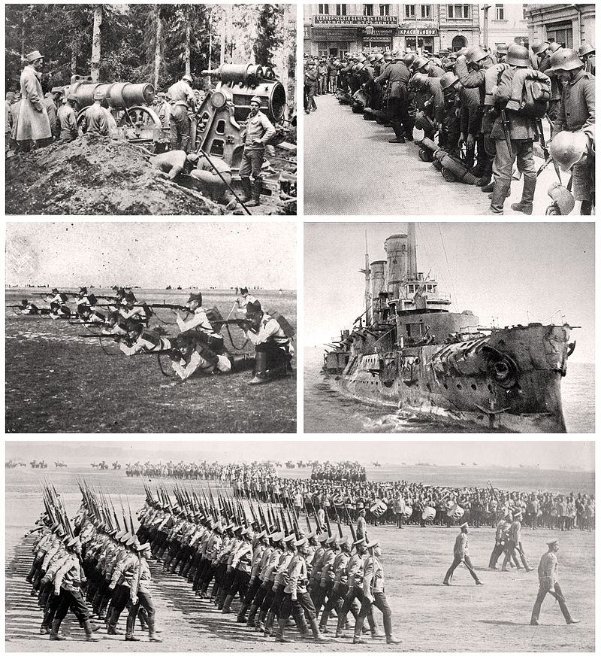
On September 9th the Germans retreated and this ruined any hopes for the Schlieffen plan to work
The Russians now invade Germany from the east.
The Germans pull troops from the Western Front and send them to the Eastern Front
This pretty much puts a stop to any further advances into France

Slide 27
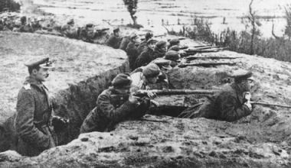
The Beginnings of Trench Warfare

Slide 28

By 1915 the opposing armies had dug miles of parallel trenches to protect themselves from enemy fire.
People would fight from these trenches

Slide 29
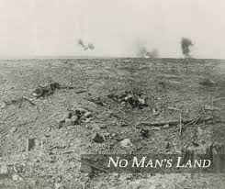
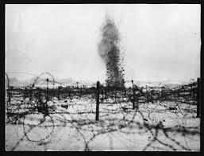
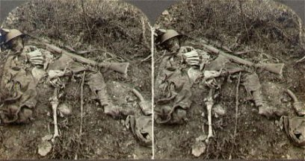
A Commander would call out “Over the Top!” and everyone in the trench would go. They then got mowed down by enemy fire in “No Man’s Land”
Staying in the trench wasn’t necessarily save either because artillery shells would fall on them and blow them, and whomever was still in them, to pieces
“Over the Top!”

Slide 30
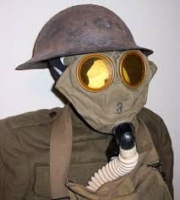

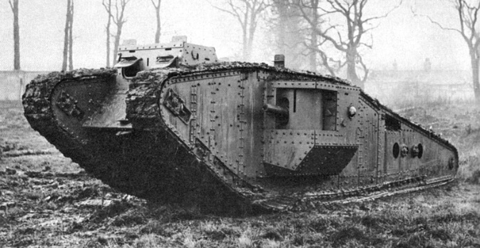


New Weapons make the stalemate worse
Mustard Gas and Chlorine Gas burned lungs and soft tissue. They were introduced by the Germans but both sides used them.
Poison Gas:
Machine Gun:
These fired ammunition automatically and made advances nearly impossible.
Armored combat vehicle with chain tracks that could cross all kinds of terrain. Introduced by the British in 1916 at the Somme.
Called Tanks because they were shipped in boxes labelled “Water Tank.”
Tank:
Submarine:
1914 Germans introduced them against British warships. Their primary weapon was the torpedo

Slide 31
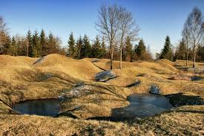
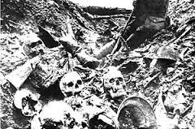
The Mincing Machine of Verdun
In 1916 the Germans launched an offensive against the French at Verdun
Both sides lost about 300,000 men (each)

Slide 32
July 1916:
The British send help to the French and attach the Germans at the Somme River NW of Verdun
On the first day of battle 20,000 British troops were killed.
By the end of the battle in November 1916 there were over ½ a million casualties on both sides
The Advances?
Germany got 4 miles at Verdun
Britain got 5 miles at the Somme

Slide 33
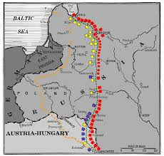
The War on the Eastern Front
This was a stretch of battlefield on the German/Russian border
It was a war between Germany/Austria-Hungary and Russia/Serbs
This front was much more mobile but slaughter and stalemate happened here too.

Slide 34
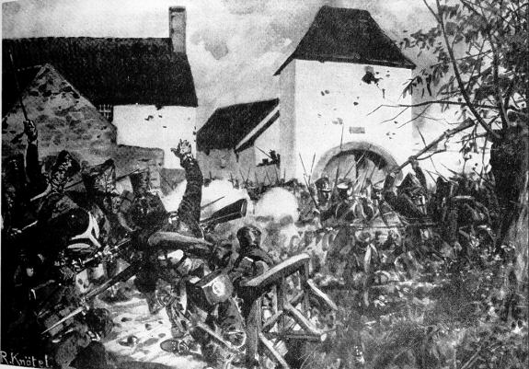
Early Battles:
Tannenberg:
In the beginning, Russian forces launched an attack into both Germany and Austria-Hungary.
By the end of August Germany had counter attacked at Tannenberg and crushed the Russians, driving them into full retreat
Over 30,000 Russians were killed and 140,000 were wounded.
The Germans had 12,000 casualties (Dead and wounded).

Slide 35
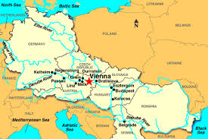
Vienna:
Russia did better against the Austro-Hungarian forces. They defeated A-H twice in September of 1914 and almost reached the Austrian capitol of Vienna.
However, by December the Russians were pushed out of Austria.

Slide 36
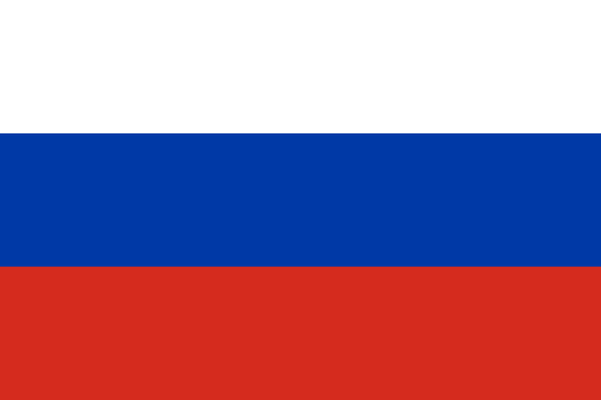
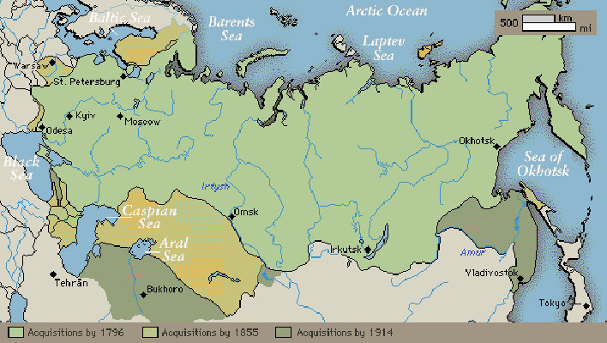
The Russian Empire:

Slide 37
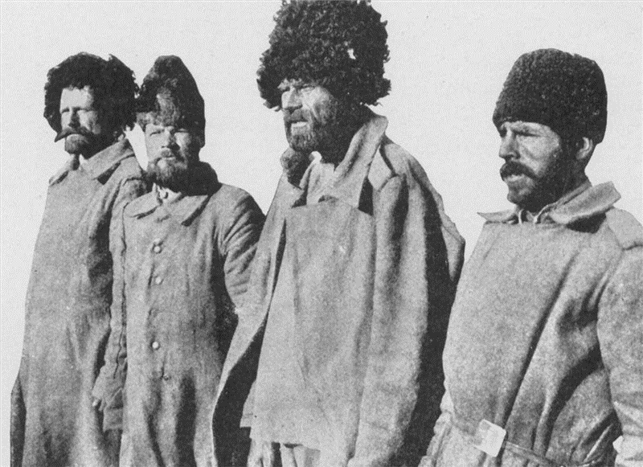
By 1916 the Russian war effort was near collapse
They hadn’t industrialized like western Europe and their army was continuously short on food, guns, ammunition, clothes, boots, and blankets
Allied ships had trouble getting supplies to Russia because the Germans and the Ottomans controlled the sea routes
The only thing keeping them in the war was their numbers.
They suffered staggering losses but still managed to pull troops from their huge population to keep the Germans tied up for years

Slide 38

A Global Conflict

Slide 39
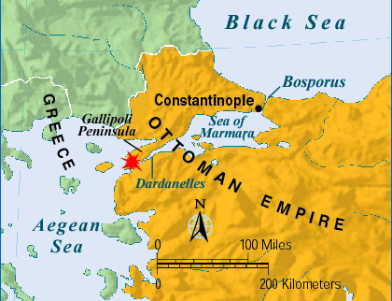
War affects the world
The Gallipoli Campaign
The point was for the Allies to be able to attack the Ottoman Empire at the Dardanelles which were the gateway to Constantinople and a way to create a supply line to Russia
Began in February of 1915: British, Australian, and New Zealand troops made repeated assaults on the Gallipoli Peninsula.
The Turks, often led by Germans, defended the region.
By May of 1915 Gallipoli was a stalemate too.
In December of 1915 the Allies gave up and retreated. They had lost about 250,000 men.

Slide 40
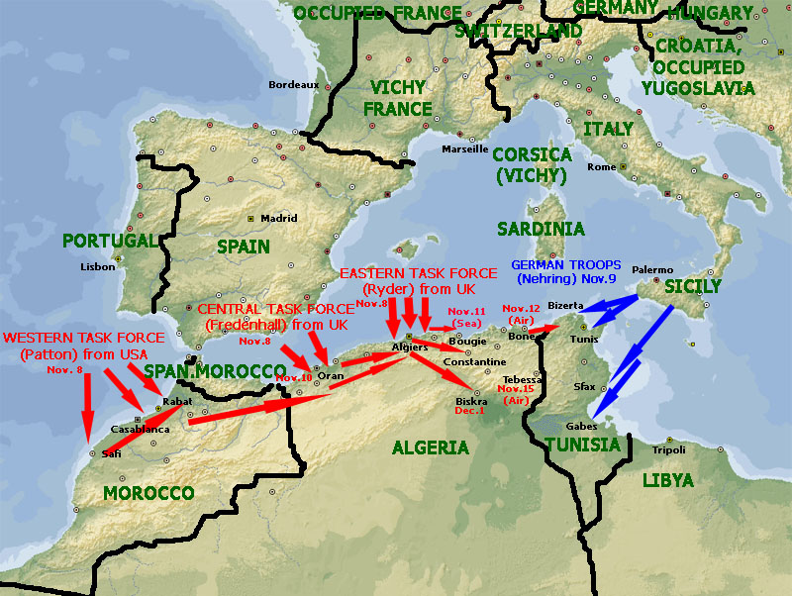
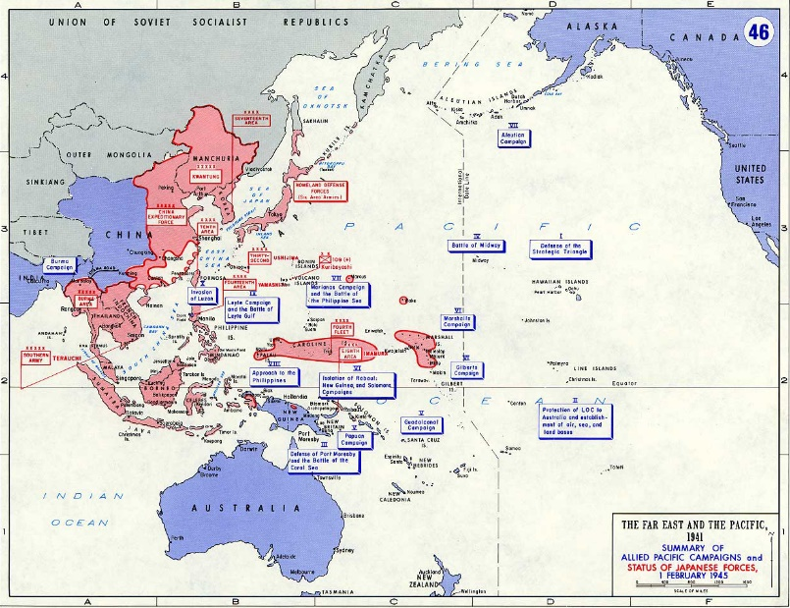
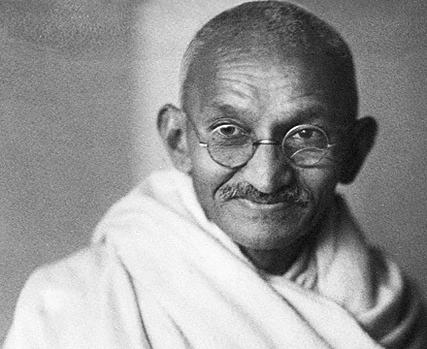
War in Africa and Asia:
The Japanese quickly overtook China and captured Germany’s Island Colonies
England and France attacked Germany’s 4 African possessions and took 3 of them.
All of the major powers looked for help from their colonies.
Some colonists didn’t want to help. Others, like Mohandas Gandhi felt that if the Indians helped the British it would help them gain independence later on

Slide 41

America Enters the War

Slide 42

By 1917 the Germans were ruling the seas with submarines and in January of 1917 they announced that they would sink any ship in British waters.
This is called unrestricted submarine warfare.
Before this, only ships flying the flags of warring nations would be attacked
The Germans had used this policy in 1915 but stopped when the British passenger liner Lusitania was sunk on May 7th 1915.
1198 people were killed including 128 Americans.
The Germans argued that the Lusitania was carrying ammo, which was true and was also an act of war
BUT they didn’t want to get the Americans involved so they stopped for a while

Slide 43


The point of resuming the unrestricted submarine warfare was to enforce a naval blockade forcing the British to surrender.
3 American ships are sunk by German U-Boats and the U.S. government ‘protests.’
The Zimmerman Note
February 1917 – U.S. officials are sent a telegram by Mexican officials that was written by Arthur Zimmerman the German Foreign secretary
The telegram staid that Germany would help Mexico ‘reconquer’ the land it had lost to the U.S. if Mexico would ally with Germany.
Mexico declines and passes the note on to the U.S.

Slide 44

The Zimmerman Telegram probably wouldn’t have been enough on it’s own to get the U.S. involved in a war.
BUT with submarine warfare and other issues the U.S. decides it’s time to get involved.
Most of the U.S. population is on the side of the Allies anyway because of common bonds of language, law, and customs with England.
U.S. also had stronger economic ties with the Allies.
April 2, 1917:

Slide 45
War Affects the Home Front

Slide 46



Total War:
The governments involved dedicated all of their resources to the war effort, including taking over the economy, making factories produce war material, and ordering every able bodied person to work. This includes women.
While all material was going to the front, goods at home were limited, which led to rationing.
Rationing is when the government decides what and how much a person can buy.
This applied to food, clothing, leather, etc.

Slide 47





Propaganda:
One sided pamphlets, posters, newspapers designed to keep up morale and support for the war

Slide 48


Women and the War:
Thousands of women now took jobs outside the home to take the place of the men who were fighting. Most of them left the workforce when the men returned.
Some worked as nurses on the front lines and saw the real horrors of war

Slide 49




Slide 50

The Allies Win

Slide 51



Russia withdraws:
In March of 1917 a civil war in Russia removed Czar Nicholas
The government tried to keep fighting but they were falling apart
5.5 million men had been killed, wounded, or taken prisoner
In November 1917 Vladimir Ilyich Lenin took power in Russia and signed a treaty with Germany
The Treaty of Brest-Litovsk in March of 1918 ended the war between Russia and Germany

Slide 52

The Central Powers Collapses
Russia’s withdrawal allowed German troops to focus on the Western Front where they launched a massive attack in March of 1918
By May they have reached the Marne River

Slide 53


The Second Battle of the Marne
140000 U.S. troops now assist the French and the British
The 2nd battle of the Marne takes place in July 1918 and 350 tanks and 2 million more fresh troops push the Germans back

Slide 54

The Central Powers Collapse
Bulgaria and the Ottoman Turks surrender
Austria Hungary has a revolution in October
November 9, 1918 Kaiser Wilhelm II steps down when troops turn on him
Germany now declares itself a republic and a representative of the new government meets with the French commander Marshal Foch in a railway car near Paris where they sign an armistice or agreement to end the war

Slide 55




The War ends on November 11th 1918

Slide 56


The Legacy of War:
Nearly an entire generation of Europeans was wiped out
Between disease, starvation, and battle, nearly 10 million Allied and Central troops died
Farmland and villages were destroyed

Slide 57



The Treasuries of Europe were drained (338 Billion dollars is the current estimate)
People were also disillusioned and it showed in their art and literature

Slide 58
A FLAWED PEACE

Slide 59








The Allies Meet
The Big Four
Woodrow Wilson USA Georges Clemenceau France Vittorio Orlando Italy David Lloyd George United Kingdom

Slide 60
Wilson’s 14 Points
Woodrow Wilson had written up a plan for peace before the end of the war in 1918. This was known as the 14 Points and they were designed to create a fair, lasting, peace.
End Secret Treaties
Freedom of the Seas
Free Trade
Reduce the size of armies and navies
Adjust colonies in regards to the colonists
- 13. Changing borders and create new nations using the principle of National Self Determination, which is the right of people to decide under which government they wanted to live
14. A League of Nations
The League of nations would be a general association of countries that would meet to talk about problems and hopefully stop them before they led to war

Slide 61


The Versailles Treaty
At the Paris Peace conference, Britain and France ignored Wilson’s proposal.
They were concerned with national security and stripping Germany of its war making power

Slide 62


The Treaty was signed June 28th 1919 – 5 years to the day of the assassination of Franz Ferdinand
It adopted a League of Nations, but none of Wilson’s other points
Spectators waiting for the treaty to be signed

Slide 63


The War Guilt Clause
Germany was blamed for the war (remember who started it?)
They: Lost Territory
Had their Military Restricted
Took SOLE responsibility for the war
Had to pay reparations to the allies for over 33 billion dollars.

Slide 64


All of Germany’s territory in Africa and Asia was given to the League of Nations as MANDATES (Which basically means they were given to Britain and France and they would be governed by the allies until they could get their independence)

Slide 65

The Western powers signed separate treaties in 1919 and 1920 with all other defeated countries.
This will lead to huge losses for these countries.
The Austro-Hungarian empire was broken up into:
Austria
Hungary
Czechoslovakia
Yugoslavia

Slide 66

The Ottoman Turks had to give up almost all of their old empire and were left with only Turkey.
Land was carved up into mandates instead of independent nations:
Palestine
Iraq (Mesopotamia)
Transjordan
  Went to GB
Syria
Lebanon
  Went to France

Slide 67

Russia, who’d left the war early, also lost land:
Romania and
Poland
Both Gained Territory
3. Finland
4. Latvia
5. Lithuania and
6. Estonia
Became independent
nations

Slide 68

The Weakness of the Treaty:
When everything was done, the Treaty of Versailles did very little to build a lasting peace
The U.S. rejected the treaty and signed a separate peace with Germany and Austria Hungary
Most Americans were against the League of Nations because they thought that the best way to stay out of war was to stay out of world affairs
This doesn’t work, as the world is back at war in 1939 (30 years later)

Slide 69
In the end, very few were happy:
German people were bitter and angry over the war guilt clause
People in Mandates wanted independence
Japan and Italy who had joined the Allies for territory didn’t get as much as they wanted
The League of Nations was practically powerless without the U.S.
Within 20 years all this bitterness, fear, anger, and hate will lead to another, more catastrophic war

Slide 70


