Slide 1
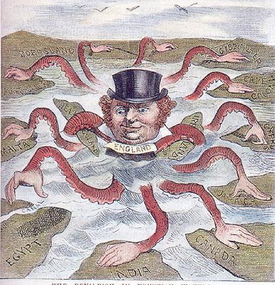
The Age of Imperialism

Slide 2
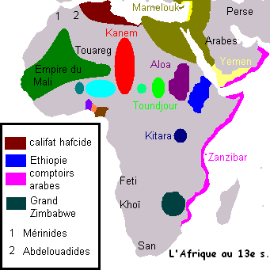
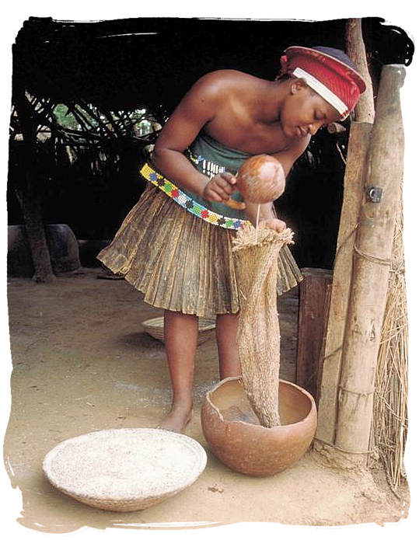
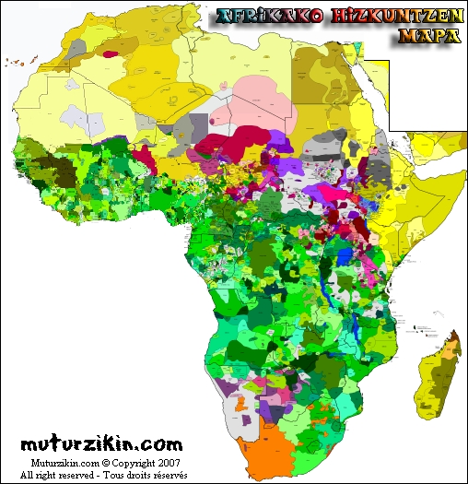
The scramble for Africa
Africa before European Domination
In the mid – 1800s, African people were divided up into hundreds of ethnic and linguistic groups
Most followed traditional beliefs
Some converted to Christianity or Islam
These groups spoke more than 1000 languages
Politically they ranged from large empires with united ethnic groups to small independent villages

Slide 3
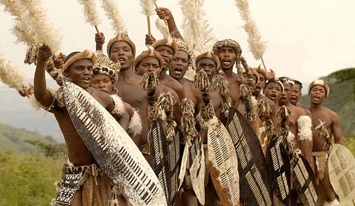

Europeans had established contacts with sub-Saharan Africans as early as the 1450s
African armies were strong enough to keep the Europeans out of most of Africa for about 400 years
By 1880 Europeans only controlled 10% of the continent and mostly on the coast
Disease and non-navigable rivers kept Europeans out for many years

Slide 4
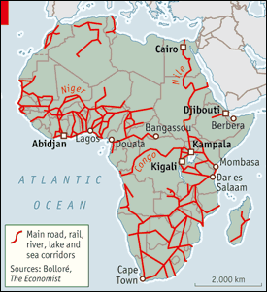
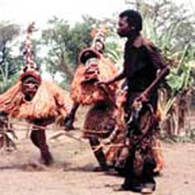
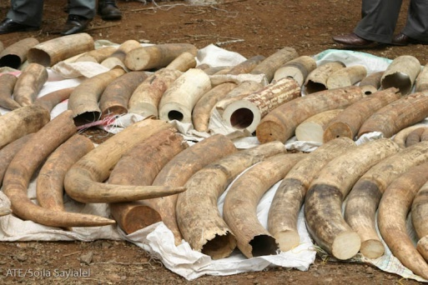

Africans controlled their own trade networks and provided trade items
Trade networks were highly specialized
One tribe, the Chokwe, devoted themselves to collecting ivory and beeswax in Angola for example

Slide 5
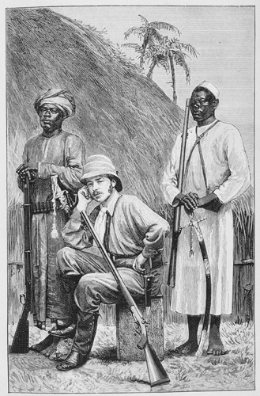
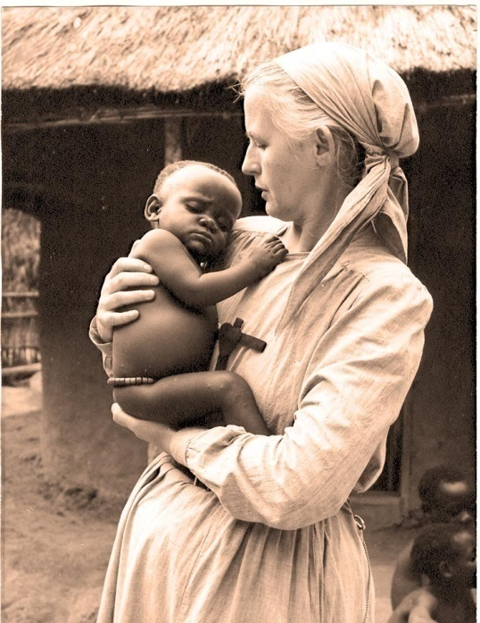
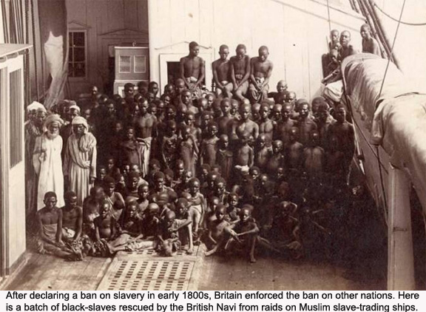

Nations compete for overseas empire
The Europeans who did make it into the interior of Africa were explorers, missionaries or humanitarians who were opposed to the slave trade
Europeans and Americans learned about Africa through travel books and newspapers.

Slide 6
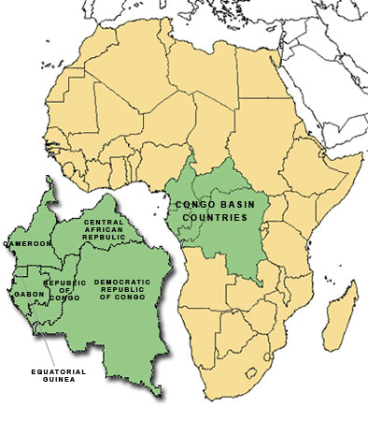
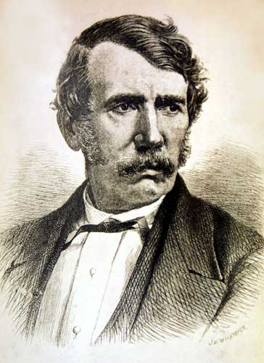
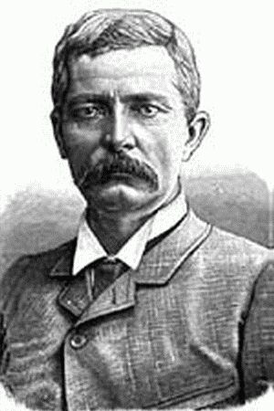
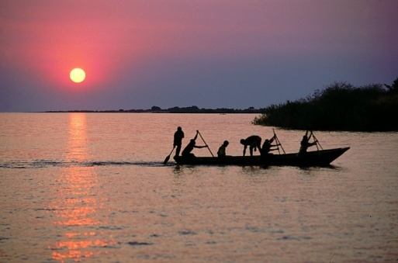
The Congo sparks interest
In the late 1860s, David Livingstone, a Scottish missionary travelled into central Africa to promote Christianity
When no one heard from him for 10 years they assumed he was dead
An American newspaper hired reporter Henry Stanley to find Livingstone
In 1871 he found Dr. Livingstone on the shores of Lake Tanganyika.

Slide 7
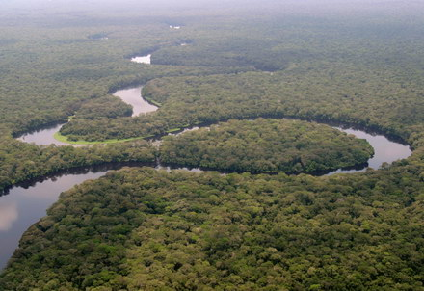
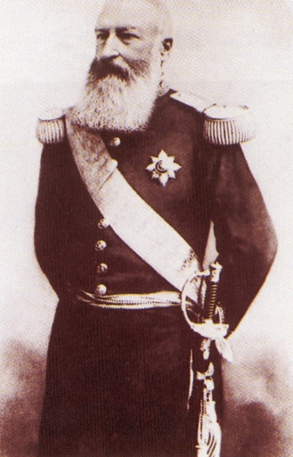
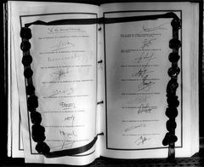
Stanley the set out to explore Africa himself and trace the course of the Congo River
His explorations got the interest of King Leopold II of Belgium
He commissioned Stanley to help him obtain land in the Congo
Between 1879 and 1882 Stanley signed treaties with local chiefs of the Congo River valley
These treaties gave Leopold control over these lands

Slide 8
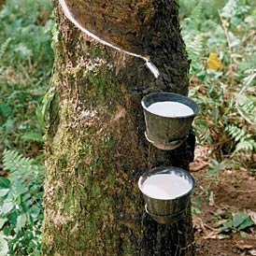
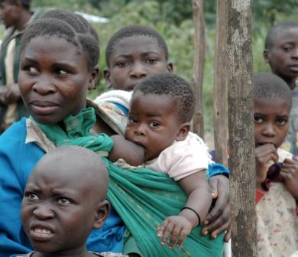
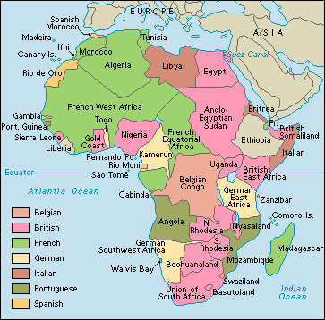
Leopold said he was colonizing these areas to stop the slave trade and spread Christianity.
However he used the Congolese people to collect sap from Rubber Trees
At least 10 million Congolese died
Because of his abuses the Belgian government took the colony away from Leopold in 1908
The French had signed a treaty getting everything north of the Congo River and the New Belgian Congo included some of their territory
It didn’t take long for all the European powers to claim land in Africa

Slide 9
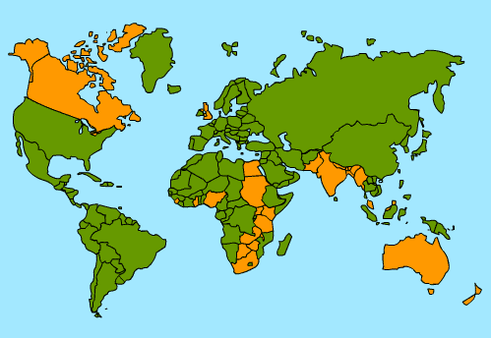
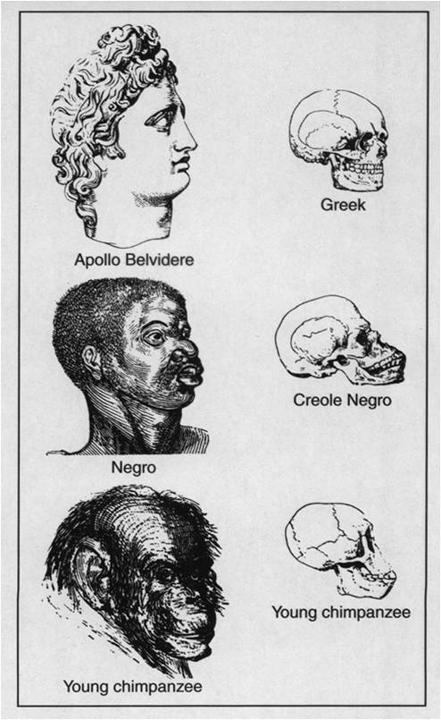
The Forces Driving Imperialism
Belief in European Superiority
National pride played a part
An Empire meant your country was powerful/great
As competition increased, each country was determined to plant their flag in Africa
Many Europeans subscribed to the beliefs of Social Darwinism and Racism
Racism – the belief that one race is superior to another
Social Darwinism – when you apply Darwin’s theory of Evolution to human society
Those who were fittest were the ones who were wealthy and prosperous
Non-Europeans were considered to be on a lower level of physical and cultural development
Because they hadn’t made the same sci and tech gains

Slide 10
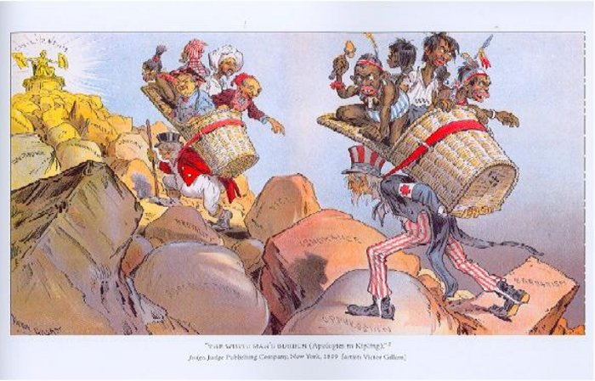
The White Man’s Burden

Slide 11
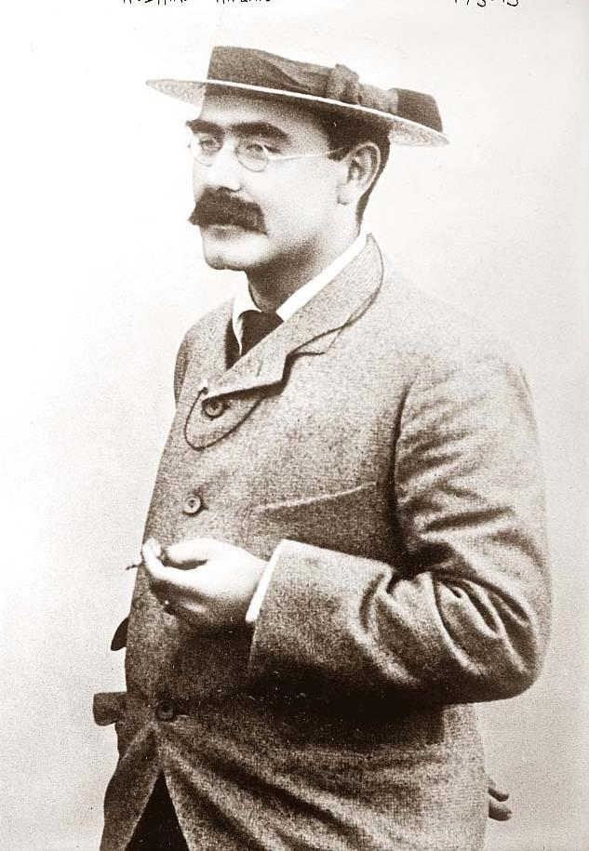
This was written as a poem by Rudyard Kipling
But really, it laid out what Europeans believed about their colonies.
Europeans felt that it was their right and duty to bring their progress to the more “backwards” countries
Missionaries also pushed for expansion for religious conversion
They also wanted to “civilize” and “westernize” the people they were colonizing

Slide 12
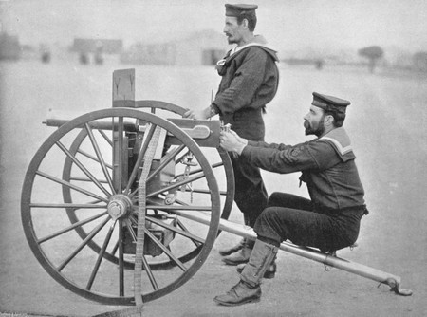

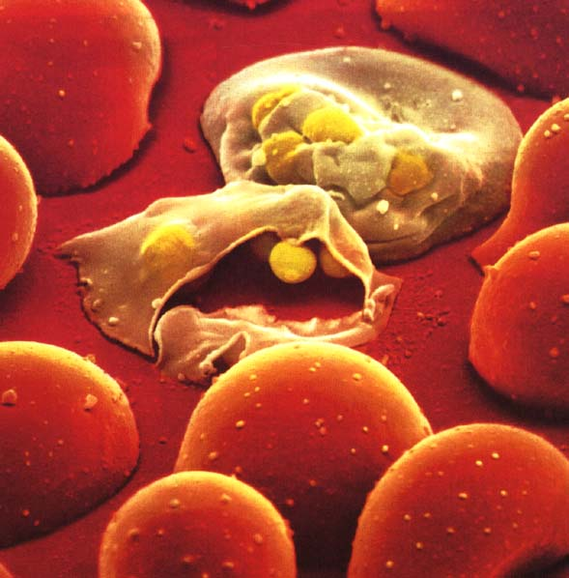

Factors promoting imperialism in Africa
One major advantage that Europeans had was technology
The Maxim Gun, invented in 1884, was the first automatic machine gun
Africans had to use outdated weapons like guns that had been traded during the slave trade years earlier
Europeans could also control their colonies
Steam engines allowed travel into the interior by rail and by river
Quinine, developed in 1829, took care of the malaria problem and allowed Europeans to travel away from the coast

Slide 13
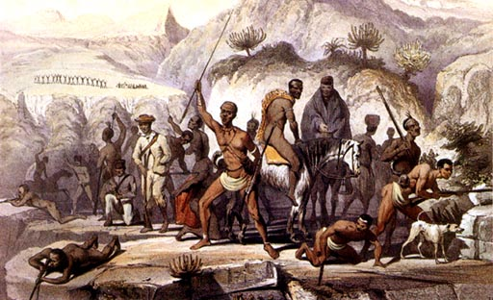
In Africa itself there were factors that made the continent easier to colonize
There were hundreds (or perhaps thousands) of different languages and cultures
Each tribe, empire or ethnic group was constantly fighting with other groups over land, water, etc.
The Africans couldn’t unite against the Europeans

Slide 14
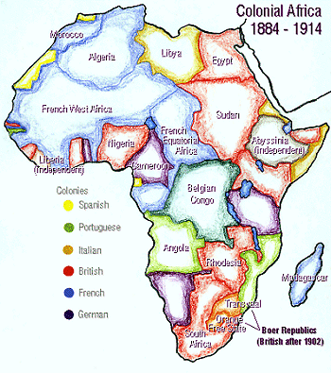

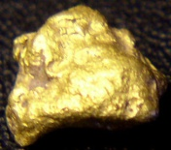
The Division of Africa
The scramble for African territory began around 1880
The French began to move from the western African coast to western Sudan
The discovery of gold and diamonds in South Africa increased the desire to colonize

Slide 15
The Berlin Conference divides Africa
European countries feared that they would go to war with each other over Africa.
To prevent this, 14 countries got together in Germany in 1884-5 to lay down ground rules for dividing Africa
This was called the Berlin Conference
Rules said that any European country could claim Africa as long as they ID’d the claim and proved they could control it
By 1914 only Ethiopia and Liberia remained Free

Slide 16
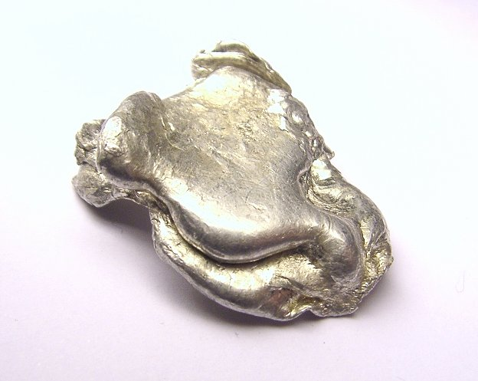
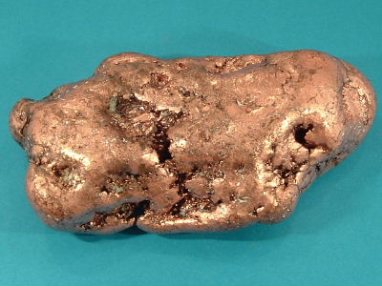


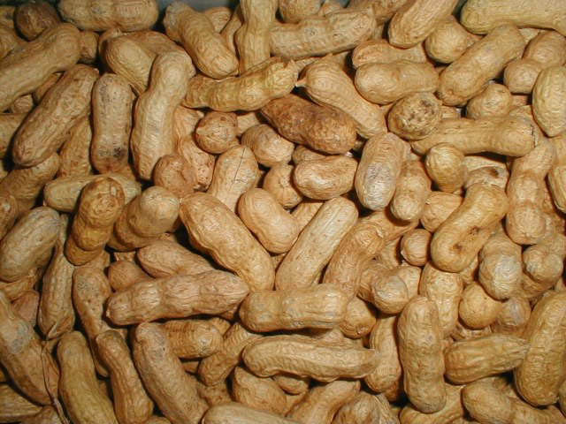

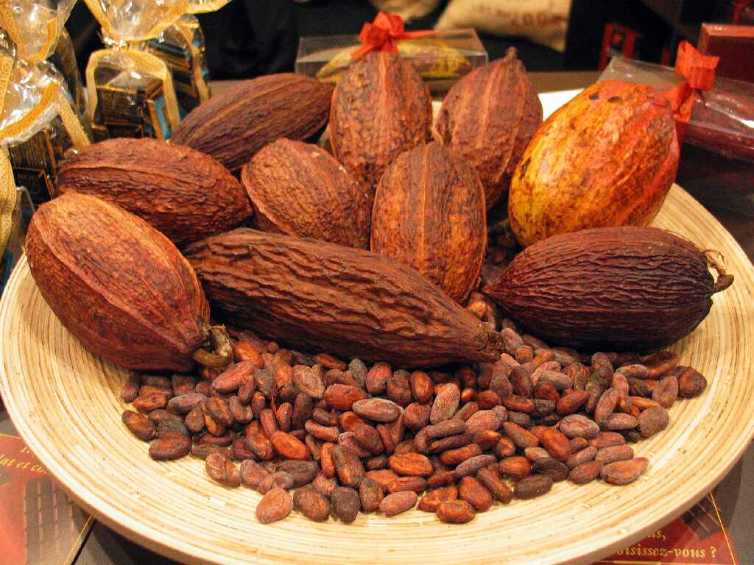
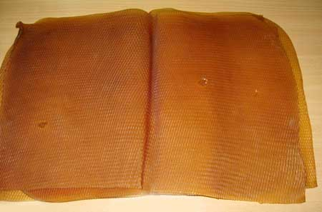
Raw Materials
Most Europeans thought that Africa would soon start buying huge quantities of European goods
They didn’t
European businesses needed raw materials from the continent and there were many natural resources in Africa
The Belgian Congo had copper and Tin
South Africa had gold and diamonds
There were also cash crop plantations that grew peanuts, palm oil, cocoa, and rubber

Slide 17
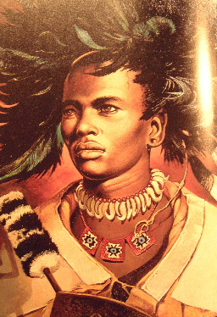
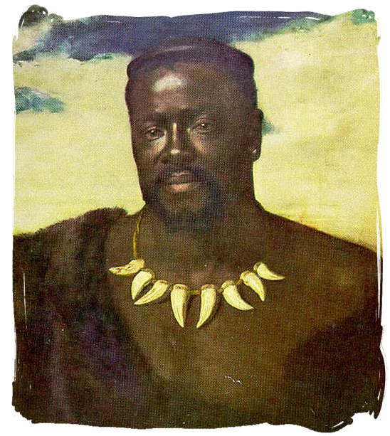
Three groups clash over South Africa
In 1816 a Zulu chief named Shaka created a large, centralized African State
His successors couldn’t keep the empire together though
In 1879 the British invaded after Cetshwayo refused to dismiss his army and accept British rule
The Zulu nearly defeated the British
The Zulu lost at the battle of Ulundi in 1879
In 1887 the Zulu nation was finally under British control

Slide 18
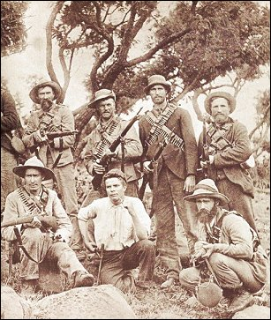
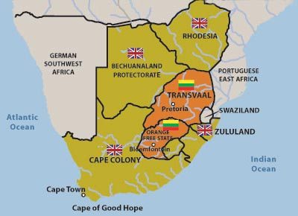
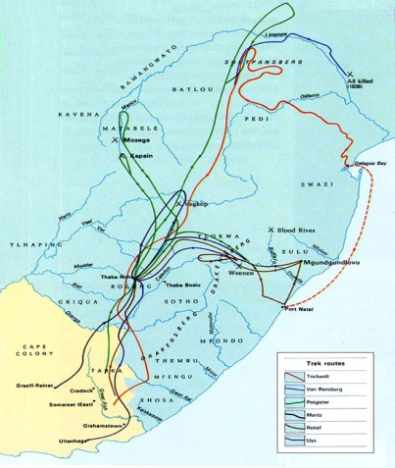
The Boers and the British settle the Cape
The first Europeans to settle in South Africa were Dutch
They came to the Cape of Good Hope and set up a weigh station for their exploring ships
Dutch Farmers known as Boers (Afrikaners) gradually took African land and set up large farms
The British took over Cape Colony in the early 1800s
The Dutch and the British clashed over land and slavery
In the 1830s the Boers began to move north – this is known as the Great Trek
They soon found themselves in conflict with the Zulu and other tribes they came across

Slide 19
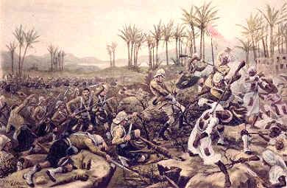
The Boer War
When diamonds and gold were discovered in Southern Africa people began to flood in
The Boers tried to protect their territory by keeping the outsiders from getting political rights
A rebellion against the Boers failed but the Boers blamed the British and in 1899 went to war against them

Slide 20
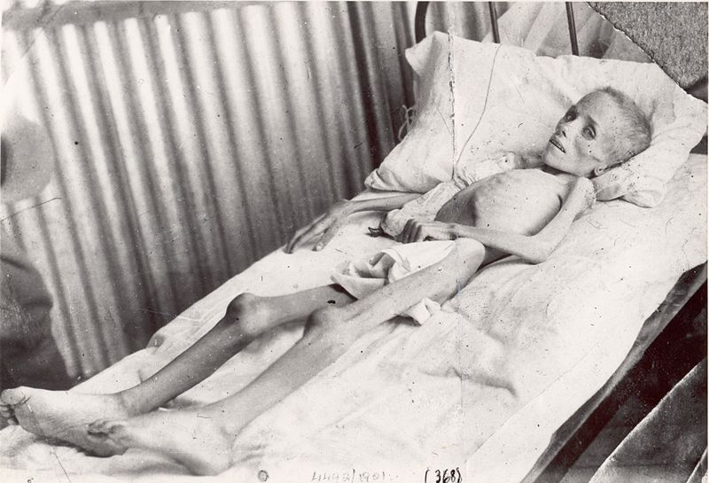
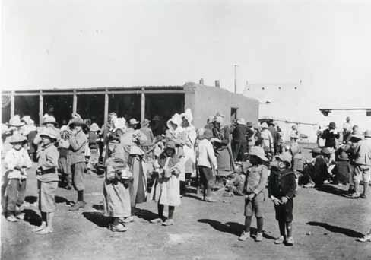
This was the first “Total War”
The Boers used commando guerilla raids against the British
The British burned farms, slaughtered livestock, and imprisoned women, children, and the elderly in concentration camps
Statistics of Deaths in Concentration Camps
Married Women | 3,288
Girls over 16 | 825
Boys over 16 | 209
Children under 16 | 22,057
Total Women & Children | 26, 379
Old Men | 1,421
Grand Total | 27, 800

Slide 21
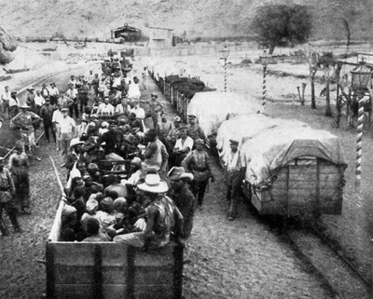
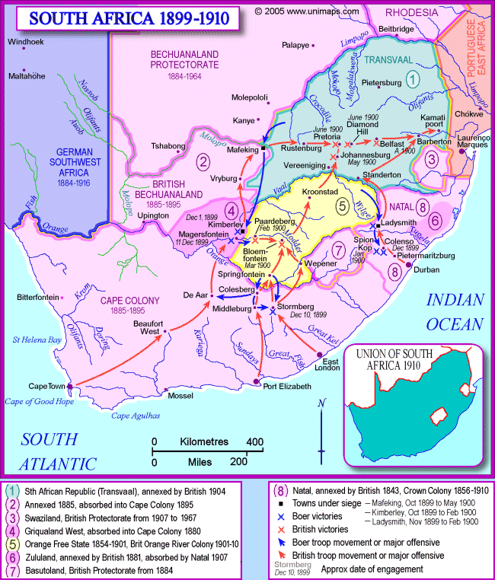
Black Africans were also involved in the war
Some fought, some served as scouts, guards, drivers, and workers
Black Africans who were captured were also put into the concentration camps
Approximately 107,000 Black Africans were put in the camps and approximately 20,000 died there
In 1910 the British won the war and the Boer republics were joined into a self-governing Union of South Africa that was controlled by the British

Slide 22
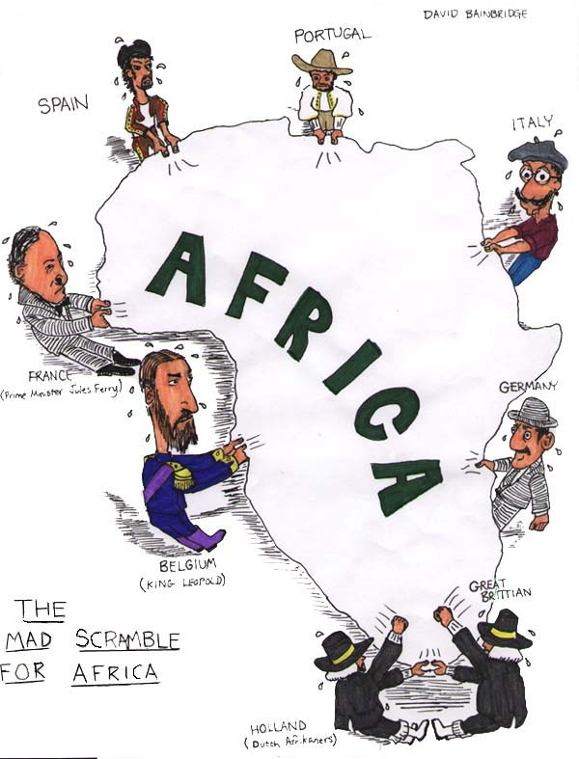
Imperialism

Slide 23
A New Period of Imperialism
Each European nation had certain policies and goals for establishing colonies
Four forms of taking and controlling territory emerged
Colony
A country or territory governed internally by a foreign power
Protectorate
A country or territory with its own internal government but under the control of an outside power
Sphere of Influence
An area in which an outside power claims exclusive investment or trading privileges
Economic Imperialism
An independent but less developed country is controlled by private business interests rather than another government

Slide 24
Methods of Management
Direct Control
Paternalism
Europeans governed their people in a parental way
Provided for needs but didn’t give them any rights
Europeans brought in their own bureaucrats and didn’t train local people in European Government
Assimilation
This was the theory that over time the local populations would adopt European culture
Mostly used by France
To aid in the transition, all local schools, courts, and business were based on French institutions
In practice, the French abandoned assimilation and used association instead. This is similar to indirect control but regarded African institutions and culture as inferior to the French

Slide 25
Indirect Control
Relied on Existing rulers
Local rulers handled much of the daily management of the colony
Each colony had a legislature that included colonial officials as well as local merchants and professionals nominated by the colonial government
Theory was that people would be trained in the British form of government and then the local population would govern itself

Slide 26
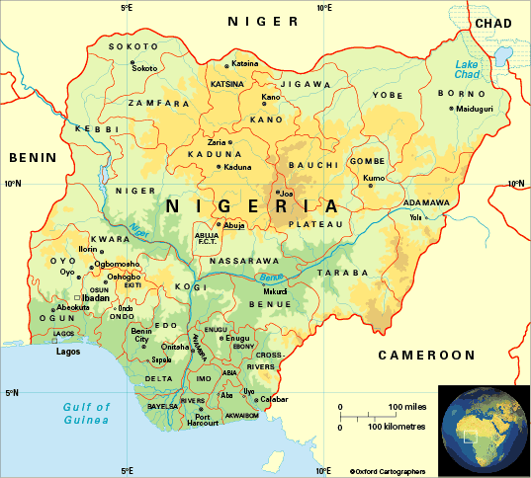
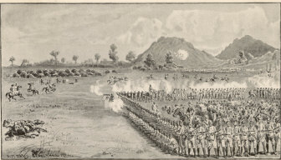
Nigeria: A British Colony
The British gained control of Nigeria through alliances and war
N. Nigeria was captured by the Royal Niger Company
The Co. took control of the palm oil trade along the Niger river after the Berlin Conference
This gave the British a protectorate over the Niger River Delta
By 1914 the British claim all of Nigeria as a colony

Slide 27
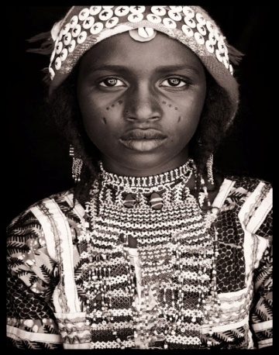
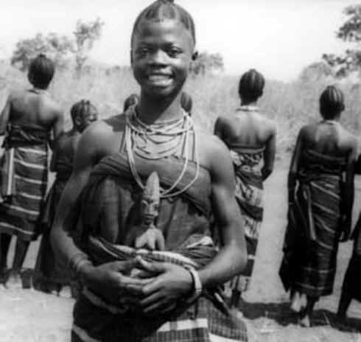

Managing the colony
Because the area was so diverse the British used indirect control
You had to claim a colony and govern it
About 250 ethnic groups lived in Nigeria
The Hausa-Fulani in the North
This worked well with the Hausa Fulani
But the Yoruba and the Igbo resented British control and loss of power
The Yoruba in the Southwest
The Igbo in the Southeast

Slide 28




African Resistance
Unsuccessful attempts at resistance
These movements generally included active military resistance and religious resistance
The Algerians resisted French rule for almost 50 years
Samori Toure led resistance in French West Africa for 16 years
In German East Africa, native people believed that maji-maji, or magic water sprinkled on their bodies would turn German bullets to water
This was unsuccessful but it united 20 different ethnic groups who believed that their war was ordained by God and their ancestors would return to help them
Official death toll was 75000, but probably double after the famine

Slide 29



Ethiopia: A Successful Resistance
Menelik II became emperor of Ethiopia in 1889
He successfully played European powers against each other
While he was doing that he built up a large modern arsenal bought from France and Russia
Menelik signed a treaty with Italy that he thought only gave up a small piece of land, but Italy claimed the whole thing as a protectorate
In 1896, at the battle of Adowa, Ethiopian forces successfully defeated the Italians and kept Ethiopia independent.
Kept his weapons stockpile as well

Slide 30
The Legacy of Colonial Rule
The Good
The Bad
The Good
The Bad
Colonialism reduced local warfare
Africans lost control of their land
Improved sanitation, hospitals and schools
Africans lost independence
Lifespan and literacy both improved
Many died of new diseases
African products became valuable on the international market
Famines b/c of cash crops instead of subsistence farming
Railroads, dams, telephone, and telegraph lines were built in villages
Traditional culture broke down
Trad. Authority figures were replaced
** This really only benefitted Europeans, not the Africans living there
Men were forced to leave villages to find ways to support their families
Admiration for Euro culture undercut African culture
Africa was divided with no regard for language, culture, or political issues that existed

Slide 31

Europeans claim Muslim lands

Slide 32



The Ottoman Empire Loses Power
Reforms Fail
After Suleyman I died in 1566, the government broke up into many bickering factions
Corruption led to financial loss
Coinage was devalued leading to inflation
Selim III came to power in 1789
He attempted to modernize the army
Older Janissaries resisted, he was overthrown, and reform stopped
Now nationalist revolts start to break out
In 1830 the Greeks win their independence and Serbia got self-rule
Ottoman weakness was becoming obvious to the European powers and now they started looking for ways to expand into Muslim areas

Slide 33

Geopolitics
This is the interest in or taking of land for its strategic location or products
This area was important to the Europeans
The Ottomans controlled access to the Mediterranean and the Atlantic sea trade
They controlled access to the Black Sea
Any landlocked European country had to go through Muslim lands to trade
Oil was also discovered in Persia in the early 1900s focusing more attention on the area

Slide 34

Russia and the Crimean War

Slide 35

The Russians had launched wars on the Ottomans for generations trying to get a warm water port on the Black Sea
In 1853 – War breaks out between Russia and the Ottoman Empire
The Crimean War
Called this because this is the peninsula in the Black Sea where most of the fighting happened
The Brits and the French want to keep Russia from gaining any more Ottoman land, so they take the side of the Ottomans and defeat the Russians

Slide 36

The war showed the weakness of the Ottomans
They continued to lose land
Russians aided the Slavs of the Balkans when they rebelled
The Ottomans lost control of Romania, Montenegro, Cyprus, Bosnia, Herzegovina, and Bulgaria
They also lost almost all of their land in North Africa

Slide 37


The Great Game
This was the geopolitical struggle between GB and Russia over Muslim lands in C. Asia
This primarily fought over India
Russia attempted to extend its empire and gain access to India’s riches
Britain defended its colony and attempted to spread its empire beyond India’s borders
Afghanistan became the center of these struggles

Slide 38



In the 1800s Afghanistan was an independent Muslim kingdom
Mountainous terrain and determined people kept invaders out
1881 – Britain withdrew from Afghanistan
1917 – The newly formed Soviet Union signs a non aggression pact with Afghanistan.
1921 – Britain agrees that it’s empire will not spread beyond the Khyber pass
1979 – The USSR invades Afghanistan

Slide 39


Egypt Initiates Reform
Military and Economic Reform
Modernization happened because of Fr interest in the area AND its strategic location at the head of the Red Sea
After Napoleon’s loss in Egypt an new leader came to power
Muhammad Ali
He was originally part of an Ottoman expeditionary force, but he broke away.

Slide 40



1831 Ali fought a series of battles where he won Syria and Arabia
European powers now recognize him and him heirs as the hereditary rulers of Egypt
Ali began a series of reforms in the military and economy
He changed Egyptian agriculture to the plantation system where they grow cotton
Peasants suffered because they lost their traditional farm land and had to grow cash crops instead of food crops
He brought Egypt to the international marketplace

Slide 41


The Suez Canal
Muhammad Ali’s grandson Isma’il continued the modernization of Egypt
He supported the building of the Suez Canal
This was a waterway to connect the Red sea with the Mediterranean
Built mainly with French $ from private groups using Egyptian labor
Opened in 1869
Isma’il’s modernization efforts were expensive and put Egypt in debt of $450,000,000
In 1882 the British took control of the canal and occupied Egypt

Slide 42




Persia Pressured to Change
Russia and Britain competed to try to bring Persia under their sphere of influence
Russia wanted access to the Persian Gulf and the Indian Ocean
Persia gave territory to Russia twice after losses in 1813 and 1828
Britain wanted Afghanistan as a buffer between India and Russia
In 1857 Persia was forced to give up all claims in Afghanistan
When oil was discovered there in 1908 interest grew

Slide 43




Persia could not develop its own resources
To raise money, the ruler began granting concessions to western business
These concessions allowed businesses to buy the right to operate in an area or develop a certain product
The Anglo-Persian oil co. began to develop Persia’s oil fields in the early 1900s
The Battle over Tobacco
The people of Persia didn’t like the selling of concessions
Religious leaders usually supported the people
1890- Nasir al-Din sold a concession to the British for Tobacco
Jamal al-Din al-Afghani wanted to modernize Persia
He organizes a tobacco boycott and the concession is cancelled
1906 – revolutionaries force the ruler to create a constitution
1908 – Russia and Britain take the country and divide it into spheres of influence

Slide 45


British Expand Control over India
The East India Company Dominates
Officially controlled by the British government BUT unofficially the East India Company ruled India with little to no interference from Britain
The Company even had their own army
Led by British officers but staffed by Indian soldiers called Sepoys

Slide 46

The “Jewel in the Crown”
India was considered the most valuable of all British colonies because of their raw materials and huge population
Over 300,000,000 people were a huge market for British goods
The British restricted the Indian economy from operating on its own
Had to produce raw materials and buy British goods, BUT making their own goods was prohibited
British Transport Trade Goods
Built RRs to transport raw products from the interior and manufactured goods back

Slide 47






Most raw materials were agricultural products
Tea
Indigo
Coffee
Opium
Cotton
Jute
Shipped to china for Tea that was then sold in England

Slide 48
Indian goods benefitted from outside conflict
Russian jute couldn’t get to Scottish Jute mills because of the Crimean War
Increased the demand of jute from Bengal
Cotton production had to increase when the U.S. Civil war cut off British cotton supplies
Impact
Negative
Positive
India lost political and economic power
Much the same as in Africa
Indians lost their industries
British ended local warfare
Emphasis on cash crops reduced food supplies
Increased sanitation and literacy
Increased presence of missionaries and racist attitudes affected traditional life
Helped India to modernize

Slide 49

The Sepoy Mutiny
Indians Rebel
Indians resented the British
1857 – a rumor spread that the cartridges of the new Enfield rifles were greased with beef and pork fat
To use the cartridges, soldiers had to bite off the ends
Hindus consider the cow sacred (and are generally vegetarians)
and Muslims can’t eat pork
Both groups were outraged
Commanders were shocked when Sepoys refused their cartridges
The British reacted badly and those who refused their cartridges were jailed

Slide 50

May 10, 1857 – The Sepoy Rebelled
They marched to Delhi and took the city
From there they moved through the rest of the country
The East India Co. took over a year to put down the rebellion
Indians couldn’t unite against the British because of weak leadership and religious issues
Muslims didn’t want the Mughals restored
Hindus preferred British leadership to Muslim leadership
Local leaders who had made deals with the EIC didn’t get involved
The Sikhs remained loyal to the British

Slide 51

Turning Point
1858 - British take direct control of India
Called the Raj
British rule in India during the reign of Queen Victoria
Cabinet ministers in England made policy, a governor
general in India carried it out
Princes who stayed loyal were rewarded
The British gained more and more control
Mutiny increased the distrust between the British and the Indians

Slide 52



Nationalism in India
Ram Mohun Roy
Well educated Indian who began a campaign to modernize India
Others began to attach themselves to Roy’s ideas and push for westernization
Nationalist groups form
Indian National Congress – 1885
Muslim League - 1906
Wanted self government for India
1905 – The British divide Bengal into a Muslim section and a Hindu section
1911 – Pressure from nationalist groups forces Britain to unite the area

Slide 53

Imperialism in Southeast Asia

Slide 54

Europeans invade the Pacific Rim
The Dutch expand control
The Dutch East India Company seized land in Malacca, fought for Java, and took Sumatra, part of Borneo, Celebes, the Moluccas, Bali, and part of Indonesia
To manage these colonies the Dutch brought settlers to run the plantations
Created a strict social class system of Dutch, educated Indonesians, then plantation workers
Dutch forced the farmers to plant 1/5 of their land as specific export crops.

Slide 55




The British take Malaya
The British wanted a trading port to compete with the Dutch
Took Singapore on the tip of the Malay Peninsula
Also took land in Malaysia and Burma (Myanmar)
Exported Tin and Rubber
Chinese encouraged to immigrate to be workers on rubber plantations
So many came to Malaysia that the native Malay became the minority in their own country

Slide 56




French Control Indochina
French had been in SE Asia since the 1600s
Helped the Nguyen Dynasty come to power
1840 – 7 French Missionaries were killed by the anti-Christian Emperor
Napoleon III ordered the French army to invade South Vietnam
They also added Laos, Cambodia (Kampuchea), and Northern Vietnam
They called the area French Indochina

Slide 57

Used Direct Control
Filled all the gov. positions with French
Didn’t encourage local industry
Increased the production of rice by 400% but most of it was exported
This started the Vietnamese resistance against the French

Slide 58

Colonial Impact
Mixed Results
Economies grew based on export of cash crops
Modernization mostly benefitted European business
Education, sanitation, and health did improve
Area became a melting pot of culture and religion because of huge influx of immigrant workers
There are still religious and cultural problems today because of this

Slide 59



Siam Remains Independent
Siam (Thailand) maintained independence all through the colonial period
It lay between British Burma and French Indochina
Siamese kings played the British and French against each other to keep their independence
Modernized under King Mongkut and his son Chulalongkorn
Started schools, reformed the legal system and reorganized government
Built its own railroads and telegraph systems
Ended Slavery
Because the changes came from within, the Siamese people escaped problems other countries faced

Slide 60

The World At War
1914 - 1918

Slide 61

Rising Tensions in Europe
Nationalism: Pride and devotion to your country and culture.
It can unify and it can tear apart.
People with similar backgrounds and cultures can become a country or they can try to remove themselves and form a new one

Slide 62

The 6 major powers of Europe:
Great Britain
Russia
Germany
Austria-Hungary
France
Italy
Were often competing with each other because of nationalism.

Slide 63



There were a couple big sources of tension between the powers
Competition for materials and markets
Territorial disputes
  The French lost Alsace Lorraine to the Germans in 1870 during the Franco-Prussian War and they were still unhappy about it in 1914
  b. Austria Hungary and Russia were both trying to dominate in the Balkans
  c. In the Balkans there were multiple ethnic groups that all wanted their independence

Slide 64
Imperialism and Militarism
Imperialism is the domination of one country economically, socially, and/or politically by another country
The major powers came to the brink of war more than once over their colonies in Africa and Asia and it led them to a lot of mistrust
Militarism is the love and glorification of the military and of war
This leads to an arms race as each country tried to outdo the others with
the number and strength of troops, weapons, etc.
By 1914 all of the major powers except Great Britain have large standing
armies
This leads to people feeling patriotic, but also to fear other countries, increasing the
levels of mistrust

Slide 65

Alliances lead to war
Otto Von Bismarck
Between 1864 and 1871 Bismarck used war to unite Germany out of 309 independent states
In 1871 Germany declared itself a “satisfied power” and decided to seek peace instead
They knew France was still angry about Alsace Lorraine and decided that isolating France was the best way to keep peace in Europe.
To do that Bismarck will make alliances with other European Powers
1879 – The Dual Alliance – Austria-Hungary and Germany
1881 – Germany signs a treaty with Russia so they won’t have to fight war on 2 fronts
1882 – The Triple Alliance – Germany, Italy, and Austria-Hungary

Slide 66

Kaiser Wilhelm II forces Bismarck to resign and then things really get bad

Slide 67

Kaiser Wilhelm II lets the Russian treaty lapse
When this happens Russia signs a treaty with France in 1892 and again in 1894
When the war starts, Germany will have to fight on two fronts. This was Bismarck’s nightmare.

Slide 68


Wilhelm II then goes on a ship building spree trying to make the German Navy equal or greater than that of Britain
Britain now joins the Triple Entente with Russia and France
This means there are now 2 major alliances in Europe:
Triple Alliance (Germany, AH, Italy) and Triple Entente (GB, Russia, France)

Slide 69


Slide 70

The people of the Balkans had been pushing for independence from the Ottoman Empire for years
A few, Greece, Bulgaria, Montenegro, Romania, and Serbia had succeeded

Slide 71

Pan-Slavism - Unity for all Slavic Peoples (Especially those controlled by non-Slavic empires)
This is the reason why Serbians wanted to extend through the Balkans
Austria – Hungary doesn’t want them to because they control some of those states
Russia does support Serbia however because they’re also Slavic
In 1908 A – H took over Bosnia and Herzegovina (Both areas were largely Slavic)
Serbia vowed to take them back, Austria – Hungary vowed to crush Serbia

Slide 72

The Assassination at Sarajevo
June 28 1914 – Archduke Franz Ferdinand and his wife Sophie make a state visit to Sarajevo, Bosnia
Unfortunately this had traditionally been Bosnia’s Independence Day. Serbia was angry that Austria-Hungary had taken Bosnia away from them

Slide 73


As the motorcade travelled along a well published route, a hand grenade was thrown by a man named Nedeljko Cabrinovic. It bounced of the door and injured a bodyguard

Slide 74



At this point, the security guards should have gotten the royal family out of there. Instead Franz-Ferdinand decided he wanted to visit the injured bodyguard then continue on with his trip. AND THEY LET HIM!!!
As the car continued down the same (!) route it reached a sharp turn and it was too large to make the turn without backing up.
When the car backed up it stopped right in front of Gavrilo Princip, a 19 year-old member of the Black Hand (Freedom Fighters? Terrorists? Depends on who you ask)
Their motto was Unity or Death

Slide 75

Princip shot the Archduke and his wife point blank, killing both of them
The Archduke’s last words were “Sophie, Sophie! Don’t die! Stay alive for the children!”

Slide 76



Pricip was a Serbian so Austria-Hungary blamed Serbia for the murders.
They issued an ultimatum that said that Serbia had to allow Austrian investigators into the country to investigate the murders.
Do what we say or else!
Serbia couldn’t agree without giving up their sovereignty to Austria – Hungary
BUT they couldn’t say no without going to war.
Serbia agreed to most of the terms of the ultimatum and offered to have an international council determine what should be done

Slide 77



July 28, 1914
Austria – Hungary said NO to these terms and declared war on
Also on July 28th, Russia started mobilizing its army because they were allies with Serbia

Slide 78

Everyone urged Austria-Hungary to negotiate but they wouldn’t.
Then Kaiser Wilhelm gave Austria-Hungary “Blank Check”
support for whatever they decided to do

Slide 79

World War I Begins:
A Timeline to War:
July 28th: Austria Hungary declares war on Serbia
July 28th: Russia begins to mobilize their troops
August 1st: Germany declares war on Russia
August 3rd: Germany declares war on France
August 5th: Great Britain declares war on Germany

Slide 80
Europe is divided into two warring powers:
The Central Powers: Germany, Austria-Hungary, Bulgaria, and the Ottoman Empire
The Allied Powers: Great Britain, France, Russia, Italy, and Japan

Slide 81

Everyone thought that the war would end quickly
Instead it turned into a stalemate along an area in Northern France called the Western Front
A stalemate is a draw or a time when there is no winner

Slide 82


The Schlieffen Plan
Germany had developed a strategy named after General Alfred Graf von Schlieffen
This was a plan for Germany to be able to fight a successful 2 front war
It called for attacking and defeating France then quickly marching east and attacking Russia
This depended on speed, because of the size of the Russian war machine (ridiculously huge), it should take them a very long time to mobilize. The Germans thought they would have time to implement the Schlieffen Plan

Slide 83

September 1914: The Germans are just outside of Paris
If they can take the city, they will defeat the French

Slide 84

On September 5th 1914 the Allies attack the Germans at the 1st Battle of the Marne
Also called the Taxicab battle because 600 civilian taxis were used to transport every available soldier to the front line

Slide 85

On September 9th the Germans retreated and this ruined any hopes for the Schlieffen plan to work
The Russians now invade Germany from the east.
The Germans pull troops from the Western Front and send them to the Eastern Front
This pretty much puts a stop to any further advances into France

Slide 86

The Beginnings of Trench Warfare

Slide 87

By 1915 the opposing armies had dug miles of parallel trenches to protect themselves from enemy fire.
People would fight from these trenches

Slide 88



A Commander would call out “Over the Top!” and everyone in the trench would go. They then got mowed down by enemy fire in “No Man’s Land”
Staying in the trench wasn’t necessarily save either because artillery shells would fall on them and blow them, and whomever was still in them, to pieces
“Over the Top!”

Slide 89





New Weapons make the stalemate worse
Mustard Gas and Chlorine Gas burned lungs and soft tissue. They were introduced by the Germans but both sides used them.
Poison Gas:
Machine Gun:
These fired ammunition automatically and made advances nearly impossible.
Armored combat vehicle with chain tracks that could cross all kinds of terrain. Introduced by the British in 1916 at the Somme.
Called Tanks because they were shipped in boxes labelled “Water Tank.”
Tank:
Submarine:
1914 Germans introduced them against British warships. Their primary weapon was the torpedo

Slide 90


The Mincing Machine of Verdun
In 1916 the Germans launched an offensive against the French at Verdun
Both sides lost about 300,000 men (each)

Slide 91
July 1916:
The British send help to the French and attach the Germans at the Somme River NW of Verdun
On the first day of battle 20,000 British troops were killed.
By the end of the battle in November 1916 there were over ½ a million casualties on both sides
The Advances?
Germany got 4 miles at Verdun
Britain got 5 miles at the Somme

Slide 92

The War on the Eastern Front
This was a stretch of battlefield on the German/Russian border
It was a war between Germany/Austria-Hungary and Russia/Serbs
This front was much more mobile but slaughter and stalemate happened here too.

Slide 93

Early Battles:
Tannenberg:
In the beginning, Russian forces launched an attack into both Germany and Austria-Hungary.
By the end of August Germany had counter attacked at Tannenberg and crushed the Russians, driving them into full retreat
Over 30,000 Russians were killed and 140,000 were wounded.
The Germans had 12,000 casualties (Dead and wounded).

Slide 94

Vienna:
Russia did better against the Austro-Hungarian forces. They defeated A-H twice in September of 1914 and almost reached the Austrian capitol of Vienna.
However, by December the Russians were pushed out of Austria.

Slide 95


The Russian Empire:

Slide 96

By 1916 the Russian war effort was near collapse
They hadn’t industrialized like western Europe and their army was continuously short on food, guns, ammunition, clothes, boots, and blankets
Allied ships had trouble getting supplies to Russia because the Germans and the Ottomans controlled the sea routes
The only thing keeping them in the war was their numbers.
They suffered staggering losses but still managed to pull troops from their huge population to keep the Germans tied up for years

Slide 97

A Global Conflict

Slide 98

War affects the world
The Gallipoli Campaign
The point was for the Allies to be able to attack the Ottoman Empire at the Dardanelles which were the gateway to Constantinople and a way to create a supply line to Russia
Began in February of 1915: British, Australian, and New Zealand troops made repeated assaults on the Gallipoli Peninsula.
The Turks, often led by Germans, defended the region.
By May of 1915 Gallipoli was a stalemate too.
In December of 1915 the Allies gave up and retreated. They had lost about 250,000 men.

Slide 99



War in Africa and Asia:
The Japanese quickly overtook China and captured Germany’s Island Colonies
England and France attacked Germany’s 4 African possessions and took 3 of them.
All of the major powers looked for help from their colonies.
Some colonists didn’t want to help. Others, like Mohandas Gandhi felt that if the Indians helped the British it would help them gain independence later on

Slide 100

America Enters the War

Slide 101

By 1917 the Germans were ruling the seas with submarines and in January of 1917 they announced that they would sink any ship in British waters.
This is called unrestricted submarine warfare.
Before this, only ships flying the flags of warring nations would be attacked
The Germans had used this policy in 1915 but stopped when the British passenger liner Lusitania was sunk on May 7th 1915.
1198 people were killed including 128 Americans.
The Germans argued that the Lusitania was carrying ammo, which was true and was also an act of war
BUT they didn’t want to get the Americans involved so they stopped for a while

Slide 102


The point of resuming the unrestricted submarine warfare was to enforce a naval blockade forcing the British to surrender.
3 American ships are sunk by German U-Boats and the U.S. government ‘protests.’
The Zimmerman Note
February 1917 – U.S. officials are sent a telegram by Mexican officials that was written by Arthur Zimmerman the German Foreign secretary
The telegram staid that Germany would help Mexico ‘reconquer’ the land it had lost to the U.S. if Mexico would ally with Germany.
Mexico declines and passes the note on to the U.S.

Slide 103

The Zimmerman Telegram probably wouldn’t have been enough on it’s own to get the U.S. involved in a war.
BUT with submarine warfare and other issues the U.S. decides it’s time to get involved.
Most of the U.S. population is on the side of the Allies anyway because of common bonds of language, law, and customs with England.
U.S. also had stronger economic ties with the Allies.
April 2, 1917:

Slide 104
War Affects the Home Front

Slide 105



Total War:
The governments involved dedicated all of their resources to the war effort, including taking over the economy, making factories produce war material, and ordering every able bodied person to work. This includes women.
While all material was going to the front, goods at home were limited, which led to rationing.
Rationing is when the government decides what and how much a person can buy.
This applied to food, clothing, leather, etc.

Slide 106





Propaganda:
One sided pamphlets, posters, newspapers designed to keep up morale and support for the war

Slide 107


Women and the War:
Thousands of women now took jobs outside the home to take the place of the men who were fighting. Most of them left the workforce when the men returned.
Some worked as nurses on the front lines and saw the real horrors of war

Slide 108




Slide 109

The Allies Win

Slide 110



Russia withdraws:
In March of 1917 a civil war in Russia removed Czar Nicholas
The government tried to keep fighting but they were falling apart
5.5 million men had been killed, wounded, or taken prisoner
In November 1917 Vladimir Ilyich Lenin took power in Russia and signed a treaty with Germany
The Treaty of Brest-Litovsk in March of 1918 ended the war between Russia and Germany

Slide 111

The Central Powers Collapses
Russia’s withdrawal allowed German troops to focus on the Western Front where they launched a massive attack in March of 1918
By May they have reached the Marne River

Slide 112


The Second Battle of the Marne
140000 U.S. troops now assist the French and the British
The 2nd battle of the Marne takes place in July 1918 and 350 tanks and 2 million more fresh troops push the Germans back

Slide 113

The Central Powers Collapse
Bulgaria and the Ottoman Turks surrender
Austria Hungary has a revolution in October
November 9, 1918 Kaiser Wilhelm II steps down when troops turn on him
Germany now declares itself a republic and a representative of the new government meets with the French commander Marshal Foch in a railway car near Paris where they sign an armistice or agreement to end the war

Slide 114




The War ends on November 11th 1918

Slide 115


The Legacy of War:
Nearly an entire generation of Europeans was wiped out
Between disease, starvation, and battle, nearly 10 million Allied and Central troops died
Farmland and villages were destroyed

Slide 116



The Treasuries of Europe were drained (338 Billion dollars is the current estimate)
People were also disillusioned and it showed in their art and literature

Slide 117
A FLAWED PEACE

Slide 118








The Allies Meet
The Big Four
Woodrow Wilson USA Georges Clemenceau France Vittorio Orlando Italy David Lloyd George United Kingdom

Slide 119
Wilson’s 14 Points
Woodrow Wilson had written up a plan for peace before the end of the war in 1918. This was known as the 14 Points and they were designed to create a fair, lasting, peace.
End Secret Treaties
Freedom of the Seas
Free Trade
Reduce the size of armies and navies
Adjust colonies in regards to the colonists
- 13. Changing borders and create new nations using the principle of National Self Determination, which is the right of people to decide under which government they wanted to live
14. A League of Nations
The League of nations would be a general association of countries that would meet to talk about problems and hopefully stop them before they led to war

Slide 120


The Versailles Treaty
At the Paris Peace conference, Britain and France ignored Wilson’s proposal.
They were concerned with national security and stripping Germany of its war making power

Slide 121


The Treaty was signed June 28th 1919 – 5 years to the day of the assassination of Franz Ferdinand
It adopted a League of Nations, but none of Wilson’s other points
Spectators waiting for the treaty to be signed

Slide 122


The War Guilt Clause
Germany was blamed for the war (remember who started it?)
They: Lost Territory
Had their Military Restricted
Took SOLE responsibility for the war
Had to pay reparations to the allies for over 33 billion dollars.

Slide 123


All of Germany’s territory in Africa and Asia was given to the League of Nations as MANDATES (Which basically means they were given to Britain and France and they would be governed by the allies until they could get their independence)

Slide 124

The Western powers signed separate treaties in 1919 and 1920 with all other defeated countries.
This will lead to huge losses for these countries.
The Austro-Hungarian empire was broken up into:
Austria
Hungary
Czechoslovakia
Yugoslavia

Slide 125

The Ottoman Turks had to give up almost all of their old empire and were left with only Turkey.
Land was carved up into mandates instead of independent nations:
Palestine
Iraq (Mesopotamia)
Transjordan
  Went to GB
Syria
Lebanon
  Went to France

Slide 126

Russia, who’d left the war early, also lost land:
Romania and
Poland
Both Gained Territory
3. Finland
4. Latvia
5. Lithuania and
6. Estonia
Became independent
nations

Slide 127

The Weakness of the Treaty:
When everything was done, the Treaty of Versailles did very little to build a lasting peace
The U.S. rejected the treaty and signed a separate peace with Germany and Austria Hungary
Most Americans were against the League of Nations because they thought that the best way to stay out of war was to stay out of world affairs
This doesn’t work, as the world is back at war in 1939 (30 years later)

Slide 128
In the end, very few were happy:
German people were bitter and angry over the war guilt clause
People in Mandates wanted independence
Japan and Italy who had joined the Allies for territory didn’t get as much as they wanted
The League of Nations was practically powerless without the U.S.
Within 20 years all this bitterness, fear, anger, and hate will lead to another, more catastrophic war

Slide 129


