Slide 1
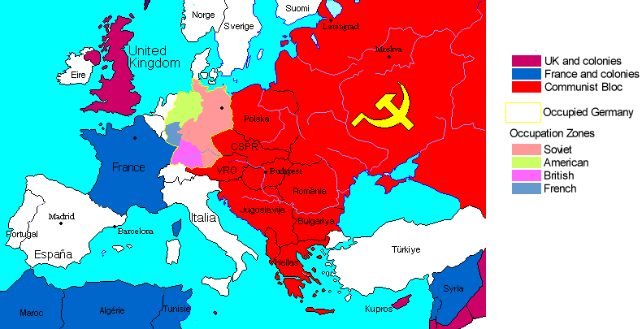
Restructuring the Post-War World
1945 - Present

Slide 2
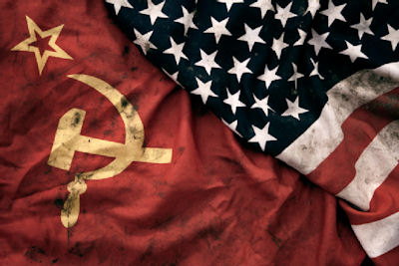
Cold War: Superpowers Face Off
The U.S. and U.S.S.R had been allies during WWII, but their alliance was weak even then.
The U.S. was upset the Stalin had signed a nonaggression pact with Germany in ’39 and Stalin was upset that the Allies hadn’t invaded German held Europe before ’44.

Slide 3
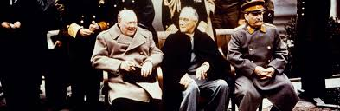
The Yalta Conference
The conference started in February of 1945 even though the war hadn’t ended yet.
Winston Churchill, Franklin Roosevelt, and Joseph Stalin met at the Soviet Black Sea resort of Yalta.
Here they agreed to divide Germany into zones of occupation controlled by the Allies and Germany would have to repay the Soviet Union for the loss of life and property.
Stalin agreed to join the war against Japan. He also agreed to allow free elections in Eastern Europe. (Churchill didn’t buy it, and he was right.)

Slide 4
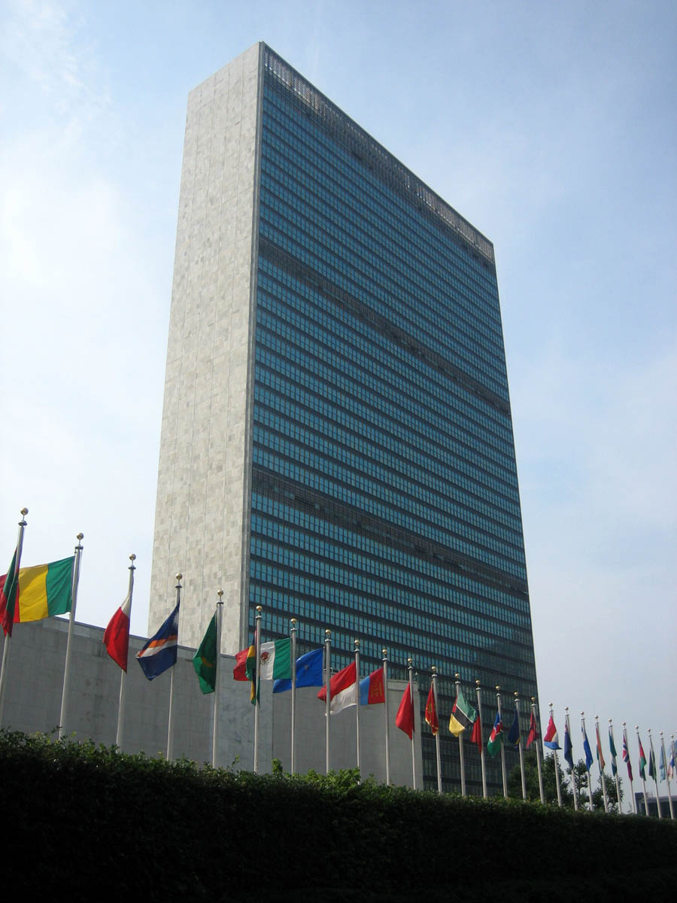
In June of 1945 the U.S. and the U.S.S.R temporarily set aside their differences and joined with 48 other countries to create the United Nations – Which was intended to protect its members from aggression.
It was based in New York.
The Charter created a large governing body called the General Assembly. There each member would cast its vote on a broad range of issues . An 11 member “Security Council” had the real power to investigate and settle disputes.
The 5 permanent members of the UNSC were Britain, China, France, the U.S. and the Soviet Union. Each one of them had to power to veto any UN action to prevent any members from voting as a bloc against any other member.

Slide 5
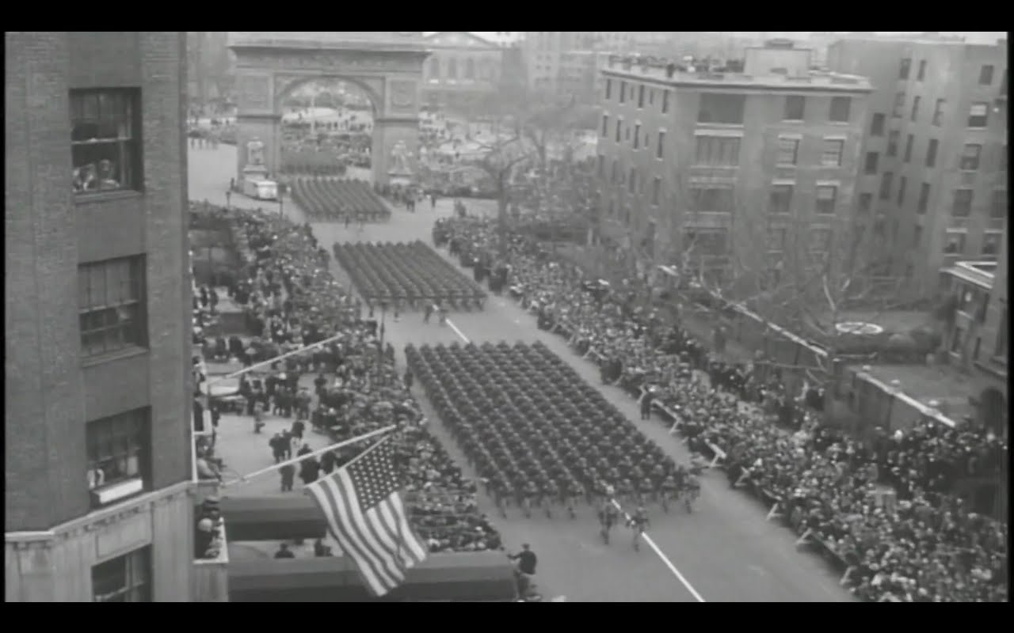
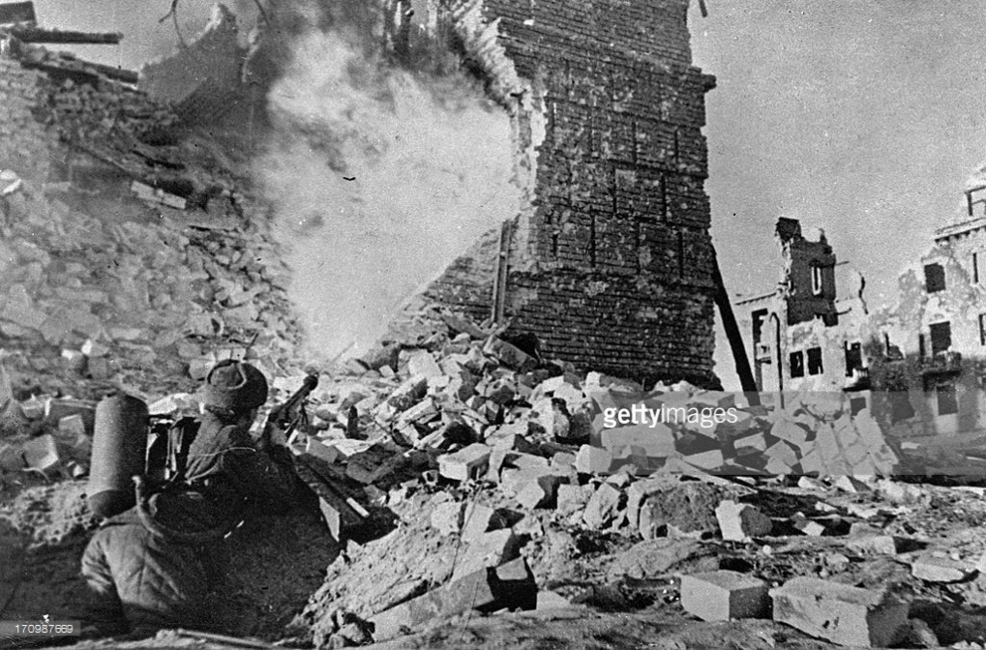
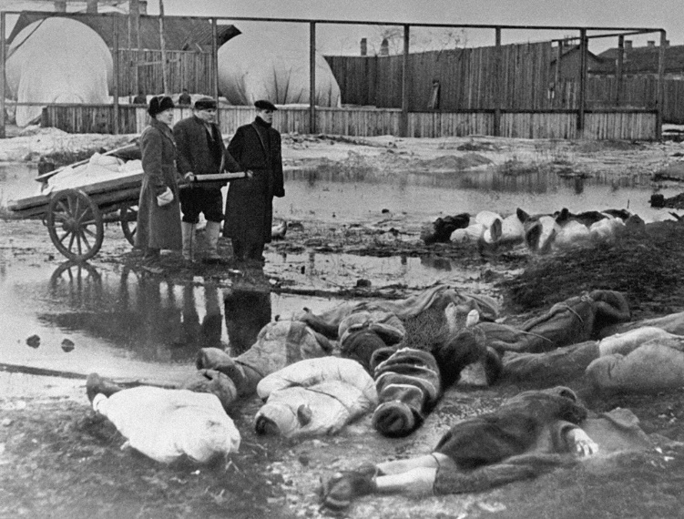
The U.S. and the U.S.S.R split sharply after the war, primarily because of the affect of the war on both nations.
The Soviet’s however lost 20 million people, including civilians (1 in 4 was injured or killed during the war), Many cities were totally destroyed as well.
The U.S. had lost a little over 420,000 people but their factories and cities were untouched.

Slide 6
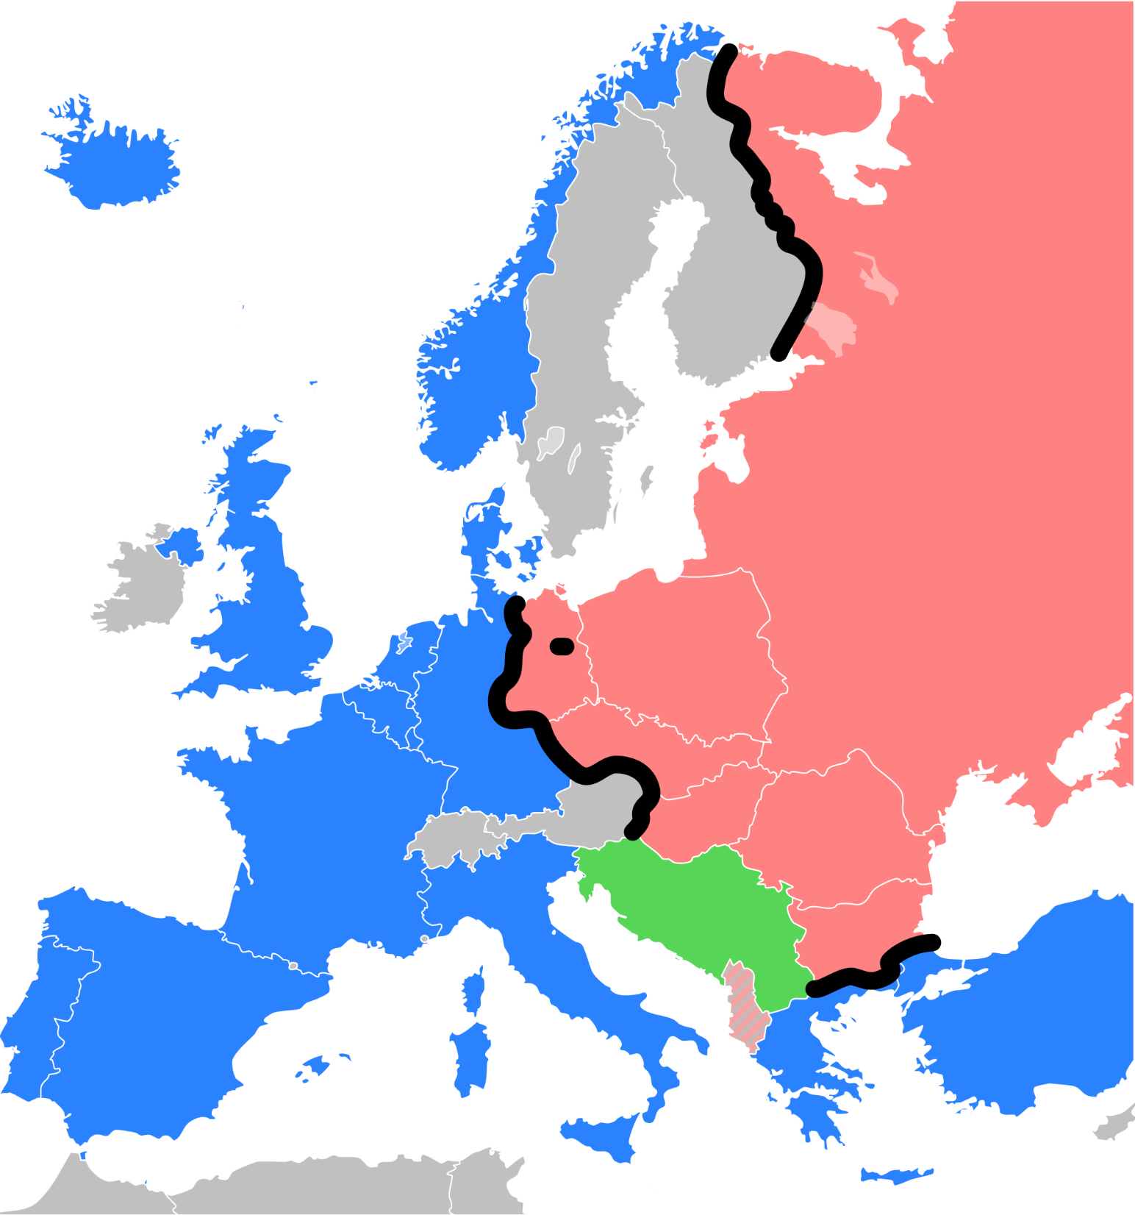
The Iron Curtain
A major goal of the Soviet Union was to shield itself from another invasion from the west. Centuries of history told them to be wary of their western border.
As WWII was ending and the Soviets pushed the Nazis back across Eastern Europe they occupied the land they liberated.
These newly liberated, and now soviet occupied countries, were seen by Stalin as a necessary buffer against aggression.
He then promptly ignored his agreements at Yalta and installed or secured Communist governments in Albania, Bulgaria, Hungary, Czechoslovakia, Romania, Poland, and Yugoslavia

Slide 7
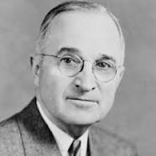
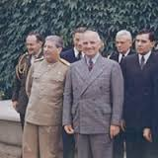
Roosevelt had died on April 12, 1945 and to new President Harry Truman, Stalin’s reluctance to allow free elections in Eastern European nations was a clear violation of those countries’ rights.
Truman, Stalin, and Churchill met at Potsdam Germany in July of 1945.
Truman pressed for free elections and Stalin refused. The next day Stalin announced that Communism and Capitalism could not exist in the same world.

Slide 8
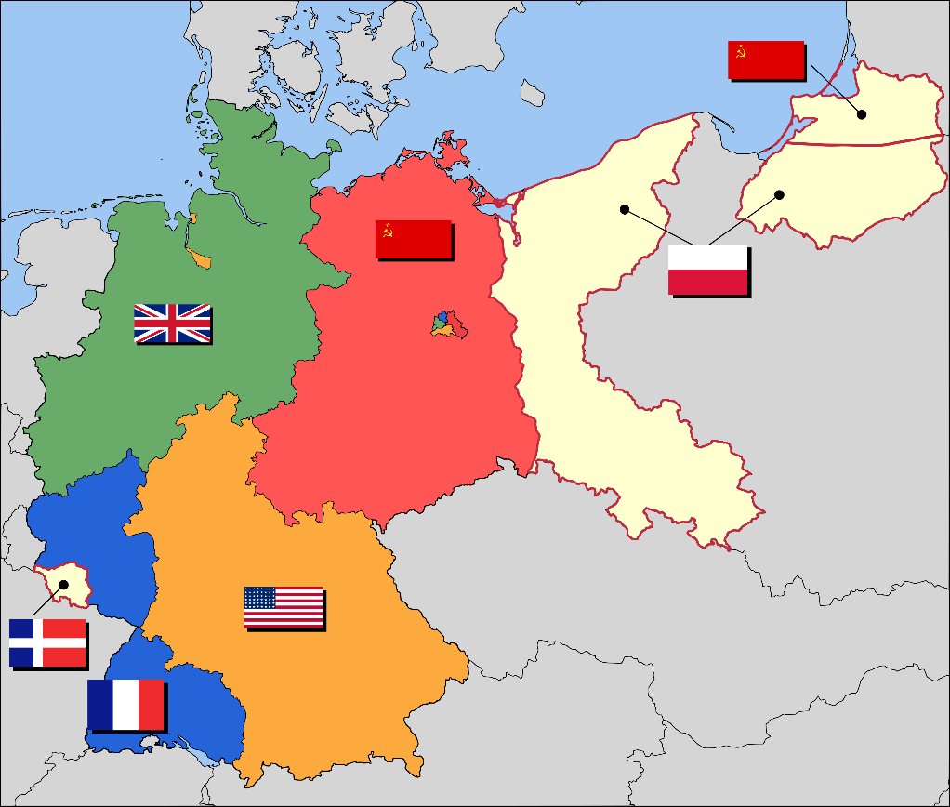
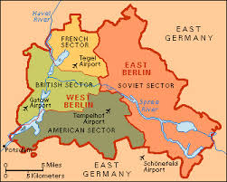

Europe was now divided between east and west.
Germany had been split into 4 sections (Each controlled by one of the Allied powers). The Soviets controlled the Eastern part that included the capital, Berlin. Berlin was then divided as well.
East Germany was renamed the German Democratic Republic and West Germany became known as the Federal Republic of Germany in 1949.
Churchill then made a speech calling this division the “Iron Curtain.”

Slide 9
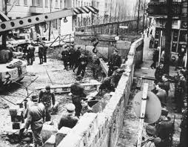
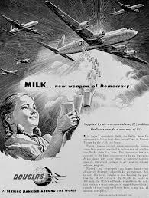
The Berlin Airlift
The US and its allies clashed with the Soviet Union over Germay.
The Soviets wanted to keep Germany weak and divided, but in 1948 France, Britain, and the U.S. decided to withdraw their forces from the Western part of the country and allow it to form into a united nation. The Soviets responded by basically holding Berlin hostage.
The Soviets cut off highway, water, and rail traffic into Berlin’s western zones. Stalin figured the west would surrender and either give up West Berlin to him or give up the idea of a reunified Germany. Instead American and British officials flew food and supplies into Berlin for nearly 11 months. In May of 1949 the Soviets lifted the blockade.

Slide 10
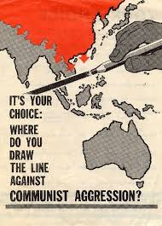
The United states then adopts a foreign policy called “containment.”
This policy was directed at blocking Soviet influence and stopping the expansion of Communism in Europe, and eventually, in Asia as well.
Policies included forming alliances and helping weak countries resist Soviet advances.

Slide 11
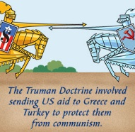
The Truman Doctrine
Truman came up with a plan to give aid to countries that were resisting Communism. Even though many people protest the U.S’ continued involvement in European affairs Congress immediately authorized more than $400 million in aid to Turkey and Greece.

Slide 12
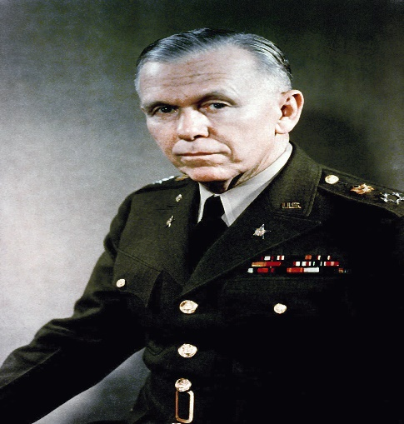

The Marshall Plan
In 1947 Secretary of State George Marshall proposed that the US give aid to needy European countries.
This plan would provide food, machinery, and other materials needed to rebuild Western Europe.
As Congress debated the 12.5 billion dollar program, the Soviets took power in Czechoslovakia. Congress immediately voted approval.
It was a spectacular success and even once-communist countries got aid when they broke away from Communist control.

Slide 13
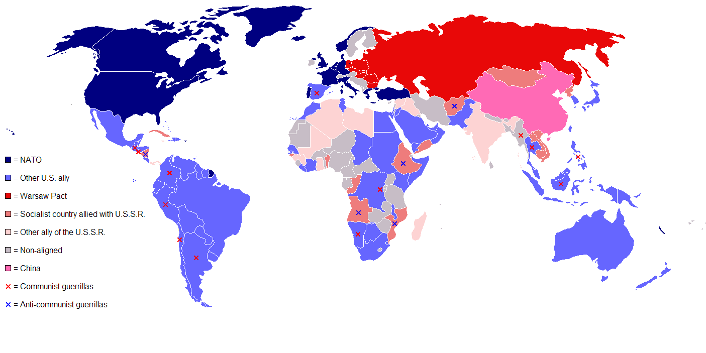
The Cold War Divides the World

Slide 14
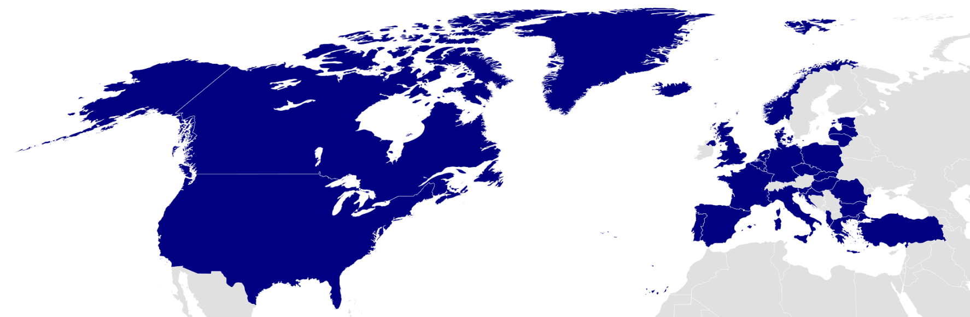
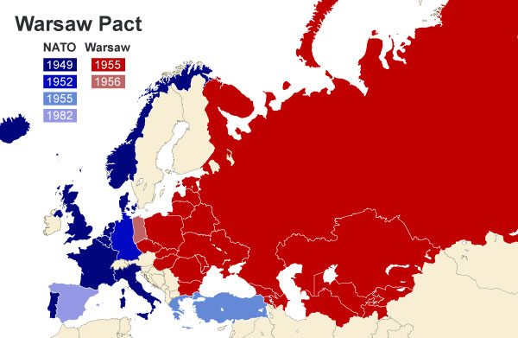
After the Berlin blockade, Western Europe was afraid of soviet aggression.
As a result, 10 western European nations joined with the U.S. and Canada in 1949 to form a defensive military alliance called NATO (North Atlantic Treaty Organization) An attack on any NATO member would be met with armed force by all member nations.
The Soviets saw NATO as a threat and created its own alliance in 1955 called the Warsaw Pact. The Warsaw Pact included the Soviet Union, East Germany, Czechoslovakia, Poland, Hungary, Romania, Bulgaria, and Albania.

Slide 15
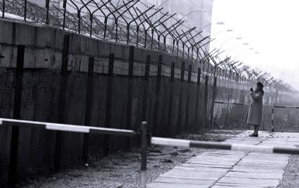
The Berlin Wall
In 1961 the East Germans built a wall to separate East and West Berlin.
The Berlin Wall ended up coming to symbolize a divided world.

Slide 16
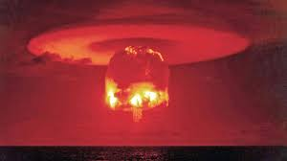
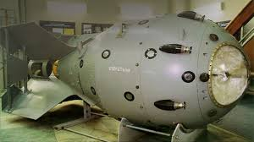
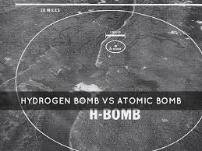
The Threat of Nuclear War
The Cold War threatened to destroy the world.
The U.S. already had atomic weapons and in 1949 the Soviet Union detonated RDS-1.
President Truman was determined to develop a more deadly weapon before the Soviets could, and in 1950 he authorized work on a thermonuclear weapon called the H-Bomb. The hydrogen bomb would be thousands of times more powerful than the A-bomb.

Slide 17
Atomic bombs use fission, or the breaking apart, of large atoms of Uranium or Plutonium.
Hydrogen bombs rely on fusion, or the joining together, of long chains of atoms to create their power

Slide 18

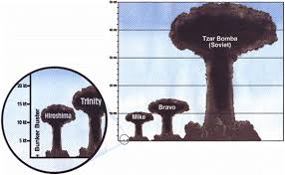
In 1952 the U.S. tested the first Hydrogen bomb.
In 1953 the soviets exploded a hydrogen bomb. In 1961 they detonated Tsar Bomba, a massive Hydrogen weapon.

Slide 19
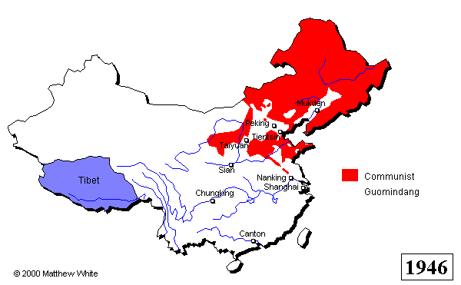
Communists take Power in China
Under Mao Zedong, the Communists had a stronghold in northeastern China.
From there they led mobilized peasant guerilla war against the Japanese in the northeast.
The communists won the support of peasants with literacy movements and increased food production plans.

Slide 20
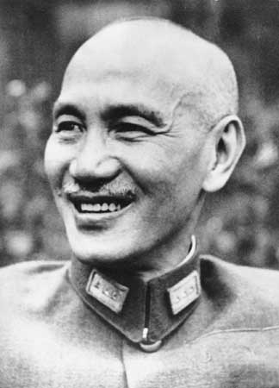
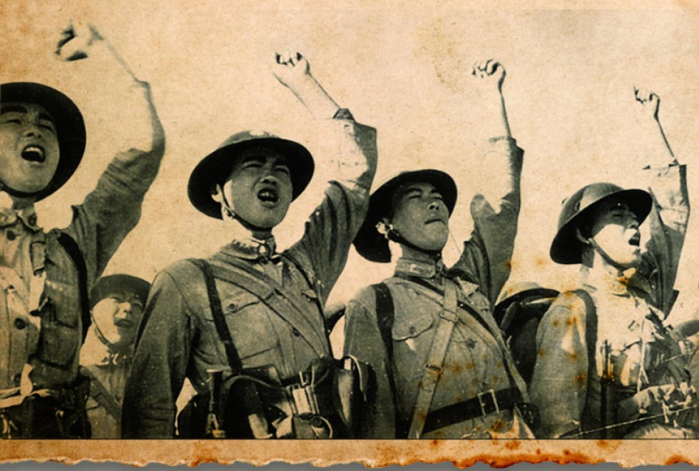
At the same time, the Nationalists, led by Jiang Jieshi were powerful in the southwestern part of china.
Jiang gathered an army of 2.5 million men while the communists were busy fighting the Japanese. He also got millions of dollars in aid from the US to fight the Japanese.
Regardless of this, the nationalists fought very few battles against the Japanese and the money and supplies often ended up with corrupt officers. The Nationalist army bided their time until the Japanese were defeated then they struck at the Communists.

Slide 21
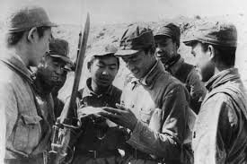
The Chinese Civil War Resumes
The civil war lasted from 1946 – 1949.
The Nationalists did well at first because they had 3x as many soldiers and $2 billion in aid from the U.S.
What the nationalists didn’t have however, was popular support and as the war dragged on, many nationalists fled to the communists.

Slide 22
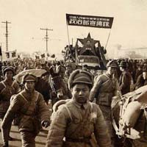
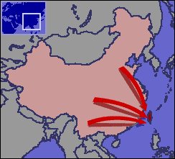
In spring of 1949 China’s major cities fell to Mao.
His troops were well trained and energetic about his plans and policies to return land to the peasants.
By October of 1949 Mao gained control of the country and proclaimed it “The People’s Republic of China.”
Jiang’s army fled south and eventually to the island of Taiwan (Formosa)
The Soviets and the Chinese signed a “treaty of Friendship” in 1950 and the anti-Communist feelings in the US grew.

Slide 23
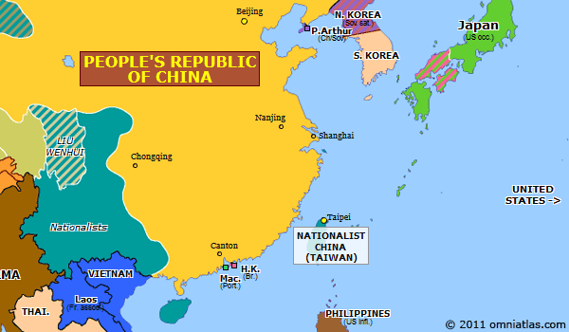
Two Chinas one Cold War
After Jian fled to Taiwan, the US helped him set up a Nationalist government on that island called the Republic of China.
The Soviets gave aid to Communist China and they signed a mutual aid treaty saying they’d come to each other’s defense if either was attacked.

Slide 24
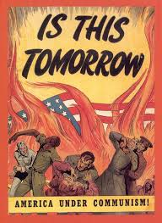
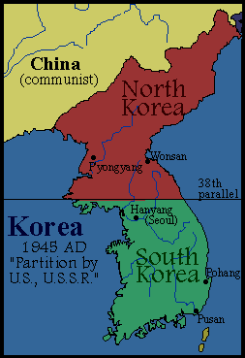
The US feared the spread of Communism in Asia and tried to stop Soviet expansion there.
When Soviet forces occupied the northern half of Korea after WWII and put in a communist government, the US supported a separate state in the South with a democratic government

Slide 25
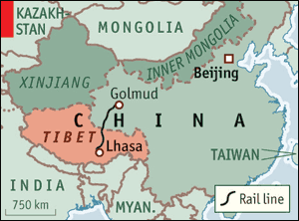
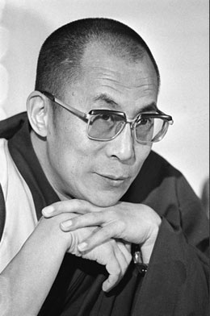
At first, under Mao, Chinese troops expanded into Tibet, India, and Inner and Outer Mongolia
In 1950 and ‘51 in a series of brutal assaults, China took Tibet. They promised self-rule to the Tibetans, who followed the
Dalai Lama, a religious leader. The Dalai Lama had to flee to India along with many other Tibetan refugees when Chinese control tightened. The two countries still hate each other today over the border area.

Slide 26
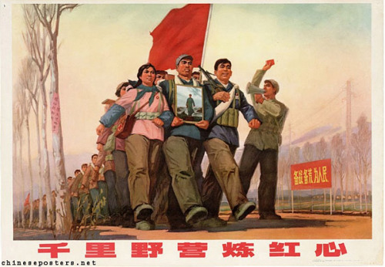
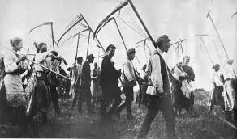
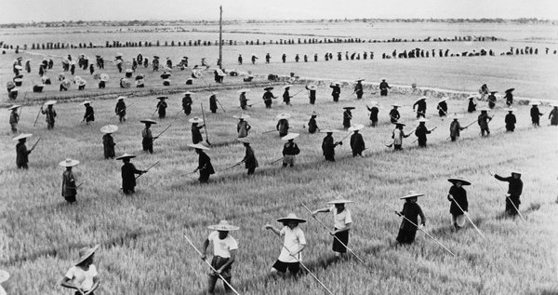
The New Mandate of Heaven
The Communists made up only 1% of the Chinese population, so to solidify their control, they claimed a Mandate of Heaven, or that Heaven had put them in power. Mao was determined to shape China’s economy based on Marxist Socialism. To do this he passed the Agrarian Reform Law in 1950 that redistributed farm land among the peasants. People who resisted the loss of their land were killed. Peasants were then forced to live and work on collective farms of 200 – 300 families.

Slide 27
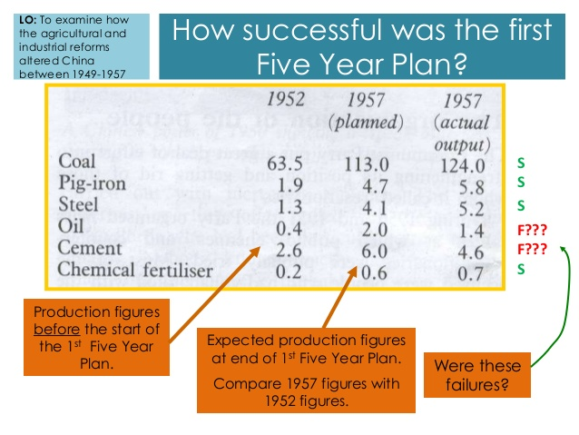
In 1953 Mao launched a five year plan setting high production goals for industry.
By 1957 Chinese output of coal, cement, steel, and electricity had increased dramatically.

Slide 28
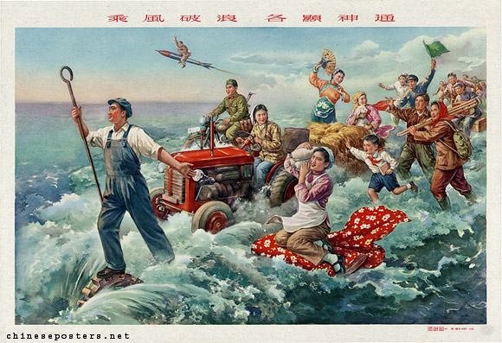
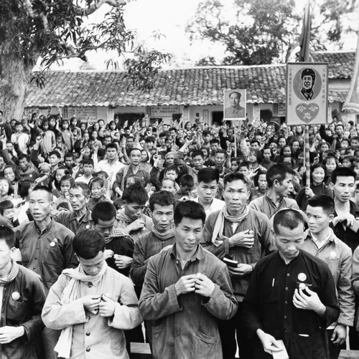
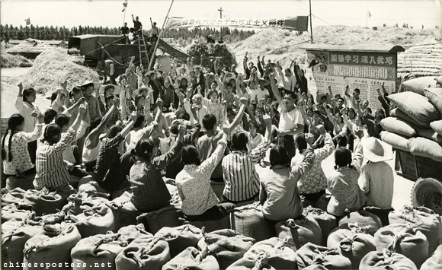
The Great Leap Forward
To expand on the 5 year plan, Mao proclaimed the “Great Leap Forward” in early 1958.
This plan called for larger collective farms, called communes and by the end of ’58 there were about 26,000 communes.
The average commune was about 15000 acres and held 25000 people. The people worked, ate, slept, and raised their children in communal rooms and they owned nothing. The program ended in 1961 after a crop failure led to the starvation of about 20,000,000 people.

Slide 29
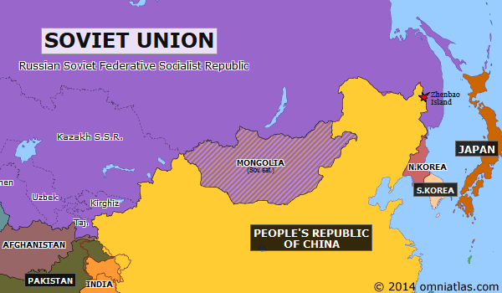
The relationship between the Russians and the Chinese began to fade as each one wanted to be the leader of the worldwide Communist movement.
There were also many territorial disputes over their long shared border.

Slide 30
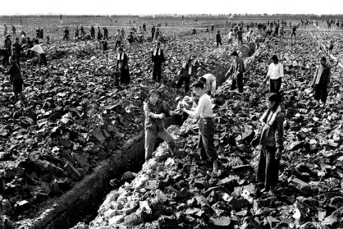
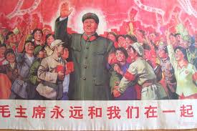
After the failure of the Great Leap Forward, China moved towards a different type of communism.
Farm families could now live in their own homes and sell crops that they grew on small private plots of land. Factory workers could compete for wages and promotions.
Mao didn’t like this type of communism because he felt it moved away from the goal of social equality.
In 1966 he urged the young people of China to “learn revolution by making revolution.” Millions of young Chinese left school and joined militia units called the “Red Guard.”

Slide 31
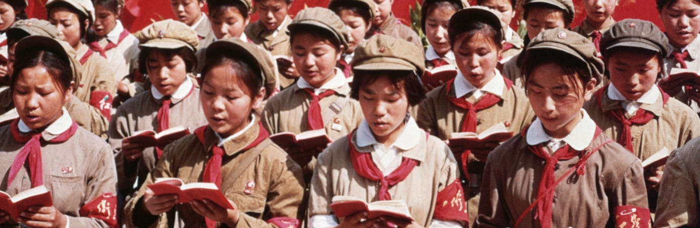
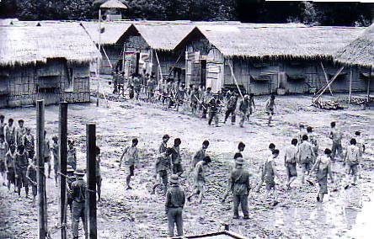
The Red Guard led a major uprising known as the cultural revolution. The goal of which was to establish a society of peasants and workers who were all equal.
Work with your hands was glorified. Work that required thought or creativity was deemed dangerous and so the Red Guard shut down schools and colleges. Intellectuals were forced to “purify” themselves through hard labor in remote villages. Thousands more were imprisoned or executed.

Slide 32
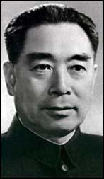
Chaos closed factories and limited farm production.
Mao decided that the Cultural Revolution had to stop and he ordered the Chinese army to put down the Red Guard.
Zhou Enlai, the Chinese premier and founder of the Chinese Communist Party began to
Restore order.

Slide 33
Containment at Home
The test of Tsar Bomba and the fall of China to the communists led to a renewed press to root out communists and spies (and communist spies, of course).

Slide 34
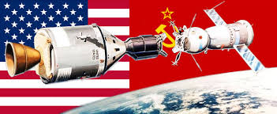
Space, The Final Frontier…
The Cold War now moves to the skies and science and technology education programs in the US and USSR are changed forever.

Slide 35



August 1957 – The Soviets announce that they have developed an Intercontinental Ballistic Missile or ICBM. This rocket, like its name states, could travel huge distances.
October 4, 1957 – the Soviets launch Sputnik, an unmanned satellite into space.
The US government poured money into Science and Tech education and a year later, the US launched their first satellite.

Slide 36


In 1955 Eisenhower had suggested that the US and USSR be able to fly over each other’s territory to guard against a nuclear attack
The Soviets say no and in 1960 the CIA started flying secret, high-altitude, spy flights over Soviet territory in U-2 spy planes.
In May of 1960, Francis Gary Powers was captured after being shot down in his U-2 over Russia.

Slide 37


Slide 38


War in Korea and Vietnam

Slide 39

The Korean War
Korea was divided after WWII along the 38th parallel.
In the North, Japanese troops had surrendered to Soviet troops
In the South, Japanese troops had surrendered to American troops
As a result of this, like in Germany, two separate countries emerged.
One was the industrialized Communist north, the other was the non-communist, rural, south supported by western powers.
In 1949 most troops had been removed from Korea, but the Soviets supplied the north with tanks, troops, money, and weapons for an eventual take over of the peninsula assuming the Americans wouldn’t defend it.

Slide 40

On June 25, 1950 North Koreans crossed the 38th parallel in a surprise attack on South Korea. Within days, the North Korean troops were deep into the south surrounding Pusan.
Truman didn’t want a repeat of Mussolini, Hitler, and the Japanese.
His containment policy was being tested and he refused to allow South Korea to fall to Communism.
South Korea also asked the UN to intervene and when the matter came to a vote the Soviet Union was absent. (They were protesting the admittance of Nationalist Taiwan instead of Communist China.)
Because of that, the USSR couldn’t veto the UN plan to send a force to Korea.
15 nations include the US and Britain participated under the command of General Douglas MacArthur.

Slide 41
The North Koreans continued their advance. And by September of 1950, they controlled the entire Korean peninsula except for a tiny area around Pusan.
That same month MacArthur launced a surprise attack at Inchon and surrounded the North Korean troops. About half of them surrendered and the rest retreated.
MacArthur’s UN troops chased the retreating North Koreans over the 38th parallel and pushed them almost all the way to the Yalu River.
In October 1950 the Chinese sent 300,000 troops into North Korea, greatly outnumbering the UN forces.
By January of 1951 UN and S. Korean troops were pushed out of N. Korea. The Chinese then moved south and captured the S. Korean capital of Seoul
By 1952 the UN had regained control of S. Korea
July 1953 UN and N. Korea signed a cease fire and st the border near the 38th parallel
4 million soldiers and civilians died.

Slide 42

During the war, MacArthur called on Truman to drop nuclear weapons on China.
Truman responded by saying that he was trying to prevent WWIII not cause it.
MacArthur went over Truman’s head and tried to appeal to congress and the press to get those bombs dropped.
In response, Truman removed him.

Slide 43




The Election of 1952
The election of 1952 was a contest between Illinois governor Adlai Stevenson (D)
and General Dwight D. Eisenhower (R)
Eisenhower ran on the promise that he would end the war in Korea and fight communism at home and abroad.
He chose Richard M. Nixon (R) of California as his running mate.
Eisenhower won with 54% of the popular vote and 87% of the electoral vote
Notes:
Eisenhower tended to be non-partisan. He tried to balance the federal budget but still kept social programs like Social Security. Had huge defense spending but warned about the idea of the military industrial complex, which was a web of high ranking defense industry executives and Defense department officials that benefitted from war and defense spending.

Slide 44


Joe McCarthy and the Red Scare
Beginning in 1950, Sen. Joe McCarthy (R-Wisconsin) said in a speech that the state department was full of communist spies
Notes:
This, in combination with the arrest of Karl Fuchs who had worked on the A-bomb and given info to the soviets increased American fears

Slide 45

This spurred several trials of both government personnel and regular citizens, the most famous of whom were
Julius and Ethel Rosenberg
The Rosenbergs were tried and convicted of treason and sentenced to death (June 1953) on very little evidence.
Notes:
It was later, much later, found that Julius had indeed passed information to the Soviets, but Ethel had not had any involvement whatsoever

Slide 46

Notes:
People were called before the committee and forced to testify. Refusal to testify could lead to prison. People who pled the 5th or were just suspected of communist sympathies lost jobs or found themselves blacklisted

Slide 47

Loyalty boards were created to question federal employees. Local governments created their own.
People from potential FBI Agents to kindergarten teachers were asked; “Are you now, or have you ever been, a member of the Communist Party of the United States.”

Slide 48

There was a fear of the spread of communism in Europe and particularly South East Asia at this time as well. The US supported the French in Indochina and after they are defeated there’s a fear that other nations will fall to communism as well.
President Eisenhower described this threat as the Domino Theory a belief that the rest of Southeast Asia were like a row of dominoes and the fall of one to communism would lead to the fall of it’s neighbors.
This Domino Theory was the justification for US foreign policy during most of the Cold War.

Slide 49


After France’s defeat, an international peace conference met in Geneva to discuss the future of Indochina.
Based on these talks, Vietnam was divided at 17* North Latitude. North of that line, Ho’s communists ruled. South of that line the US set up an anti-Communist government under the leadership of Ngo Dinh Diem
Ngo ruled the south as a dictator and opposition to his government grew. Communist guerillas called Vietcong began to gain strength in the countryside.

Slide 50

The Cold War Divides the World

Slide 51

After WWII the world’s nations were grouped into three “Worlds.”
The First World include industrialized, capitalist, nations like the U.S.
The Second World was the communist nations led by the Soviet Union
The Third World was developing nations not aligned with either of the Super Powers (US or USSR)

Slide 52

The Third World was located in Africa, Latin America, and Asia. They were economically poor and politically unstable, because of years of colonial control. Each of these nations needed a stable economy to build their society around and U.S. capitalism or Soviet communism were the main choices.

Slide 53

The U.S., the USSR, and to some extent China, used a variety of ways to influence the Third world.
They backed revolutions, liberation movements, and counterrevolutions as it suited their needs.
The CIA and the KGB often used secret activities ranging from spying to assassinations (both countries assassinated people that were ‘in the way’ of them achieving whatever goals they had in whatever nation they were in).

Slide 54


The US gave military aid, built schools, developed anti-poverty programs, and sent volunteers to work in Third World Nations
The Soviets offered military and technical assistance. They also sent food.

Slide 55

Brinkmanship is the policy of going to the brink of war to make the other side back down
Espionage is spying on other countries to try to gain an advantage
Foreign Aid is when financial or social aid (food) is given by a nation to a Third World nation to try to win allies.
Multinational Alliances included NATO and the Warsaw Pact
Propaganda is material that is intended to make one nation better than another. It was often broadcast as movies and radio.
Surrogate Wars are wars that are fought as substitute wars. The U.S. and U.S.S.R didn’t fight each other directly, instead they backed opposing sides in other conficts. (Korea, Vietnam, Iran, etc.)

Slide 56


Developing nations often needed assistance and they became very important to the competition between the U.S. and the U.S.S.R., and later on, China.
Many countries like India and Indonesia tried to stay neutral and uninvolved.
In 1955 Indonesia hosted the Bandung conference where many Asian and African nations met to create a “third force” of independent, nonaligned, countries.

Slide 57


Confrontation in Latin America
In the 1950s Cuba was ruled by the unpopular dictator Fulgencio Batista, who was supported by the US
The Cubans had a popular revolution in January of 1959 that overthrew Batista.
That revolution was led by a young Fidel Castro.
At first, Castro was popular for bringing social reform and improving the economy. However he became a dictator that suspended elections, jailed or executed his opponents, and tightly controlled the press

Slide 58



When Castro nationalized the Cuban economy he took over US owned sugar mills and refineries.
In response to this Eisenhower ordered an embargo on all trade with Cuba. In response, Castro turned to the Soviets for help.
In 1960, the CIA began training anti-Castro Cuban exiles and in April 1961 sent them to invade Cuba with the promise of US backup. The exiles landed at the Bay of Pigs and the US did not send the promised air support and the exiles lost very quickly.

Slide 59

Confrontations in the Middle East

Slide 60


The oil industry was causing issues between religious and secular groups.
This was most evident in Iran. After WWII, Iran’s leader Shah Mohammed Reza Pahlavi
began to move towards western governments and wealthy oil companies.
Nationalists resented these alliances and united under Prime Minister Muhammed Mossadeq
He nationalized a British owned oil company and in 1953 forced the shah to flee. The US helped restore the Shah to power out of a fear of communism spreading to Iran.

Slide 61


With American support, Shah Pahlavi began to westernize the country and by the end of the 1950s Tehran was a modern, western style city.
Conservative Muslim leaders known as ayatollahs led religious opposition to Pahlavi’s government and western influence. The most powerful of these was Ayatollah Ruholla Khomeini
Iranians rioted in every city in late 1978 spurred on my Khomeini's tape recorded messages. The Shah fled in 1979 and Khomeini returned to establish an Islamic state and to export Iran’s militant form of Islam.
Millions of Iranians however were still extremely poor.

Slide 62

Khomeini was ruled by strict Islamic beliefs that controlled his domestic policies, but his foreign policy was dominated by a strong continuing hatred for the US and its support of the Shah.
In 1979 young Islamic revolutionaries took the US embassy in Tehran and took more than 60 American hostages. They demanded that the US force the shah to face trial. Most of the hostages were held for 444 days until they were finally released in 1981.

Slide 63

Khomeini encouraged Muslims everywhere to overthrow their secular leadership. It was intended to unify all Muslims but instead heightened tension with Iraq, a traditional enemy of Iran.
Saddam Hussein governed Iraq as a secular state.
In 1980 a war broke out between Iran and Iraq. The US supported both sides because it didn’t want to change the balance of power in the area. The Soviets supported Iraq.
A million Iranians and Iraqis died in the war before a UN negotiated cease fire in 1988

Slide 64


After WWII Afghanistan managed to maintain its independence from both the Soviet Union and the US, but in the 1950s Soviet influence grew and in the late 1970s a Muslim revolt threatened to topple the government.
In 1979 Soviet troops invaded Afghanistan expecting to prop up the communists there and then quickly withdraw. Instead the Soviet Union found themselves stuck there fighting a rebel force that outmaneuvered them.
The Afghanis, called mujahedeen (holy warriors) were supplied with American weapons. The Taliban got it’s start here and took over in 1996 after soviet withdrawal in 1989.

Slide 65


President Carter had warned the Soviet union about an invasion to try to control the Persian Gulf and to protest the invasion of Afghanistan, Carter cut off US grain shipments to the USSR and ordered a US boycott of the 1980 Moscow Olympics.
In the 1980s Soviet Premier Mikhail Gorbachev acknowledged the devastation of the war and withdrew all troops by 1989. It was too little to late to stop the issues in Afghanistan.

