Slide 1
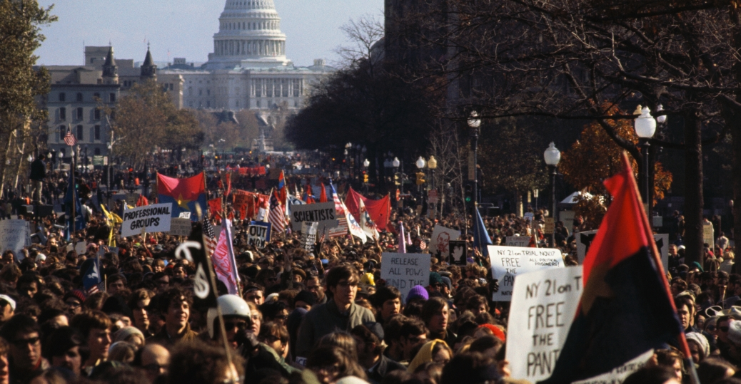
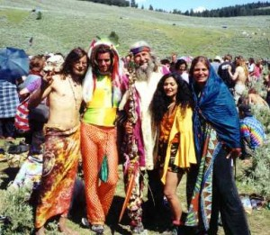
Bell Ringer & Vocab
What images come to mind when you hear the word hippie?
Content Vocab
Doves
Hawks
Hippies
Academic Vocab
Protest
Free Speech Movement
Draft
http://www.history.com/topics/vietnam-war/vietnam-war-history

Slide 2
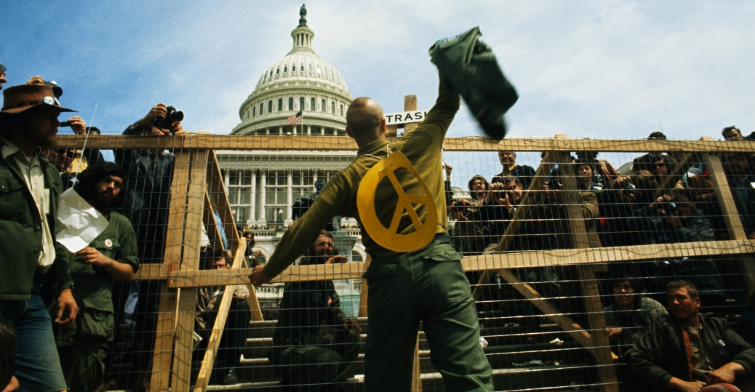
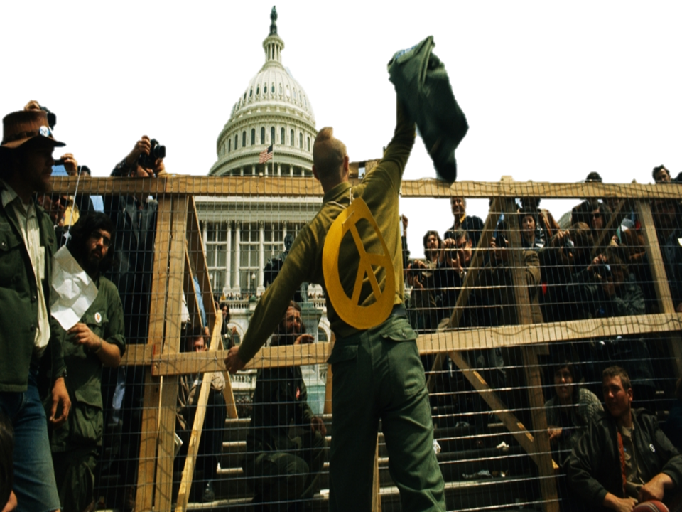
Counter Culture & Protest

Slide 3
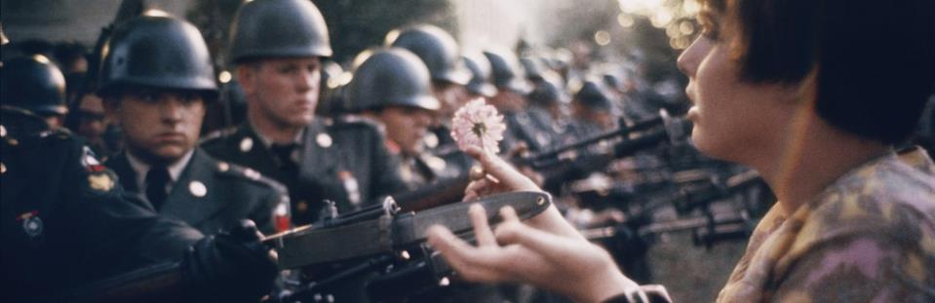
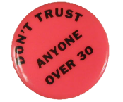
1.Peace and Prosperity
2.Fear of Nuclear War
3.Civil Rights Movement
4.Baby Boom
5.College Enrollment
The Youth Movement of the 1960s
Young activists began to challenged the American political and social system and conventional middle class values.

Slide 4
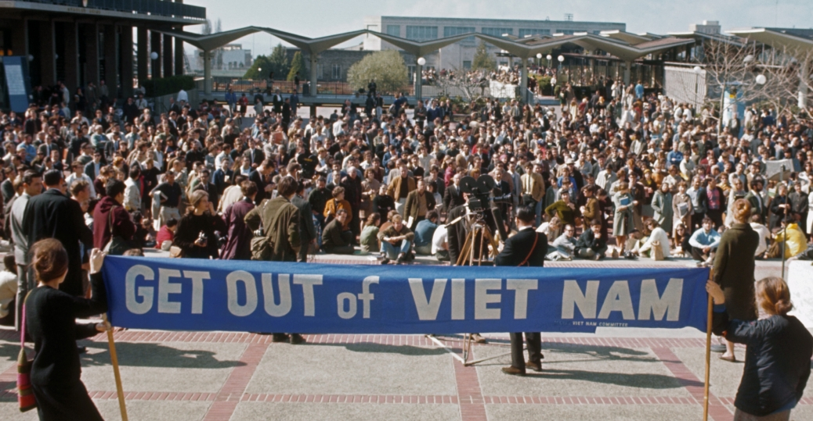
Overview of the Protest Movement
The antiwar movement gained momentum in 1965, when President Lyndon B. Johnson ordered massive U.S. military intervention and the sustained bombing of North Vietnam.
In the spring of 1965, "teach-ins" against the war were held on many college campuses.
Students for a Democratic Society (SDS) organized the first national antiwar demonstration in Washington;
  20,000 people, mainly students, attended.
Notes:
The first American protests against U.S. intervention in Vietnam took place in 1963→ small scale protest

Slide 5
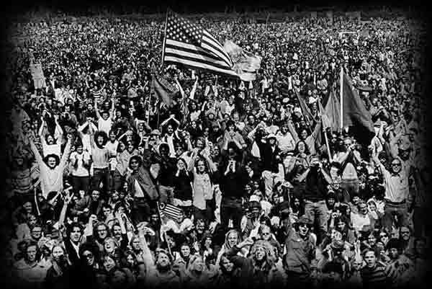
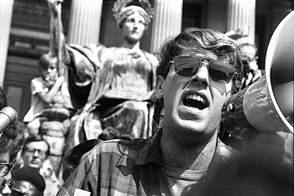
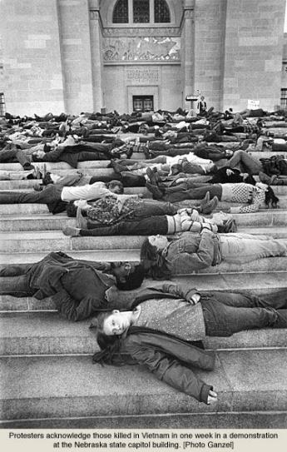
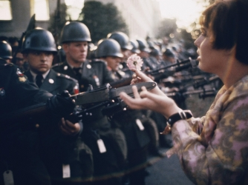
Origins of the Movement
The economic boom of the 1950s led to a dramatic increase in college enrollment.
College gave young people the opportunity to share their feelings and fears about the future with others.
http://www.nytimes.com/interactive/2008/12/20/opinion/20081220opchart_ready.html?scp=1&sq=1968&st=cse
Notes:
Mark rudd

Slide 6
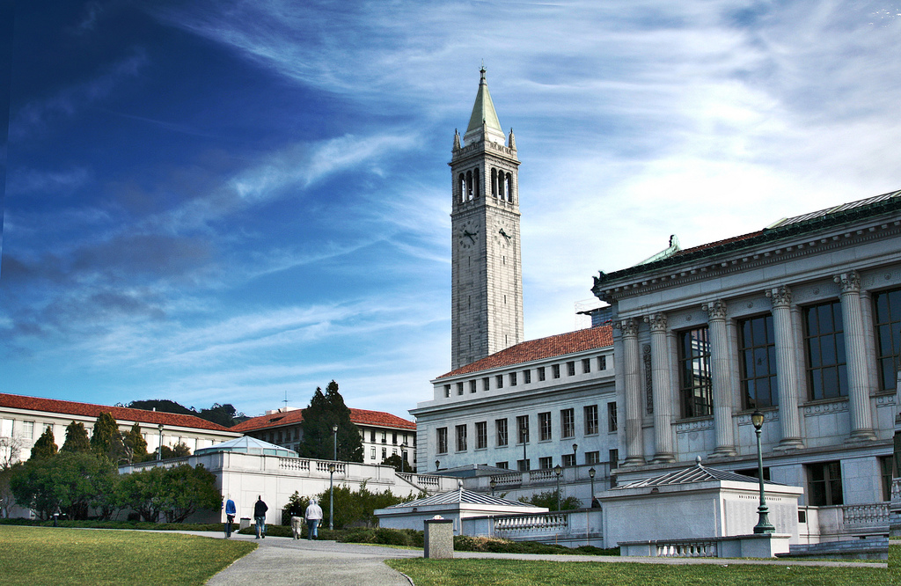
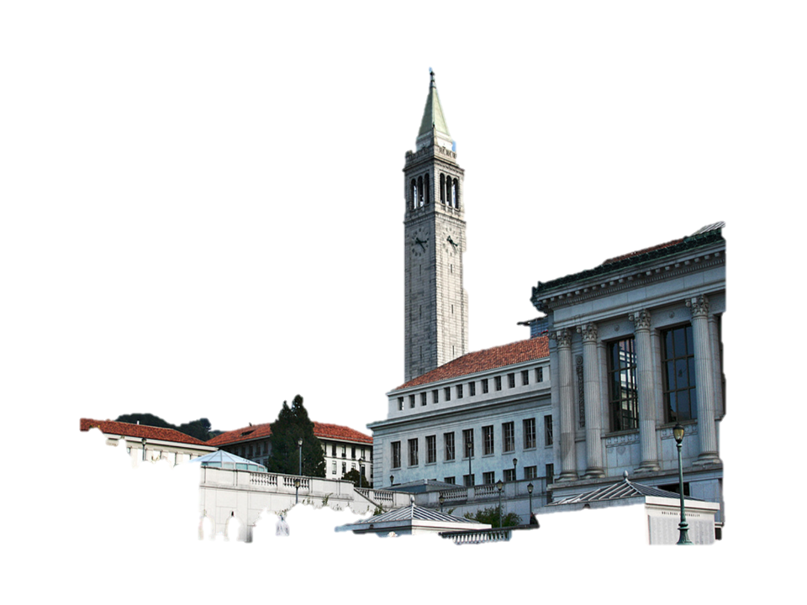
UC Berkeley
A group of activists at the University of California at Berkeley began the Free Speech Movement.
The group, disgruntled by several practices at the university, staged a sit-in at the administration building

Slide 7
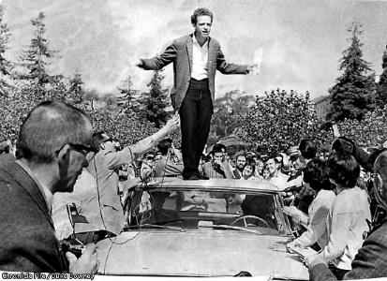
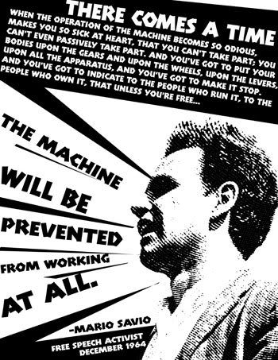
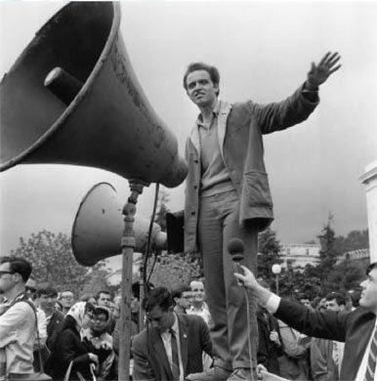
https://www.youtube.com/watch?v=PhFvZRT7Ds0

Slide 8

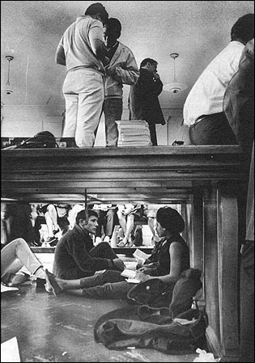
Freedom of Speech
After some 700 protesters were arrested, a campus-wide strike stopped classes for two days.
The administration gave in to the student’s demands, and the Supreme Court validated the student’s rights to freedom of speech and assembly on campus.
  The Berkeley revolt became the model for college demonstrations around the country.

Slide 9
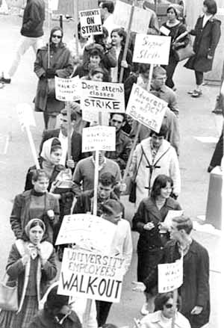
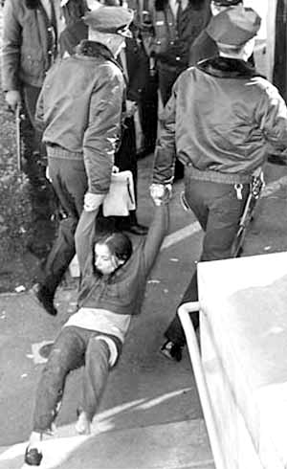
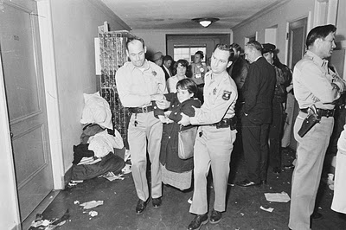
http://www.youtube.com/watch?v=eCM-mROkbCs

Slide 10
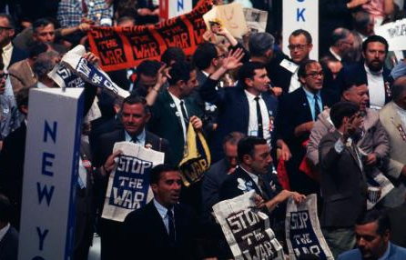
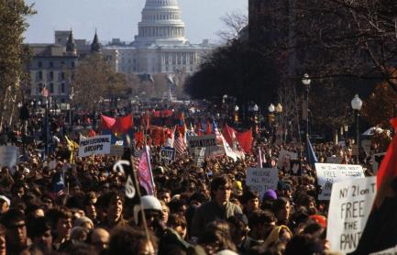
Notable Protests
1968: Democratic National Convention in Chicago
thousands of Vietnam War protesters battle police in the
Democratic Party falls apart over an internal disagreement over Vietnam.
1969: Washington DC
Vietnam Moratorium Committee staged what is believed to be the
largest antiwar protest in United States history
half a million people
peaceful demonstration

Slide 11
In Washington D.C., veterans protest the fighting in Indochina by discarding their medals and uniforms over the fence at the U.S. Capitol.

Slide 12
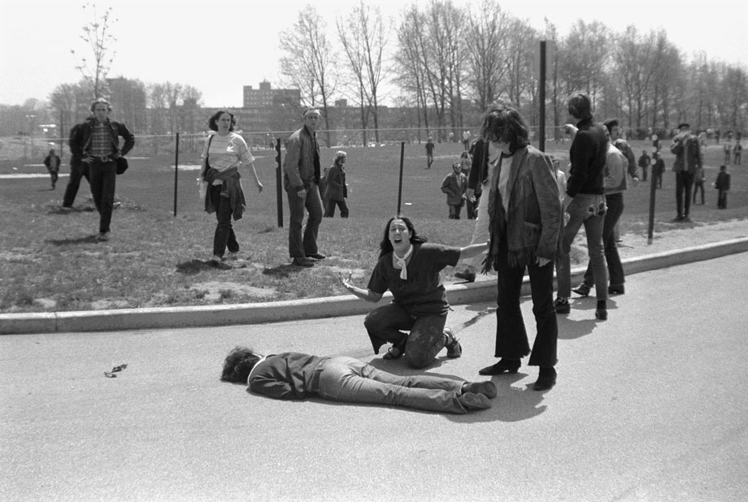
At Kent State University in Ohio the National Guard confronts protestors, after an ROTC building was set on fire. The National Guard opened fire on the students killing four and wounding eight.

Slide 13
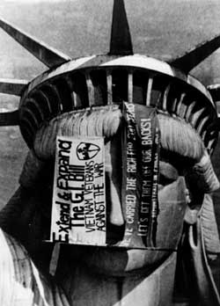
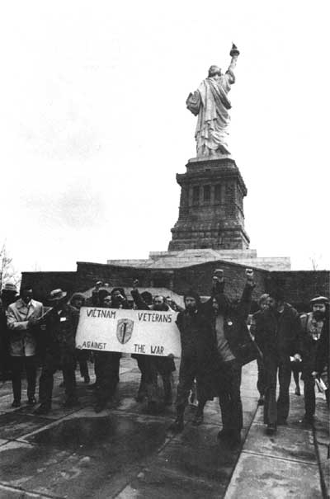
1971, fifteen VVAW (Vietnam Veterans Against the War) activists barricaded and occupied the Statue of Liberty for two days in a successful attempt to bring attention to the antiwar cause.

Slide 14
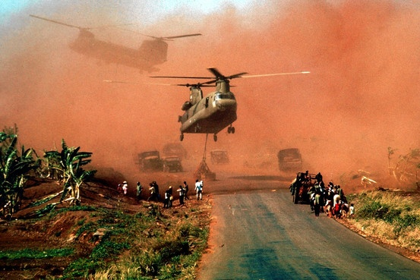
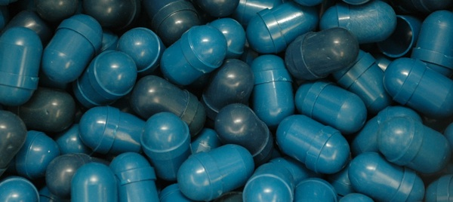
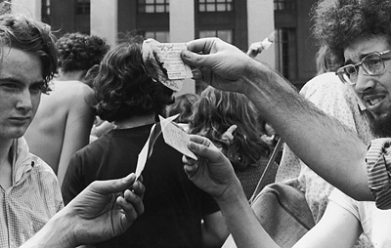
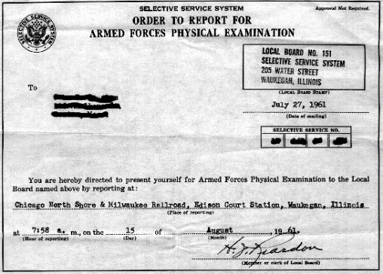
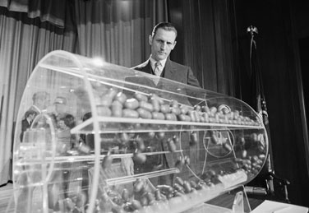
The Draft
Young also protestors focused their attention on what they felt was an unfair draft system.
While college students could delay military service until graduation, those with low income and limited education were called to serve.
As a result, minorities, especially African Americans, were called to war.
Many draftees refused to serve. Others moved to Canada and other nations.
http://www.history.com/topics/vietnam-war/vietnam-war-protests/videos/dodging-the-draft

Slide 15
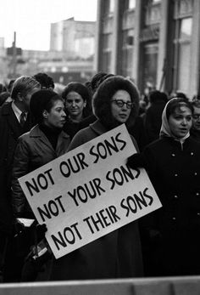
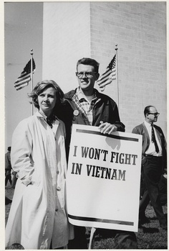
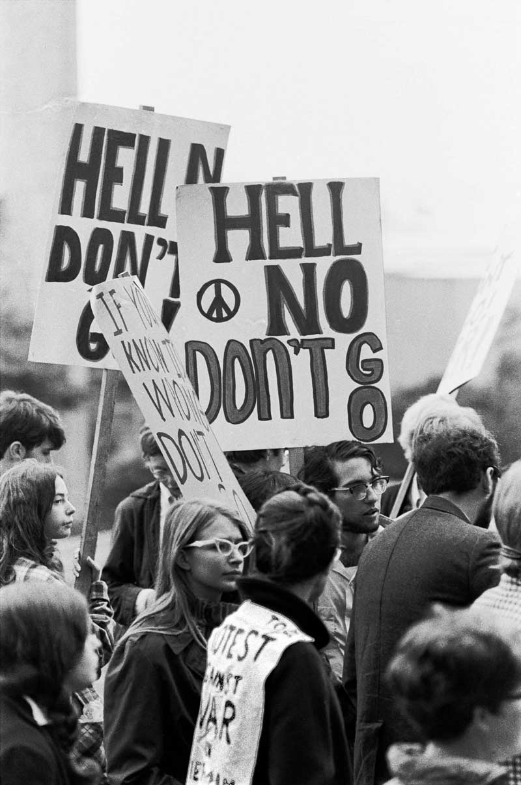
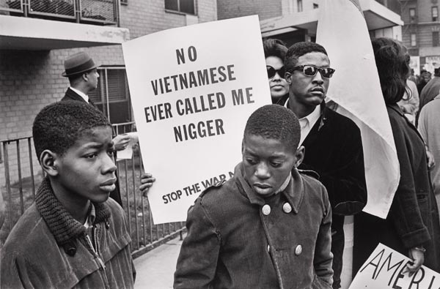
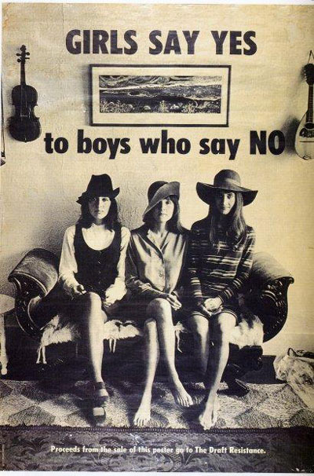
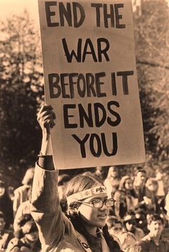
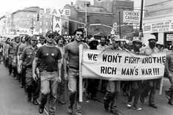

Slide 16
Who should be drafted for war and why?

Slide 17
Current Draft Laws
What the law says
  Men between the ages of 18 and 25 are required to register for the selective service
  Failure to register can incur $250,000 in fines and up to five years in prison
1.52 million men were drafted for the Korean War
1.85 million men were drafted for the Vietnam Conflict
Notes:
http://www.sss.gov/FSbenefits.htm

Slide 18
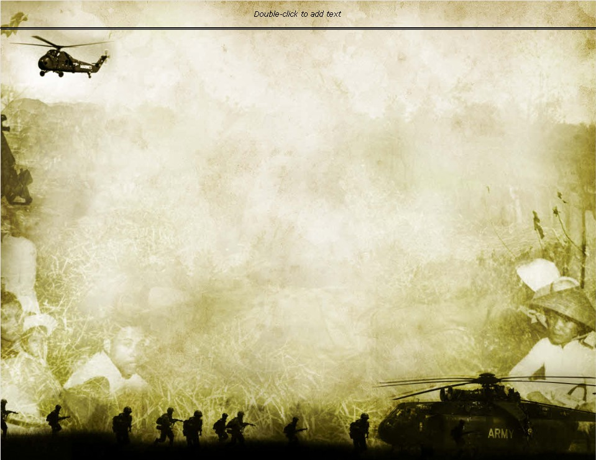
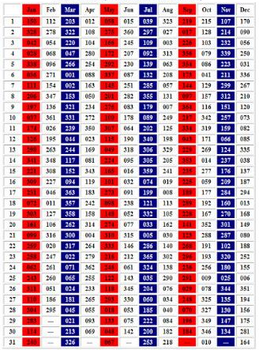
Would You Have Been Drafted?
The year is 1969. This is what a draft card would have looked like. Lets see if you would have been drafted to serve in the Vietnam War?
http://www.random.org/integers/
Now that you know your lottery number, how would you have felt and what would you have done if you were an 18 year old in 1969?
REGISTRATION CARD
First Name:____________ MI:______ Last:___________________
Address:___________________________ City:________________
State:_____________________________ Zip Code:____________
Permanent Telephone Number:________________ Place of Birth: (city)___________(state)_______________
Date of Birth: (month)________(day)________(year)________
Name and Address of Person Who Will Always Know Your Address:___________________________________
Employers Name and Address:________________________________________________
I AFFRIM THAT I HAVE VERIFIED ABOVE ANSWERS AND THAT THEY ARE TRUE:
Signature: X__________________________
https://www.youtube.com/watch?v=SSnw1JaL2uA
Notes:
Pick 18- #1-367

Slide 19
Checking for Understanding
What California University led the way for college protests during the 60s?
Berkeley

Slide 20
Checking for Understanding
Why did some feel the draft was unfair?
college students could delay military service until graduation, those with low income and limited education were called to serve

Slide 21
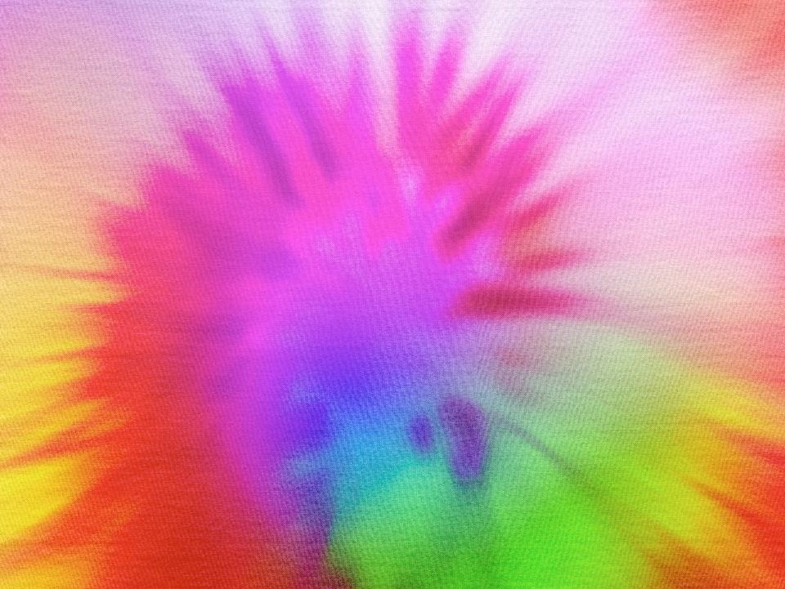
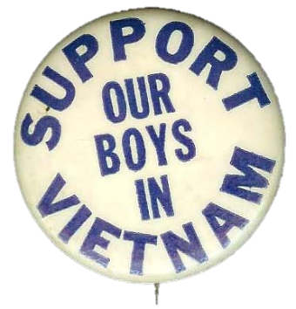
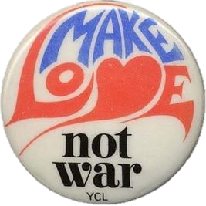
Doves vs Hawks
By 1968 the nation seemed divided into two camps—the doves and the hawks.
  The doves wanted the United States to withdraw from the war
  Hawks felt the United States should stay and fight.

Slide 22
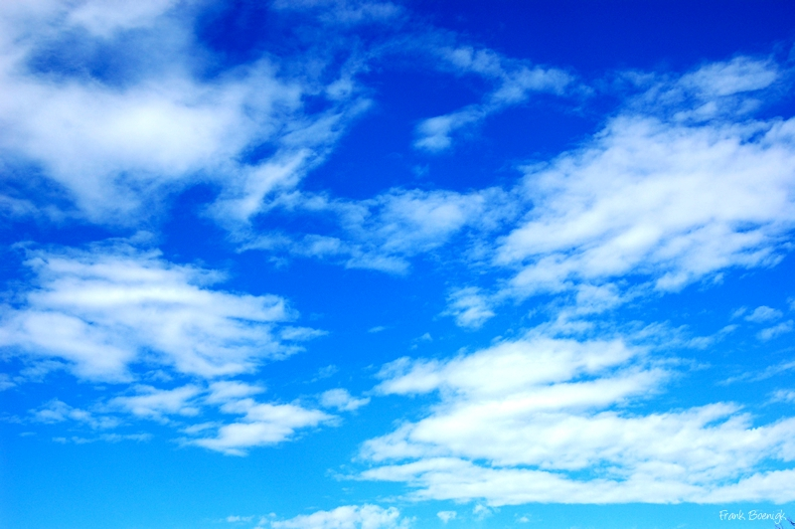
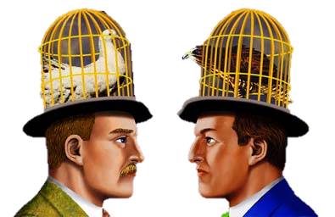
Doves vs Hawks
Do you agree or disagree?
We must protect our economic interests in Asia. We have many investments there and being involved in Southeast Asia will ensure protection for decades.
Communism in Asia – specifically Southeast Asia – is not a threat to us. Why should we care about what goes on there? We have problems of our own here!
Our government leaders have misled us – we are not winning!
The war in Vietnam is a civil war between North and South Vietnam; it is none of our business. Would we have wanted France to get involved in our Civil War in the 1860s?
We must help the South Vietnamese friends who want American democratic institutions
We must stop communist aggression – the Domino Theory is a valid fear. If one nation in Southeast Asia falls to the communists, neighboring countries soon will too.
We are killing innocent Vietnamese. We must stop fighting and negotiate a treaty as soon as possible.
We will loose good young men and waste billions of dollars.
Fighting in Vietnam is a patriotic duty and an honor.
We should not uphold and give financial support to the corrupt government in South Vietnam; this is a no-win war.
We must win the war to secure the peace.

Slide 23
Checking for Understanding
What were people called that wanted the United States to withdraw from the war?
Doves

Slide 24
Checking for Understanding
What were people called that felt the United States should stay and fight?
Hawks

Slide 25
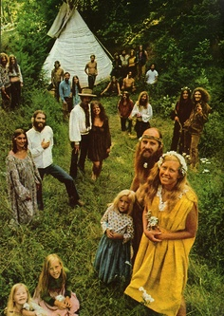

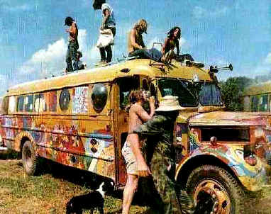
Counterculture
Some young Americans did not challenge the system.
  wanted to create their own society.
The counterculture, or hippies, were mostly white youths from middle- and upper-class backgrounds.
  lived a life that promoted flamboyant dress, rock music, drug use, and free and independent living.
http://www.youtube.com/watch?v=k3TmpRqDisg

Slide 26
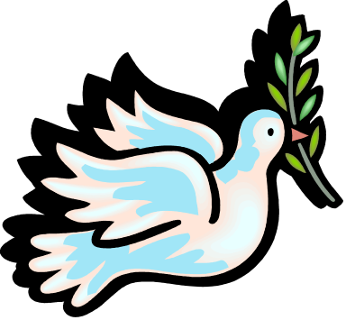
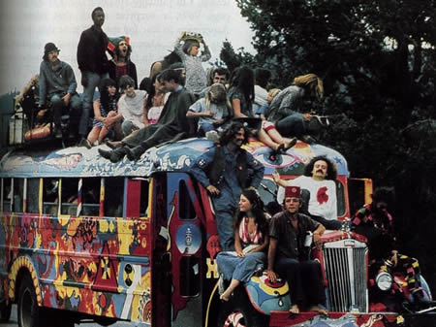
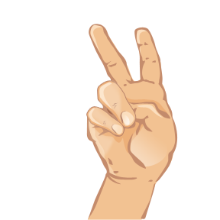

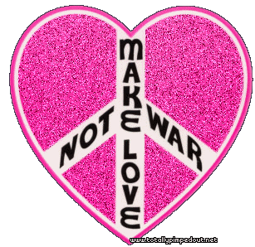
Hippies
a society that was free, closer to nature
full of love, empathy, tolerance, and cooperation.
rejected materialism, many embraced spirituality
Long hair, Native American headbands, shabby jeans, and drugs were common.

Slide 27


Slide 28


Bright Colors
During the beginning of the hippie subculture, the drug of choice at the time was LSD.
Using LSD was inspired by the use of Peyote by Native Americans in the Southwest.
In addition, the Native American’s dress of bright colors inspired the clothing of the hippies

Slide 29



Drugs like marijuana and LSD were a big part of the hippy/counterculture movement.
Using drugs made hippies feel like the were rebelling from mainstream society.
Drug Culture

Slide 30


Acid Trip
http://www.youtube.com/watch?v=y9uYEM2osYQ&feature=related

Slide 31

The VW Bus became known as a counterculture and hippie symbol, and many buses were repainted with custom paint jobs.

Slide 32



Unmarried couples of all ages feel free to travel and live together without societal disapproval.

Slide 33






Woodstock
Woodstock-Over 500,000 people arrived to hear the most notable musicians and bands of the era.
Music festival in NY that lasted 3 days
“For thousands who couldn’t even hear the music” it was a “profound religious experience.”
Meager resources were shared with everyone.
Many people at Woodstock used illegal drugs
http://www.nytimes.com/interactive/2009/08/10/arts/music/20090810-woodstock-song-vote.html?scp=4&sq=woodstock&st=cse
Notes:
33

Slide 34


Hippies
Communes or group living arrangements in which members shared everything and worked together, were formed as hippies dropped out of society.
One of the most popular hippie destinations was the Haight-Ashbury district in San Francisco.

Slide 35




Slide 36


Slide 37


Slide 38








Slide 39

Peace rally, in San Francisco 1967. 67,000 people protesting the Vietnam war.

Slide 40


Would you be part of
the Mainstream
Or the Counterculture

Slide 41


Fashion
Mainstream: You will never get anywhere in life dressed like that
Counterculture: Why don’t you loosen up? You dress like everyone else. Be an individual

Slide 42
Communal Living
Mainstream: How can you live in all that dirt with so many people? Don’t you miss your privacy?
Counterculture: Why do you feel the need to fence yourself off from everybody else? Don’t you feel isolated

Slide 43
Political Activism
Mainstream: You should either love America or leave it.
Counterculture:
How can you just blindly swear allegiance to the American government?

Slide 44
Sexuality
Mainstream: Your sexual conduct is not only immoral but dangerous.
Counterculture: Why can’t you respect my choices? My actions are not hurting you.

Slide 45
Music
Mainstream: You call this music? How can you listen to it?
Counterculture: Your music is boring and unimaginative. Why don’t you get with it.

Slide 46
Drugs
Mainstream: Drugs are against the law and will take you nowhere.
Counterculture: I’m not hurting anyone. Why don’t you just lay off?

Slide 47




Hippie Decline
The counterculture declined, as some hippie communities became a place where criminal activity was common.
Drug use declined as the excitement faded and as more young people became addicted or died from overdoses.
http://www.youtube.com/watch?v=59ahx9ckqIw

Slide 48





Famous Rock Stars from the who Overdosed in the 60s-70s
Brian Jones (Rolling Stones)
Jim Morrison (Doors)
Janis Joplin
Jimi Hendrix
Elvis

Slide 49
Checking for Understanding
Describe 3 Characteristics of Hippies?

Slide 50
Checking for Understanding
What Music festival took place in NY that lasted 3 days with the most famous musicians and bands of the era?
Woodstock

Slide 51
Checking for Understanding
What was a negative effect of the Hippie lifestyle?
Addicted to drugs

Slide 52


"Fortunate Son“-1969
By Creedence Clearwater Revival
Some folks are born made to wave the flag
Ooh, they're red, white and blue
And when the band plays "Hail to the chief"
Ooh, they point the cannon at you, Lord
It ain't me, it ain't me, I ain't no senator's son, son
It ain't me, it ain't me; I ain't no fortunate one, no
Yeah!
Some folks are born silver spoon in hand
Lord, don't they help themselves, oh
But when the taxman comes to the door
Lord, the house looks like a rummage sale, yes
It ain't me, it ain't me, I ain't no millionaire's son, no
It ain't me, it ain't me; I ain't no fortunate one, no
Some folks inherit star spangled eyes
Ooh, they send you down to war, Lord
And when you ask them, "How much should we give?"
Ooh, they only answer More! more! more! yoh
It ain't me, it ain't me, I ain't no military son, son
It ain't me, it ain't me; I ain't no fortunate one, one
It ain't me, it ain't me, I ain't no fortunate one, no no no
It ain't me, it ain't me, I ain't no fortunate son, no no no
https://www.youtube.com/watch?v=rbNnvPBokNs

