Slide 1
Culture and Socialization
Unit #2

Slide 2
Enduring Understandings
Each culture is ethnocentric
People’s environment influences their social behavior
Socialization starts at birth and continues throughout our lives
The beliefs and ideals of a society influence the social, political, and economic decisions of that society

Slide 3
Essential Questions
What makes up culture?
How does the Nature v. Nurture debate play a role in Sociology?
What is the American culture?
How does American culture change overtime?

Slide 4
Mastery Objectives
Recognize the difference between conflict, functional, and symbolic approaches to the study of culture, socialization, social structure, deviance, and complex organizations
Identify the most important agents of socialization in the United States

Slide 5
Mastery Objectives
Illustrate how social institutions are linked and interdependent within a social system in addition to identifying changes in American social institutions
Give examples that demonstrate how the definition of deviance is relative to time, place, situation and social status, that is, how social deviance is socially constructed

Slide 6
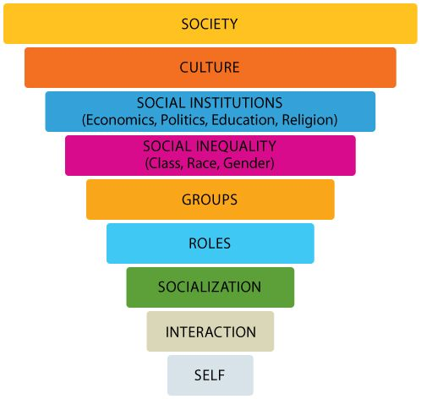

Slide 7
Vocabulary
culture | society | norms | folkways
mores | taboo | laws | sanctions
ethnocentrism | cultural universals | cultural particulars | socialization
self-concept | looking-glass self | significant others | generalized others
“me” | “I” | desocialization | resocialization
anticipatory socialization | reference group | social structure | ascribed status
achieved status | master status | rights | obligations
role conflict | role strain

Slide 8
Vocabulary
primary groups | primary relationships | secondary groups | secondary relationships
in-group | out-group | GSI cooperation | GSI conflict
GSI social exchange | GSI coercion | GSI conformity | Formal Organizations
Informal Organizations | deviance | positive deviance | negative deviance
strain theory | control theory | differential association theory | labeling theory
primary deviance | secondary deviance | criminal justice system | recidivism

Slide 9
Culture
Unit 2 Section 1

Slide 10
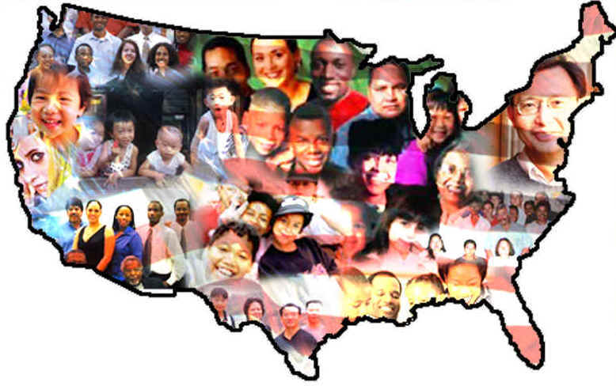
Culture is the knowledge, language values, customs, and physical objects that are shared by members of a society.

Slide 11
American Culture
Includes: Beliefs, rules, customs, family systems, and a capitalist economy
  Nuclear Family, Golden Rule, …
Culture helps to explain human social behavior
Culture provides a blueprint that people in society use to guide their relationships with others

Slide 12
What is Our American Culture?
Knowledge | Language | Values | Customs | Physical Objects

Slide 13
What is Our American Culture?
Knowledge | Language | Values | Customs | Physical Objects
Movies | Music | Internet/Social Media | BBQs | Twin Towers
Beaches | School | Doctors/Health Care | Movies | Ford
School/Edu | Computers | NYC | Beaches | Drugs
Books | Fashion | Grand Canyon | School/Edu | Cell Phones
TV/Media | Facebook | Disney/Universal | Books | American Flag
Internet/Social Media | TV | Take Responsibility | TV/Media | Eagle
Disney/Universal | Movies | Kindness | Internet/Social Media | Burgers and hotdogs
Religion | Religion | Family First | Fairs/Carnivals | T.V
English | Gangs | Good Company | Bullying | Video games
Equality | Cell Phones | Life Lessons | Disney/Universal | Alcohol

Slide 14

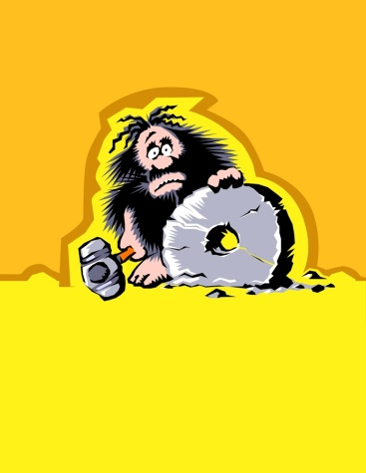
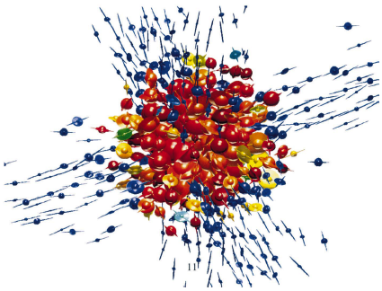
Culture Changes for Three Reasons
Discovery
  process of finding something that already exists
Invention
  creation of something new
Diffusion
  borrowing of aspects of culture from other cultures

Slide 15
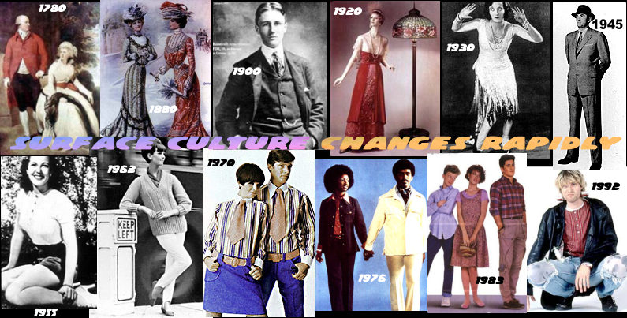
Culture Changes with the Times

Slide 16
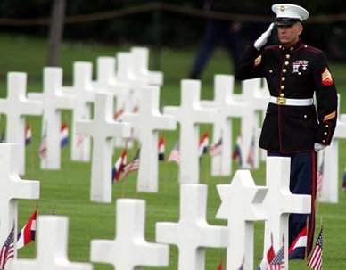
Society
Society is a specific territory inhabited by people who share a common culture and human behavior is based on culture
Culture and Society are
tightly interwoven.
One cannot exist
without the other.
Culture is learned

Slide 17
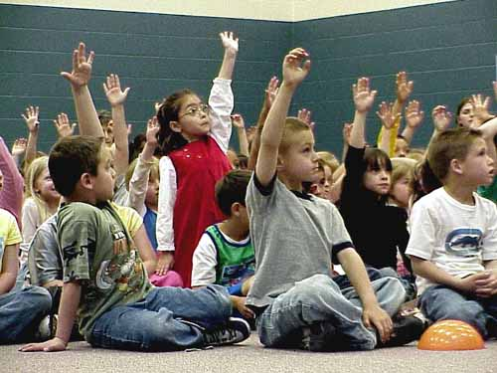
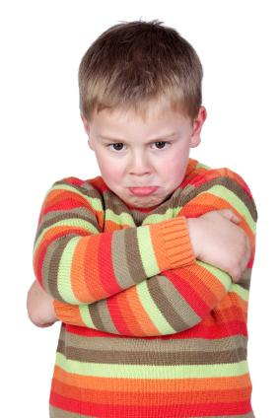
Norms and Values
Norms are rules defining appropriate and inappropriate behavior

Slide 18
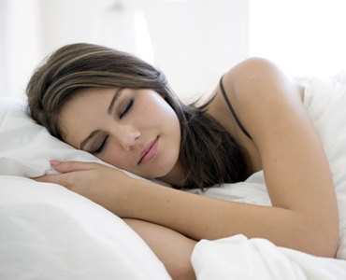
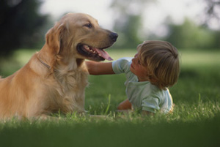
Norms and Values
Folkways are norms that have little moral significance
They are usually routine ways of doing things developed by trial and error, consists often of preferences rather than demands, variable from one situation to another.
Violation of folkways elicit mild social reaction.

Slide 19
Examples of Folkways
smoking
wearing heavy makeup
sending thank you cards
listening to loud rock music
learning to play intellectual games
using proper etiquette
using proper table manners
wearing the appropriate clothing for the occasion

Slide 20
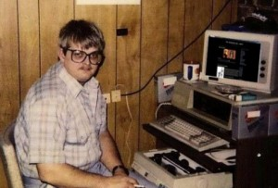
Norms and Values
Mores is norms that have moral dimensions and that should be followed by members of the society
These consists of demands rather than preferences.
Conformity is a social requirement
“Negative mores”- ‘Thou shall not’ are called taboos.
By the time you graduate college, you should be out of the house or your scorned as worthless

Slide 21
Examples of Mores
do not kill
pay back borrowed money
keep important promises to friends
rise for the National Anthem
do not cry ‘fire’ in a public place
obey traffic signals
do not abuse children
wear enough clothes to conform to the American standard of decency

Slide 22
Norms and Values
Taboo a rule or behavior, the violation of which calls for strong punishment, has to generate strong social disgust
The definition of taboo varies according to region, religion and society. Hence, some practices could be considered taboo in one society, while could be considered merely immoral acts in another: still in some other society it might be considered normal

Slide 23
Taboo: What can you come up with?

Slide 24
Examples of World Taboo’s
Cannibalism
Incest
Abnormal Sexual Relationships (pedophilia, necrophilia)
Murder
Suicide
Corpses
Eating Carnivorous Animals (except bear, dog, shark, fox)
Food and Drink (based on region, religion, ethnicity, geography)
Inter-racial and Inter-religion marriages
Bodily Functions

Slide 25
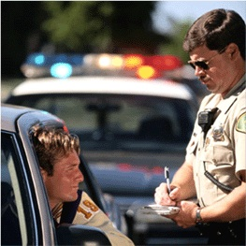
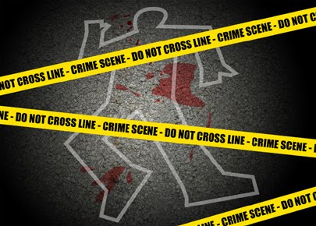
Norms and Values
Law is a norm that is formally defined and enforced by officials (murder)

Slide 26
Examples of Laws/law making
ADA
OSHA
EPA
FDA
Murder laws
Slander laws
Speed Limits
Stealing
Drug Crimes
Property Crimes

Slide 27

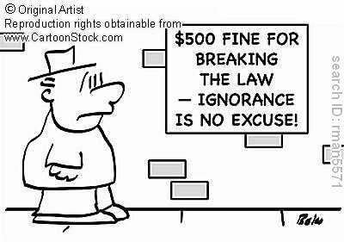

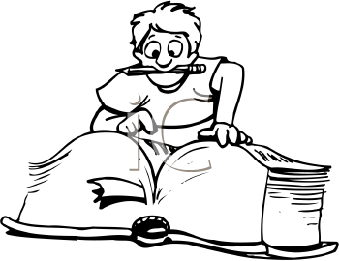

Norms and Values
Sanctions are rewards (positive) and punishments (negative) used to encourage people to follow norms
  break a law; you pay
  you study for a test, you get an A and that A gets you into a great college
A

Slide 28
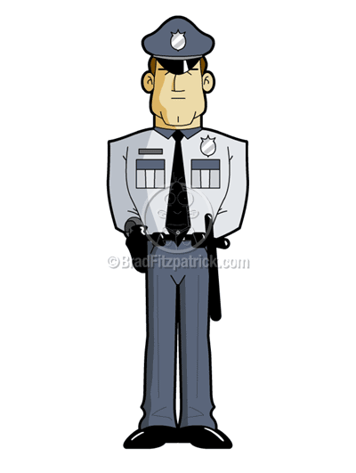
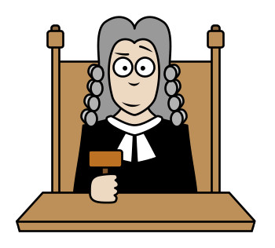


Norms and Values
Formal Sanctions are sanctions imposed by persons given special authority (government, police, schools, or corporations)

Slide 29
Formal Sanctions
promotions
pay raises
bonus gifts
rewards
smiles
pats on the back
fines
low grades
school suspension
job termination
imprisonment
detention
Positive Formal Sanctions
Negative Formal Sanctions

Slide 30
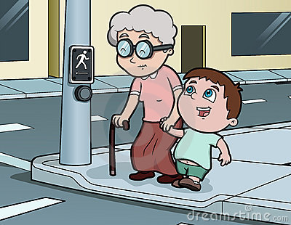
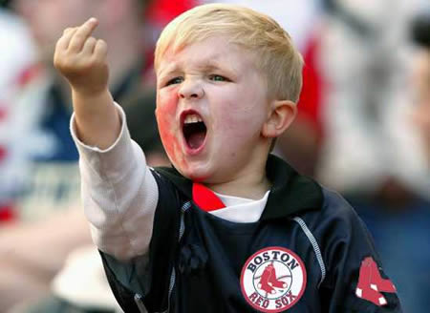
Norms and Values
Informal Sanctions are rewards and punishments that can be applied by most members of a group

Slide 31
Informal Sanctions
smiles
compliments
praise
standing ovations
cheers
frowns
gossip
scoldings
insults
being ignored
Positive Informal Sanctions
Negative Informal Sanctions

Slide 32
Cultural Diversity and Similarity
Ethnocentrism-which is the tendency to assume that one's own culture is good, while that of another is strange or even immoral.
  Judging others in terms of one’s own cultural standards
  Usually, we are so used to the values and behavioral norms that we've grown up with that they seem to be human nature rather than just elements of our own culture.

Slide 33
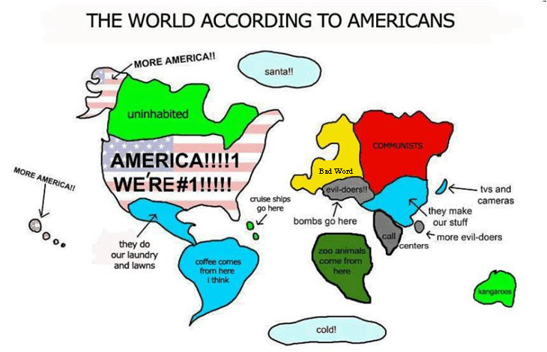

Slide 34
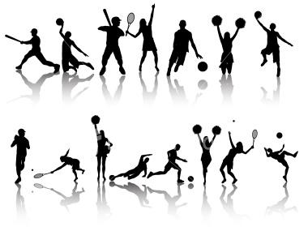


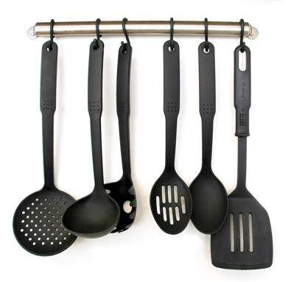
Cultural Diversity and Similarity
Cultural universals-general cultural traits that exist in all cultures
  Including but not limited too:
    Sports, cooking, courtship, division of labor, education, etiquette, funeral rites, family, government, hospitality, housing, inheritance rules, joking, language, medicine, marriage, mourning, music, property rights, religious rituals, sexual restrictions, status differences, and tool making.

Slide 35
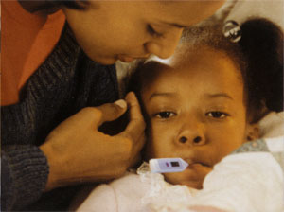
Cultural Diversity and Similarity
Cultural particulars-the ways in which a culture expresses universal traits.

Slide 36
Examples of Cultural Differences
Greece-”loose tooth, throw on a roof”
Norway- “eats burgers with knife and fork”
England- “flip someone off by doing peace sign backward”
Japan- “cover abdomen in rainstorm”
India- “won’t give gift or change with their left hand”
Colombia- “students learn of five continents not seven”
China- “potty training takes place in the street”
United Kingdom- “roundabouts take place of street lights”
Taiwan- “#4 is unlucky”
China-”One menu for whole table, host orders all food”

Slide 37
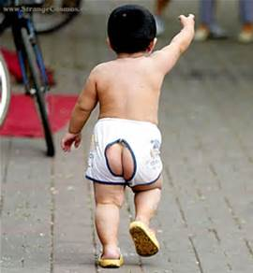

Slide 38
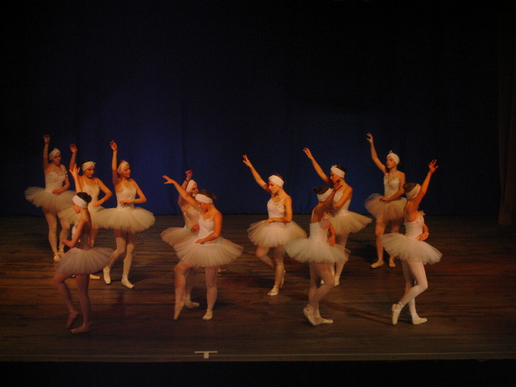
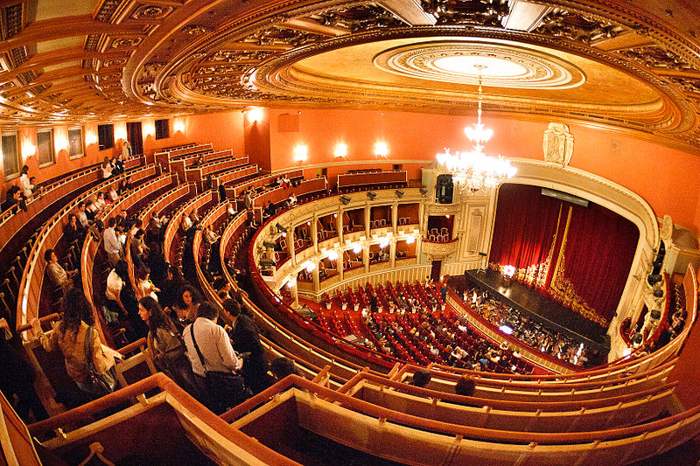
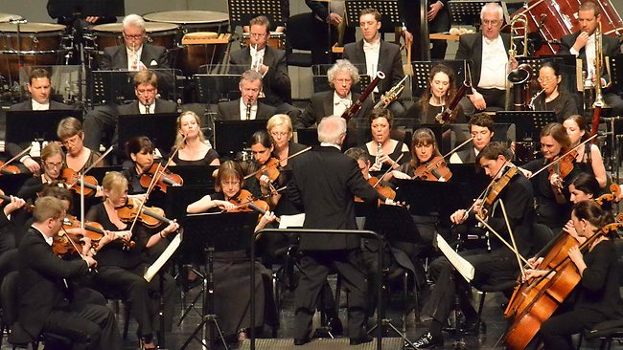
High Culture
Patterns of culture and experiences that exist in the highest classes of society.
This tends to be associated with wealth, power, intellectualism, and prestige.
These activities also tend to be expensive.

Slide 39
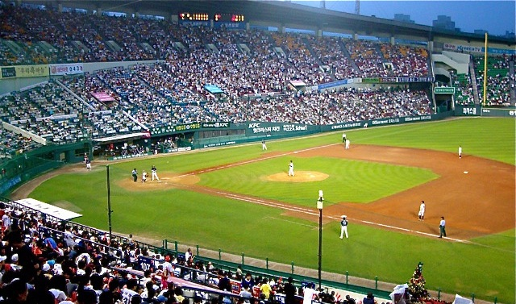
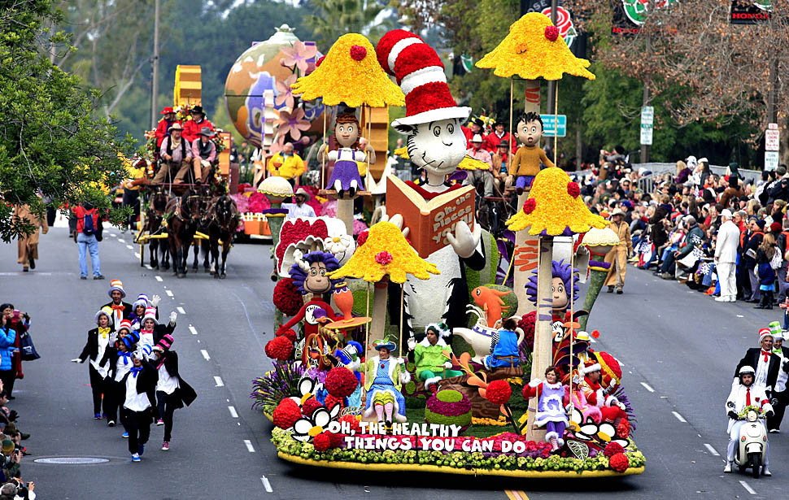
Popular (Pop) Culture
Popular or pop culture is tv, movies, parades, baseball, etc that is popular among the general population.
High Culture and Pop culture vary over time and what is high culture can become pop culture and vice versa

Slide 40
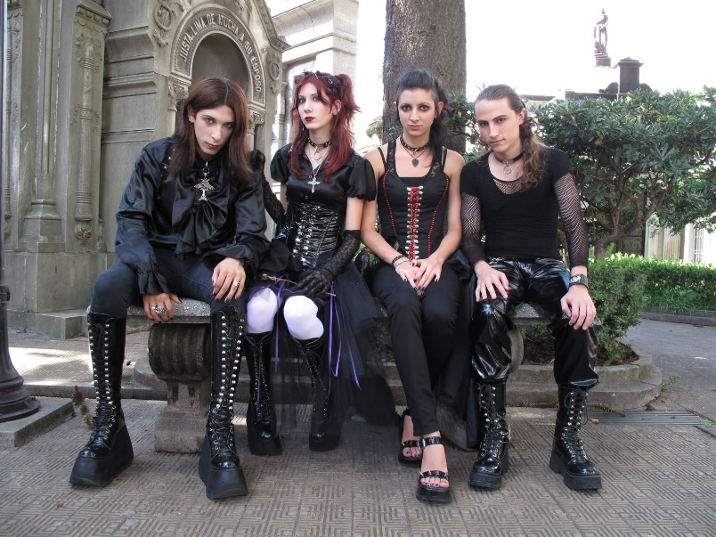
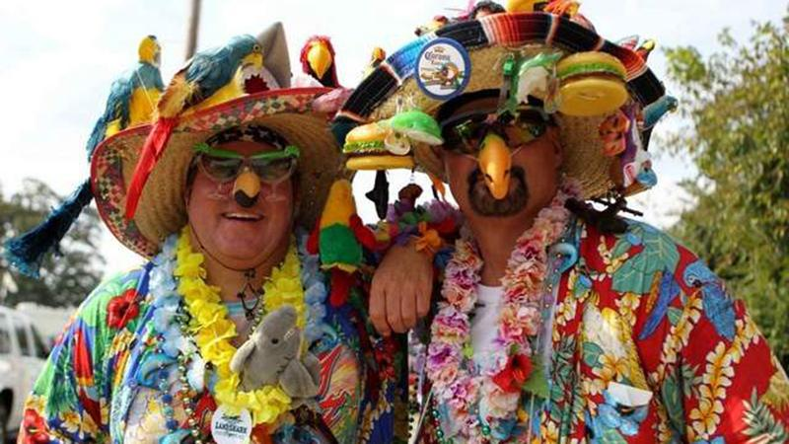
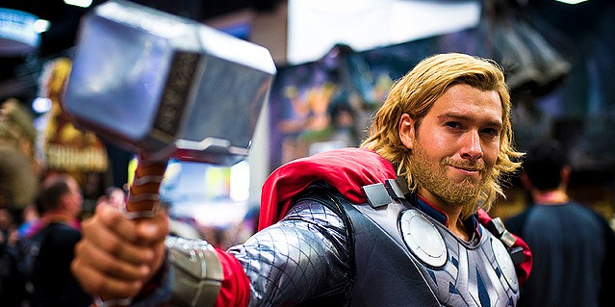
Subculture
A part of the larger culture that differentiates itself through actions, dress, shared experiences, etc.

Slide 41
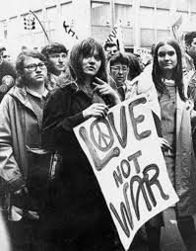
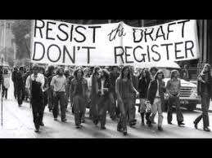
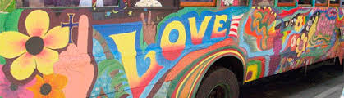
Counterculture
A way of life or attitudes in conflict with the prevailing norms of the day. Subcultures and counterculture often have some crossover. Counterculture is more actively against prevailing norms and occasionally mores.

Slide 42
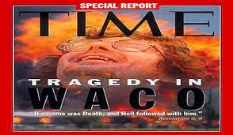
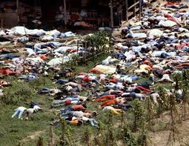
Cults:
Word comes from the word culture, and is considered a counterculture. These can be religious, ideological, etc in nature and usually have a specific power structure and a specific message

Slide 43
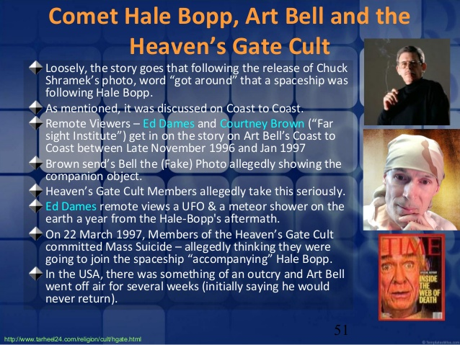

Slide 44
Socialization
Unit 2 Section 2

Slide 45
Socialization
a continuing process whereby an individual acquires a personal identity and learns the norms, values, behavior, and social skills appropriate to his or her social position
human infants are born without culture
the general process of acquiring culture is socialization
it is important in the process of personality formation

Slide 46
Socialization
Perspectives | View of Socialization | How the Media Influence Socialization
Functionalism | stressed how socialization contributes to a stable society | network television programs encourage social integration by exposing the entire society to shared beliefs, values, and norms
Conflict Theory | views socialization as a way for the powerful to keep things the same | newspaper owners and editors exercise power by setting the political agenda for a community
Symbolic Interactionism | holds that socialization is the major determinant of human nature | through words and pictures, children’s books expose the young to the meaning of love, manners, and motherhood

Slide 47
Functionalism and Socialization
Agents of Socialization
Family
School
Peers
Media
Religion
Work
Government
Social/Club Groups
Ethnic Background

Slide 48
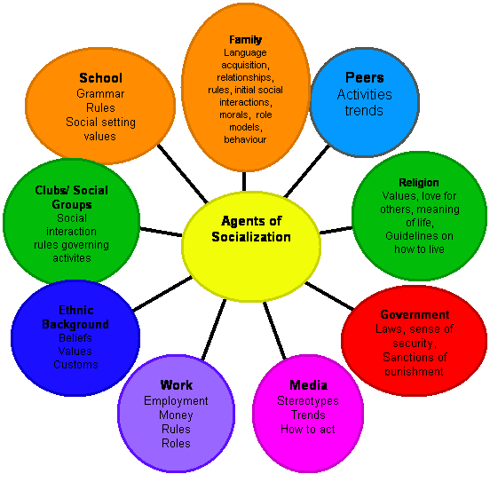

Slide 49
Theories of Self-Development

Slide 50
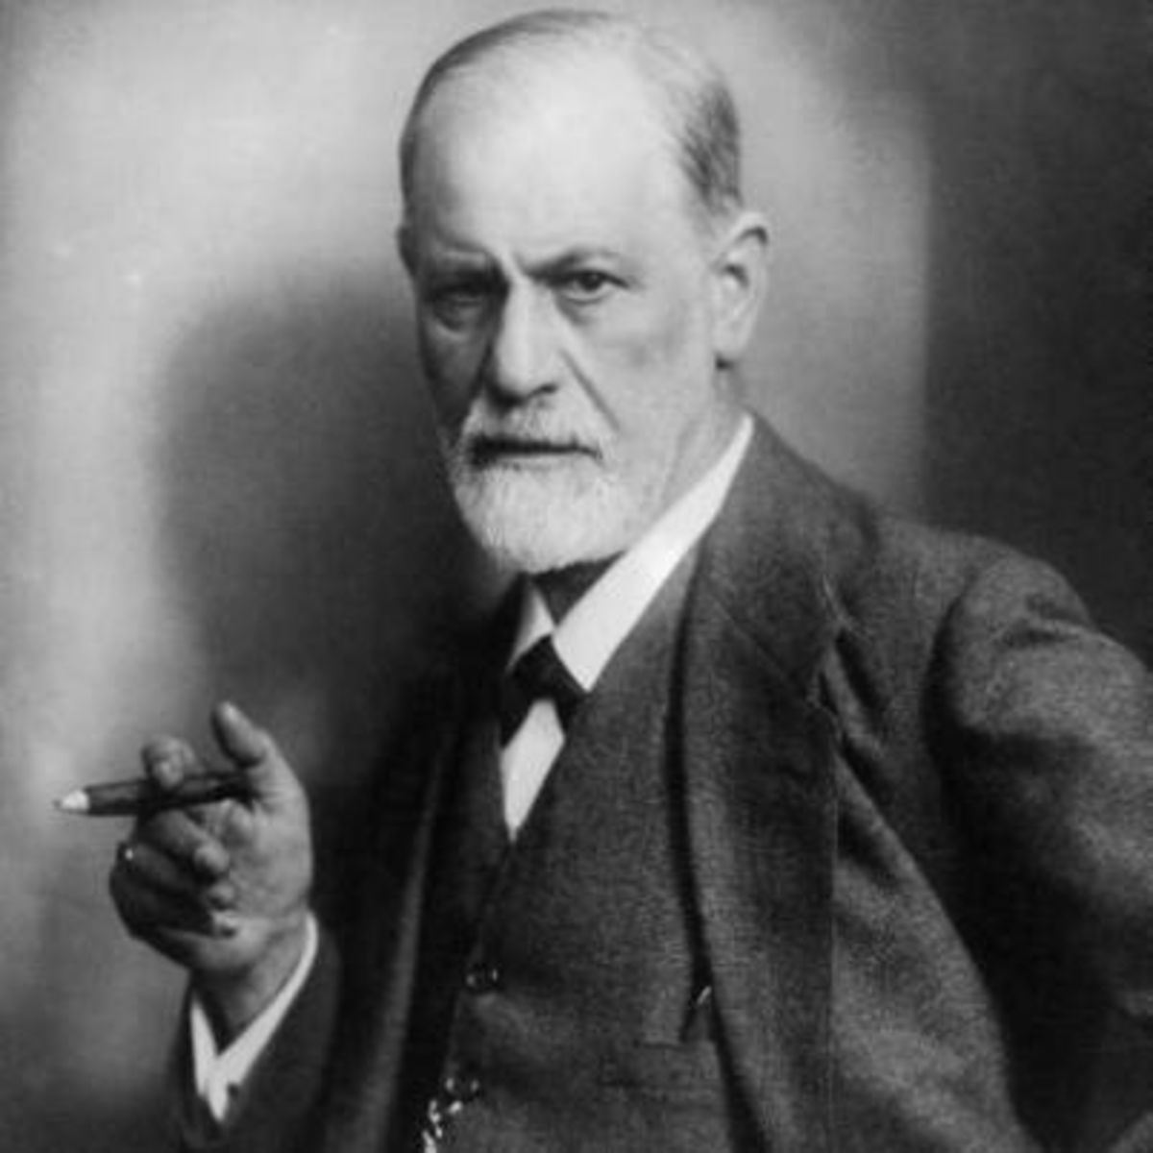
Sigmund Freud
Believed that personality and sexual development were closely linked.
Divided the maturation process into psychosexual stages: Oral, anal, phallic, latency, and genital.
Said that people’s self-development was linked to early stages of development
(fixations – being stuck in a certain stage – resulted in psychological consequences. E.g. oral fixation may lead to smoking or overeating, anal fixation may lead to being a neat freak, phallic fixation may lead to promiscuity or emotional immaturity.

Slide 51
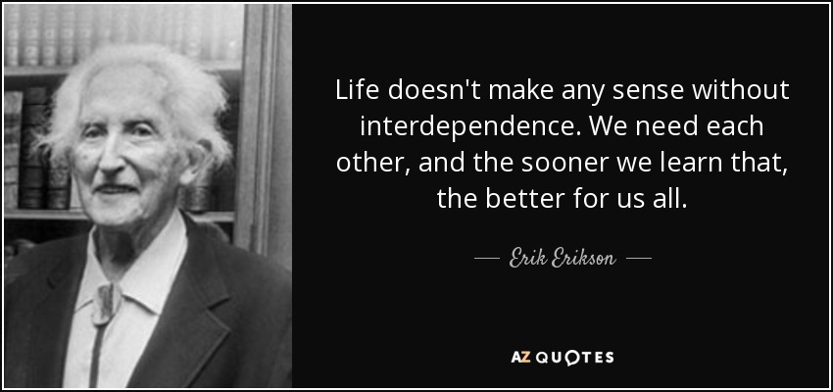
Erik Erikson
Work based partly on Freud but believed that personality continually changed over time and are never truly finished.
He believed in 8 stages of development beginning with birth and ending with death.
Gave credit to more social aspects.

Slide 52
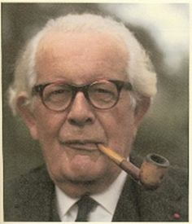
Jean Piaget
Specialized in child development and focused on the role of social interactions and realized that Self evolved through a negotiation between the world as it exists in one’s mind and the world that exists as it is socially experienced

Slide 53
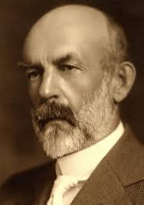
Charles Cooley
Said that self understanding is constructed in part by their perception of how other people see them.
This is called the Looking Glass Self

Slide 54
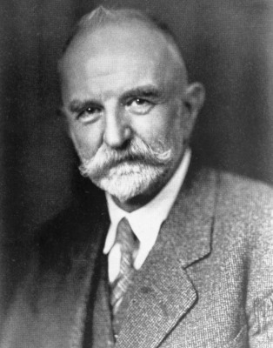
George Herbert Mead
Studied the self – a person’s distinct identity that is developed through social interaction.
In order to engage in the creation of self and individual has to be able to view themselves through the eyes of others
He believed that there was a specific path of development that all people go through:
Preparatory – Children are only capable of imitation
Play – Children begin to take on the role of others
Game - Take on several roles
Generalized other – the common behavioral expectaionts of general society – you can imagine how others view you.

Slide 55
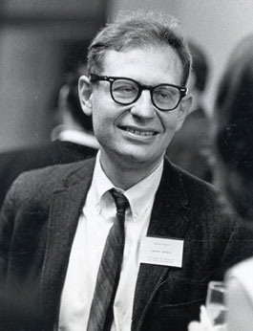
Lawrence Kohlberg
Moral development – the way people learn what society considered to be good and bad and which is important for a smoothly functioning society. It prevents people from acting on unchecked urges and instead consider what is most important for society.
Preconventional – young children experience the world only through their senses
Conventional – becoming increasingly aware of other’s feelings and taking them in to consideration
Postconventional – viewing morality in more abstract terms (generally adulthood) and that legality and morality do not necessarily line up.

Slide 56

Carol Gilligan
Said that Kohlberg's ideas may be gender biased since his experiments were done only with male subjects.
Her studies showed that males and females do develop morality differently and they understand it differently
Boys tend to have a justice perspective by placing emphasis on rules and laws
Girls tend towards a care and responsibility perspective and put more emphasis on people’s reasons behind behavior that seems morally wrong
Neither perspective was better, but each serves a different purpose: Boys are socialized for the work environment while girls are socialized for the home environment

Slide 57
Symbolic Interactionism and Socialization
Looking-Glass Self (C. Cooley)
Write a paragraph: when you wake up in the morning, are you dressing for yourself OR how others see you? Secondly, if not for rules and expectations, would you dress differently than you do? Why or why not?
  Image of self on what others think of you
we imagine how we appear to others
reaction of others to our appearance
evaluate ourselves according to how we imagine others have judged us

Slide 58
Symbolic Interactionism and Socialization
Self–Concept (C. Cooley)
Write a paragraph: describe yourself without physical features, focus on values, attitudes, beliefs, and personality.
  Image of self as having an identity separate from others
  Judging oneself on reactions from others

Slide 59
Symbolic Interactionism and Socialization
Significant Others (G. Mead)
Write a paragraph: list and describe who your significant others are and why? How have they shaped your self-concept?
  Those people whose reactions are most important to your self-concept
  I = is myself as I am
  Me = is myself as others see me

Slide 60
So, why does socialization matter?

Slide 61
Nature V. Nurture
Often debated as to what has more influence on development
Nature – Our beliefs, temperaments, interests and talents are set from birth
Nurture – who we are is a result of our surroundings.
Scientists often study identical twins to study this

Slide 62
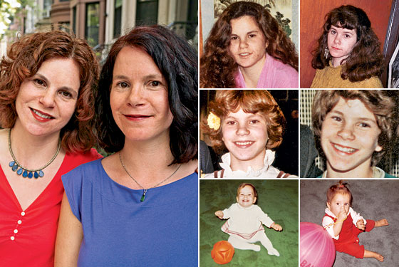
Twin Studies
Elyse Schein and Paula Bernstein were identical twins separated at birth and adopted to separate families.
When they finally met they looked alike, behaved alike, used the same hand gestures and facial expression

Slide 63
Symbolic Interactionism and Socialization
Generalized Others →integrated conception of norms, values, and beliefs of one’s community or society
“Me”→the part of the self formed through socialization
  Accounts for predictability and conformity
“I”→the part of the self that accounts for unlearned spontaneous acts
“I” and “me” work together

Slide 64
Desocialization and Resocialization
Symbolic Interactionism describes four processes associated with socialization after childhood.
  Desocialization
  Resocialization
  Anticipatory Socialization
  Reference groups

Slide 65
Desocialization and Resocialization
Step 1→desocialization→ the process by which people give up old norms, values, attitudes, and behaviors.
  In total institutions, to speed this up, people are stripped of their identity by wearing standard issue clothes, sharing an area with a person, and having a number instead of a name
  Destroying the former self-concept

Slide 66
Desocialization and Resocialization
Step 2→ resocialization→ the process in which people adopt new norms, values, attitudes, and behaviors.
  In total institutions, this is done through rewards and punishment. Reward for taking on “new” identity and punishment for nonconformity.
  These steps occur in all of us naturally
    Child to teenager; young adult to career adult; elderly to retirement or widowhood

Slide 67
Anticipatory Socialization
Step 3→ Anticipatory Socialization→ the process of preparing (in advance) for new norms, values, attitudes, and behaviors.
  This generally does not occur in total institutions because it is voluntary changes.
  This generally occurs as we shift from childhood to preteen to teen.
  Also, someone that accepts their addiction and starts using the 12 step program

Slide 68
Anticipatory Socialization
Reference Group→ the group you use to evaluate themselves and from which they acquire attitudes, values, beliefs, and norms.
  This is a tool for the anticipatory socialization step.
Socialization is a gradual process over your lifetime.

