Slide 1
Doing Sociological Research
Chapter 2

Slide 2
Scientific Method
Seven steps including the Hypothesis
Identify the problem
Review the literature
Formulate hypotheses
Develop a research design
Collect data
Analyze data
State findings and conclusions

Slide 3
Research Methods
Experiments
Case Study
Survey
Field Study
Participant
Observation

Slide 4
Making Connections
Variables
Quantitative: measured numerically = numbers
145 Seniors like Mr. McEvoy
  Mean: average
  Mode: # occurring most often
  Median: direct middle number
2. Qualitative: measured by category = likeness (everything but numbers)
Mr. McEvoy is the favorite teacher

Slide 5
Making Connections
3. Independent: causes something to occur (stands alone, IF)
IF it rains…, IF I throw…
4. Dependent: reflects a change (depends on IND; THEN)
THEN I get wet…, THEN I will catch it…
5. Intervening: changes the relationship between an IND and DEP variable (BUT)
BUT I have an Umbrella, BUT there was a wind gust.

Slide 6
Making Connections
Causations
Causation: belief that events occur in predictable ways and that one event leads to another
Push=fall
Multiple Causation: the belief that an event occurs as a result of several factors working in combination
Dropping Out

Slide 7
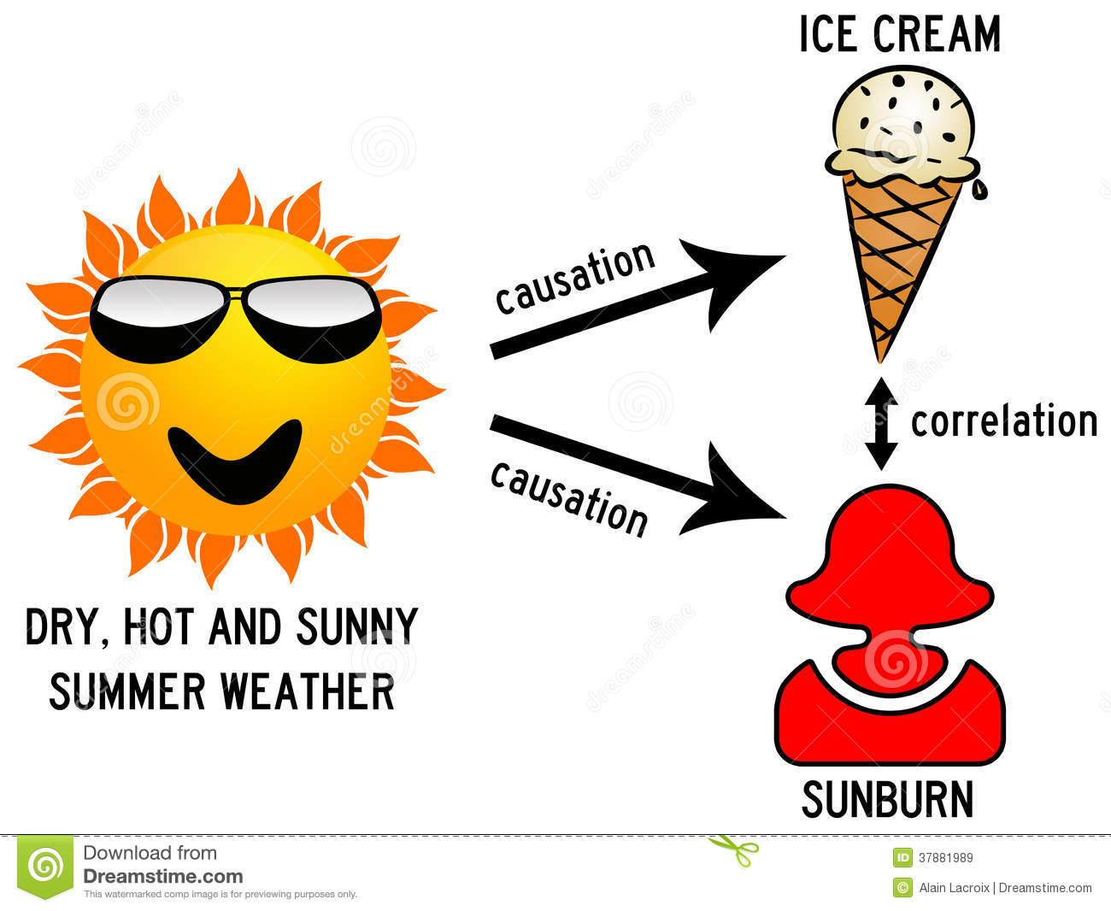

Slide 8
Class Activity
What causes crime?
What causes someone to dropout?
What causes poverty?
What causes addiction?

Slide 9
Making Connections
Correlation: the relationship between two variables
Positive: (changes in the same direction)
Negative (changes in the opposite direction)
Spurious: a relationship between two variables that is actually caused by a third factor (relationship can be explained by third factor)

Slide 10
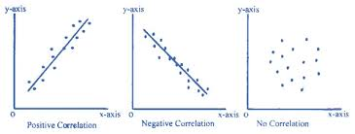

Slide 11
