Slide 1
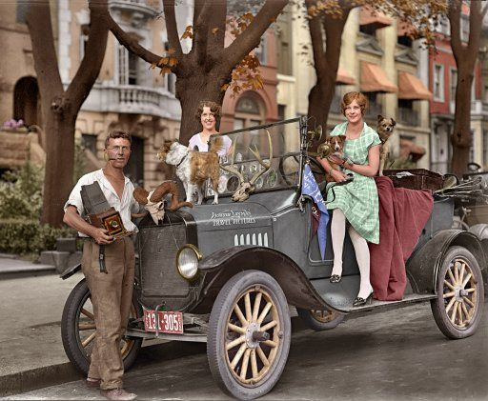
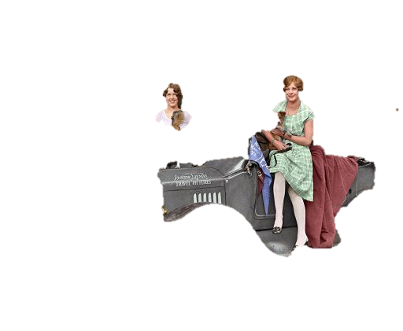
Journey Through Your Life
During the
Great Depression

Slide 2

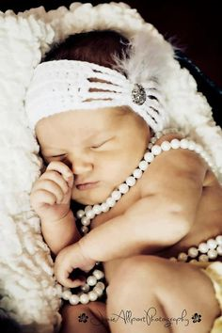
Congratulations
It 1929 and you are loving life. In the past year you got married and had a baby girl.
  Sign your marriage certificate & name your child

Slide 3

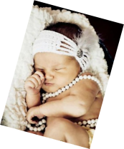

Your Home
You want to make sure your family has the best things in life and a future of prosperity.
You feel so confident in America’s financial security you decide to invest a huge portion of your savings into the stock market to start your new family off in the right direction

Slide 4
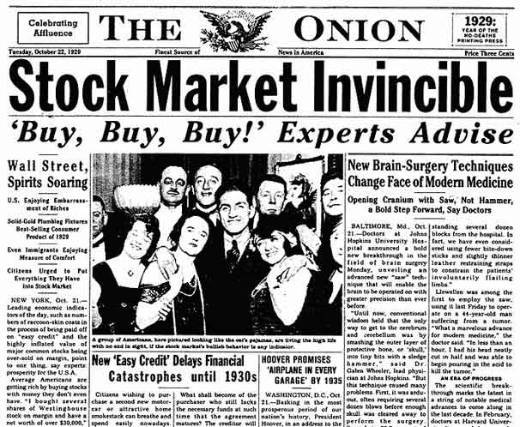

Slide 5
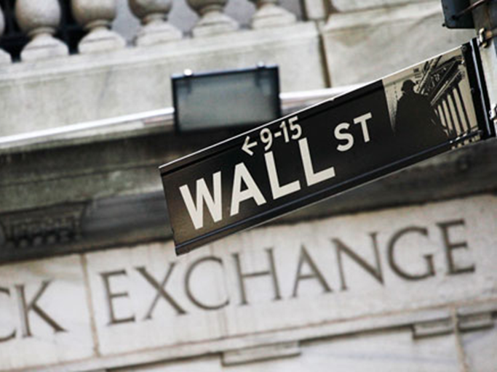

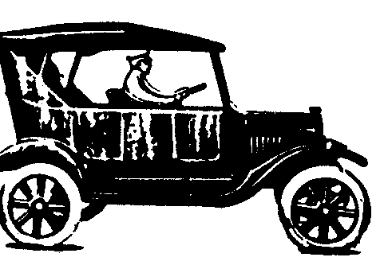
Stocks to Invest In:
1: Tel-Tone Telephone Company
4: Gotham Bank
Choose one of the stocks to invest your life savings into. Write the # associated with your stock on your Travel Log
2: Radio Corporation
5: Ford Motors
3: Mammoth Oil
6: Kansas & Pacific Railroads

Slide 6
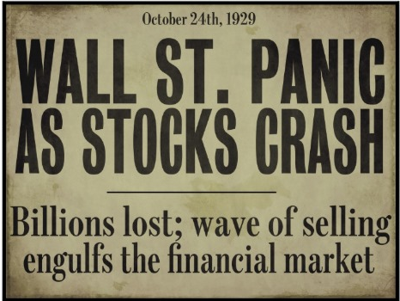

Slide 7
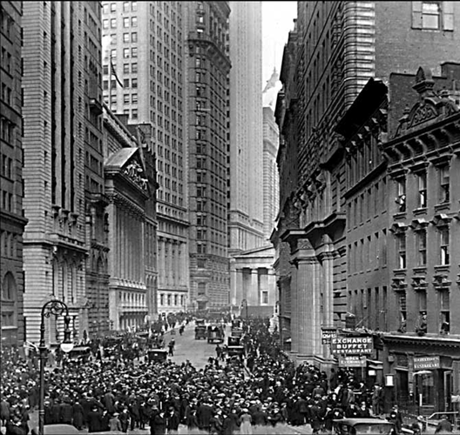
The Great Crash
By late 1929, a lack of new investors in the stock market caused stock prices to drop
On October 29, 1929, stock prices fell drastically on Black Tuesday, resulting in a $10 to $15 billion loss in value. While this did not cause the Great Depression, it did undermine the economy’s ability to hold out against its other weaknesses.

Slide 8
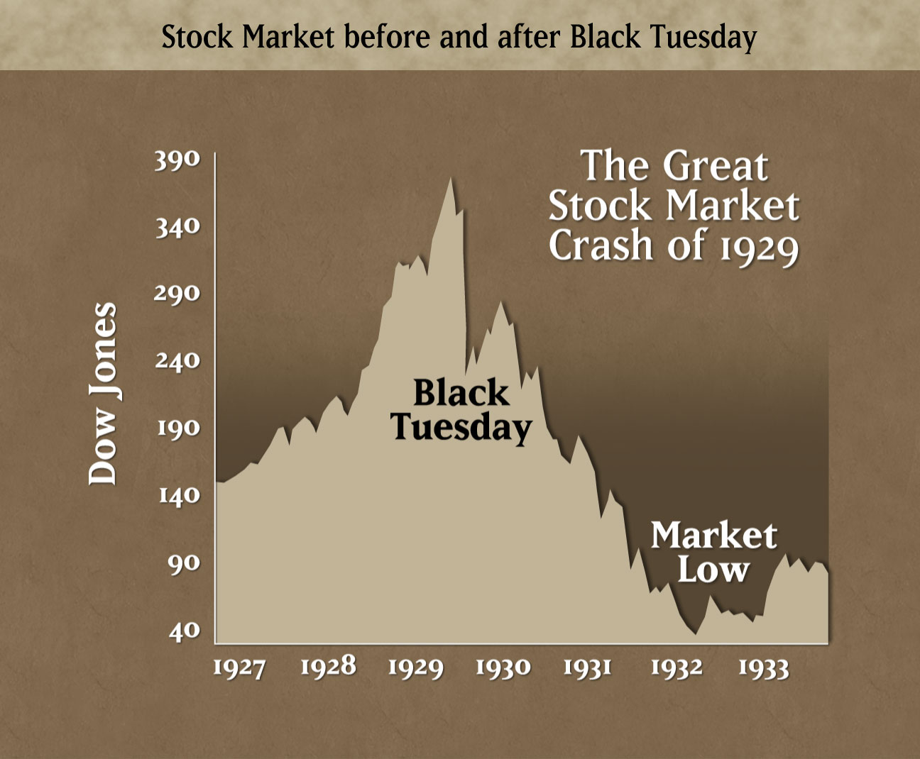

Slide 9
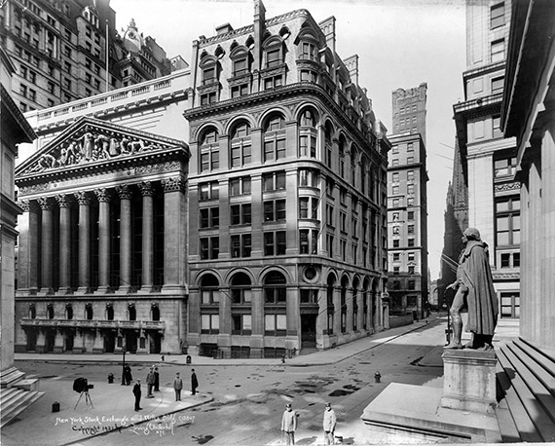
The Great Depression Begins
The Stock Market crash signaled the beginning of the Great Depression
The Great Depression is generally defined as the period from 1929 – 1940 in which the economy plummeted and unemployment skyrocketed

Slide 10

Worth of Your Stocks
1: TEL-TONE TELEPHONE COMPANY- This stock declined in value by 50%- You just lost ½ of your life savings. You put what you have left in the bank.
4: GOTHAM BANK- This stock declined in value by 90%. You just lost 90% of your life savings
2: RADIO CORPORATION-YOU got lucky! This stock remained the same so you pull your money out and put it in the bank for safe keeping.
5: FORD MOTORS- This stock declined in value by 50%- You just lost ½ of your life savings
On your Travel Log note what happened to your stock
3: MAMMOTH OIL- This stock is worthless & you now owe $ because you bought it on the margin
6: KANSAS & PACIFIC RAILROADS- This stock declined in value by 90%. You just lost 90% of your life savings

Slide 11
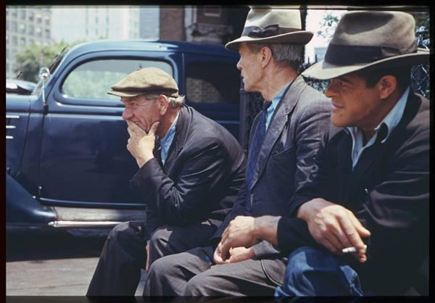
You are now in despair as you and your family are barely hanging on to hope.
With most of your savings depleted you cannot afford for anything more to go wrong so you look to president Hoover for answers

Slide 12
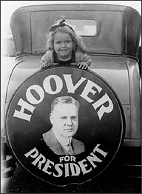

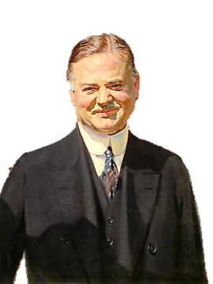
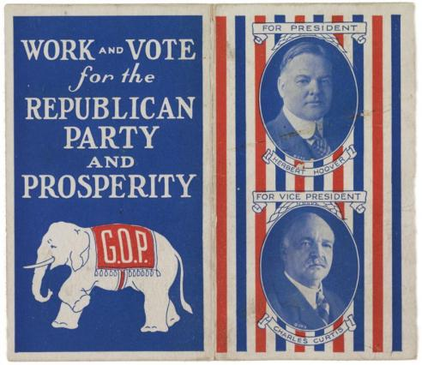
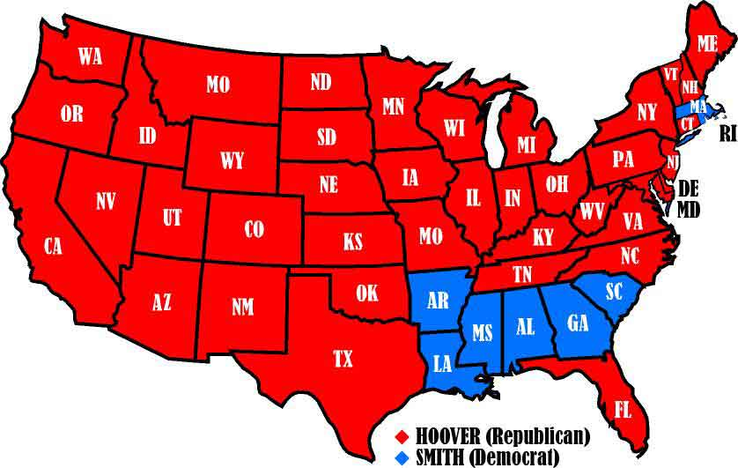
Hoover Elected in 1928
-Republican Herbert Hoover ran against Democrat Alfred E. Smith in the 1928 election
-Hoover emphasized years of prosperity under Republican administrations
-Hoover won an overwhelming victory

Slide 13
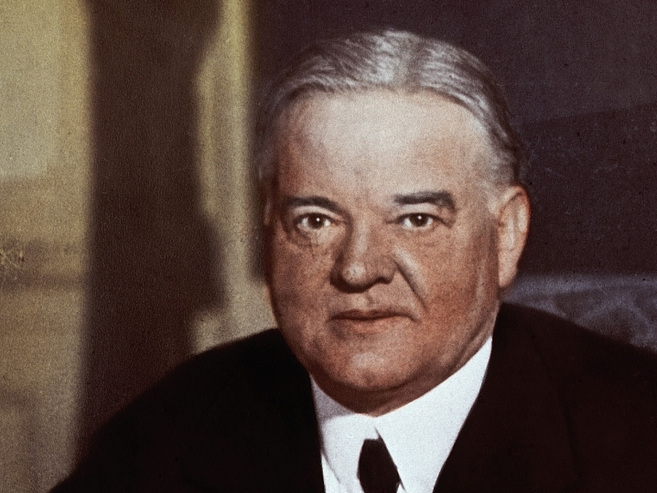
I believe in “Rugged Individualism”…the idea that people succeed through their own efforts. People should take care of themselves, not depend on governmental hand-outs
He said people should “pull themselves up by their bootstraps”
After the stock market crash, President Hoover tried to reassure Americans
He said, “Any lack of confidence in the economic future . . . Is foolish”
He recommended business as usual
H. Hoover

Slide 14
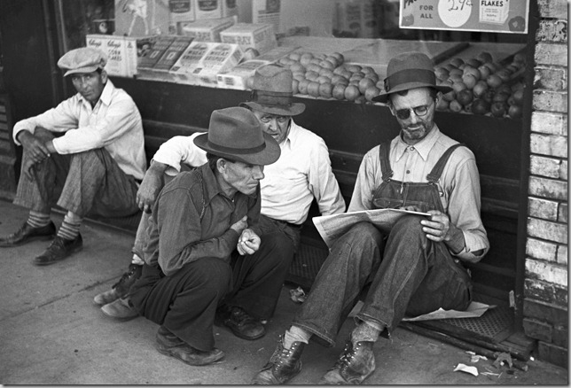
This article says that Hoover doesn’t believe it is the government’s job to fix the economy or provide financial assistance. Well… Thanks for nothing Hoover.
Well thanks for nothing Hoover

Slide 15

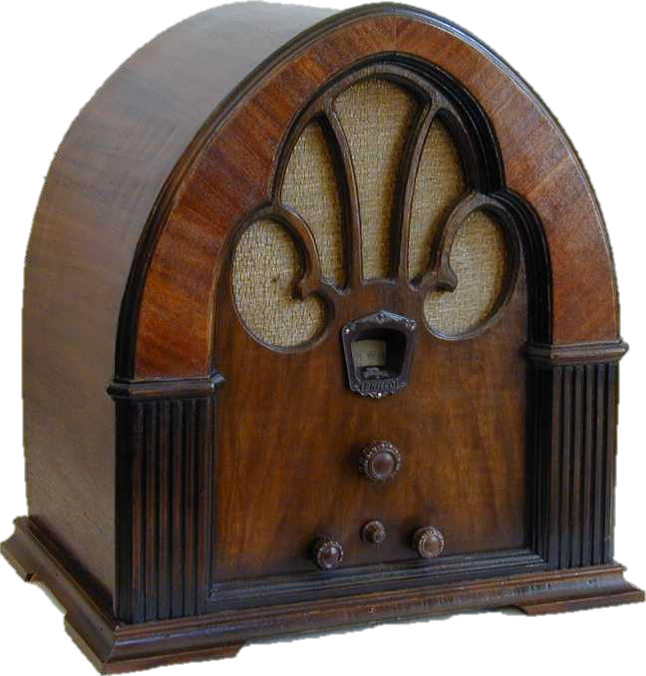
RADIO ANNOUNCEMENT
As a result of the stock market crash it appears many people are not able to repay their loans to the bank. The banks may run out of money if this continues

Slide 16
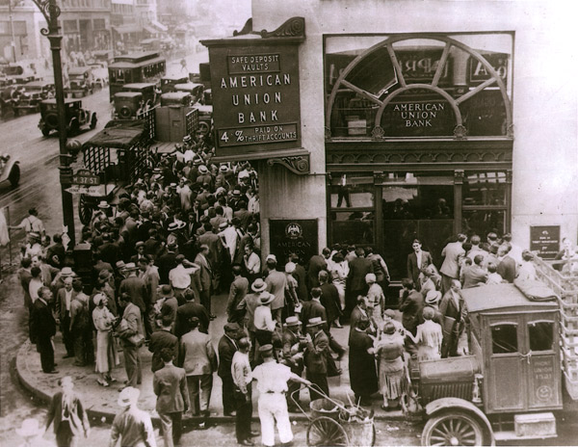
Bank Run
You rush to your bank to pull
out all of your money

Slide 17
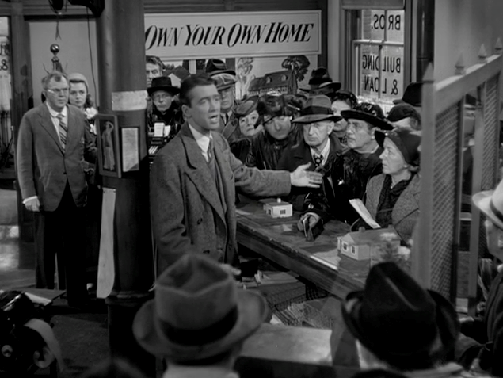


Bank Failures
After the crash, many Americans panicked and withdrew their money from banks
In addition as a result of the crash many people were not able to repay their loans to the banks.
Banks had invested in the Stock Market and lost money
In 1929- 600 banks fail
By 1933 – 11,000 of the 25,000 banks nationwide had collapsed
When the banks collapsed depositors lost their savings
Notes:
https://www.youtube.com/watch?v=EOzMdEwYmDU

Slide 18
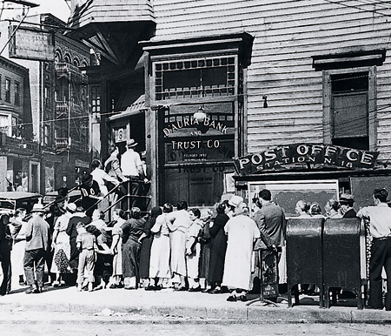

Bank Run
Choose one of the #s & write the # on your Travel Log
1
2
3
4

Slide 19
Bank Run
On your Travel Log note what happened to your savings
1- You pushed your way to the front but the teller was only able to give $50
2- The mob of people was too overwhelming. The bank ran out of money before you could withdraw anything
3- You are arrive at the bank first thing in the morning but most of the money was withdrawn the day before so the most they can give you is $65
4- The mob of people was too overwhelming. The bank ran out of money before you could withdraw anything

Slide 20
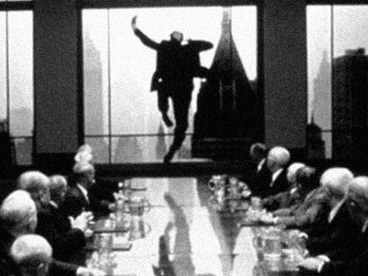
Suicide
STOP! Mr. Robinson. It’s not worth it!

Slide 21

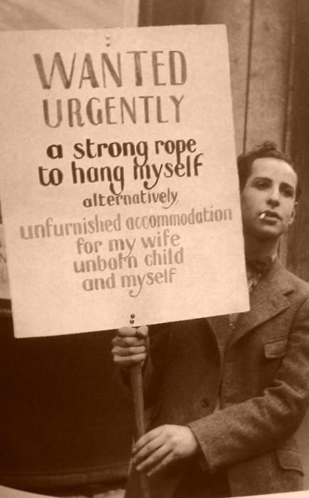
With the loss of so much so quickly many people unfortunately committed suicide
The suicide rate climbed 30 percent between 1929 and 1932

Slide 22
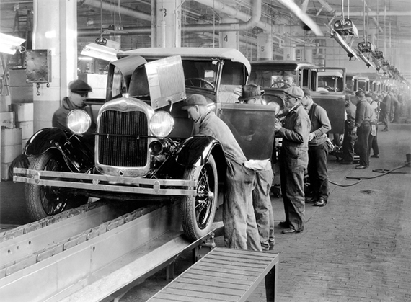

But at least you still have your job

Slide 23
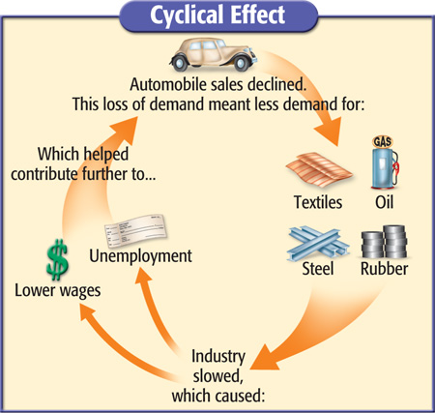

Slide 24
Low Sales
Downward Momentum of the Great Depression
Job Layoffs
Less Income
Fewer Purchases
Lower Sales
More Layoffs

Slide 25
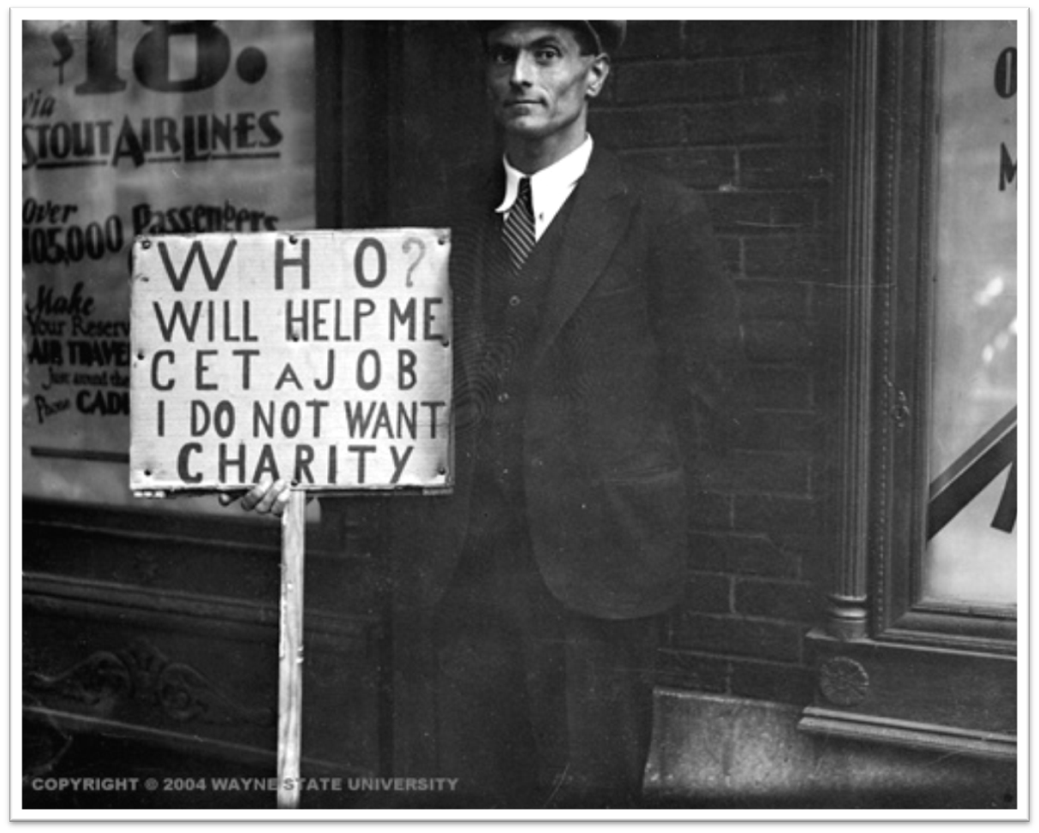
Reduction in Purchasing
Between 1928-1932, the U.S. Gross National Product (GNP) – the total output of a nation’s goods & services – fell nearly 50% from $104 billion to $59 billion

Slide 26
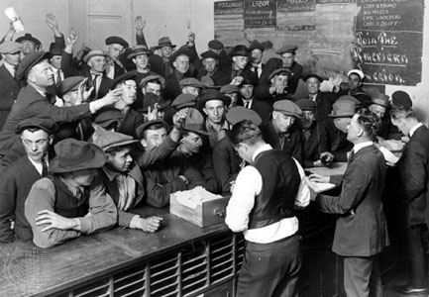
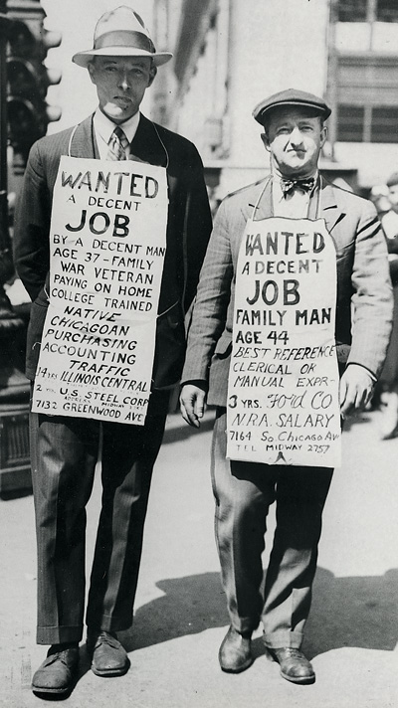
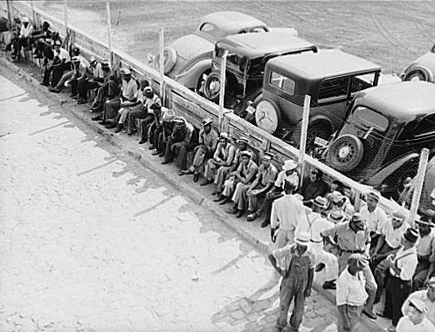
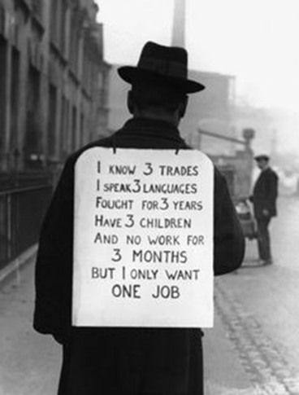
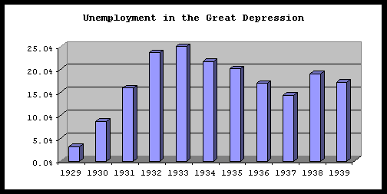
No Work
By 1933 thousands of banks and closed and millions of Americans were unemployed
90,000 businesses went bankrupt
Unemployment leaped from 3% in 1929 to 25% in 1933
14 million are jobless- 1933
Notes:
Unemployed workers often stood at bread lines to receive free food or at soup kitchens where private charities gave a free meal to the poor.

Slide 27
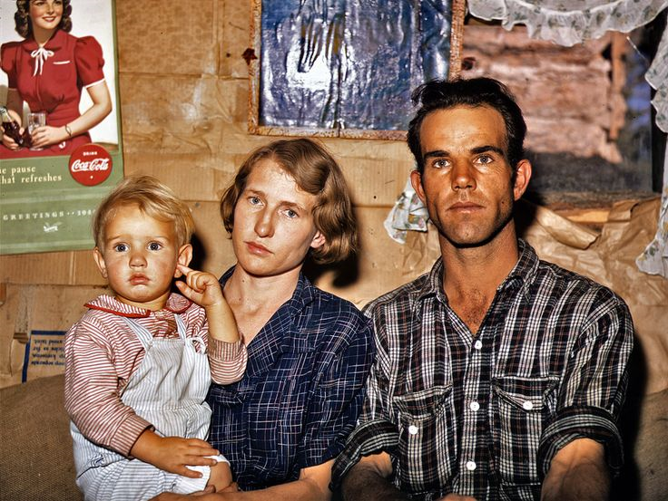

New Ways to Make a Living
1
4
With the loss of our job we need to find new ways to save & make money. Choose one of the #s & write the # on your Travel Log
2
5
3
6

Slide 28

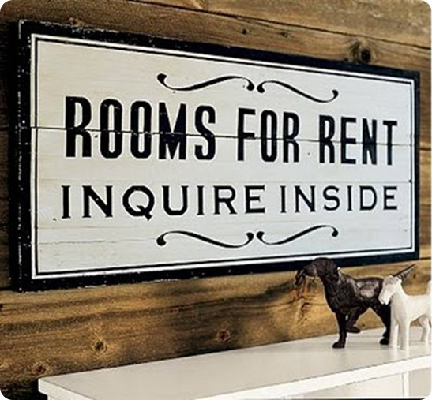
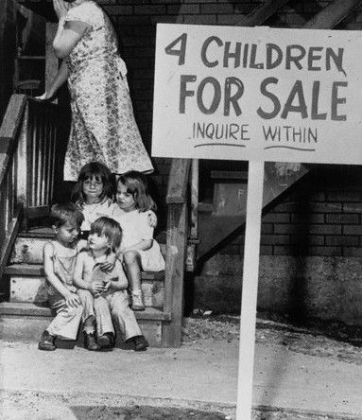
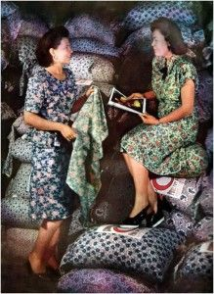
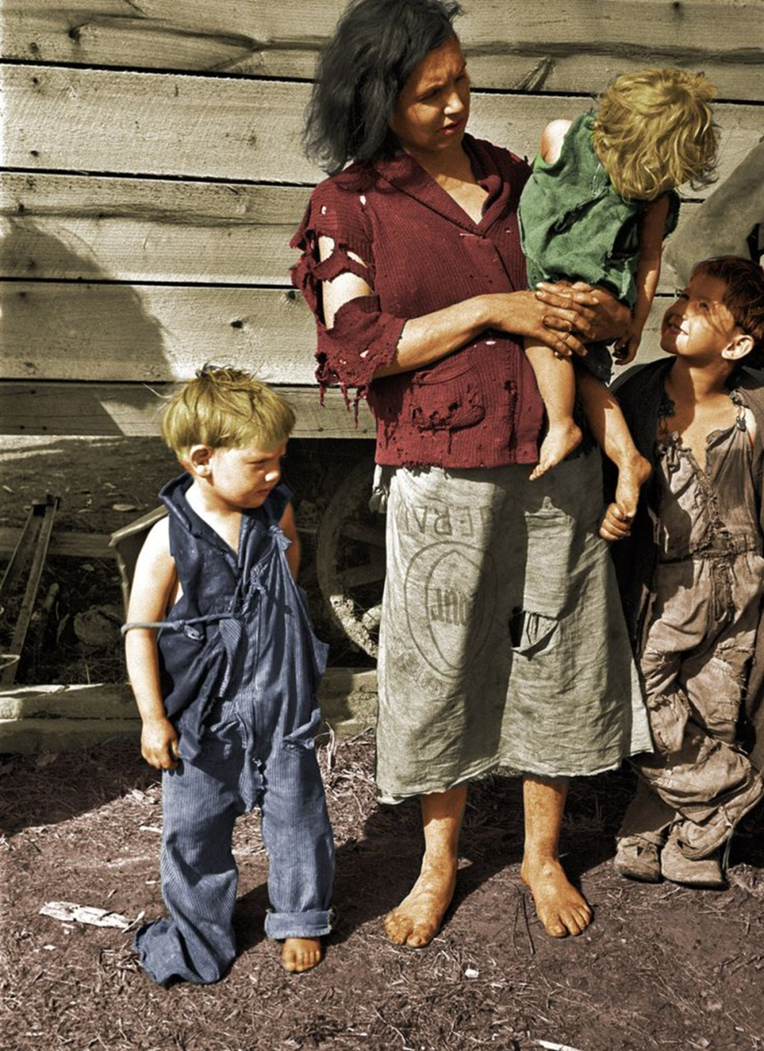
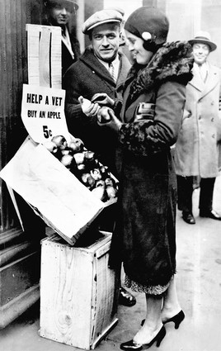
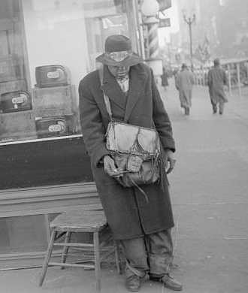

New Ways to Make a Living
1- Take in tenants
4- sell all of your furniture
On your Travel Log note what new ways your family resorted to, to make extra money
2- Put your child up for adoption
5- Beg on the corner
3- Make your clothing out of flour sacks
6- Sell Apples
Notes:
Depression Era: when they realized women were using their sacks to make clothes for their children, the mills started using flowered fabric for their sacks. The label was designed to wash out.

Slide 29

Your Home
It wasn’t enough to save your house!

Slide 30
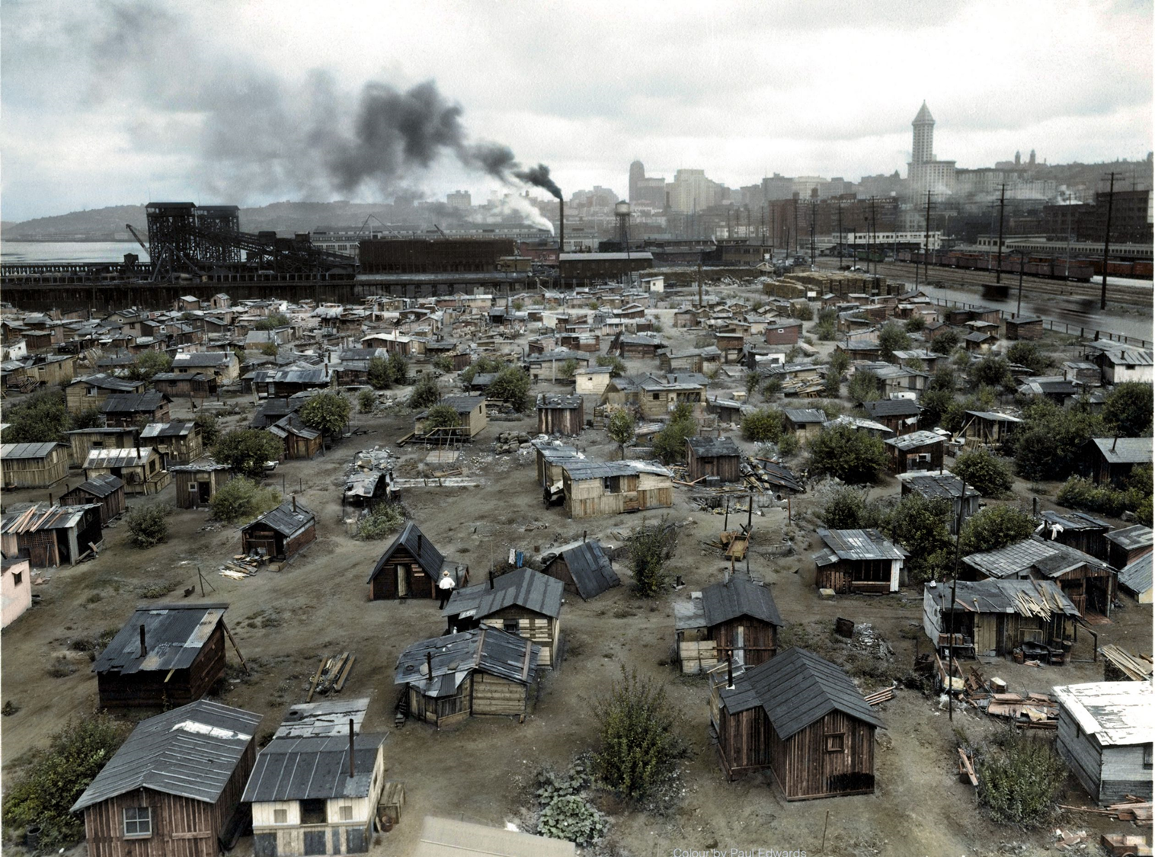
With no home, you move to a Hooverville in Washington DC

Slide 31
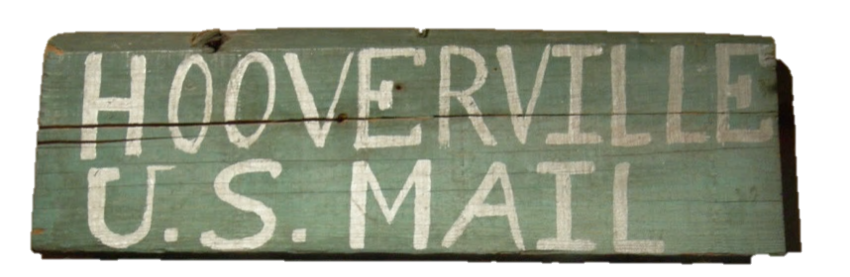
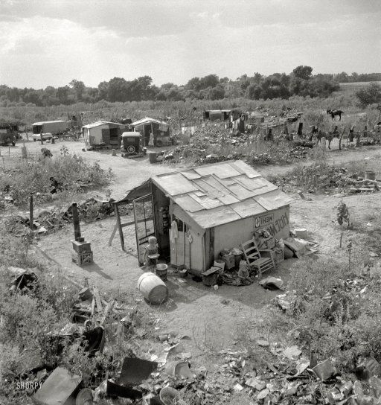
HOOVERVILLES
A "Hooverville" or shanty town was a community of houses or “shantys” made from scraps they could find
By calling them “Hoovervilles” people conveyed their disgust and disappointment with Hoover.

Slide 32
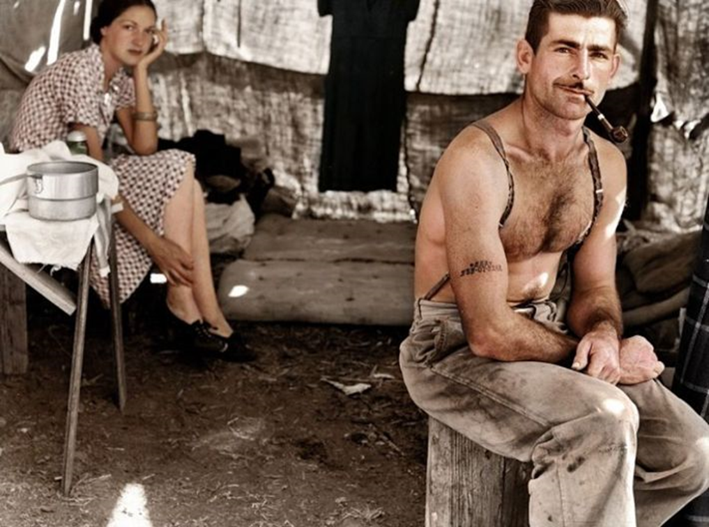
Hi Neighbor!

Slide 33
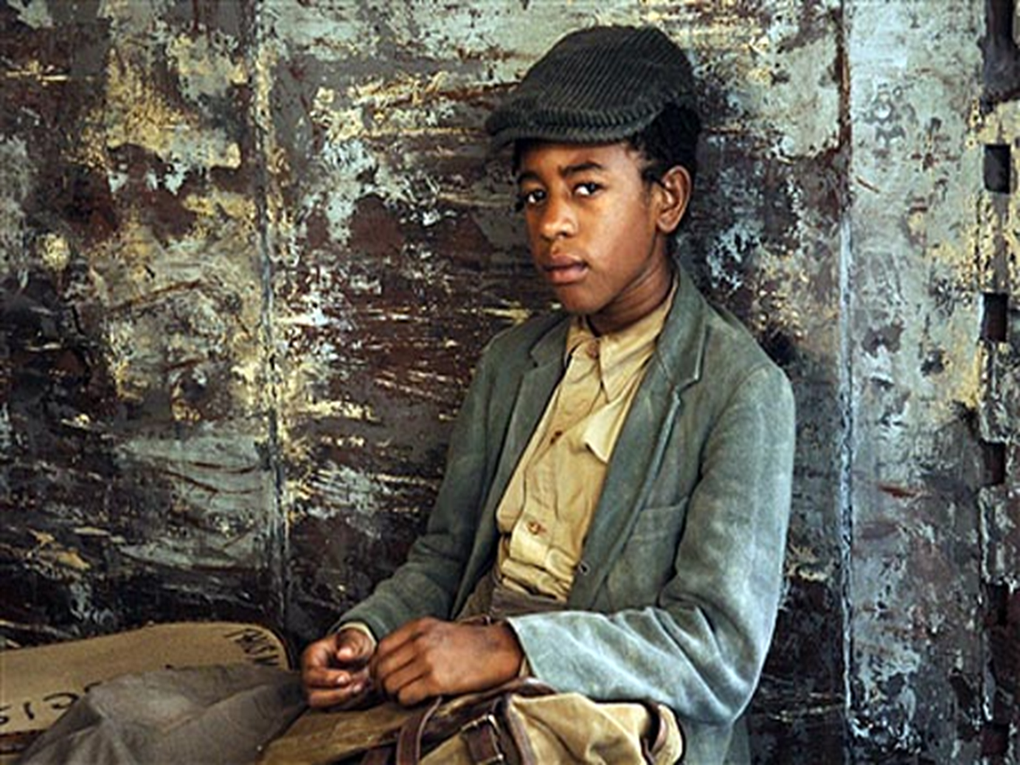
Any spare food?

Slide 34
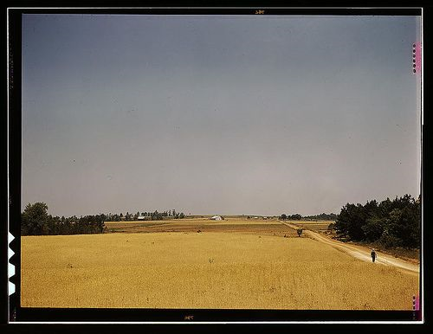
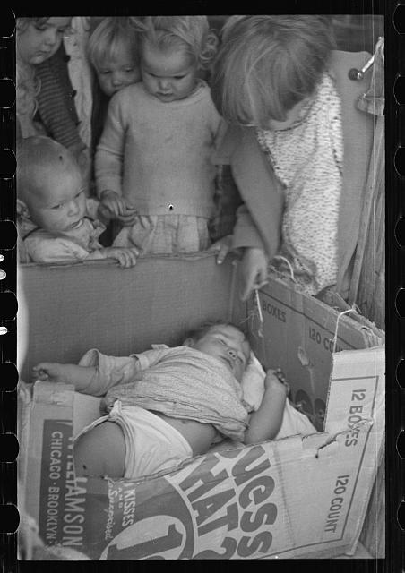
Life has changed a lot

Slide 35

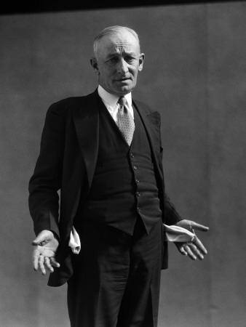
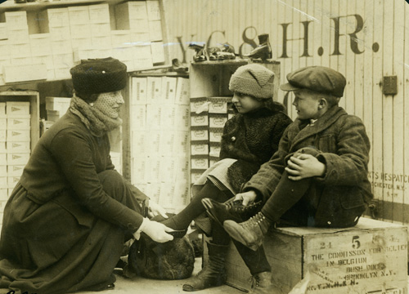
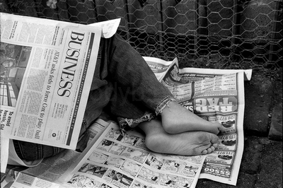
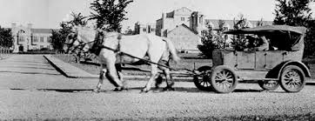
In addition to the term “Hooverville,” President Hoover’s name was used mockingly in other ways during the Great Depression.
When soles wore out of shoes, the cardboard used to replace them was dubbed “Hoover Leather”
“Hoover Flags”
“Hoover Wagon”
“Hoover Blankets”

Slide 36





Part of the reason you came to DC to set up your Shanty was to show your support for the passage of the PUTNAM BILL. If Congress passes the PUTNAM BILL it would be VERY beneficial for WWI Veterans like yourself.

Slide 37



Bonus Army
Spring of 1932 about 15,000 World War I vets arrived in Washington to support the passage of the proposed Putnam Bill
If the bill passed WWI Vets would be issued a $1000 bonus immediately instead of waiting until its scheduled date of 1945
Pay us our bonus early!

Slide 38



Slide 39


Putnam Bill Rejected
On June 17, 1932 the Senate voted down the Putnam Bill
Hoover called the Bonus marchers, “Communists and criminals”

Slide 40



Marchers Clash with Soldiers
Hoover told the Bonus marchers to go home– most did
2,000 refused to leave
Hoover sent a force of 1,000 soldiers under the command of General Douglas MacArthur and his aide Dwight Eisenhower
MacArthur’s 12th infantry gassed more than 1,000 marchers, including an 11-month old baby, who died
  Burned down Shantys
Two vets were shot and scores injured
Americans were outraged with Hoover

Slide 41


BONUS MARCHERS
1
4
2
5
Choose one of the #s & write the # on your Travel Log
3

Slide 42


BONUS MARCHERS
1- Your baby died as are result of the gas
4- Your Shanty & belongings burned down
On your sheet note what happened to you or your family
2- You were hospitalized & now have medical bills
5- You left crying before the troops came
3- Arrested for rioting

Slide 43

Does this mean we are officially HOBOS? So embarrassing!
Only until we get to Oklahoma to live with my sister
On the Move Again

Slide 44

Hobos, or homeless Americans who wandered around hitching rides on railroad cars, searched for work and a better life.
HOBOs

Slide 45


Riding the Rails
During the Great Depression some people, primarily men and teenage boys, took advantage of their homelessness and rode the rails across the United States.

Slide 46

Don’t let me catch you illegally riding on my train!

Slide 47


Hobo Markings
Since people reacted in different ways to these homeless “hobos”, these wanderers began to use markings to help fellow hobos who came after them.
These might be left in chalk on a fencepost, on the side of building, or some other place that would be visible to other hobos who came along later.

Slide 48





You jump off the train in Kansas when it slows down at a small town crossing. After wandering through town, you stop at a small, cozy-looking farm just outside the town. The smell of freshly baked bread wafts toward your from the open kitchen window. You are about to go try to sneak some of the bread when you notice the marking below in white chalk on the side of the fencepost.
What Would You Do?
1. Steal the bread
2. Keep Walking
Write down the # you choose on your handout

Slide 49


Hopefully you chose #2 to keep walking. This sign means “Man With a Gun”. If you had tried to steal the bread you might have been shot.
Drawn the symbol & the meaning on your handout

Slide 50





You keep walking until you see another farmhouse and an old barn. You think you’ll try to sneak into the barn and sleep there for the night but notice the marking below carved into a nearby fence post. Based on this marking, do you:
What Would You Do?
1. Go to the farmhouse & ask for food
2. Keep Walking
Write down the # you choose on your handout

Slide 51

If you chose to keep walking then you missed a free meal. This sign means “Good for a handout”
Drawn the symbol & the meaning on your Travel Log

Slide 52




The next day you are walking by a small house when you notice that they have a large apple tree with plenty of juicy, ripe apples on some low branches. You think about hopping the fence and grabbing a few for dinner but see the marking below marked on the fence. Based on the marking, do you:
1. Jump the fence & steal the apples
2. Keep Walking
Write down the # you choose on your Travel Log

Slide 53

Drawn the symbol & the meaning on your Travel Log
Hopefully you either went to the door and asked or kept walking. If you had hopped the fence you might be in some pain.
This sign means “Mean Dog Here”

Slide 54


More Hobo Signs

Slide 55

I’m hungry!
Lets go find a breadline or soup kitchen

Slide 56

You are here
Getting a free handout in the breadline

Slide 57


Then you head over to the Soup Kitchen

Slide 58

Soup kitchens in America started around 1929
When soup kitchens first appeared, they were run by churches or private charities.
  Al Capone opens the first soup kitchen
By the mid-1930s, state and federal governments also were operating them.
Soup kitchens served mostly soup and bread. Soup was economical because water could be added to serve more people, if necessary
Soup Kitchens

Slide 59

Soup Kitchen Meal
1
2
Choose one of the #s & write the # on your Travel Log to find out what you ate
3
4

Slide 60

Soup Kitchen Meal
On your Travel Log note what you ate
1- They ran out. NO SOUP FOR YOU!
2- Beef Stew & Sweet Roll
3- Potato & Carrot Soup w/ French Roll
4- Cabbage &Tomato Soup w/ bread slice

Slide 61

You arrive in Oklahoma
Your sister is taking you in

Slide 62

Soon after you arrive sever Dust Storms continue to plague the area

Slide 63

This dust makes it hard to breath. WOOO my dress!

Slide 64
Dust Bowl
AKA Black Blizzard
The Dust Bowl was the name given to the Great Plains region devastated by drought in 1930s depression
The 150,000-square-mile area, encompassing the Oklahoma and Texas panhandles and neighboring sections of Kansas, Colorado, and New Mexico
When drought struck from 1934 to 1937, the soil lacked the stronger root system of grass as an anchor, so the winds easily picked up the loose topsoil and swirled it into dense dust clouds,
Choking cattle and farm lands

Slide 65






Slide 66



Dust Bowl Causes
1. drought
3. overproduction of crops
2. high winds
4. Loss of prairie grasses due to over plowing

Slide 67

Uncle, why did the Bank man say we have to leave?

Slide 68

Okies
Road trip to California
Many Midwestern farmers and Great Plains farmers lost their farms.
60 percent of the population left the region
Many families moved west to California hoping to find a better life

Slide 69


Slide 70









Some of the sights along the way

Slide 71


Road Problem
1
2
Choose one of the #s & write the # on your Travel Log to find out what road issue you encountered
3
4

Slide 72
Road Problem
1- Ran out of gas & had to beg for spare change
2- Ran out of food so you had to dig through trash cans along the way
On your Travel Log note what problem you encountered
3- Engine problems resulted in you not traveling for a week until you found the part you needed
4- With car troubles you turned your car into a HOOVER WAGON

Slide 73

Finally, back on the Road
At least we found this mattress as a result

Slide 74

You stop the car to view the amazing construction of the
Boulder Dam

Slide 75

Hoover Dam
Hoover successfully organized and authorized the construction of the Boulder Dam (Now called the Hoover Dam)
The $700 million project was the world’s tallest dam (726 feet) and the second largest (1,244 feet long)
The dam currently provides electricity, flood control and water for 7 western states

Slide 76



Building Hoover Dam required more than 5 million barrels of concrete. The finished dam contains enough concrete (4.5 million cubic yards) to build a two-lane highway from Seattle, Washington to Miami, Florida.

Slide 77
Hoover- Too Little, Too Late
By 1932 Hoover concluded that the only way to provide funding for borrowers was for the government to do the lending, so he requested that Congress set up the Reconstruction Finance Corp
His Federal Home Loan Bank Act and Reconstruction Finance Corp were two measures enacted to protect people’s homes and businesses
Hoover gradually softened his position on government intervention in the economy
He created the Federal Farm Board to help farmers
He also created the National Credit Organization that helped smaller banks

Slide 78



Las Vegas
A total of 21,000 men worked on building the dam over the course of its construction (around 5,000 at any one time) and the region’s growing population turned Las Vegas from a sleepy town to a bustling city

Slide 79


Bet It ALL
While traveling through Las Vegas you find a $10 Casino Chip & you decide to bet it all on Roulette in the hopes of increasing your money. Choose which color you would bet on. Write the corresponding # on your Travel Log.
1: Red
2: Black
3: Green

Slide 80

Click to Spin
Bet It ALL
1: Red
Note on your Travel Log the outcome of your bet. Did you win or Lose
2: Black
3: Green

Slide 81

Last stretch of Road to Cali

Slide 82



Finally Reach California and settle in the newly named town of Mira Loma

Slide 83

Okies in California
Migrant workers become source of cheap labor
Okies were not welcomed as the added to the job competition of the area

Slide 84

New Struggles
The corporate owned larger and more modernized farms of CA along with the crops were unfamiliar
Life for migrant workers was hard
paid by the quantity of fruit and cotton picked
earnings ranging from seventy-five cents to $1.25 a day
Out of that, they had to pay twenty-five cents a day to rent a tar-paper shack with no floor or plumbing
In larger ranches, they often had to buy their groceries from a high-priced company store

Slide 85

Hopefully the new President, Franklin Roosevelt will be able to pull us out of this mess
Hopefully thing will get better with the new President FDR

Slide 86

FDR
Hoover was not re-elected President
Franklin D Roosevelt is elected in 1932
Though the relief and reform measures put into place by President Franklin D. Roosevelt helped lessen the worst effects of the Great Depression in the 1930s, the economy would not fully turn around until after 1939, when World War II kicked American industry into high gear

Slide 87


How Does your story end?
Add up all your numbers & record the sum on your sheet

Slide 88
How Does your story end?
ODD #- For the rest of the 1930s you work inconsistent farm jobs & eventually HUSBAND gets drafted for WWII
On your TRAVEL LOG note how your journey ends
1. EVEN #- For the rest of the 1930s you are lucky and get hired by the PWA & WPA (government job programs). When the war starts both spouses will work in the factories

