Slide 1
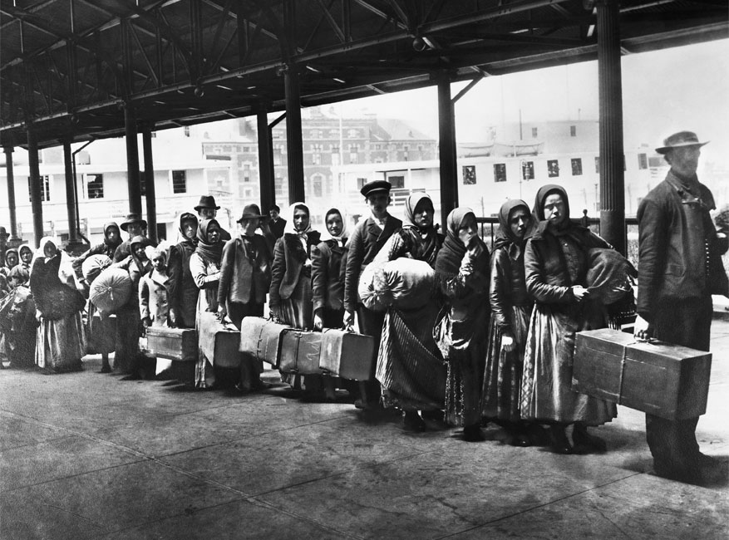
Immigration in America

Slide 2
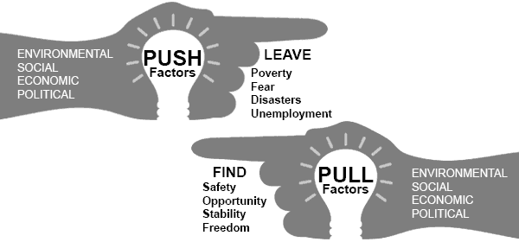
Why did immigrants come to the US?
There were both Push (things driving people out of their homeland) and Pull (things bringing people to the US) factors involved in US immigration in the late 19th and early 20th centuries.

Slide 3
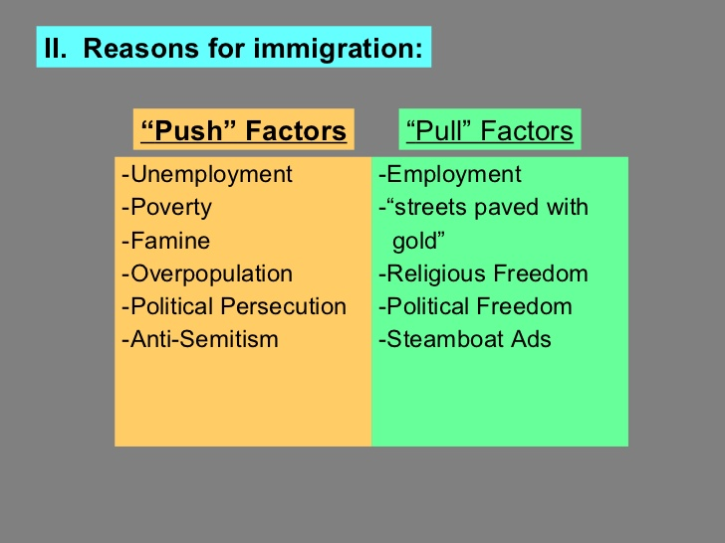

Slide 4


Slide 5
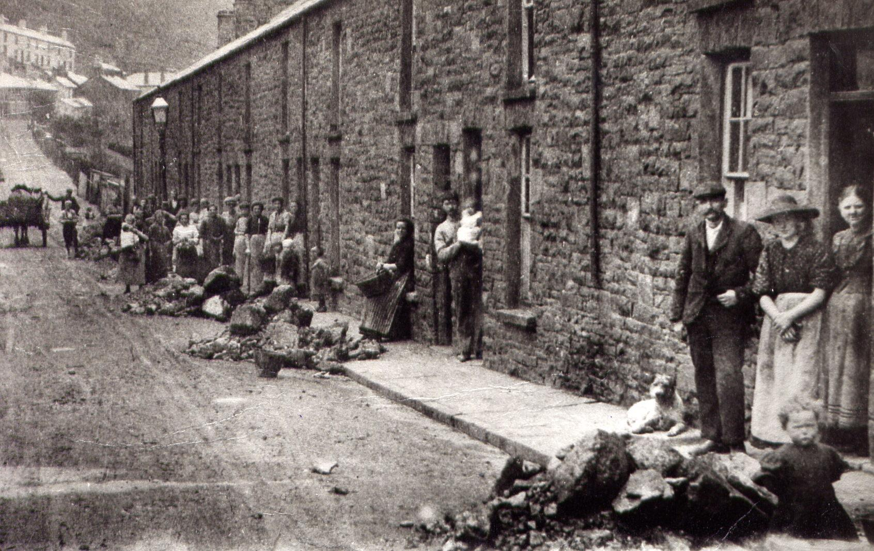
Poverty

Slide 6
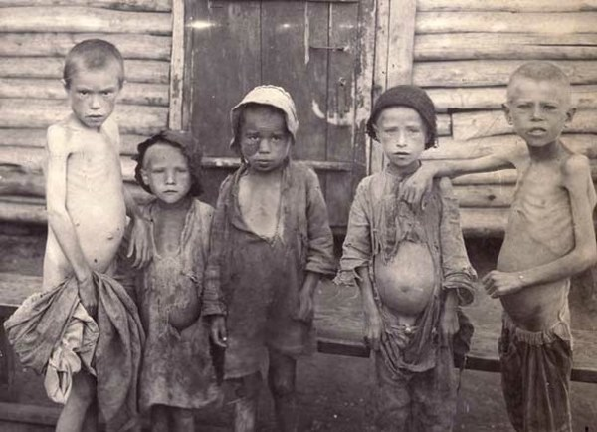
Famine

Slide 7
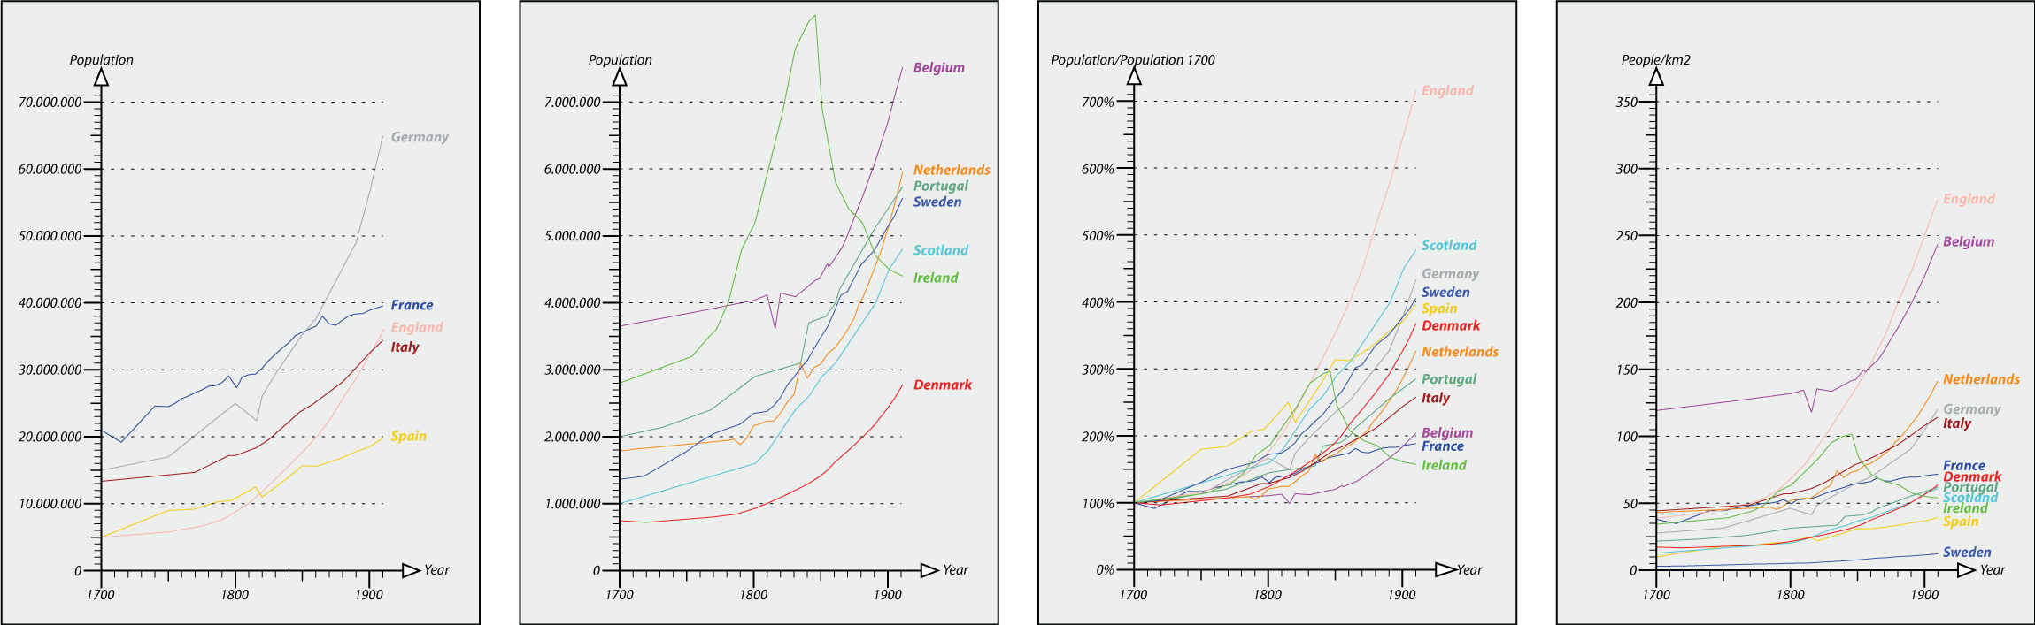

Slide 8
Religious persecution, especially of Jews, throughout Europe was common all through history.
There was also a lot of anti-Semitism throughout Europe and the United States
There was also a fear of non Protestants in the US.

Slide 10

“Birds of Passage”
A temporary Immigrant only here for work
Short period of time to gain wealth and move back home to mother country

Slide 11
Old v. New Immigrants
OLD | New
North and Western Europe | South and Eastern Europe, China, Japan, Mexico
Protestant | Catholic, Jewish, E. Otrthodox
White, Anglo-Saxon, Protestant | All ethnicities and skin colors
English | Chinese, Japanese, Italian, Greek
Germany, Ireland, France, GB | Italy, Greece, Czech, China, Japan, Mexico
Assimilated Easier | Ethnic Communities, hard assimilation

Slide 12
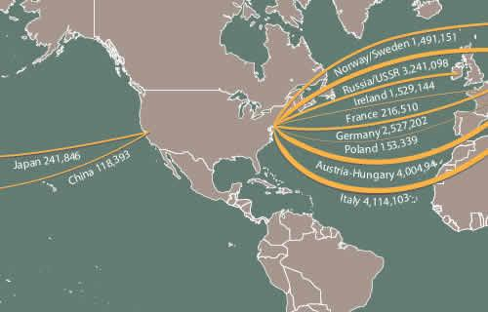
The New Immigrants

Slide 13
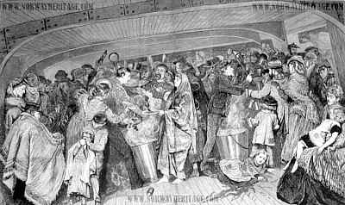
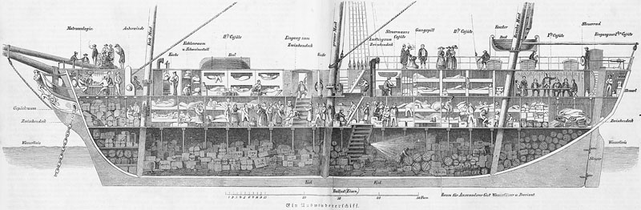
Steerage-cheapest area on boat

Slide 14
Length of Trip
Europe = 1 Week
Asia = 3 Week

Slide 15
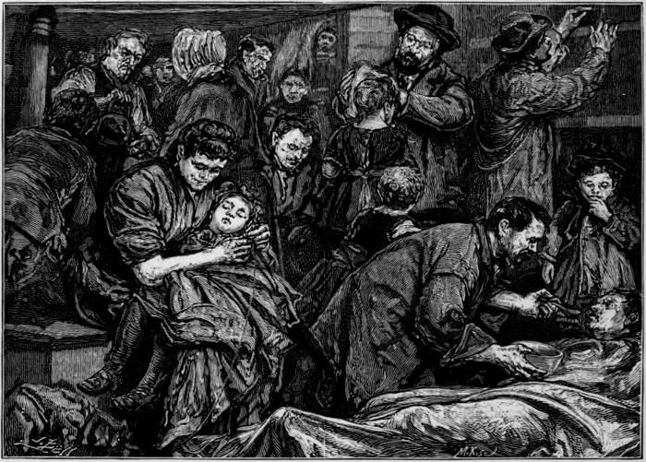
What difficulties did immigrants face on their journey to the US?
Crowded, dark steamships that took 1-3 weeks
Disease from overcrowding
Leaving loved ones
Did they make mistake
No money, did not know anyone
violence

Slide 16
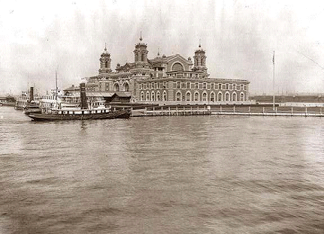
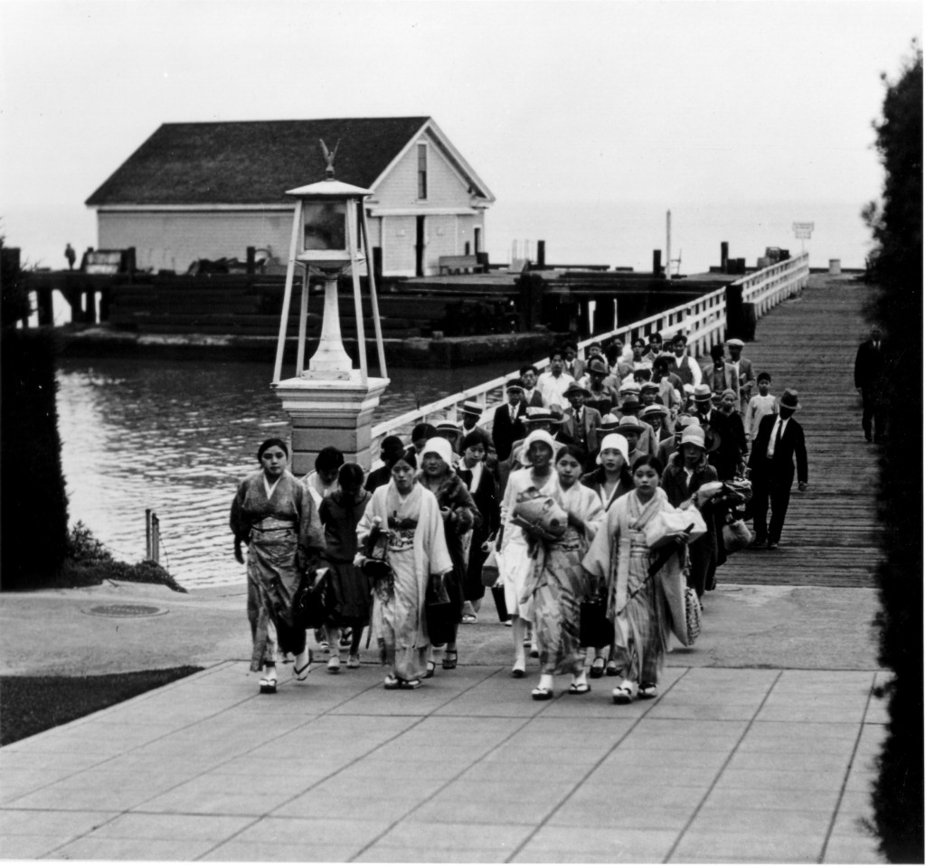
Ellis and Angel Island
Ellis Island = New York
  Europeans (geographically)
Angel Island = California
  Asians (geographically)

Slide 17
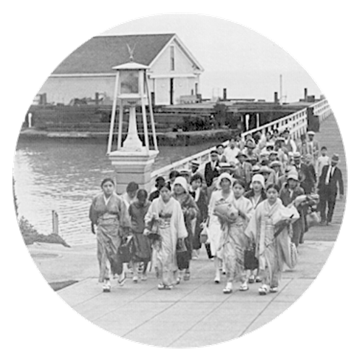
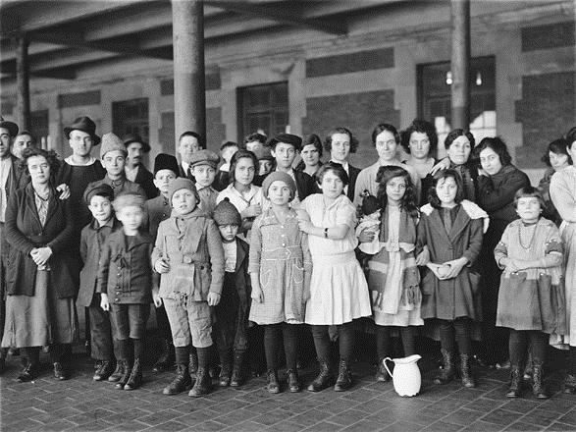
What were the differences and similarities between the two US immigration centers?
Angel Island: long detention in filthy buildings, harsh questioning, Asian (mostly Chinese) immigrants.
Ellis Island: the process took five hours or more, included a physical examination, some questioning like no convictions, ability to work, showing some money, European immigrants

Slide 18
“hyphenated” American
Immigrants did not want to lose their identity but wanted to assimilate in America
Italian-American
African-American
Chinese-American
Japanese-American
French-American

Slide 19
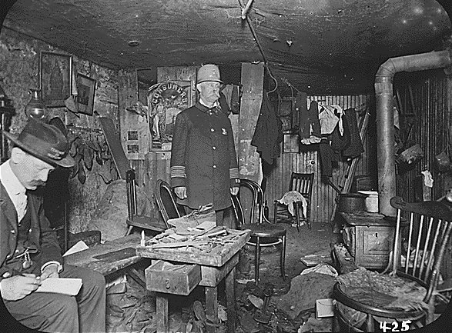
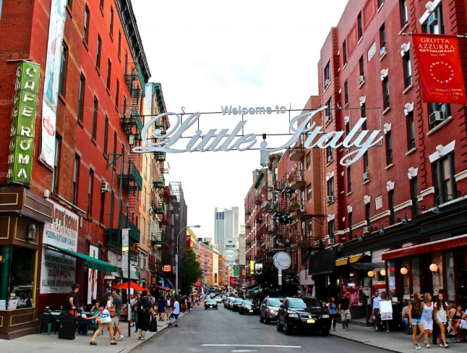
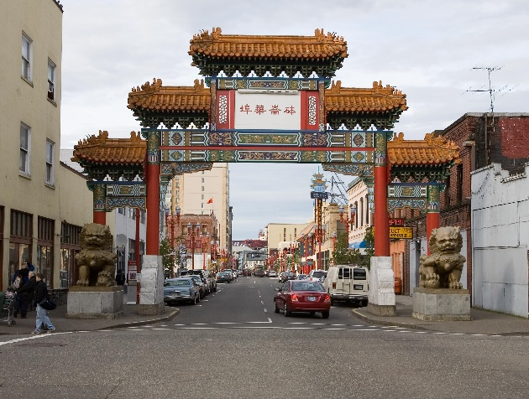
How did many immigrants live after arriving in America?
“Dark Room” Apartments (inside apartments)= no windows or ventilation
Ethnic Communities/Neighborhoods
  Development of Ghetto
  Little Italy, Chinatown, North End, Southie
Church became a refuge for many of the people who arrived. It gave them a community that they could identify with.

Slide 20
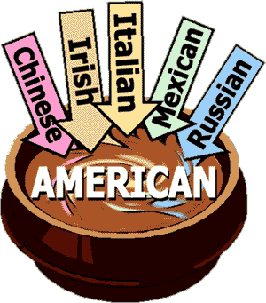
The Melting Pot
The mixture of people from different cultures and races who blend together by abandoning their native language and customs.
Do you believe in the idea of a melting pot?

Slide 21
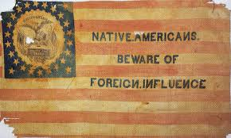
Nativism
Favoring native born people over foreign born
This came out of the labor movement
Hate immigrants because they are taking the jobs

Slide 22
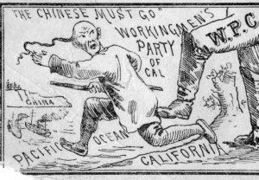
Chinese Exclusion Act
Prohibited Chinese laborers from emigrating to the US
1882 = 10 years
1892 = extend 10 more
1902 = extended
open-ended
1943 = Finally Ended

Slide 23
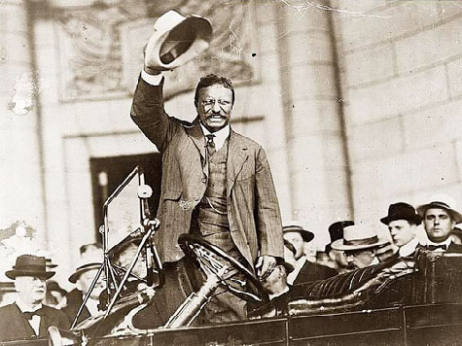
Gentlemen’s Agreement
1907
Large number of Japanese Emigrate because of Russo-Japanese War
Large population in CA
San Francisco segregates school children to educate them
Japan furious
President T. Roosevelt handles situation:
  Desegregate schools in San Francisco, CA
  Japan sends no more workers to US

