Slide 1
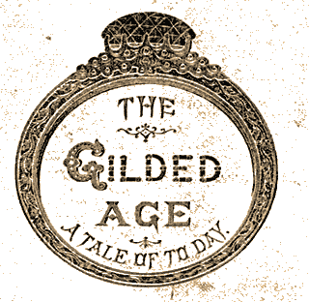
Politics in the Gilded Age
1870 - 1900

Slide 2
Political corruption in Postbellum America
Farmers were the largest group in America
  Crop prices were shrinking as the availability of land and cultivation tools grew.
  They will eventually organize into a 3rd Party to challenge the politicians at the time
Presidents had little power because of highly contested elections.
  Congress refused to put any support behind presidents that didn’t have huge backing from the general population

Slide 3
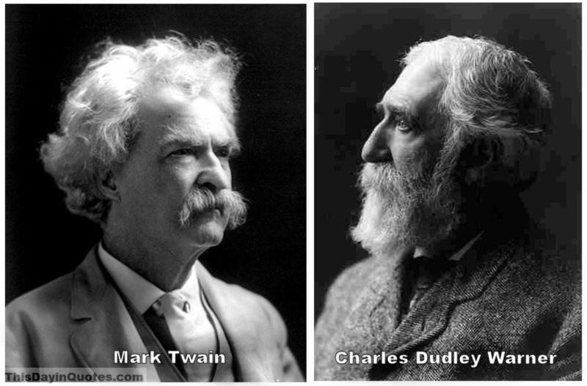
The Gilded Age
Named after a satire by Mark Twain and Charles Dudley Warner

Slide 4
Between 1872 – 1896 presidents didn’t like to go beyond the interests of their supporters, congressmen didn’t want to tie their career goals to weak presidents, and weak presidents were more likely to support random agendas because they owed huge favors to their parties and financial supporters

Slide 5
Patronage: The Spoils System Vs. Civil Service
Spoils System – the ability of the president to practice political Patronage
  Patronage – in this case it means that the president can name his friends and supporters to various political posts
    This was important because all the presidents from 1876 – 1892 won with less than 50% of the popular vote, so they owed lots of favors to the people who helped them get their job

Slide 6
Table 20.1 U.S. Presidential Election Results (1876–1896)
Year | Candidates | Popular Vote | Percentage | Electoral Vote
1876 | Rutherford B. Hayes | 4,034,132 | 47.9% | 185
 | Samuel Tilden | 4,286,808 | 50.9% | 184
 | Others | 97,709 | 1.2% | 0
1880 | James Garfield | 4,453,337 | 48.3% | 214
 | Winfield Hancock | 4,444,267 | 48.2% | 155
 | Others | 319,806 | 3.5% | 0
1884 | Grover Cleveland | 4,914,482 | 48.8% | 219
 | James Blaine | 4,856,903 | 48.3% | 182
 | Others | 288,660 | 2.9% | 0
1888 | Benjamin Harrison | 5,443,663 | 47.8% | 233
 | Grover Cleveland | 5,538,163 | 48.6% | 168
 | Others | 407,050 | 3.6% | 0
1892 | Grover Cleveland | 5,553,898 | 46.0% | 277
 | Benjamin Harrison | 5,190,799 | 43.0% | 145
 | Others | 1,323,330 | 11.0% | 22
1896 | William McKinley | 7,112,138 | 51.0% | 271
 | William Jennings Bryan | 6,510,807 | 46.7% | 176
 | Others | 315,729 | 2.3% | 0

Slide 7

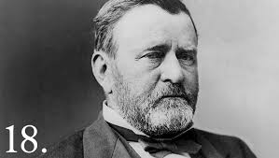
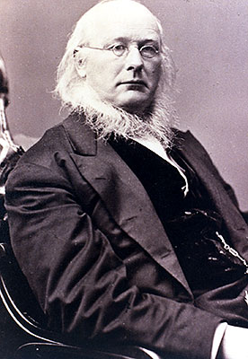
The Liberal Republican Party
Civil service reformers created this to try to unseat President Grant.
It led to people leaving the Republican party and joining the Democrats.
They put Horace Greeley up as their candidate
Their platform called for a thorough reform of the civil service as one of the most pressing necessities facing the nation

Slide 8
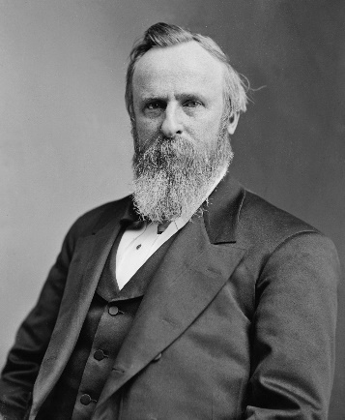
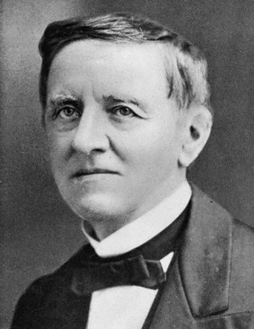
The Election of 1876
One of the most controversial elections in history.
Country was in the middle of the economic downturn caused by the “Panic of 1873” and basically guaranteeing that Republican incumbent Grant was NOT going to get reelected
Rutherford B. Hayes was nominated instead he was a reformer and he had no scandals in his past
The Democrats nominated Samuel J. Tilden, governor of NY and self made millionaire who made his political career by fighting against Tammany Hall and eventually getting Boss Tweed arrested and imprisoned

Slide 9
The Compromise of 1877
The election turns out to be very close, and 3 southern states end up having their electoral votes challenged
In the Compromise of 1877 Republican party leaders offered Southern Democrats an offer they really couldn’t or wouldn’t refuse:
If they gave Hayes the electoral votes and the victory the remaining US Troops would be removed
from those 3 southern states. (This would bring an end to radical Reconstruction governments in
those states and allow the southern Democrats to end federal control of their states)

Slide 10
After weeks of deliberation the electoral commission voted straight party lines and gave Hayes the win 8-7 in each of the disputed states
Radical reconstruction ended, SC and LA had federal troops removed and Redeemers – mostly Southern Dems. – regained control of the politics and society of the south.
African Americans referred to this as “The Great Betrayal.”

Slide 11
Hayes election didn’t cause political corruption in Washington D.C., but it did set the stage for politically motivated agendas and backroom deals

Slide 12
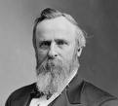
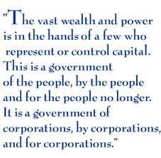
Rutherford B. Hayes (R)(1876-1880)
Supported Reform BUT he did little during his actual presidency
Supported Hard Money (Gold based money system)
Supported Civil Service Reform – getting jobs based on Merit instead of patronage – but again did little about actual reform because he owed so many political favors
Customhouses→ Hayes hired independents to investigate the corruption within; he ended up firing two corrupt republican officials

Slide 13
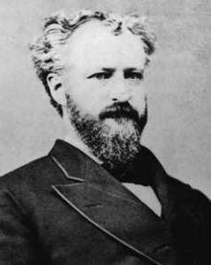
Roscoe Conkling and the Stalwarts
Senator (R – NY)
Supporter of Grant who didn’t want any of Hayes’ reforms
Stalwarts strongly supported the continuation of the spoils system.

Slide 14
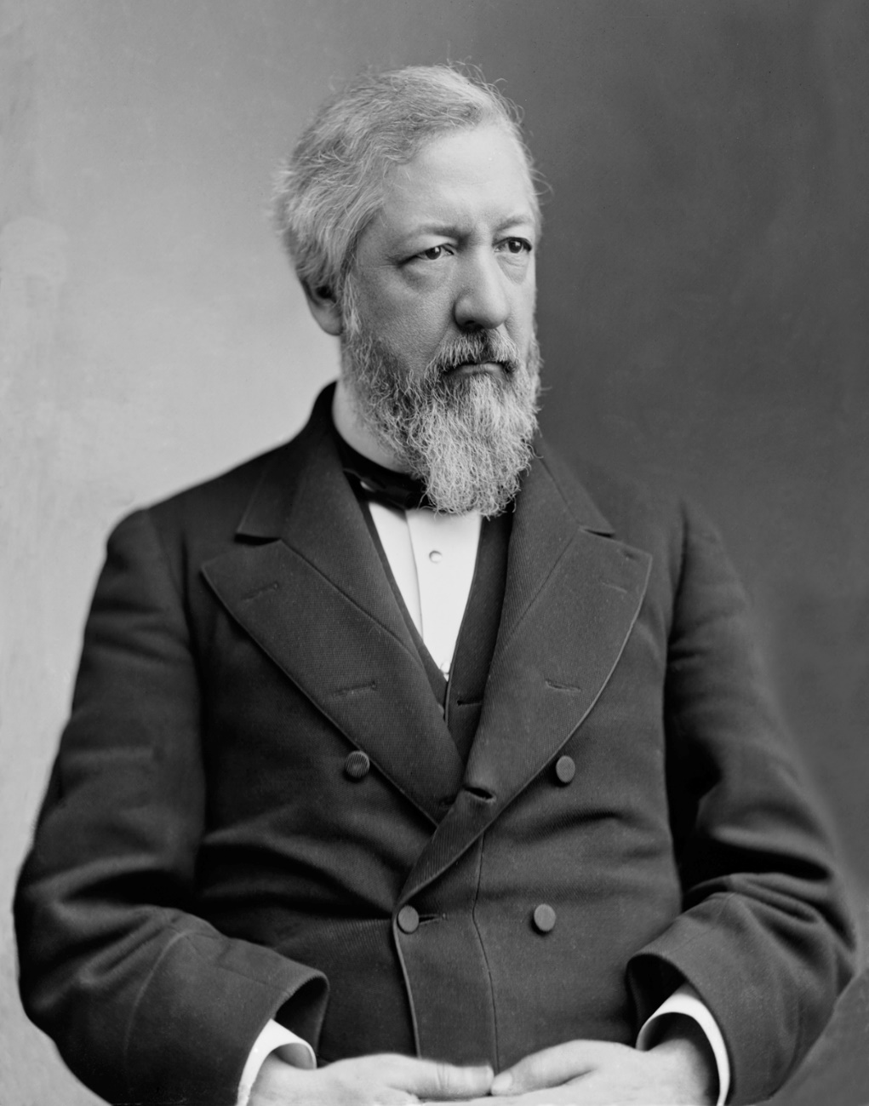
James Blaine and the Half-Breeds
Senator (R – Maine)
His followers, the Half Breeds, got their nickname from the Stalwarts because they considered them only “half-Republican.”
Advocated for some Civil Service reform

Slide 15
Hayes failed to make any significant legislation during his presidency.
He tried to get civil rights for African-Americans and the Democrat controlled congress stopped him.
He halted the coinage of silver and this added to the pressures of the Panic of 1873.

Slide 16
He did manage to make some inroads to Civil Service Reform however
He adopted a new patronage rule that said that a person already appointed to office could not be removed for only political reasons, it had to be in the name of efficient government operation
He declared that party leaders could have no official say in political appointments
He decided the government appointees were ineligible to manage campaign elections.

Slide 17
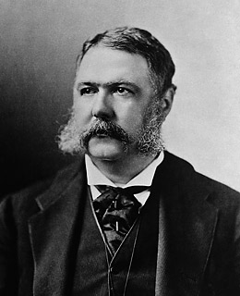
Hayes’ first target was Chester A. Arthur
Arthur was a Conkling man and Hayes removed him from his job at the NYC Customs House, notorious for using his position to collect favors for Conkling .
When Hayes removed him however, even the Half-Breeds distanced themselves from him.
The loss of whatever public support he had was washed away by the Compromise of 1877 and declining support from Congressional supporters sealed his fate and he won’t be reelected.

Slide 18
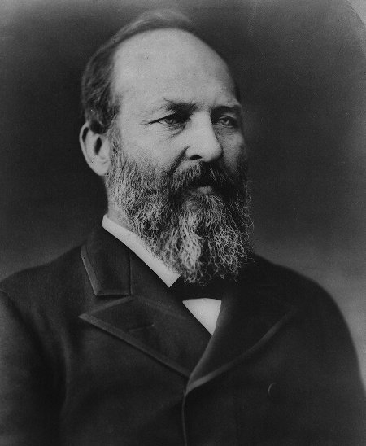
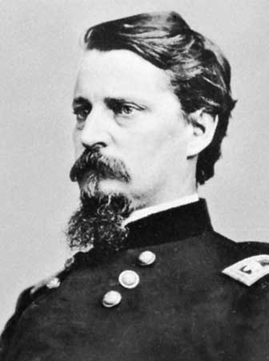
With Hayes doomed, the Republicans began to fight over who would be his successor in 1880
The Stalwarts at first wanted Grant back.
The Half-Breeds put up their leader James Blaine.
However, they were deadlocked and compromised on Sen. James A. Garfield of Ohio with Chester Arthur as his VP running mate.
The Democrats put up Winfield Scott Hancock, a Union Commander and Gettysburg hero, as their candidate.
Garfield won by a very small margin and less than ½ the
popular vote
Garfield
Arthur

Slide 19
James A. Garfield (1880)
Put up by the Republicans (both Stalwarts and Half-Breeds)
Assassinated 4 months into his presidency by Charles Guiteau (“I am the Stalwart of Stalwarts”)
  He expected to be made Ambassador to France because he wrote a speech for the Garfield Campaign
    ”I executed / the Divine command. And Garfield did remove / to save my party / and my country / from the bitter fate of war....”
    “The Doctors killed Garfield, I just shot him.”
    Patronage and the Spoils system were blamed for this and reform sped up.

Slide 20
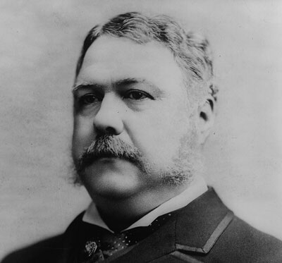
Chester A. Arthur (1881-1885)
Vice President under Garfield
Takes over after assassination
Republican, initially a stalwart but becomes a reformer
Once he became president he shifted to Reformer
Pendleton Civil Service Act (1883)
  A bipartisan Civil Service Commission to make appointments to federal jobs with merit system based on exam (approximately 15% of jobs)
  Presidents can enlarge the list but never shrink it

Slide 21
Tariffs in the Gilded Age
What is a tariff? A tax on imported goods.
Higher Tariffs: Force Americans to buy domestically produced goods rather than higher-priced imports
Lower Tariffs: Would reduce prices and lower the average American’s cost of living. Many working- class families and farmers.
In 1882, The U.S. Tariff Commission was created to investigate the propriety of increasingly high tariffs. They concluded that there should be a 25% rollback in most tariffs.
Unfortunately, the best Arthur could do was the “Mongrel Tariff” of 1883 that lowered rates by barely 5%

Slide 22
Because of his attempts at reform, Arthur soon found himself abandoned by the Republican Party.
The Half-Breeds turned to Blaine again, but he had some corruption scandals. Some Republicans broke away from the traditional Half-Breed V. Stalwart debate and formed their own party called Mugwumps

Slide 23
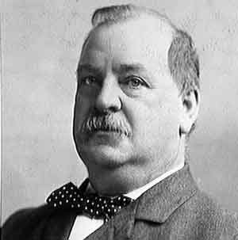
The Democrats decided to try to get the Mugwumps on their side and put up Grover Cleveland as their candidate.

Slide 24
Grover Cleveland
(1885-1889) and (1893-1897)
First Democrat in 28 years
Urged Congress to create the Interstate Commerce Act of 1887
  Created the Interstate Commerce Commission to oversee railroad prices
Had attacked machine politics in NYC
Generally liked by the people for his attempts at civil service and tariff reform.
Repealed the Sherman Silver Purchase act (1890) in 1893
  People were trading in silver certificates for gold, depleting the nation’s gold supply

Slide 25
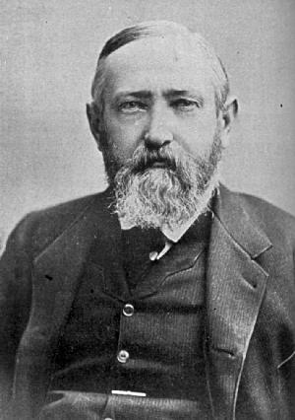
Benjamin Harrison (1889-1893)
A Republican
  Put up to counter Cleveland’s re-nomination
  Won on electoral votes, Cleveland beat him in the popular vote
He supported a HIGH tariff
  He wanted domestic production to be supported
McKinley Tariff Act 1890 → highest tariff to date
  Some as high as 50%!!
Sherman Anti-Trust Act 1890
  Tried to stop monopolies
Sherman Silver Purchase Act 1890
  This act required the minting of 4 million oz of silver into coins each month to circulate more cash into the economy, raise the price of farm goods, and help farmers pay their way out of debt.
Force Bill (Proposed)
  To protect votes in the South
Education Bill (proposed)
  To support public education and literacy rates among African Americans

Slide 26
Gold vs. Silver
The Government remained committed to the Gold Standard even though there was a push for a bimetallic standard.
The Gold Standard limited the amt of money in circulation and ultimately helped businesses and forced everyday Americans into deeper debt
The bimetallic standard would create inflation, put more money into circulation, and help farmers.
Silver was demonetized in 1873

