Slide 1
The Jazz Age: Redefining the Nation, 1919 - 1929
Chapter 24

Slide 2
24.1 Prosperity and the Production of Popular Entertainment

Slide 3
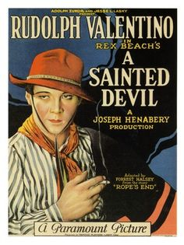
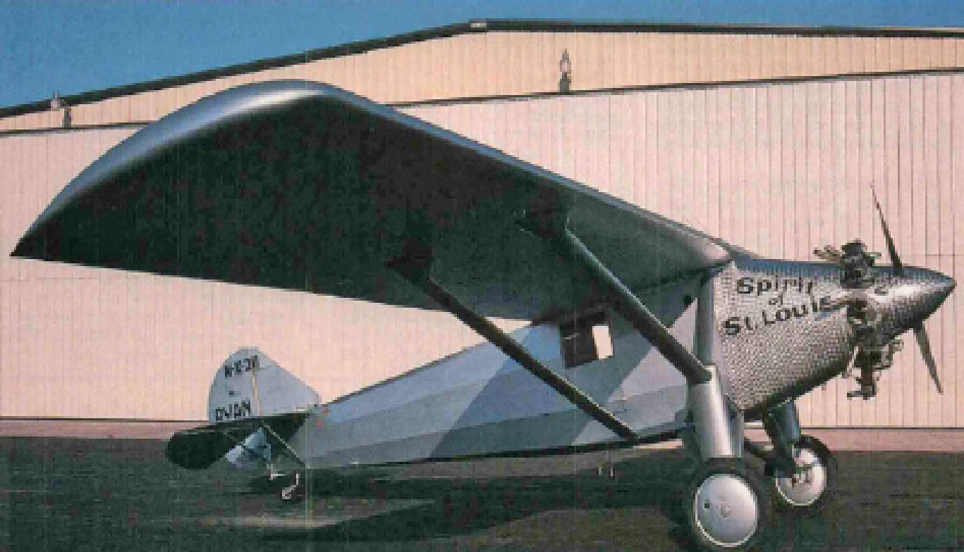
American Prosperity really showed itself in the growth of entertainment and technology.
Why?

Slide 4
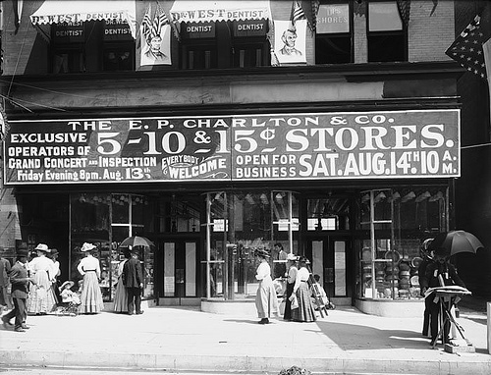
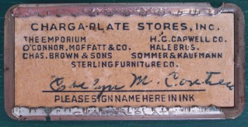
Most Americans thought that the new prosperity after the war would go on forever.
Production was up.
National income was up.
New chain stores popped up selling groceries, medicines, shoes and clothes.
5 and dime stores also spread rapidly.
People started to buy on credit and pay off their debt in installments.
This allowed for more people to buy more consumer goods that they wouldn’t have been able to afford otherwise.

Slide 5
The prosperity of the age, however, was mostly imaginary.
Major industries like iron and railroads weren’t doing very well and farmers were producing too many crops so prices were dropping.
People were spending money they didn’t have to buy on credit and pay off their loans in installments.
Americans were mostly concerned with the present however and they continued to buy and spend without too much concern for their futures.

Slide 6
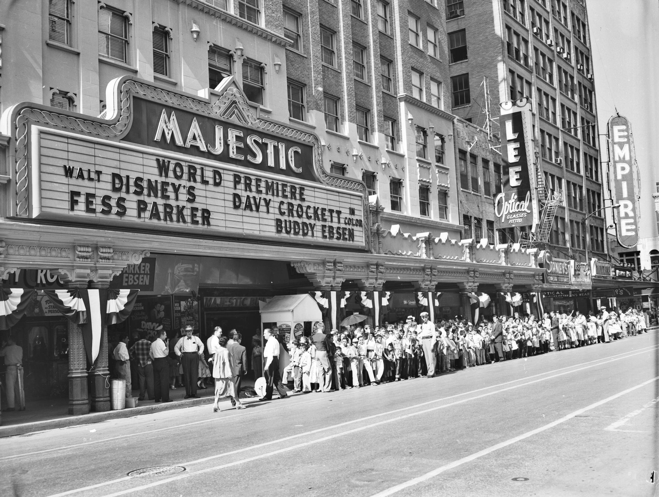
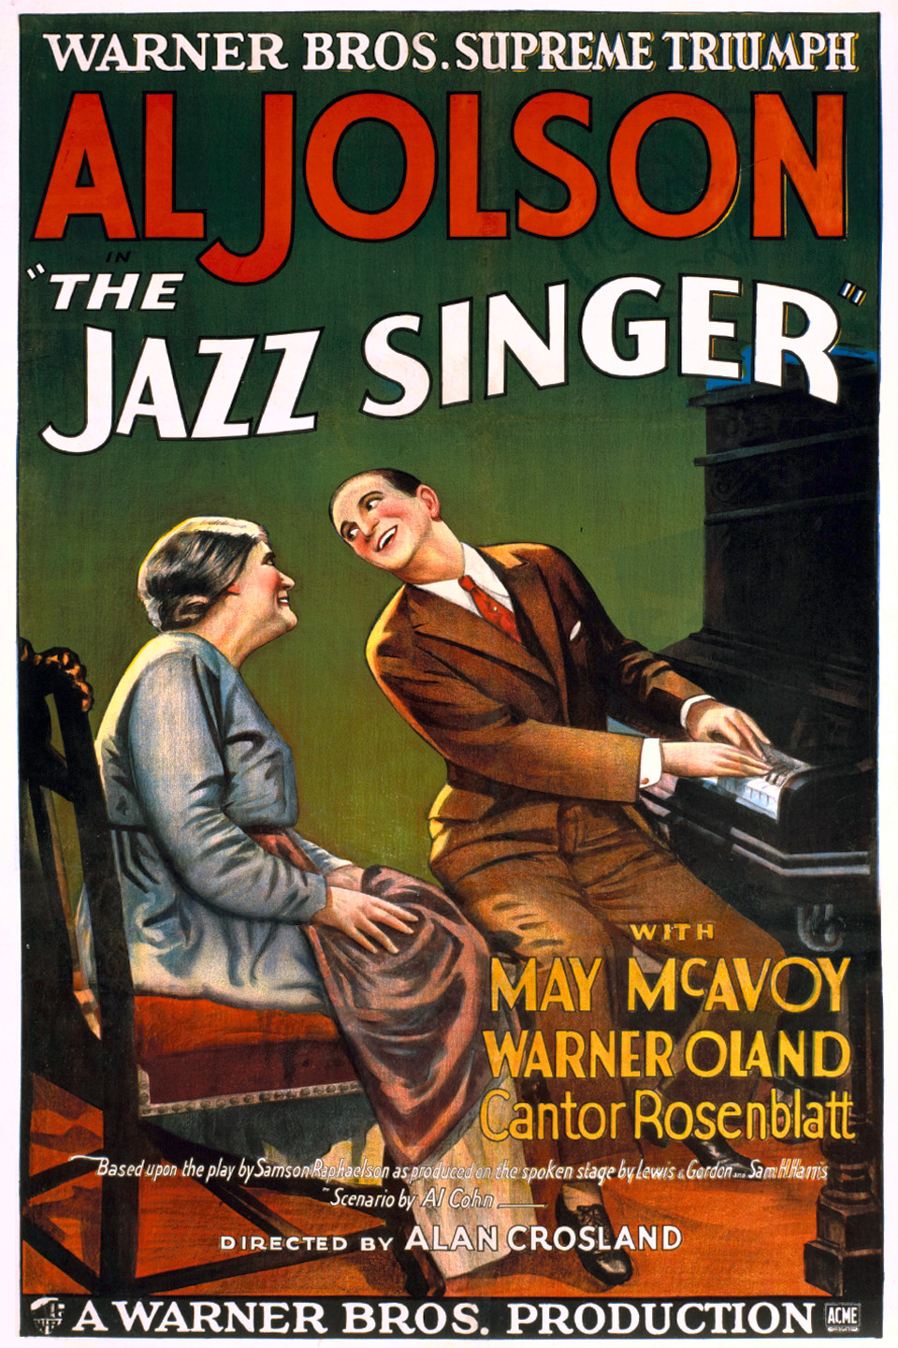
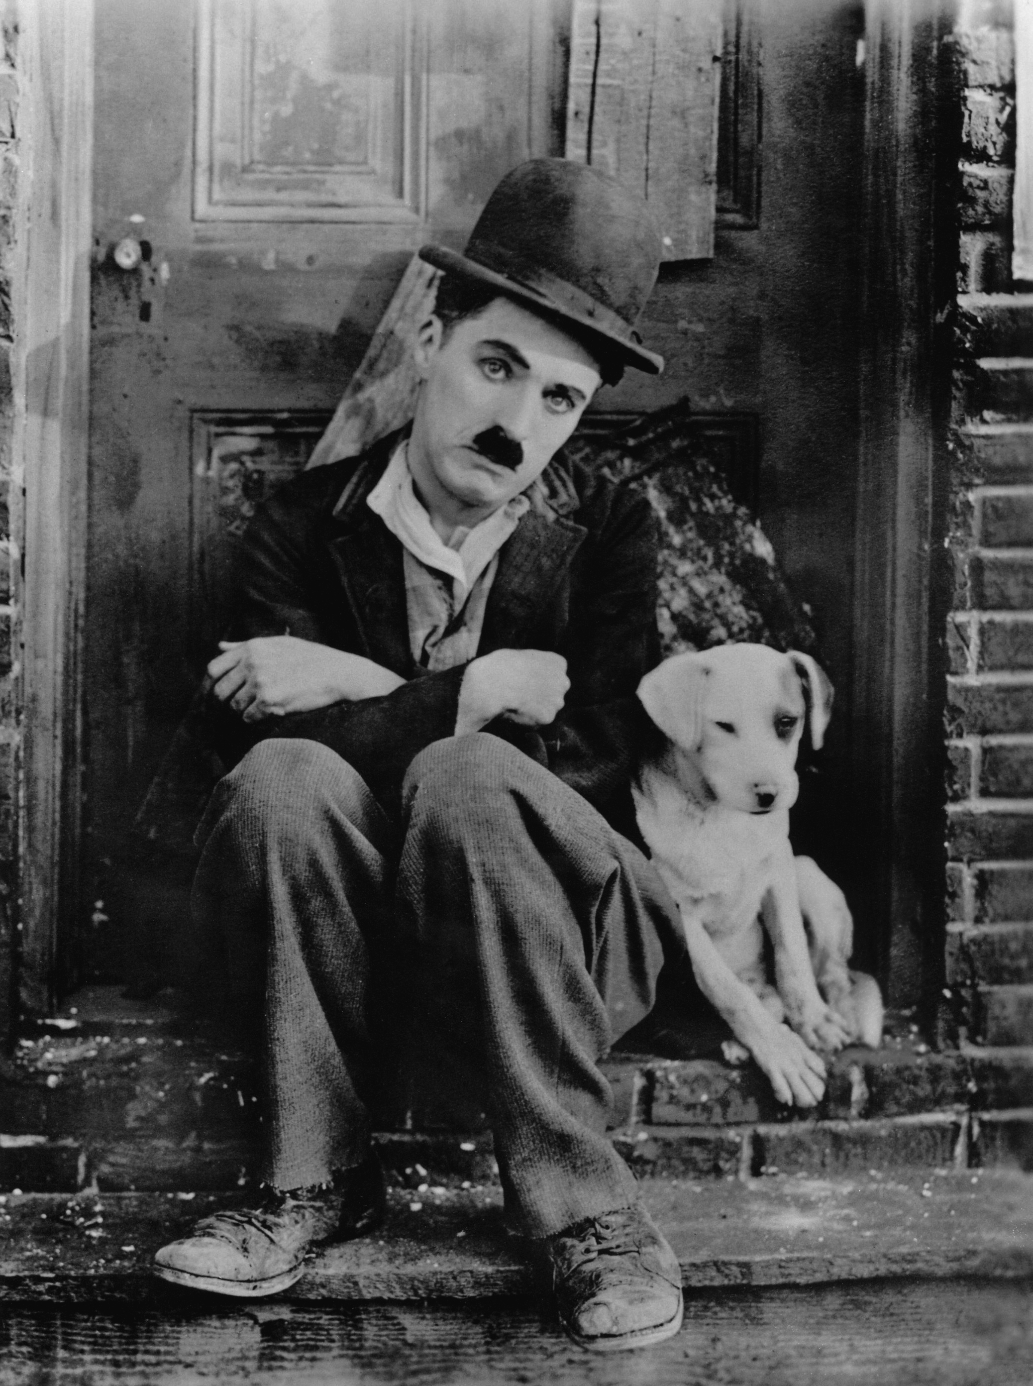
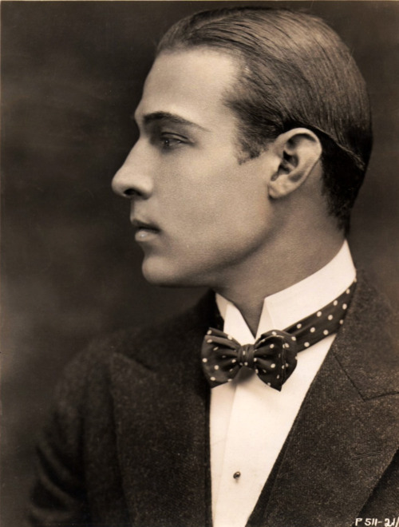
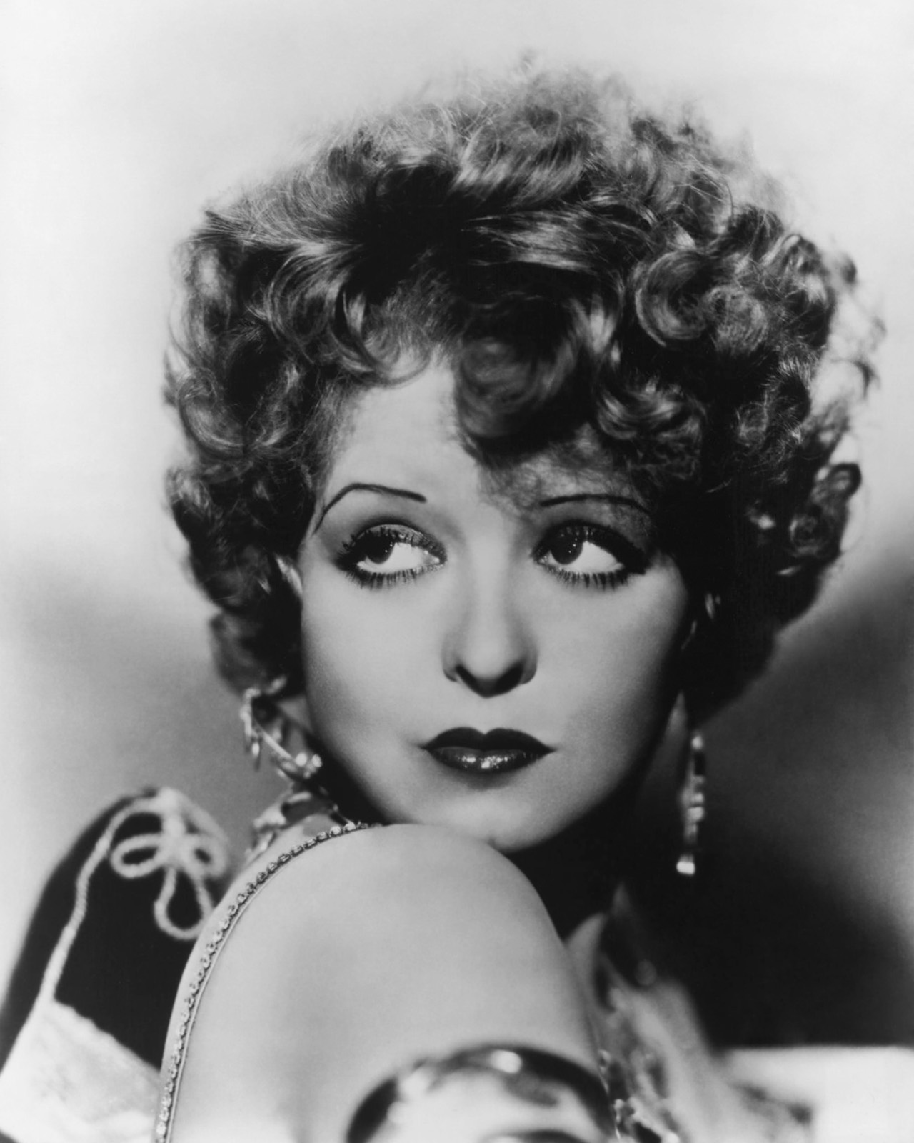
Entertainment
People began to go to “movie places” to see “moving pictures.”
For 25 ¢ an American could go to the movies and loose themselves in the story and forget their troubles for a while
People often went to the movies more than once a week.
Movies were originally silent films, that were then replaced by “talkies” or films with speaking parts. (The first one was The Jazz Singer)

Slide 7
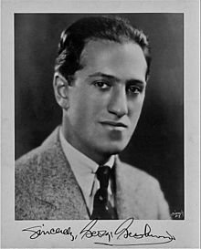

Playwrights and Composers began to break away from the European style and became more popular
George Gershwin became popular when he combined traditional music with American Jazz
The song playing in the background is Rhapsody in Blue, by Gershwin.

Slide 8
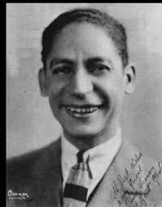
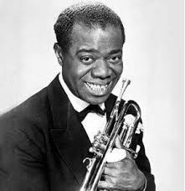
Jazz emerged and became popular in the United States.
It was developed primarily by African-American musicians in New Orleans, Memphis, and Chicago.
It was composed of lively, loose, beats.
The song playing in the background is Wild Cherry Rag by Eddie Morton

Slide 9
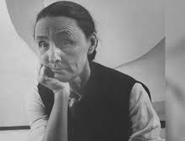
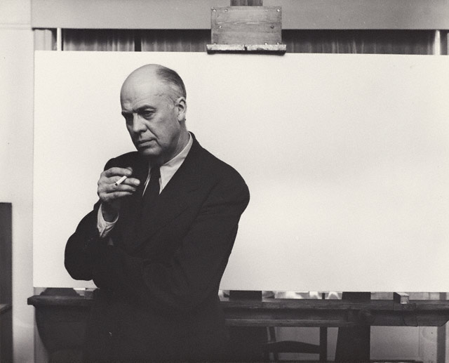
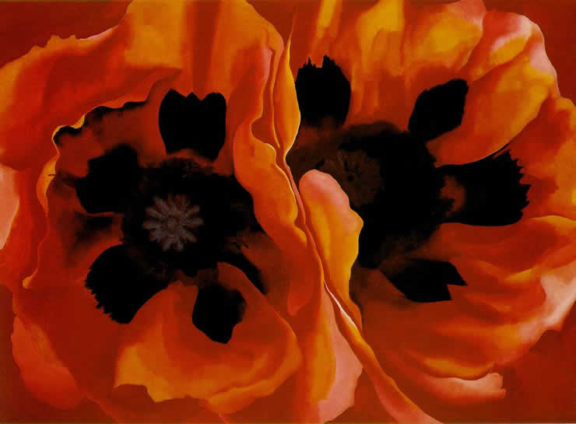
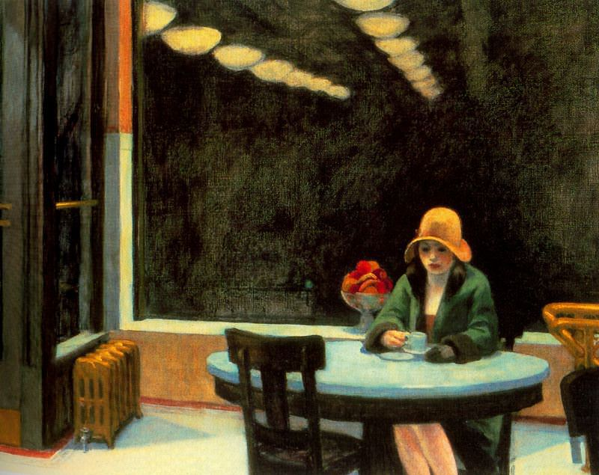
Artists like Georgia O’Keeffe and Edward Hopper began to capture vivid images in their paintings

Slide 10
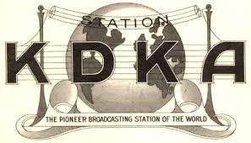
Radio became very popular after WWI. Originally it had been used for battlefield communication
In 1920 KDKA Pittsburg became the world’s first commercial radio station.

Slide 11

It didn’t take long for every major city to have a station broadcasting news, plays, and live sporting events.
Eventually, almost all families owned their own radio.
1940 – Superman –The Baby from Krypton

Slide 12
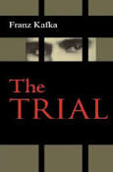
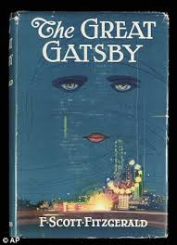
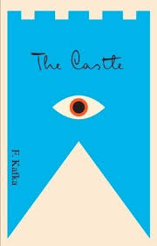
Literature of the 1920s

Slide 13
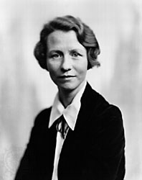
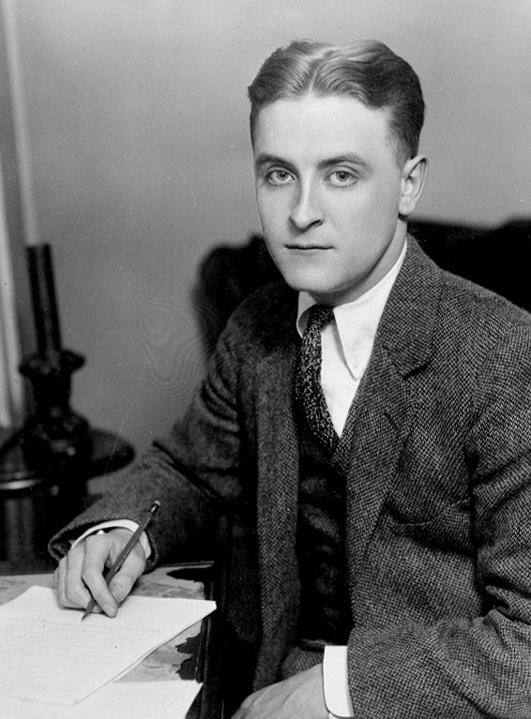
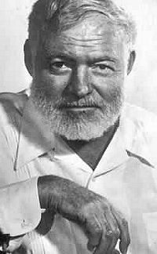
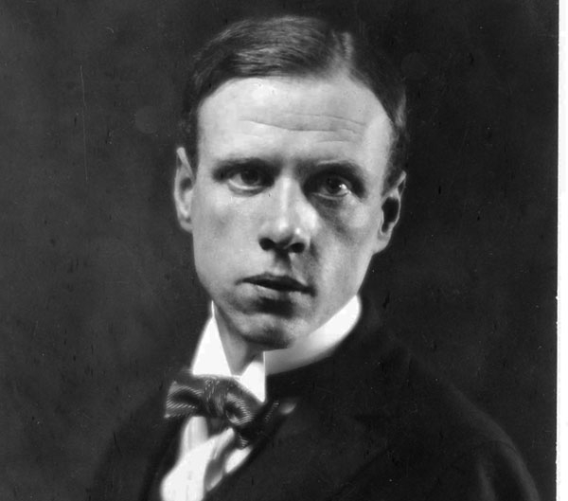
Edna St. Vincent Millay
Wrote Poetry celebrating youth and independence and freedom from “normal” society.
Ernest Hemmingway
Moved to Paris and wrote books like The Sun Also Rises, and For Whom the Bell Tolls that criticized the glorification of war and the destruction that it caused
Sinclair Lewis
Wrote Babbitt to criticize Americans for their conformity and materialism.
F. Scott Fitzgerald, wrote This Side of Paradise and The Great Gatsby.
He was trying to show the negative side of the happiness and freedom of the “Jazz Age” by showing rich, good looking, seemingly happy people, putting themselves and others in danger.

Slide 14
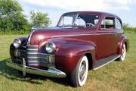
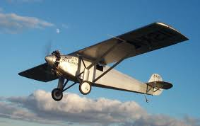
War time technological advances made the car affordable to the average family.
People began to travel for pleasure and new businesses opened to cater to them.
People also moved to the suburbs and began to commute to work in the city
Technology Improves Life
International air travel also became a goal after the war and in 1919 two British pilots made the first successful transatlantic journey from Newfoundland to Ireland

Slide 15
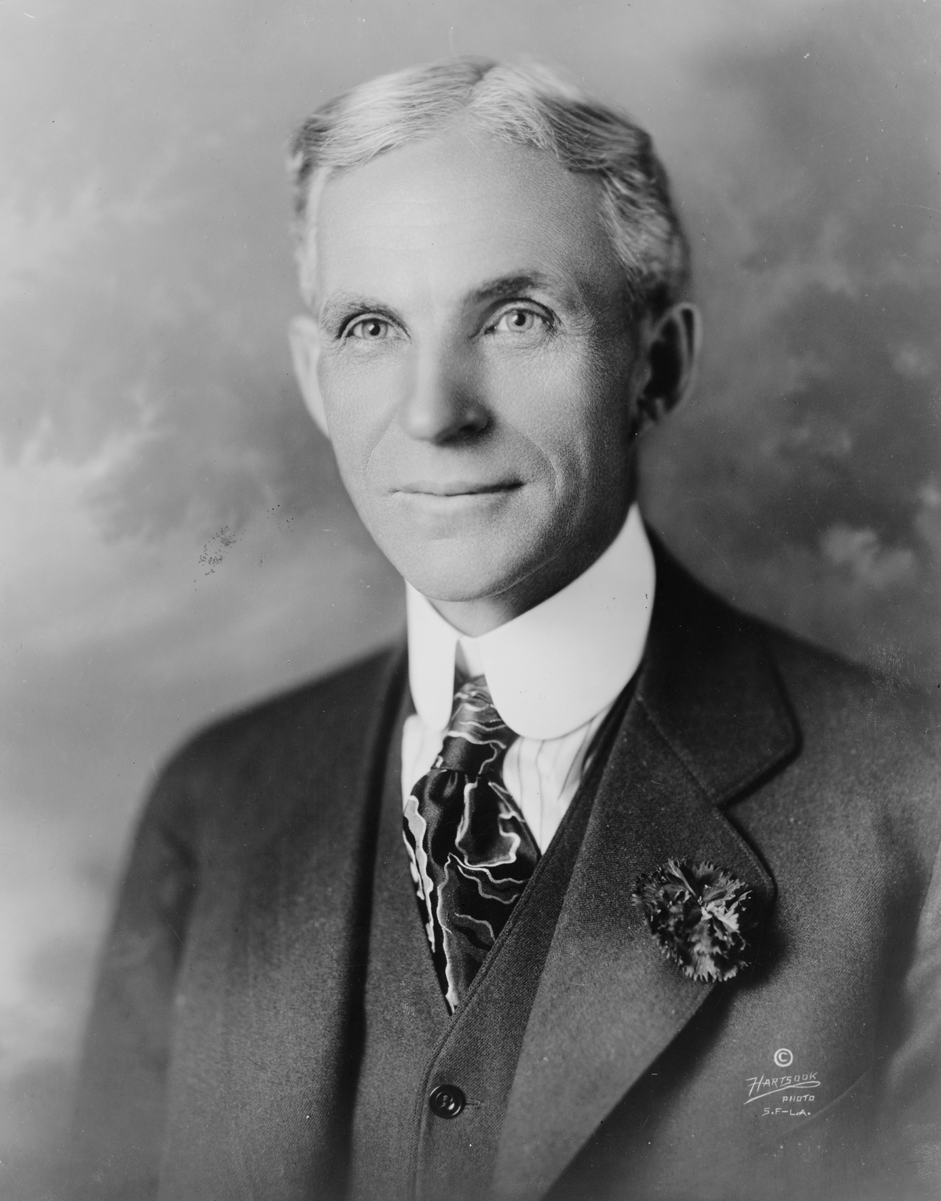
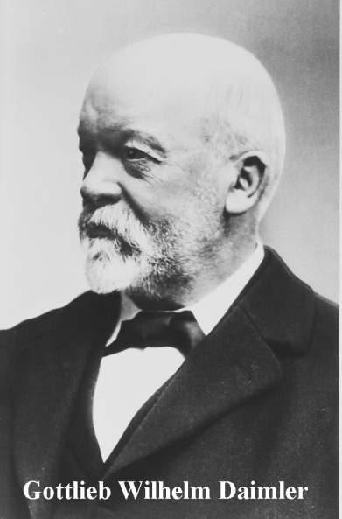
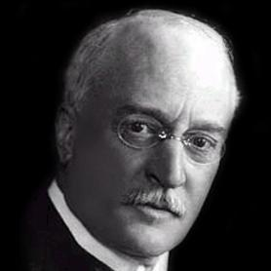
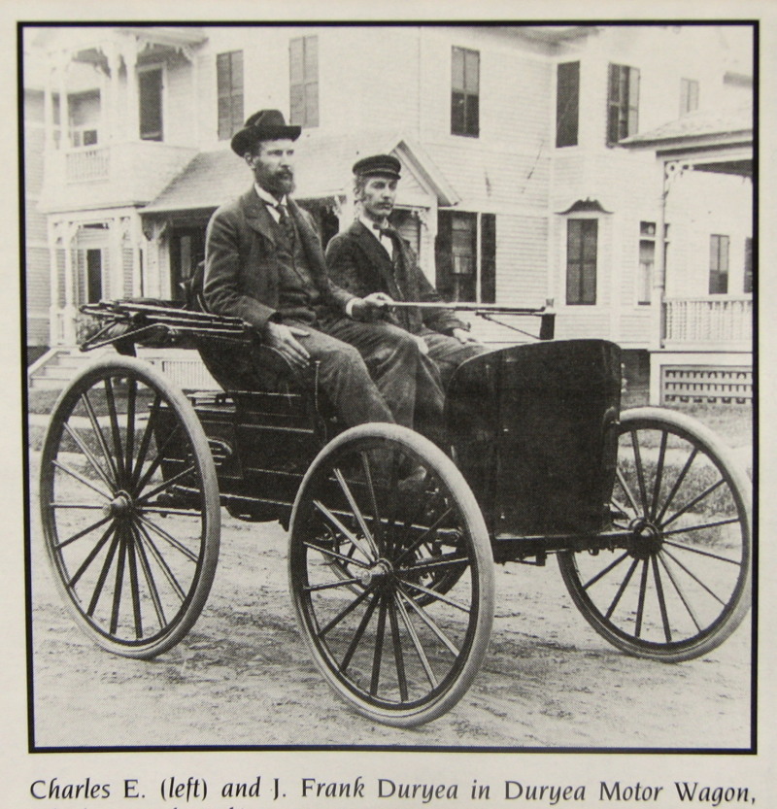
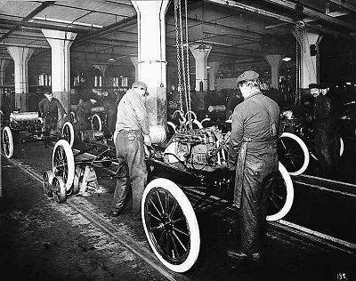
Henry Ford Sparks the Automobile Industry
In the 1880s Gottlieb Daimler and Rudolph Diesel used gasoline to power the first cars in Germany.
In the US, the Duryea brothers were working on the automobile as well
Technology developed quickly but was very expensive
Ford decided to make cars that were more affordable using standard, interchangeable parts, built on an assembly line

Slide 16
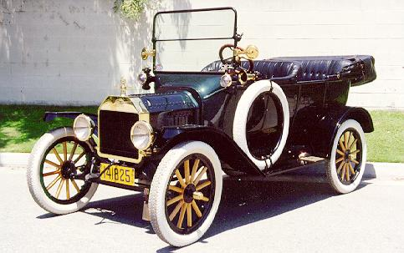
An assembly line is a line of workers that each put a single piece on the unfinished cars as they passed on a moving belt
Assembly line workers could put together an entire Model T Ford in less than 2 hours
In 1908 it sold for $850 but dropped to less than $300 in 1924 when production prices dropped. This made car ownership a real possibility for a good number of people.
“Any customer can have a car painted any color that he wants so long as it is black.”

Slide 17


Slide 18
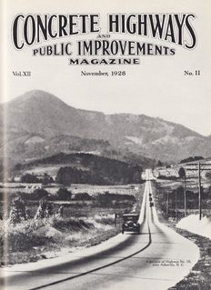
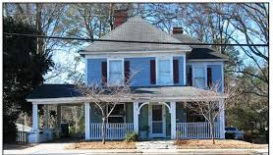
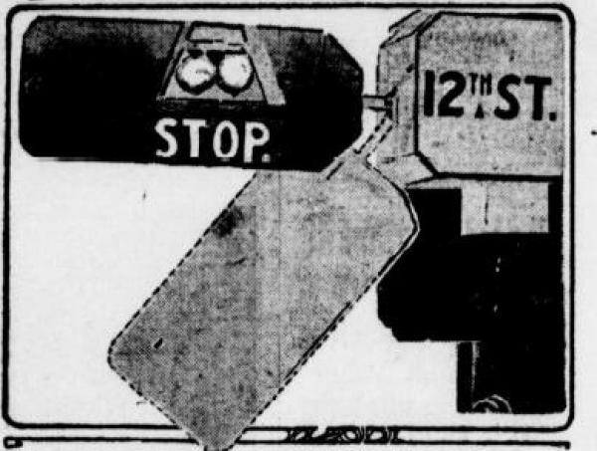
The car literally changed the United States
There is now a demand for paved roads that could be driven in all weather.
Houses now are being built with a garage or a carport. (And very small lawns)
It also caused rapid growth in rubber, glass, steel, aluminum, gasoline (and gas stations), repair shops, pubic garages, motels, shopping centers, , and traffic signals

Slide 19
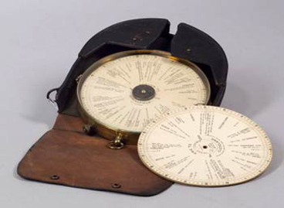
There was even an early “GPS” invented in 1909.
The Jones Live-Map attached to your odometer and spun as you drove, leading you to your destination.

Slide 20
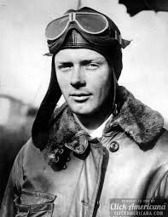
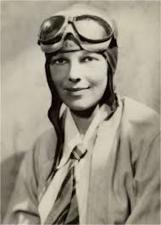
In 1927 Charles Lindbergh made the first solo flight across the Atlantic in 33 hours. He flew from New York to Paris.
In the 1920s the rich could fly on passenger airlines both domestically and internationally.
Amelia Earhart was the first woman to fly solo across the Atlantic. She did this in 1932.

Slide 21
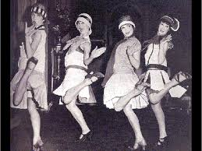
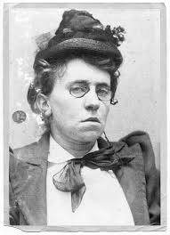
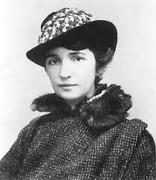
New Challenges in Society
Young people began challenging conventional thought and were especially willing to break with the past.
The Roles of Women Change
Women had begun to work outside the home during WWI and this support of the war effort helped win suffrage in many countries, including the US, after the War ended.
Women also began to wear loose fitting clothes, cut their hair short or “bobbed,” wear makeup, drink and smoke in public, and drive cars.
Many however still followed the traditional path of marriage and family.
Others however spoke out for greater freedoms and new careers such as medicine, education, and journalism.
Margaret Sanger and Emma Goldman fought for the right to use birth control

Slide 22
24.2 Transformation and Backlash

Slide 23
After World War I ended the US faced a staggering rise in immigration and ideological division over the League of Nations, socialism, and other social movements.

Slide 24
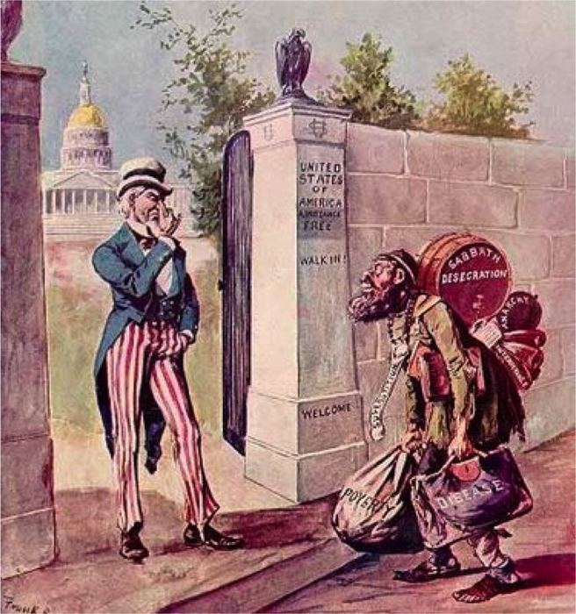
Nativism
This was the idea that prized White, English speaking Americans over any other race or ethnic group coming into the United States. This was primarily in response to the growing number of immigrants coming in from Eastern Europe.
They also spread fear over a perceived foreign threat pointing out the assassinations of world leaders by anarchists and even using the assassination of William McKinley in 1901 as proof.
This also led to renewed Isolationism.
Notes:
Isolationism is the idea that the united states should stay to itself and out of world affairs.

Slide 25

Fear of Communism
Communism is:
This leads to a Red Scare
Started in 1919 after the Czar was overthrown in Russia.
A communist party formed in the US and 70,000 radicals joined including some from the IWW.
Several dozen bombs were mailed to government and business leaders and people began to fear a communist takeover
Notes:
Communism is an economic and political idea where the government controls all means of production. There is no private ownership. This favors dictators as well.

Slide 26
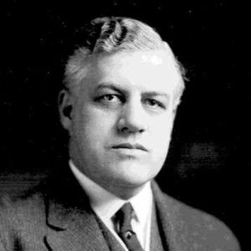
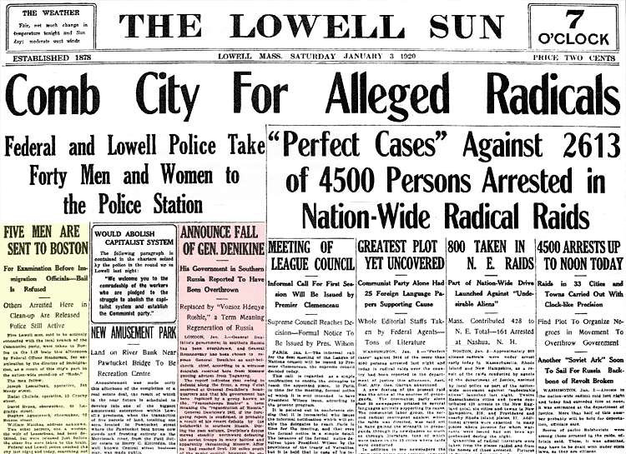
Attorney General A. Mitchell Palmer decided to take action to combat the “Red Scare.”
The Palmer Raids
August 1919 Palmer appointed J. Edgar Hoover as his assistant. Palmer, Hoover, and FBI agents hunted down suspected Communists, socialists, and anarchists.
They invaded private homes and offices, jailed suspects without lawyers, and deported hundreds of foreign born radicals without a trial.
The raids were a failure. They turned up NOTHING. People soon began to think Palmer had other motives and he lost public support.

Slide 27
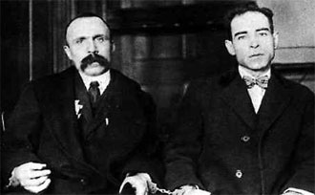
Sacco and Vanzetti
The two most famous victims of this movement were Nicola Sacco and Bartolomeo Vanzetti, a shoemaker and a fish peddler. Both were Italian immigrants and anarchists. Both had also dodged the draft in WWI.
In May of 1920 they wer arrested and charged with the robbery and murder of a factory paymaster and his guard in S. Braintree, MA. The trial was a joke. There was no real evidence (Witnesses said the murderers “looked Italian…”), they had alibies, the judge was clearly prejudiced
A Jury found them guilty and sentenced them to death.

Slide 28
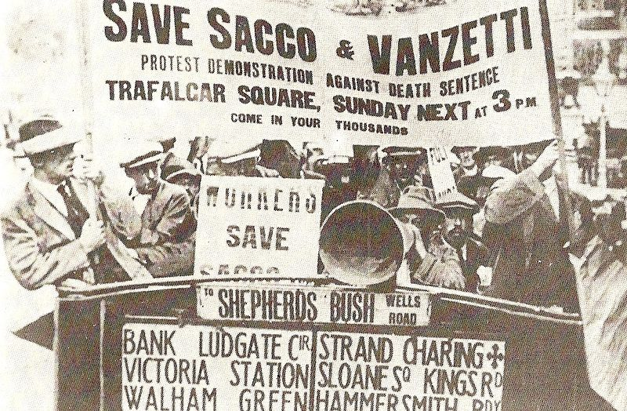
Protests broke out all over the world including; Tokyo, London, and Buenos Aires.
The International Workers of the World called for a 3 day general walkout of all unionized industries.
Felix Frankfurter, who would later be nominated to the Supreme Court by Franklin Roosevelt went as far as to say that the trial judge practically cooperated in the process of condemning Sacco and Vanzetti simply on racial and political grounds.

Slide 29
The Emergency Immigration Act of 1921
Sometimes called the Emergency Quota Act, it introduced numerical limits on European immigration for the first time in the history of the U.S.
Created a quota system that restricted annual immigration from
any country to 3% of the residents from that country as of the
1910 census
The National Origins Act of 1924
Went even further by lowering the level to 2% of the 1890 census.
This particularly targeted Southern and Eastern Europeans because they’d only just started to arrive in large numbers in 1890

Slide 30
There was very little opposition to this in congress.
Both labor unions and the KKK supported the bill.
When Coolidge signed it into law he declared,
“America must be kept American.”

Slide 31
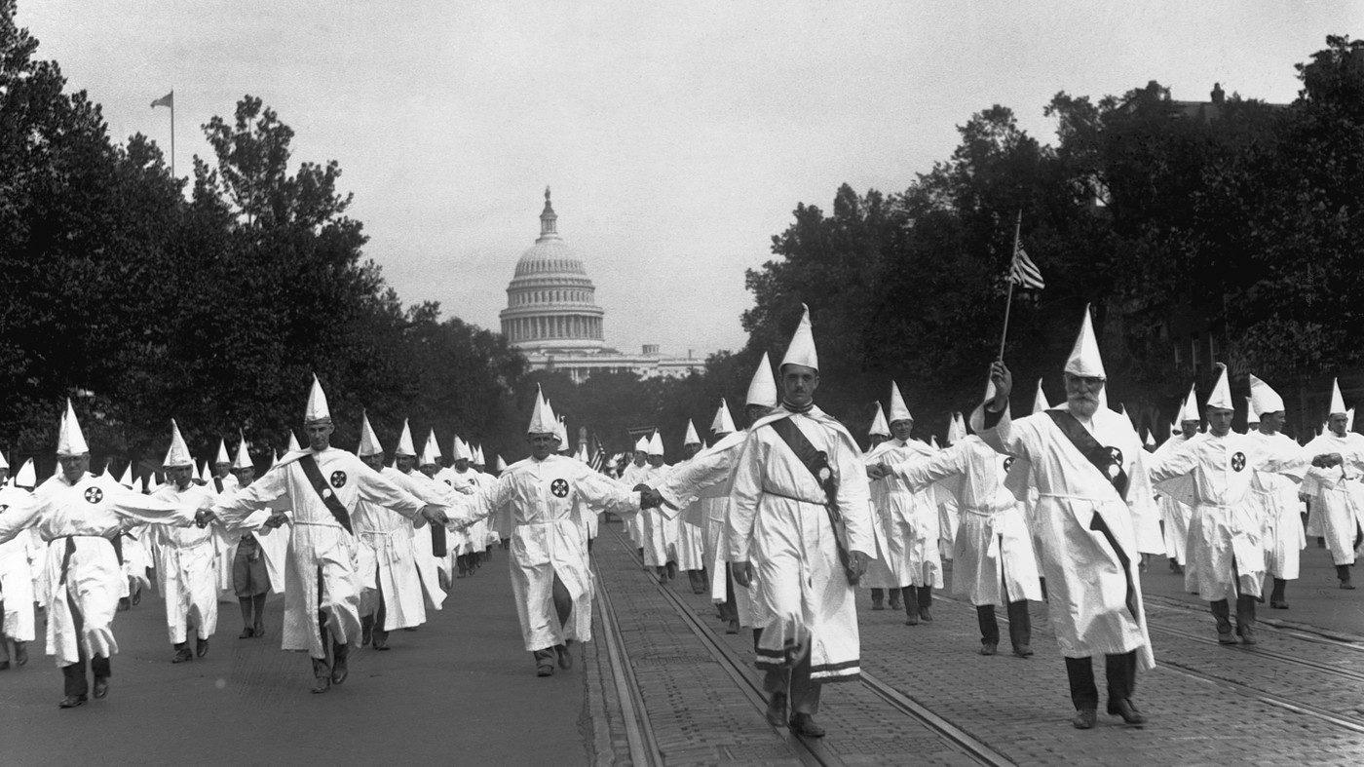
The Klan Rises Again
The Ku Klux Klan which hadn’t really been in the picture since 1877 suddenly saw a resurgence in popularity due to a perceived threat to the white, Protestant, Anglo-Saxon United States.
By 1924 the KKK had 4.5 million members
A film called “The Birth of a Nation” based on “The Clansman” offered a racist, white-centric view of the Reconstruction era. The popularity of this film was a deciding factor in the re-growth of the Klan in America

Slide 32
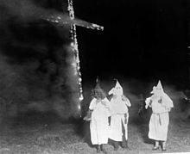
The Second Ku Klux Klan
Founded by William Simmons in Stone Mountain, Georgia in 1915
They publicly got rid of the idea of using violence and got mainstream support from others with similar prejudice. (Violence did NOT stop – especially in the South)
And it wasn’t just men, women were now involved as well, protesting the distribution of Bibles in public schools as well as burning crosses and publicly denouncing Catholics, Jews, immigrants, and non Whites.
By 1924 there were 6 million members.

Slide 33
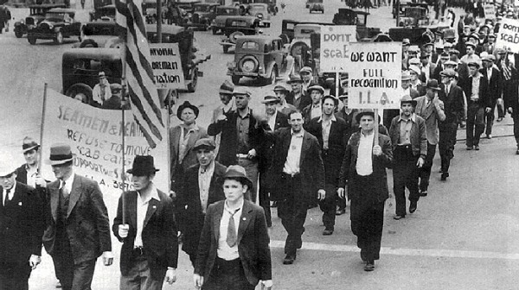
A Time of Labor Unrest
During WWI strikes weren’t allowed.
The AFL pledged to avoid them.
However, in 1919 there were more than 3,000 strikes with 4 million people walking off the job.
Striking workers were often labeled as Communists.
Notes:
The AFL is the American Federation of Labor

Slide 34
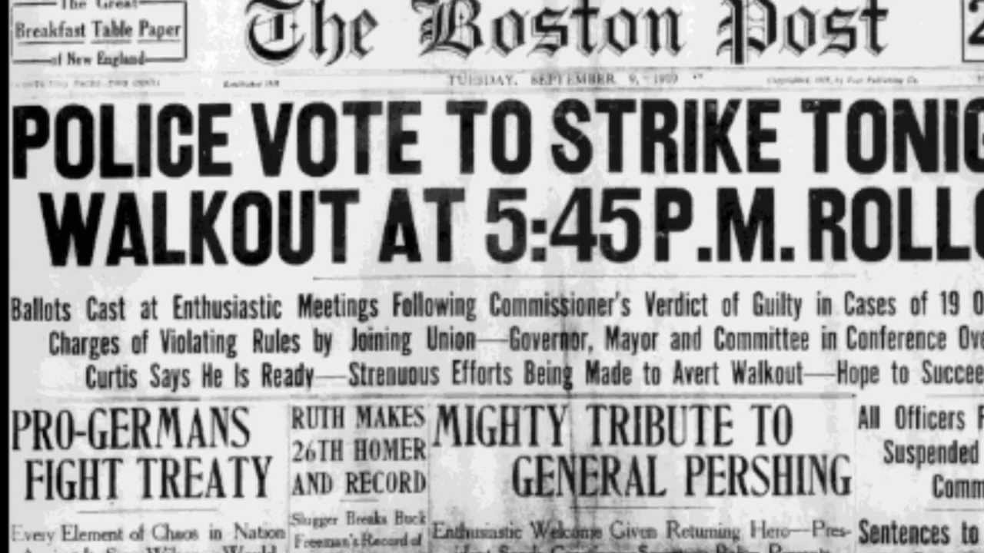

Boston Police Strike
Boston PD hadn’t had a raise since 1914.
They had been denied the right to unionize.
When some of them asked for a raise, they were fired.
In response, MA gov. Calvin Coolidge called out the National Guard
The Strike ended but the police weren’t allowed to go back to work. They were replaced instead.
Coolidge said there was never a right to strike against public safety.
He was hailed as a national hero.

Slide 35


The Steel Mill Strike
Steel workers wanted the right to negotiate for a shorter day and a living wage. They also wanted uon representation and collective bargaining rights.
300,000 workers walked off their jobs and the mills hired strikebreakers to fill in and they also used force.
Workers were beaten by the police. The mills started a propaganda campaign linking the strikers to communism.
The strike ended in a deadlock in January 1920 and a report in 1923 shocked the public. In response the workday was shortened to 8 hours but the workers still couldn’t unionize.

Slide 36



Faith, Fundamentalism, and Science
Fundamentalism:
To people living in the country, the things going on in the cities seemed sinful.
Fundamentalists began to reject some of the new scientific ideas, such as evolution, that were developing.
In the 1920s fundamentalists began to demand that laws were passed to prohibit the teaching of evolution in schools.
Notes:
Fundamentalism is the literal, nonsymbolic, interpretation of the bible.
Billy Sunday (Upper Left) was a baseball player turned preacher who was very popular.
Aimee Semple McPherson was a Canadian Pentecostal preacher who led huge services in California that involved faith healing. They were also radio broadcast to the congregation and the public.

Slide 37




The Scopes Monkey Trial
In March of 1925 Tennessee passed a law that made it a crime to teach evolution
The ACLU promised to defend any teacher who would challenge the ban.
A young biology teacher named John Scopes accepted the challenge and read a section of a textbook in class that promptly got him arrested
The ACLU hired Clarence Darrow to defend Scopes and William Jennings Bryan served as the prosecutor.
This trial was not about Scopes’ guilt. He was honest about reading the passage.
Notes:
It was from Civic Biology and it said : We hae now learned that animal forms may be arranged so as to begin with simple once-celled organisms and culminate with a group which includes man himself.”

Slide 38



The trial was about the roles of evolution, science in general, and religion in public schools.
The trial started on July 10, 1925.
It didn’t matter that witnesses stated that the Bible could be interpreted in different ways, Scopes was found guilty and fined $100.
The Tennessee Supreme Court eventually changed the verdict on a technicality, but the law banning the teaching of evolution stayed in effect.
Notes:
Darrow questioned Bryan on his belief that the Bible should be translated literally. The following was so big that the judge had to move the trial outside to accommodate the audience. Bryan stuck to his beliefs pretty closely, only really making the audience gasp when he said that the world was made in 6 days but not 6 24 hour days.

Slide 39
A New Generation
24.3

Slide 40

Cities became the place to be and more people began to leave rural areas for urban ones.
Rural areas were morally conservative and there was very little privacy. Cities offered something different. Cities were more morally permissive. They tolerated gambling, drinking, and casual dating.
People in cities were also judged by accomplishment than by background.
Scientific discoveries and current events were everyday topics of discussion

Slide 41

The New Woman
Women adopted a short skirts and short haircuts and became known as flappers.
Some became more assertive and began smoking, openly talking about sex, and drinking in public (with BOYS!! – scandal)

Slide 42

Many middle-class men and women started to see marriage as a partnership, though housework and childrearing would still be the mother’s job. There would still be a significant double standard for the roles and activities of men and women.
More women started to enter the workforce and companies started creating machines that would save time and labor for housework. Women often took “women’s work” – teacher, librarian, nurse but there was also a growing demand for clerical workers – secretaries, stenographers, clerks, typists, and office machine operators.
Though 10 million women were working by 1930, they were paid less and often viewed as temporary workers who’s real job was in the home
Notes:
A double standard is a set of principles that grant greater freedom to one group, (in this case men, sexually) than another.

Slide 43

The Changing Family
The birthrate in the US had been declining for decades and that decline sped up in the 1920s.
Marriages became more based on romantic feeling than economic necessity. Children no longer worked outside the home so they spent more time with their parents until they became teenagers.

Slide 44





The Harlem Renaissance

Slide 45


The Great Migration helped start the Harlem Renaissance
Goals:
The NAACP encouraged African Americans to protest racial violence.
James Weldon Johnson became a leader of the NAACP and he led the fight to protect African Americans’ rights, and protect them from violence
Marcus Garvey believed that African Americans should build a separate society. He was more radical than the NAACP. In 1914 he founded the Universal Negro Improvement Association (UNIA). In 1918 he moved UNIA to NYC and opened offices in the ghettos to recruit followers. Garvey also promoted African American business and helped create the Back to Africa Movement.
Notes:
The Great migration was the movement of African Americans from the South to Northern Cities. There were many reasons for this move, but the primary one was less violence and more jobs in the North. By 1920 nearly 40% of African Americans lived in cities. Began during reconstruction, but sped up between 1910 and 1920
Unfortunately in 1919 there were approximately 25 race riots throughout those northern cities.
WEB DUBOIS actually led a parade of 10,000 Afircan Amerianmen in NY to protest Violence
The Back to Africa movement encouraged African Americans as well as blacks in the Caribbean to go back to Africa and help the native people throw off colonial oppression and build a nation.

Slide 46



African American Writers of the Harlem Renaissance
Notes:
McKay was a novelist, poet, and Jamaican immigrant. He urged African Americans to resist prejudice and discrimination. He also expressed the pain of living in the ghetto
Hughes was also a poet that describedthe difficult lives of working class African Americans.
Hurston wrote novels and short stories, poems, and boks of fokelore, in which she portrayed the lives of poor unschooled southern blacks.

Slide 47




Performers of the Harlem Renaissance
Paul Robeson was an actor who is most famous for playing Othello in London and NYC
Louis Armstrong was a Jazz musician that made personal expression an important part of the music.
Yes I’m in de barrel
Edward Kennedy “Duke” Ellington was a Jazz pianist and composer who led a 10 piece orchestra at the Cotton Club
Sentimental lady
Bessie Smith was a female blues singer and by 1927 was the highest paid black artist in the world
Tain’t nobody’s buizness if I do

Slide 48






Prohibition

Slide 49

In 1919 the Anti-Saloon League and other temperance groups were finally successful in getting the sale, manufacture, transportation and use of alcohol banned with the 18th amendment.
It was very difficult to enforce however and many rural Americans turned to making their own “moonshine’
Notes:
Moonshine is homebrewed liquor

Slide 50

Basically all this did however, was make people distrust law enforcement, drink in secret bars (speakeasies), carry hidden flasks, go to cocktail parties, and even get Drs. to prescribe liquor.

Slide 51


Begin bootlegging
And the organized crime of trafficking liquor
Notes:
Bootlegging is smuggling booze over state lines
NASCAR started because of this

Slide 52

Prohibition also showed just how politically divided the country was
The Democratic party found themselves split between the Northern “Wets” and the Southern “Dries”
This will split the party and allow the Republicans to take over in the 1920s.
All of the politicians of the time period supposedly supported the law, at least out loud, but they refused funding for enforcement.
Prohibition also sparked a rise in organized crime. Al Capone ran extensive bootlegging and criminal operations to the tune of $100 million annually.
Notes:
Wets didn’t want prohibition. Dries favored it.
Capone’s gang was called the Chicago Outfit or the Chicago Mafia.
Their activities included bootlegging, prostitution, gambling, loan sharking and even murder.
He also ran soup kitchens during the depression that made people compare him to a modern day Robin Hood

Slide 53
The Republican Ascendancy:
Politics in the 1920s
24.4

Slide 54


Warren Harding and the Return to Normalcy
Harding was quite shrewd and politically astute though his critics say he was lazy, weak and incompetent.
His running mate was Calvin Coolidge
Harding promised a Return to Normalcy.
He and Coolidge won by the greatest majority in the history of 2 party politics – 61% of the popular vote

Slide 55


Harding’s cabinet reflected his pro-business agenda.
Herbert Hoover - Secretary of Commerce
Andrew Mellon - Secretary of the Treasury
Harding cut tax rates, created a formal budgeting process that had to be approved by congress, and reduced the national debt.
Notes:
Hoover was a mechanical engineer and miner
Mellon had made his fortune in banking and aluminum – he believed that government should run just as efficiently as any business.

Slide 56

As Europe began to recover however, US exports dropped.
To protect US agriculture and other businesses threatened by lower-priced imports Harding pushed through the Emergency Tariff of 1921
While this did increase American purchasing power it also caused inflation of the prices of many goods in the US.

Slide 57
Harding did manage to make a formal peace with Germany and Austria even though congress did NOT approve the treaty of Versailles.
He also brought world leaders together to agree to reduce armaments world wide, foster cooperation in the Far East, and reduce the size of navies world wide.
Notes:
Those agreements lasted until about the 1930s

Slide 58


Unfortunately, Harding’s presidency was also riddled with scandals
The Ohio Gang
Teapot Dome Scandal
Harding turned to bad advisors and even his drinking and poker buddies for guidance.
Albert Fall, Sec. of Interior, leased navy reserves in Teapot Dome, Wyoming and two other sites in CA to private companies without opening the bidding.
He got $300,000 in cash and bonds and a herd of cattle for his ranch. He was fined $100,000 and got a year in prison.

Slide 59



Veteran’s Bureau Scandal
Colonel Charles Forbes, head of the Veteran’s Bureau, had stolen most of the $250 million set aside. Harding allowed Forbes to resign and leave the country but when Harding died Forbes came back and was convicted.

Slide 60
Harding died on August 2, 1923 before his first term ended and Coolidge became president.
He dedicated himself to getting rid of the stain of the Harding scandals
He won the 1924 election easily and declared that he would not run again in 1928.
In 1928 Herbert Hoover was put up by the Reps against Alfred Smith (D). Hoover won with 21 million votes and the US continued to prosper.

