Slide 1
Age Of empire: American Foreign Policy, 1890-1914
Chapter 22

Slide 2
The U.S. Expands outwards
Chapter 22 Section 1

Slide 3
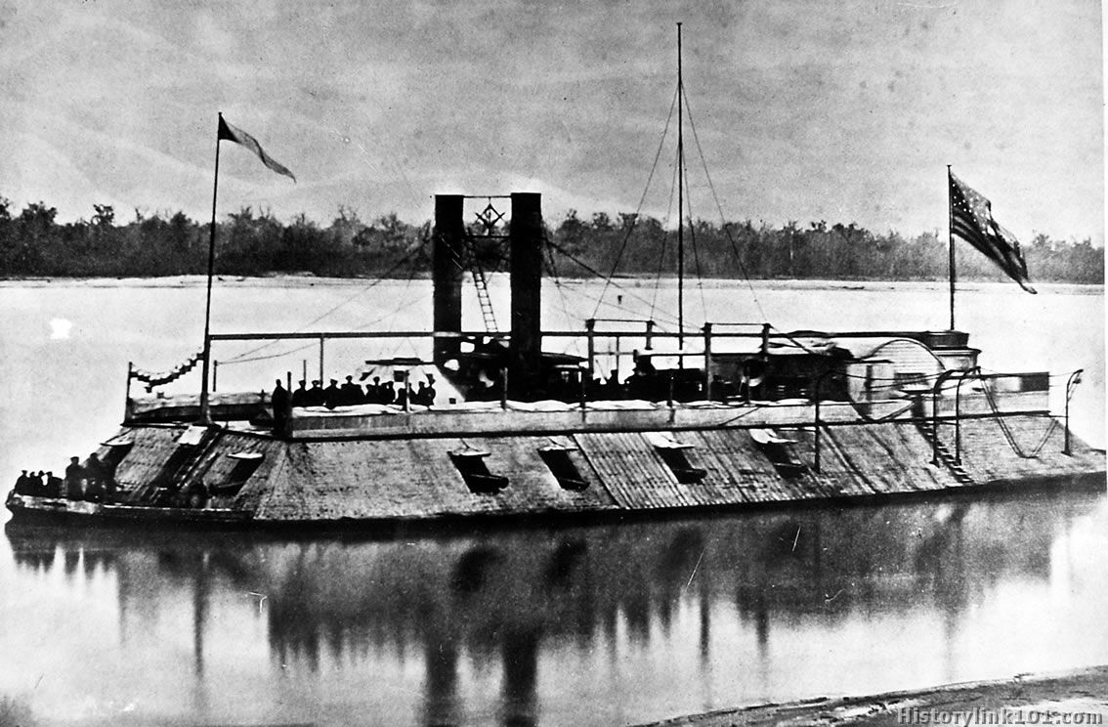
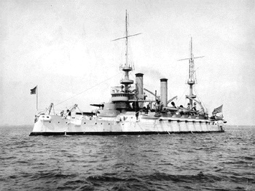
America’s Limited but Aggressive Push Outwards
At the end of the Civil War the U.S. had very little ability to have strong international diplomacy
The U.S. only had 24 diplomats that had gotten their jobs through bribes
Foreign expansion needed a strong military presence, especially a Navy.
  After the Civil War, the U.S. was in no position to maintain a Navy.
  As late as 1890 a majority of Naval vessels were classified “Old Navy” – a mixture of Iron hulled and wholly wooden ships
  There were only 13 all steel, triple hulled, steam engine ships in service by 1890

Slide 4
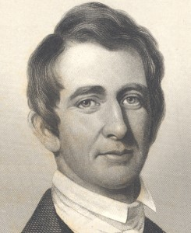
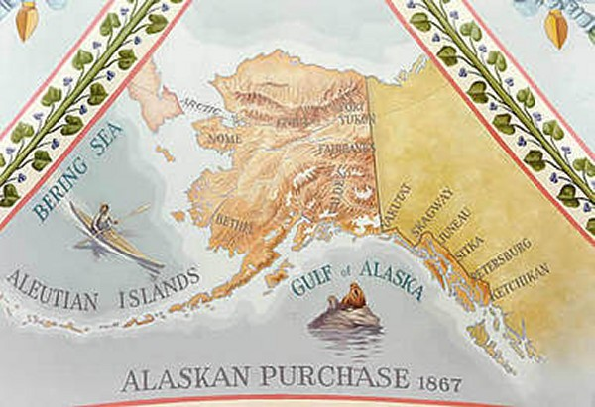
William Seward, (Secretary of State 1861 – 1869) tried to expand American political and social influence in both Asia and Latin America:
A treaty with Nicaragua set the course for the eventual building of the Panama Canal
He also pushed through the annexation of Midway Islands in the Pacific Ocean, giving the U.S. an easy path to Asia
He often spoke of his desire to obtain British Colombia, the Hawaiian Islands, parts of the Dominican Republic, Cuba; explaining that this would give the U.S. “Control of the World.”
His most notable expansion happened in 1867 when he purchased Alaska from Russia for $7.2 million.
Critics called this “Seward’s Folly.”
When gold and other minerals were found however, people changed their tune.

Slide 5
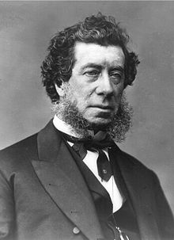
Seward’s successor, Hamilton Fish, (1869 – 1877) spent most of his time settling international disputes about American interests
The Alabama Claims:
A U.S. Senator claimed that Confederate forces won strategic battles because they had the help of a British cruiser, and he demanded $2 billion in reparations….or you know, Canada.
A joint commission representing both countries settled on a $15 million payment instead.

Slide 6
Business, Religious, and Social Interests set the Stage for Empire
Industrialists wanted empire because it gave them more access to international markets for exports and better deals on raw materials
Progressives, Social Reformers, and Religious leaders wanted to expand democratic and Christian influences abroad – Many believed in the idea of Social Darwinism – or the idea that intelligence was based on Race and that they “owed” the “less evolved” populations their social uplift.
This was called The White Man’s Burden by Rudyard Kipling.

Slide 7
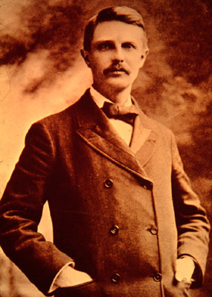
Frederick Jackson Turner
The Frontier Thesis: American democracy was formed by the American Frontier. “American energy will continually demand a wider field for its exercise.”
There was no more room for this to happen domestically, but, the outlet could instead be the world.
These new areas would also provide areas for population growth, either as settlers or as a place for immigrants.

Slide 8
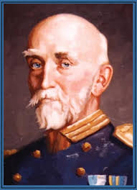
The Plan for Empire
While he was Assistant Secretary of the Navy, Theodore Roosevelt wanted to expand the U.S. Navy to help expand American influence around the world.
Alfred Thayer Mahan wrote The Influence of Seapower upon History. He made 3 suggestions
1. Government had to build a stronger, more powerful Navy
2. There needed to be a series of Naval Bases to fuel this flee
3. Create a canal across Central America that would reduce the time and power
required to move the Navy from the Atlantic to the Pacific.
By 1898 the navy had increased to 160 vessels (114 new steel ones) and the U.S. had become the 3rd most powerful navy in the world.
Midway and other islands in the pacific were added to U.S. territory and provided more coaling stations Mahan had wanted.

Slide 9
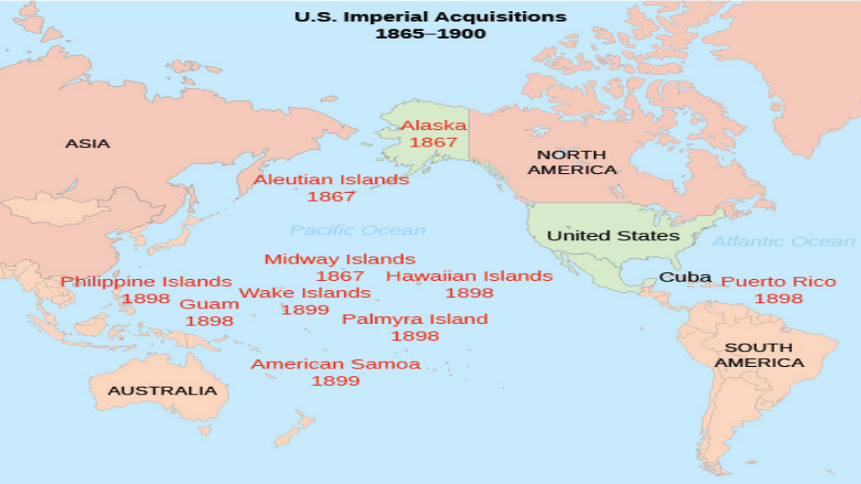

Slide 10
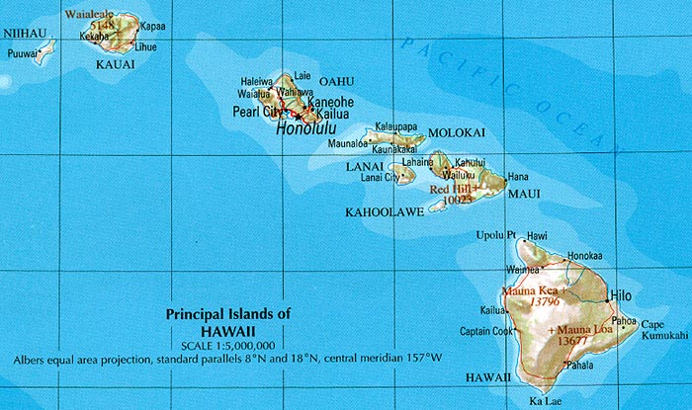
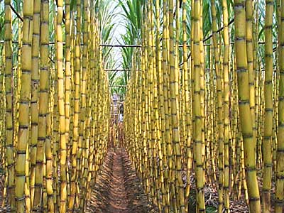
Hawaii becomes a republic
1790s Hawaii is a port on the way to China and East India
1820s Americans established sugarcane plantations
By the 1850s sugar plantations account for 75% of Hawaii’s wealth

Slide 11
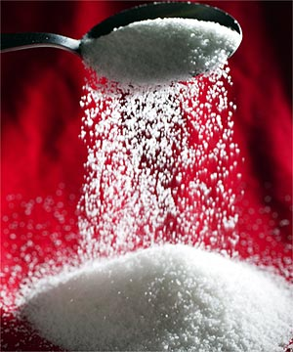
1890s McKinley Tariff Act eliminated tariffs on all sugar now entering the U.S.
Hawaiian sugar is cheaper now than sugar coming from elsewhere
Business leaders start to push for annexation
This is the adding of territory to the U.S.
If they become part of the U.S. sugar can be sold for an extra $.02/lb

Slide 12
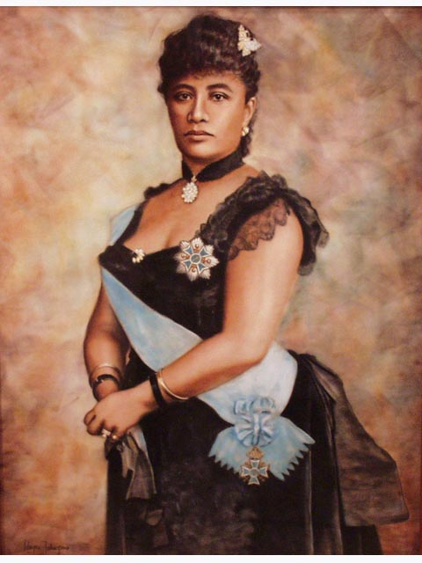
Queen Liliuokalani
1893 she called for a new constitution that would increase her power and restore the political power of Hawaiians
1893 – she is overthrown by U.S. businessmen

Slide 13
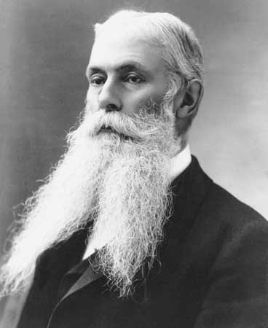
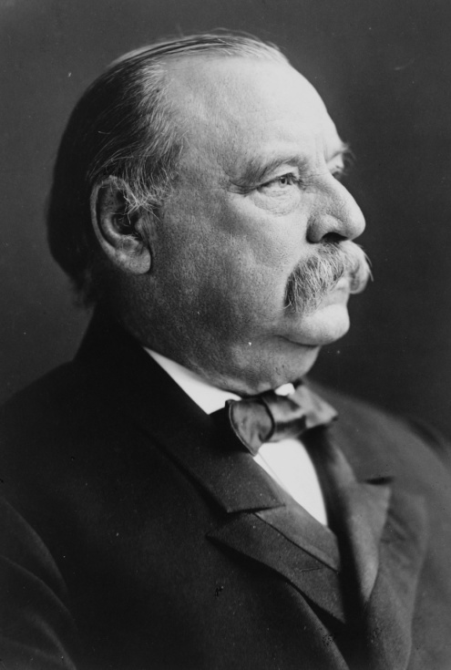
1894 Sanford B. Dole (pineapples) was named president of the new Republic of Hawaii
Asked U.S. to annex it but President Cleveland said no
U.S. annexed Hawaii in 1898
The U.S. had similar strategic interests in the Samoan Islands in the South Pacific and joined a 3 part protectorate with GB and Germany over the Samoan Islands assuring access to strategic ports located there.

Slide 14
The Spanish American War and Overseas Empire
Chapter 22 Section 2

Slide 15
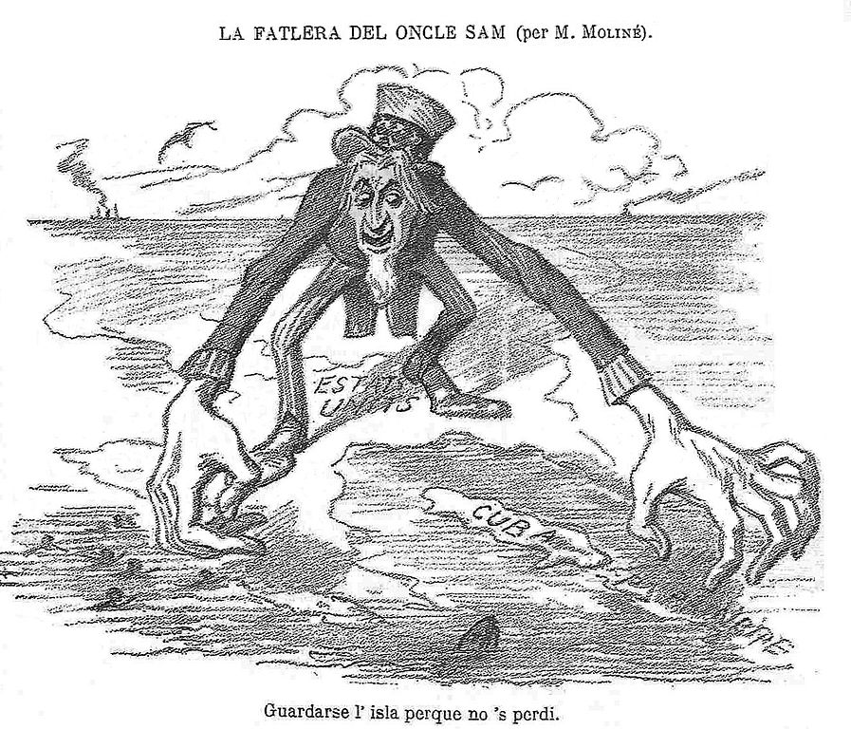
This is the first significant international conflict since the war with Mexico in 1846 and it will greatly alter the balance of power in the world

Slide 16
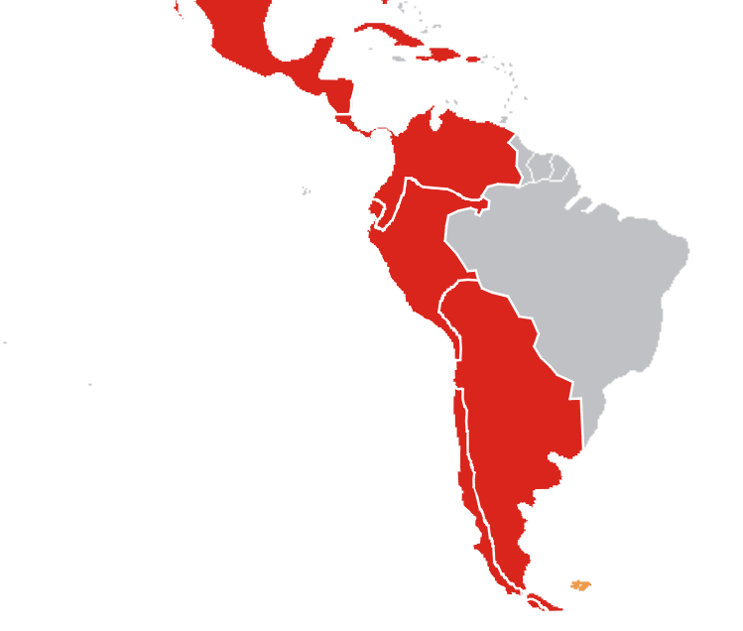
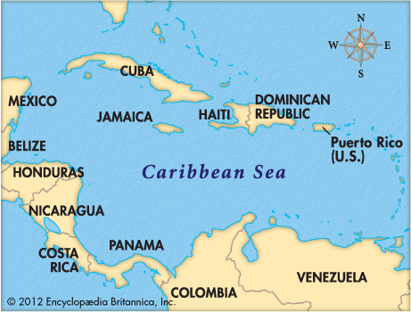
The Spanish-American War
Had less to do with US/Spanish foreign affairs and more to do with Cuba and other Spanish possessions.
Historically, Spain controlled a large part of South America.
But, by 1890 only Cuba and Puerto Rico remained colonies.
Cuba Libre fighters had been trying to win independence for years

Slide 17
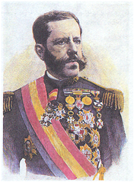
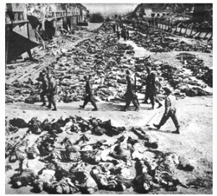
In 1895 General Valeriano Weyler (The Butcher) puts down an insurrection and forced the rebels into military re-concentration camps in the cities. Many of the rebels died in these harsh conditions.
Most Americans were sympathetic to Cuba because of Spanish brutality. Others (Planters/Shippers) wanted America to get involved because they wanted to protect their financial interests.
Cuba Libre (Founded by Jose Marti) set up an office in New York City and that also stirred American interest.

Slide 18
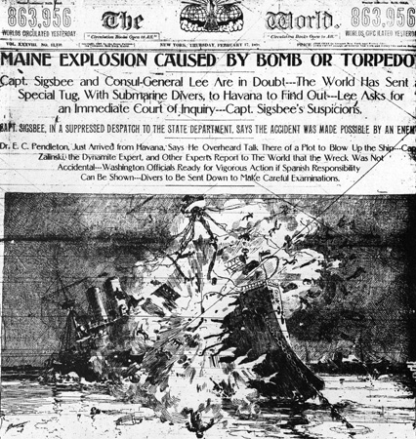
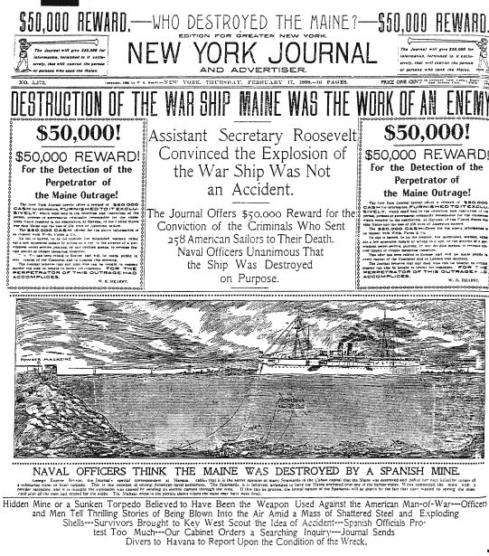
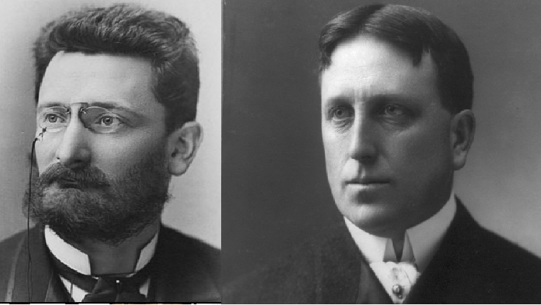
Yellow Journalism
Major U.S. newspapers competed for readership by using the most sensational stories they could
The NY Journal led by William Randolph Hearst
The NY World led by Joseph Pulitzer

Slide 19
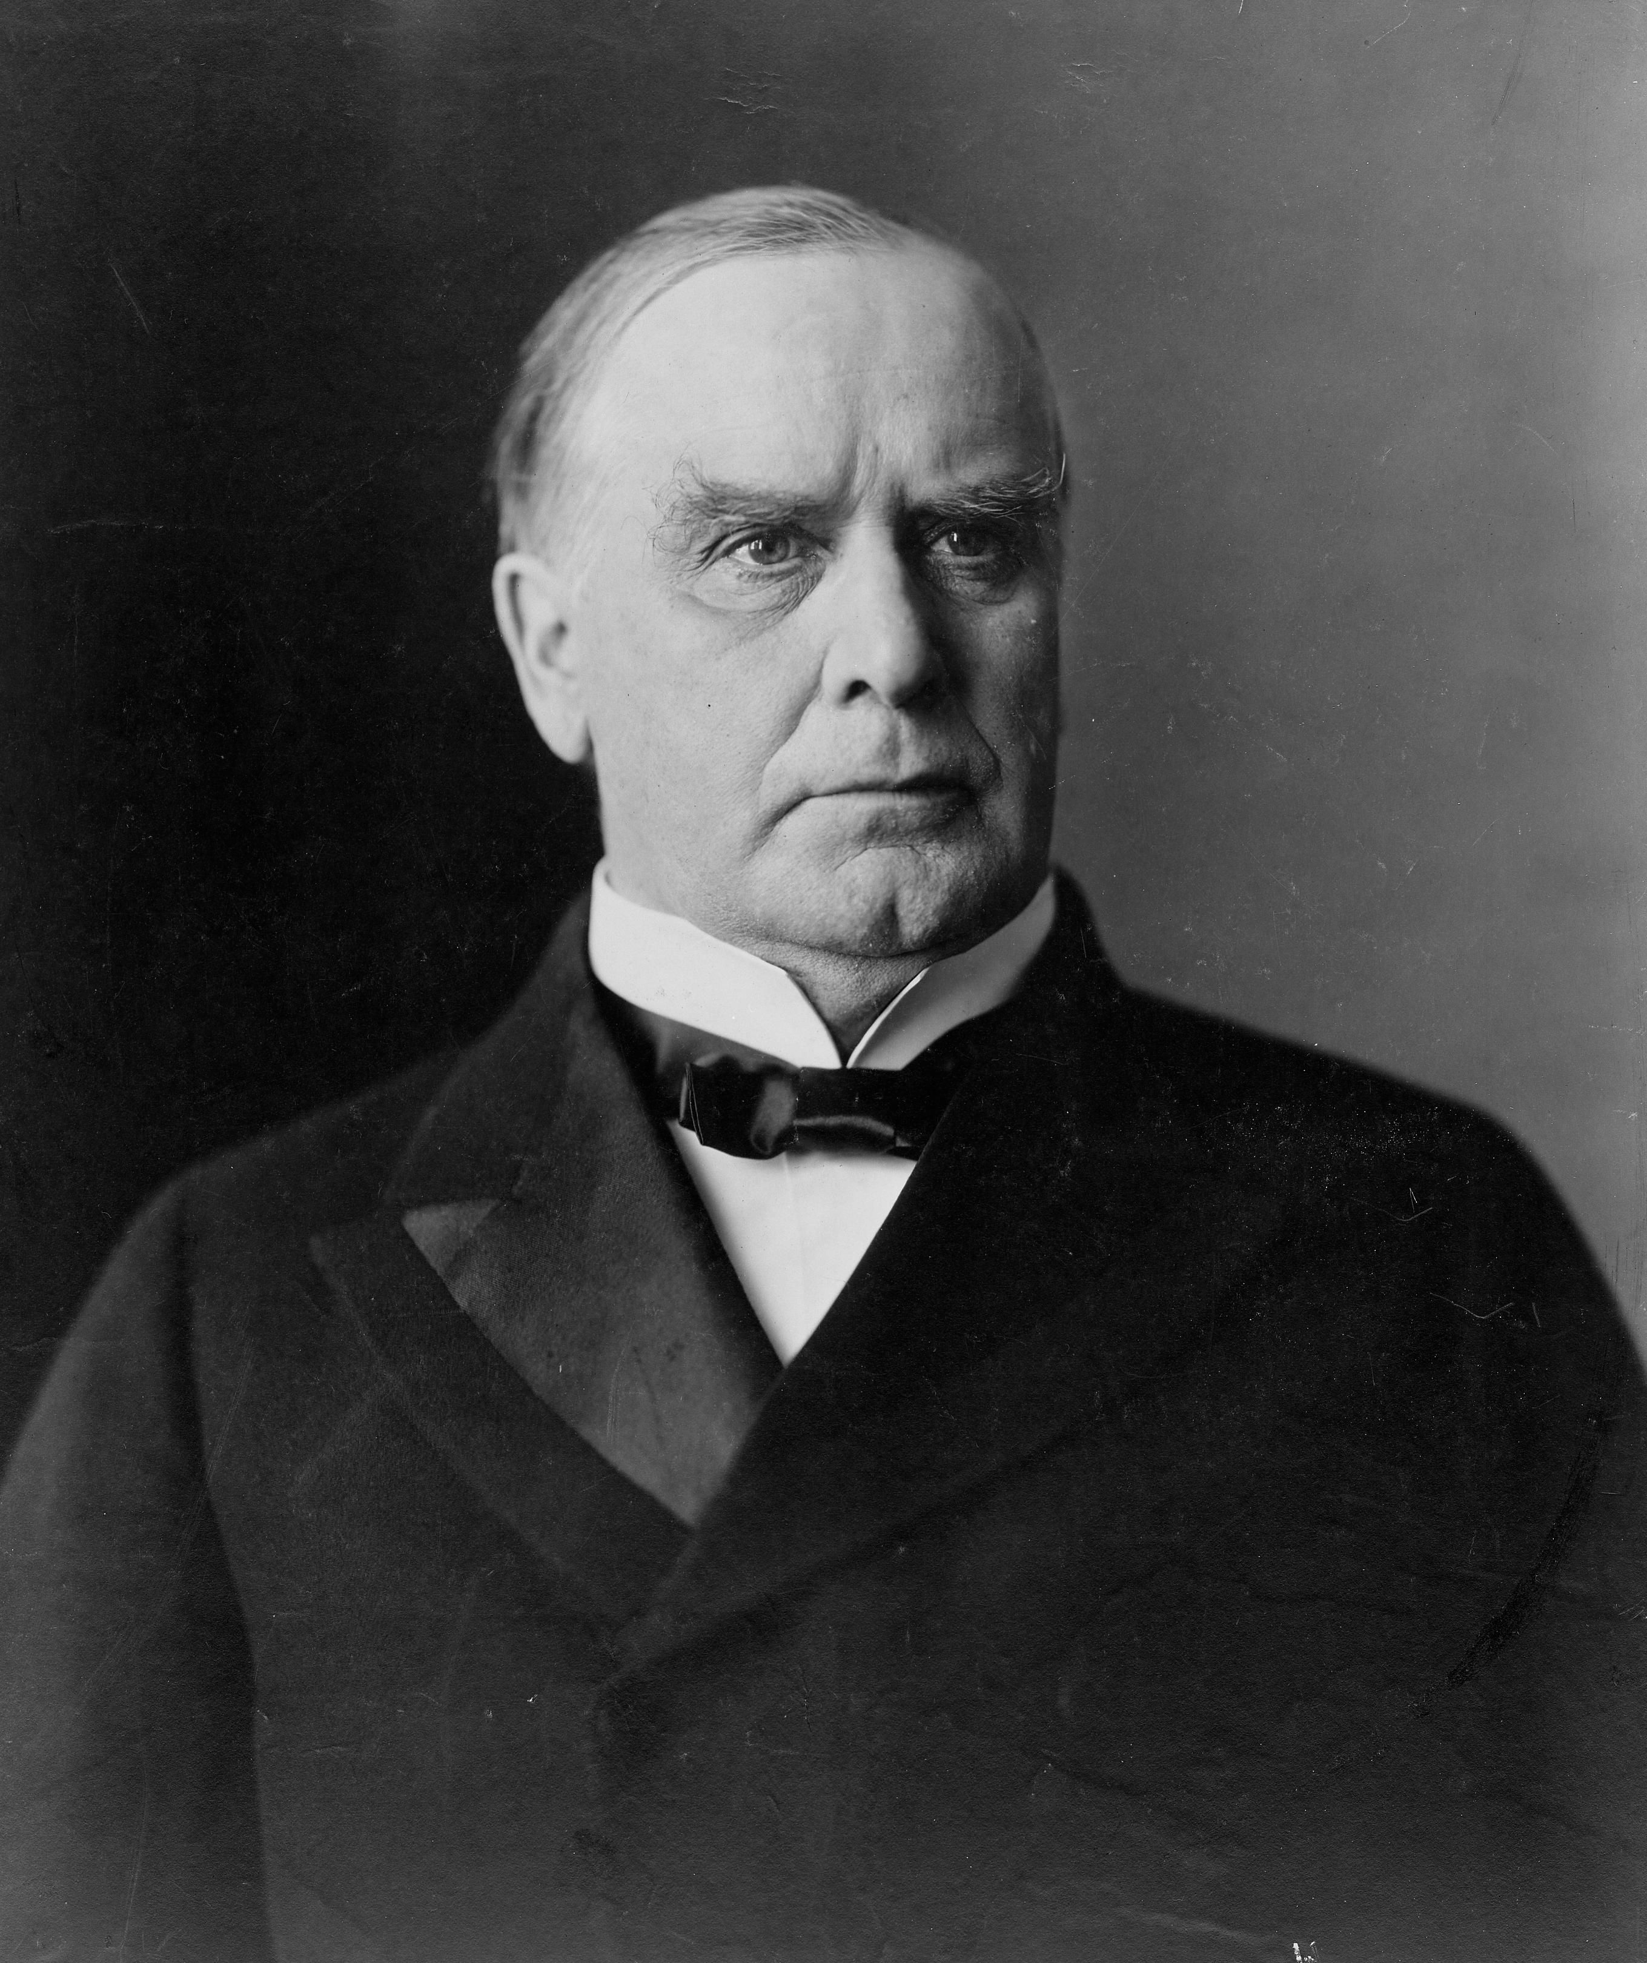
President McKinley didn’t see the war with Spain as a good idea. He knew the U.S. troops and Navy were mostly untested.
Also, he was running for re election.
He did publicly speak out against Spain’s treatment of the rebels and urged Spain to find a peaceful solution in Cuba

Slide 20
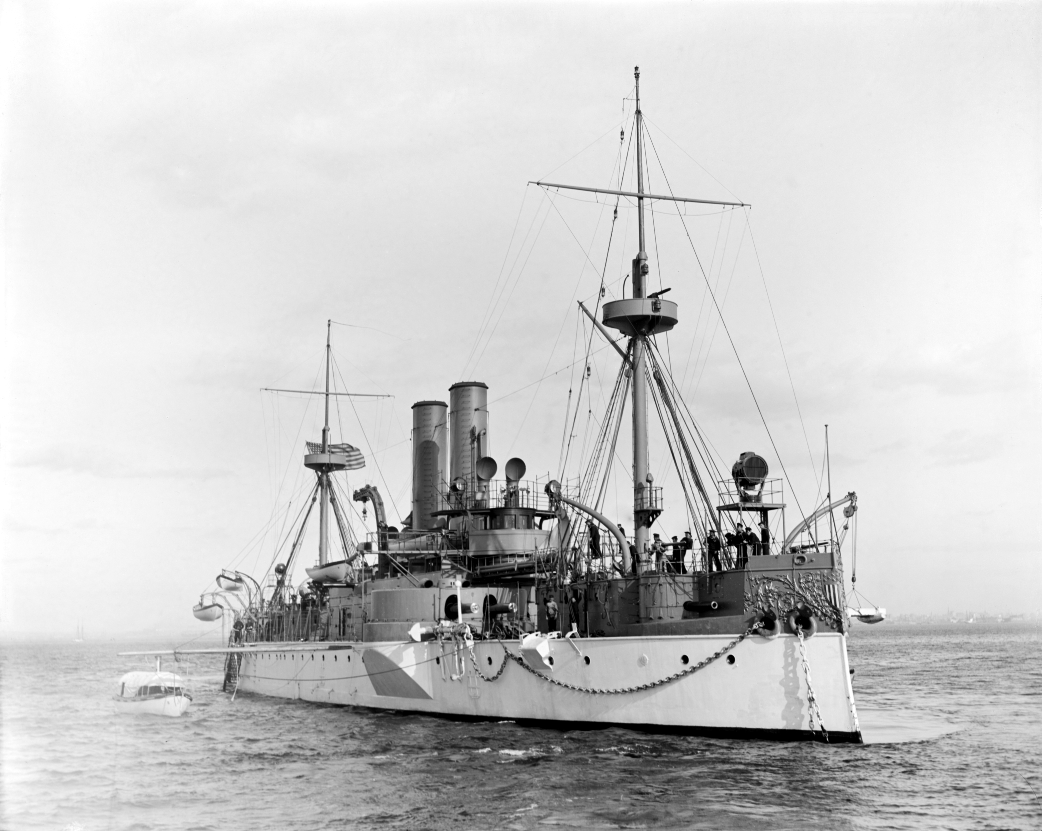
This all changed in February 1898 when McKinley ordered the USS Maine to anchor off the coast of Cuba to observe and prepare for evacuations

Slide 21
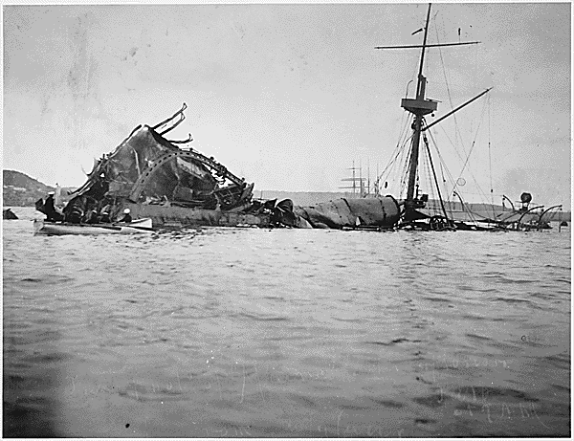
Remember the Maine!!
On February 15th an explosion destroyed the Maine and more than 250 American Sailors died.
Yellow Journalists quickly jumped on the headline that the explosion was caused by a Spanish Attack and all Americans should rally to war.
Americans rallied to the cry for War.
Modern evidence suggests the Maine was probably destroyed by her powder kegs being stored too close to the hot boilers.

Slide 22
McKinley tried one more time to avoid war, asking the Spanish to stop with the reconcentrado and to give Cuba their independence.
Spain refused.

Slide 23
On April 19, 1898 Congress officially recognized Cuban independence and authorized McKinley to use military force to remove Spain from the island.

Slide 24
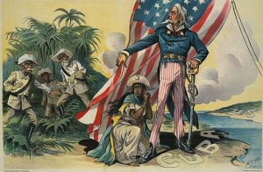
At the same time, Congress passed the Teller Amendment to the War Resolution. This said that the U.S. would not annex Cuba after the war.

Slide 25
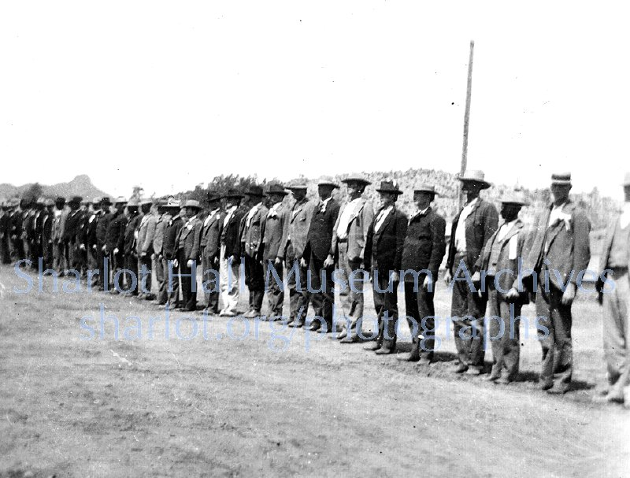
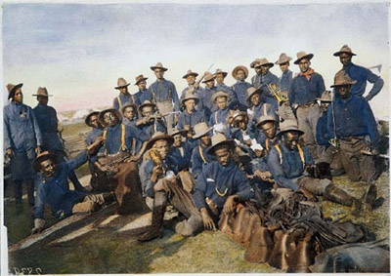
The US had fewer than 30,000 soldiers and sailors.
However over a million men without uniforms and supplying their own guns showed up to volunteer.
Almost 10,000 African American men also volunteered. They were segregated and faced violence but they still agreed to fight for the United States.

Slide 26
The Spanish saw this as a war for Cuba, the United States however saw it as a war for empire.
They wanted to further Mahan’s strategy for Pacific sea bases.

Slide 27
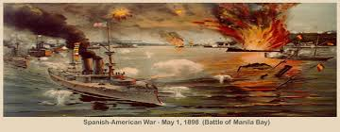
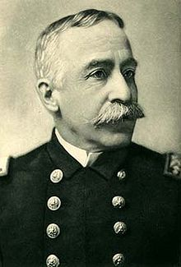
Roosevelt ordered navy ships to attack the Spanish fleet in the Philippines.
The fleet was led by Commodore George Dewey and it was a decisive victory.
They sank all of the Spanish ships and the Americans took almost no losses.
By mid-August 1898 a U.S. Army force landed to take the islands from Spanish control.

Slide 28
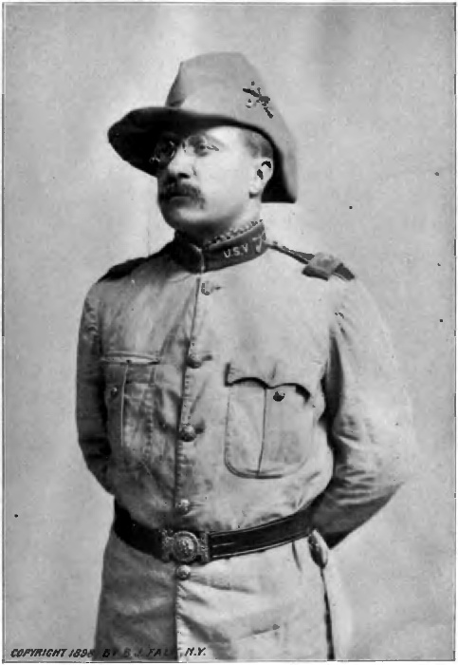
Theodore Roosevelt left his post as Assistant Secretary of the Navy to volunteer as a lieutenant colonel in the U.S. Cavalry in Cuba.

Slide 29
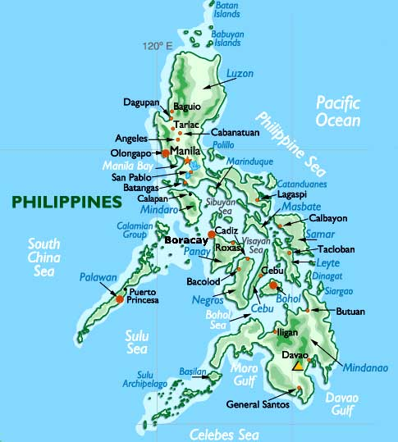
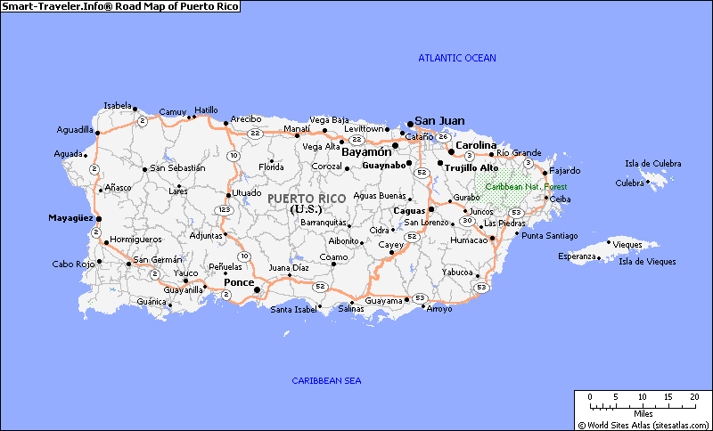
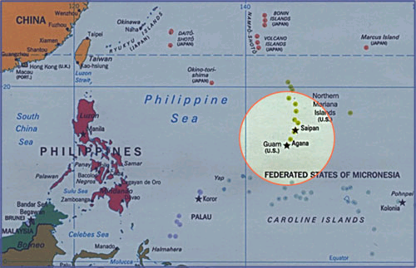
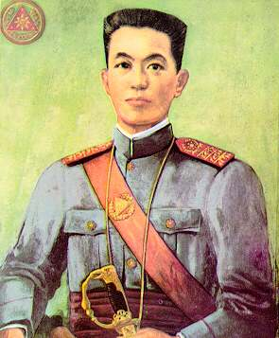
United States Imperialism in the Pacific Islands
The Philippines change hands
The United States got the Philippines, Puerto Rico, and Guam after the Spanish-American War in 1898
Emilio Aguinaldo claimed that the U.S. had promised immediate independence

Slide 30
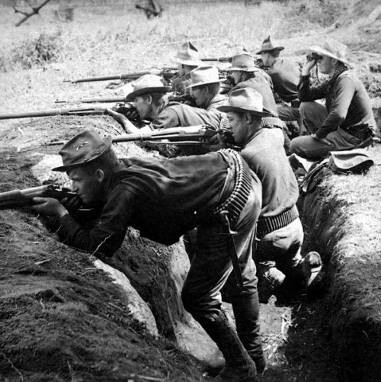
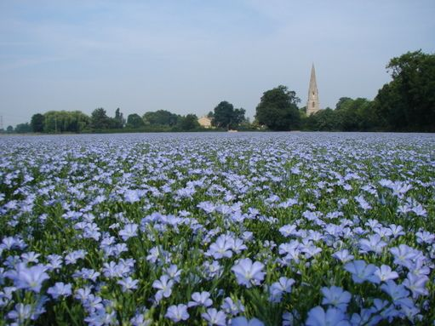
Declared independence and established the Philippine Republic
U.S. defeated the Filipino nationalists in 1902 then promised to prepare them for self-rule
Built roads, railroads, hospitals, and schools BUT they encouraged cash crops and that led to famine

Slide 31
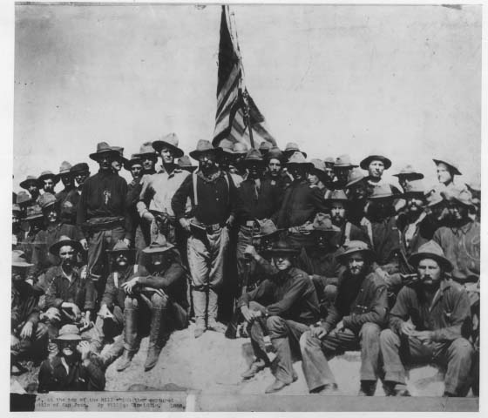
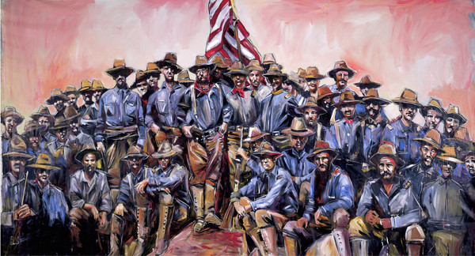
Victory in Cuba
In June of 1898, 17,000 American troops landed in Cuba.
July 1898 – fierce fighting near Santiago. Teddy Roosevelt led the Rough Riders up Kettle Hill (near San Juan Hill) and surrounded Santiago.
The Rough Riders were a voluntary cavalry unit made up of adventure-seeking college graduates (many of whom were friends with Roosevelt) veterans, and cowboys from the southwest.

Slide 32
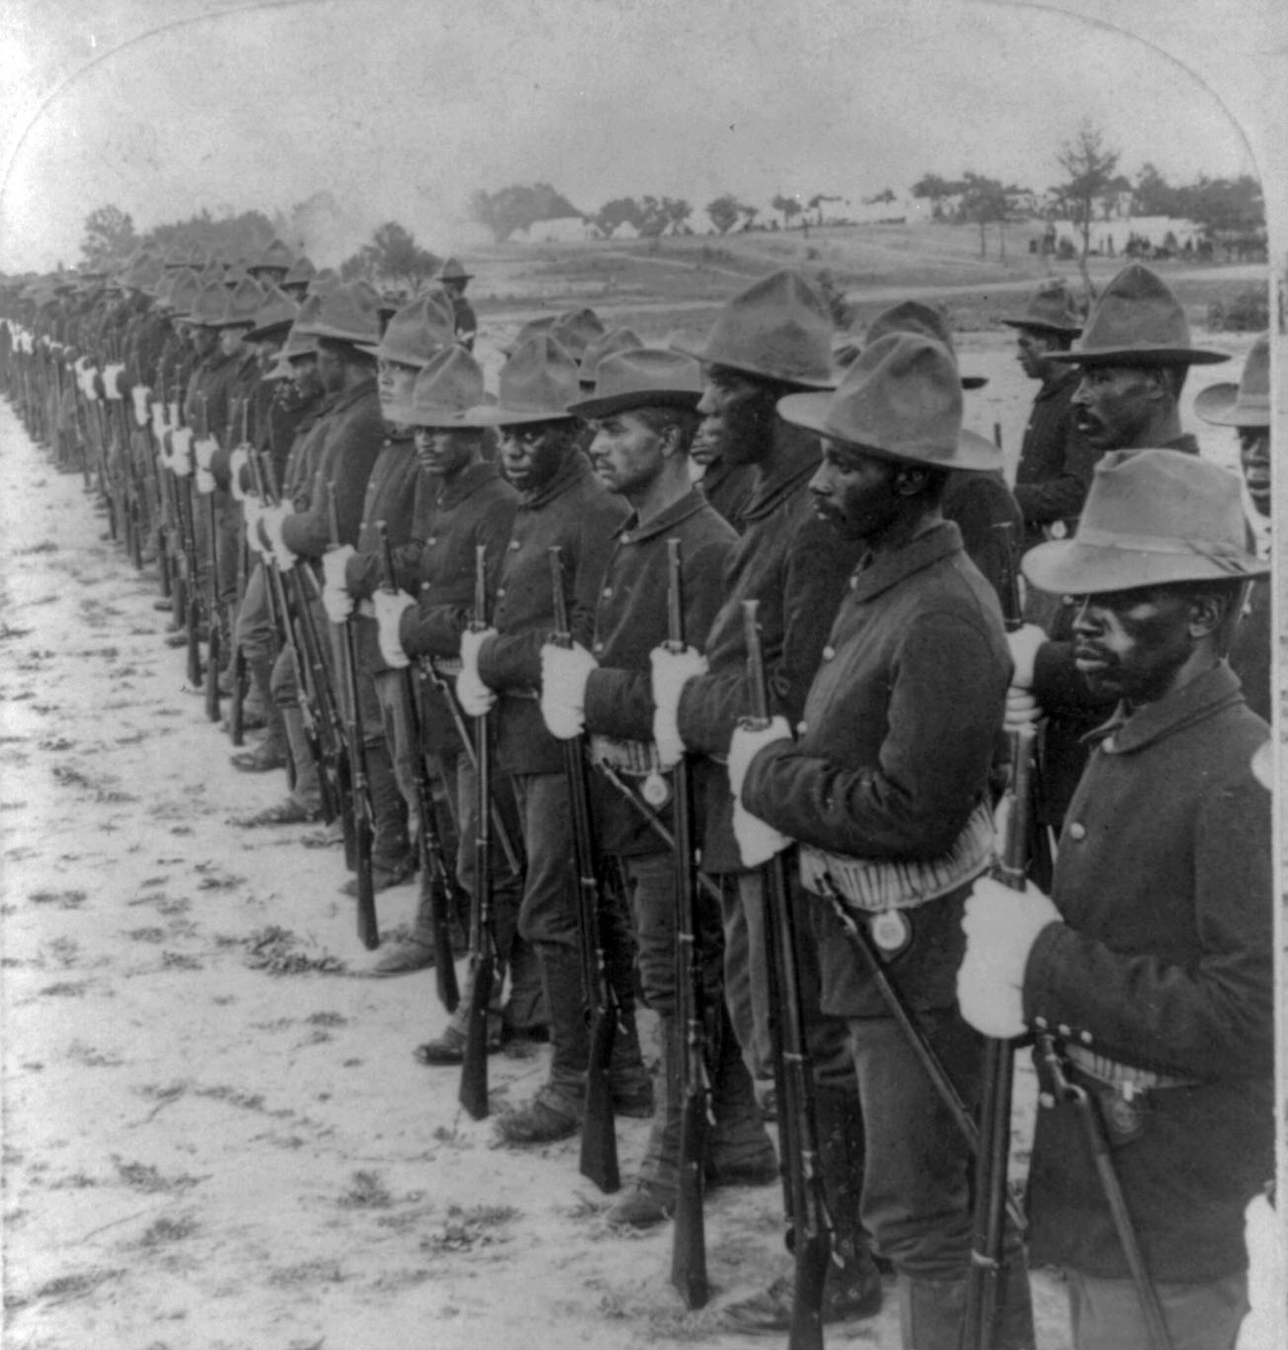
While the charge of the Rough Riders is probably the best known of the battles, their victories wouldn’t have been possible without the help of several veteran African American regiments.

Slide 33
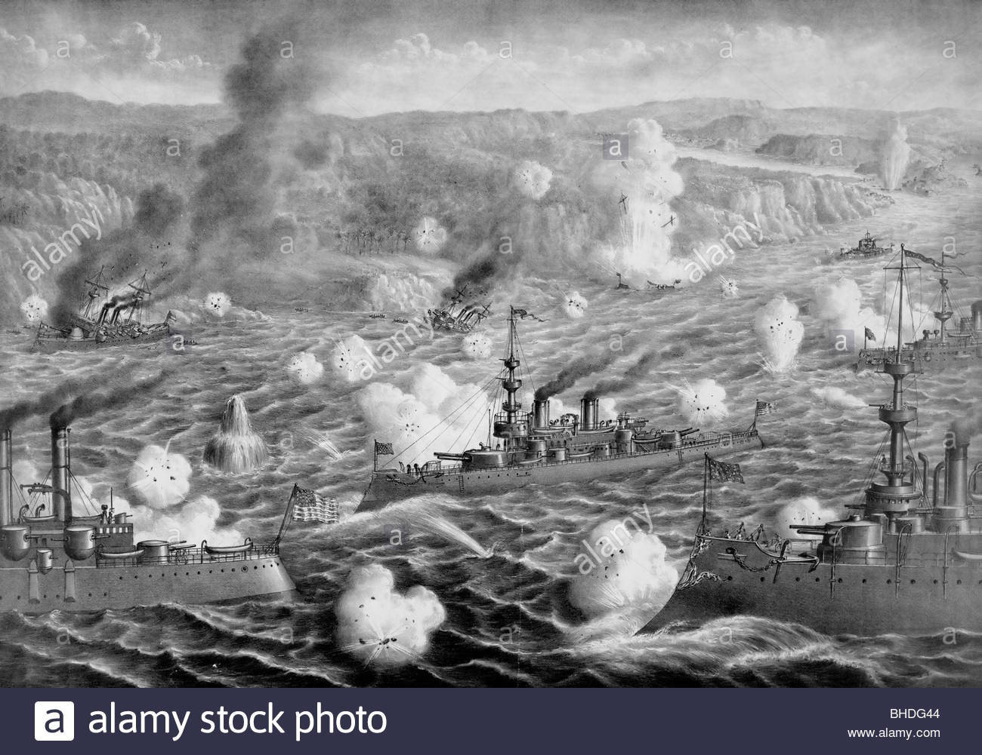
When the Spanish fleet tried to escape to the sea they ran into a American naval blockade that resulted in their total destruction and the sinking of every ship. Now, without a navy, Spain lost Puerto Rico as well

Slide 34
The War was very short, but also very significant to Americans that felt it was a reconciliation of the North and South.
Casualties: Most of the casualties of the war didn’t come from fighting, but from the diseases Malaria and Yellow Fever.
American casualties:
Total servicemembers | 306,760
Battle deaths | 385
Other deaths in service (nontheater) (Disease) | 2,061
Nonmortal woundings | 1,662

Slide 35
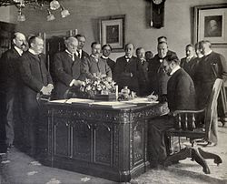
October 1898 – Spanish and American diplomats meet in Paris to work out the peace.
The Spanish were committed to getting the Philippines back. (Neither the U.S. nor Spain considered Filipino independence, mostly because of racism

Slide 36
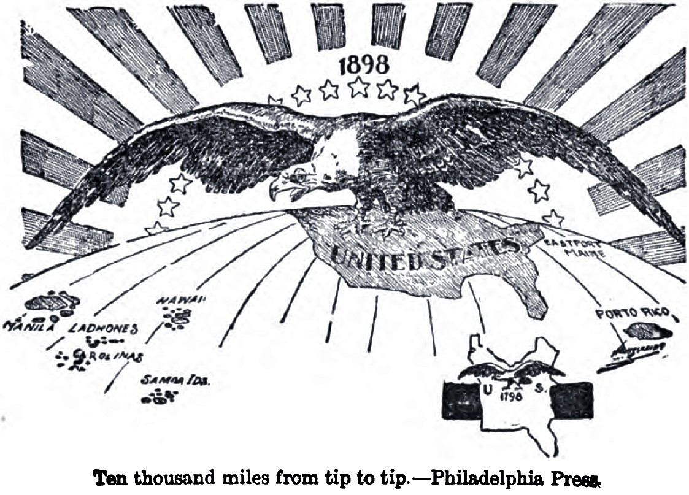
The Treaty of Paris was signed on December 10. 1898:
Spain recognized Cuban independence, and American control of Puerto Rico and Guam
McKinley insisted, and got, control of the Philippines as an annexation in return for a $20 million payment to the Spanish.
Most importantly however, the U.S. is recognized as an empire

Slide 37
At home, not all Americas supported the treaty or the idea of an American empire.
Many prominent Americans got together and created the Anti-Imperialism League in 1898 to oppose U.S. expansion.
Some felt that empire building went against democracy, some worried about competition from workers. Others felt that assimilation of other races would hurt the country.

Slide 38
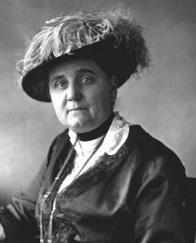
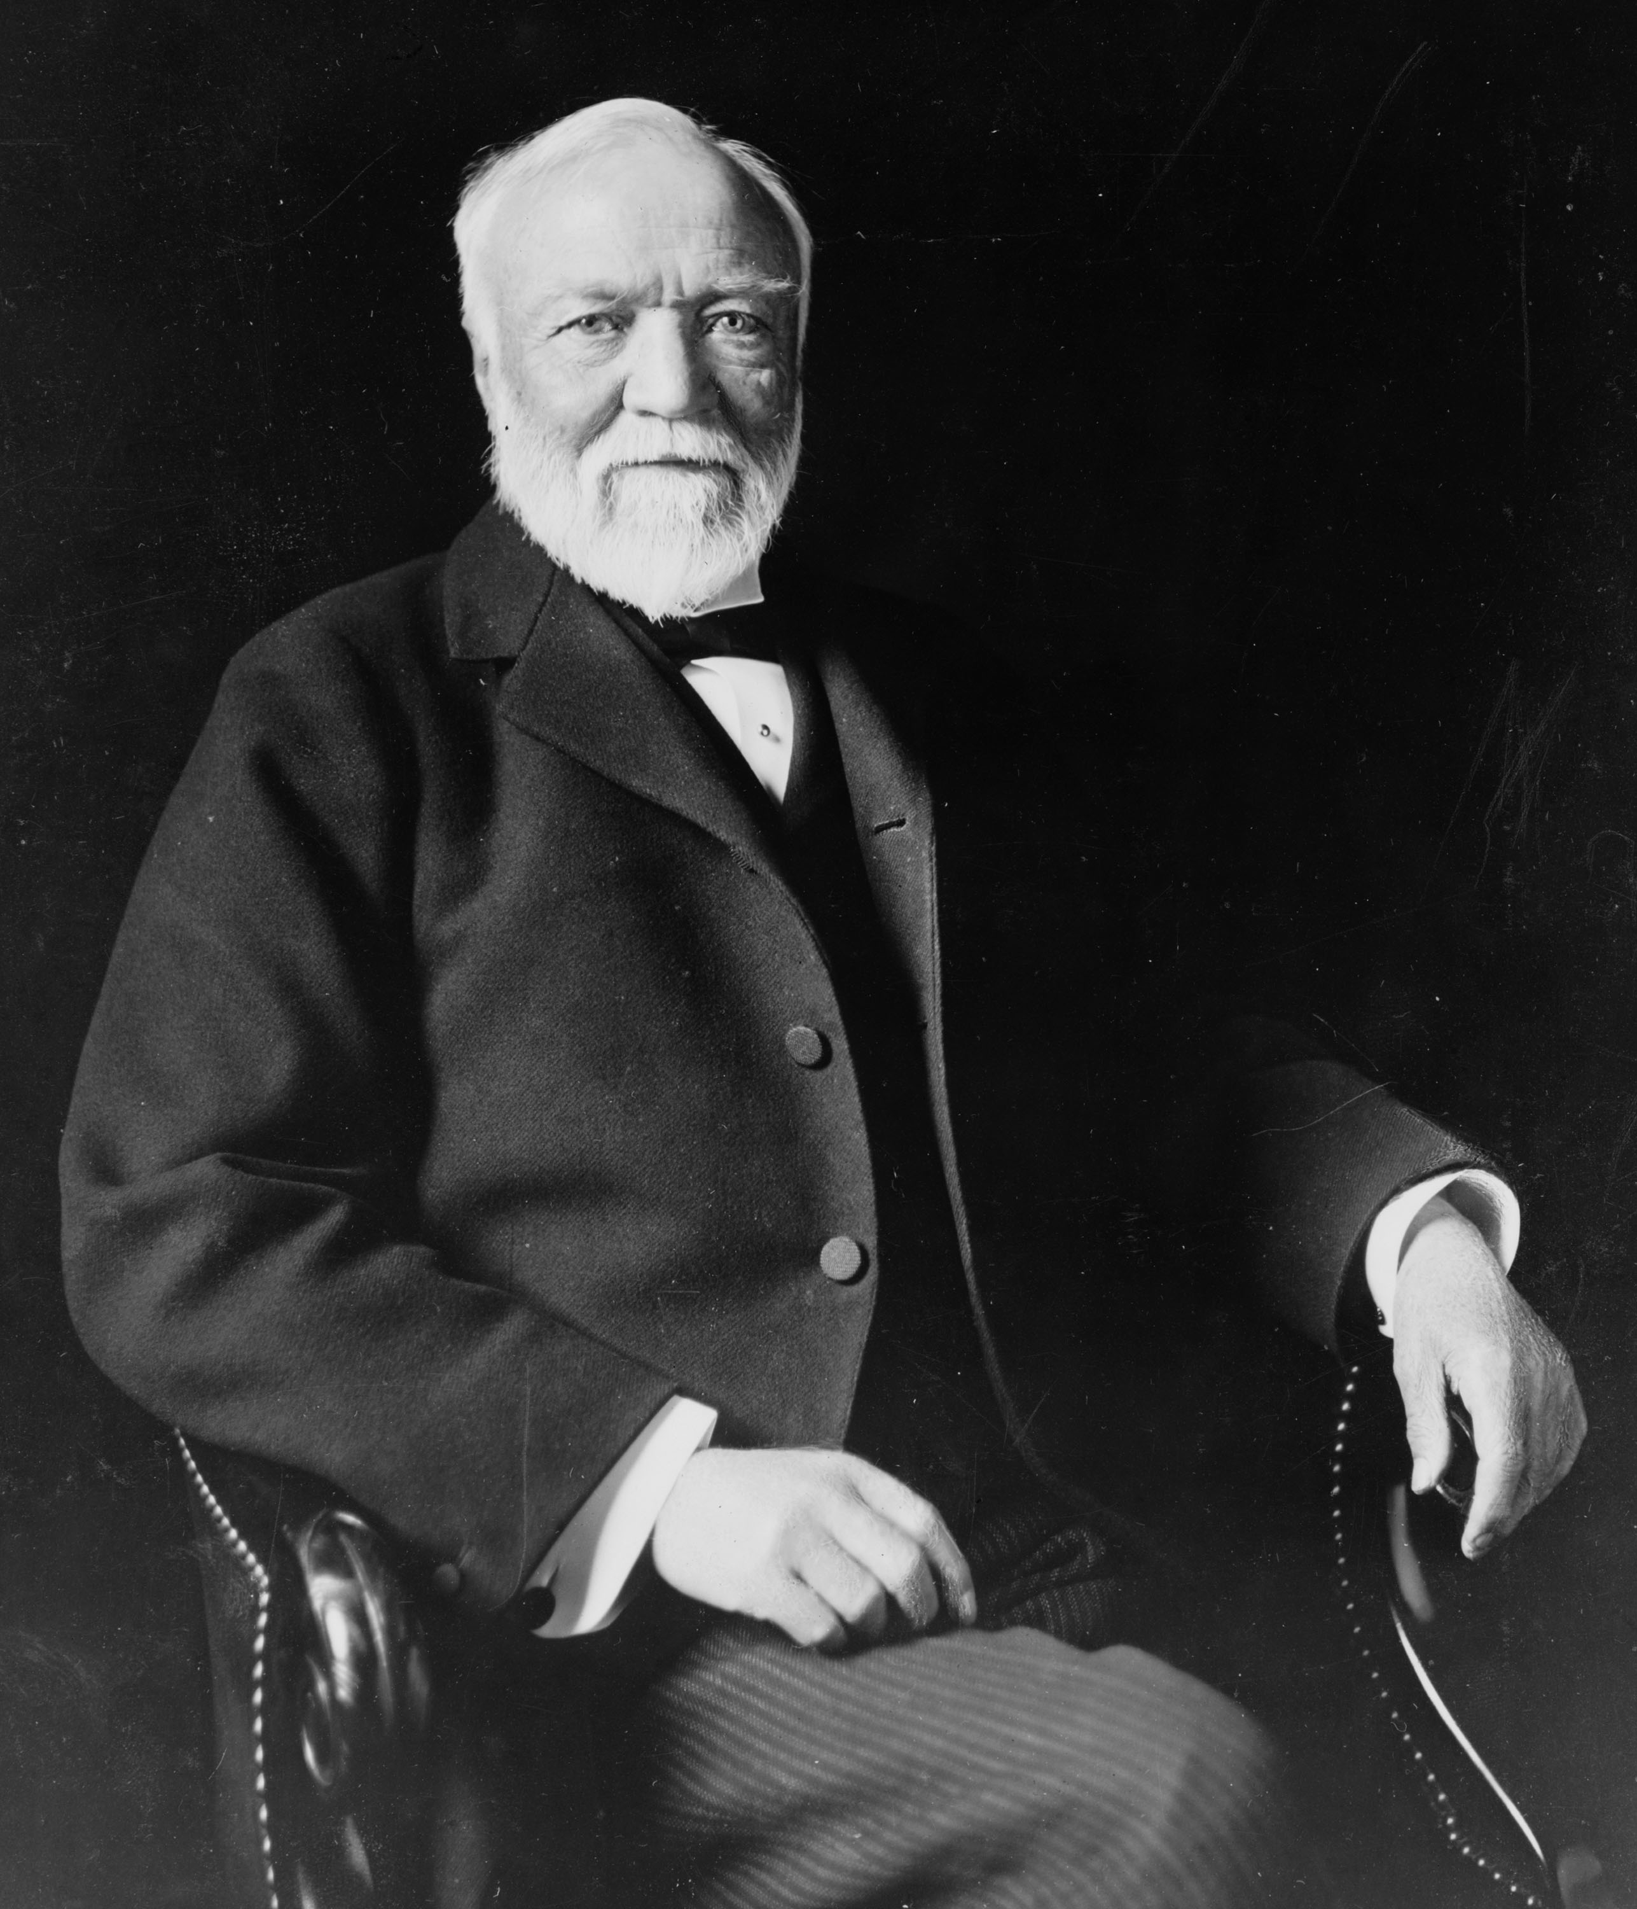
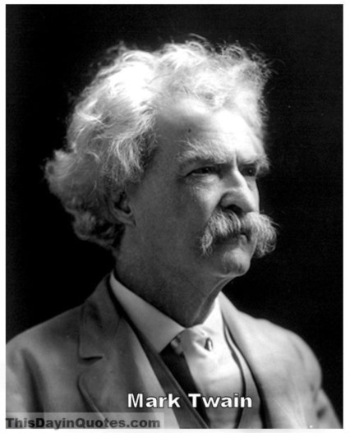
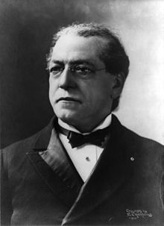
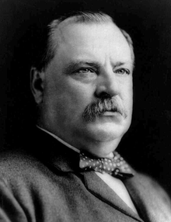
Mark Twain
Samuel Gompers
Grover Cleveland
Andrew Carnegie
Jane Addams

Slide 39
Treaties require a 2/3 majority in congress and the Anti-Imperialist League was causing trouble.
Many people in the US didn’t support the idea of an empire anyway.

Slide 40
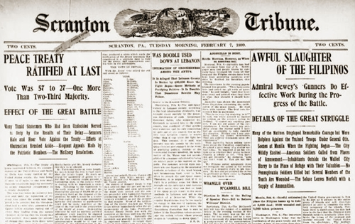
A Filipino uprising about a week before the vote, however, was the push that the undecided senators needed.
They were now convinced that that they needed an American presence in the Philippines to keep another European power out of the area.
It was formally ratified on February 6, 1898

Slide 41
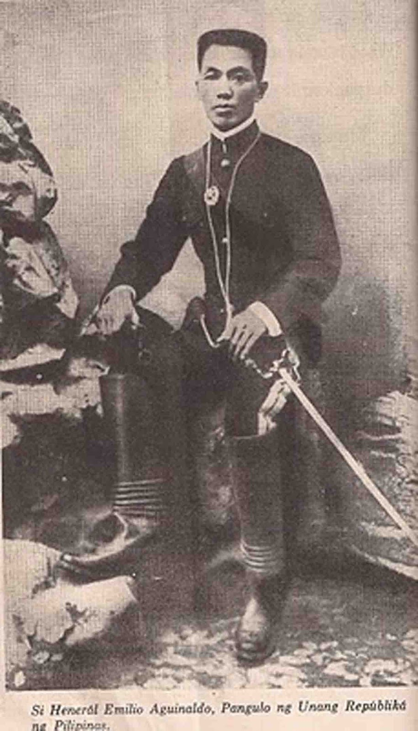

Filipino rebels led by Emilio Aguinaldo led Filipino rebels for three years.
This war for independence cost over 4000 American lives and over 20,000 Filipino combatants.
Estimates of civilian casualties are as high as 25,000

Slide 42

In 1901 President McKinley appointed Taft
as civil governor of the Philippines to try to keep the US military and Filipino civilians from direct confrontation.

Slide 43


Under Taft, the US Built roads, railroads, hospitals, and schools.
The Taft Commission continued to modernize and improve daily life for the country, but there was fighting until 1902.
Much of the commission’s rule dealt with legislative reforms to local government and national agencies.
They offered jobs to resistance leaders in exchange for their support.
The Philippines will stay under US control until 1946 when they gain their independence.

Slide 44


The US now continued to add territory.
Hawaii – became a territory in 1902
Alaska – became a territory in 1912
The Foraker Act of 1900 established Puerto Rico as a territory (Puerto Ricans got citizenship in 1917)

Slide 45

Guam and Samoa were under the control of the US Navy.
Cuba adopted a Constitution based on the US Constitution
Though the Teller amendment had forbidden the US from annexing Cuba, the Platt Amendment guaranteed the US a naval base and coaling station at Guantanamo Bay.
It also prohibited Cuba from making treaties with other countries that could threaten its independence.
Finally the Platt amendment allowed the US to interfere in Cuban affairs if threats to a stable government arose

Slide 46
Economic Imperialism in East Asia
22.3

Slide 47
China:
Many countries including the US wanted to make economic inroads into China.
China had been forced to accept the “Open Door Policy” after the loss of the Opium Wars (1842-1844) to the British.
The Open Door Policy gave all foreign nations free and equal access to all Chinese ports.

Slide 48

The United States saw how quickly China was being carved into “Sphere’s of Influence” and they decided to intervene.
However, US businesses wanted the whole market, not just a piece of it.
With the blessing of John Hay, Secretary of State, several American businessmen created the American Asiatic Association in 1896 to pursue trade opportunities.

Slide 49


Slide 50
The Open Door Notes
All countries agree to maintain free access to al treaty ports in China
All countries agree to pay railroad charges and harbor fees (with no special access)
All countries agree that China would be permitted to collect any taxes on trade within its borders.
While it looked like open access for all, the reality is that the US was producing higher-quality goods at lower prices than anyone else. This would flood the Chinese market with American goods and basically squeeze out any competition.

Slide 51

Many countries sent half hearted replies that didn’t really answer the questions, others flatly denied the policy.
Like that mattered…
Hay declared the notes the new policy on China and unleased American products throughout the nation.
China actually was welcoming of the notes since they stressed aht the US would preserve the Chinese government and territory.

Slide 52

The Boxer Rebellion
The goal was to get rid of all western influence in China (including trade and missionaries)
The US, Great Britain, and Germany sent 2000 troops to withstand the rebellion
These troops symbolized the American commitment to keeping Chinese territory whole
The US will maintain this defense of the Open Door principles throughout WWII.

Slide 53

Roosevelt’s “Big Stick” Foreign Policy

Slide 54

While McKinley used military strength and coercion to expand the American Empire, Roosevelt used a different foreign policy approach: “Speak Softly, and carry a big stick, and you will go far.”
He felt that because the US had been so successful there was no need to use force to reach US goals, as long as the military could threaten force.
He felt that coercive power could be dangerous in the wrong hands, BUT the bests interests of the Western Hemisphere were also the best interests of the United States.

Slide 55


Construction of the Panama Canal

Slide 56


There had been several attempts to build a canal between 1881 – 1894 by France.
Each of these failed because of a combination of money issues and health issues, the worst of which included Yellow Fever and Malaria. France lost 22 thousand workers to disease.

Slide 57

Roosevelt, being Roosevelt, was determined to succeed. He wanted the canal for military reasons but also for trade reasons.
The most strategic point for this canal was across the 50 mile isthmus of Panama (at the time, part of Colombia)

Slide 58
Roosevelt negotiated with Colombia, sometimes threatening to go to a different country instead.
Columbia finally agreed to a treaty that gae the US a lease on the land across panama in exchange for a payment of $10 million, and an annual rent of $250,000

Slide 59

The people of Columbia were unhappy with this so the Columbian senate rejected the treaty.
Roosevelt now told journalists that the US would strongly support a Panamanian revolution against Columbia if that ever happened.
In November of 1903 he sent American battleships on “practice maneuvers” to Columbia when the Panamanians revolted. This blocked Columbian warships from putting down the uprising.

Slide 60
Within a week, Roosevelt recognized Panama’s independence. He then offered them the same terms that he’d offered Columbia: $10 million up front and $250,000 a year rent. They agreed and Panama became a US protectorate until 1939

Slide 61


Slide 62

Construction began in May of 1904.
The U.S. built infrastructure AND put up mosquito netting and fumigation systems to protect workers from Yellow Fever and Malaria.
They built a lock-system canal instead of a sea level canal and workers had to excavate 170+ million cubic yards of earth. To do this they used new rail mounted steam shovels.
Teddy Roosevelt visited, becoming the first sitting president to leave the US while in office, and he eve took a turn on one of the machines.
The canal opened in 1914

Slide 63
The Roosevelt Corollary
This was an addition to the Monroe Doctrine
Roosevelt now wanted to let the world know that the colonization of the Western Hemisphere was over and the interference there by foreign powers wouldn’t be tolerated.
Except interference by the United States…to maintain peace and stability, of course. This made the United States an international police power to correct any “chronic wrongdoings” by anyone who may threaten the stability of the area.

Slide 64

Roosevelt instantly put this to work and made Panama and Cuba protectorates, and managed the Dominican Republic’s custom service monies.
No one liked it, but no one felt that they should risk the reprisals that may come from resistance.
Other president’s after Roosevelt will soften the blow a little by proclaiming a “Good Neighbor Policy” instead, which renounced American intervention in other nations’ affairs.

Slide 65
The Russo-Japanese War
Roosevelt supported the Open Door notes as economic policy, but he did want a stronger military presence in the area that the Open Door notes didn’t provide.
Instead of directly swinging the “big stick” he would try to maintain a balance of power in the area instead.
In 1904 Roosevelt got his chance.

Slide 66

The Russo-Japanese War
In 1904 Russian troops began to build up long the Manchurian border. This was a direct threat to the area.
In response to this, the Japanese launched a surprise naval attack on the Russian fleet and they scored a quick victory
At first Roosevelt supported the Japanese position, but once they won, he became concerned about the growth of Japanese influence in the area.
He felt that it may be a threat to China and American access to Chinese markets.

Slide 67

The Treaty of Portsmouth
In 1905 Roosevelt arranged for diplomats from Japan and Russia to meet at a secret peace conference in Portsmouth, NH.
Japan got: control over Korea, several former Russian bases in Manchuria, and the southern half of Sakhalin Island.
For his efforts at peace, Roosevelt received the Nobel Peace Prize

Slide 68


When Japan decides to force out American business interests from Manchuria in 1906 – 1907.
Roosevelt now decides to wield that Big Stick by sending the U.S. Great White Fleet on maneuvers in the Western Pacific. He said it was a goodwill tour, but the message was clear.

Slide 69
Taft’s Dollar Diplomacy
22.5

Slide 70
When Taft became president in 1909, he chose to adapt Roosevelt’s foreign policy philosophy to one that reflected American economic power at the time.
It became known as Dollar Diplomacy – the decision to substitute dollars for bullets.
This was still a show of force, just economic force instead of military might.

Slide 71

Several Central American countries owed money to various European countries. Taft was afraid that those European countries would use military intervention in the Western Hemisphere.
Taft quickly paid off those debts with U.S. dollars. Of course, now Central America was in debt to the U.S. When Nicaragua refused to accept American loans to pay off it’s debt to Great Britain, Taft sent a warship with marines to pressure the government to agree

Slide 72
The Lodge Corollary – said that no foreign corporation, except ones from the U.S. could obtain strategic land in the Western Hemisphere.
This was in response to Mexico considering allowing a Japanese Corporation into the country.

Slide 73
In Asia, Taft followed the policies of Thodore Roosevelt. He tried to maintain the balance of power in the area. At first, he was very successful working with the Chinese government to further develop the railroad industry with international financing.
However, trying to expand the Open Door policy into Manchuria was met with resistance from both Japan and Russia.
Taft’s policies did create difficulties for the U.S. that continue to today.
Central America’s debt will create economic concerns and create nationalist movements that didn’t want the U.S. there.
In Asia, Taft’s efforts to negotiate between China and Japan only made tensions worse between Japan and the U.S.
It did not create a balance of power, instead it encouraged the Japanese to dig in and strengthen.

Slide 74
Taft’s presidency ends in 1913.
At that time the U.S. is on it’s path towards empire.
The world perceived the U.S. as the major power in the Western Hemisphere – this won’t be challenged until the rise of the Soviet Union during the Cold War
The U.S. had clearly marked its intentions in Asia.
This will all change in 1914 when the “Great War” started and the U.S. is drawn in.

