Slide 1
The Great Depression and the New Deal
Chapter 25 and 26

Slide 2
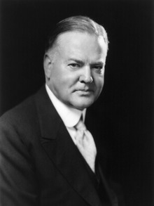
Herbert Hoover Becomes President
In 1928 Herbert Hoover was put up by the Republicans against Alfred Smith (D). Hoover won with 21 million votes and the US continued to prosper.
At least for a while.
Though Hoover had never run for public office he had the backing of the people because the Republican leadership before him had created years of prosperity.

Slide 3
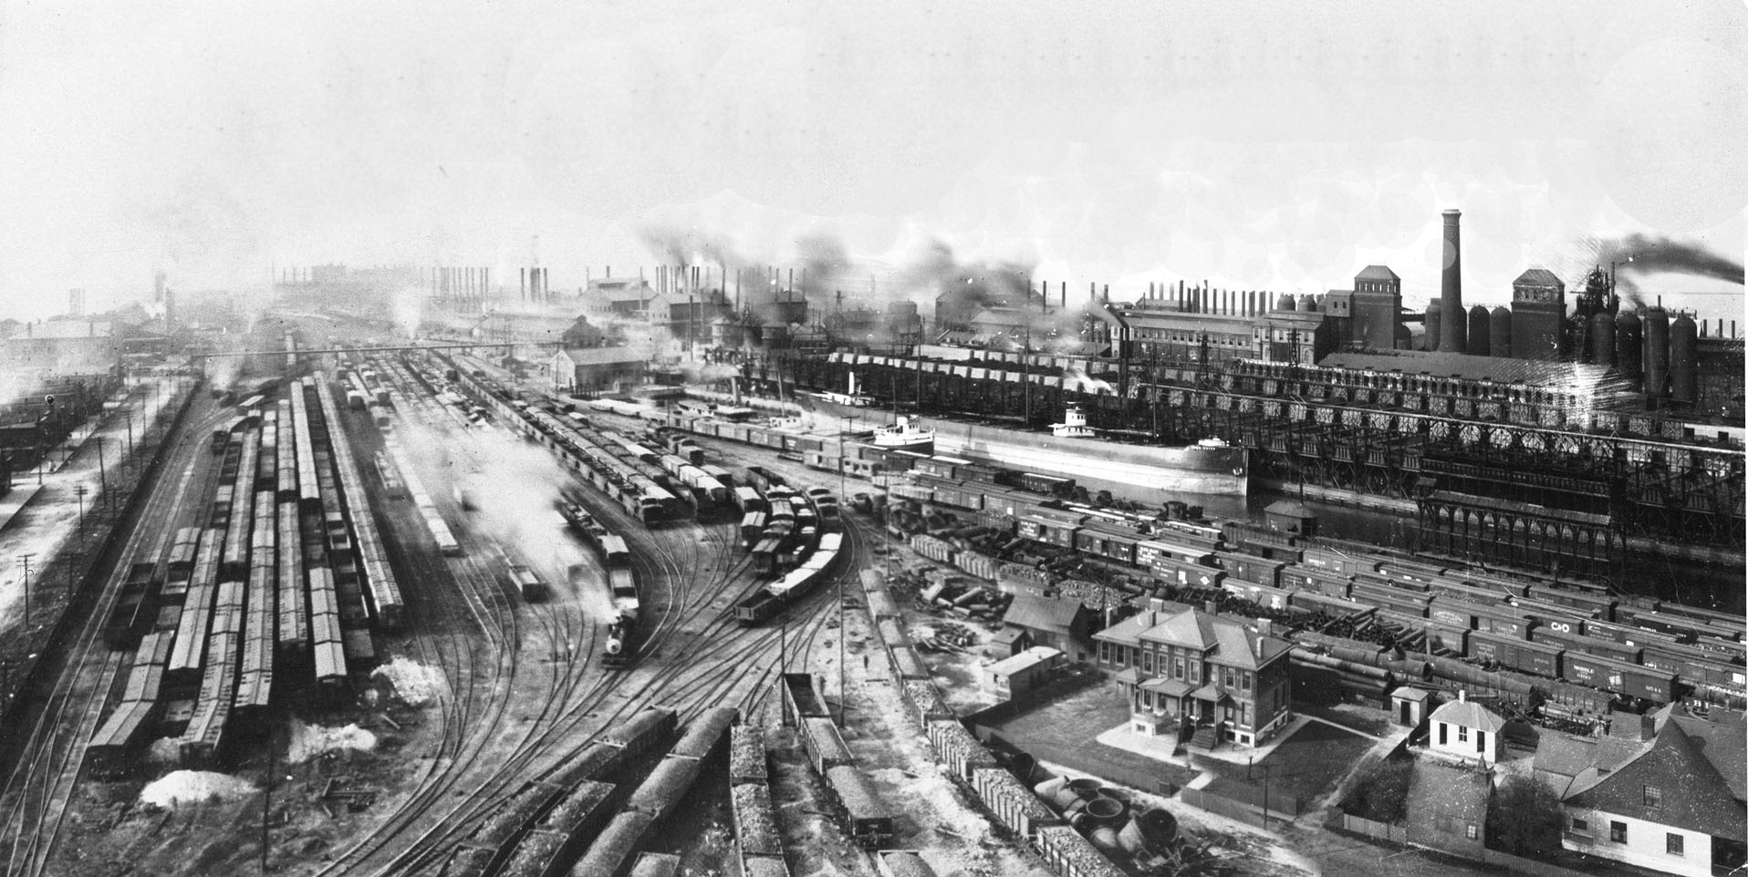
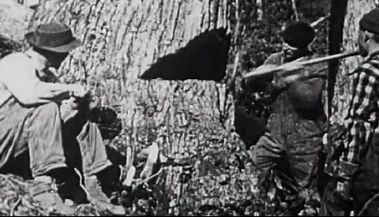
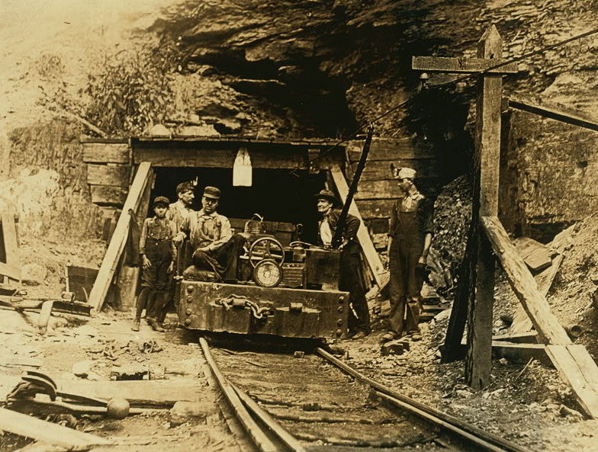
Major US industries weren’t doing well
Railroads
Steel
Textiles
Mining and lumbering
Coal mining
Housing starts
Notes:
Railroads lost business to new methods of transportation, Steel and textiles were barely making a profit. Mining and lumbering had been in high demand during the war but no longer. Coal mining was particularly hard hit because of the development of new energy sources. Housing starts are the number of new houses being built. That number was also in decline.

Slide 4
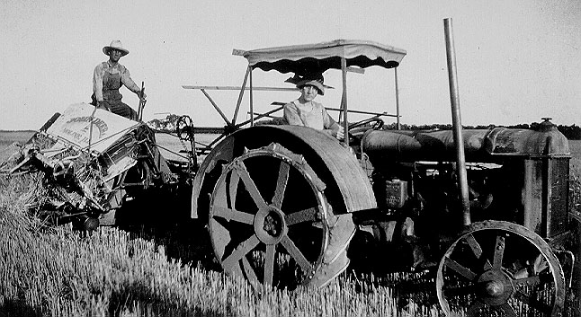
Farmers needed the most help
During WWI demand had soared for crops like wheat and corn. To meet the demand, farmers had taken out loans for land and equipment.
What happened when the war ended?
How did farmers respond to this?
Between 1919 and 1921 annual farm income dropped from $10 billion to just about $4 billon.
Farmers had gone into debt and were having trouble making payments. Banks foreclosed on the land to pay back the loans. The more farms failed the more land was repossessed. No one bought it and now rural banks started to fail as well.
Notes:
Dmand and prices dropped by 40% or more.
Farmers increased production hoping to sell more crops. This just led prices to drop even further.

Slide 5
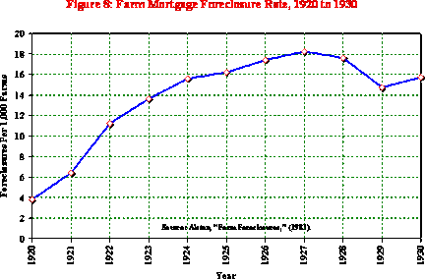
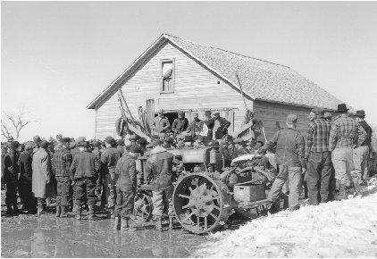
Congress tried to help farmers with price supports
McNary-Haugen Bill
This called for price supports on key products such as wheat, corn, cotton, and tobacco. The government would buy surplus crops at guaranteed prices and sell them n the world market.
Coolidge vetoed the bill twice. He said “Farmers have never made money. I don’t believe we can do much about it.” It never became law.

Slide 6
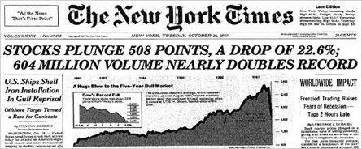
Financial Collapse and the Great Depression
Most American families at this time made less than $2,000 a year, which meant that they couldn’t afford to buy all the goods being produced in American factories. This led to lay offs in the factories and fewer people being able to buy goods.
The same happened with farms that now were producing huge amounts of crops and facing stiff competition from foreign countries.
Farmers and Factory owners couldn’t pay their debts to the banks, businesses closed, banks closed, yet some people continued to invest

Slide 7
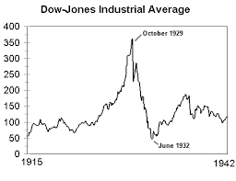
In 1929 stocks for sale at the NYSE were soaring in price, which meant many people who couldn’t afford them borrowed money from their stockbroker to pay for them.
Called “buying on margin.”
In September of 1929 some people began to sell their stocks thinking that prices were going to go down soon. By October the market was in a steep slide and no one wanted to buy.
On Tuesday October 29,1929 a record number of stocks were sold (16,000,000) and the market collapsed.
Black Tuesday
Notes:
The Dow Jones industrial average is the most widely used measure of the health of the US economy. The DOW is measured on 30 representative large firms on the NYSE. NYSE New York Stock ExchangeThis worked great when stocks were high, people used the dividends to pay their loans, but when prices fell, they lost everything. Speculation was also rampant, where people purchased high risk stocks hoping to become rich quickly.

Slide 8
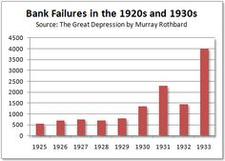
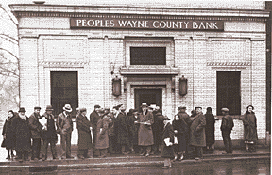
Banks and Business Failures
Bank Runs were common
In 1929 600 banks closed, by 1933 11,000 of the nations 25,000 banks had failed.
Notes:
After the crash, many people panicked and withdrew their money from banks. Some people couldn’t get their money because the bank had used their money to invest in the stock market. That money was now gone. T

Slide 9
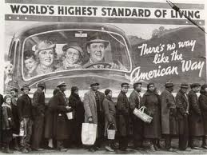
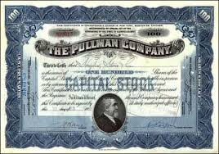
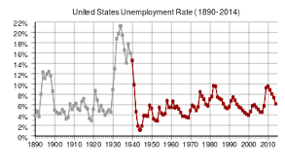
People who had money now had nothing.
Stocks were worthless.
Unemployment rates skyrocketed, while production, prices and wages declined

Slide 10
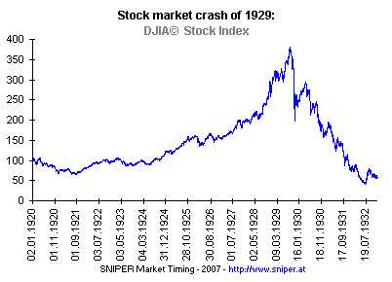
A Worldwide Depression
Communication and ease of travel made it so that global economies were more interconnected than ever.
By the 1920s the nations that had suffered the worst in WWI were starting to rebuild their economies, often times by borrowing money from the United States.

Slide 11
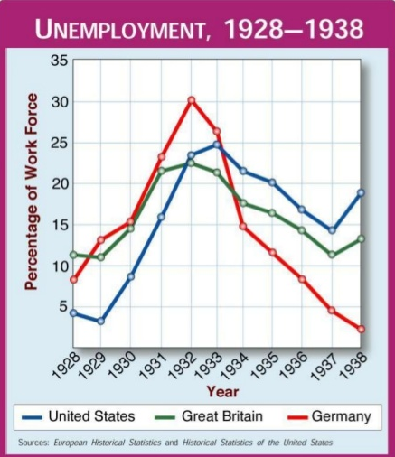
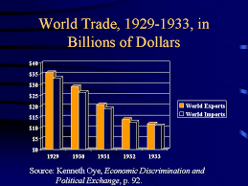
This leads to a Global Depression
Nervous American bankers begin to demand repayment of foreign loans and investors withdrew their money from Europe.
Congress placed new, high, tariffs on European goods and demand collapsed, causing worse conditions in the U.S and the World

Slide 12
The Crash of 1929 was the trigger of the depression. BUT the actual spiral was caused by lack of economic and banking safeguards, and the belief that wealth and prosperity were to be pursued at all costs allowed the depression to truly begin

Slide 13
President Hoover was not prepared for the scope of the crisis
He encouraged people to “tighten their belts” and businesses to keep people employed.
He was against the idea of a government “handout”
In 1930 congress passes the Hawley-Smoot Tariff Act
Notes:
This was supposed to protect manufacturers and farmers from foreign competition, but instead it reduced the flow of goods into the US and prefvented oher countries from earning American currency to by American goods. Many countries raised their own tariffs in respons.

Slide 14
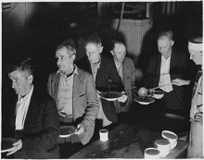
When it was finally clear that these things weren’t working, Hoover created:
The President's Emergency Committee for Employment (PECE) – this helped state governments provide assistance but did not provide food as he thought that direct handouts wouldn’t help.
1930 – 31 – Congress passed a $47 million bill that would provide drought victims with fertilizer and animal feed (no food)
1931 – Congress attempted to pass the Federal Emergency Relief Bill
Notes:
This was later renamed President's Organization of Unemployment Relief (POUR)
FERB would’ve provided $375 million to states to help provide food, clothing, and shelter to the homeless, but Hoover opposed the bill and it was defeated by 14 votes.
Hoover actually cared a great deal about the poor, he didn’t take his salary, gave 25,000 of his own money to charities, helped raise 500,000 in private funds to support the conference on child health hand welfare. He just felt that personal charity was more important and better than federal charity.

Slide 15
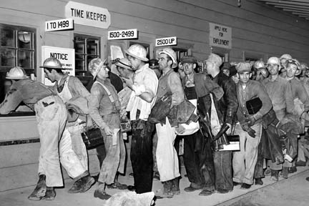
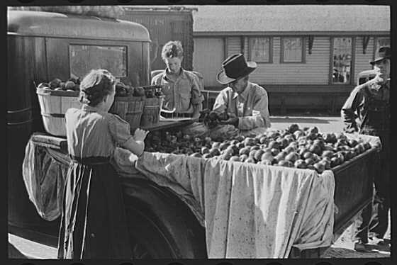
Effects of the Great Depression
Effects on society
  25% of the workforce were unemployed at its peak
  Wages were as low as $.10 per hour
  Blacks often first fired
  Women who worked for less than men were often retained
  Many sold produce on the street
View Great Depression Begins Video

Slide 16
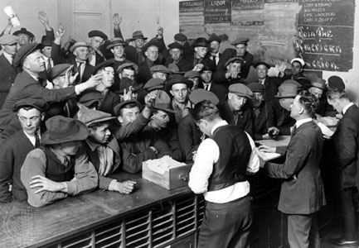
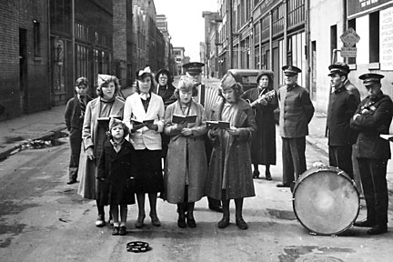
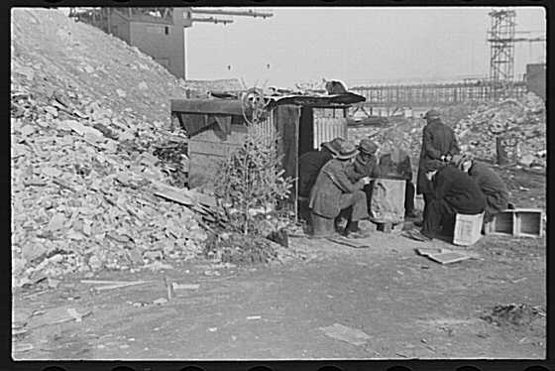
Effects of the Great Depression
Effects on Cities
  Cities tried to provide relief with Red Cross and Salvation Army
  Breadlines were common
  Shantytowns developed outside of cities-came to be called Hoovervilles
  Poverty and crime spread throughout US
Job Bureau
Salvation Army
Welcome to Hooverville
Hooverville with Christmas Tree

Slide 17
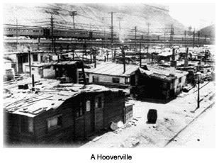
Effects of the Great Depression

Slide 18
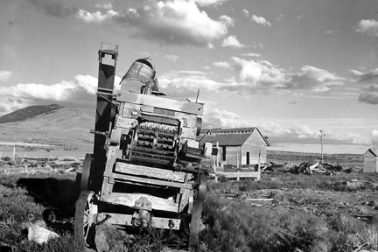
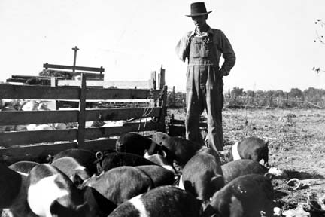
Effects of Great Depression
Effects upon farming
  Farmers had more than they could sell-prices dropped
  Farmers could not afford mortgages and many “lost the farm”

Slide 19
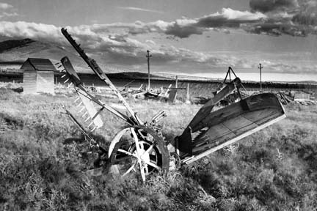
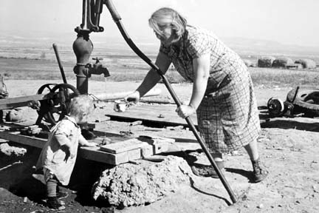
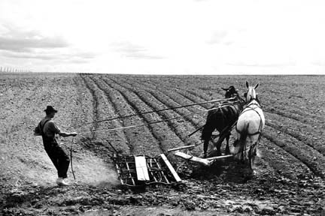
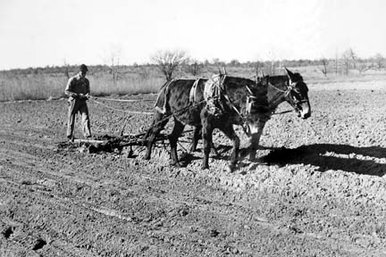

Slide 20
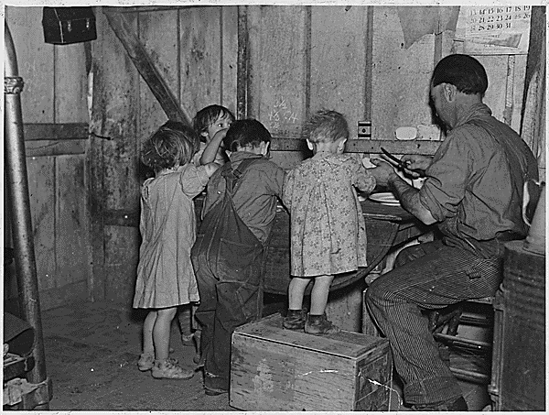
Effects of Great Depression
Effects of families
  Families moved in together
  Divorce rates rose
  Young people waited to get married and start families
  Women made their own bread, soap, clothes out of flour sacks, etc.
  Families rented out rooms of their houses
Christmas dinner in Iowa, 1935
View 1930’s Summary Video

Slide 21
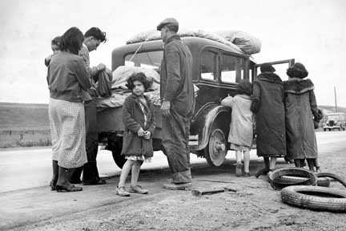
Effects of Great Depression

Slide 22
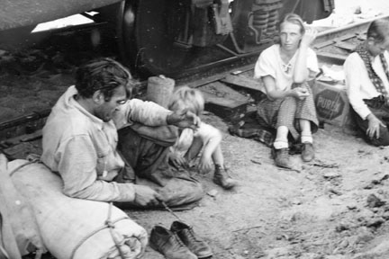
Effects of Great Depression

Slide 23
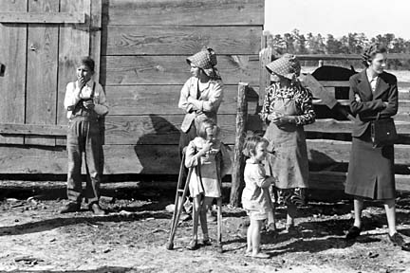
Effects of Great Depression

Slide 24
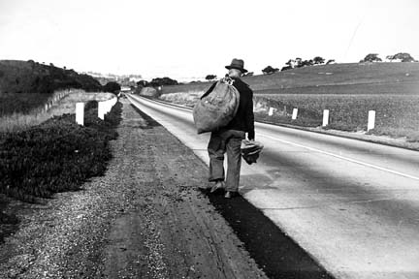
Effects of Great Depression

Slide 25
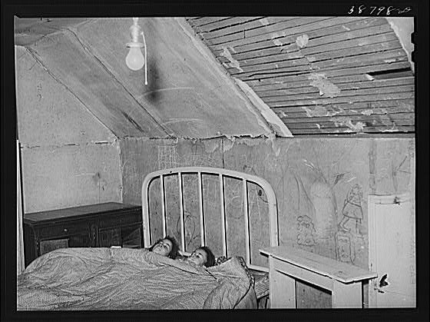
Effects of Great Depression

Slide 26
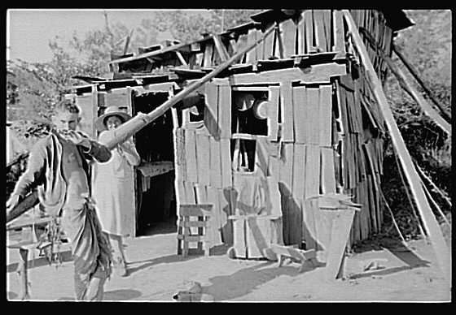
Effects of the Great Depression

Slide 27
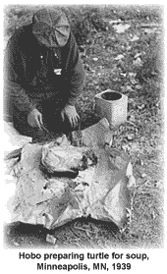
Effects of the Great Depression

Slide 28
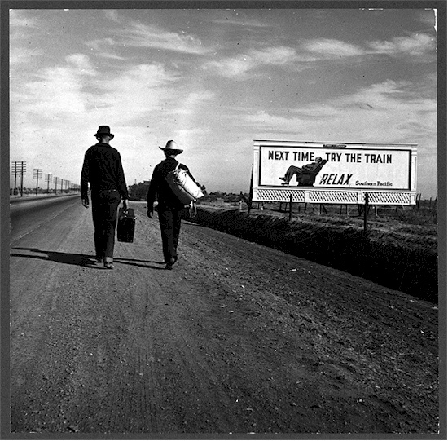
Effects of the Great Depression

Slide 29
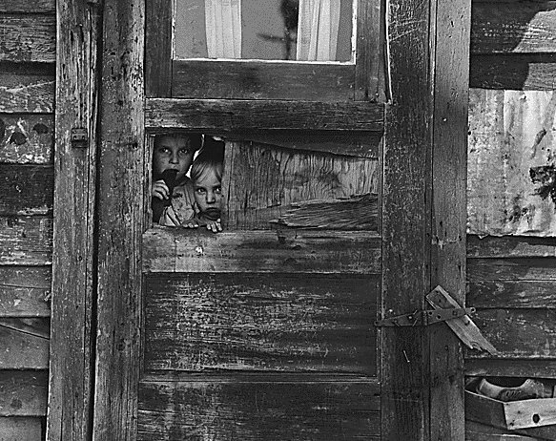

Slide 30
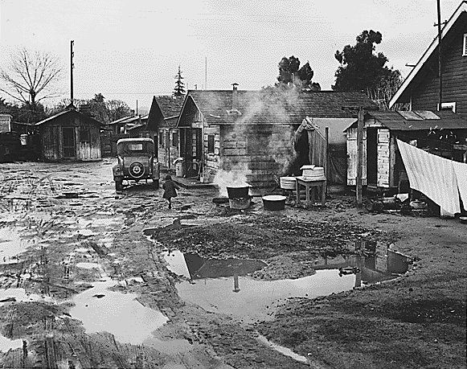

Slide 31
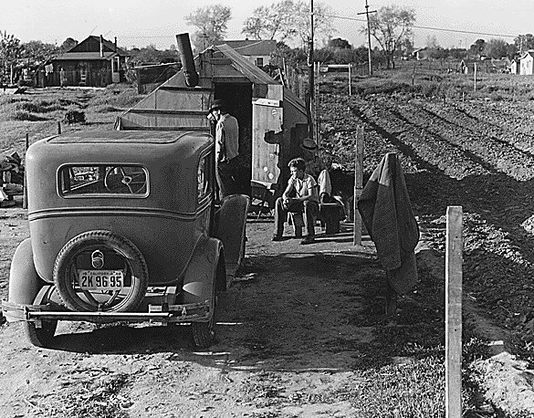

Slide 32
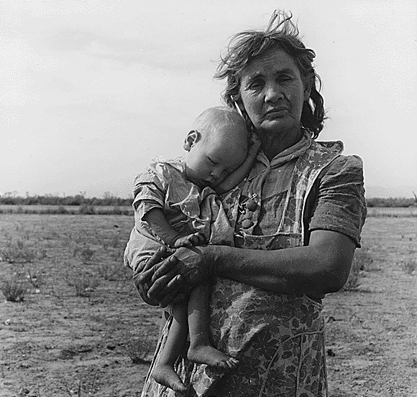

Slide 33
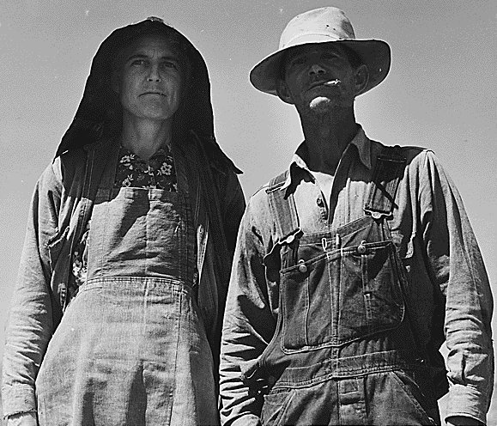

Slide 34
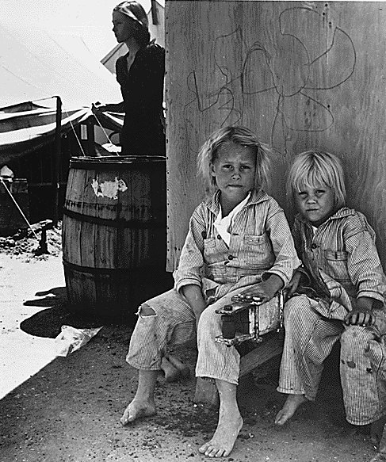

Slide 35
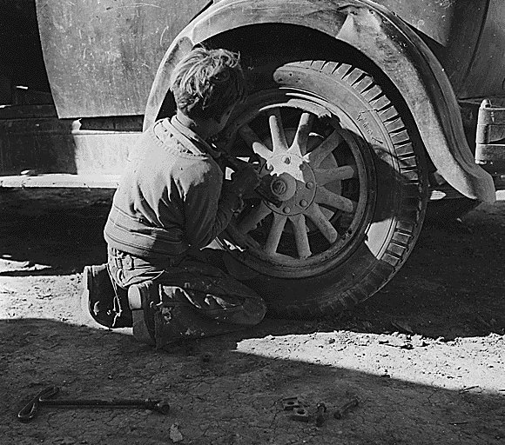

Slide 36
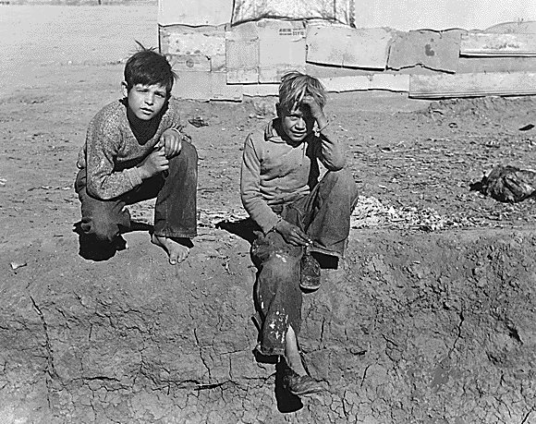

Slide 37
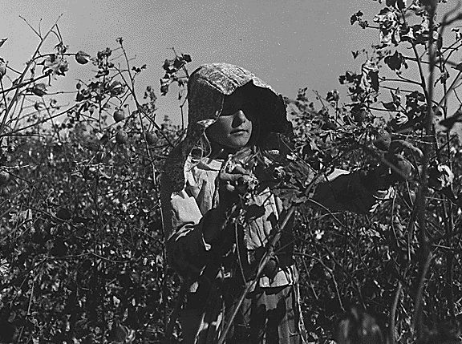

Slide 38
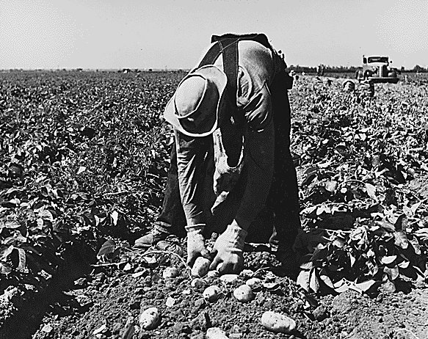

Slide 39
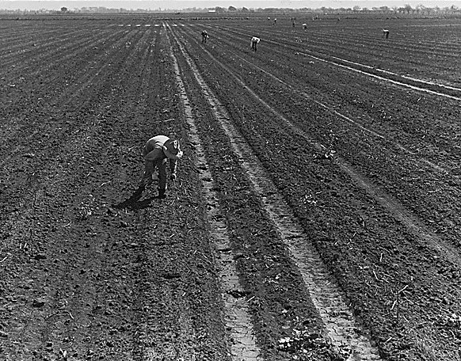

Slide 40

Effects of the Great Depression
Effects on the Economy
  Gross National Product fell from $103 billion in 1929 to $56 billion in 1933
  GNP is all of the goods and services produced in a year

Slide 41


Effects on the Economy-Cont.
20% of banks closed
Once bank closed all money in it is lost
Investors and businesses lost millions of dollars
Production was drastically cut, costing jobs and plants to close down
Police guarding the banks as they are closed.

Slide 42
The Human Toll
Unemployment:
  1929 – 3 million
  1930 – 4 million
  1931 – 8 million
  1932 – 12.5 million
90% of companies cut worker pay; 75% of all workers were on part-time schedules
By 1933, the average family income fell 40%; multiple families crowded in one-room shacks, caves, and even sewer pipes!

Slide 43

Effects of the Great Depression

Slide 44


Hoover’s Policies during Depression
Herbert Hoover was elected in 1928 promising “a chicken in every pot, a car in every garage.”
  Was blamed for much of the depression even though it was not his fault
  Hoover was in the wrong place at the wrong time
Herbert Hoover
View Hoover Video
Hard Times are still “Hoovering” over us

Slide 45

IV. The Response of the Hoover Administration
Positive statements aggravate the Depression crisis
Hoover’s background
Hoover’s actions to stem the economic crisis
Creation of the Reconstruction Finance Corporation (1932)
“Trickle Down” Solutions

Slide 46

IV. Hoover’s Response (cont.)
Unemployment continued and farm prices dropped dramatically
Violent farm protests by 1932
Hoover was limited by his own governmental philosophy
Hoover championed “voluntarism” as a solution

Slide 47

IV. Hoover’s Response (cont.)
Growing inability to compromise with Congress
Hoover’s unpopularity grows
His name becomes synonymous with the Depression
Economic and Political blunders
The Bonus March (Summer of 1932)

Slide 48


Hoover’s Policies
Hoover did not feel it was governments responsibility to provide direct relief to the people
Hoover felt local governments should help and charities
Hoover listening to radio
Hoover Dam

Slide 49


Hoover’s Policies
Reconstruction Finance Corporation
  Helped faltering railroads, banks, life insurance companies.
  *Hoover tried to stabilize key businesses.

Slide 50



The Human Toll
Breadlines, soup kitchens, tin-can shanties and “Hoovervilles”
“Arkies” and “Okies”

Slide 51
The Dispossessed
Minorities (African Americans and Mexican Americans) suffered the most
70% of Charleston’s black population and 75% of Memphis’ black population was unemployed
In the South, living conditions for black families were deplorable; income averaged less than a dollar a day
In the North, conditions were also distressed
Mexican Americans faced opposition from labor unions; “repatriation” sent more than 400,000 to Mexico

Slide 52

The Dispossessed

Slide 53
Private and Public Charity
Great Depression overwhelmed private charities and local governments
In 1932, total public and private relief expenditures amounted to only $317 million - $26 per each unemployed American

Slide 54

Homeless Family searching for work and shelter

Slide 55

“Brother can you spare a dime”
Lyrics to a famous song of the depression
Song tells of hardships faced by Americans during the depression

Slide 56

Brother Can You spare a Dime
  Full of that Yankee Doodle-de-dum.
  Half a million boots went slogging through hell,
  And I was the kid with the drum.
  Say, don't you remember they called me Al,
  It was Al all the time.
  Why don't you remember, I'm your pal --
  Say, buddy, can you spare a dime?
  Once in khaki suits, ah, gee, we looked swell
  Full of that Yankee Doodle-de-dum.
  Half a million boots went slogging through hell,
  And I was the kid with the drum.
  Say, don't you remember they called me Al,
  It was Al all the time.
  Why don't you remember, I'm your pal --
  Buddy, can you spare a dime?
Lyrics
  They used to tell me I was building a dream
  And so I followed the mob.
  When there was earth to plow or guns to bear,
  I was always there, right on the job.
  They used to tell me I was building a dream
  With peace and glory ahead --
  Why should I be standing in line, just waiting for bread?
  Once I built a railroad, I made it run,
  Made it race against time.
  Once I built a railroad, now it's done --
  Brother, can you spare a dime?
  Once I built a tower, up to the sun,
  brick and rivet and lime.
  Once I built a tower, now it's done --
  Brother, can you spare a dime?
  Once in khaki suits, gee, we looked swell

Slide 57


Slide 58


Slide 59

Scottsboro Case
9 black teenage boys were accused of raping two white girls on a train
An example of intolerance of the time period
Inspired the book “To Kill a Mockingbird”
Scottsboro Boys

Slide 60


Dust Bowl
A terrible drought and heavy winds blew the dry topsoil in the mid-west to the east.
Made worse by poor farming practices (lack of crop rotation)
Many farmers packed up and moved West to California
Were called Okies (most moved from Oklahoma)
Inspired book The Grapes of Wrath
Family in Dust Storm
Dust Storm in Colorado 1935

Slide 61


Slide 62



Dust Bowl

Slide 63


Dorothea Lange
Photographer during the Great Depression whose photographs help bring aid to farmers out west
Dorothea Lange -1936
Migrant Mother -Lange’s most famous picture

Slide 64


Dorothea Lange’s Pictures

Slide 65


Slide 66


Slide 67


Slide 68


Slide 69


Slide 70


Slide 71


Slide 72


Slide 73


Slide 74


Slide 75


Bonus Army and Bonus March
1932 thousands of WWI veterans marched to Washington asking for payment of bonus to be given in 1945.
Veterans camped out in shantytown outside of the Capitol and White House
Congress did not give them “bonus”

Slide 76



Bonus Army and Bonus March

Slide 77


Election of 1932
Franklin D. Roosevelt, Democrat, defeated Herbert Hoover by promising a “New Deal” for America
FDR promised social programs that helped ease the depression
Hoover in 1932 Campaign
FDR at Political Rally in 1932

Slide 78


Slide 79

Roosevelt to Hoover: “Just leave them Herb. I’ll do it all after March 4th.”

Slide 80

Why a New Deal was needed?
Great Depression had worsened
American banking system was near collapse
Millions of people were jobless
Many businesses were bankrupt

Slide 81


FDR Reassures the nation
“The only thing we have to fear is fear itself”-FDR
Bank Holiday
  All banks in US were closed
  Only banks that were stable were reopened
Fireside Chats
  Radio addresses by FDR to tell America what was going on and reassure them on “their level”
View Franklin D. Roosevelt Video

Slide 82

Goals of the New Deal
The 3 R’s
Relief, Recovery, and Reform
Relief to the people who were poor, hungry, and unemployed
Recovery to businesses that were failing
Reform the economic institutions in the US

Slide 83

Alphabet Soup/ ABC Agencies
EBRA-Emergency Banking Relief Act
  Allowed federal govt. to examine banks
FDIC-Federal Depository Insurance Corporation
  Guaranteed bank deposits up to $5,000. Put faith back in banks
FERA-Federal Emergency Relief Act
  Gave federal money to states to offer soup kitchens and help homeless
View New Deal Video

Slide 84



Alphabet Soup/ ABC Agencies
PWA-Public Works Administration
  Gave federal dollars to states and local govt. to build roads, bridges, schools, etc.
WPA-Works Progress Administration
  Provided thousands of jobs from 1935 to 1940
  Built roads, schools, etc. but also helped writers and artists
CWA-Civil Works Administration
  Worked on construction projects
WPA mural on wall
CWA working on road construction

Slide 85


Alphabet Soup/ ABC Agencies
TVA-Tennessee Valley Authority
  Promoted regional development and public planning in one of poorest regions in US
  TVA built dams, operated electrical power plants, manufactured fertilizer, and worked with flooding and erosion
Hydroelectricity plant built in Alabama by TVA
Alabama Video
2005 Map of TVA locations: Red-dam, Purple-nuclear, Orange-fossil fuels

Slide 86



Alphabet Soup/ ABC Agencies
CCC-Civilian Conservation Corps
  Employed young men ages 18-25
  Jobs included outdoors fighting fires, restocking lakes with fish, restoring battle fields, cleaning up cemeteries, etc.

Slide 87



Alphabet Soup/ ABC Agencies
NRA-National Recovery Administration
  Guaranteed reasonable profits for businesses and fair wages for labor
AAA-Agricultural Adjustment Administration
  Encouraged farmers to reduce production. Gave money to farmers for NOT farming on land. 6 million pigs were slaughtered.
*Both of these Acts were declared unconstitutional by the Supreme Court
Hog Reduction Program of AAA

Slide 88

Alphabet Soup/ ABC Agencies
SEC-Securities and Exchange Commission
  A federal agency that regulates the stock market and limits speculation
FHA-Federal Housing Administration
  Insured bank loans on new homes and old houses
FDR signing bills into law

Slide 89

Alphabet Soup/ ABC Agencies
NLRA-National Labor Relations Act or Wagner Act
  Passed in 1935
  Wagner Act gave workers the right to join a union and collectively bargain
  Outlawed unfair business practices
Social Security Act-1935
  Federal insurance program that paid people over 65, disabled, and children whose parents are deceased
View Second New Deal Video

Slide 90

Movies and Radio
Movies remained very popular during the Depression.
  People wanted an escape from tough times
  Gone with the Wind
Radio was very popular
  The Lone Ranger, The Shadow, and
  War of the Worlds

Slide 91

Criticisms of the New Deal
1. gave the government too much power
2. government borrowed too much money for programs
3. did not help minorities, elderly, and women enough (although African-Americans begin to leave the Republican Party and join Democratic)

Slide 92



Critics of the New Deal
Father Charles Coughlin
  Catholic priest who used his radio show to oppose the New Deal.
  Called New Deal an “evil conspiracy” and a form of fascism
Senator Huey Long
  Previous Governor from Louisiana who proposed the “Share our Wealth” Program.
  Provide $5,000 every year to families

Slide 93


Critics of the New Deal
Supreme Court
  Struck down NRA and AAA as unconstitutional
FDR proposed the Court Packing Bill or Judiciary Reorganization Bill
  President could appoint new justices for every one over 70 years old
  Would make the Supreme Court have 15 members and FDR could appoint 6 new ones
FDR is widely criticized for this

Slide 94


Effects of the New Deal
Keynesian economics
  Deficit spending is ok in difficult times
Unions grew more powerful
Social Security is established
Role of the US government is greatly expanded
Government spending is increased dramatically
Americans began to depend on the government more
People who lived through this era are greatly impacted for the rest of their lives
Video Quiz

Slide 95


Slide 96
XVIII. Summary of the Results of the “New Deal”
Did not end the Depression
Many agricultural problems unsolved, especially for southern Blacks and tenant farmers
Did restore national hope
Controls were built into the economy to avert future crises
--Federal Securities Act of 1933 and SEC (1934)
The Government as “broker state”
Restoration of confidence in U.S. government and economy—but both different than before 1932

