Slide 1
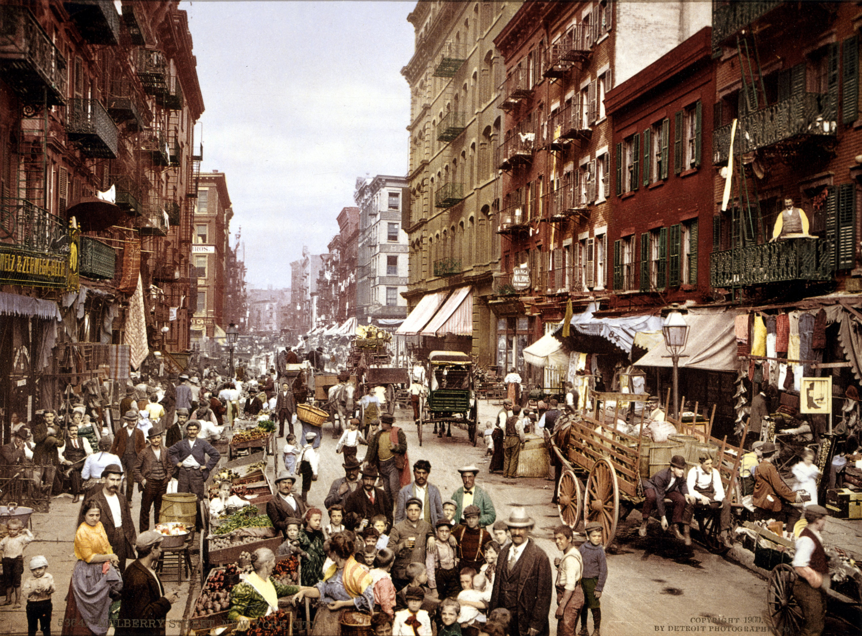
The Growing Pains of Urbanization
1870-1900

Slide 2

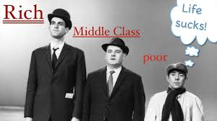
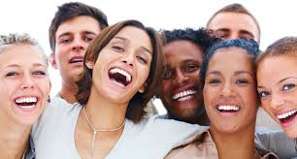
The Challenges of Urbanization:
Issues:
Language
Class
Race
Ethnicity
Low wages
Overcrowded buildings
Poor sanitation
Widespread disease

Slide 3
Why did many immigrants settle in the nation’s cities?
Hope of better wages and in industrial labor
Growth of industry, particularly textile industry, which then encouraged people to move to the cities for jobs.
People wanted to be near other people like themselves so they settled near others of the same ethnic background.

Slide 4
technology v. labor
Farm laborers being replaced with tractor, mower reaper, etc….
But I need a job?
Move to cities because jobs are plentiful
  (until more immigrants come in and take the jobs)
  Growth of nativism, anti-immigrant laws

Slide 5
Urbanization→ Growth of Cities
Move from rural to cities to eventually suburbs
Moving to suburbs helps to establish social classes in America
Mass influx to cities:
  Jobs, communities, transportations, night life, family ties

Slide 6

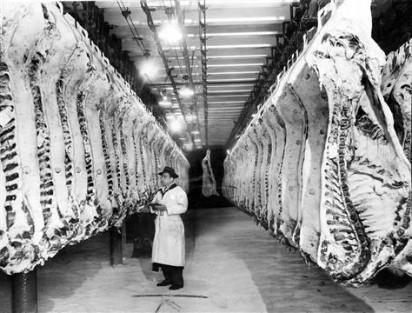
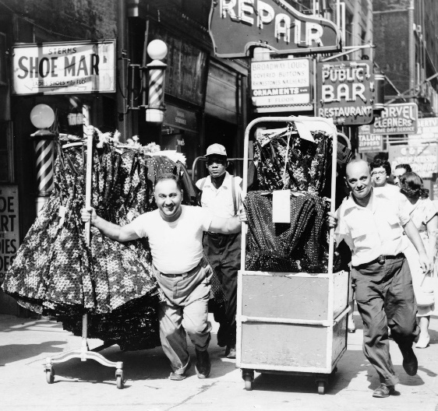

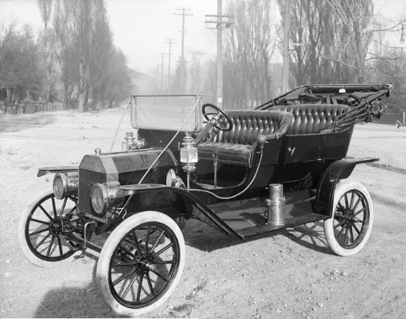
Cities developed character based on their core industries:
Pittsburgh – Steel
Chicago – Meat Packing
New York – Garment and Financial
Detroit - Automobiles

Slide 7
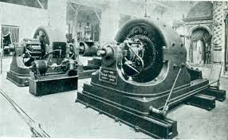
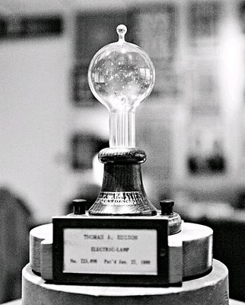
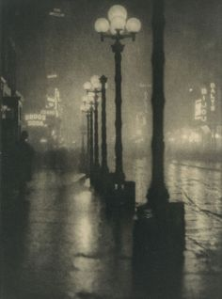
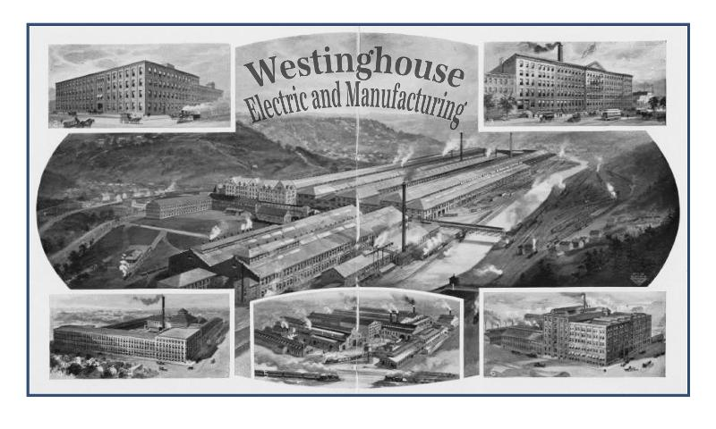
Innovations lead to successful urbanization
Electric Lighting: Edison’s light bulb and Tesla’s AC current allowed factories to stay open 24/7 and to not rely on water as a sole source of power. Cities also began lighting the streets.

Slide 8
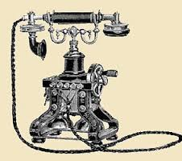

Communication improvements: The telephone allowed instant communication over larger distances. Businesses can now take orders instantly from across the country.

Slide 9
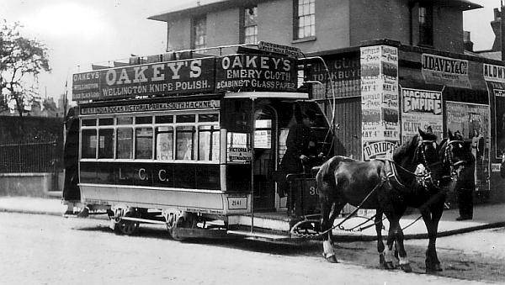
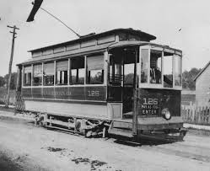
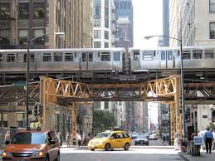
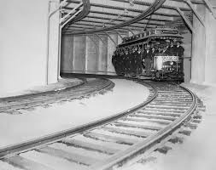
Intracity transportation: Allowed people to travel easily within the city itself. Originally horse drawn “omnibuses,” these are replaced by electric trollies. More crowded cities developed elevated trains and subways. (Boston, NY, Chicago)

Slide 10
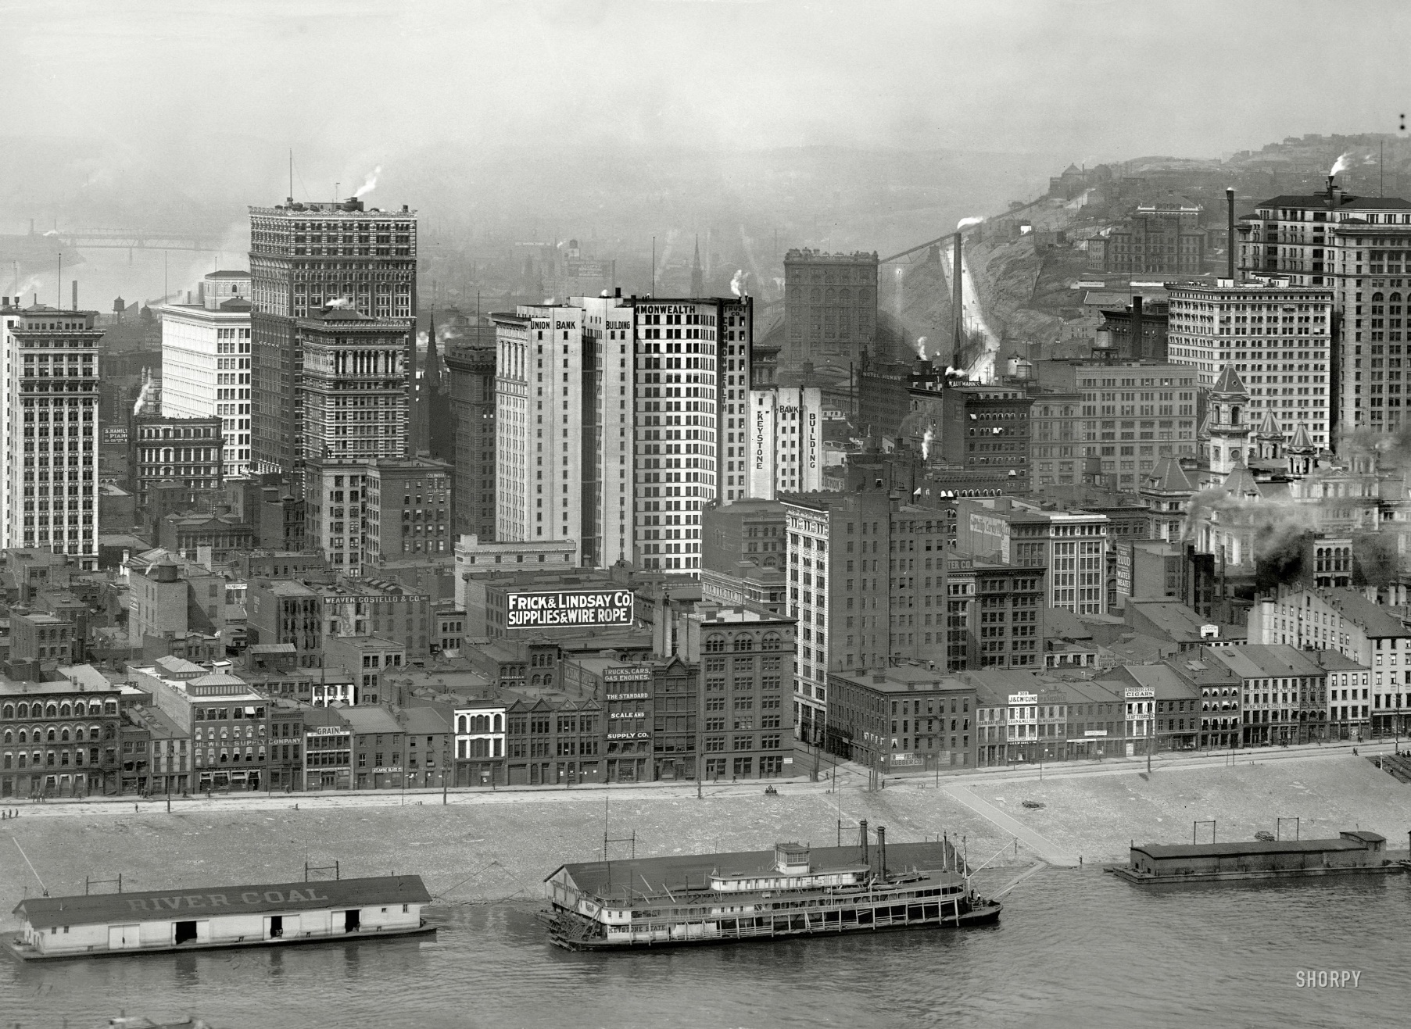
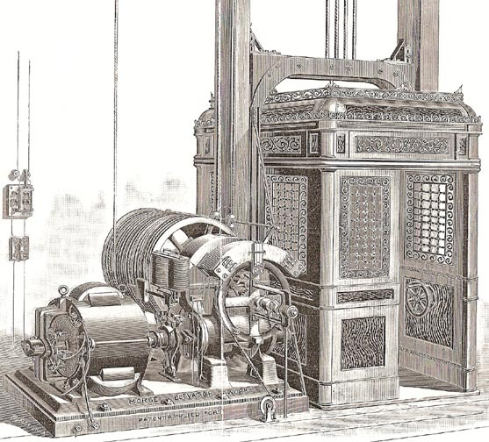
Skyscrapers: Upward growth replaced outward growth in cities with limited space like Boston and NY. Better steel made taller buildings possible, the invention of the elevator by James Otis made taller buildings plausible.

Slide 11
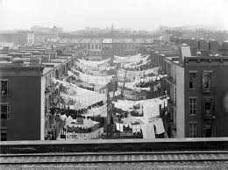
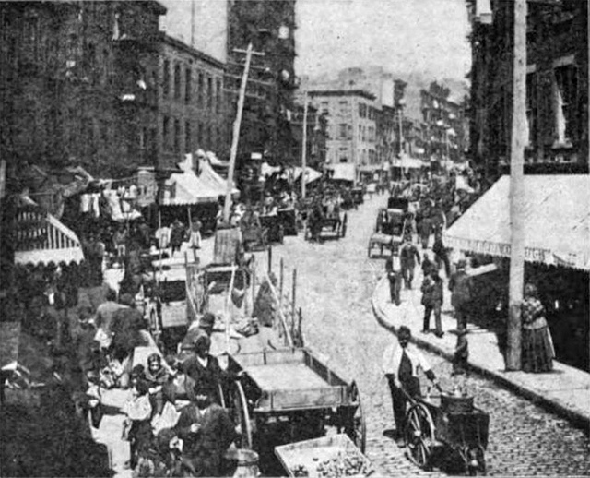
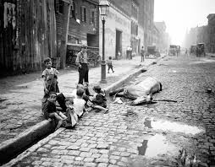
The immediate challenges of urban life were crowding, pollution, crime, and disease

Slide 12
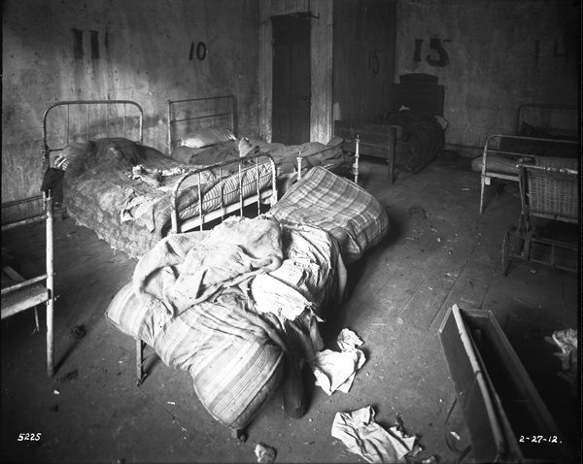
What were the housing problems that many poor city people faced?
Sharing with other families
No windows
No ventilation
Lack of bathrooms
Unsanitary
No privacy - can hear through the walls

Slide 13
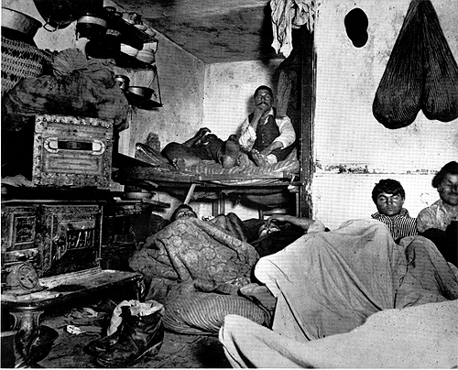
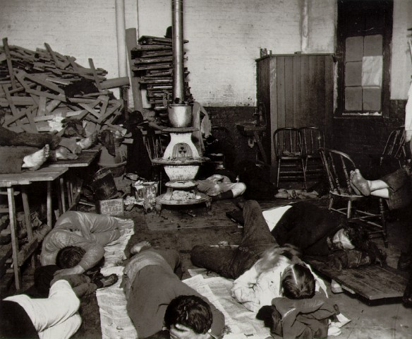
Jacob Riis: Photographer and Journalist
Exposed the living conditions of Immigrants in his book, How the Other Half Lives

Slide 14
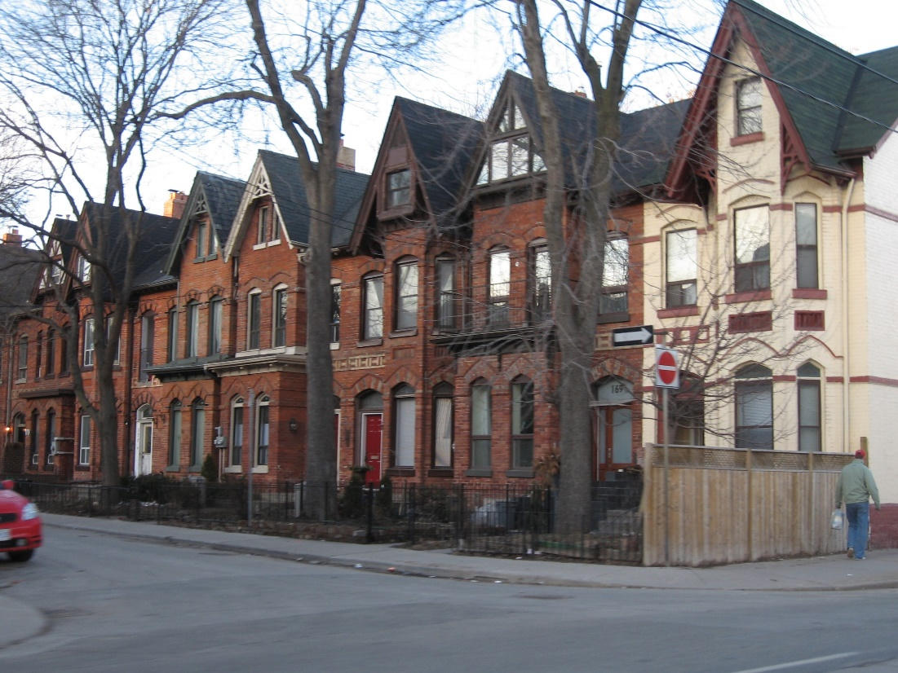
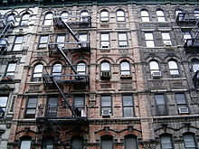
row houses and tenements
Row house = single family dwellings that shared side thin walls
  Like a condominium
Tenements = multifamily urban city dwellings
  Up to 9-12 per room or more
  http://openstaxcollege.org/l/tenement

Slide 15
Besides housing, what other difficulties did immigrants and poor residents encounter?
Discrimination
Food, lack of it
Disease
Crime and punishment
Sanitation
Fire

Slide 16
segregation v. discrimination
Segregation is to separate people based on ethnicity, religion, etc…
  Japanese in Japanese schools (Gentlemen’s Agreement)
Discrimination is to not allow someone to do something based on who they are.
  “Irish need not apply”

Slide 17
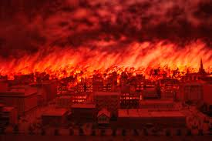
The Great Chicago Fire
October 8-10, 1871

Slide 18
Problems and Solutions
Water→ 1870-filtration and chlorination (YEAH! Drinkable Water)
Sanitation→ sewer lines and sanitation departments (Indoor toilets and no more odor in the streets)
Crime→1840-NYC Police Department
Fire→1853-Ohio-first paid fire dept., 1874-sprinklers in buildings, 1900-full time fire depts.
Other→ Instead of building structures out of wood and using candles/kerosene to heat houses→ we switch to brick, stone and concrete

Slide 19
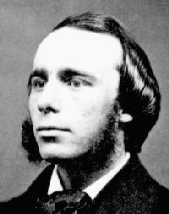
The Social Gospel Movement
Churches wanted to apply their philosophy that all Christians, whether church leaders or social reformers should be just as concerned about the conditions of secular life as they were about the after life.
Reverend Washington Gladden was a minister who preached about social change instead of heaven and hell.
As a result, churches started including gyms and libraries ad offer classes on hygiene and health care.
Groups like the Salvation army and the YMCA also began to expand.

Slide 20
Social Gospel Movement
Salvation would come through helping the poor.
Jane Addams leads the charge on this by setting up settlement houses
Settlement houses were designed to help immigrants (poor) receive the necessary skills for job training, citizenship, learn American culture, etc…
Addams was the co-founder of the Hull House in Chicago

Slide 21
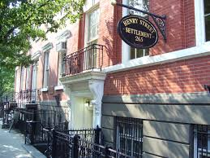
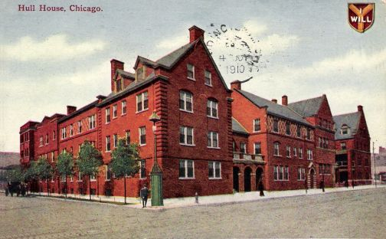
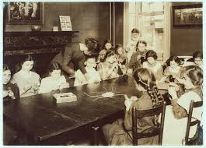
The Settlement House Movement
Women such as Jane Addams (Chicago – Hull House) and Lillian Wald (NYC – Henry St. Settlement) led this movement in the US.
They created settlement houses that gave help to the working class, particularly women.

Slide 22
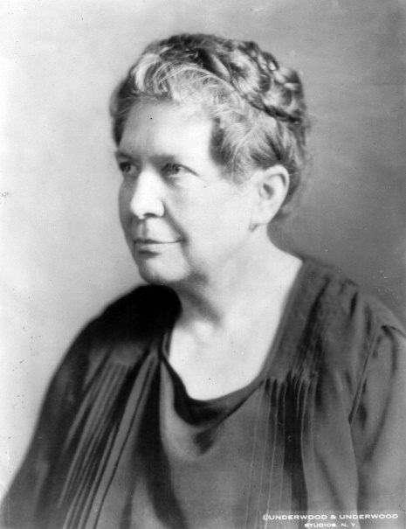
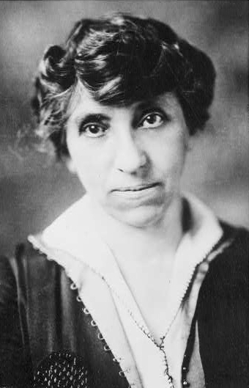
Settlement Houses
These allowed women who had graduated from college to live and work among the poor women they worked with
Led to the development of a political agenda that included housing laws, child labor laws, worker’s compensation, etc.
Florence Kelley joined with Wald in NY to create the National Child Labor Committee and advocated for the creation of the Children’s Bureau in the U.S. Department of Labor
Julia Lathrop became the first leader of the Children’s Bureau.

Slide 23
Americanization Movement
Helping Immigrants assimilate into American culture
Providing the proper skills necessary for American citizenship

Slide 24
The Great Migration
Between the end of the Civil war (1865) and the Great Depression (1929) nearly 2,000,000 African Americans fled the rural south to seek jobs and opportunity elsewhere.
Some moved west, like the old immigrants, but most travelled to the Northeast and the Upper Midwest.

Slide 25
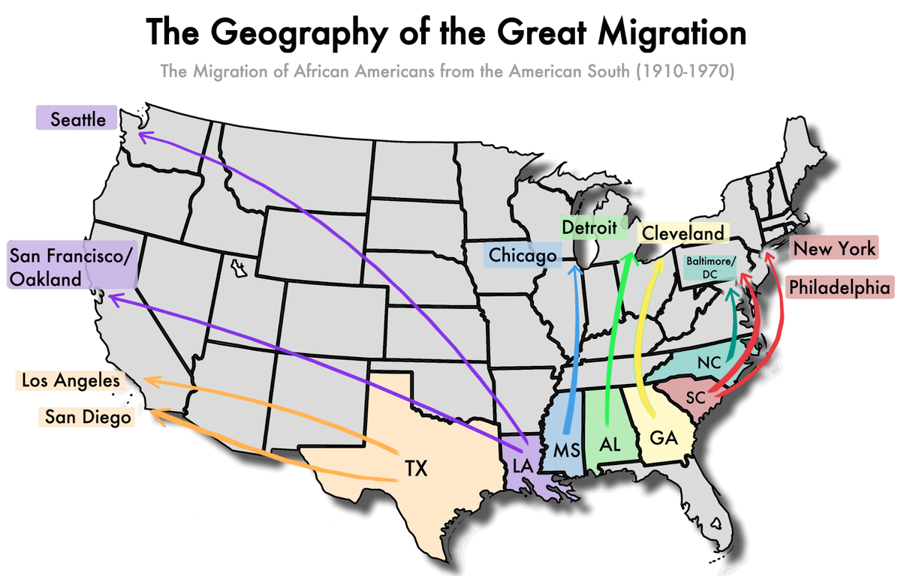

Slide 26
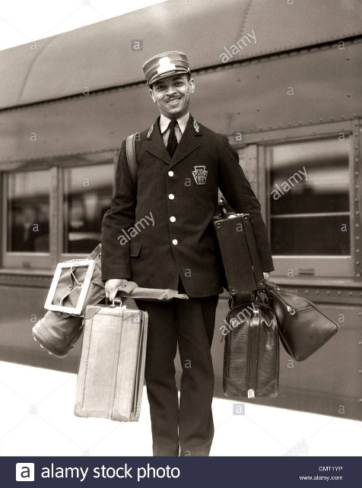
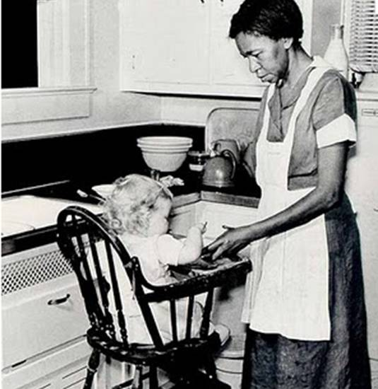
Push Factors | Pull Factors
Racial Hatred – KKK, Death Threats, Violence, Lynching (1865 – 1900 – 3500 racially motivated lynching and other murders) | Job Opportunities
 | Less violence
 | Opportunity to earn wages
 | Chance to Vote
Most African American men were stuck with menial jobs however because of a lack of education and existing racism.
Women had the double whammy of their race AND their gender and generally found jobs as maids or servants

Slide 27
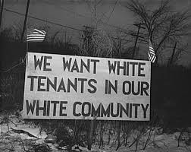
While higher wages in the North and more available housing were available, it also cost more to live in the North. So as a result, African Americans often found themselves living in overcrowded, unsanitary conditions like the tenement slums that other immigrants lived in in the cities.
Discrimination was still prevalent in the North and the Eastern European immigrants resented the completion for jobs in the cities.
Whites in neighborhoods sometimes signed covenants agreeing not to sell to blacks, banks ‘redlined’ mortgages to make getting a loan impossible.
This led to African Americans being concentrated into some of the worst slums in the cities, which has unfortunately continued well into the 20th century.

Slide 28
So, why move then?
It was the NONeconomic gains that made it better:
greater educational opportunity
more personal freedom
More money was allocated to both Blacks’ and Whites’ educations
less violence
compulsory school attendance

Slide 29
Relief from the Chaos of Urban Life
Machine Politics and the Rise of Popular Culture

Slide 30
Machine Politics:
Every resident, no matter what, was a ward resident with an alderman to speak for them
When the aldermen were approached with a problem they worked through the “Machine” to get things done.
favors = votes. Votes = quick solutions. Cost of fixing things included kickbacks to the boss.

Slide 31
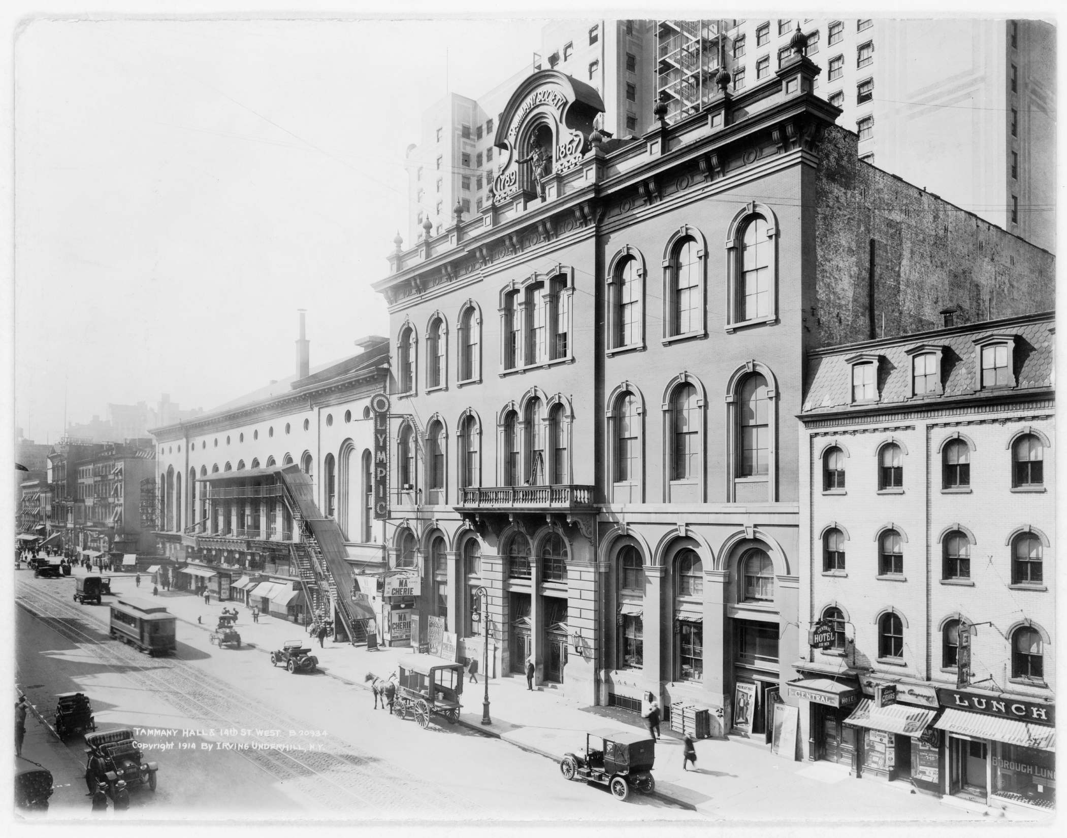
Tammany Hall

Slide 32
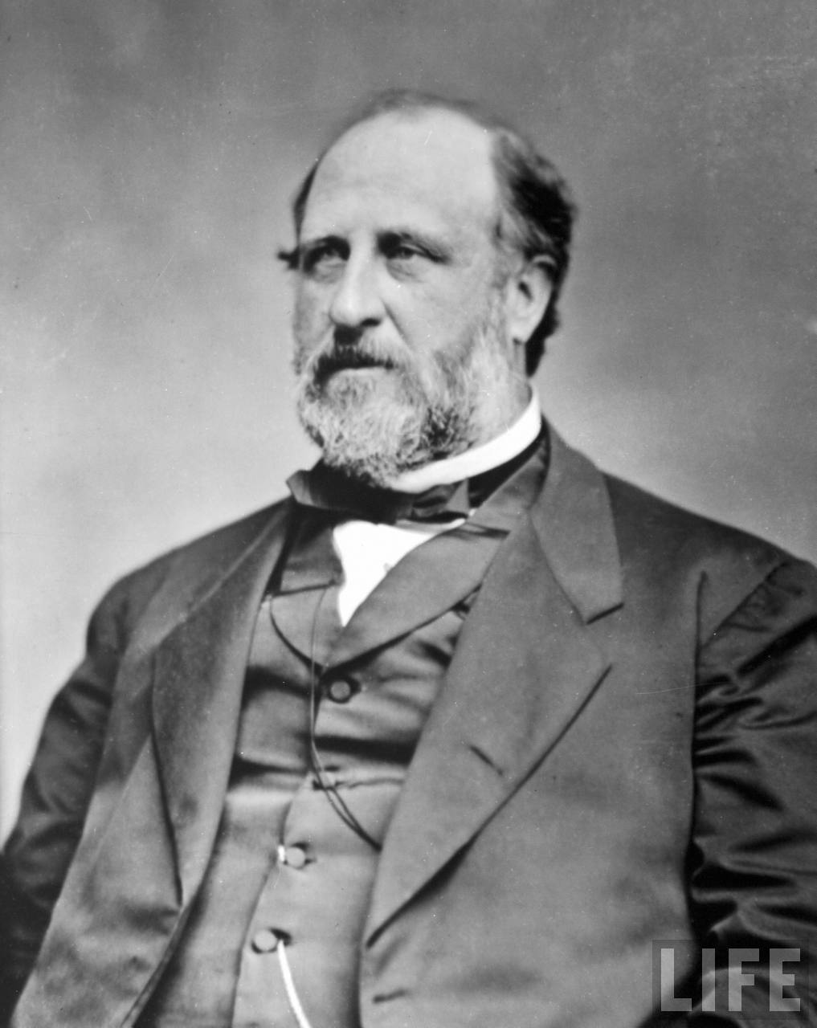

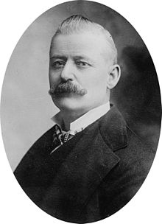
Boss Tweed
Graft
George Plunkitt

Slide 33
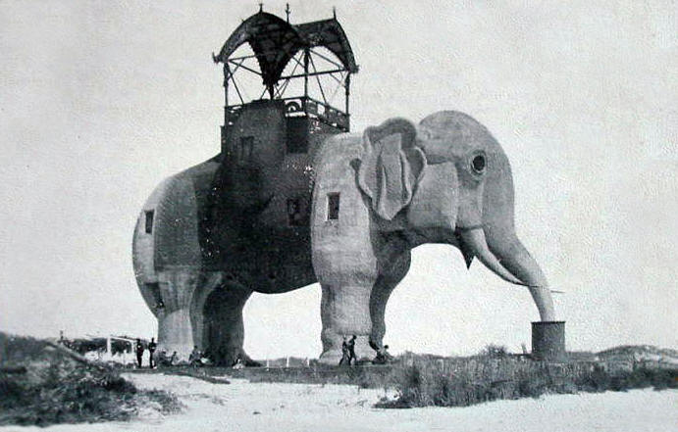
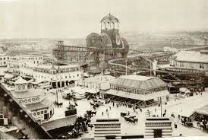
Popular Culture and Entertainment

Slide 34
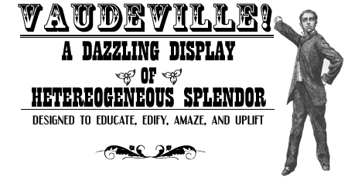
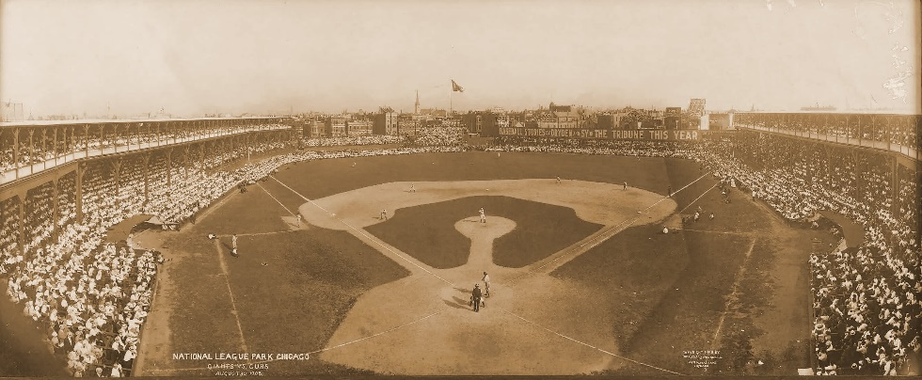
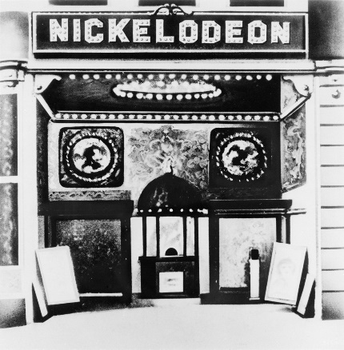
Amusement Parks like Coney Island
  Freak shows
  Animal acts (diving horses, electrocuted elephants)
  Movies
  Rides
Vaudeville
  Singing, dancing, comedy, animal acts, magic
Professional Baseball
  Cheap (ticket to a double header, two hot dogs, and a beer cost about $1)
  Allowed people to feel like part of the group by cheering for a “home” team
Nickelodeons
  Theaters that showed short films between live acts

Slide 35
Life varied by social class
Wealthy:
  preferred “highbrow” entertainment like classical music concertos, social gatherings, and fine art museum
  Generally highly educated
The Middle Class preferred to escape and often travelled away from the cities. They also lived in suburbs.
  Middle Class women were expected to take pride in creating a positive home environment for their husband and children. Magazines like Ladies Home Journal and Good Housekeeping became very popular.
  Some middle class women even began going to college (Some co-ed, many women’s only.)
  Women still married but they now had the opportunity for jobs outside the home like teachers and professors

Slide 36
The Morrill Acts of 1862 & 1890
Set aside public land and federal funds to create land-grant colleges that were affordable to the middle class and offered useful degrees

Slide 37
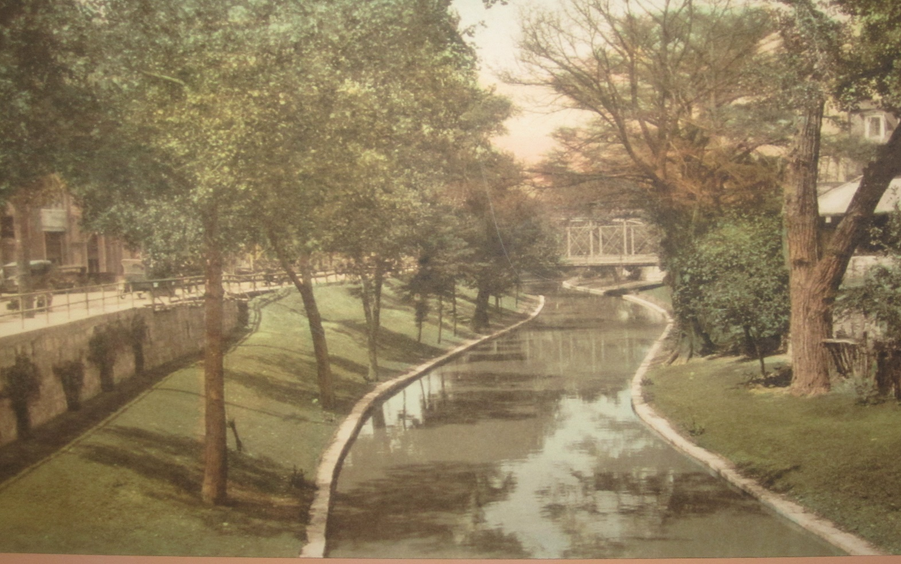
City Beautiful
Reformers like Frederick Law Olmstead and Daniel Burnham championed the idea of the White City (because of the bright white paint on the walls of some buildings)
This movement encouraged 3 principal ideals:
Create large city parks
build wider boulevards to decrease traffic and allow for trees and greenery between lanes
add more suburbs to help with the congestion.

