Slide 1
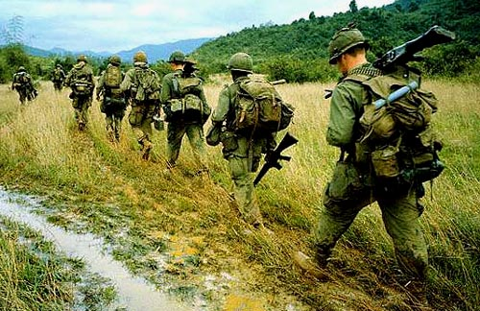
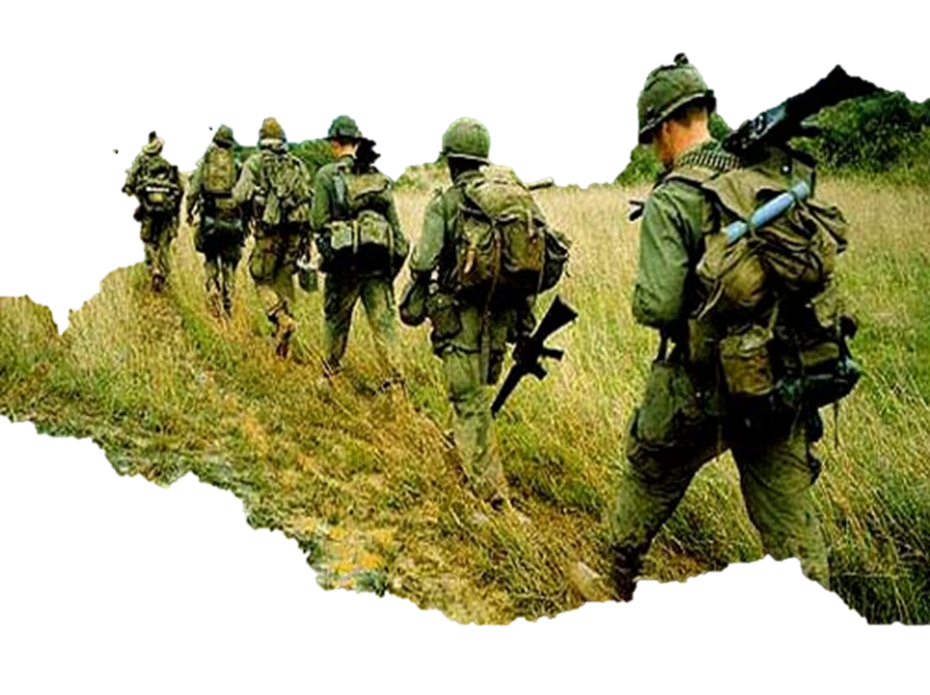
Vocabulary &
Bell Ringer
If these were the conditions that you were forced to live in for your lifetime would you be willing to go to war to change it?
Starvation
Poor living conditions
Forced Religion
Other Country making decisions over your country
Limited education
No way to improve social status
Low wages
Exploited Laborers
Opium & Alcohol use
Content Vocab
Domino Theory
Napalm
Agent Orange
Vietcong
Gulf of Tonkin Resolution
Ho Chi Minh
Academic Vocab
containment
1
1965-1975
Notes:
1

Slide 2
The Beginning of the
Vietnam War
1
1965-1975
Notes:
http://www.historyisaweapon.com/defcon2/hochiminh/
2

Slide 3
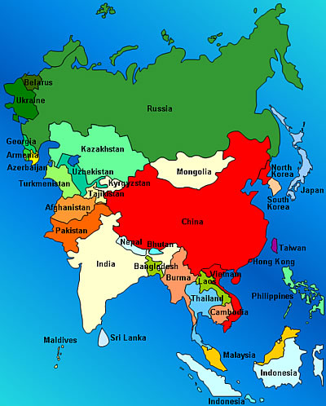
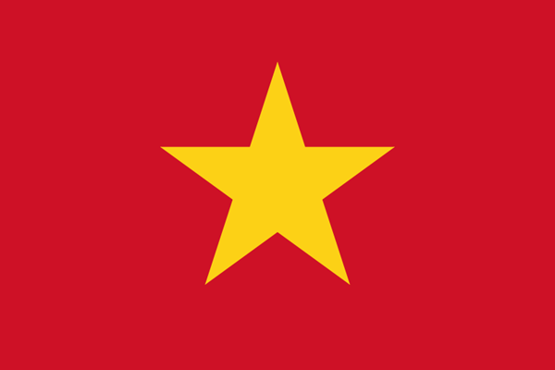
Where is Vietnam?

Slide 4
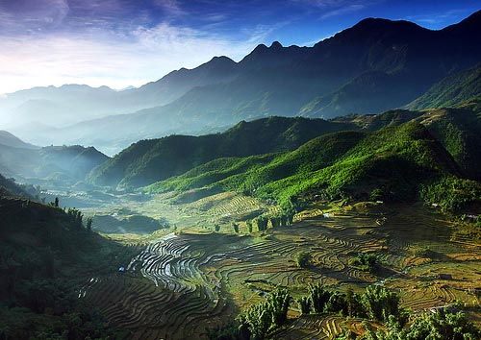
Major Events
1945
Ho Chi Minh declares an independent Vietnam
1954
Battle of Dien Bien Phu
1968
Tet Offensive
1964
Gulf of Tonkin
1973
Paris Peace Agreement
1975
Fall of Saigon
Timeline of Key Events

Slide 5

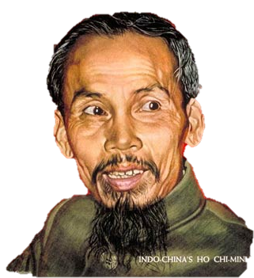
Vietnam Before WWII
During the early 1900s, nationalism
was strong in Vietnam.
As the Vietnamese sought independence or reform of the French colonial government, several political parties formed.
One of the leaders of the nationalist movement was Ho Chi Minh who, during his travels to the Soviet Union, had become an advocate of communism.
Notes:
5

Slide 6
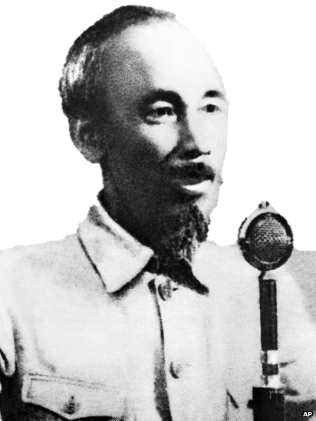
Under Japanese Control
In 1930 Ho Chi Minh helped form
the Indochinese Communist Party and worked to overthrow the French.
Ho Chi Minh was exiled to the Soviet Union and China. Upon his return to Vietnam in 1941, Japan had control of the country (WW2).
He organized the nationalist group, Vietminh, which united Communists and non-Communists to force Japan out.
Notes:
Ho Chi Minh had been fighting for Vietnamese independence since World War I.
The U.S. gave France aid to win its support in American anticommunist efforts in Western Europe.

Slide 7
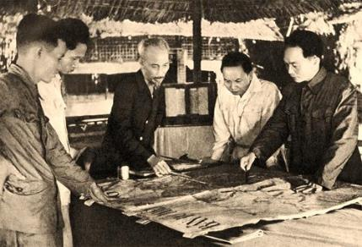

Under French Control Again
With the Allies’ victory over Japan
in 1945, Ho Chi Minh and his forces declared Vietnam an independent nation.
But…France sent in troops to regain its colonial empire.
  US backed France because we didn't want Vietnam to be Communist

Slide 8
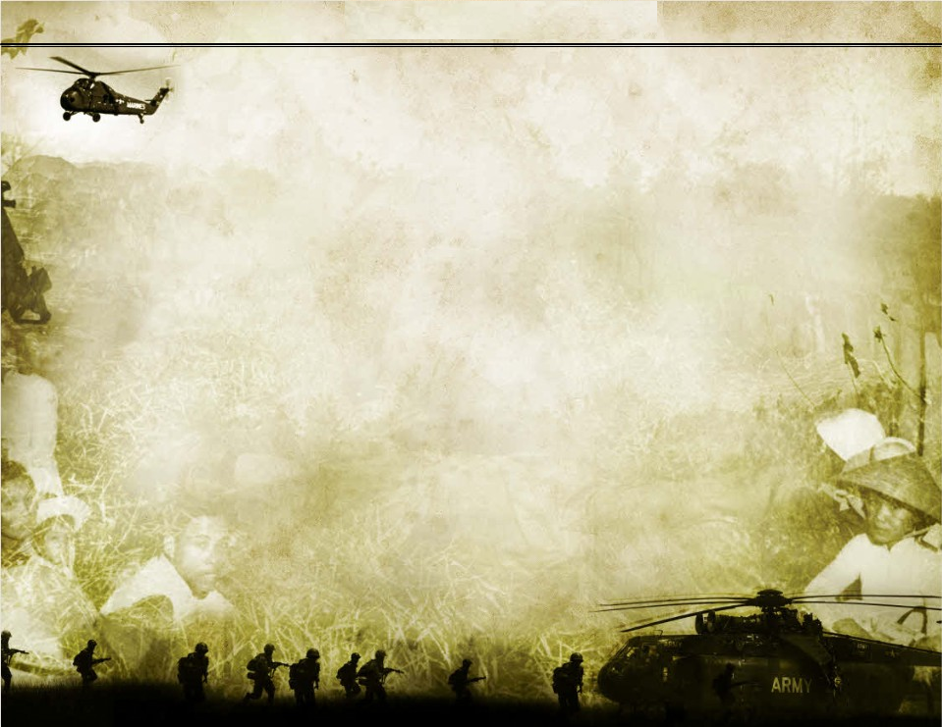
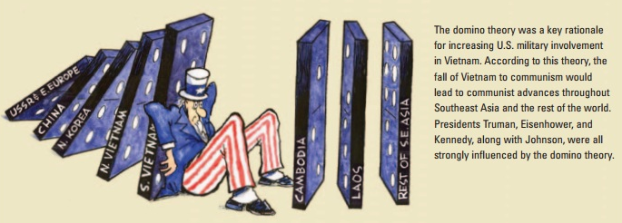
Domino Theory
The United States, under the Truman and Eisenhower, supported the French military.
Eisenhower defended the United States policy in Vietnam with the domino theory—the belief that if Vietnam fell to communism, other nations in Southeast Asia would do the same.

Slide 9
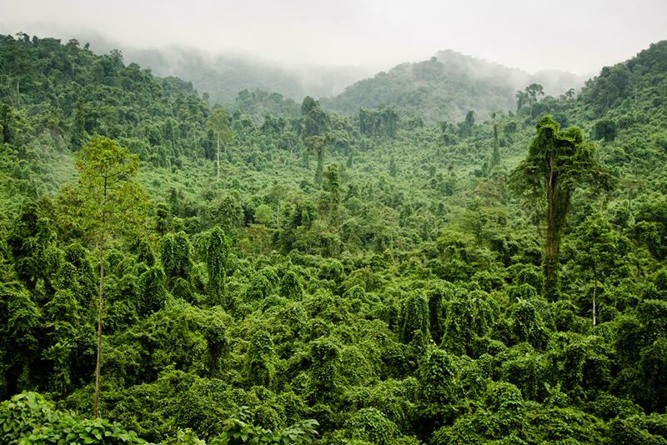
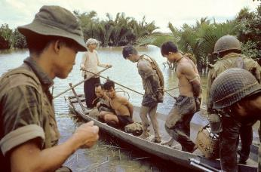
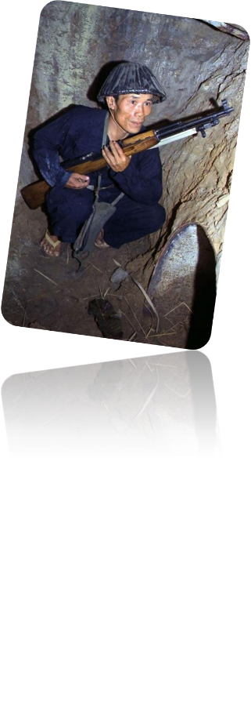
French Have Difficulty
Despite aid from the United States,
the French struggled against the Vietminh.
They frequently used the tactics of guerrillas, or irregular troops who usually blend into civilian population and are difficult for regular armies to fight.
They used hit-and-run and ambush tactics.

Slide 10
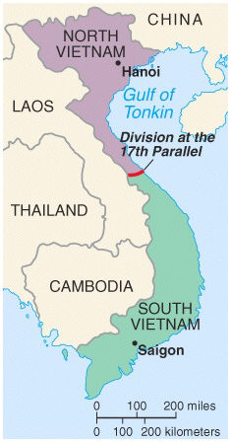
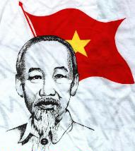
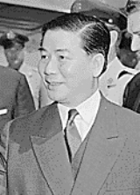
Geneva Accords
By 1954 the Vietminh force the French to make peace and withdraw from Indochina.
Negotiations to end the conflict, called the Geneva Accords, divided Vietnam along the 17th parallel, with Ho Chi Minh and the Vietminh controlling North Vietnam and a pro-Western regime in South Vietnam.
The Accords also recognized Cambodia’s independence.
http://www.history.com/topics/vietnam-war/audio#dien-bien-phu-falls

Slide 11
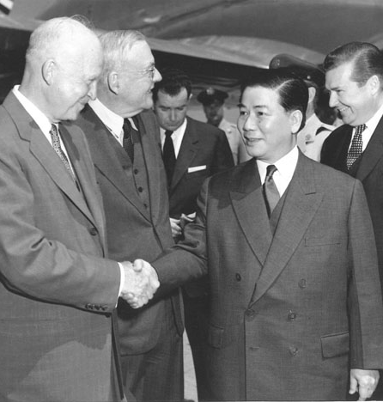
United States Steps in
After the French defeat, the United States took a more active role in halting the spread of communism
Ho Chi Minh became a national hero despite his tough leadership
The USA (Eisenhower) promised Diem aid and training to build a strong government in South Vietnam

Slide 12
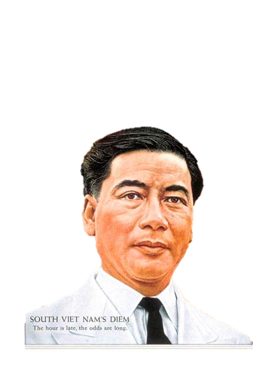
Tensions Escalate
In 1956 elections were held to form a single government.
The United States stepped in to protect the new government in the South led by Ngo Dinh Diem, a pro-Westerner and anti-Communist.
The tension between North and South Vietnam escalated with the United States caught in the middle.

Slide 13
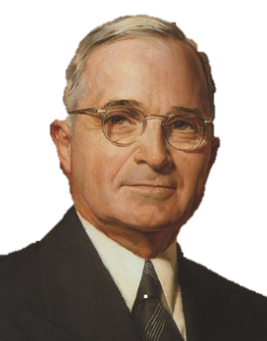
Truman Doctrine
My Doctrine to the RESCUE!
Stated in the Truman Doctrine, the United States would have to step in here.
  This was our major justification for U.S. foreign policy during the Cold War

Slide 14
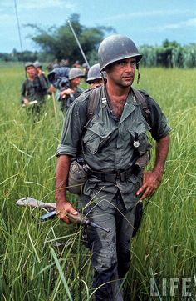
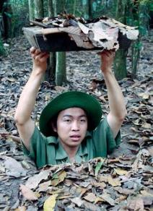
Vietcong
After Ngo Dinh Diem refused to
hold national elections, Ho Chi Minh and his followers created a new guerrilla army known as the Vietcong.
  Their goal was to reunify North and South Vietnam.
The United States continued to send aid to South Vietnam.

Slide 15
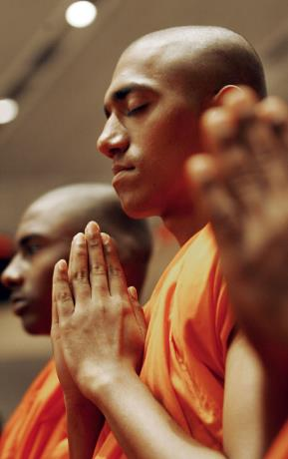
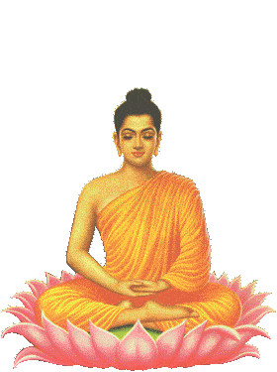
Diem is Disliked
The unpopularity of South Vietnam’s President Diem increased because his government was corrupt, and he discriminated against Buddhism, one of the country’s most widely practiced religions.
He burned temples, and killed hundreds of Buddhist clerics (some protested)

Slide 16
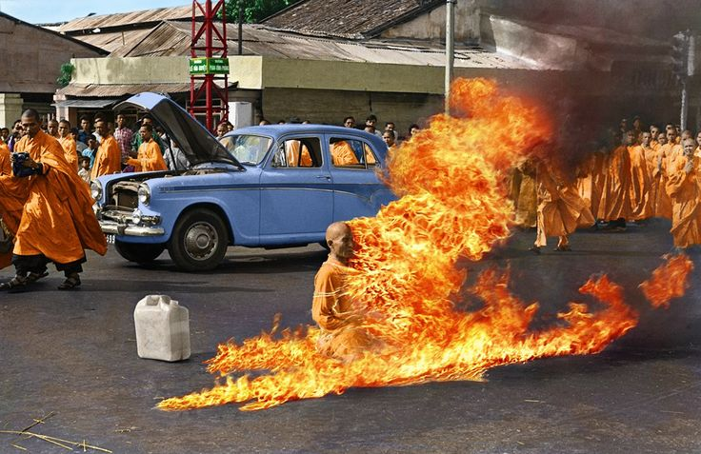
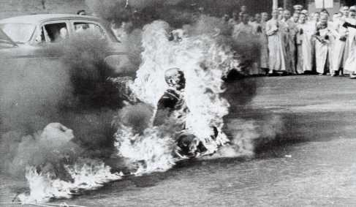
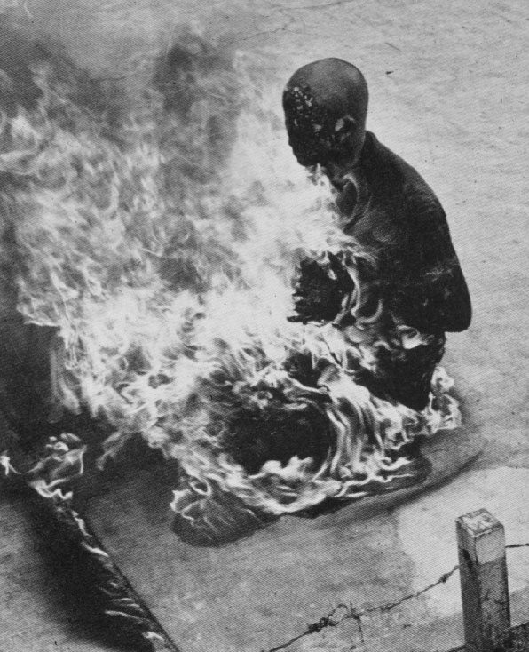
Monks publicly burned themselves to protest corrupt Southern government

Slide 17
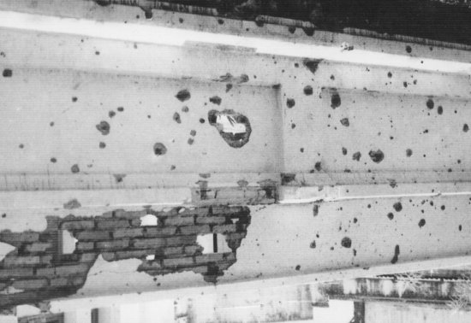

Diem was overthrown and later executed.
  forcing the United States to become more involved.
Bullet marked walls from President Diem's assassination.

Slide 18
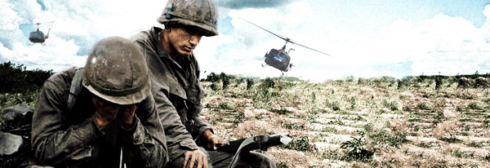
Vietnam In HD
Notes:
Recommended Video

Slide 19
Discussion Questions:
1. How were France and the USA involved with Vietnam even before the war began?
2. Why did South Vietnam become increasingly unstable?

Slide 20
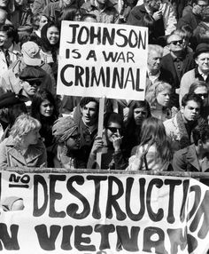
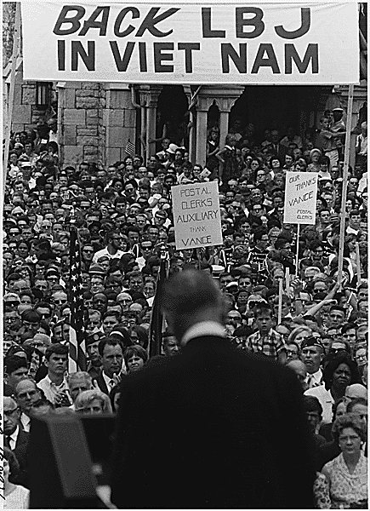
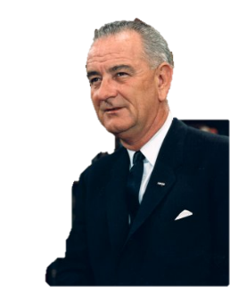
Johnson’s War
After Kennedy’s assassination, President Lyndon Johnson inherited the problem
of Vietnam.
At first, President Johnson was cautious regarding Vietnam, yet he was determined to prevent South Vietnam from becoming Communist.
Politically, Democrats needed to keep South Vietnam from becoming Communist, or Republicans would use it against them.

Slide 21
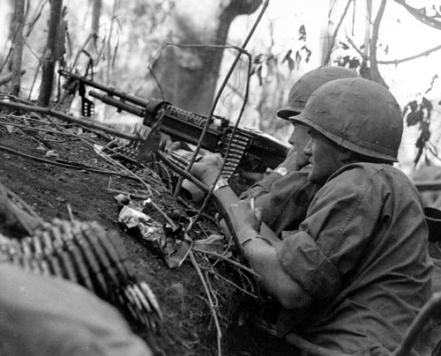
Strong Support for Containment
Johnson was initially opposed to sending ground troops into Vietnam
“I am not about to send American boys 9 or 10,000 miles away from home to do what Asian boys ought to be doing for themselves.”
Soon after (March 1965), he began sending tens of thousands of troops to fight in Vietnam
His close advisors (Robert McNamara, Dean Rusk) pushed him towards this
In 1965, 61% of Americans supported the war, while 24% opposed it

Slide 22
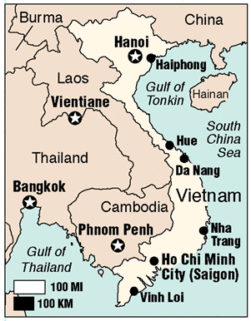
Gulf of Tonkin
On August 2, 1964, President Johnson announced that North Vietnamese torpedo boats fired on two American destroyers in the Gulf of Tonkin.
A similar attack reportedly occurred two days later. The Senate and the House passed the Gulf of Tonkin Resolution on August 7, 1964, authorizing the president to take all necessary measures to repel any armed attack on U.S. forces.

Slide 23
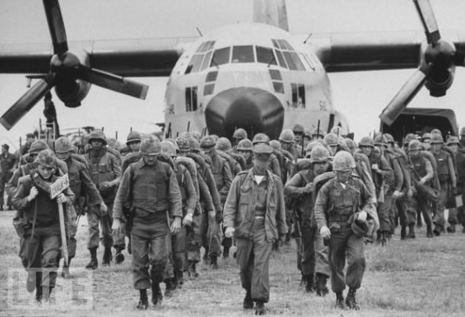
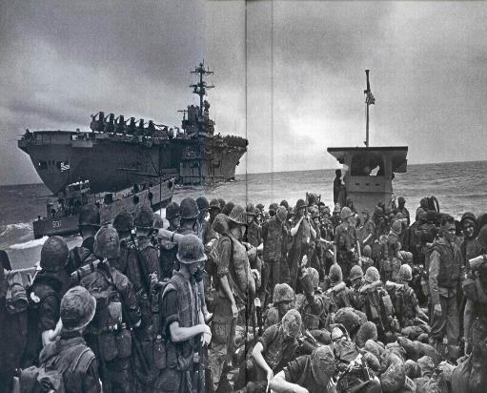
Gulf of Tonkin Resolution
  Authorized the President to “take all necessary measures to repel any armed attack against the forces of the United States and to prevent any further aggression.”
  This essentially gives the war powers of Congress to the president

Slide 24
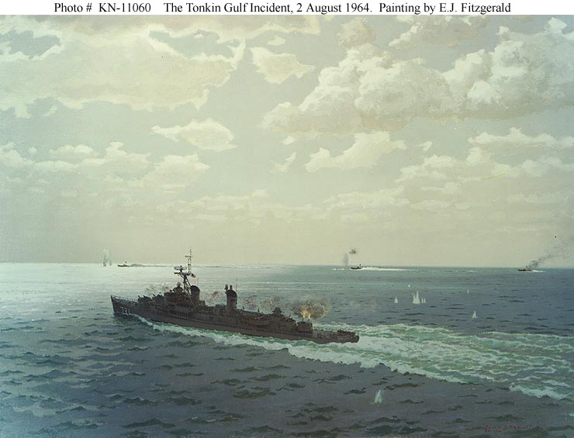
#1’s Read Document A & Answer the questions in complete sentences
#2’s Read Document B & Answer the questions in complete sentences
Group Response: Paragraph
Was the U.S. planning to go to war in Vietnam before August 1964?
#3’s Read Document C & Answer the questions in complete sentences
#4’s Read Document D & Answer the questions in complete sentences
Notes:
Go to site for Documents: http://sheg.stanford.edu/upload/Lessons/Unit%2011_Cold%20War/Gulf%20of%20Tonkin%20Resolution%20Lesson%20Plan.pdf

Slide 25
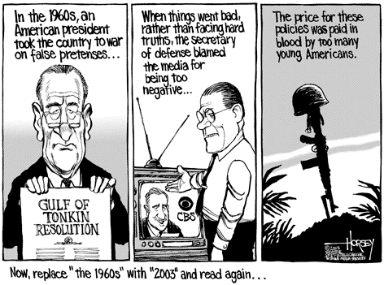
Lyndon B. Johnson’s Speech Peace Without Conquest
April 7, 1965
“The first reality is that North Vietnam has attacked the independent nation of South Vietnam.”
“We are there because we have a promise to keep. Since 1954 every American President has offered support to the people of South Vietnam.”

Slide 26
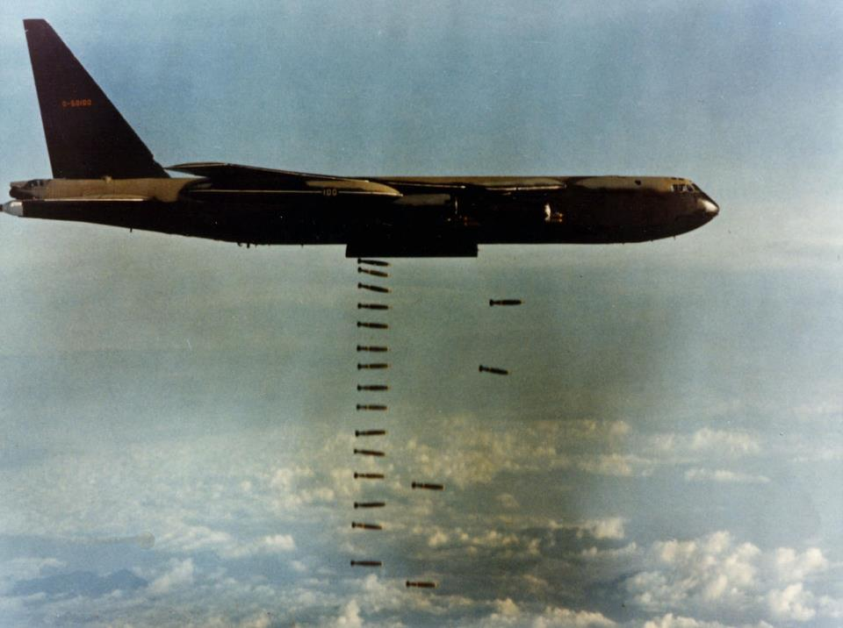
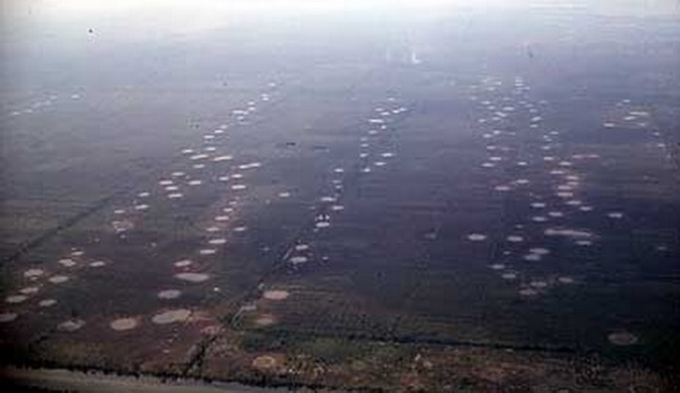
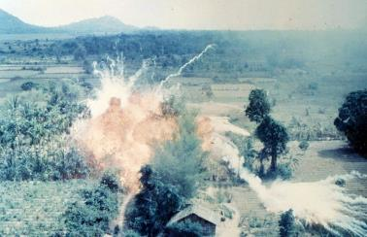
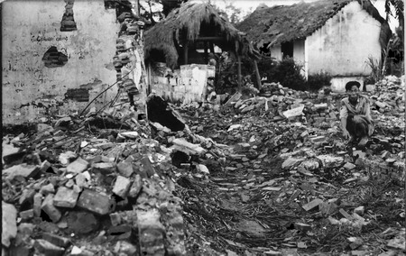
Operation Rolling Thunder
After the Gulf of Tonkin Resolution was passed, the Vietcong began attacking bases where American advisers were stationed in South Vietnam.
After an attack in February 1965, Johnson ordered massive bombing in North Vietnam→ Operation Rolling Thunder

Slide 27
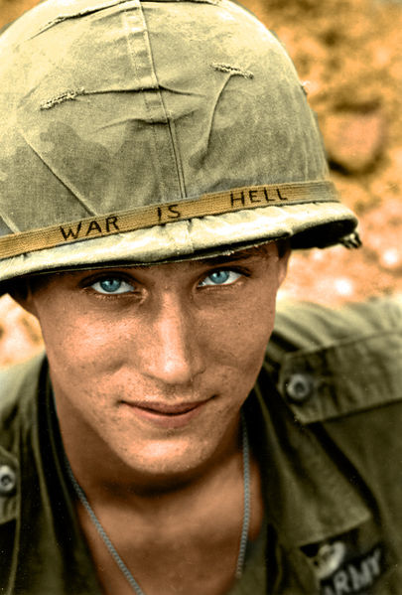
Increased American Involvement
While the polls showed that Johnson’s approval rating had increased, some dissenters in the White House warned that if the United States became too involved, it would be difficult to get out.
In March 1965, however, Johnson increased American involvement, and American soldiers were fighting alongside the South Vietnamese troops against the Vietcong.
https://www.youtube.com/watch?v=Z3Wih7Q0DVs

Slide 28
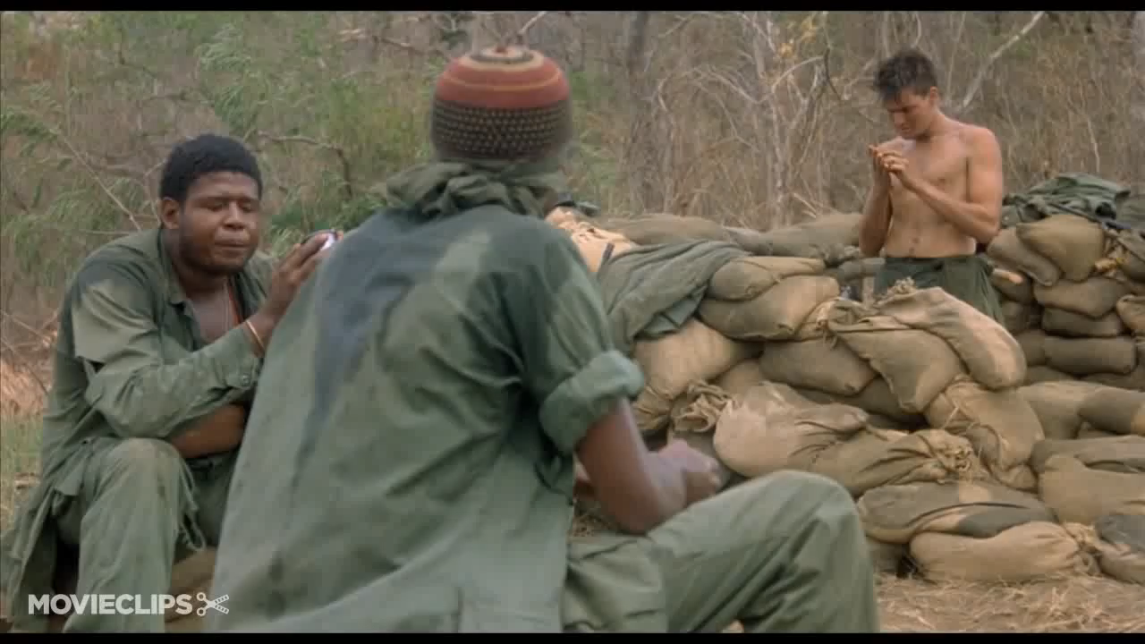

Slide 29
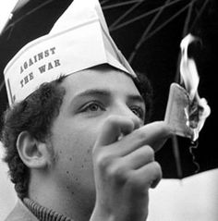
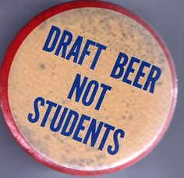
1.85 million men were drafted for the Vietnam Conflict
The Draft

Slide 30
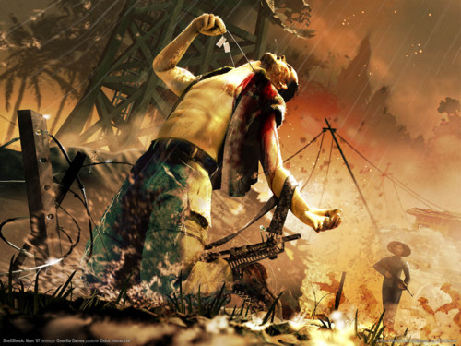


Methods of War
US believed its superior weaponry would lead to victory over the Vietcong
Ambushes
Booby traps
Guerrilla tactics
Blended in in with general population
Ho Chi minh Trail
  Trail that the Viet Cong used to transport arms and supplies to armies in the South; transported through various countries via the jungle
“Search and destroy” missions (Green Berets)
  bring the enemy into the open to fight by bombing and cutting off supply lines
Agent Orange
  Chemical that strips plants of leaves; ruins farmland and destroys jungle
    Important in the thick jungle areas of Vietnam
Napalm
  Jellied gasoline that explodes on contact; ruins farmland and destroys jungle
Viet Cong
USA
Notes:
Viet Cong Booby Trap: “three quarters of the way throught he tangle, a trooper brushed against a two-inch vine, and a grenade slung at chest high went off, shattering the right side of his body… nearby troopers took hold of the unconscious soldier and, half carrying, half dragging hun, puled him the rest of the way throuhg the jungle.”
30

Slide 31
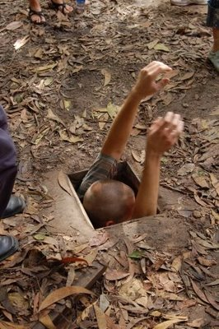
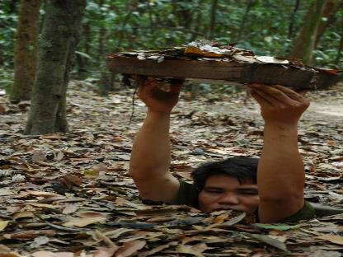
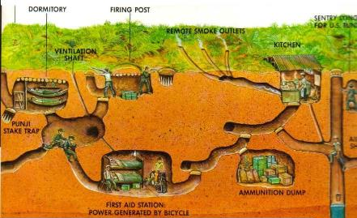
Where are they?!
The Vietcong lived amongst the people, so it was hard to tell who was friend or foe
The Vietcong also had elaborate networks of tunnels
These tunnels could withstand airstrikes, help them launch surprise attacks and then disappear.
The tunnels were burrowed deep and often connected villages
“The more the Americans tried to drive us away from our land, the more we burrowed into it.” – Leader of the Vietcong
The terrain was laced with booby traps and land mines from both sides

Slide 32
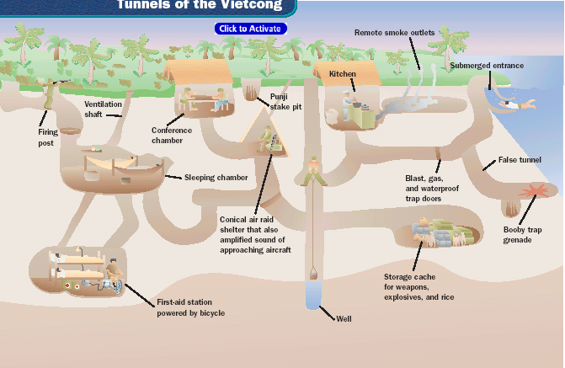

Slide 33

Even women fought for the Vietcong

Slide 34

US soldiers conducted search and destroy missions – killing suspected Vietcong members, their livestock, and burning their villages
Many villagers fled to refugee camps (over 3 million people) in S. Vietnam

Slide 35


Tactics
By 1965 some 180,000 American combat troops were fighting in Vietnam, with the number doubling by 1966.
Many Americans believed they could win in Vietnam.
To take Vietcong’s hiding places away, American planes dropped napalm, a jellied gasoline that explodes on contact, and Agent Orange, a chemical that strips leaves from trees and shrubs. Farmlands and forests were turned into wastelands.

Slide 36


Napalm
It is an extremely flammable, gasoline-based defoliant and painful weapon that can generate temperatures in excess of 2,000 degrees.

Slide 37



Napalm

Slide 38



Agent Orange is an herbicide (plant killer) used by the U.S. during the Vietnam War
An estimated 21,136,000 gal. of Agent Orange was sprayed across South Vietnam
4.8 million Vietnamese people were exposed to Agent Orange, resulting in 400,000 deaths and disabilities, and 500,000 children born with birth defects
Agent Orange

Slide 39

Agent Orange
CLICK LINK: http://www.youtube.com/watch?v=GXu2KmzAX-A

Slide 40

Vietcong Stamina
Americans underestimated the Vietcong’s strength, stamina, and morale.
Johnson refused to order a full invasion of North Vietnam, fearing China would get involved in the war.
President Johnson also refused to allow a full-scale attack on the Vietcong’s supply line, known as the Ho Chi Minh trail. This made winning difficult.
As American casualties increased, many American citizens began questioning the United States involvement in the war.

Slide 41


Body Count Tallies
Westmoreland’s strategy was attrition – destroy their morale and wear them down
He also introduced the idea of a “body count” to encourage his men and discourage the enemy
The US viewed Vietnam as a military struggle – the Vietcong viewed Vietnam as a battle for there very existence

Slide 42

Ho Chi Minh Trail
Analyzing Why did the Ho Chi Minh Trail pass through Laos and Cambodia instead of South Vietnam?
to avoid discovery and capture of troops and supplies passing along the trail.

Slide 43





American Difficulties
We were fighting a guerilla war in unfamiliar territory.
The South Vietnamese government we were defending was very unpopular.
We could win every battle and still lose the war.
U.S. bombing raids only strengthened people against the South Vietnamese government.

Slide 44

Sinking Morale
Troops eventually became frustrated because of:
1. Guerilla warfare
2. Harsh Jungle Conditions
3. Making No Headway against the enemy

Slide 45

Drug Abuse
Many troops turned to:
Alcohol
Drugs
Prostitution
and infighting among their own men

Slide 46
Discussion:
1. In what ways do you think the Vietcong’s attitude helped them to fight the US soldiers?
2. What are your thoughts on Westmoreland’s war of attrition and the body count? (Morale)

