Slide 1

Bell Ringer & Vocab
Why do you think the Vietnam War was so unpopular?
Content Vocab
Tet Offensive
Veitnamization
Pentagon Papers
Kent State Massacre
War Powers Act
Richard Nixon
Academic
Resolution
Notes:
1

Slide 2

The End of the
Vietnam War
1965-1975
Notes:
2

Slide 3
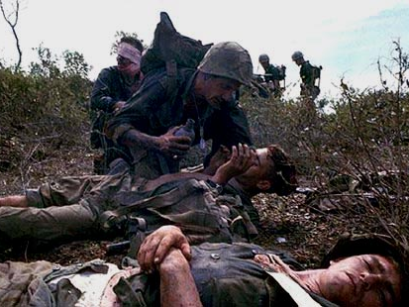
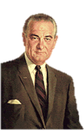
Credibility Gap
When American troops first entered the Vietnam War, many Americans supported the military effort.
As the war drag on, public support decreased.
Americans began to question the government and believed a credibility gap had developed, making it difficult to believe what the Johnson administration said about the war.
We are winning the war! (NOT REALLY)

Slide 4
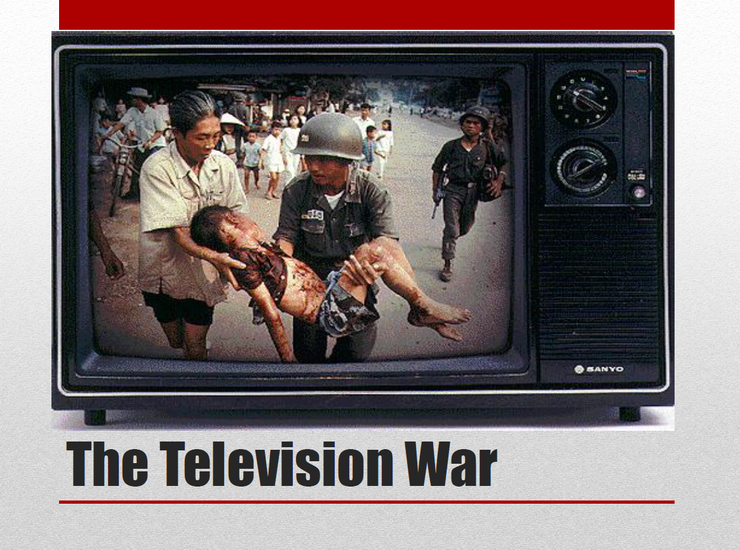

Slide 5
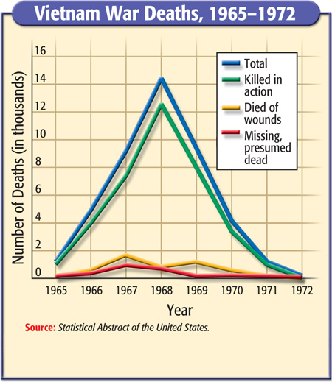

Slide 6
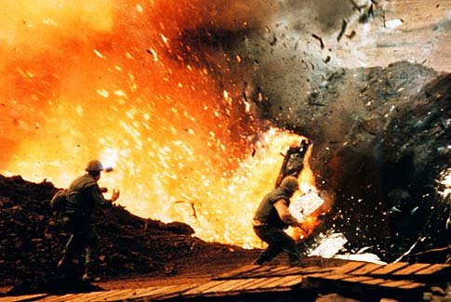
1968- Tet Offensive
The year 1968 began with a surprise attack by the Vietcong and the North Vietnamese army on numerous cities.
The simultaneous strikes, while ending in military defeat for the Communist guerillas, stunned the American public.
That same year Robert Kennedy and MLK were assassinated
Notes:
6

Slide 7
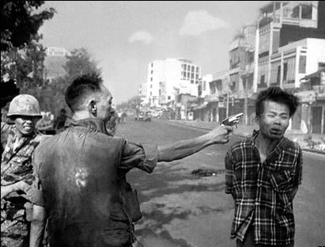
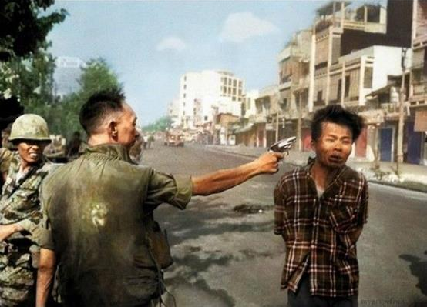
Tet- Offensive
Both sides agreed to a truce to celebrate the New Year.
Vietcong launched major attacks on over 100 cities and 12 U.S. air bases that lasted 1 month
Militarily it was a defeat for the Vietcong. Psychologically defeat for the US
The credibility gap increased as the US continued to lose.
Officer shoots man (An execution of a Vietcong prisoner) February 1, 1968
http://www.history.com/topics/vietnam-war/vietnam-war-history/videos/tet-offensive
Notes:
7

Slide 8
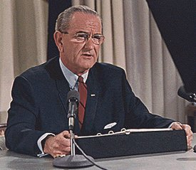
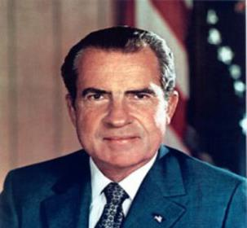
Turning Point in the 1960s
After the Tet Offensive, support for the war decreases
Johnson tells the nation that he will not run for re-election
Nixon wins the election, promises to end War
Notes:
8

Slide 9
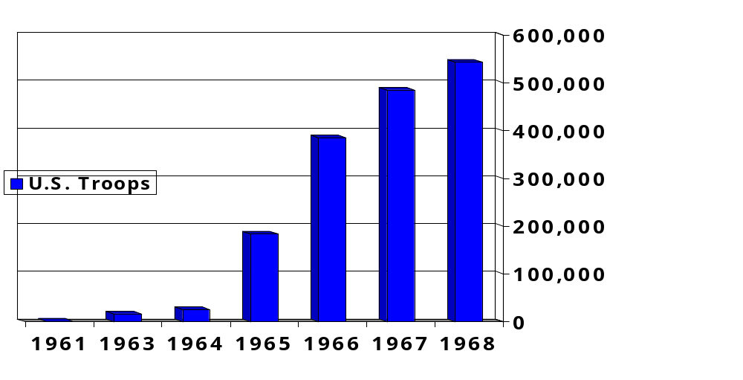
US Troop Deployments
in Vietnam
Notes:
9
Kennedy’s advisors were clearly fighting a covert war by 1963.
MacNamara has suggested that he believes Kennedy would have pulled the U.S. out, but evidence in inconclusive.
JFK realizes Diem is a liability; offers quiet support to a Vietnamese military coup d’etat.
The coup results in the brutal murders of Diem and his brother
The Vietnamese generals overthrow one another. A relatively stable, but tyrannical government emerges. It is little better than Diem’s.

Slide 10
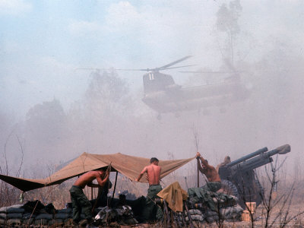
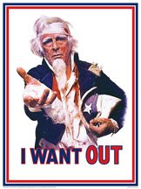
Nixon in the White House
In 1969, Nixon announced the first U.S. troop withdrawals from Vietnam. However, as Nixon pulled out the troops, he continued the war against North Vietnam, a policy that some critics would charge prolonged the war for several more years…
Notes:
10

Slide 11
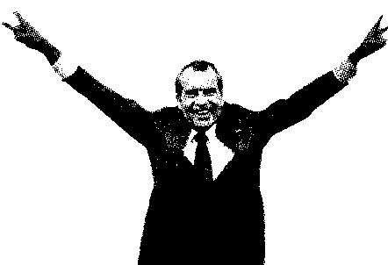
Vietnamization
Peace talks but no agreement who should rule Vietnam
Vietnamization-Nixon’s plan to end the war
  Gradual withdrawal of US, S. Vietnam would take on more combat roles
Time to LEAVE!
Notes:
11

Slide 12
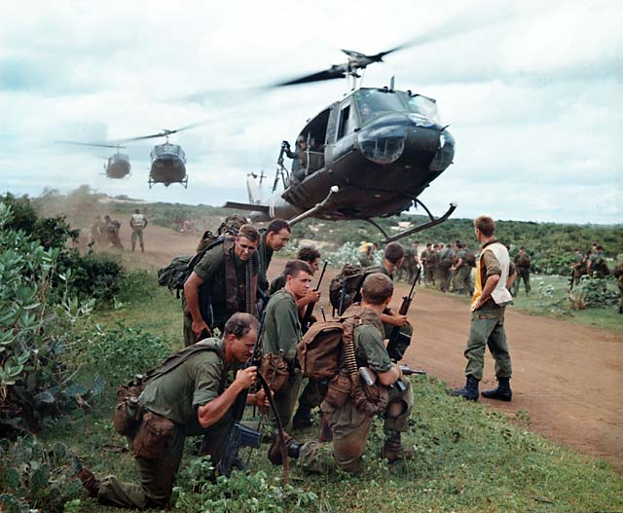
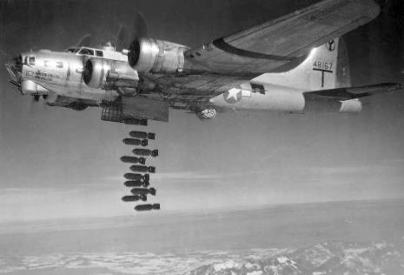
Nixon in the White House
“Peace with Honor”-maintain US dignity during the withdrawal.
Nixon secretly ordered the bombing of Laos and Cambodia which held a number of Vietcong soldiers
Notes:
12

Slide 13
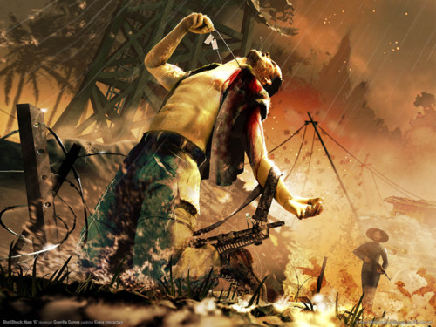
Checking for Understanding
Why did Americans believe there was a “credibility gap” in what the Johnson administration said about the war in Vietnam?
Govt is telling Americans that we are winning the war yet on TV we can see that is not true.

Slide 14
Checking for Understanding
What are three important events that occurred in 1968.
Tet Offensive
King assassinated
Kennedy assassinated

Slide 15
Checking for Understanding
What was Vietnamization?
This was Nixon’s plan to gradually withdraw American troops and for South Vietnam to assume more of the fighting.

Slide 16

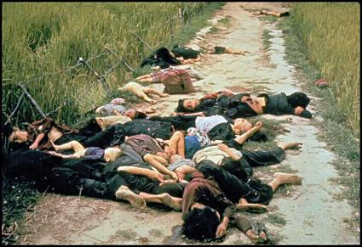
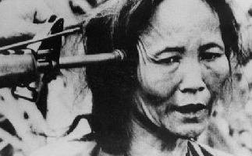
Anti-War Feelings
In 1969 Americans learned of a 1968 event that further increased their feelings that this was a senseless war.
My Lai Massacre- US troops were ordered to find Vietcong in the village.
No Vietcong were found, troops shot 200 innocent people.
Notes:
16

Slide 17
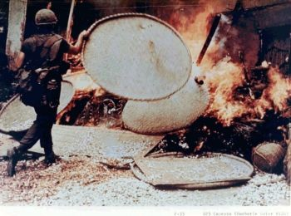
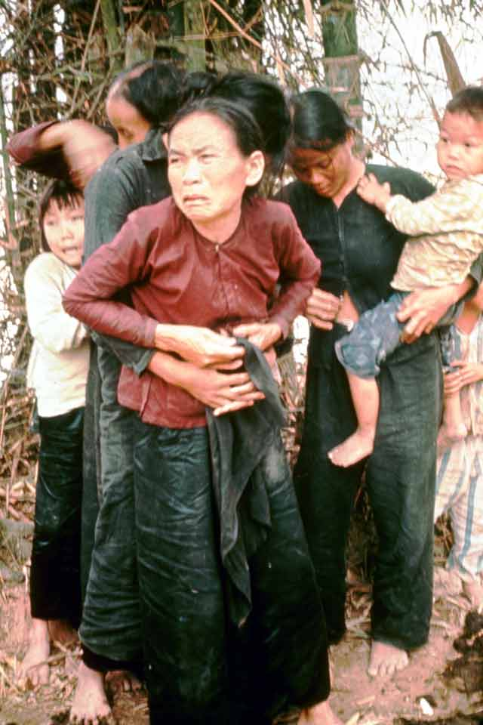
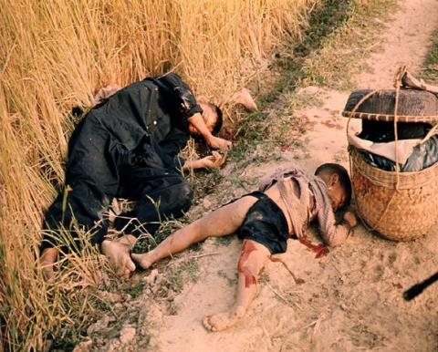
My Lai Massacre
https://www.youtube.com/watch?v=rHk4TGWx0ZM

Slide 18
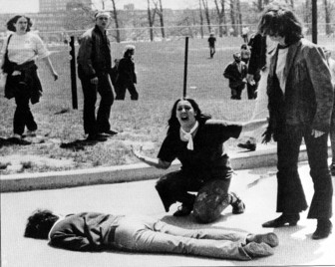
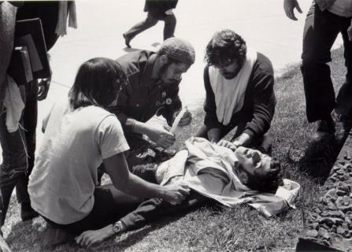
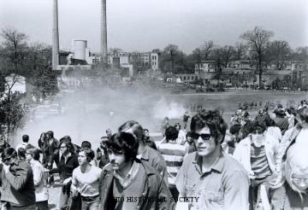
Kent State
Nixon invades Cambodia
College students protest and held the nations 1st general student strike.
  1.5 million students closed down 1,200 campuses
Kent State-students protesting the war and entrance into Cambodia
Guard sent in and killed 4 students
Notes:
18

Slide 19
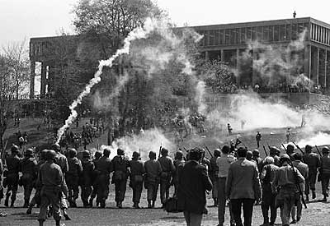

Slide 20
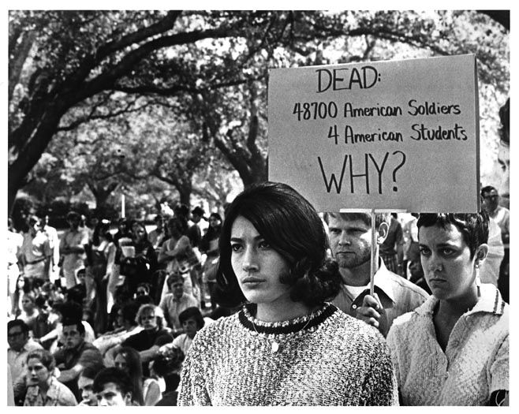
Louisiana State University protest against the Vietnam War following the Kent State University May 4 shooting

Slide 21
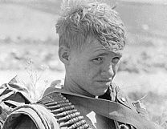

Pentagon Papers
1970 Congress repealed the Tonkin Gulf Resolution due to Nixon’s escalation of the war-
Pentagon Papers-Secret documents about the war.
Confirmed the gov. lied about the war
  Showed plans to enter the war even though Johnson promised he would not
  Never a plan to end the war as long as the North persisted
Notes:
21

Slide 22
Checking for Understanding
What were the students protesting at Kent State?
US invasion of Cambodia.

Slide 23
Checking for Understanding
Who were the majority of people killed at the My Lai Massacre?
Innocent women and elderly

Slide 24
Checking for Understanding
What did the Pentagon Papers expose?
Confirmed the gov. lied about the war

Slide 25
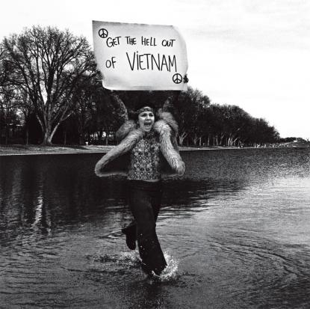
America Leaves in 1973
    U.S. signed an “Agreement on Ending the War and Restoring Peace in Vietnam”
    Conditions
      U.S. to remove all troops
      North could leave troops already in South
      North Vietnam would resume war
    For America the war ends in 1973
Notes:
25

Slide 26

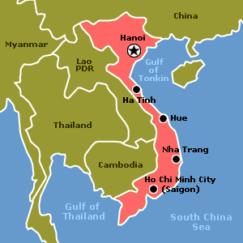
Finally… a United Vietnam
    Two more years of fighting continued.
    North attacks and defeats the South. South’s capital of Saigon is renamed Ho Chi Minh City
Notes:
26

Slide 27
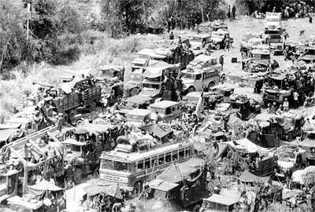
Fall of Saigon
South Vietnamese
Attempt to Flee the Country
Notes:
27

Slide 28
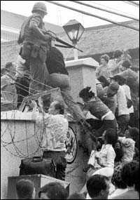
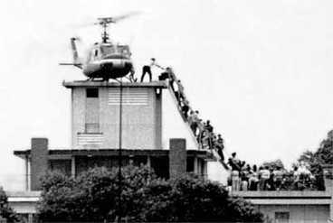
Fall of Saigon
April 30, 1975
America Abandons Its Embassy
Notes:
28

Slide 29
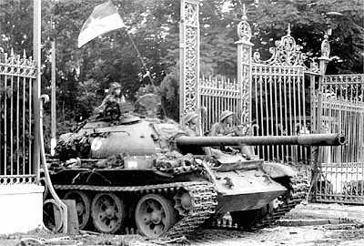
Fall of Saigon
North Vietnamese
at the Presidential Palace
Notes:
29

Slide 30
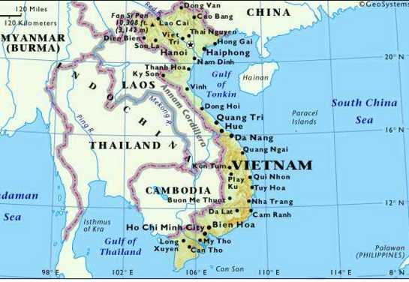
A United Vietnam
Formerly Saigon
Notes:
30

Slide 31
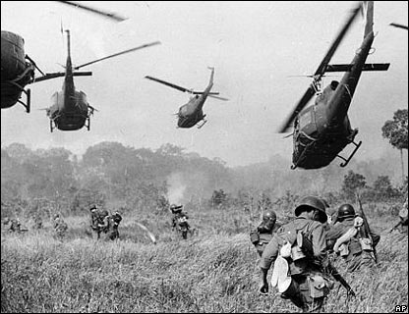
Impact
Vietnam unified under Commun-ism
3 million Vietnamese killed
58,000 Americans killed
300,000 wounded
$150 billions U.S. spend in funding the war
changed attitudes about war
26th Amend- lowered the voting age
Notes:
31

Slide 32


In 1996 it was estimated that 10 million land mines still remain in the ground in Cambodia and Vietnam.

Slide 33
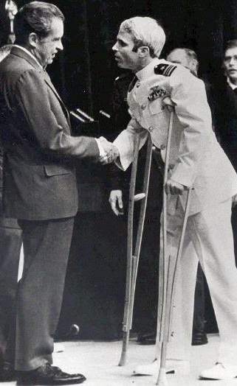
Impact
War Powers Act-president informs Congress in 48 hrs if sent into hostile areas without declaration of war
May not stay for more than 90 days unless Congress approves
2,583 American POWs / MIAs still unaccounted for today.
Notes:
33

Slide 34
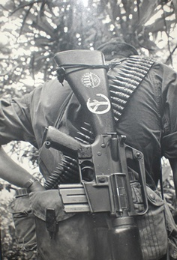
Lessons Learned for Future Presidents
Wars must be of short duration.
Wars must yield few American casualties.
Restrict media access to battlefields.
Develop and maintain Congressional and public support.
Set clear, winnable goals.
Set deadline for troop withdrawals.
Notes:
34

Slide 35
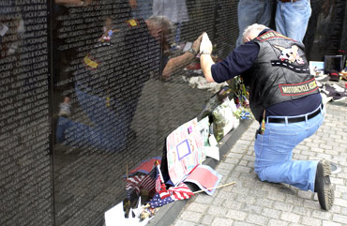
Notes:
35

Slide 36

Notes:
36

Slide 37
Checking for Understanding
What year does the war end?
1973

Slide 38
Checking for Understanding
How many Americans were killed?
58,000

