Slide 1
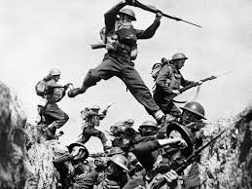
The World At War
1914 - 1918

Slide 2
M.A.I.N Causes of WWI
Militarism
Alliances
Imperialism
Nationalism

Slide 3
Imperialism and Militarism
Imperialism is the domination of one country economically, socially, and/or politically by another country
The major powers came to the brink of war more than once over their colonies in Africa and Asia and it led them to a lot of mistrust
Militarism is the love and glorification of the military and of war
This leads to an arms race as each country tried to outdo the others with
the number and strength of troops, weapons, etc.
By 1914 all of the major powers except Great Britain have large standing
armies
This leads to people feeling patriotic, but also to fear other countries, increasing the
levels of mistrust

Slide 4
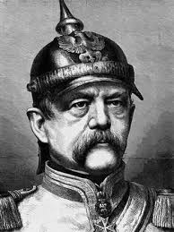
Alliances lead to war
Otto Von Bismarck
Between 1864 and 1871 Bismarck used war to unite Germany out of 309 independent states
In 1871 Germany declared itself a “satisfied power” and decided to seek peace instead
They knew France was still angry about Alsace Lorraine and decided that isolating France was the best way to keep peace in Europe.
To do that Bismarck will make alliances with other European Powers
1879 – The Dual Alliance – Austria-Hungary and Germany
1881 – Germany signs a treaty with Russia so they won’t have to fight war on 2 fronts
1882 – The Triple Alliance – Germany, Italy, and Austria-Hungary

Slide 5
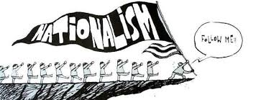
Rising Tensions in Europe
Nationalism: Pride and devotion to your country and culture.
It can unify and it can tear apart.
People with similar backgrounds and cultures can become a country or they can try to remove themselves and form a new one

Slide 6
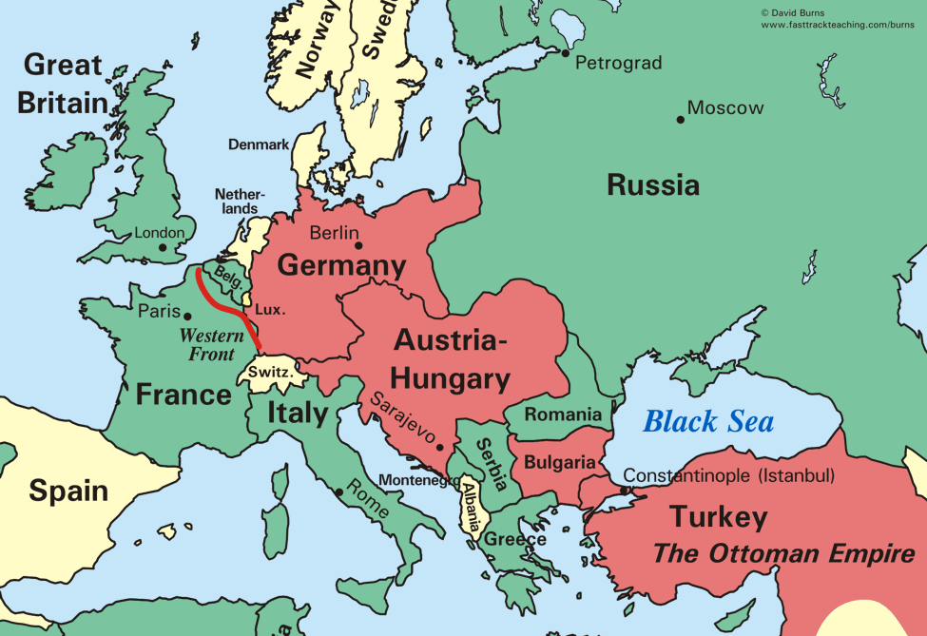
The 6 major powers of Europe:
Great Britain
Russia
Germany
Austria-Hungary
France
Italy
Were often competing with each other because of nationalism.

Slide 7
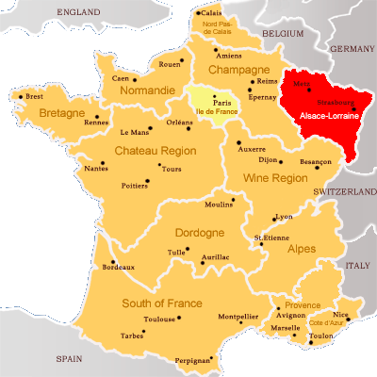
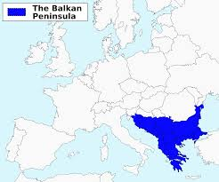
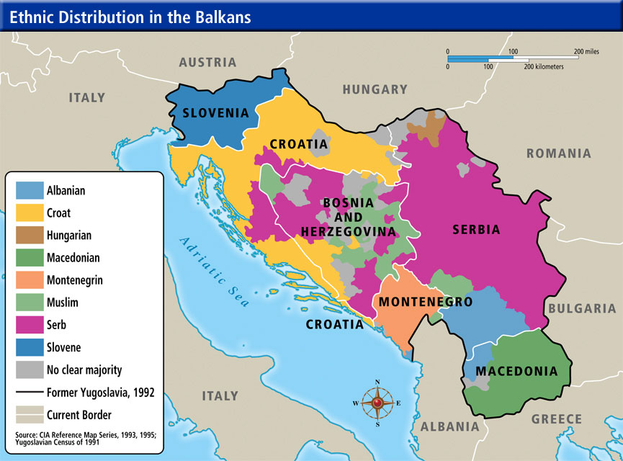
There were a couple big sources of tension between the powers
Competition for materials and markets
Territorial disputes
  The French lost Alsace Lorraine to the Germans in 1870 during the Franco-Prussian War and they were still unhappy about it in 1914
  b. Austria Hungary and Russia were both trying to dominate in the Balkans
  c. In the Balkans there were multiple ethnic groups that all wanted their independence

Slide 8
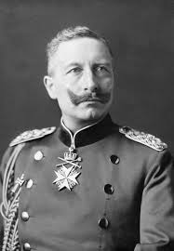
Kaiser Wilhelm II forces Bismarck to resign and then things really get bad

Slide 9
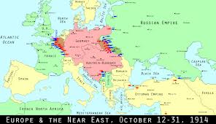
Kaiser Wilhelm II lets the Russian treaty lapse
When this happens Russia signs a treaty with France in 1892 and again in 1894
When the war starts, Germany will have to fight on two fronts. This was Bismarck’s nightmare.

Slide 10
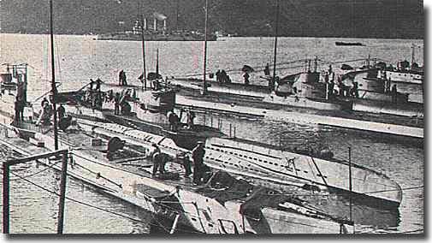
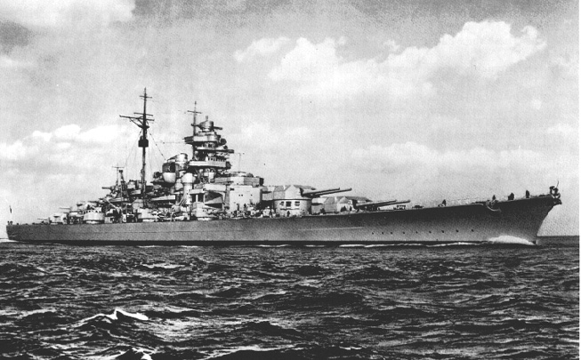
Wilhelm II then goes on a ship building spree trying to make the German Navy equal or greater than that of Britain
Britain now joins the Triple Entente with Russia and France
This means there are now 2 major alliances in Europe:
Triple Alliance (Germany, AH, Italy) and Triple Entente (GB, Russia, France)

Slide 11
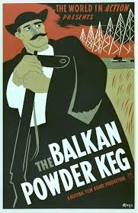

Slide 12
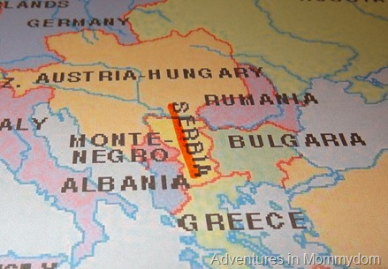
The people of the Balkans had been pushing for independence from the Ottoman Empire for years
A few, Greece, Bulgaria, Montenegro, Romania, and Serbia had succeeded

Slide 13
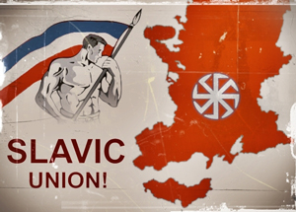
Pan-Slavism - Unity for all Slavic Peoples (Especially those controlled by non-Slavic empires)
This is the reason why Serbians wanted to extend through the Balkans
Austria – Hungary doesn’t want them to because they control some of those states
Russia does support Serbia however because they’re also Slavic
In 1908 A – H took over Bosnia and Herzegovina (Both areas were largely Slavic)
Serbia vowed to take them back, Austria – Hungary vowed to crush Serbia

Slide 14
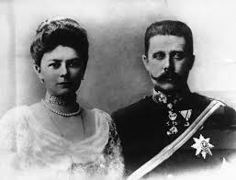
The Assassination at Sarajevo
June 28 1914 – Archduke Franz Ferdinand and his wife Sophie make a state visit to Sarajevo, Bosnia
Unfortunately this had traditionally been Bosnia’s Independence Day. Serbia was angry that Austria-Hungary had taken Bosnia away from them

Slide 15
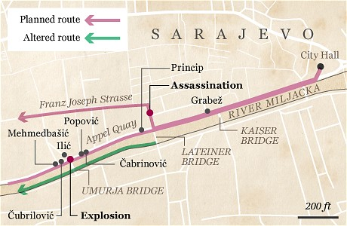
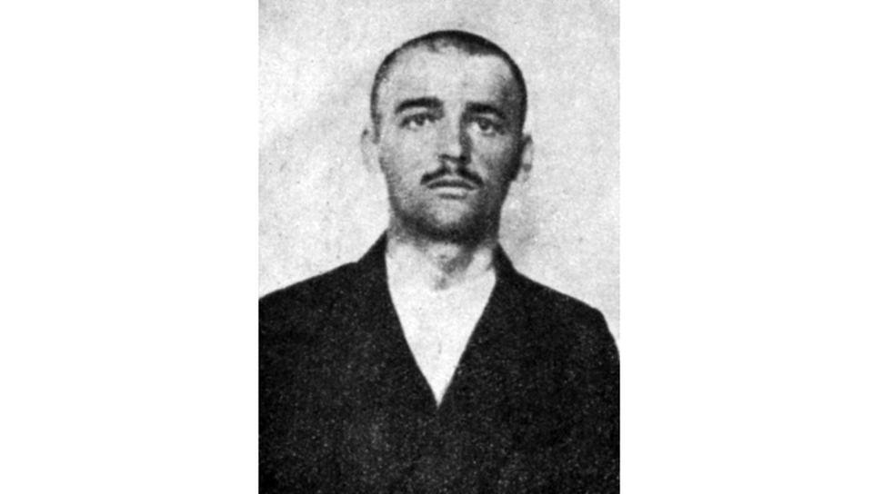
As the motorcade travelled along a well published route, a hand grenade was thrown by a man named Nedeljko Cabrinovic. It bounced of the door and injured a bodyguard

Slide 16

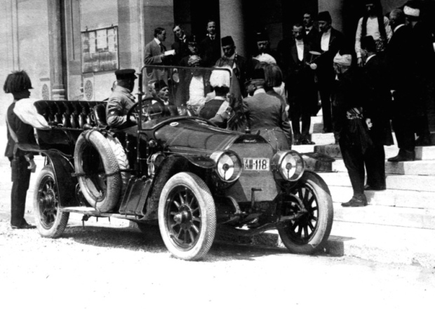
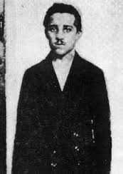
At this point, the security guards should have gotten the royal family out of there. Instead Franz-Ferdinand decided he wanted to visit the injured bodyguard then continue on with his trip. AND THEY LET HIM!!!
As the car continued down the same (!) route it reached a sharp turn and it was too large to make the turn without backing up.
When the car backed up it stopped right in front of Gavrilo Princip, a 19 year-old member of the Black Hand (Freedom Fighters? Terrorists? Depends on who you ask)
Their motto was Unity or Death

Slide 17
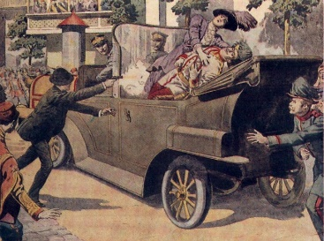
Princip shot the Archduke and his wife point blank, killing both of them
The Archduke’s last words were “Sophie, Sophie! Don’t die! Stay alive for the children!”

Slide 18
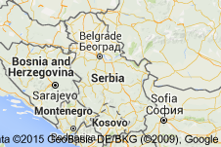

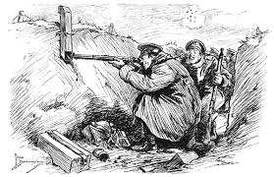
Pricip was a Serbian so Austria-Hungary blamed Serbia for the murders.
They issued an ultimatum that said that Serbia had to allow Austrian investigators into the country to investigate the murders.
Do what we say or else!
Serbia couldn’t agree without giving up their sovereignty to Austria – Hungary
BUT they couldn’t say no without going to war.
Serbia agreed to most of the terms of the ultimatum and offered to have an international council determine what should be done

Slide 19
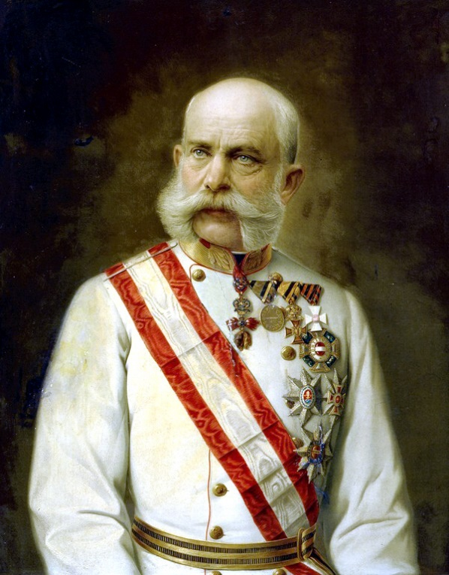

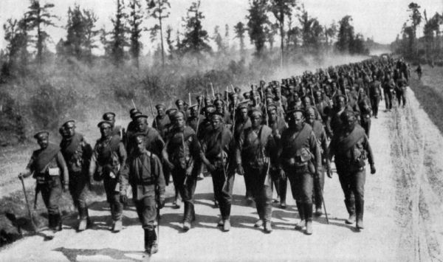
July 28, 1914
Austria – Hungary said NO to these terms and declared war on
Also on July 28th, Russia started mobilizing its army because they were allies with Serbia

Slide 20
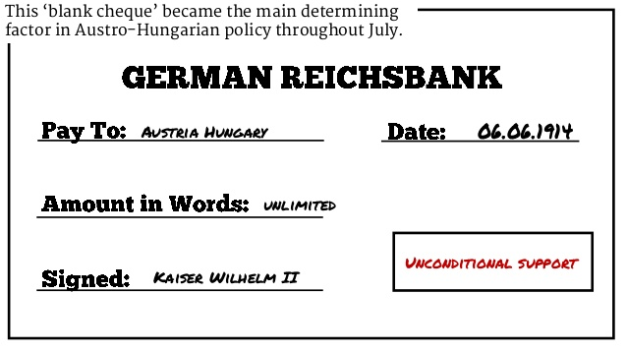
Everyone urged Austria-Hungary to negotiate but they wouldn’t.
Then Kaiser Wilhelm gave Austria-Hungary “Blank Check”
support for whatever they decided to do

Slide 21
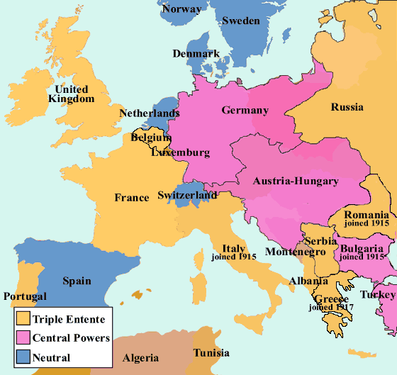
World War I Begins:
A Timeline to War:
July 28th: Austria Hungary declares war on Serbia
July 28th: Russia begins to mobilize their troops
August 1st: Germany declares war on Russia
August 3rd: Germany declares war on France
August 5th: Great Britain declares war on Germany

Slide 22
Europe is divided into two warring powers:
The Central Powers: Germany, Austria-Hungary, Bulgaria, and the Ottoman Empire
The Allied Powers: Great Britain, France, Russia, Italy, and Japan

Slide 23
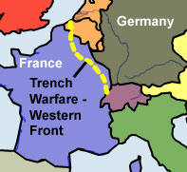
Everyone thought that the war would end quickly
Instead it turned into a stalemate along an area in Northern France called the Western Front
A stalemate is a draw or a time when there is no winner

Slide 24
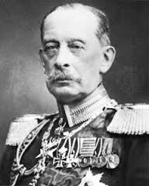
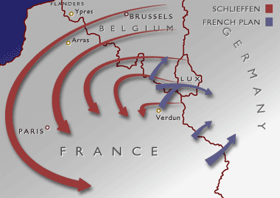
The Schlieffen Plan
Germany had developed a strategy named after General Alfred Graf von Schlieffen
This was a plan for Germany to be able to fight a successful 2 front war
It called for attacking and defeating France then quickly marching east and attacking Russia
This depended on speed, because of the size of the Russian war machine (ridiculously huge), it should take them a very long time to mobilize. The Germans thought they would have time to implement the Schlieffen Plan

Slide 25
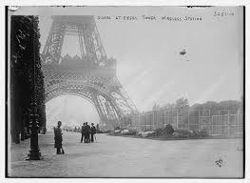
September 1914: The Germans are just outside of Paris
If they can take the city, they will defeat the French

Slide 26
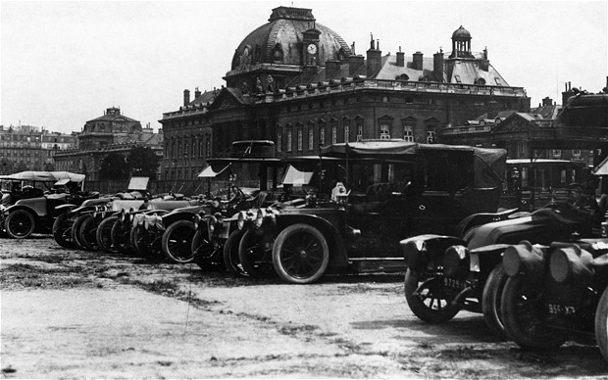
On September 5th 1914 the Allies attack the Germans at the 1st Battle of the Marne
Also called the Taxicab battle because 600 civilian taxis were used to transport every available soldier to the front line

Slide 27
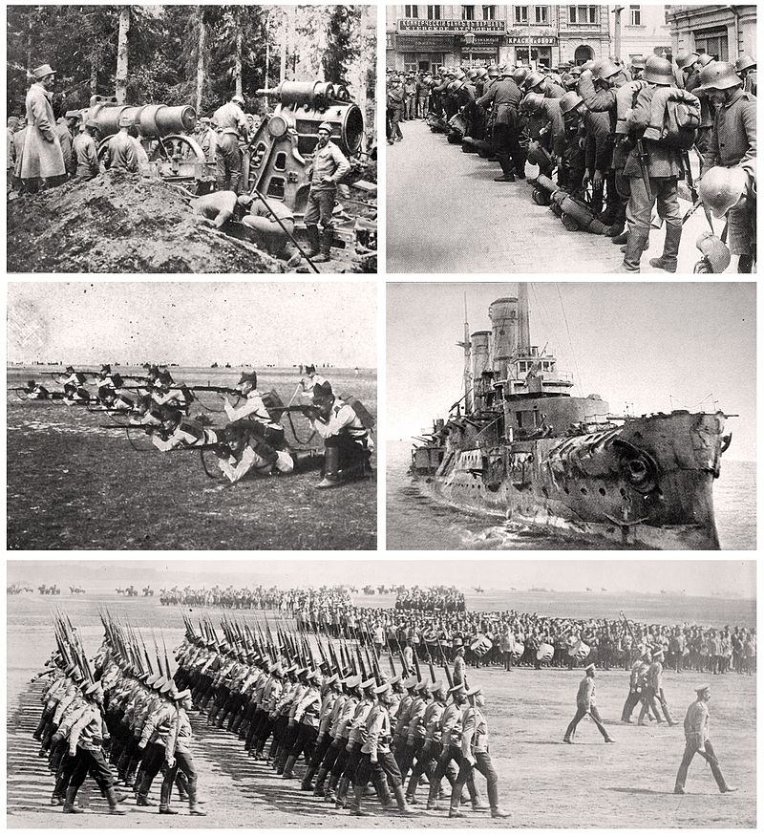
On September 9th the Germans retreated and this ruined any hopes for the Schlieffen plan to work
The Russians now invade Germany from the east.
The Germans pull troops from the Western Front and send them to the Eastern Front
This pretty much puts a stop to any further advances into France

Slide 28
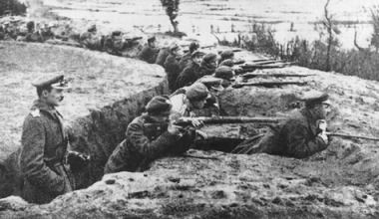
The Beginnings of Trench Warfare

Slide 29

By 1915 the opposing armies had dug miles of parallel trenches to protect themselves from enemy fire.
People would fight from these trenches

Slide 30
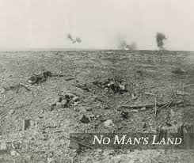
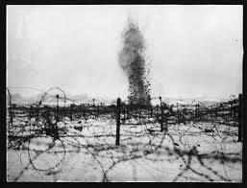
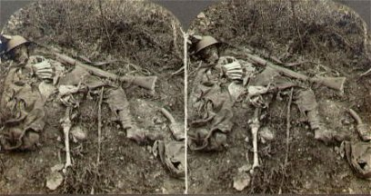
A Commander would call out “Over the Top!” and everyone in the trench would go. They then got mowed down by enemy fire in “No Man’s Land”
Staying in the trench wasn’t necessarily save either because artillery shells would fall on them and blow them, and whomever was still in them, to pieces
“Over the Top!”

Slide 31
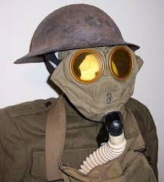

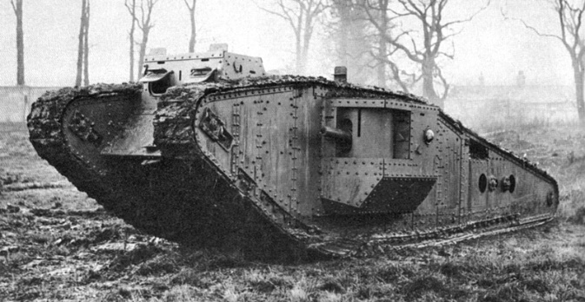


New Weapons make the stalemate worse
Mustard Gas and Chlorine Gas burned lungs and soft tissue. They were introduced by the Germans but both sides used them.
Poison Gas:
Machine Gun:
These fired ammunition automatically and made advances nearly impossible.
Armored combat vehicle with chain tracks that could cross all kinds of terrain. Introduced by the British in 1916 at the Somme.
Called Tanks because they were shipped in boxes labelled “Water Tank.”
Tank:
Submarine:
1914 Germans introduced them against British warships. Their primary weapon was the torpedo

Slide 32
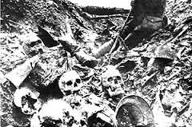
The Mincing Machine of Verdun
In 1916 the Germans launched an offensive against the French at Verdun
Both sides lost about 300,000 men (each)

Slide 33
July 1916:
The British send help to the French and attach the Germans at the Somme River NW of Verdun
On the first day of battle 20,000 British troops were killed.
By the end of the battle in November 1916 there were over ½ a million casualties on both sides
The Advances?
Germany got 4 miles at Verdun
Britain got 5 miles at the Somme

Slide 34
The War on the Eastern Front
This was a stretch of battlefield on the German/Russian border
It was a war between Germany/Austria-Hungary and Russia/Serbs
This front was much more mobile but slaughter and stalemate happened here too.

Slide 35
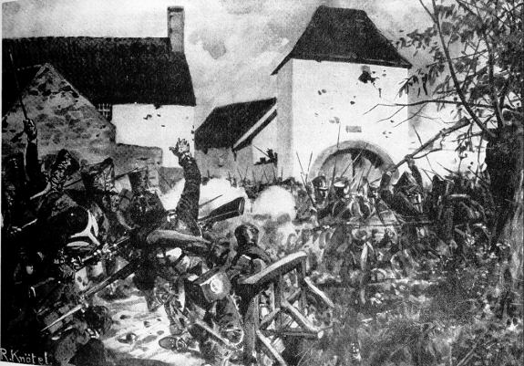
Early Battles:
Tannenberg:
In the beginning, Russian forces launched an attack into both Germany and Austria-Hungary.
By the end of August Germany had counter attacked at Tannenberg and crushed the Russians, driving them into full retreat
Over 30,000 Russians were killed and 140,000 were wounded.
The Germans had 12,000 casualties (Dead and wounded).

Slide 36
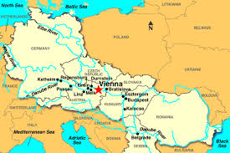
Vienna:
Russia did better against the Austro-Hungarian forces. They defeated A-H twice in September of 1914 and almost reached the Austrian capitol of Vienna.
However, by December the Russians were pushed out of Austria.

Slide 37

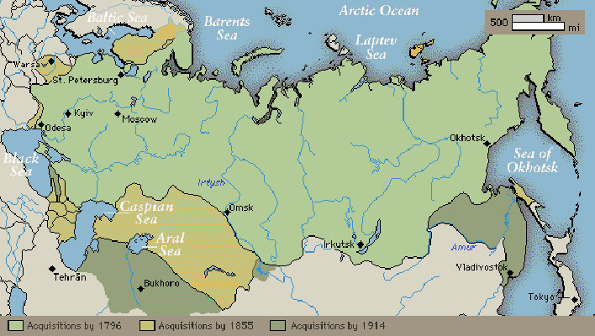
The Russian Empire:

Slide 38
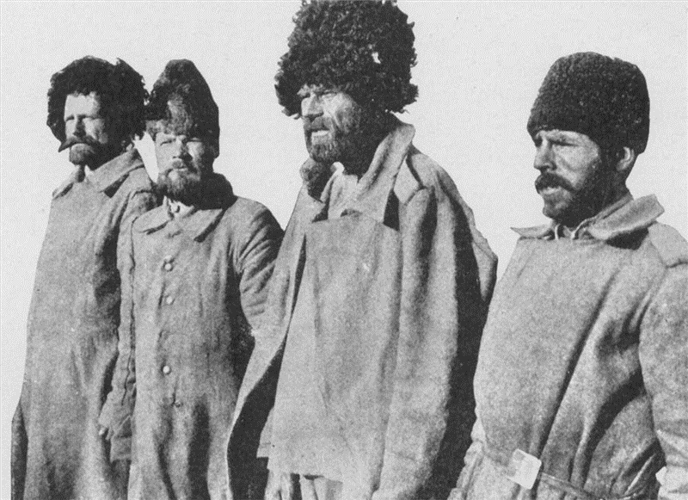
By 1916 the Russian war effort was near collapse
They hadn’t industrialized like western Europe and their army was continuously short on food, guns, ammunition, clothes, boots, and blankets
Allied ships had trouble getting supplies to Russia because the Germans and the Ottomans controlled the sea routes
The only thing keeping them in the war was their numbers.
They suffered staggering losses but still managed to pull troops from their huge population to keep the Germans tied up for years

Slide 39
A Global Conflict

Slide 40
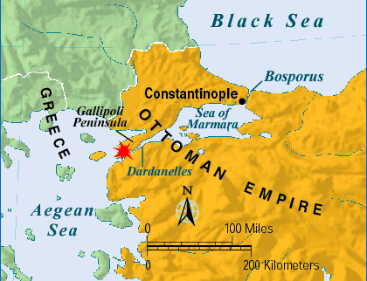
War affects the world
The Gallipoli Campaign
The point was for the Allies to be able to attack the Ottoman Empire at the Dardanelles which were the gateway to Constantinople and a way to create a supply line to Russia
Began in February of 1915: British, Australian, and New Zealand troops made repeated assaults on the Gallipoli Peninsula.
The Turks, often led by Germans, defended the region.
By May of 1915 Gallipoli was a stalemate too.
In December of 1915 the Allies gave up and retreated. They had lost about 250,000 men.

Slide 41
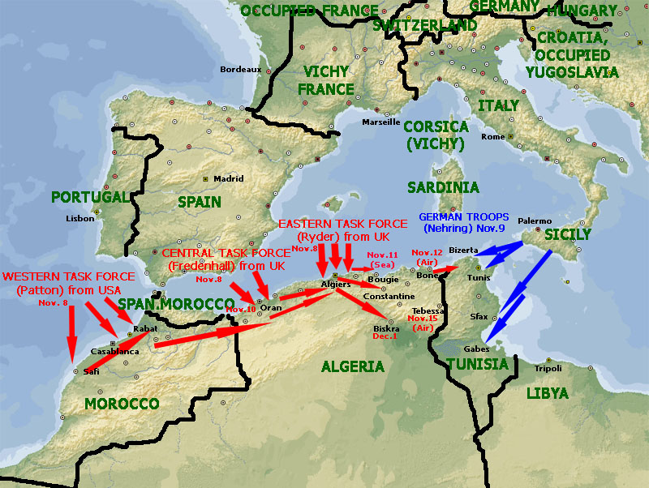
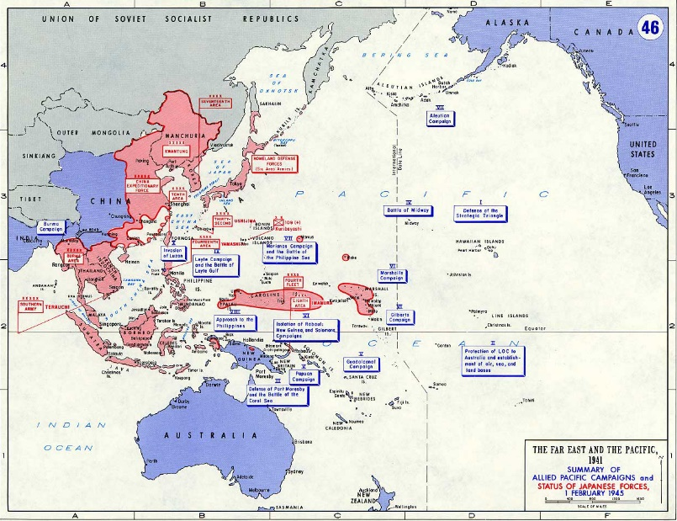
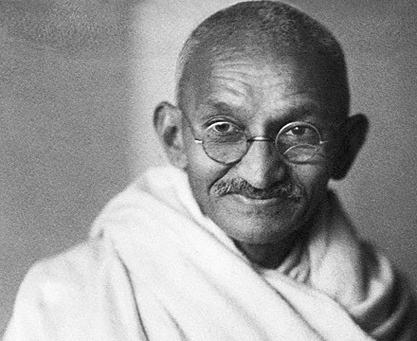
War in Africa and Asia:
The Japanese quickly overtook China and captured Germany’s Island Colonies
England and France attacked Germany’s 4 African possessions and took 3 of them.
All of the major powers looked for help from their colonies.
Some colonists didn’t want to help. Others, like Mohandas Gandhi felt that if the Indians helped the British it would help them gain independence later on

Slide 42
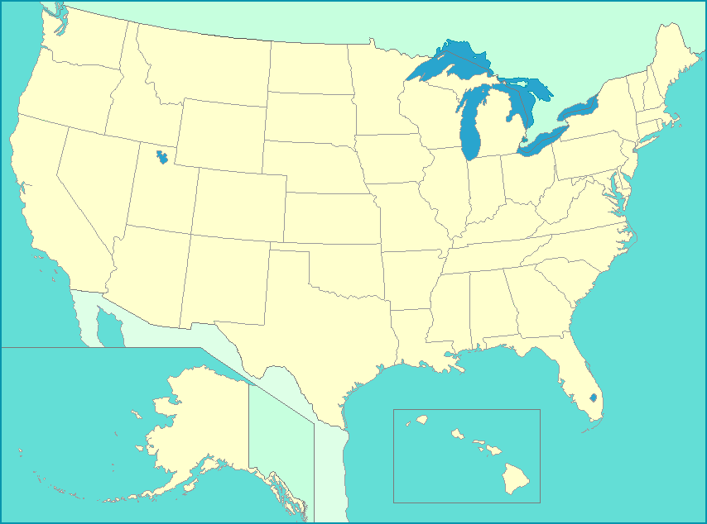
America Enters the War

Slide 43
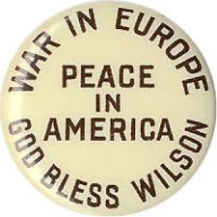
Wilson tried to maintain neutrality – he didn’t want to take sides or enter the war.
Wilson agreed to a “preparedness campaign” that included the passage of the National Defense Act of 1916 and the Naval Appropriations Act of 1916
These acts doubled the size of the army to 225,000 and expanded the U.S. fleet to include battleships, destroyers, submarines, and other warships.

Slide 44
Maintaining neutrality was difficult however because the Allies relied heavily on American imports.
Private banks made extensive loans to England
Deep ethnic divisions: Anglo-Saxon Americans saw the first loyalty to be to Britain. Newer immigrants supported other countries in the war.

Slide 45
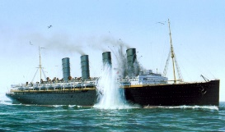

By 1917 the Germans were ruling the seas with submarines and in January of 1917 they announced that they would sink any ship in British waters.
This is called unrestricted submarine warfare.
Before this, only ships flying the flags of warring nations would be attacked
The Germans had used this policy in 1915 but stopped when the British passenger liner Lusitania was sunk on May 7th 1915.
1198 people were killed including 128 Americans. Another British liner, the Arabic, on August 30th 1915.
The Germans argued that the Lusitania was carrying ammo, which was true and was also an act of war
BUT they didn’t want to get the Americans involved so they stopped for a while
The Germans wanted to continue using this, to try to cripple the British economy and end the war before the U.S. could enter.
February 1917 – US Merchant Ship Laconia is sunk. March 1917 – four more American ships as well

Slide 46


The point of resuming the unrestricted submarine warfare was to enforce a naval blockade forcing the British to surrender.
3 American ships are sunk by German U-Boats and the U.S. government ‘protests.’
The Zimmerman Note
February 1917 – U.S. officials are sent a telegram by Mexican officials that was written by Arthur Zimmerman the German Foreign secretary
The telegram staid that Germany would help Mexico ‘reconquer’ the land it had lost to the U.S. if Mexico would ally with Germany.
Mexico declines and passes the note on to the U.S.

Slide 47

The Zimmerman Telegram probably wouldn’t have been enough on it’s own to get the U.S. involved in a war.
BUT with submarine warfare and other issues the U.S. decides it’s time to get involved.
Most of the U.S. population is on the side of the Allies anyway because of common bonds of language, law, and customs with England.
U.S. also had stronger economic ties with the Allies.
April 2, 1917:

Slide 48

The Selective Service Act
In order to meet the need for more troops, the Selective Service Act was passed in May of 1917.
This required men to register with the government in order to be randomly selected for military service.

Slide 49
War Affects the Home Front

Slide 50
Congress gives power to Wilson
War Industries Board
Under the leadership of Bernard Baruch it encouraged companies to use mass production techniques to increase efficiency and to eliminate waste by standardizing products. Also set production quotas and allocated raw materials.
Industrial production increased but prices soared to nearly double what they were at the beginning of the war.
The Fuel Administration monitored coal and gasoline supplies as well as creating daylight-savings time to take advantage of the greater amount of daylight in the summer time.

Slide 51
War Economy
Blue collar workers saw their wages increase but prices were going up as well so actual income didn’t change much
Union membership increased because dangerous conditions increased.
The National War Labor Board was created in 1918 to deal with disputes between management and labor.
If you refused to obey the boards’ decisions you could lose your draft exemption.
“Work or Fight”

Slide 52



Total War:
The governments involved dedicated all of their resources to the war effort, including taking over the economy, making factories produce war material, and ordering every able bodied person to work. This includes women.
While all material was going to the front, goods at home were limited, which led to rationing.
Rationing is when the government decides what and how much a person can buy.
This applied to food, clothing, leather, etc. And this was primarily in Europe at this time.
The Food Administration under Herbert Hoover called on people to follow the “gospel of the clean plate.”
Meatless, sweetless, wheatless, and porkless were days of the week.

Slide 53


Selling the War
Now the government had to figure out how to finance the war and then how to convince people to support the war.
The US spent about 35.5 billion fdollars on the war effort.
About 1/3 of this came from taxes the other 2/3 came from bonds.

Slide 54


George Creel was the head of the Committee on Public Information.
He persuaded the nations artists and advertising agencies to create thousands of works promoting the war.
He also recruited 75,000 men to serve as “Four-Minute Men” wo spoke about everything relating to the war.
He ordered a printing of nearly 25 million copies o f ”How the War Came to America” and distributed 75 million pamphlets, booklets, and leaflets with the enthusiastic help of the boy scouts.

Slide 55





Propaganda:
One sided pamphlets, posters, newspapers designed to keep up morale and support for the war
While this did promote patriotism, it also inflamed hatred of certain ethnic groups and opponents of the war

Slide 56

Attacks on Civil Liberties Increase
Anti-Immigrant Hysteria:
The main target of these attacks were Americans who had emigrated from other nations like Germany and Austria-Hungary. German Americans took the worst of it.
People with German names lost their jobs.
Orchestras refused to play music by German Composers.
Some towns with German names changed them.
Schools stopped teaching the German language.
Librarians removed books by German authors.
Things with German names often got their names changed; Dachshunds became “Liberty Pups” for example.

Slide 57


Worst of all however was the violence.
German Americans were attacked in the streets. One man was lynched and the mob that killed him was cleared

Slide 58

The Espionage and Sedition Acts
A person could be fined up to $10,000 and sentenced to 20 years in prison for interfering with the war effort, saying anything disloyal, profane, or abusive about the government or the war effort
These acts clearly violated the 1st Amendment, led to over 2,000 prosecutions for “anti-war” activities, and nearly 1,000 people were convicted.

Slide 59



These acts targeted newspapers and magazines, socialist leaning congressmen, university professors, socialist and labor leaders.
Eugene V. Debs got 10 years for speaking out against the war & the draft
Emma Goldman, an anarchist, got 2 years plus a $10,000 fine for organizing the No Conscription league. She was later deported to Russia.
“Big Bill” Haywood and other leaders of the Industrial Workers of the World were accused of sabotaging
the war effort because they urged workers to strike for better conditions and higher pay.
Haywood skipped bail and fled to Russia.

Slide 60


Social Change
African Americans and the War
Black public opinion was divided.
WEB Dubois believed that supporting the war effort would lead to greater calls for racial justice.
William Monroe Trotter, founder of the Boston Guardian, felt that the victims of racism should NOT support a racist government. He supported protests instead.

Slide 61

The Great Migration
The greatest effect of the first word war on African Americans’ lives is that it accelerated the Great Migration which was the large scale movement of hundreds of thousands of Southern blacks to Northern cities.
Contributing Factors:
Many African Americans sought to escape racial discrimination in the South
A boll weevil infestation, floods, and droughts, had ruined many of the South’s cotton fields.
In the north there were job opportunities.
  Henry Ford opened his assembly line to black workers in 1914
  The outbreak of war slowed European immigration so now there were job opportunities in steel mills, munitions plants, and stockyards.
  Northern manufacturers sent recruiters with free railroad passes through the south.
  The Chicago Defender, a black-owned newspaper talked up the prosperity of African Americans in the North vs. lynchings in the South.

Slide 62



Women and the War:
Thousands of women now took jobs outside the home to take the place of the men who were fighting. Most of them left the workforce when the men returned.
Some worked as nurses on
the front lines and saw the
real horrors of war

Slide 63




Slide 64

Women’s contributions to the war effort will help bolster support for the Women Suffrage Movement.

Slide 65


Slide 66


In the fall of 1918 approximately ¼ of the US population was struck by the Spanish Flu.
It crushed the economy by shutting down factories. Cities ran short on coffins and people lay unburied for more than a week.
It struck the young and healthy
In the army more than ¼ of US soldiers were affected. In some AEF units, 1/3rd of the troops died. The Germans died in higher numbers.
Approximately 500,000 Americans died before it disappeared in 1919.
Approx. 30 million people worldwide were killed by the Spanish Flu Pandemic.

Slide 67


Slide 68

The Allies Win

Slide 69



Russia withdraws:
In March of 1917 a civil war in Russia removed Czar Nicholas
The government tried to keep fighting but they were falling apart
5.5 million men had been killed, wounded, or taken prisoner
In November 1917 Vladimir Ilyich Lenin took power in Russia and signed a treaty with Germany
The Treaty of Brest-Litovsk in March of 1918 ended the war between Russia and Germany

Slide 70

The Central Powers Collapses
Russia’s withdrawal allowed German troops to focus on the Western Front where they launched a massive attack in March of 1918
By May they have reached the Marne River

Slide 71


The Second Battle of the Marne
140000 U.S. troops now assist the French and the British
The 2nd battle of the Marne takes place in July 1918 and 350 tanks and 2 million more fresh troops push the Germans back

Slide 72

The Central Powers Collapse
Bulgaria and the Ottoman Turks surrender
Austria Hungary has a revolution in October
November 9, 1918 Kaiser Wilhelm II steps down when troops turn on him
Germany now declares itself a republic and a representative of the new government meets with the French commander Marshal Foch in a railway car near Paris where they sign an armistice or agreement to end the war

Slide 73




The War ends on November 11th 1918

Slide 74


The Legacy of War:
Nearly an entire generation of Europeans was wiped out
Between disease, starvation, and battle, nearly 10 million Allied and Central troops died
Farmland and villages were destroyed

Slide 75



The Treasuries of Europe were drained (338 Billion dollars is the current estimate)
People were also disillusioned and it showed in their art and literature

Slide 76
A FLAWED PEACE

Slide 77








The Allies Meet
The Big Four
Woodrow Wilson USA Georges Clemenceau France Vittorio Orlando Italy David Lloyd George United Kingdom

Slide 78
Wilson’s 14 Points
Woodrow Wilson had written up a plan for peace before the end of the war in 1918. This was known as the 14 Points and they were designed to create a fair, lasting, peace.
End Secret Treaties
Freedom of the Seas
Free Trade
Reduce the size of armies and navies
Adjust colonies in regards to the colonists
- 13. Changing borders and create new nations using the principle of National Self Determination, which is the right of people to decide under which government they wanted to live
14. A League of Nations
The League of nations would be a general association of countries that would meet to talk about problems and hopefully stop them before they led to war

Slide 79


The Versailles Treaty
At the Paris Peace conference, Britain and France ignored Wilson’s proposal.
They were concerned with national security and stripping Germany of its war making power

Slide 80


The Treaty was signed June 28th 1919 – 5 years to the day of the assassination of Franz Ferdinand
It adopted a League of Nations, but none of Wilson’s other points
Spectators waiting for the treaty to be signed

Slide 81


The War Guilt Clause
Germany was blamed for the war (remember who started it?)
They: Lost Territory
Had their Military Restricted
Took SOLE responsibility for the war
Had to pay reparations to the allies for over 33 billion dollars. (~ 402 Billion in today’s money)

Slide 82


All of Germany’s territory in Africa and Asia was given to the League of Nations as MANDATES (Which basically means they were given to Britain and France and they would be governed by the allies until they could get their independence)

Slide 83

The Western powers signed separate treaties in 1919 and 1920 with all other defeated countries.
This will lead to huge losses for these countries.
The Austro-Hungarian empire was broken up into:
Austria
Hungary
Czechoslovakia
Yugoslavia

Slide 84

The Ottoman Turks had to give up almost all of their old empire and were left with only Turkey.
Land was carved up into mandates instead of independent nations:
Palestine
Iraq (Mesopotamia)
Transjordan
  Went to GB
Syria
Lebanon
  Went to France

Slide 85

Russia, who’d left the war early, also lost land:
Romania and
Poland
Both Gained Territory
3. Finland
4. Latvia
5. Lithuania and
6. Estonia
Became independent
nations

Slide 86

The Weakness of the Treaty:
When everything was done, the Treaty of Versailles did very little to build a lasting peace
The U.S. rejected the treaty and signed a separate peace with Germany and Austria Hungary. Henry Cabot Lodge and other Conservatives felt that it went aginst the U.S. policy of Isolation. They were also suspicious of the voluntary provision for joint economic and military action against aggression.
Most Americans were against the League of Nations because they thought that the best way to stay out of war was to stay out of world affairs
This doesn’t work, as the world is back at war in 1939 (30 years later)

Slide 87
In the end, very few were happy:
German people were bitter and angry over the war guilt clause
People in Mandates wanted independence
Japan and Italy who had joined the Allies for territory didn’t get as much as they wanted
The League of Nations was practically powerless without the U.S.
Within 20 years all this bitterness, fear, anger, and hate will lead to another, more catastrophic war

Slide 88


