Slide 1
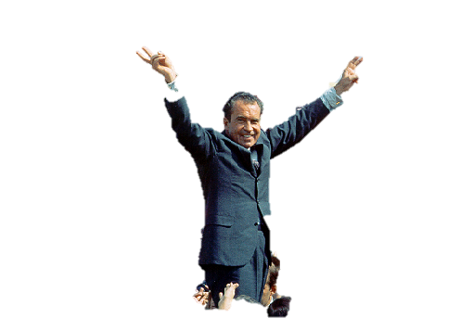
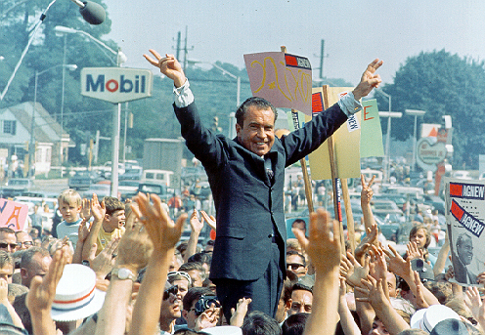
Richard Nixon
37th President

Slide 2
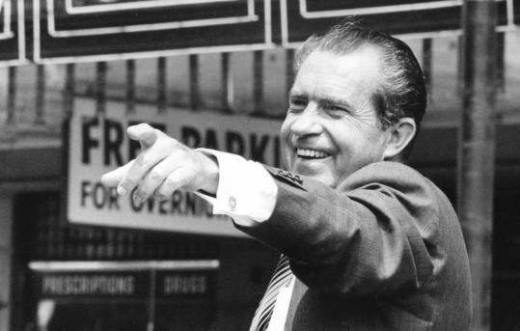
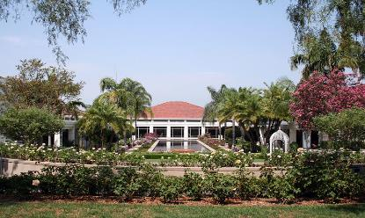
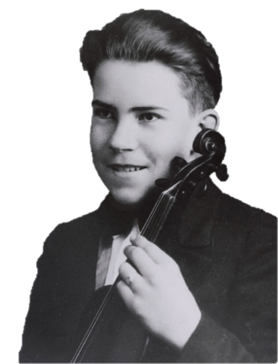
Nixon Background
Nixon Library
Born in Yorba Linda, California
Graduated from Duke Law School
Lieutenant Commander in WWII
Elected to the House of Representatives in1946 and to the Senate in 1950
Vice President for Eisenhower from 1953 until 1961
Lost Presidential election of 1960 to JFK

Slide 3
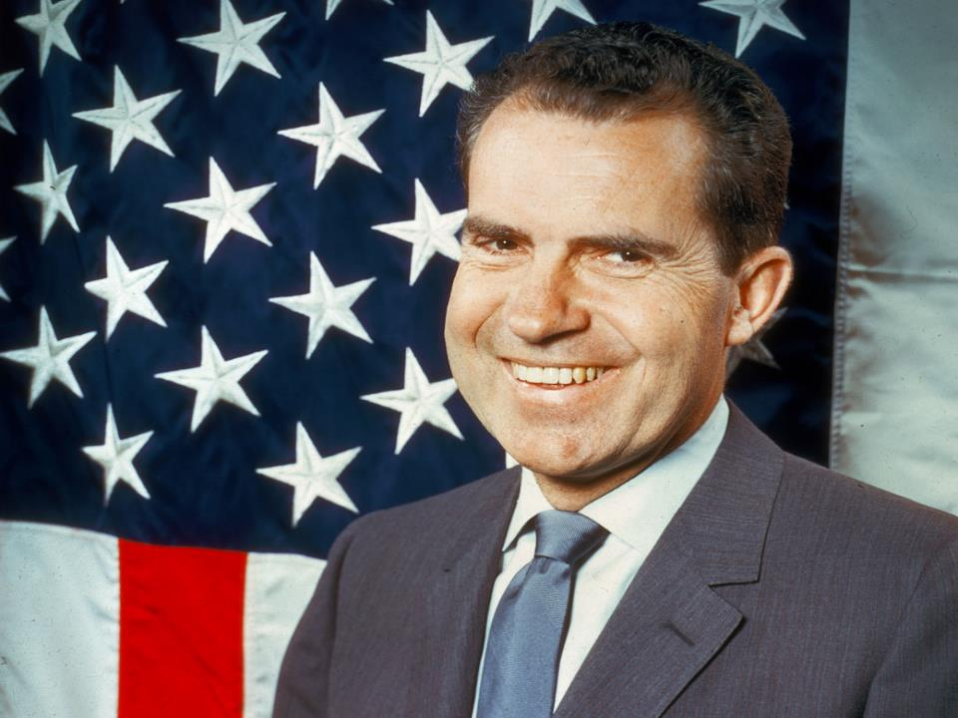
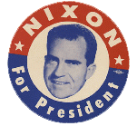
This means he:
  Defended the status quo
  Opposed rapid change
  Disliked gov’t involvement in economy
  Wanted to give more power to states
In other words—make gov’t smaller, have less of a role in everyday lives
He was a Conservative

Slide 4
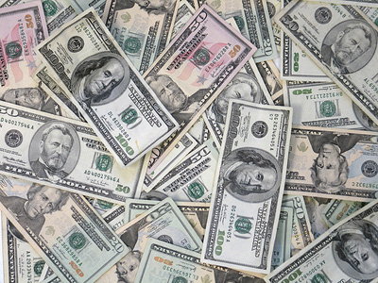
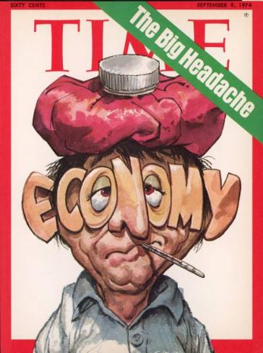
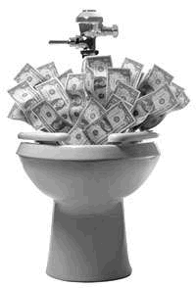
The Economy
During the 1970s, the economic
prosperity of the 1950s and 1960s began
to disappear.
Economic troubles began under Johnson.
  deficit spending to fund the Vietnam War and the Great Society program without raising taxes.
  created inflation- increase in prices, devalue of the dollar

Slide 5
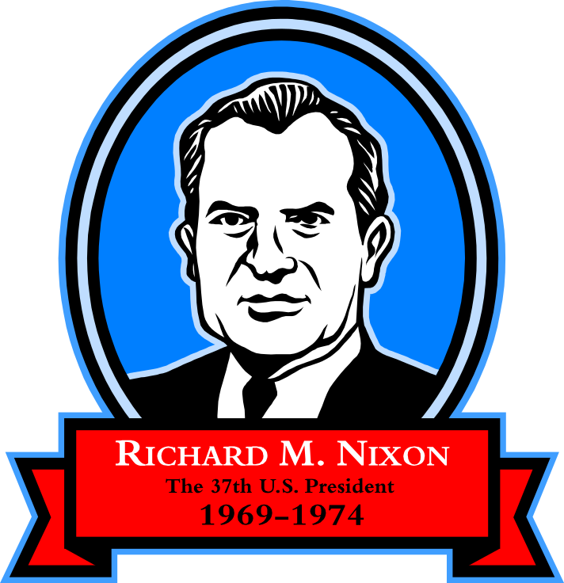

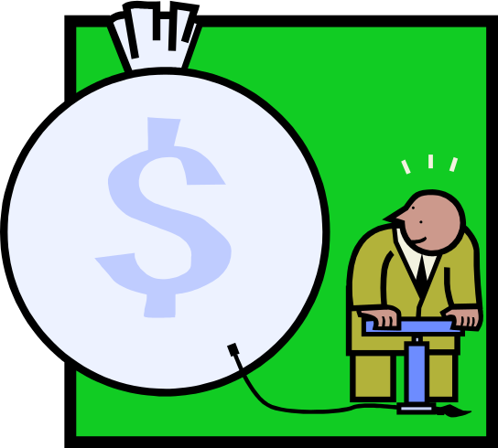
One of the biggest problems facing Nixon was a weak economy.
During 1967 & 1973, inflation & unemployment increased. This is known as STAGFLATION.

Slide 6
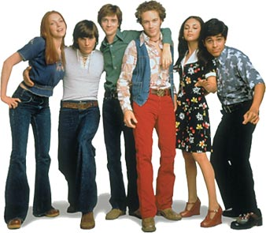
Stagflation had several causes. Unemployment increased because trade competition increased. This made it harder for Americans to sell their goods overseas.
Stagflation
Workers’ wages did not keep up with rising prices
Milk & hamburger prices rose 200%
Bread prices rose 400%
Car prices rose 72%
We Want work!
The nation also had trouble finding jobs for millions of baby boomers who reached working age.

Slide 7

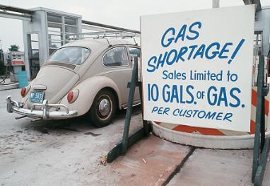
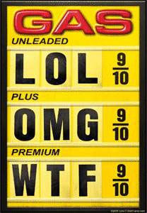

Oil/Gas Shortage
In 1973 OPEC announced an embargo of petroleum to countries that supported Israel.
The price of a barrel of crude oil increased from $3 in 1973 to $30 in 1980.
  2009 it was over $100 per barrel
After OPEC raised its prices, the price controls created an oil shortage.
Americans had to schedule their lives around the availability of gasoline during the OPEC oil embargo.

Slide 8
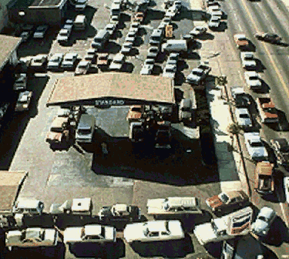

Slide 9
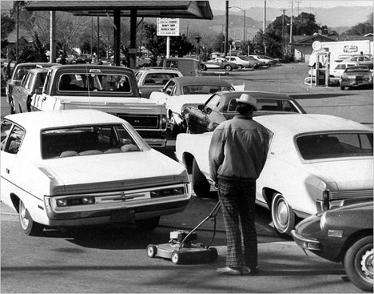
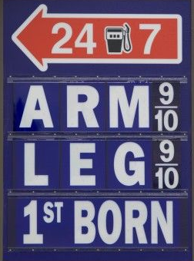
Needs to mow his lawn

Slide 10
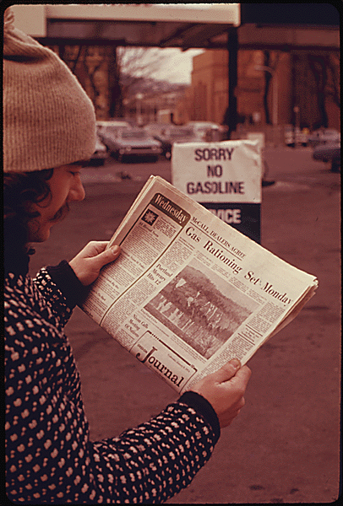
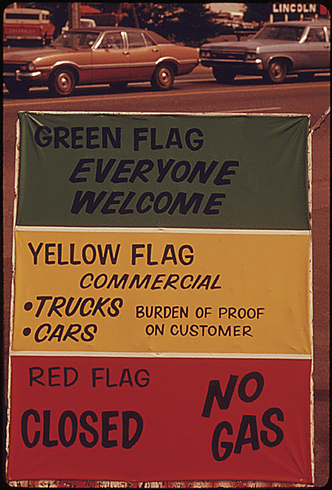
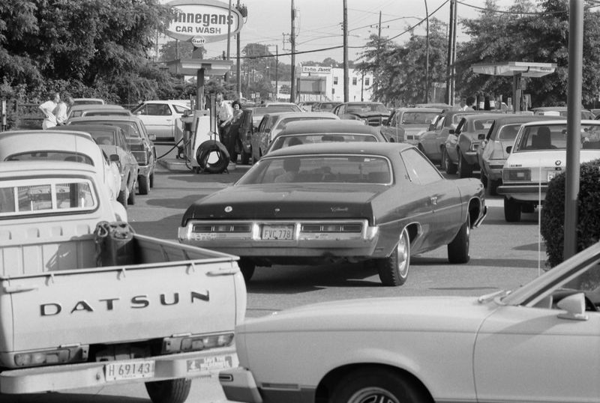
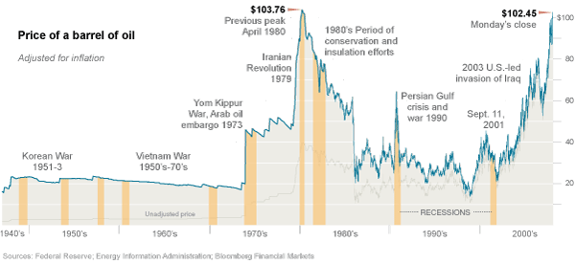
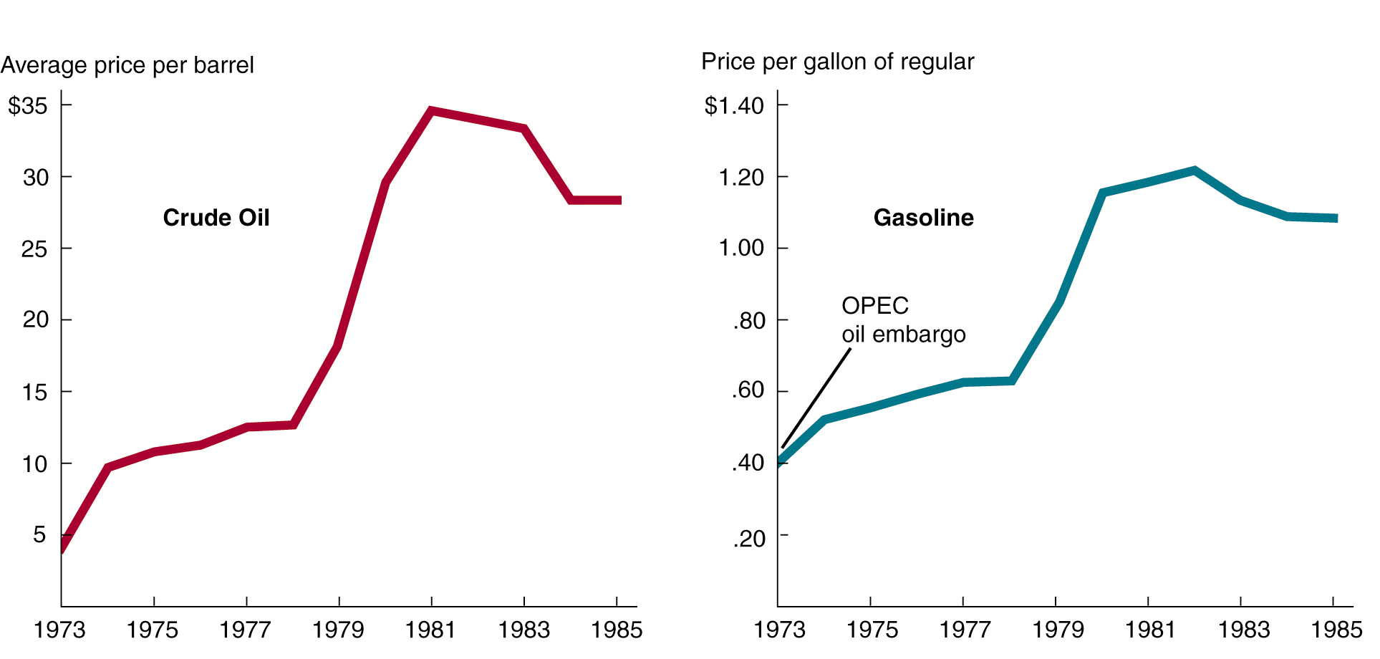
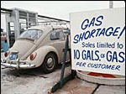
The Oil Shocks:
Price Increases of Crude Oil & Gasoline
The OPEC oil embargo
Iranian Revolution

Slide 11
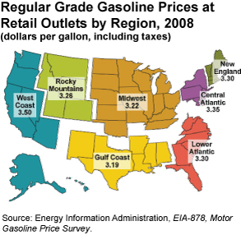


Slide 12
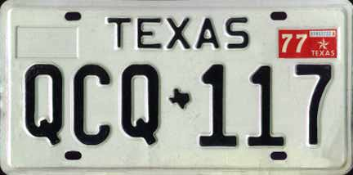
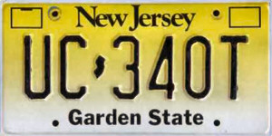
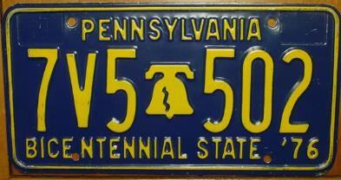
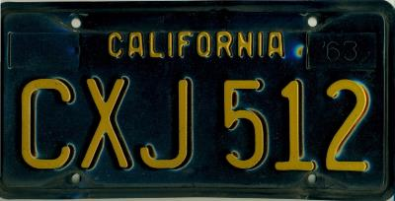
Some states implemented gas rationing. Only people with an odd-numbered license plate could purchase gas on an odd-numbered day

Slide 13
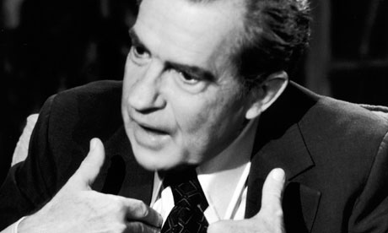
Foreign Policy
Nixon’s foreign policy had at least 3 Major Successes:
  1. US got out of the Vietnam War
  2. Re-opens relations with China
  3.Arms Control with the Soviet Union
  “Détente” – relaxing of tensions

Slide 14
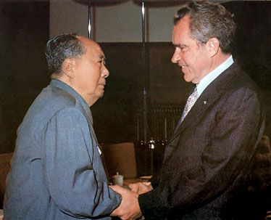
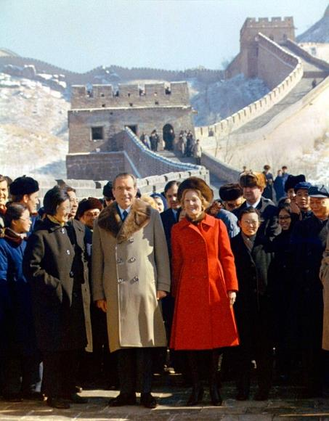
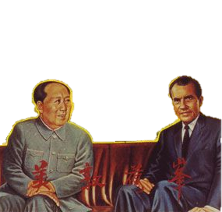
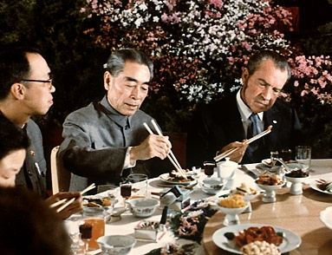
Visit to China
“We want the Chinese with us when we sit down and negotiate with the Russians.”
President Richard Nixon was the first president to visit Communist China in 1972
The visit was extensively covered on television. This trip led to the US later recognizing the government of the People’s Republic of China.

Slide 15
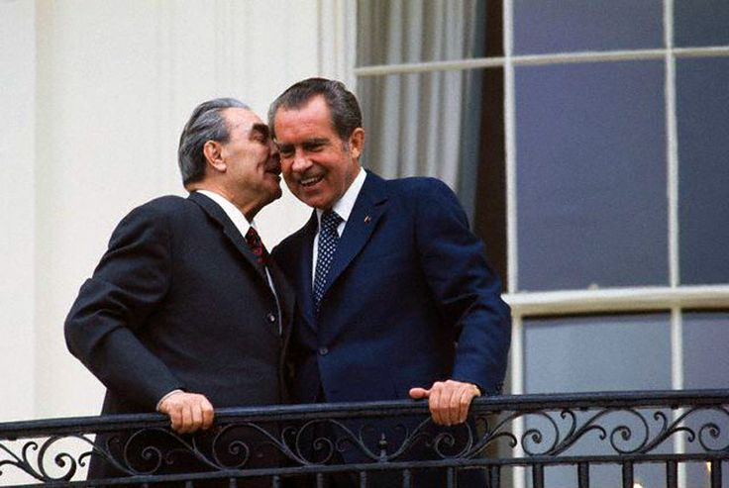
In May, 1972, Nixon visited the Soviet Union and met with Soviet leader, Leonid Brezhnev.
Nixon and Kissinger used the new relationship with China to put pressure on the Soviets to agree to a treaty limiting antiballistic missiles.
This led to the Strategic Arms Limitations Talks (SALT I)
Visit to USSR
Nixon and Brezhnev signed the SALT I Treaty:
  5 yr agreement that limited the number of missiles each country could have

Slide 16
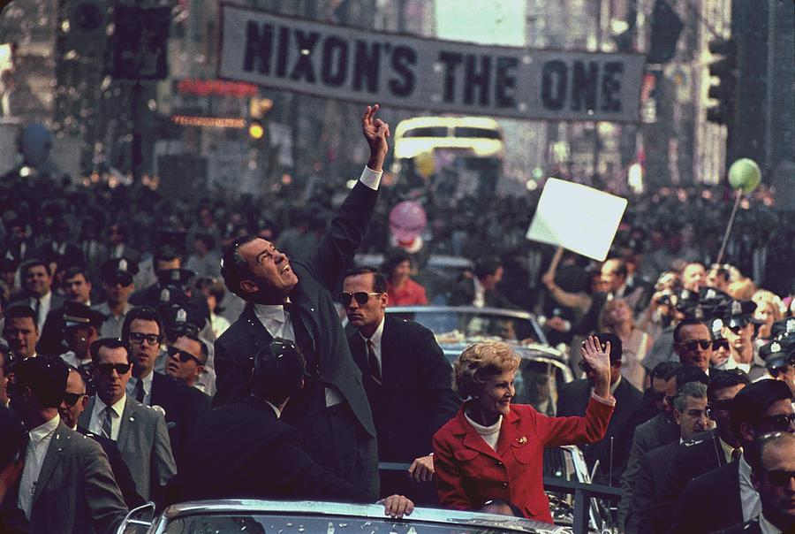
Election 1972
Nixon wins, partly b/c of détente, partly because of his promise that peace was just around the corner in Vietnam

Slide 17

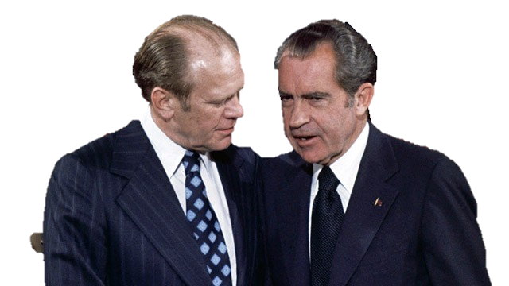
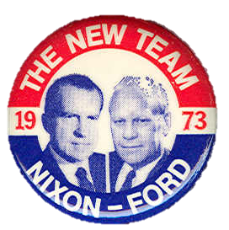
Ford is Vice President
Nixon defeats democratic George McGovern in 1972.
Nixon’s Vice President Spiro Agnew resigns amid charges of bribery, tax evasion, and unethical conduct.
Nixon appoints Gerald Ford as his VP

Slide 18
Paranoia will be his downfall
But his extreme fear of losing an election causes him to become involved in activities he will later come to regret…

Slide 19
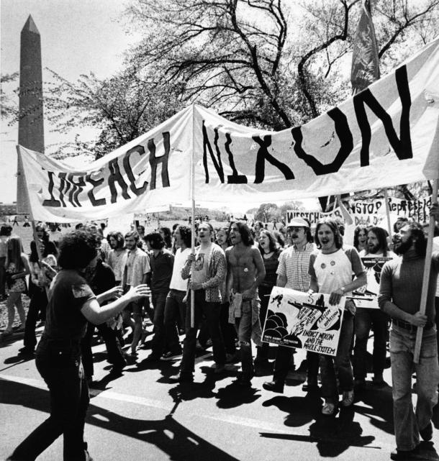
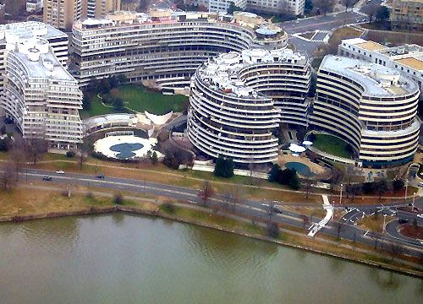
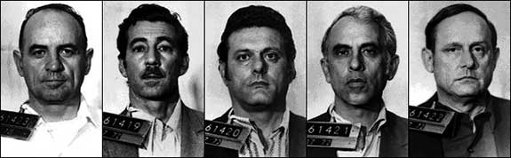
During the campaign Nixon had ordered five of his aides to break into the Democratic Party headquarters to search for “anything they could find” to discredit the Democrats.
The men were caught and Nixon denied and tried to cover up any connection to the incident.
Nixon also had a secret taping system in the Whitehouse. He was ordered to turn in the tapes. When he finally did, there was 18 minutes of “blank silence”.
This led to a an in-depth investigation which led to Nixon’s resignation.
Watergate Scandal
Notes:
In January 1973
Just before sentencing, one of the burglars admits that he lied under oath and that the White House may have been involved
Nixon publicly denies any involvement and appoints a special prosecutor
It’s too late—the Senate already begins their own investigation
30 hours of testimony
Former aides reveal that Nixon was involved in the cover-up of the break-in
This is shocking news
Another aide reveals that Nixon had taped nearly all of his conversations
This starts a long battle by Congress to get the tapes

Slide 20
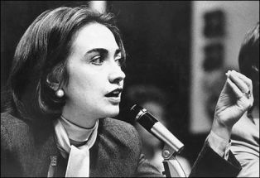
Q. Who am I? (Yale Law School graduate of 1973)
Hillary Rodham Clinton- In 1974 she was a member of the impeachment inquiry staff in Washington, D.C., advising the House Committee on the Judiciary during the Watergate scandal.

Slide 21
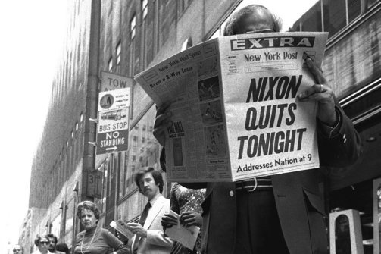
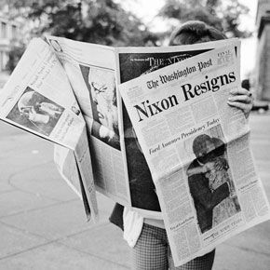
Nixon’s Resignation
Nixon resigned on August 9,1974.
He never admitted to criminal wrongdoing, although he conceded errors of judgment. During the Watergate scandal, Nixon's approval rating fell to 23%.
Gerald Ford became the 38 president, the only man never to be elected to the presidency or vice presidency.
http://www.history.com/topics/us-presidents/richard-m-nixon/videos/nixon-announces-his-resignation?m=528e394da93ae&s=undefined&f=1&free=false

Slide 22
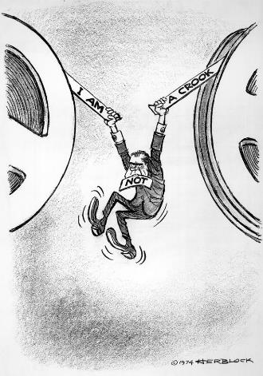
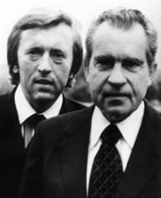
Effects of Watergate
25 members served prison terms
Reaffirmed the role of the press
Proved the President is not above the law
People doubt the presidency after Pentagon Papers and Watergate
https://www.youtube.com/watch?v=lP_l2IFiQzs
http://www.pinterest.com/pin/266556871669826313/
Notes:
22

Slide 23
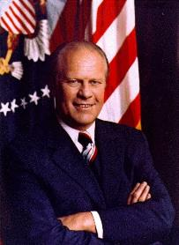
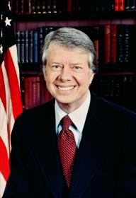
“The Ford and Carter Years”
1974 to 1981

Slide 24
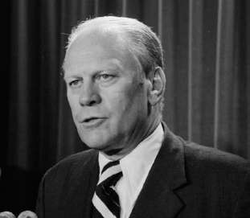
I.) Tough Road Ahead
President Ford faces:
1. Rough Economy
a. high inflation
b. high unemployment
c. energy problems
d. public distrust of govt.
On the Watergate Scandal:
“ Our long national nightmare is over”
After becoming vice president:
“I’m a Ford, not a Lincoln”

Slide 25
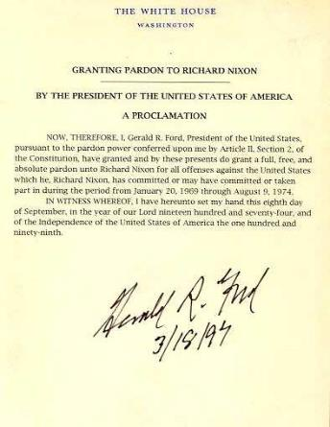
II.) Ford’s Policy
September 8, 1974: President Ford pardon’s Nixon
Economy:
1. “Whip Inflation Now” (WIN): Ford calls Americans to cut back use of oil and gas
2. “Tight Money Policy”: cut govt. spending & higher interest rates
Outcome: worst economic recession in 40 years

Slide 26


Foreign Policy:
1. Henry Kissinger remains secretary of state
2. Détente: negotiates with China & Soviet Union
3. Helsinki Accords: 35 nations agree to cooperation
Outcome: Ford’s greatest accomplishment
4. South Vietnam surrenders; Congress sends no aide

Slide 27

III.) Election of 1976
Republican Nominee:
Gerald Ford
Democrat Nominee:
Jimmy Carter
“I will never lie to the American people”
Election Day Results: Jimmy Carter wins with 40.8 million votes to Gerald Fords 39.1 million

Slide 28


IV.) Carter Faces Problems
Energy Crisis:
1. reliance on foreign oil
Outcome: National Energy Act of 1979
Economic Crisis:
1. violence in Middle East produces fuel shortage in U.S.
2. inflation rises from 7.6% to 11.3% in 1979; 14% 1980
3. Standard of living goes from 1st to 5th place in world

Slide 29

3. Changing Economy
a. less manufacturing and more service jobs
b. overseas competition

Slide 30

V.) Carter’s Policy
Civil Rights:
1. administration include more African-Americans and women than any before
2. Regents of UC v. Bakke
B. Human Rights & Foreign Policy:
1. rejected “Realpolitik”
2. use moral principles as guide (Wilson)
3. commit to promoting human rights

Slide 31


C. Establishing Human Rights Foreign Policy:
1. 1977 U.S. & Panama Treaty
(U.S. give up ownership of Panama Canal Dec. 31. 1999)
Outcome: improves U.S.-Latin
American relations
2. Carters human rights policies end Détente & raise Cold War tensions
1. Soviet invasion of Afghanistan
2. SALT II signed by Carter/Brezhnev
but not ratified by Senate

Slide 32


Camp David Accords:
1. 1977: peace negotiations begin between Israel
(Menachem Begin) and Egypt (Anwar el-Sadat)
2. 1978: Carter, Sadat, & Begin meet at Camp David & agree to agreement
Israel withdraws from Sinai
& Egypt recognizes Israel
E. Iran Hostage Crisis:
1. Jan. 1979: revolution in Iran overthrows the shah of Iran with Ayatollah Ruhollah Khomeini
2. Nov. 4, 1979: 52 Americans taken hostage from U.S. embassy in Tehran
3. Outcome: negotiations for 444 days result in release Jan. 20, 1981

